Slide 1
KinX
Brandon B., Jiakun L., Tony W., Shahab F.

Slide 2
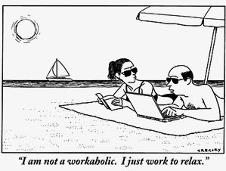
The problem
People have less quality time to spend with their families:
Workaholic culture
Fewer people meeting in person due to online social networks
Not enough clear overlap in people’s free time

Slide 3
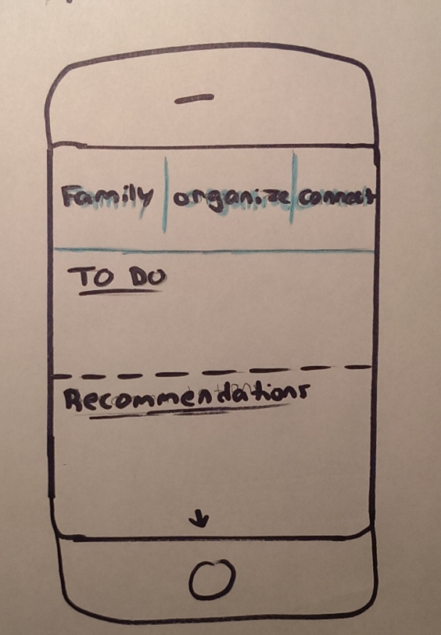
Our solution & value prop
KinX works on three fronts: Family, Organization, & Connection

Slide 4
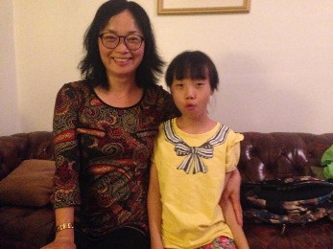
Contextual inquiry: interviews
8 interviewees
Ages ranging from 17 to 75
Common user values:
The ability to spend more time with their families without hurting other aspects of their lives (e.g., careers)

Slide 5
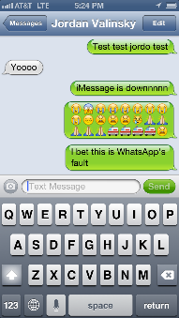
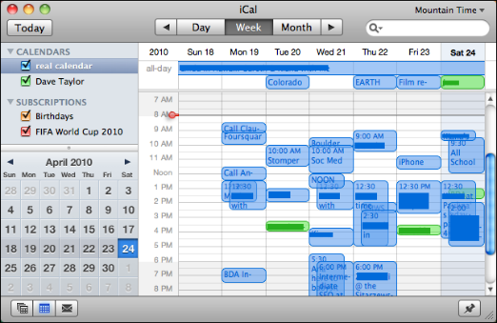
Existing behaviors

Slide 6
Data summary
Source used | Age | Sex | Occupation
Mobile Apps + In-person | 17 | M | High school senior
Mobile Apps + text | 18 | M | Going to college
Fb + mobile apps | 20 | M | Student (non-Stanford)
Mobile apps | 37 | F | Professor
Text + phone | 54 | F | Homemaker
Phone + in-person | 55 | M | Engineer
Phone + in-person | 55 | F | Homemaker
Phone + text + in-person | 75 | F | Retired
Mobile is a great platform
People use a variety of sources to communicate and organize family-related events

Slide 7
KinX: task analysis
New behavior: One app solution
fb is to individuals as Linkedin is to professionals as KinX is to families

Slide 8
Some sample questions
1. How does your family predominantly communicate?
2. Where do you feel any communication gaps occur within your family?
3. How often do you text the people in your family?
4. Do you have a family group chat?
5. Do you ask other families how they operate?
6. What is your preferred device to use? How often do you use it? What else do you use often?
7. Do you value the input of your friends higher than that of reviews from something like yelp?

Slide 9
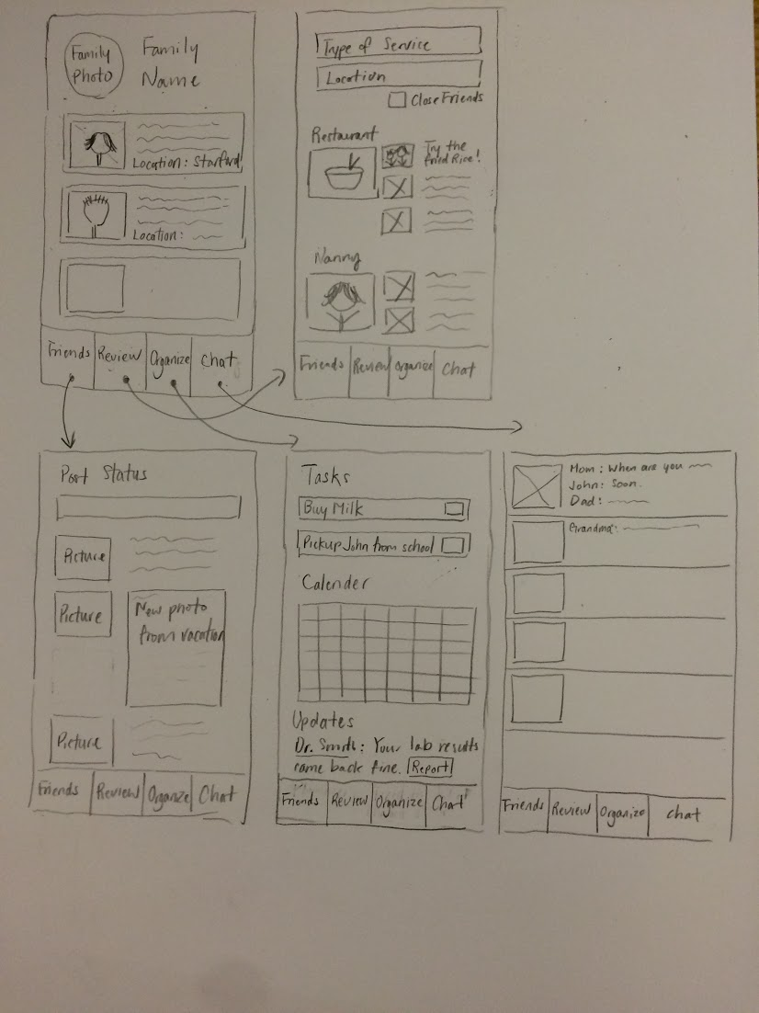
KinX is a one app solution that allows for communication & organization

Slide 10
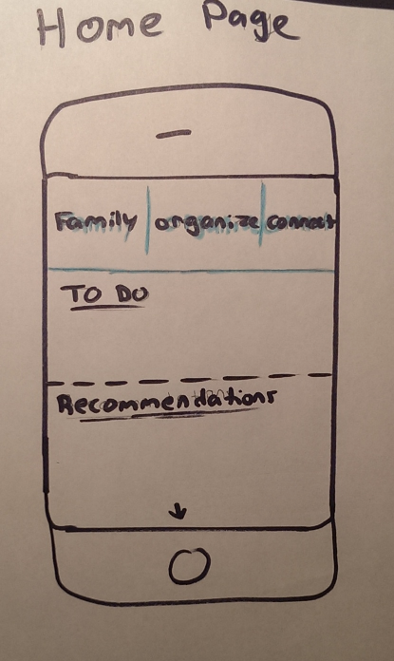
KinX works on three fronts: Family, Organization, & Connection

Slide 11
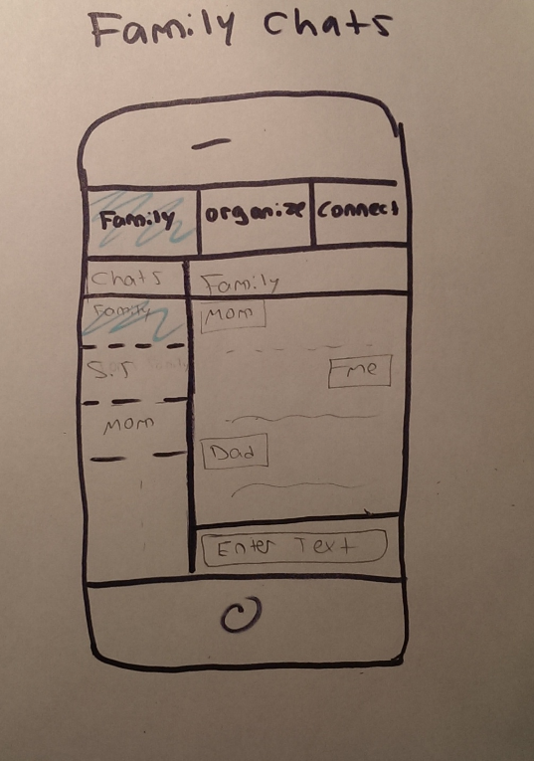
KinX facilitates intra-family communication

Slide 12
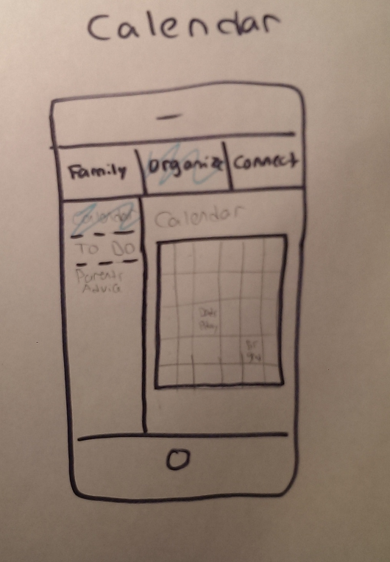
The app provides structure and organization to help families operate

Slide 13
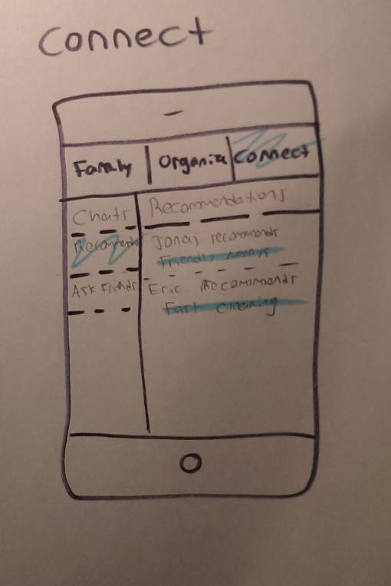
KinX enables inter-family communication, enabling many possibilities

Slide 14
Through KinX, families can streamline busy work and spend more quality time with each other

Slide 15
The different functionalities of the app come together in a streamlined fashion across both communication & organization

Slide 16
KinX
Bringing families together

