Slide 1
Contextual Inquiry, Task Analysis & Rough Sketches
David McLaren, Matthew Appleby, David Khavari, and Aaron Sekhri

Slide 2
2800 companies
$18 trillion

Slide 3
discretionary investor
Investors who judge companies on the basis of quantitative as well as qualitative factors

Slide 4
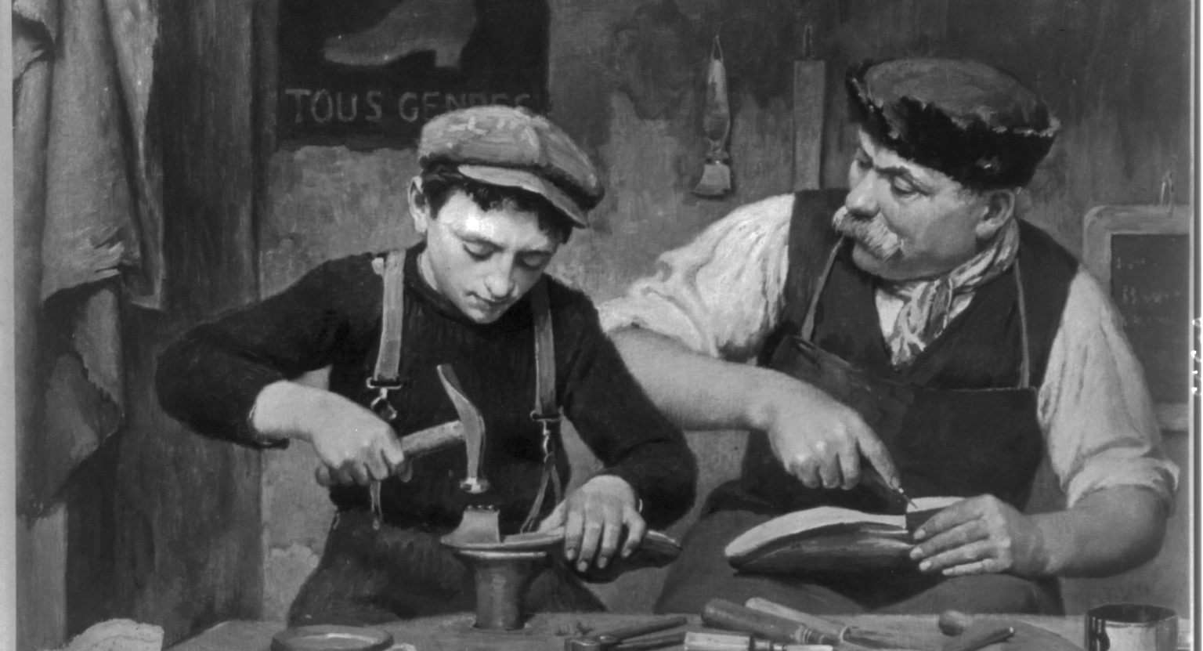
mASTER/APPRENTICE
bRIDGE EIMON
/ jOHN hOCHSTATTER
/ jASON VAN DER MERWE

Slide 5
educated,
Amateur,
motivated
Contextual analysis

Slide 6
Affiliation
Contextual analysis

Slide 7
irrespective of experience, a personal connection to the industry or company is a constant
insight (!)

Slide 8
hearing past the noise
task analysis
Notes:
This involves actually finding companies, based on non-quantitative factors.

Slide 9
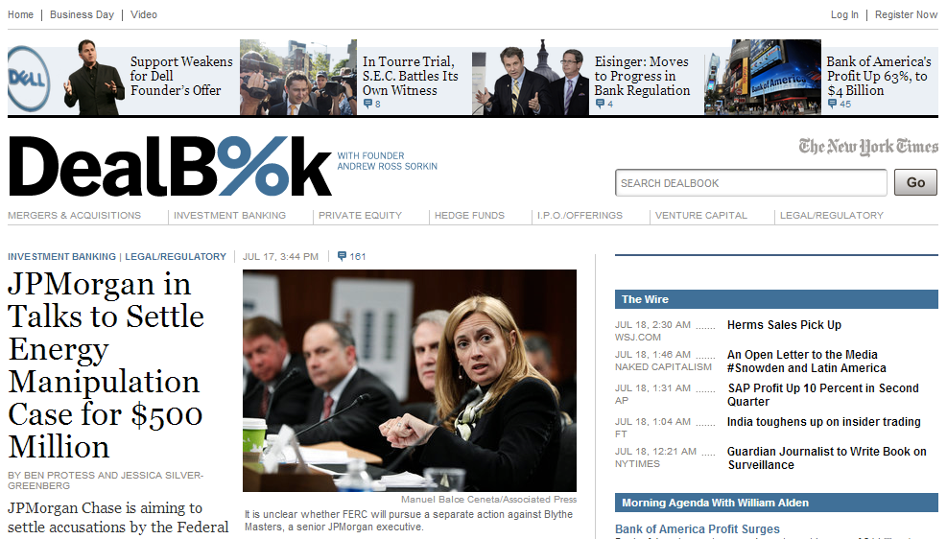
the best information?
task analysis

Slide 10
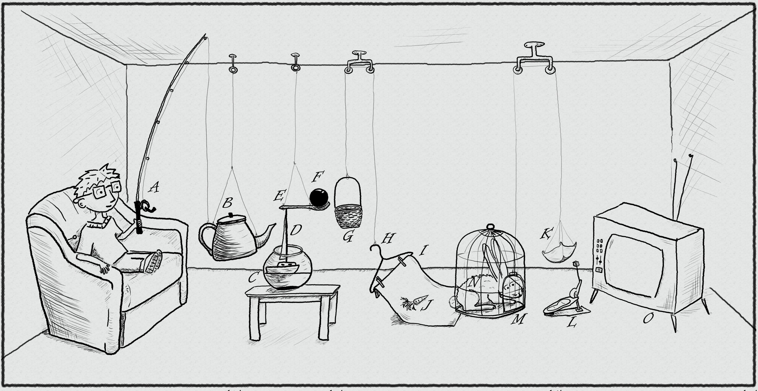
OVER-COMPLICATION
tASK ANALYSIS

Slide 11
Passive investors
task analysis

Slide 13
the final four
our best ideas

Slide 14
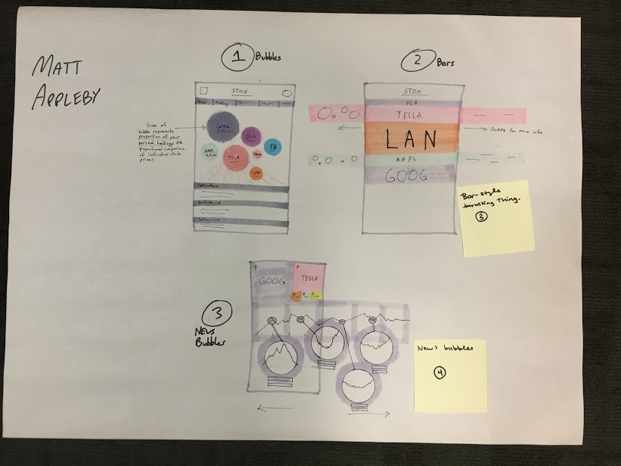

Slide 15
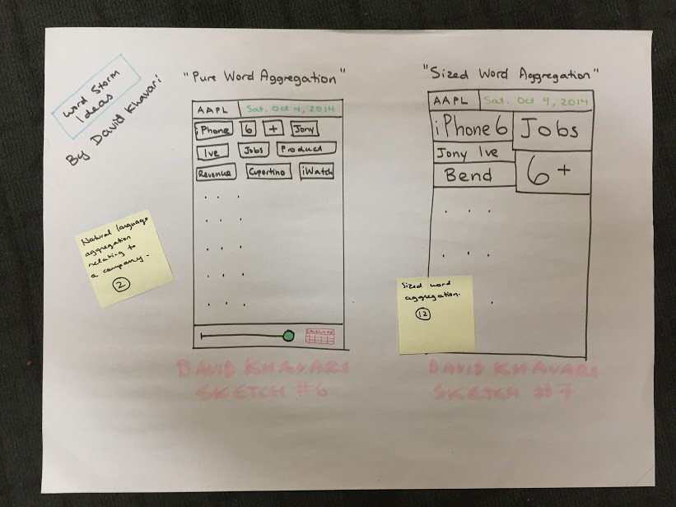

Slide 16
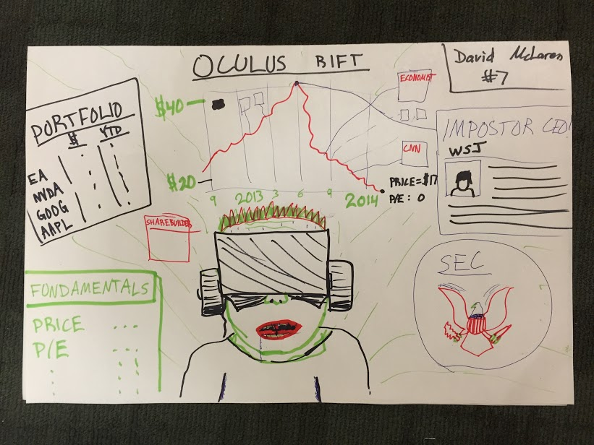

Slide 17
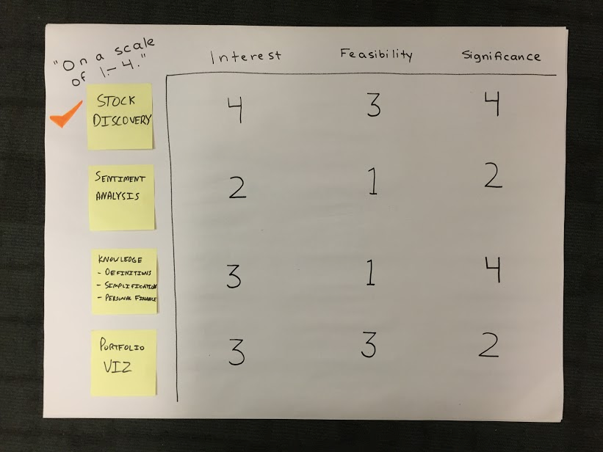

Slide 18
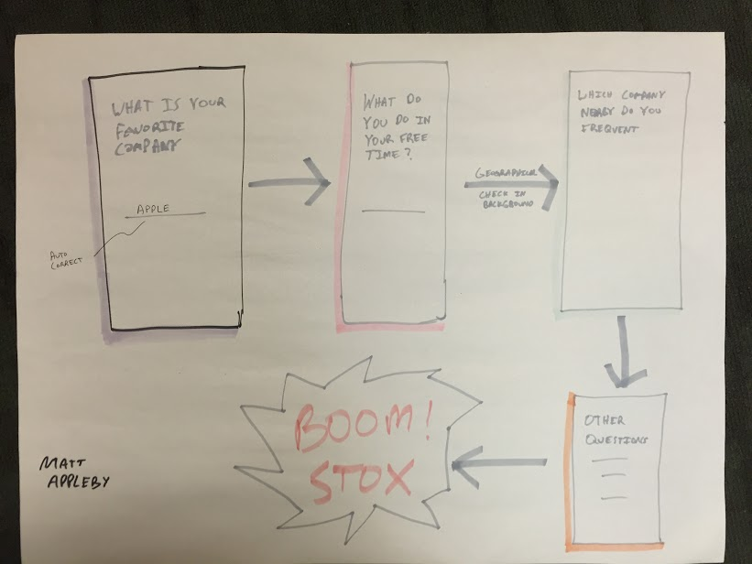

Slide 20
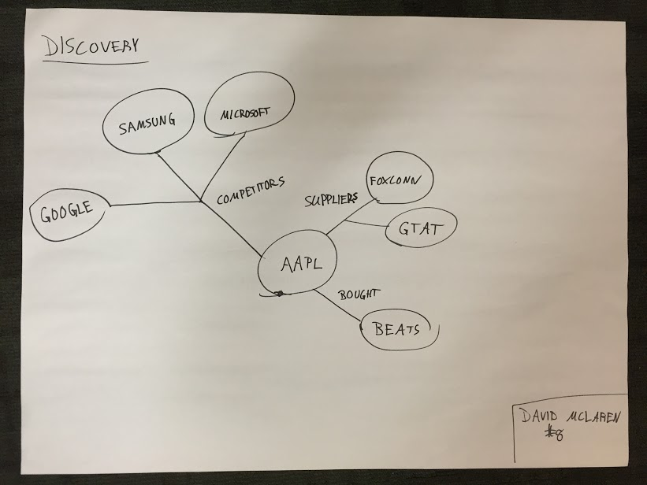

Slide 21
questions?

