Slide 1
Moustafa Asfour
|
|
|
Raissa Largman
Matt Taylor
Kate Wendell

Slide 2
UNCHARTED
Problem & Solution
Heuristic Evaluation Feedback & Revised Designs
Prototype Implementation Status
Live Demo

Slide 3
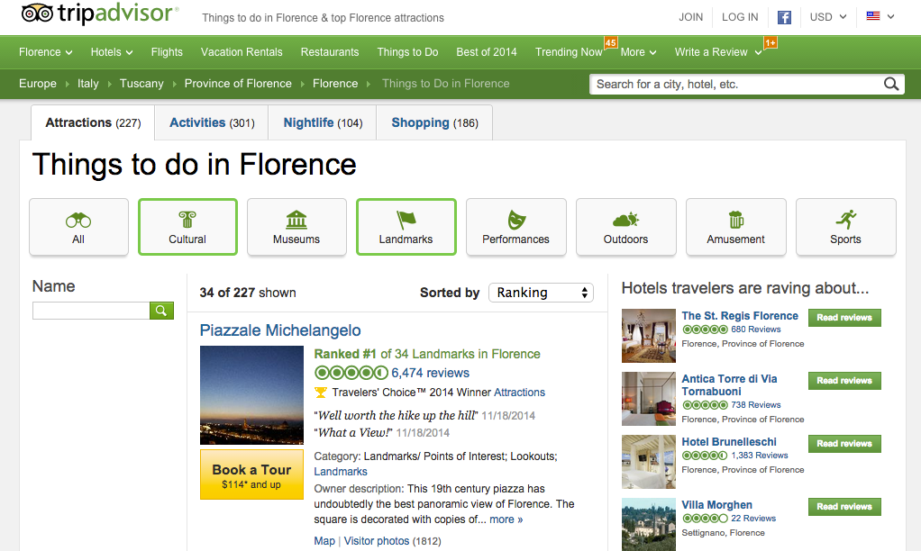
Problem

Slide 4
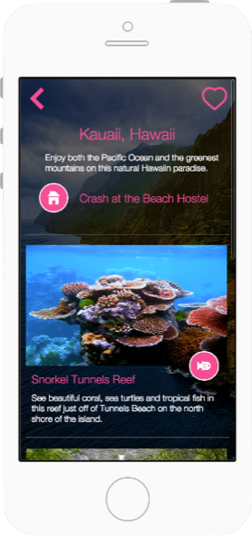
Solution

Slide 5
Heuristic Evaluation Feedback

Slide 6
Heuristic Evaluation Feedback
1. User Freedom and Control

Slide 7
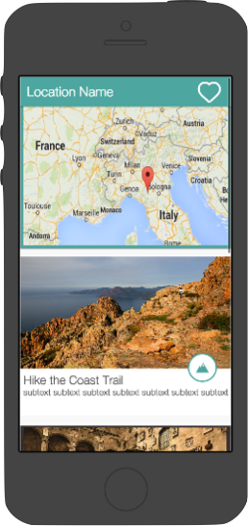
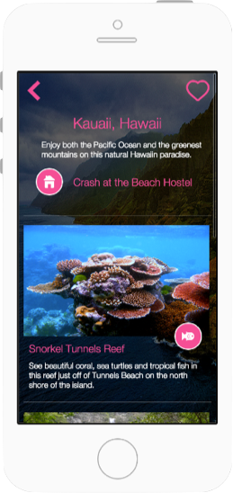
Heuristic Evaluation Feedback
2. Visibility of System Status

Slide 8
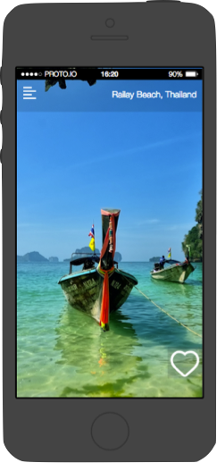
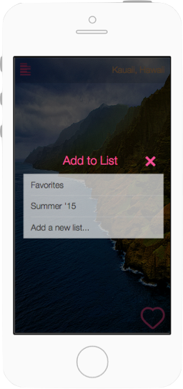
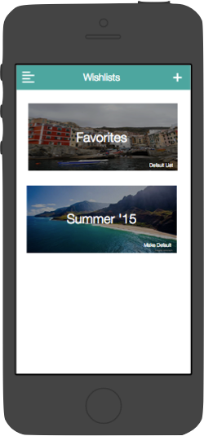
Heuristic Evaluation Feedback
3. Recognition Rather than Recall

Slide 9
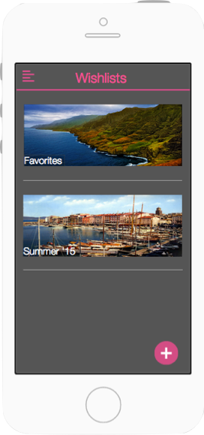
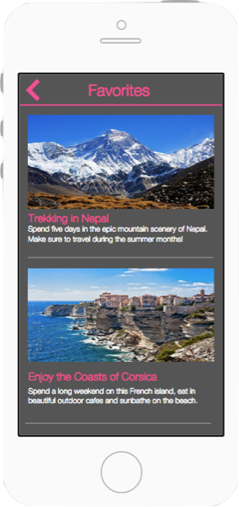
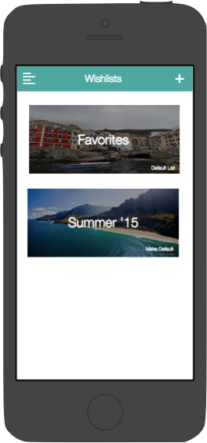
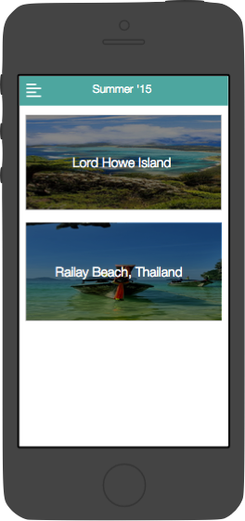
Heuristic Evaluation Feedback
4. Visibility of System Status

Slide 10
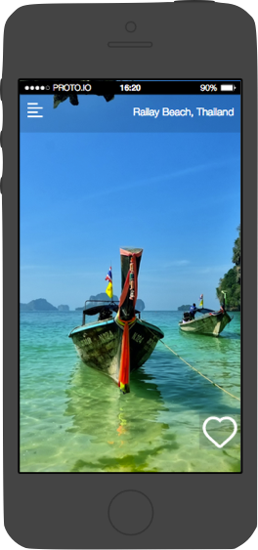
Heuristic Evaluation Feedback
5. Recognition Rather than Recall

Slide 11
Prototype Implementation Status

Slide 12
Prototype Implementation Status
JavaScript Framework Meteor
Mongo Database
iOS Simulator

Slide 13
Prototype Implementation Status
Task One: Browse Destinations
- Destination Content
-Destination View Template
- Trip Details View Template
- Swiping Gesture

Slide 14
Prototype Implementation Status
Challenges Implementing Task One
-Meteor has much less documentation
-JQuery mobile package for swipe gesture
- Aesthetic: image stretching, icons, animations

Slide 15
Prototype Implementation Status
Whats Next
-Filtering
-Wishlists
-More content

Slide 16
prototype Demo

