Slide 1
mWork: Low-fi Prototyping
October 24th, 2014 | CS147 HCI + D
Lea Coligado | Design + Development
Andrea Sy | Managment + Design
Allen Yu | Documentation + User Testing
John Yang-Sammataro | Development + Management

Slide 2
Overview
Mission
Tasks & Scenarios
Low-Fi Prototype
Method
Results
Summary
Discussion and Q&A

Slide 3
Mission

Slide 4
mWork helps complete tasks by connecting clients with micro-tasks that require human intelligence to previously inaccessible pools of mobile device carrying workers

Slide 5
“micro-tasks for the masses”

Slide 6
Tasks
Complex, Moderate, Simple

Slide 8
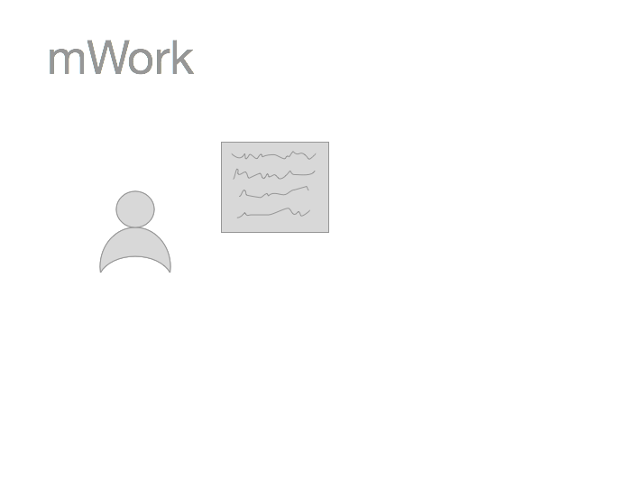

Slide 9
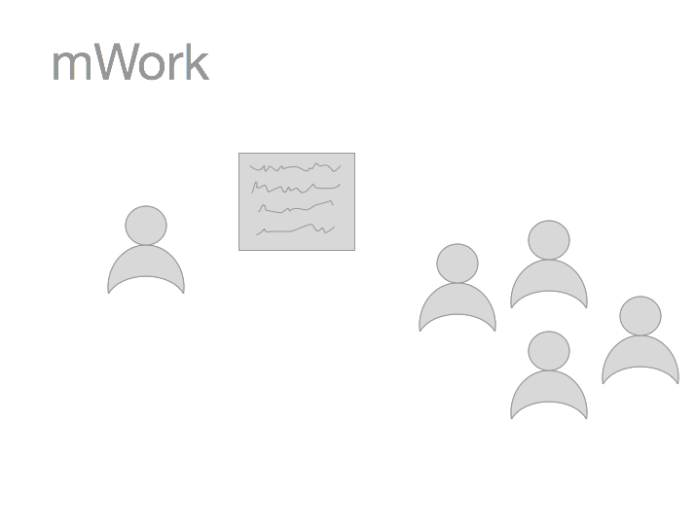

Slide 11
Matching client tasks to workers (moderate)

Slide 12
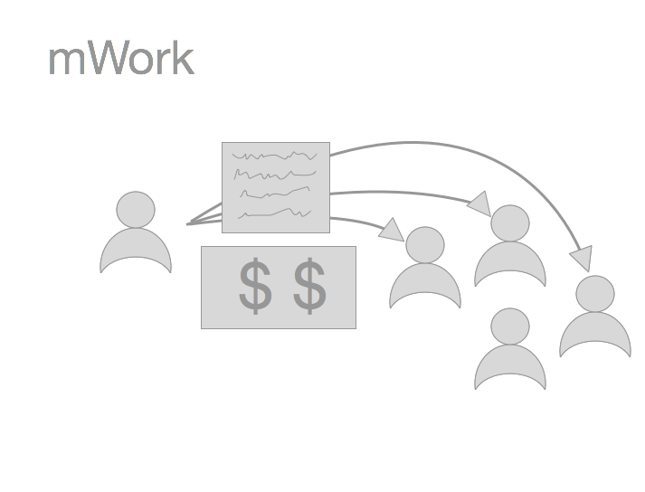

Slide 13
Paying users (client) cashing out (workers) (both complex)

Slide 14
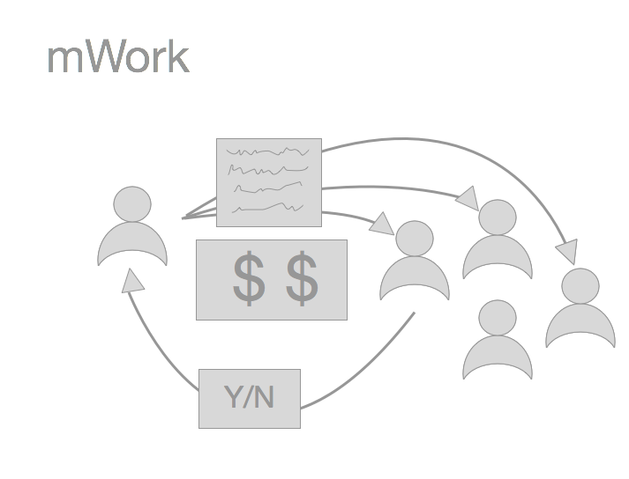
Categorizing content (simple)

Slide 15
Tasks
Categorizing content (simple)
Matching clients to workers (moderate)
Payments

Slide 16
Tasks (Client / Worker Split)
Categorizing content (simple)
Worker interface
Matching clients to workers (moderate)
Client: filtering workforce
Worker: choosing tasks
Payments
Client: paying workers
Worker: cashing out earnings

Slide 17
Low-Fi Prototype

Slide 18
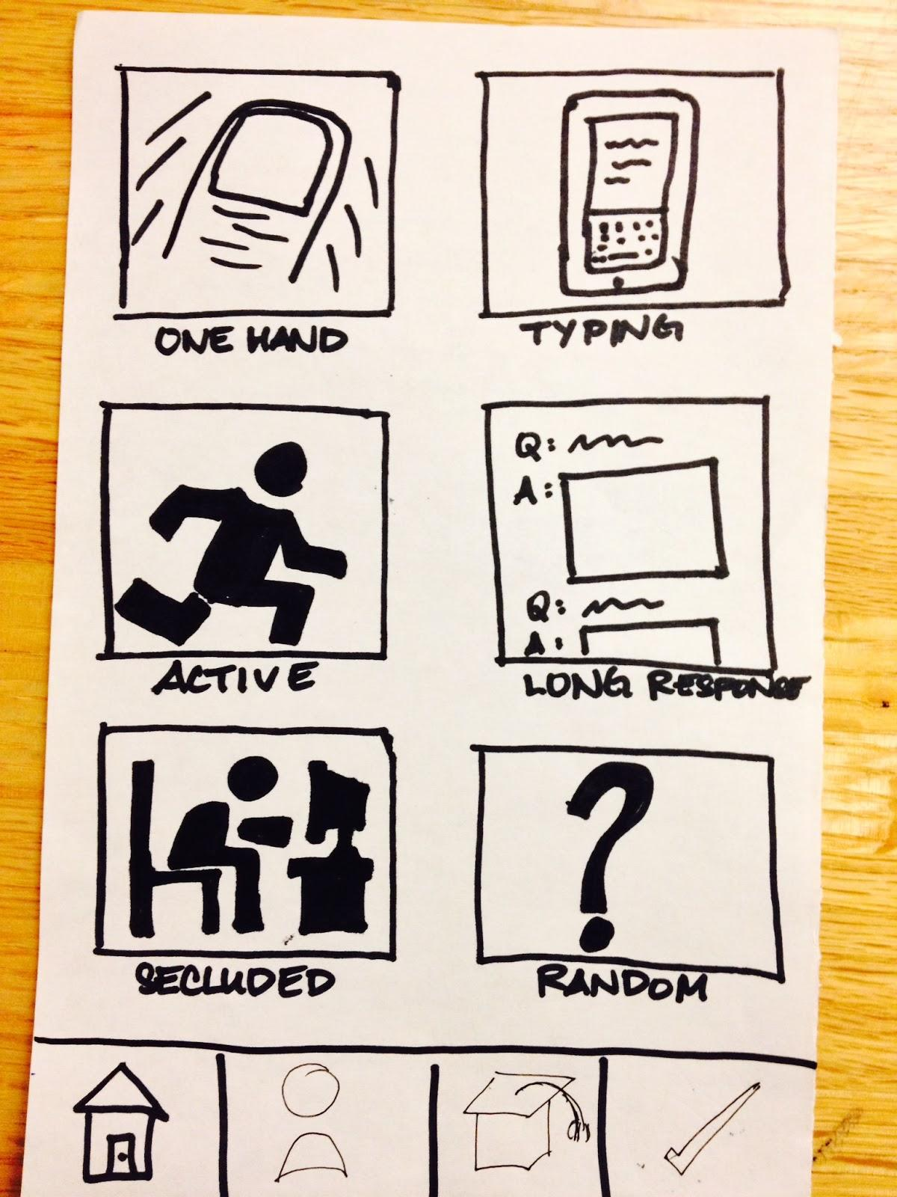
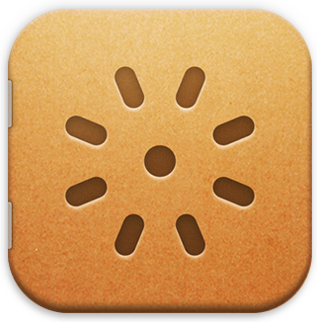
Tools
+
+

Slide 19
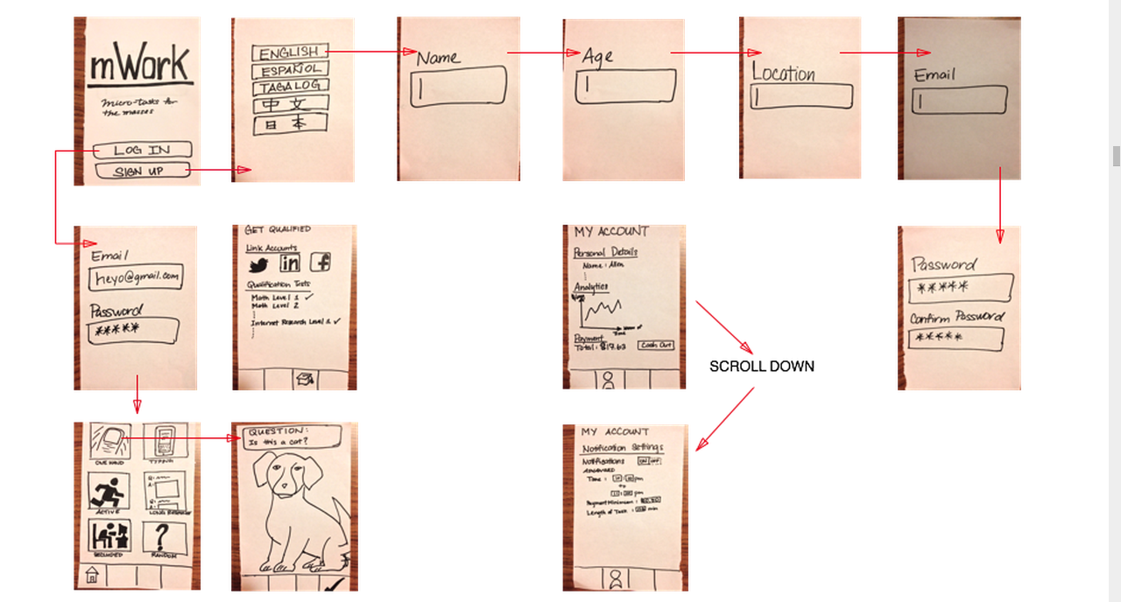
The Big Picture: Worker

Slide 20
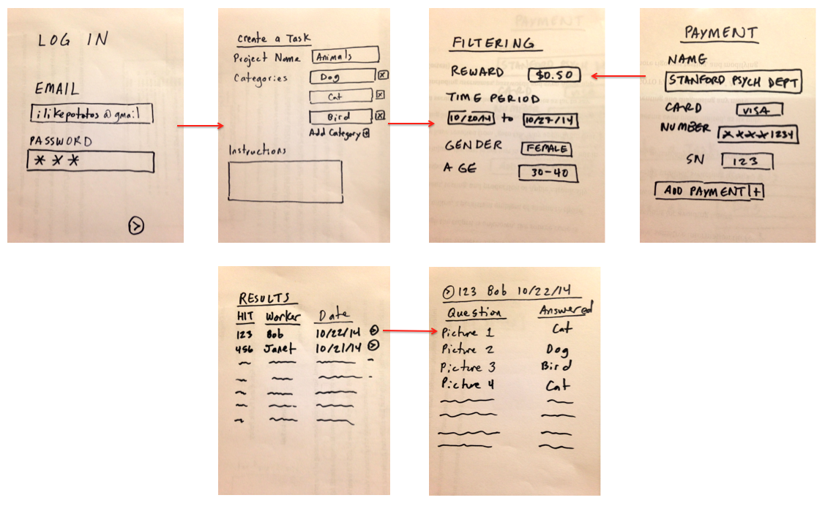
The Big Picture: Client

Slide 21
Worker
Tasks and scenarios

Slide 22
Task 0: Sign-up
(Super Simple)

Slide 23
Task ½: Login
(Super Simple)

Slide 24
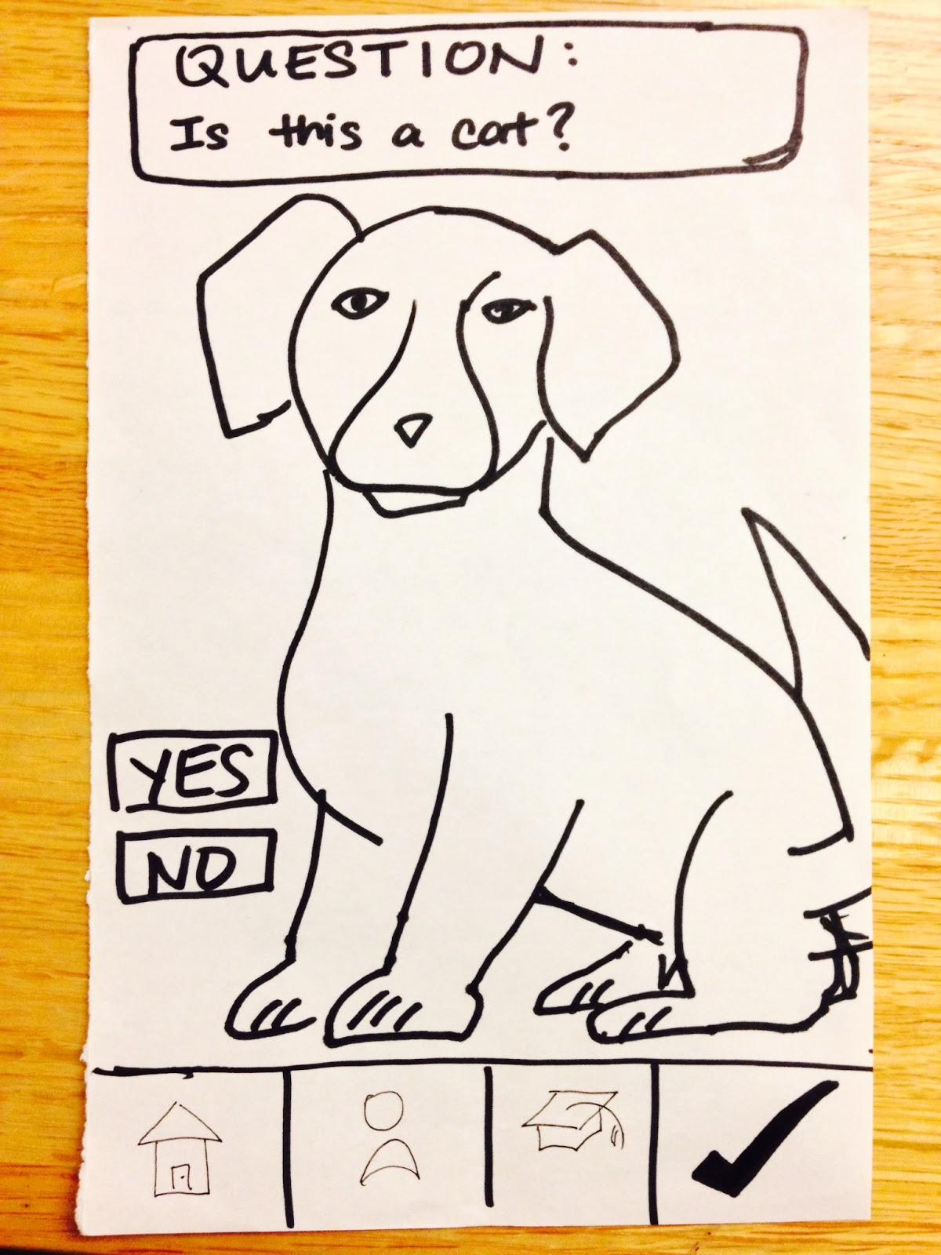
Task 1: Categorizing Content
(Simple)

Slide 25
Task 2: Matching a task with a user
(Moderate)

Slide 26
Task 3: Cashing Out
(Complex)

Slide 27
Client
Tasks and Scenarios

Slide 28
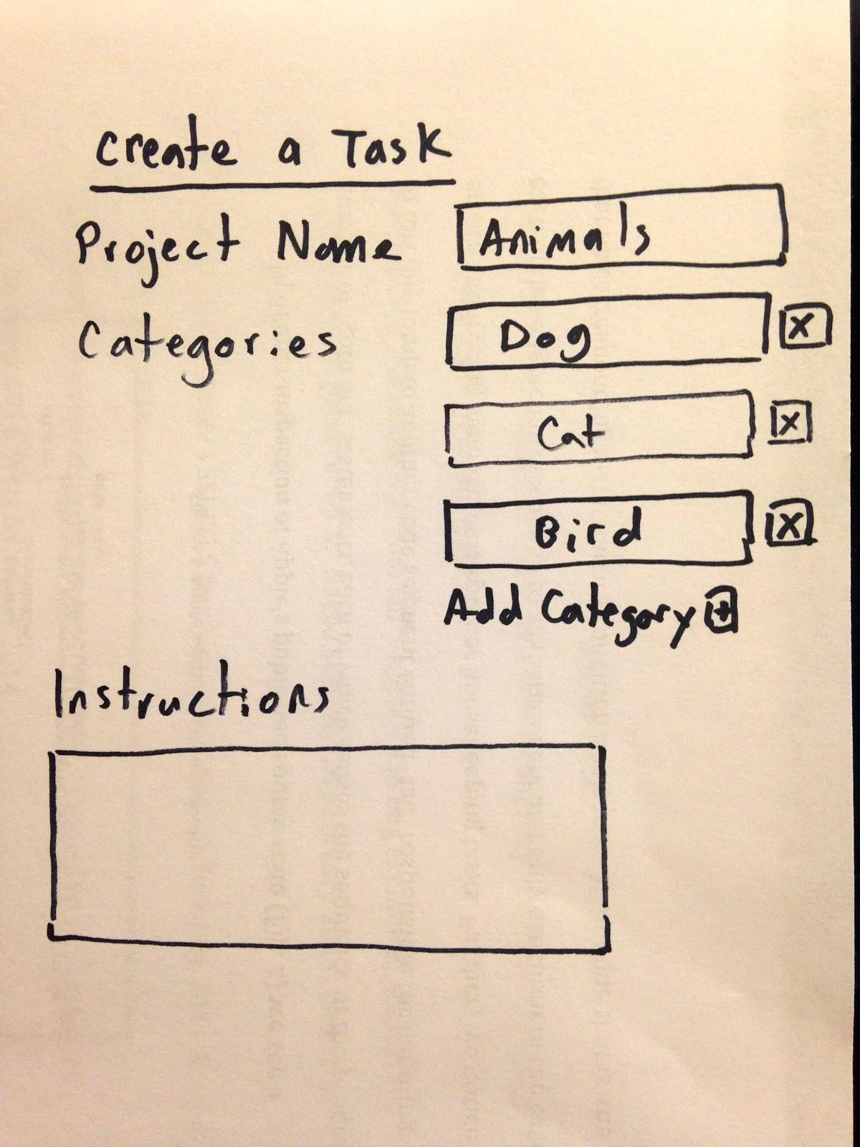
Task 1: Micro-Task Creation
(Complex)

Slide 29
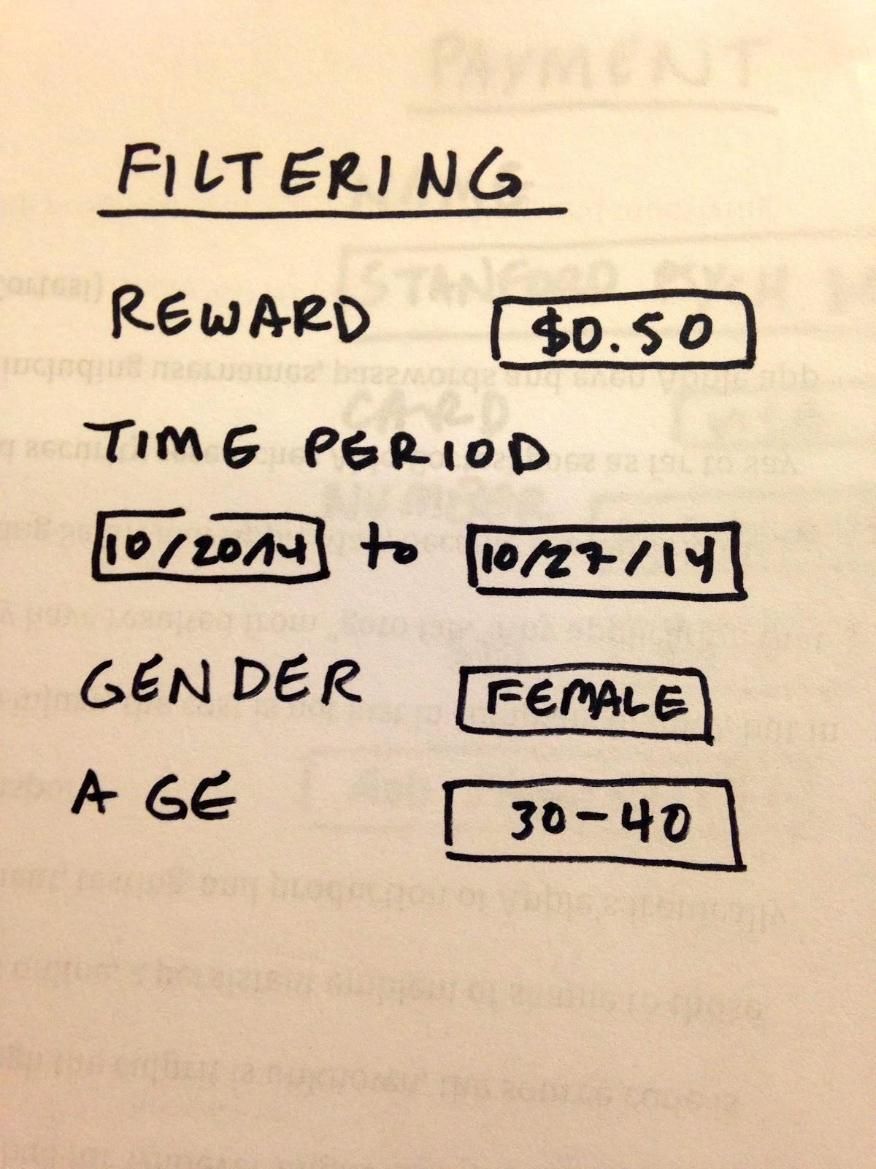
Task 2: Filtering Workers
(Moderate)

Slide 30
Task 3: Result Analysis
(Simple)

Slide 31
Method
Participants, environment, procedure

Slide 32
Participants
(Workers)

Slide 33
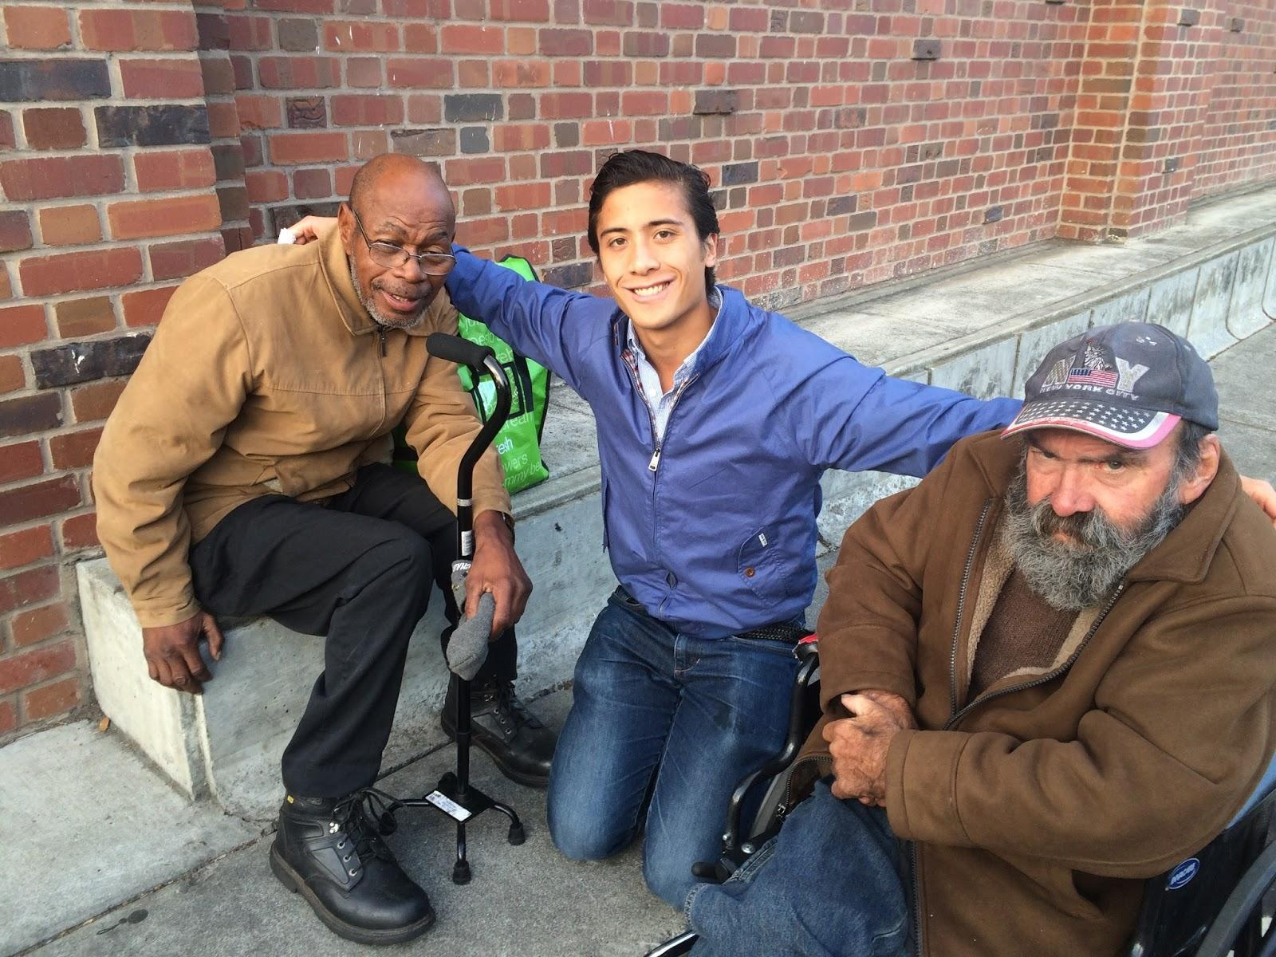
Worker Candidates: V and R

Slide 34
Worker Candidates: V and R
Homeless Palo Alto residents
Construction and marine veteran
Disabilities
Unemployed

Slide 35
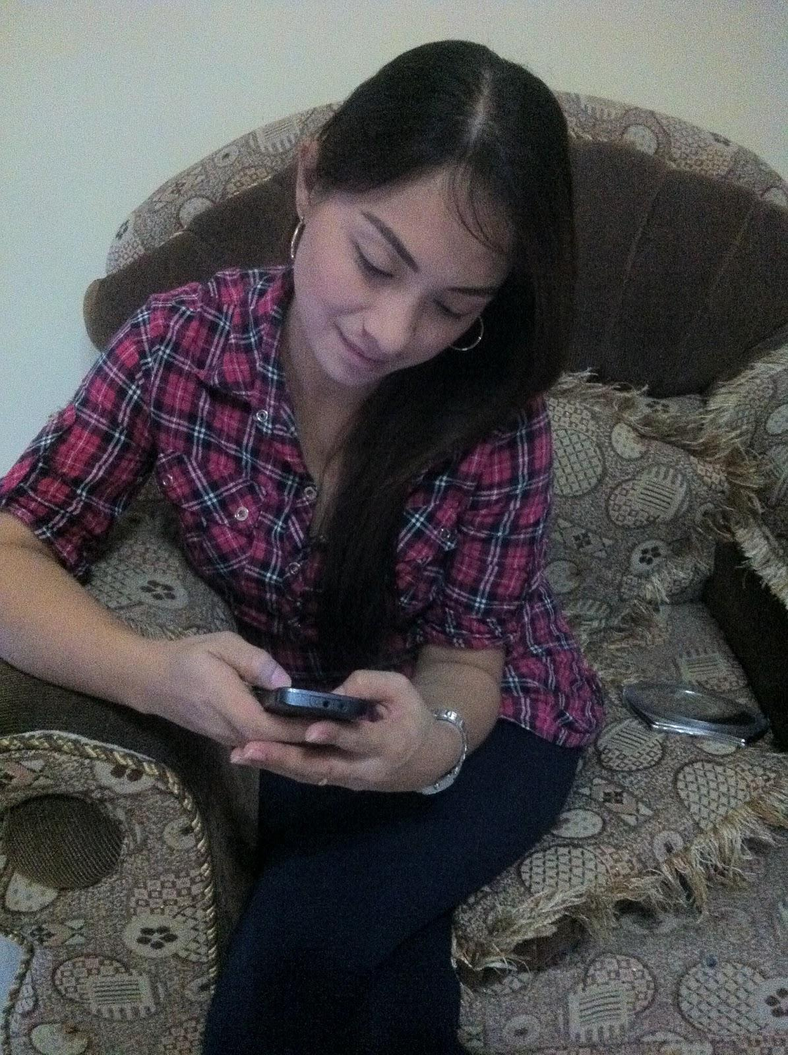
Worker Candidate: JC

Slide 36
Worker Candidate: JC
Filipina from Manila
Day-time executive assistant
Uses her iPhone extensively for communication

Slide 37
Participant
(Client)

Slide 38
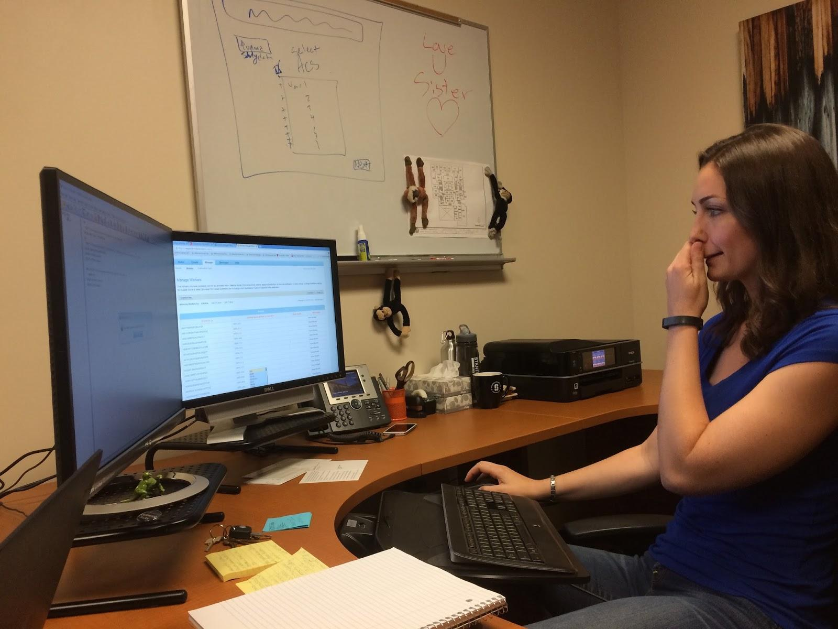
Client Candidate: CR

Slide 39
Client Candidate: CR
~ 30 year old Stanford humanities lab manager
Already uses Amazon mTurk to run studies

Slide 40
Procedure

Slide 41
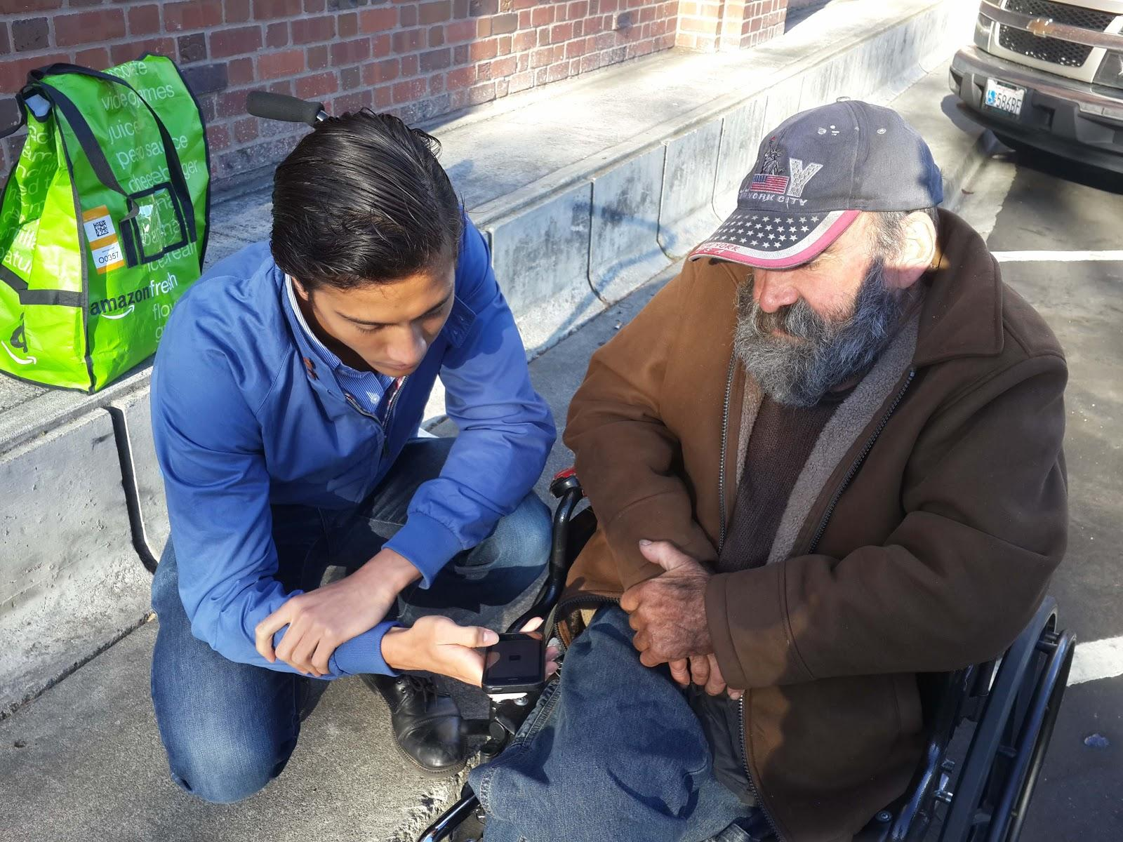
An experimenter works with participant 007

Slide 42
Procedure
“In situ” testing
Two group members → interaction + recording
Application purpose, overview, and tasks
Contextual interview
POP walk through + guidance
Edible compensation

Slide 43
Results

Slide 44
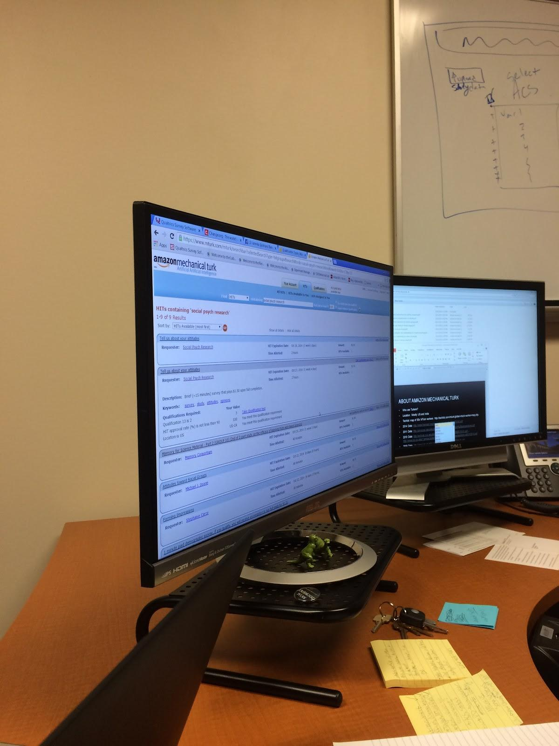
The desktop of a an interviewed client.

Slide 45
Key Takeaways: Client
Make micro-task creation “like Google forms” (existing models)
Drag and drop
More complicated = Third Party
Allow additions of filters
CSVs are critical for exporting data

Slide 46
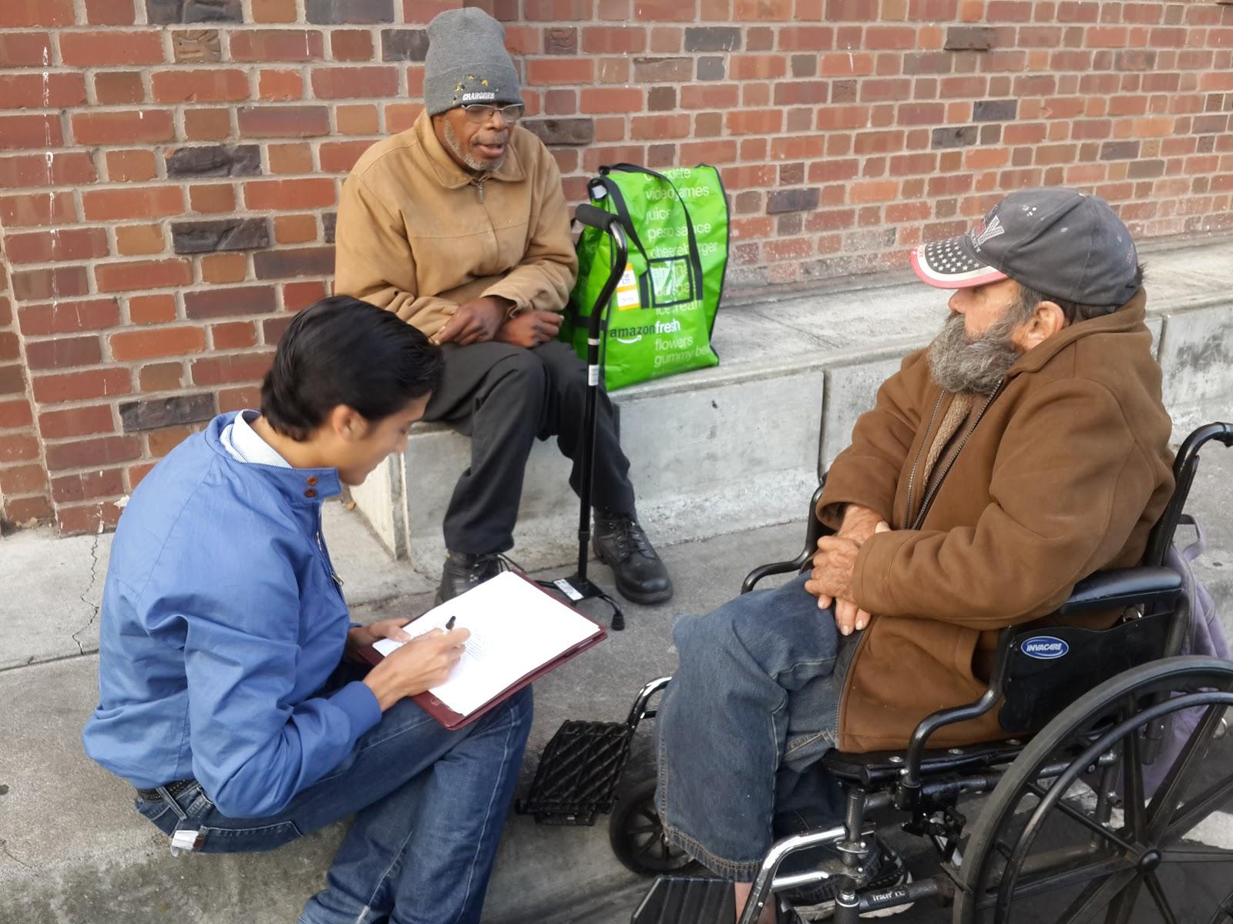
Summarizing the interview with participants 1299 and 007

Slide 47
Key Takeaways: Workers
Icon clarity
Looking for a linear flow
Fewer options
Free form is challenging
No email?
Bigger situational problems (homeless)
How do you tackle disabilities?
Questions of legitimacy

Slide 48
Suggested UI Changes

Slide 49
Client: Suggested UI Changes
Drag and drop
More filters (optional additions)
Third party integration easy and key
MVP CSV focus for results

Slide 50
Worker: Suggested UI Changes
Clarity + simplicity of flow
Rethinking + simplifying free form → time limit
Voice interface?

Slide 51
Suggested UI Changes

Slide 52
Suggested UI Changes
customer or product?

Slide 53
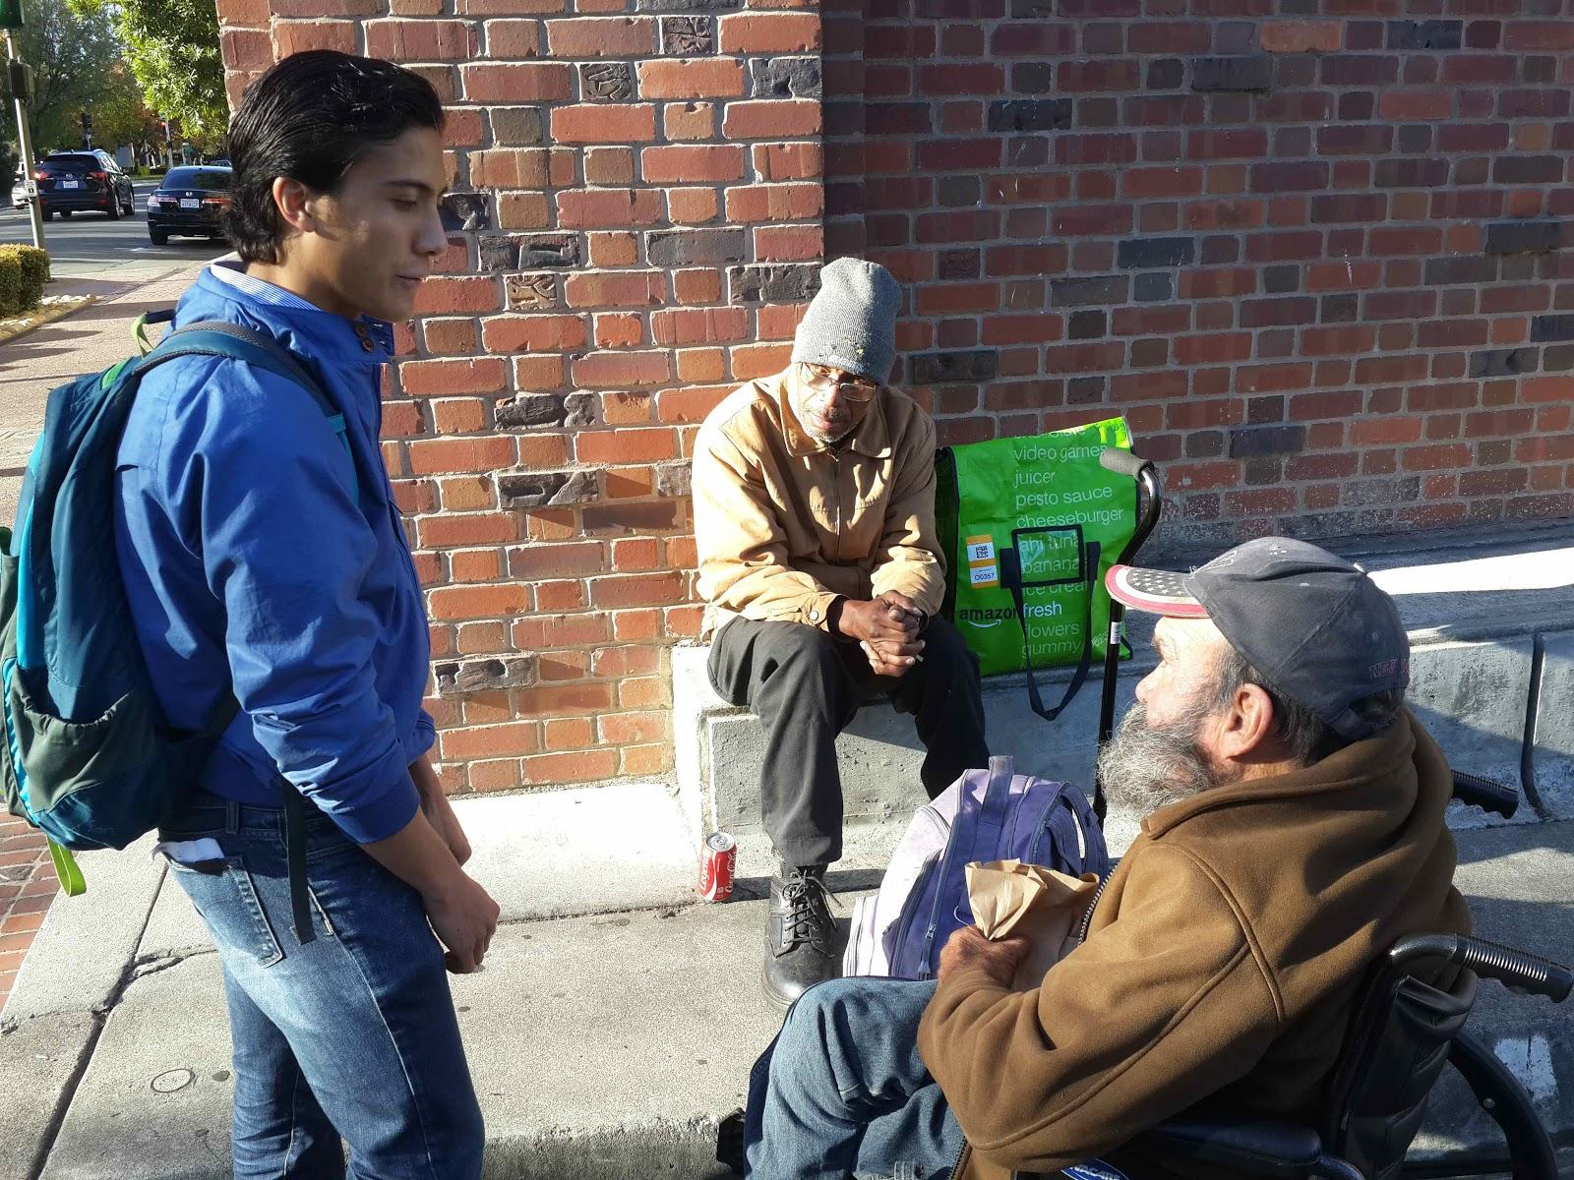
Talking with homeless participants.

Slide 54
Results: “Wow” moments
Disabilities
Contextual problems (alcoholism, bureaucracy…)
Social security, disability, and VA benefits?
Education of customers

Slide 55
Results: “Wow” moments
Disabilities
Contextual problems (alcoholism, bureaucracy…)
Social security, disability, and VA benefits?
Education of customers
Developing world a better fit than homeless in the United States?

Slide 56
Re-thinking

Slide 57
Rethinking
Product
Customers
Personal lives

Slide 58
Summary

Slide 59
Summary
Mission: mWork = “micro-tasks for the masses”
Tasks: Categorization, task matching, payments
Valuable UI feedback from low-fi prototype
More impactful product + customer target + life feedback from participants
Rethinking next steps

Slide 60
Thank you!

Slide 61
Discussions and Q&A

Slide 62
Image Sources
Pop Image: http://blog.lookthink.com/wp-content/uploads/2012/11/pop.png
Handshake: http://www.snaboitiz.com/wp-content/themes/StudioPress_Red/images/handshake.jpg
All other images by presentation authors

