Slide 1
ID8
Alka, Julie, Lawrence, Sukhi
Helping you connect the dots

Slide 2
Connect the dots
We create a private space for spontaneous idea generation
Promote creativity through association of ideas and thoughts

Slide 3
Problem
How to innovate in a saturated market?
What should I draw for my art class?
What to write about for PWR?
What do do for my 147 project?
Environment does not encourage innovation or creativity

Slide 4
Overview
Heuristics evaluation
Problems with user control
Revised design
How to make users understand flow
Prototype implementation
Android

Slide 5
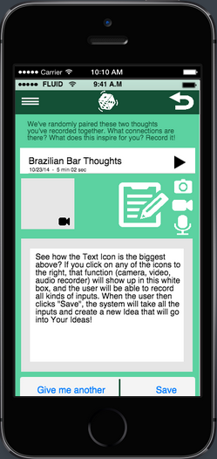
“Random” screen
H2-2 (Match between system and the real world). Setup of icons is very confusing in “random” screen.

Slide 6
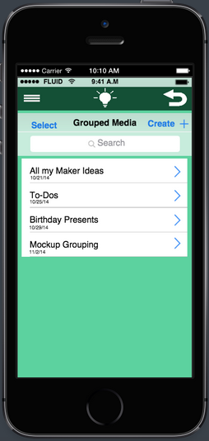
“Ideas” screen
H2-3 (User control and freedom). Selecting group of ideas doesn’t show annotations
H2-3. Client can see only the ideas that are already grouped together.
H2-3. Unclear what “select” button does.

Slide 7
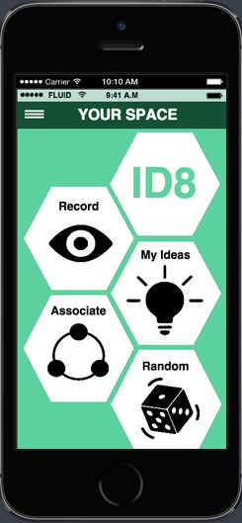
Other heuristics issues
Icons:
users don’t want to rely on icons
some icons are hard to understand
Flow:
functionality of many actions is confusing
requires instructions
Layout:
lacking consistency

Slide 8
Improvements: icons
always show name of the icon
use more intuitive icons for functionalities like “record”

Slide 9
Improvements: flow
have an introductory tutorial
more consistent layout
remove “select”

Slide 10
Improvements: functionality
show annotations when you select ideas
select ideas that are not grouped in lists

Slide 11
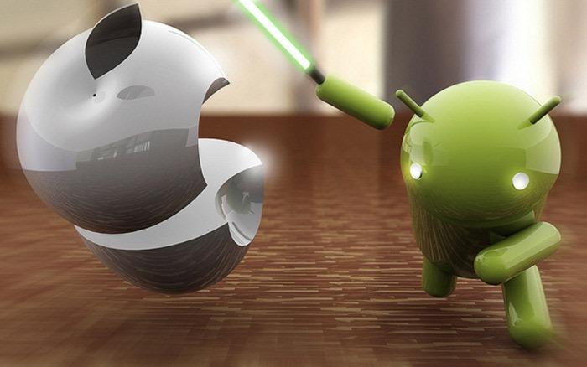
Implementation: Android

Slide 12
Implementation: Android
IDE: Eclipse + ADT
Phone from prof. Landay
Android Developer: Sukhi

Slide 13
ID8
Thanks!

