Slide 1
Creative Confidence
Sukhi Gulati
Lawrence Murata
Alka Nath
Julie Ni

Slide 2
Overall Problem & Solution
Problem Overview
Creativity is a world view
Few tools to develop a creative intuition
Creativity is often difficult to achieve
Lack of inspiration
Fear of judgement
Societal influences limit creativity
A private space to record, exercise, and integrate creativity.

Slide 3
Contextual Inquiry

Slide 4
Interviewees
Proposed Solution
Brian - an intercollegiate debate coach who is well known within the debate community. He doesn’t consider himself creative but his job includes counterintuitively creative elements.
Sonja - 22 year old industrial design student at U. of Oregon who was visiting the d. school. She is a problem solver, and allowed great insight into current tools.
James - Professional dancer and choreographer on Broadway - got a phone interview with him. We initially thought he would be a target user, he gave insight into the creative process.

Slide 5
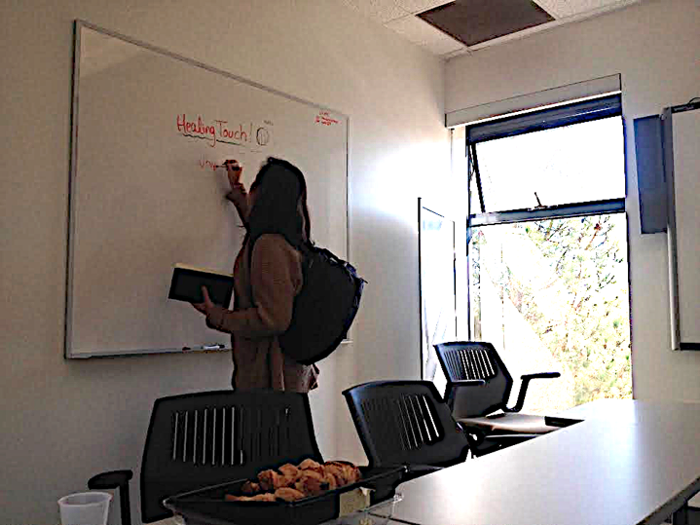
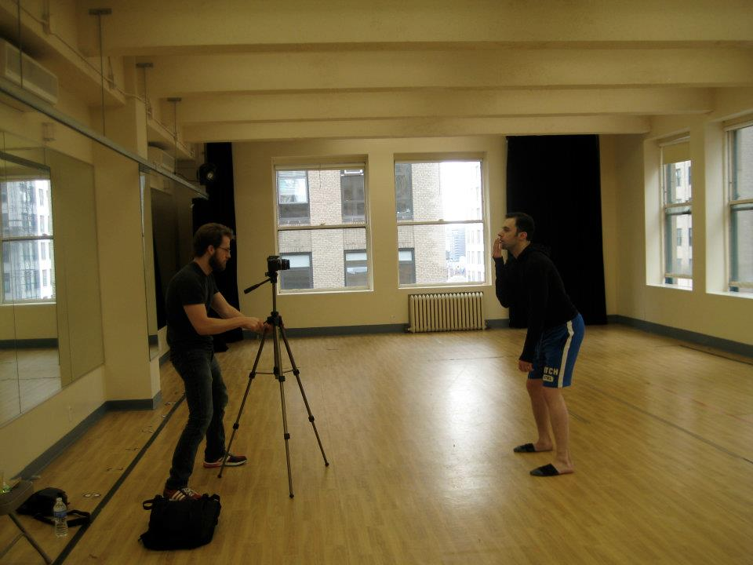
Workspaces
Proposed Solution

Slide 6
Contextual Inquiry Results
Proposed Solution
The Creative Process
Associative Ideation
Draw inspiration from multiple sources
Occurs spontaneously, often during mundane situations, or in comfort zones
On-the-spot thinking
Needs to be integrated into daily life/tasks
Creativity takes mental energy
People are less likely to go out of their way to be creative if it’s not “demanded” in their profession

Slide 7
Task Analysis

Slide 8
Problem Overview
OUR IDEAL USERS
Non-Creative professionals
Can be Involved with:
Idea generation
Research
Problem solving

Slide 9
TASKS AS DESIRED AND LEARNED
Problem Overview
Find inspiration
Practice creative skills
Capture insightful moments and ideas
Achieved through:
Intuition and repetition
Experimenting
Positive reinforcement

Slide 10
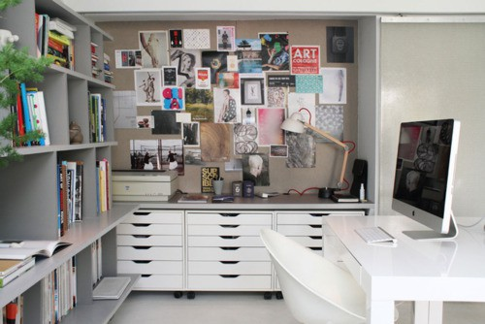
WHERE USERS WORK
Problem Overview
Office
At home/bedroom
While walking in the park
Coffee Shop
No judgement zone

Slide 11
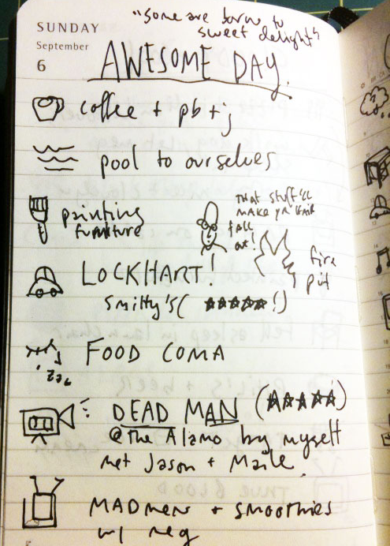
AVAILABLE TOOLS
Problem Overview
YouTube videos
Arrows/circling on whiteboard
Logbook
*These tools need to be actively sought out
Need to be integrated with daily life

Slide 12
USER COMMUNICATION
Problem Overview
Whiteboard/post-it notes
Talking to each other
Our idea = creativity as an internal process
Idea Genesis (Internal) → Feedback (External)

Slide 13
Three Representative Tasks

Slide 14
TASK 1: Capture and Save
Problem Overview
Record ideas and insights and save for later
For spontaneous and on-the-go creation

Slide 15
TASK 2: Connect the Dots
Problem Overview
Draw connections and associations
Link seemingly unrelated ideas together → new idea!

Slide 16
TASK 3: Maintain Momentum
Problem Overview
Keep continuous flow of inspiration
How to minimize times of “feeling stuck”
Step away from the process to refocus
Remain open to inspiration

Slide 17
Application Ideas

Slide 18
PROJECT-ORIENTED
Problem Overview
Project Lists
Creative Zones
Research Oriented Tools
Search Term Mapping / Association
Discovery Visualization
Language Processing Based Ideation
Chronological Progress Charting

Slide 19
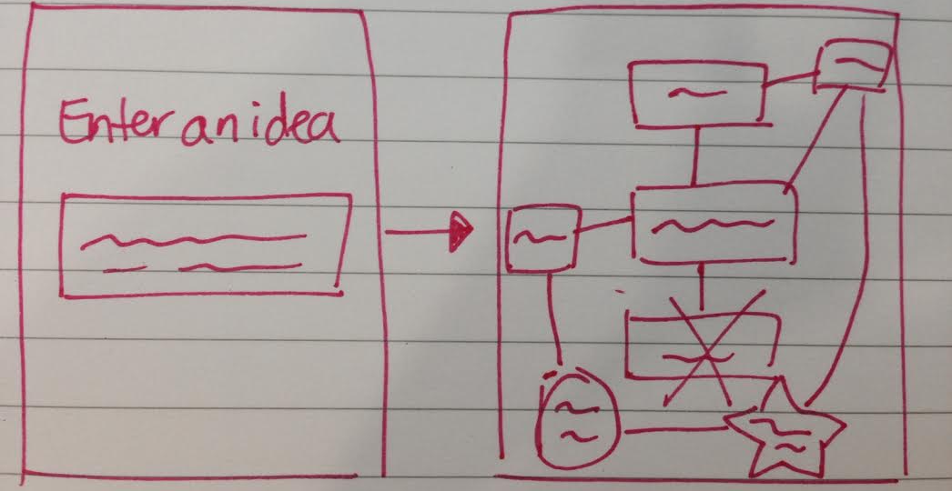
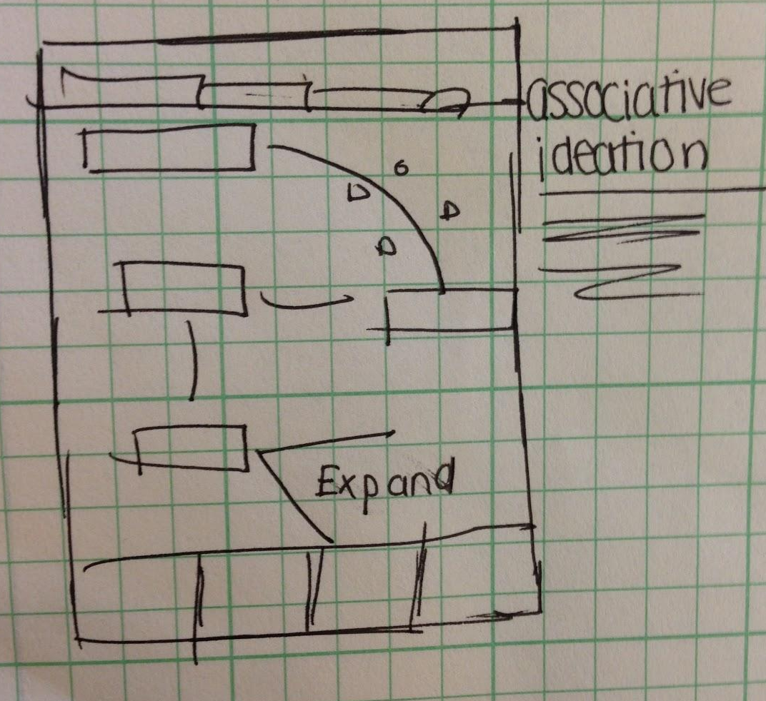
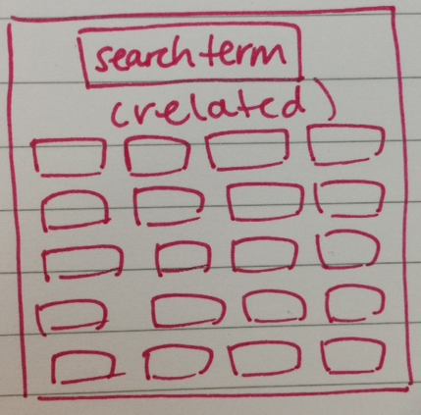
PROJECT-ORIENTED
Problem Overview

Slide 20
WORLDVIEW
Problem Overview
Integrated Creativity
A New Way of Thinking
Observation Processing
Associating Observations
Recording Ideas
Text, Audio, Video
Idea Visualization

Slide 21
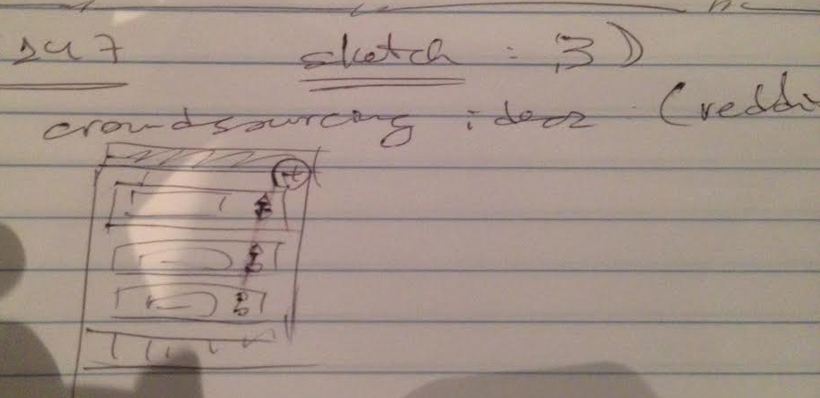
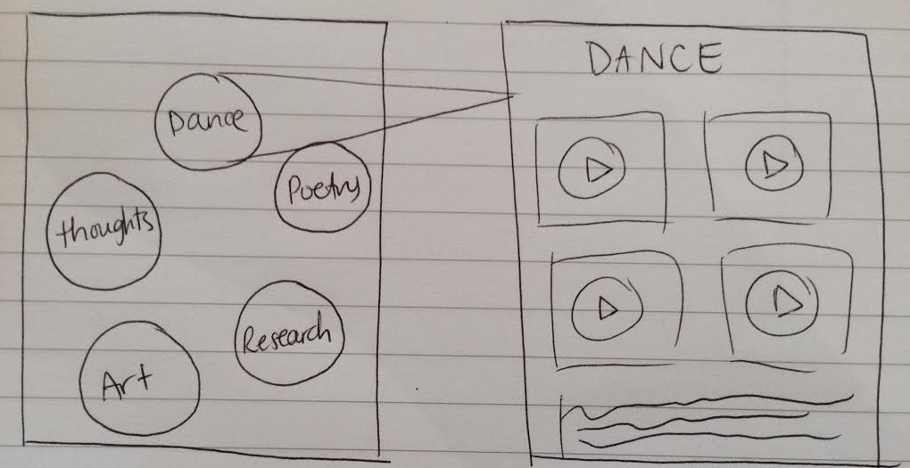
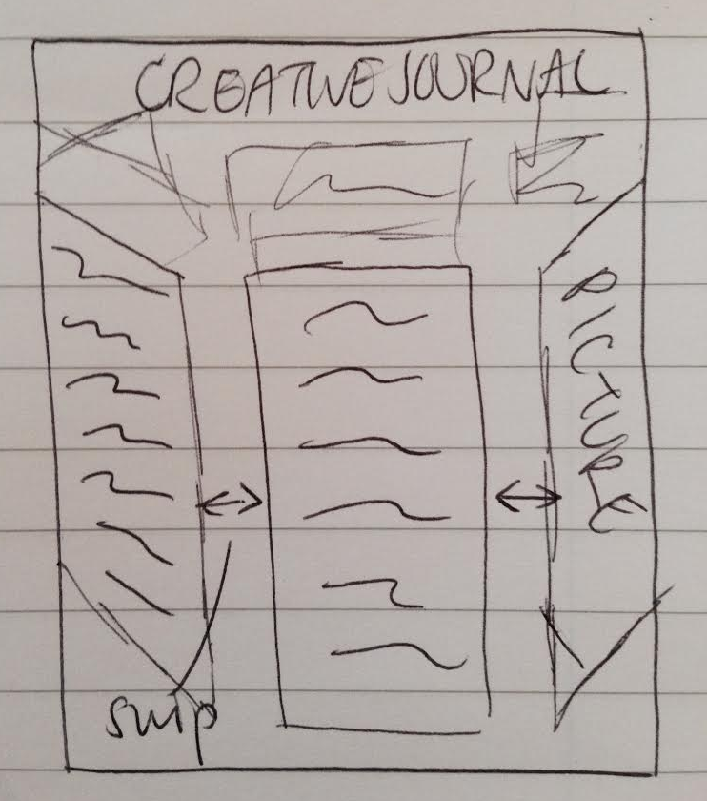
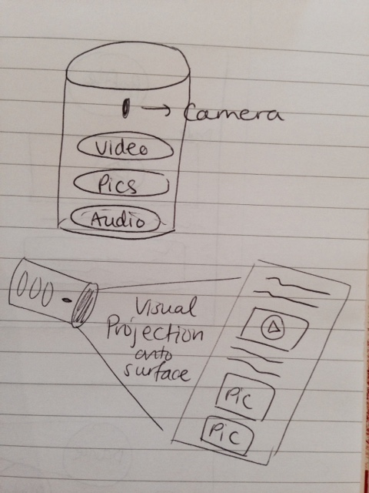
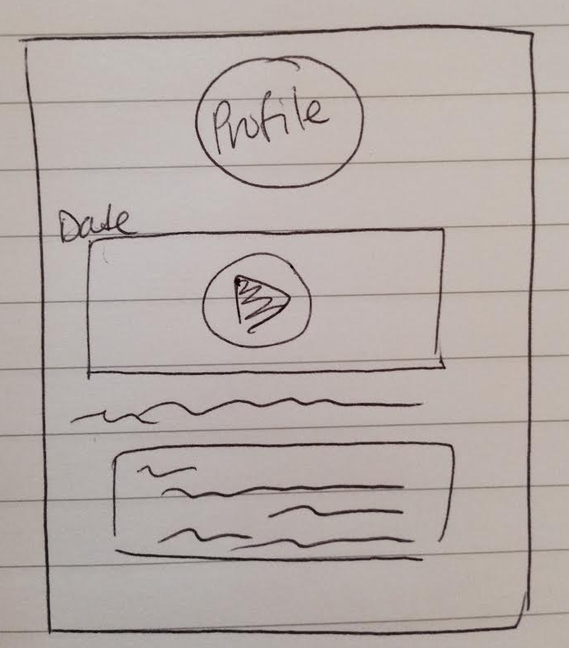
WORLDVIEW
Problem Overview

Slide 22
CREATIVE DIGITIZED DIARY
Problem Overview
Journal day-to-day progress
Encouraging daily thought -- automatically logged
Reminders to log
Accessible at any point in the day-- wearable!
Structured loosely - more like a diary, but varied input types
Timeline view - see progress over time
Not geared towards a specific end
Personal growth

Slide 23
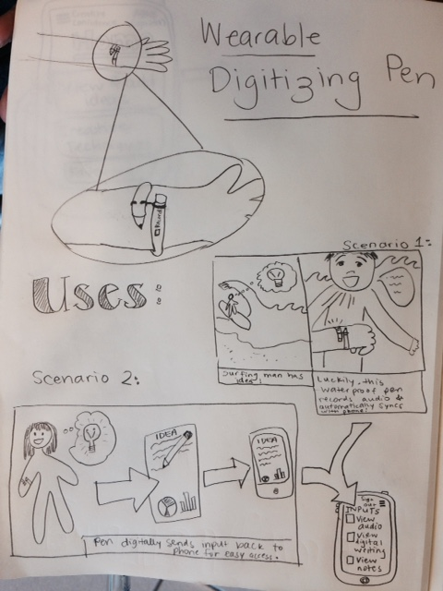
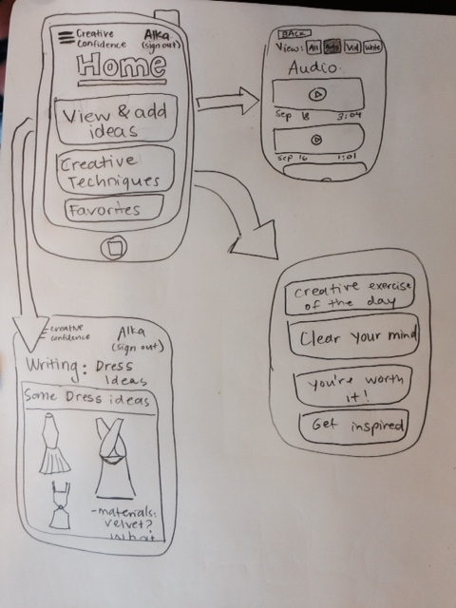
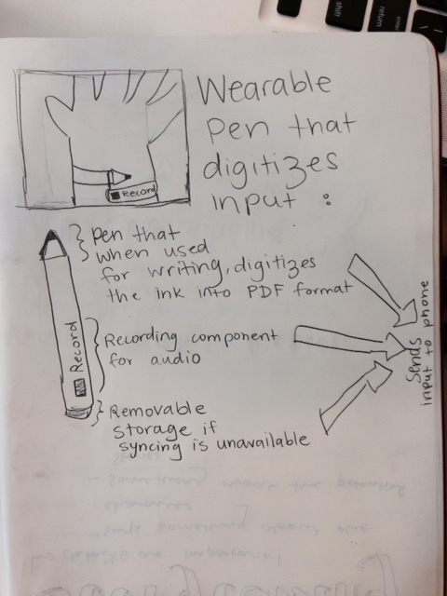
Creative Digitized Diary
Problem Overview

Slide 24
Summary
Creative Confidence is an integrated, daily-use tool used for developing creative intuition through repetition and associative ideation.

