Slide 1
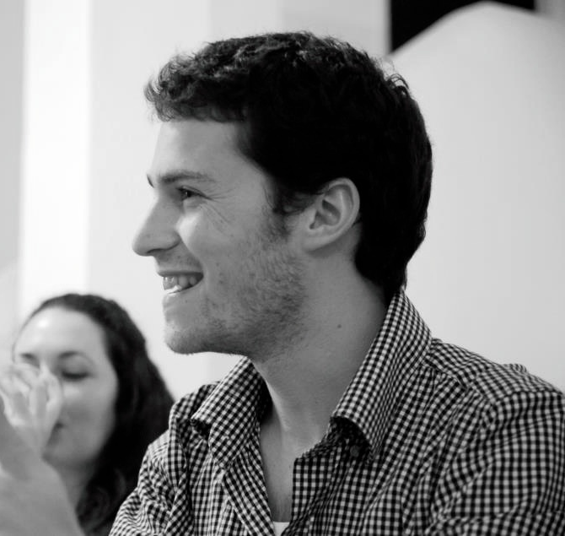
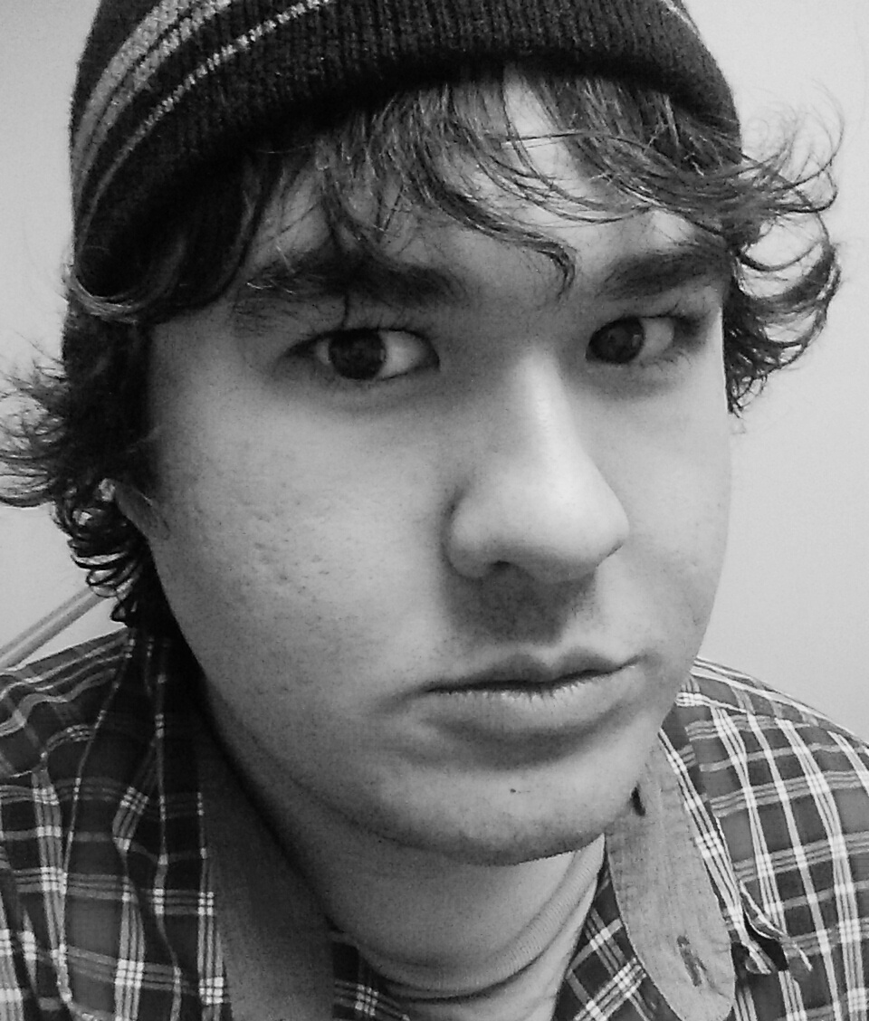
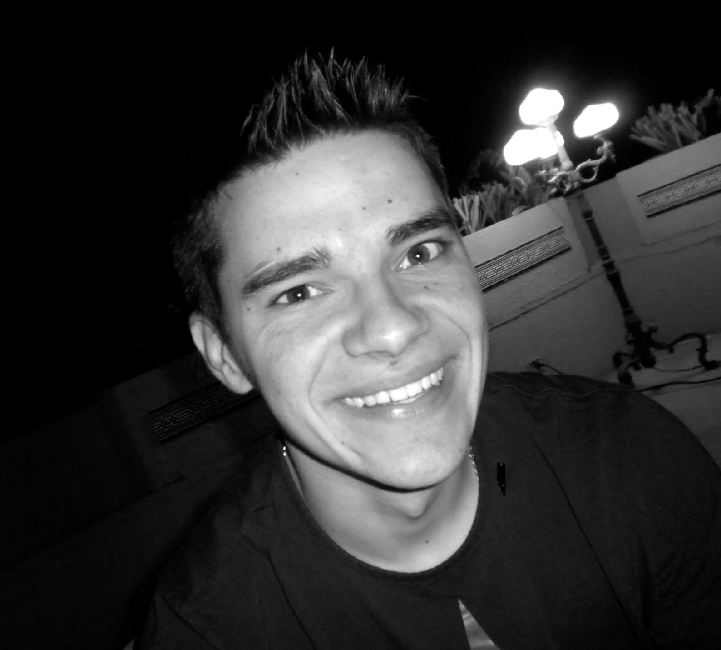
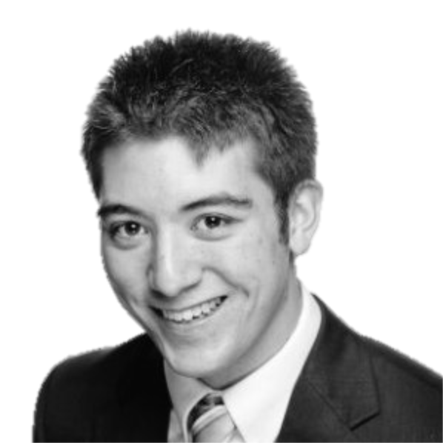
Huddle
Social Event Discovery
Nadav
Manager
Brandon
Design
Mike
Development
Joe
User Testing
Notes:
TODO: Need real title

Slide 2
Agenda
Mission
Tasks
Medium-fi prototype
Updated Scenarios
Tools Used
Summary

Slide 3
Mission Statement
“Huddle’s mission is to remove the hassles
of event creation and scheduling
and make it easy to discover and explore
with friends.”
Huddle, 2014

Slide 4
Tasks
Scheduling (voting) complex
Communication (vote+notify) moderate
Event curating (creation) simple

Slide 5
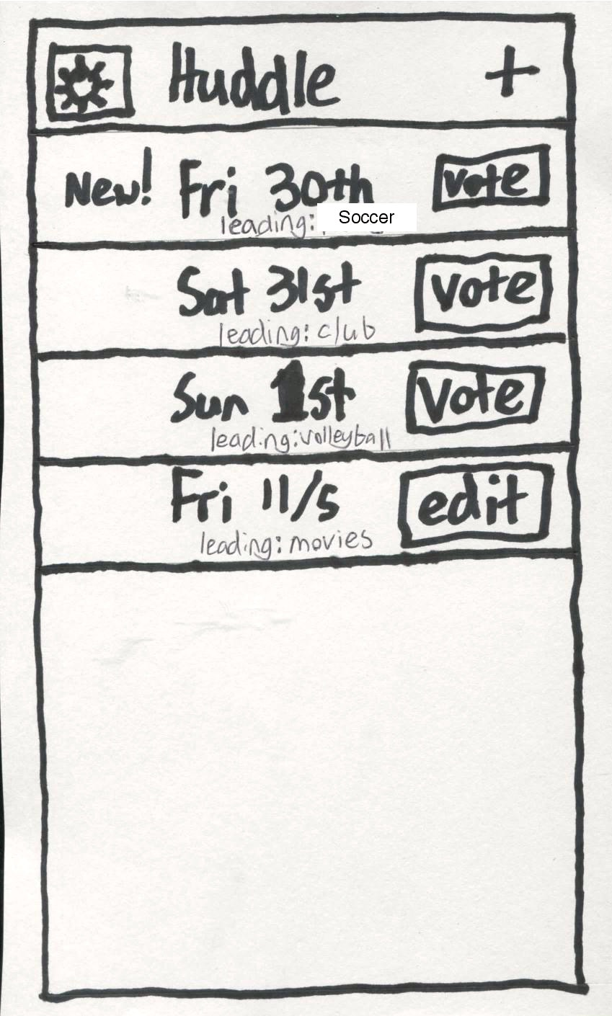
Revised UI Design: Home Screen

Slide 6
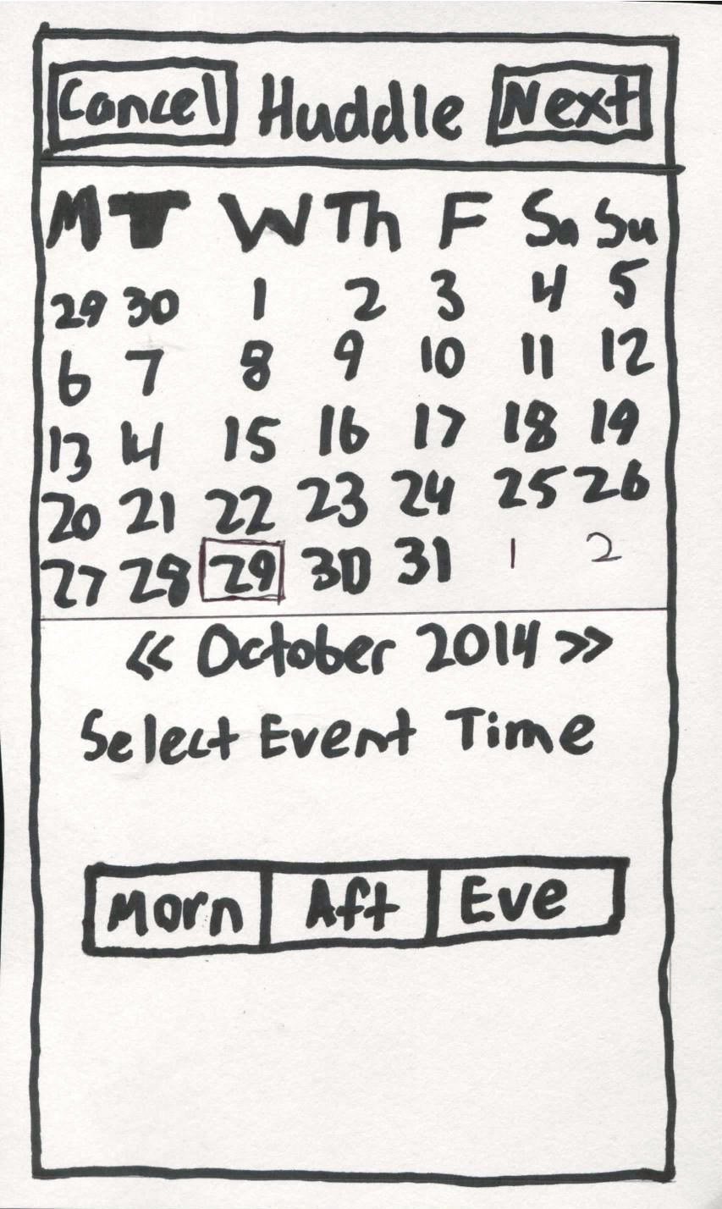
Revised UI Design: Calendar

Slide 7
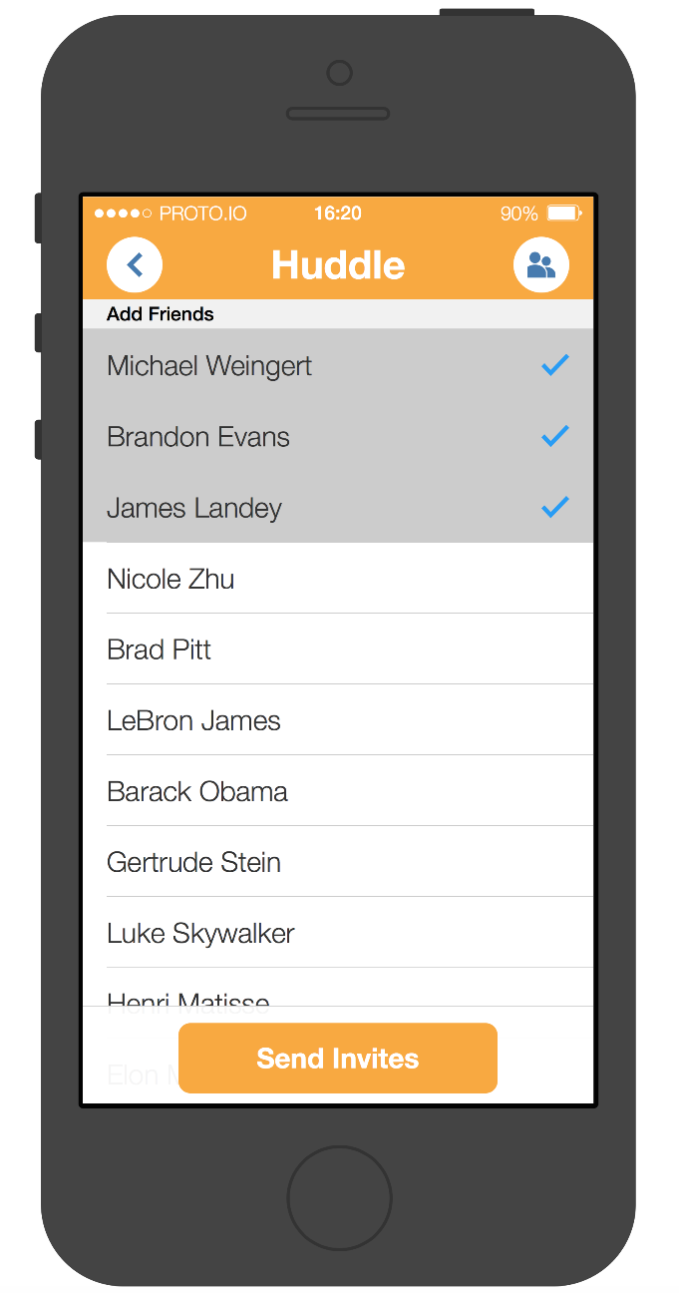
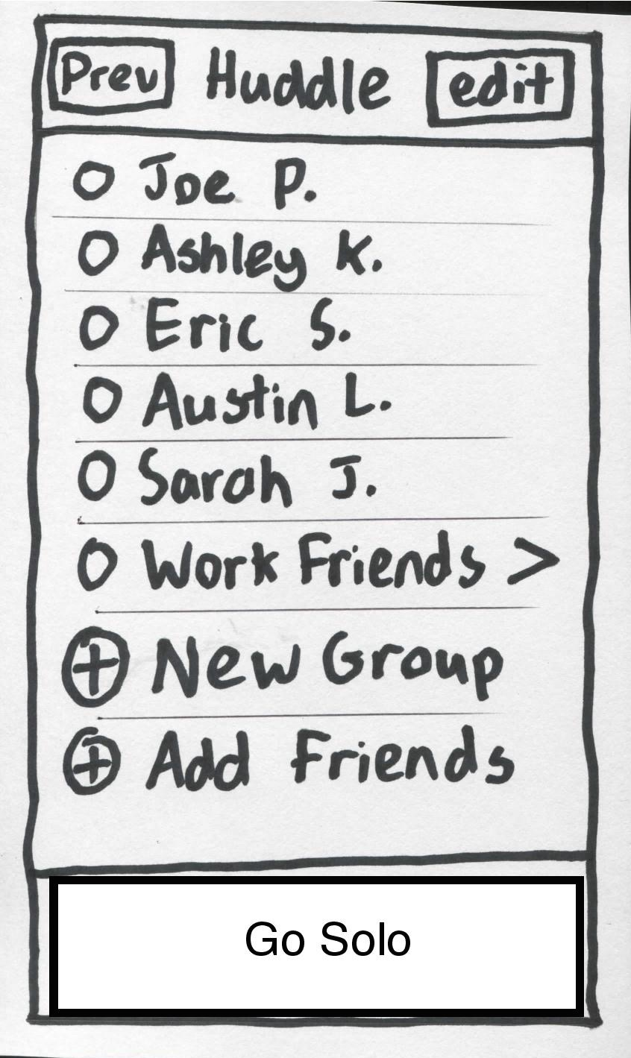
Revised UI Design: Add Friends

Slide 8
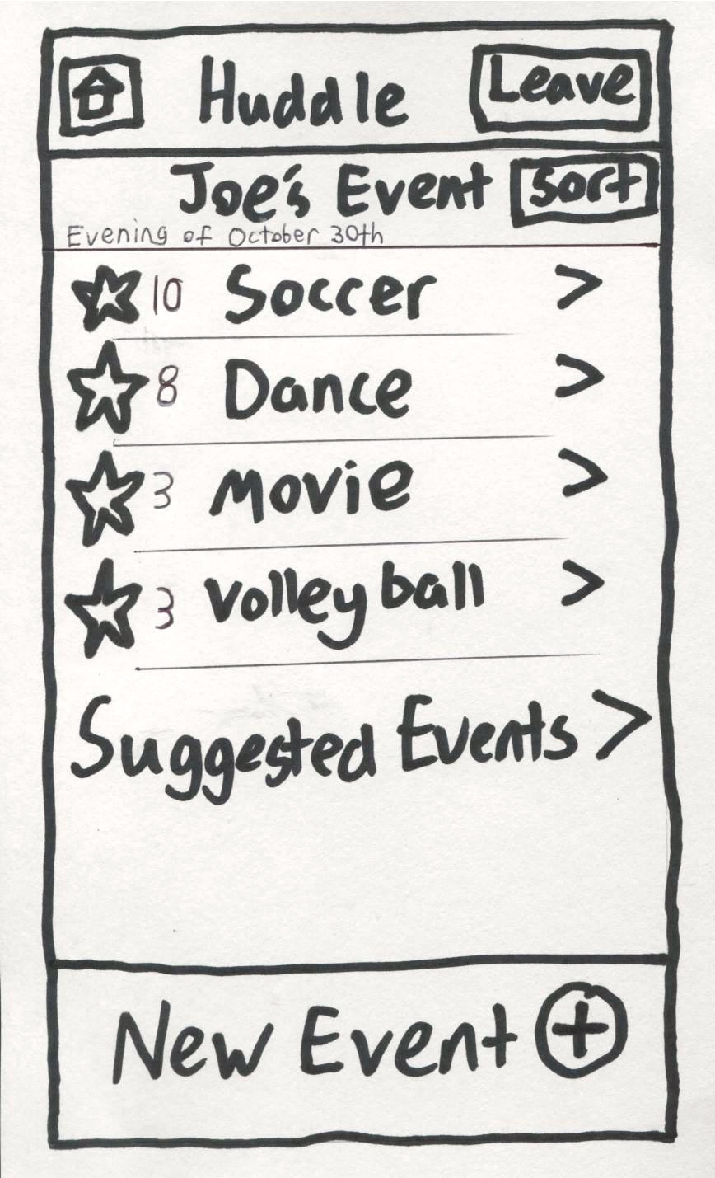
Revised UI Design: Curated Event

Slide 9
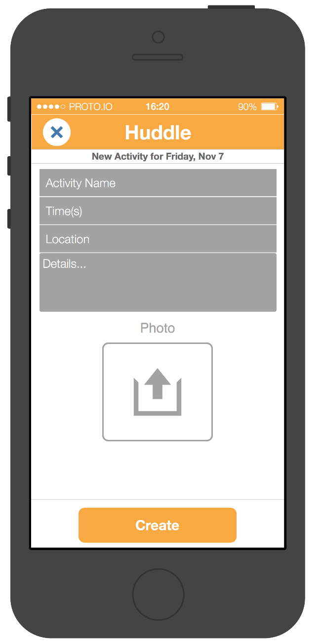
Revised UI Design: New Event + Votes

Slide 10
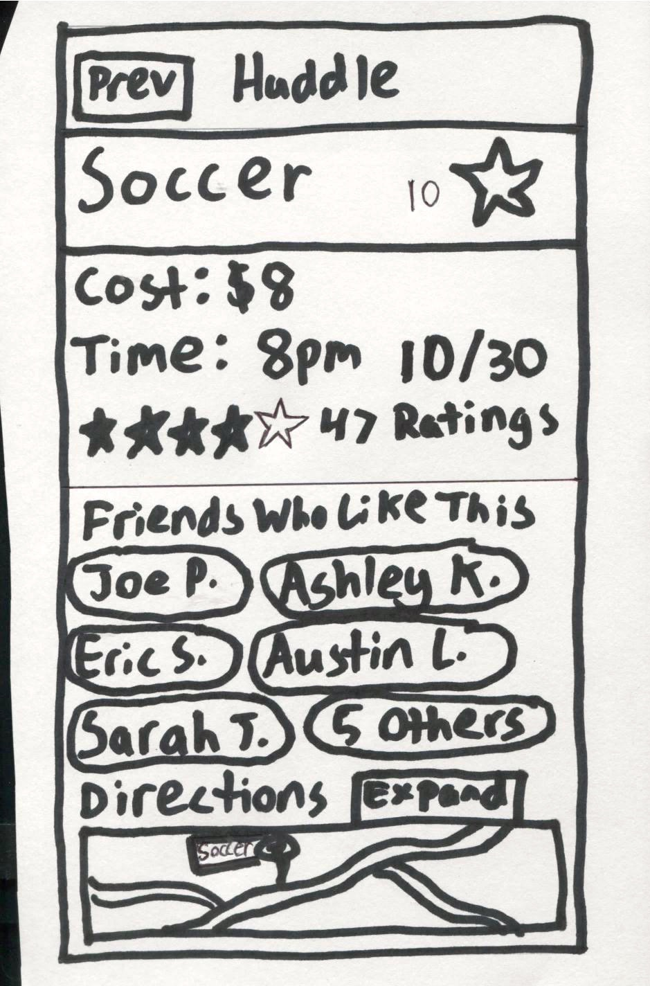
Revised UI Design: Event Description

Slide 11
Scenario #1: Event with Friends

Slide 12
Scenario #2: Vote Friend’s Event

Slide 13
Scenario #3: Solo Event

Slide 14
Tools Used
Proto.io – easy to get base functionality
“Faking” UI
No event curation
No voting

Slide 15
Summary
Proposed medium-fi prototype
Some changes from lo-fi prototype
Updated tasks + UI + scenarios
Outlined work to fix for future

Slide 16
Thank you
The Huddle Team
Notes:
TODO: Need real title

