Slide 1
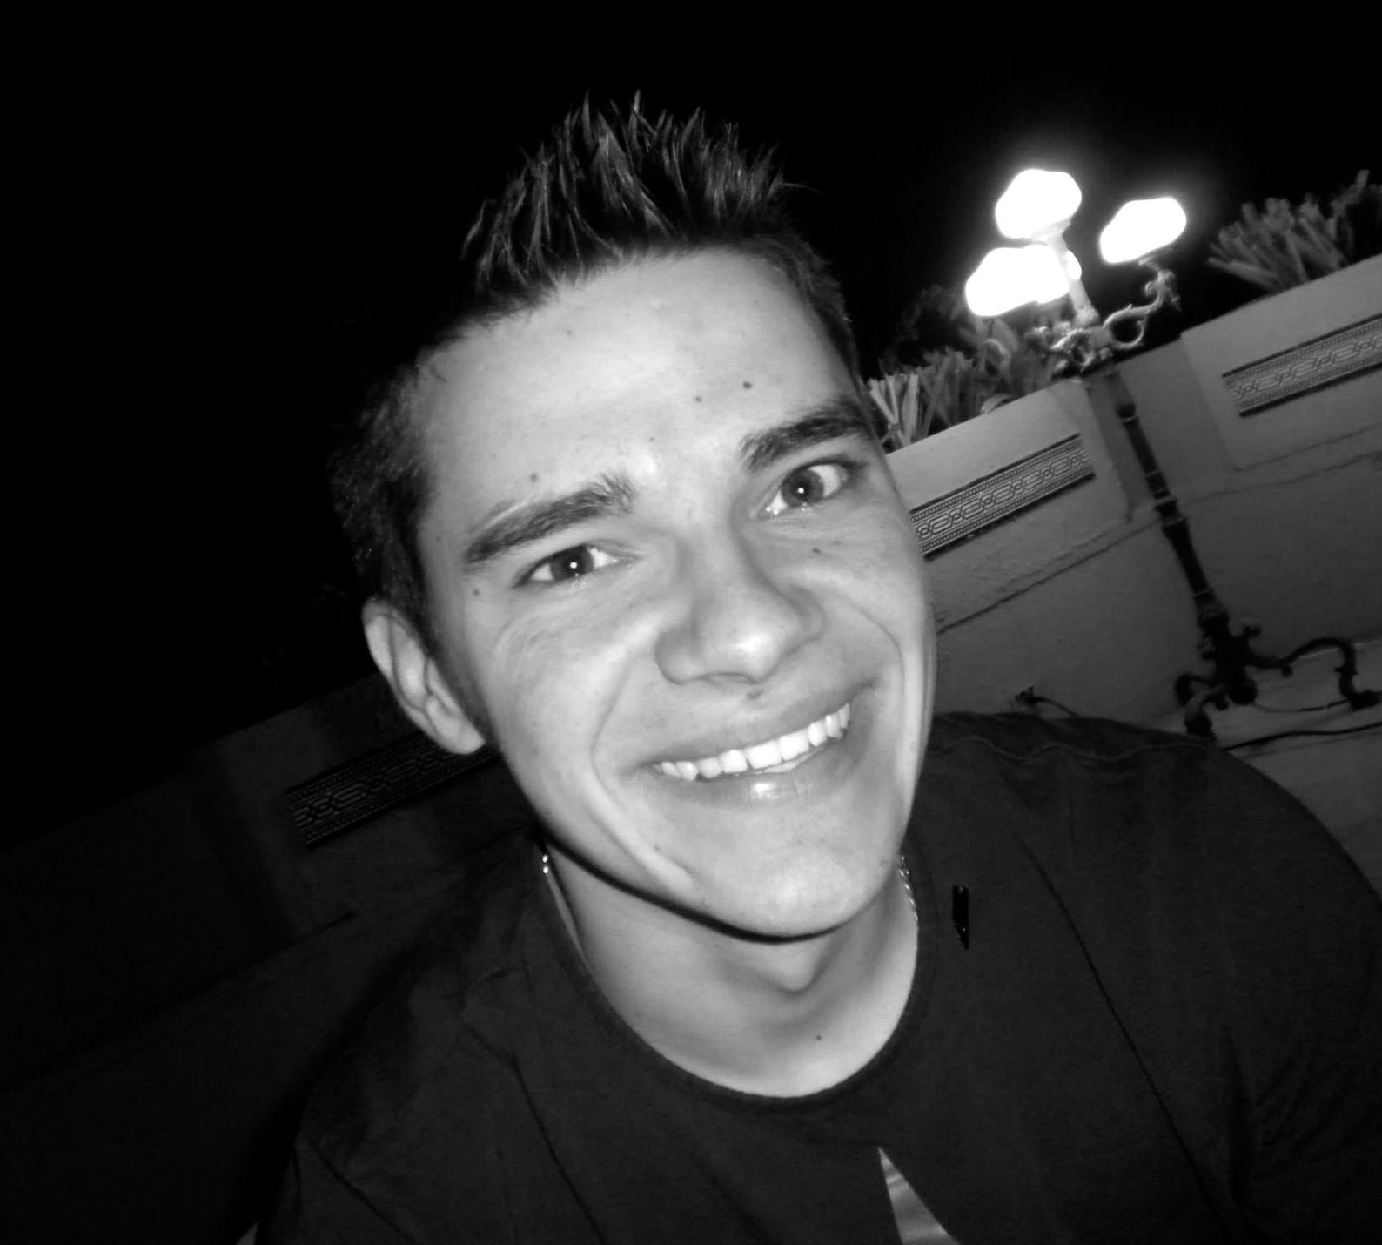
Huddle
Social Event Discovery
Nadav
Manager
Brandon
Design
Mike
Development
Joe
User Testing
Notes:
TODO: Need real title

Slide 2
Agenda
Mission
Tasks
Lo-fi prototype structure
Scenarios
Method & Results
UI suggestions and Discussion

Slide 3
Mission Statement
“Huddle’s mission is to remove the hassles
of event creation and scheduling
and make it easy to discover and explore
with friends.”
Geneva, 1998

Slide 4
Tasks
Scheduling complex
Communicating (voting) moderate
Event curating simple

Slide 5
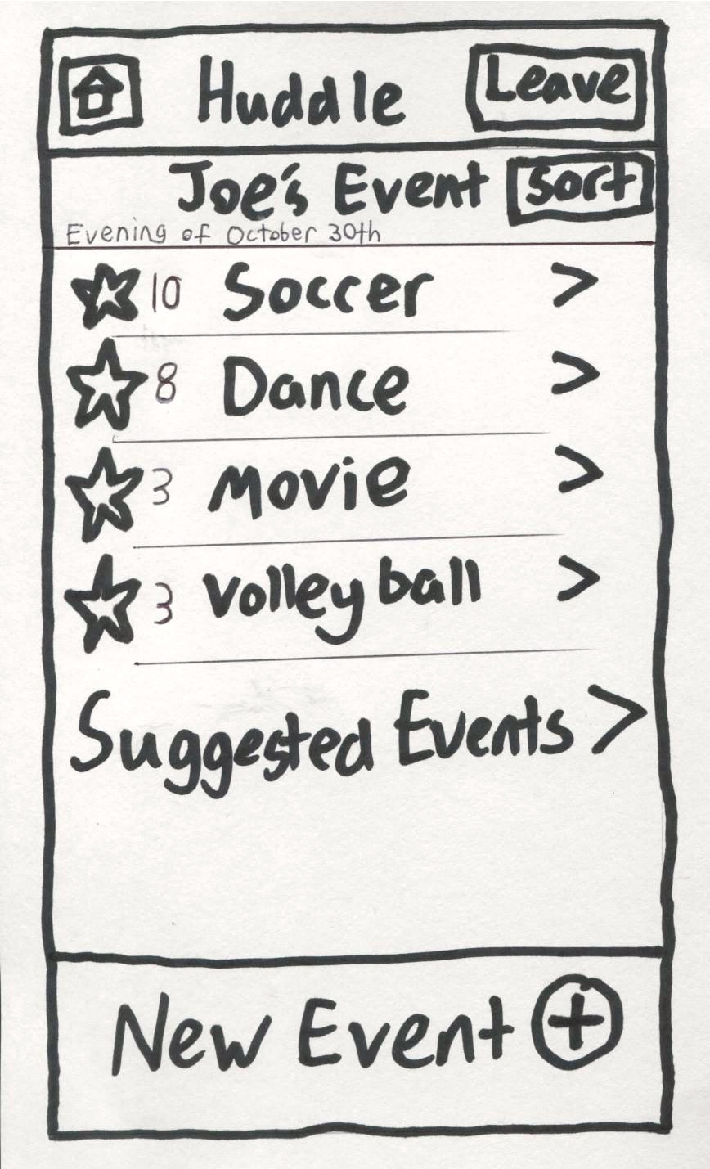
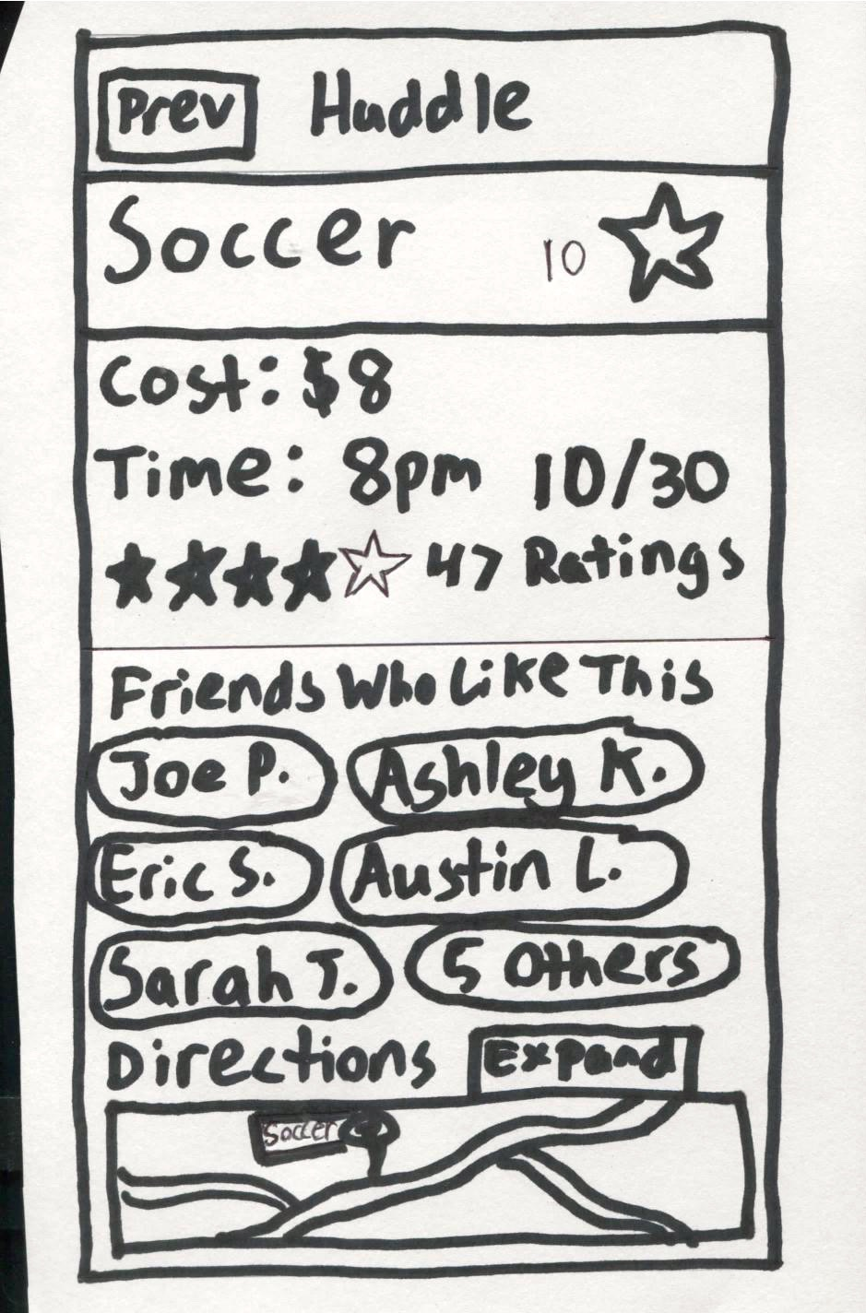
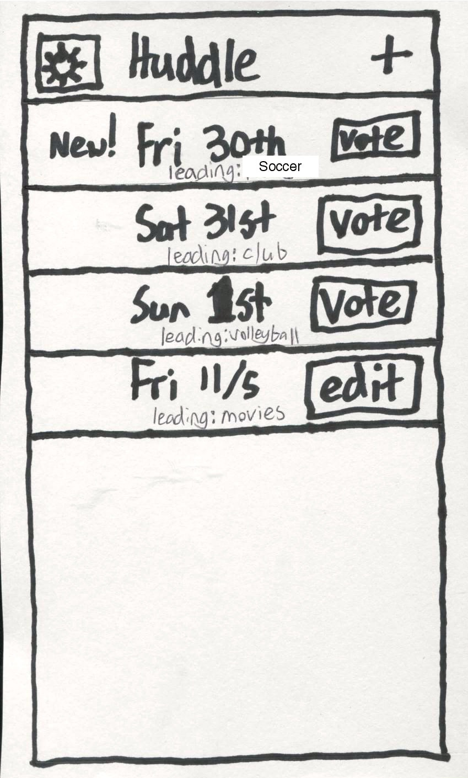
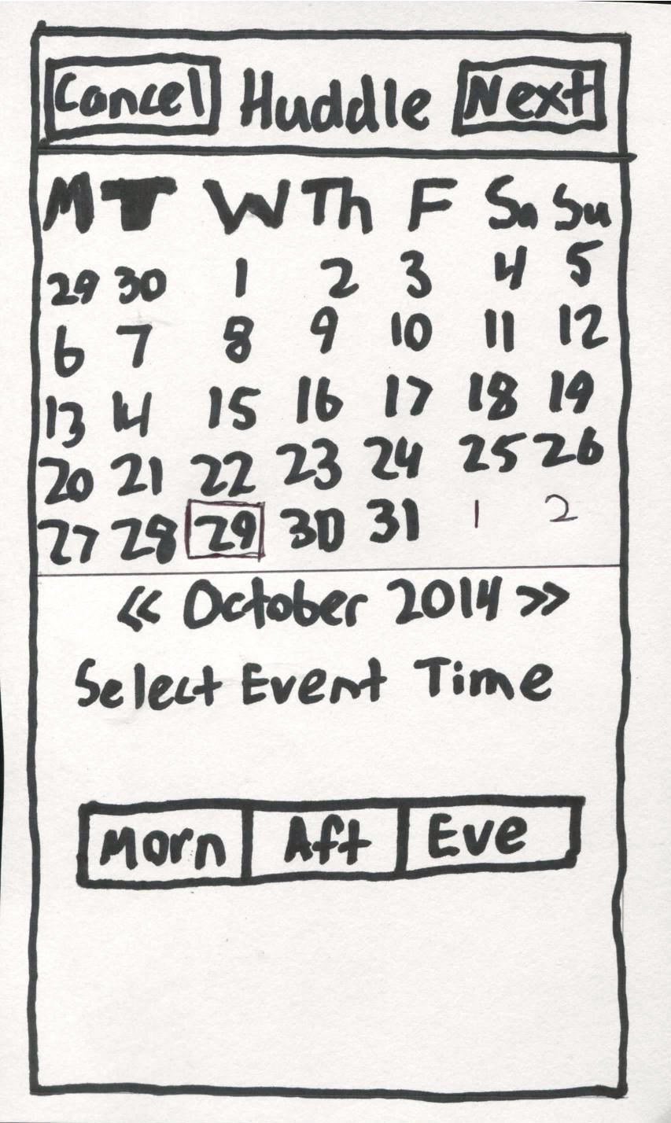
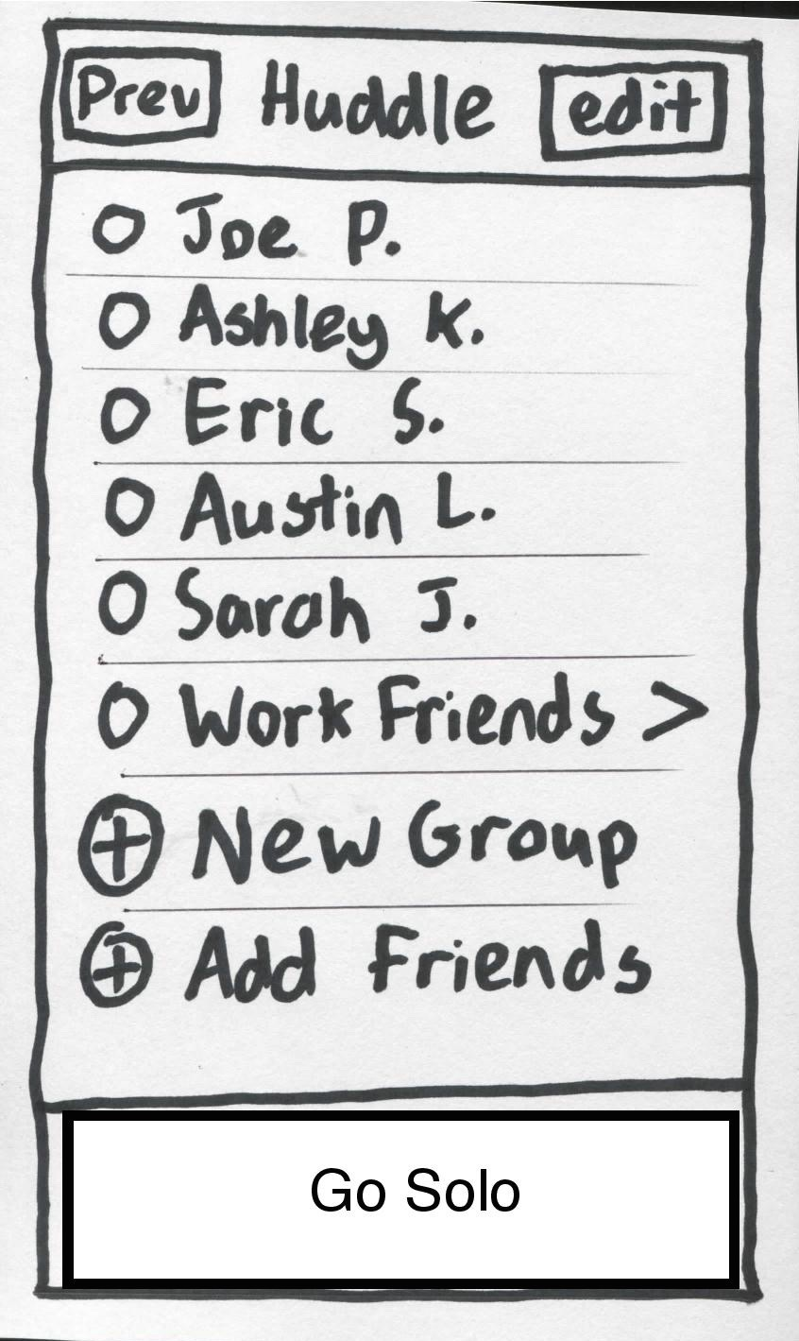
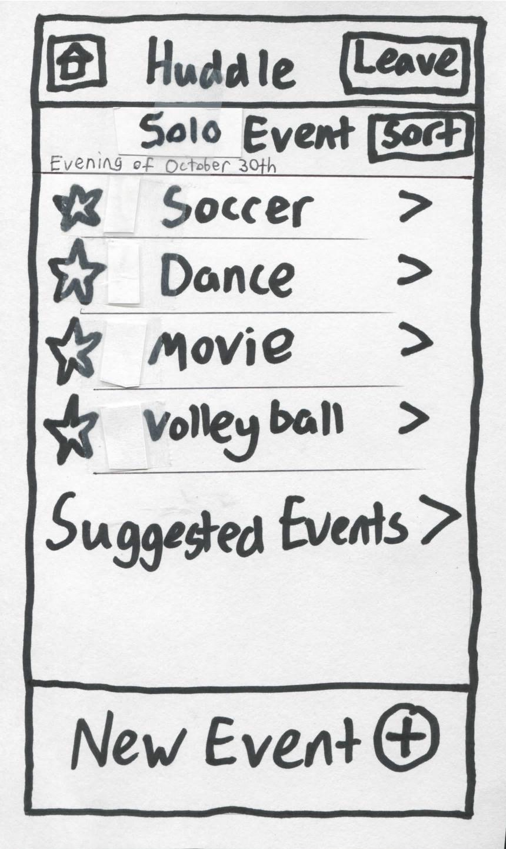
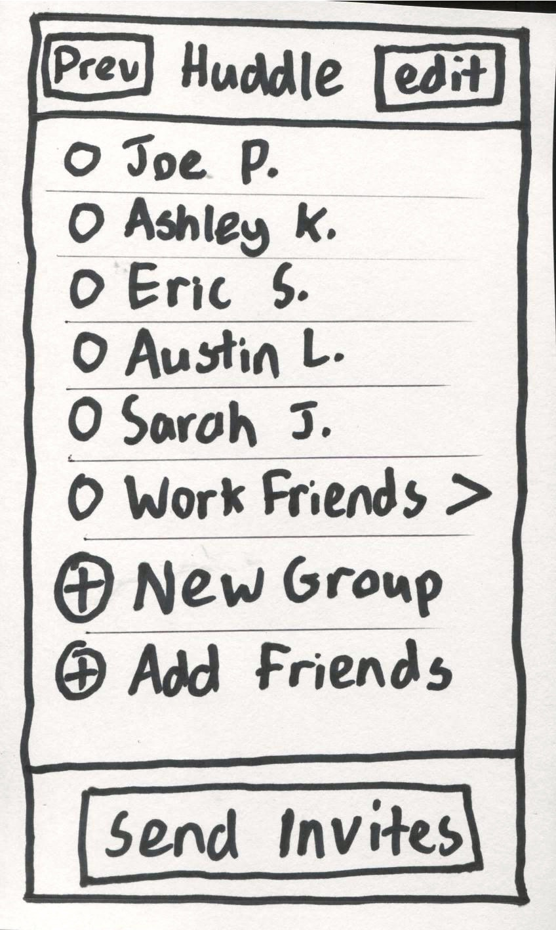
Lo-fi prototype structure

Slide 6
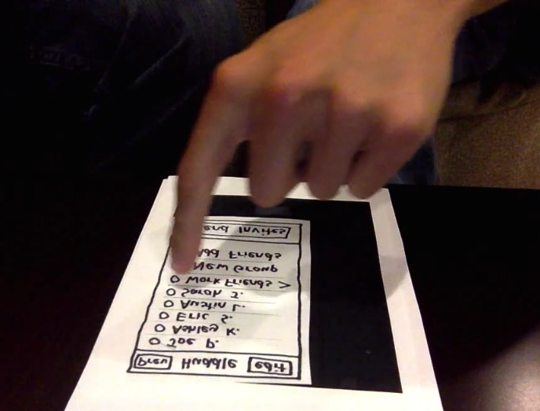
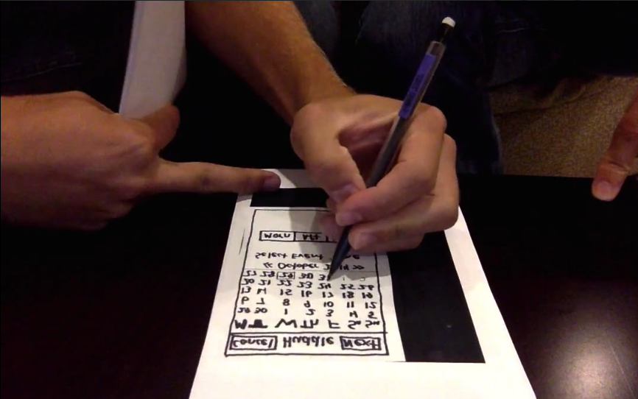
Lo-fi prototype structure

Slide 7
Scenario I
Want to go out with friends
Tasks: scheduling, communicating, event curating

Slide 8
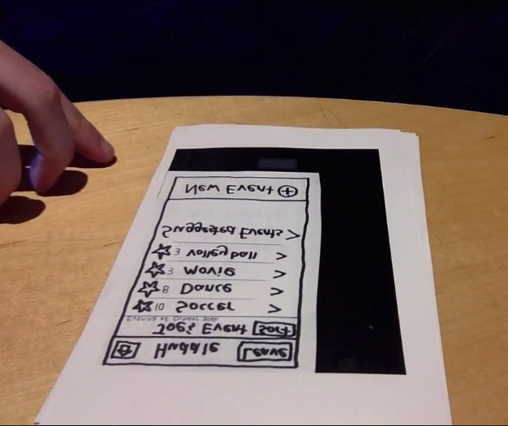
Scenario II
Receive and respond to Huddle invite
Tasks: scheduling, communicating, event curating

Slide 9
Scenario III
Going Solo
Tasks: scheduling, event curating

Slide 10
Experiment Method
Tested on three people from out target audience
Mid 20’s
Rely on mobile device to find and coordinate events
Quiet environment
All agreed to participate, without compensation

Slide 11
Experiment Procedure
Brief overview and purpose
Users were instructed to think out loud
A webcam recorded actions and dialogue
Subjects were prompted to create an outing, respond to an outing invitation, find something to do alone
The three scenarios allowed all three of the major tasks to be tested, sometimes multiple times.

Slide 12
Experiment Results
Positive - subjects expressed satisfaction with the layout and flow
Workflow for creating an outing appeared easy to figure out
Subjects had a strong sense of how the app worked and navigated easily
A number of clear shortcomings that confused, handicapped, or frustrated subjects:
Notes:
TODO: Need picture

Slide 13
Experiment Results
Critical Incident | Severity Rating | Experienced by user(s):
‘Next’ button on calendar screen; month- or page-next? | 2 | 1, 3
Does tapping on event vote or open info? | 2 | 1
Outing selection on home screen; vote button confusing | 2 | 1
New Event on event feed seems out of place | 1 | 1
Inconsistent terminology: event, outing, activity, etc. | 2 | 1
Name of outing happens automatically? How? | 2 | 1
What does Leave mean on event page? | 2 | 2
Did not consider voting for multiple events or voting directly on event page. | 2 | 2, 3
No intuitive interaction on event page when going solo | 3 | 2
Outing creator should be able to propose events first. | 2 | 3
Notes:
TODO: Need picture

Slide 14
Experiment Results & Discussion
Major takeaways:
General flow – date > friends > events
Buttons – “Leave”, “Vote”, “Next.”
Terminology – event / activity / outing
Solo flow – consistency vs. functionality
The “what now?” question
Notes:
TODO: Need picture

Slide 15
Thank you
The Huddle Team
Notes:
TODO: Need real title

