Slide 1
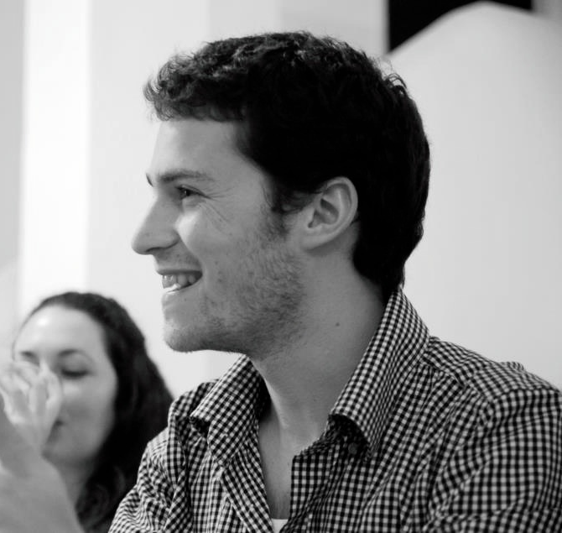
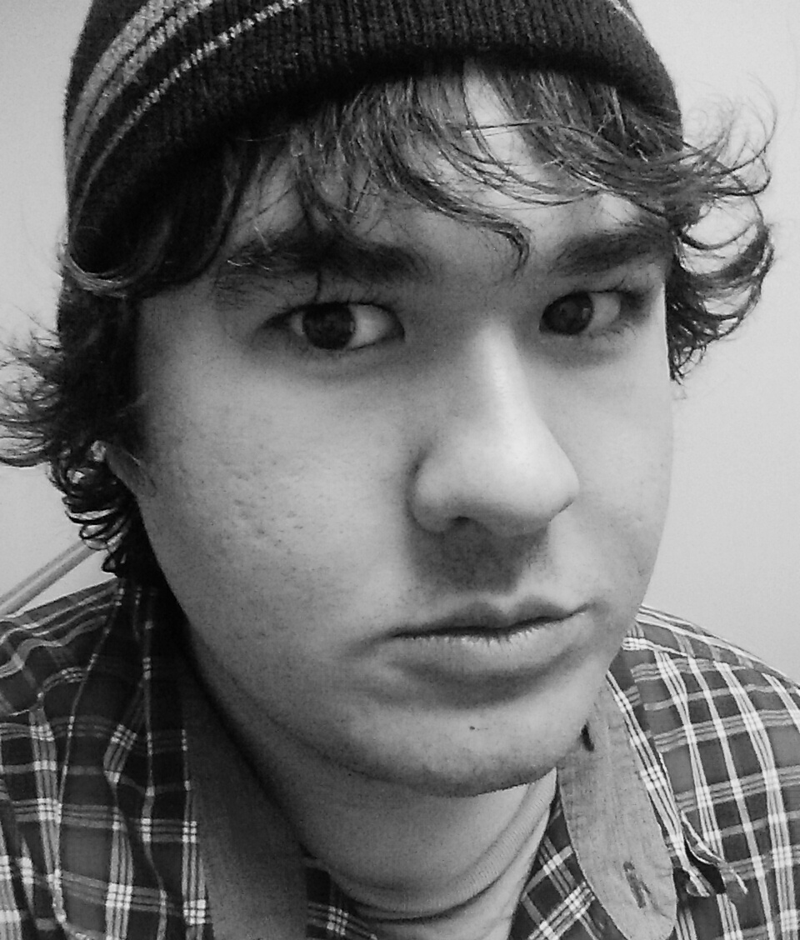
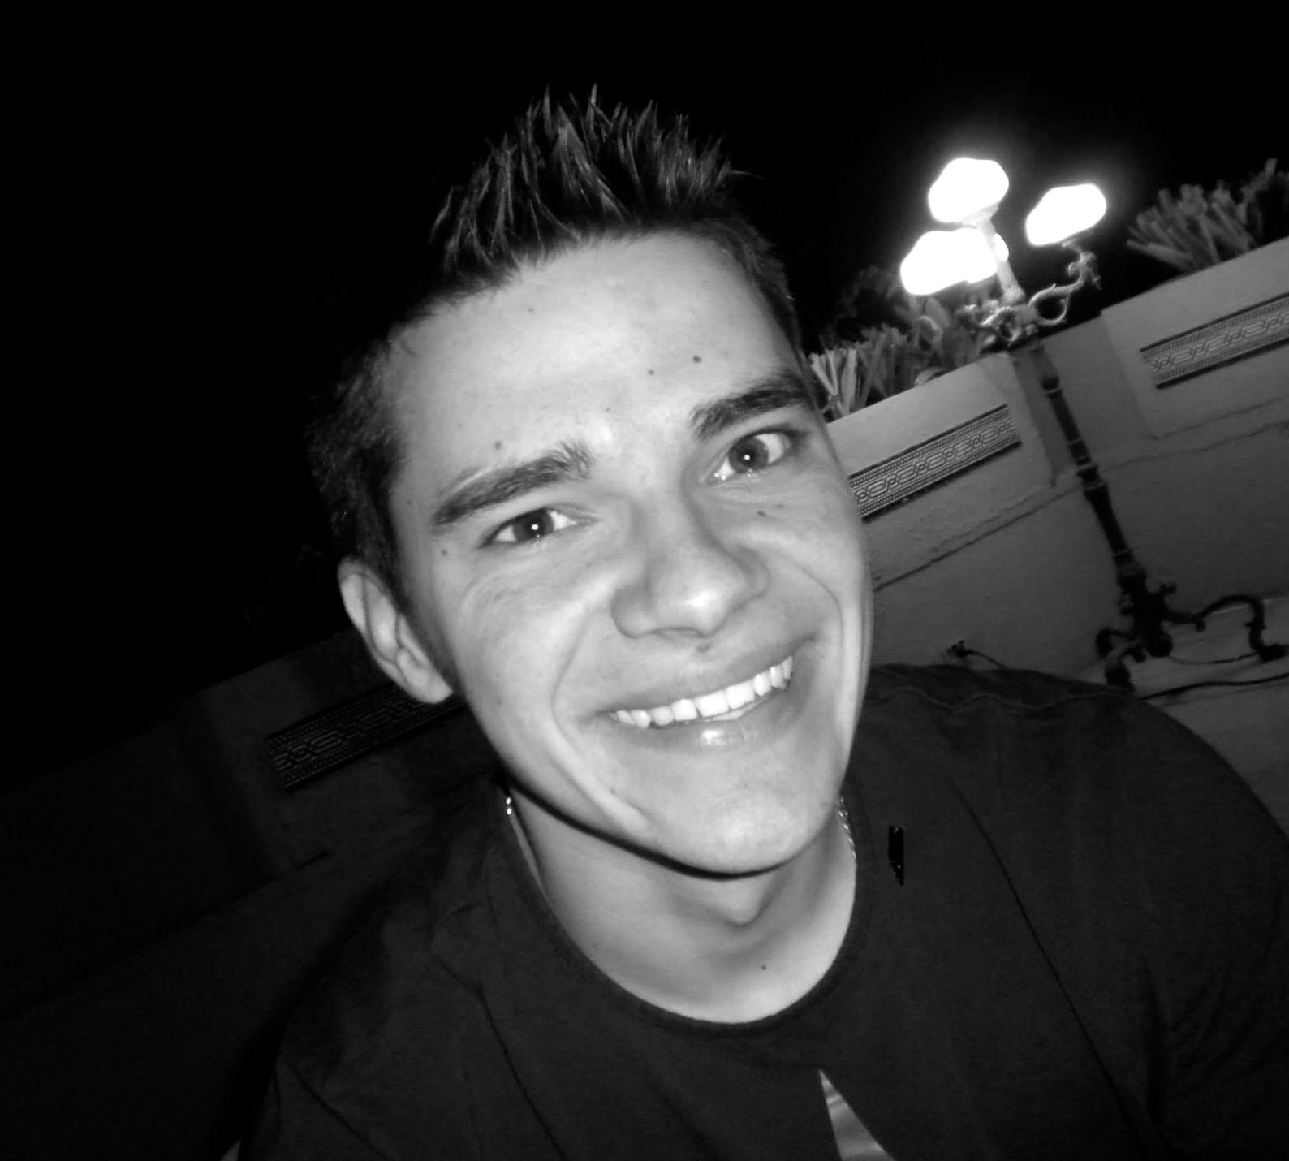
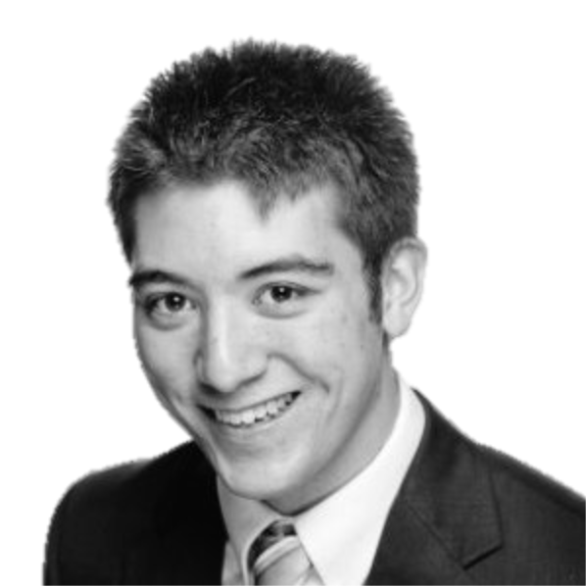
Huddle
Social Event Discovery
Nadav
Manager
Brandon
Design
Mike
Development
Joe
User Testing
Notes:
TODO: Need real title

Slide 2
Agenda
Motivation
Research
Task Analysis
Applications
Sketches
Conclusion
Notes:
TODO: Is the graphic too cheesey?

Slide 3
Motivation
Customer has some free time
?
Customer has a new, fulfilling experience

Slide 4
Research
What are the considerations when choosing activity?
What tools are used to explore options?
How are decisions reached?
?

Slide 5
Research
What are the considerations when choosing activity?
What tools are used to explore options?
How are decisions reached?
To find out: Interviews
?

Slide 6
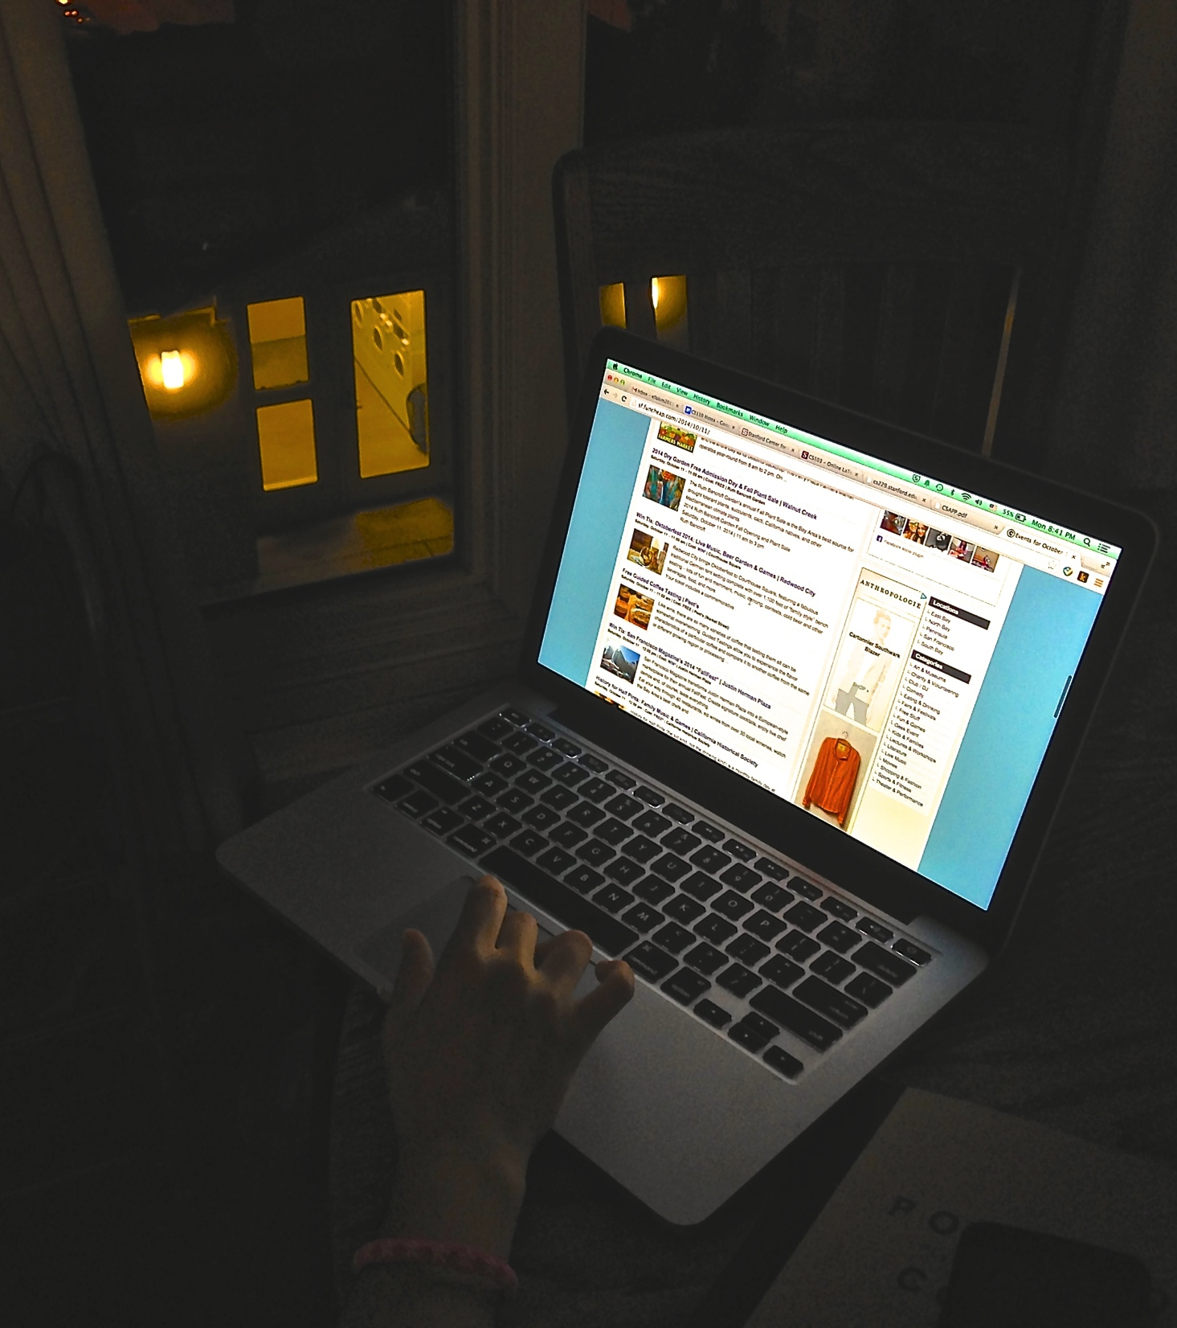
Research
Ella
Google
Lives in San Francisco, CA
Mid-20’s
What she told us
First contacts friends (3-5)
Email and Google Chat
www.sf.funcheap.com

Slide 7
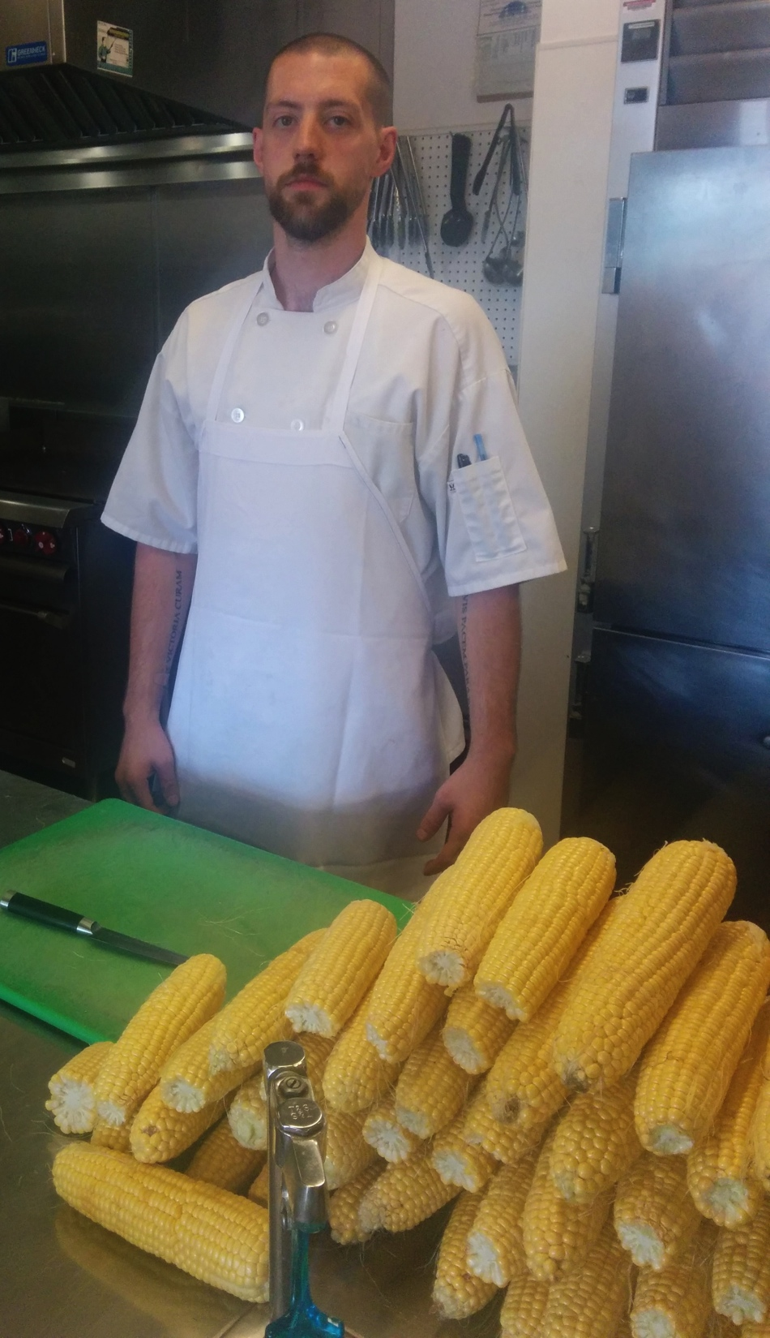
Research
Elijah
Private Chef at Stanford
Married, lives in San Jose
29 years old
What he told us
Meticulous routine during week
Uses Yelp, but doesn’t trust users
Reads forums for hikes
Halloween in Santa Cruz w/ friend

Slide 8
Research
Vlad
Software Engineer
Lives in Seattle
23 Years old
What he told us
Needs to justify city rent
Prioritizes friends and company
New experiences are with friends
Notes:
TODO: Need picture

Slide 9
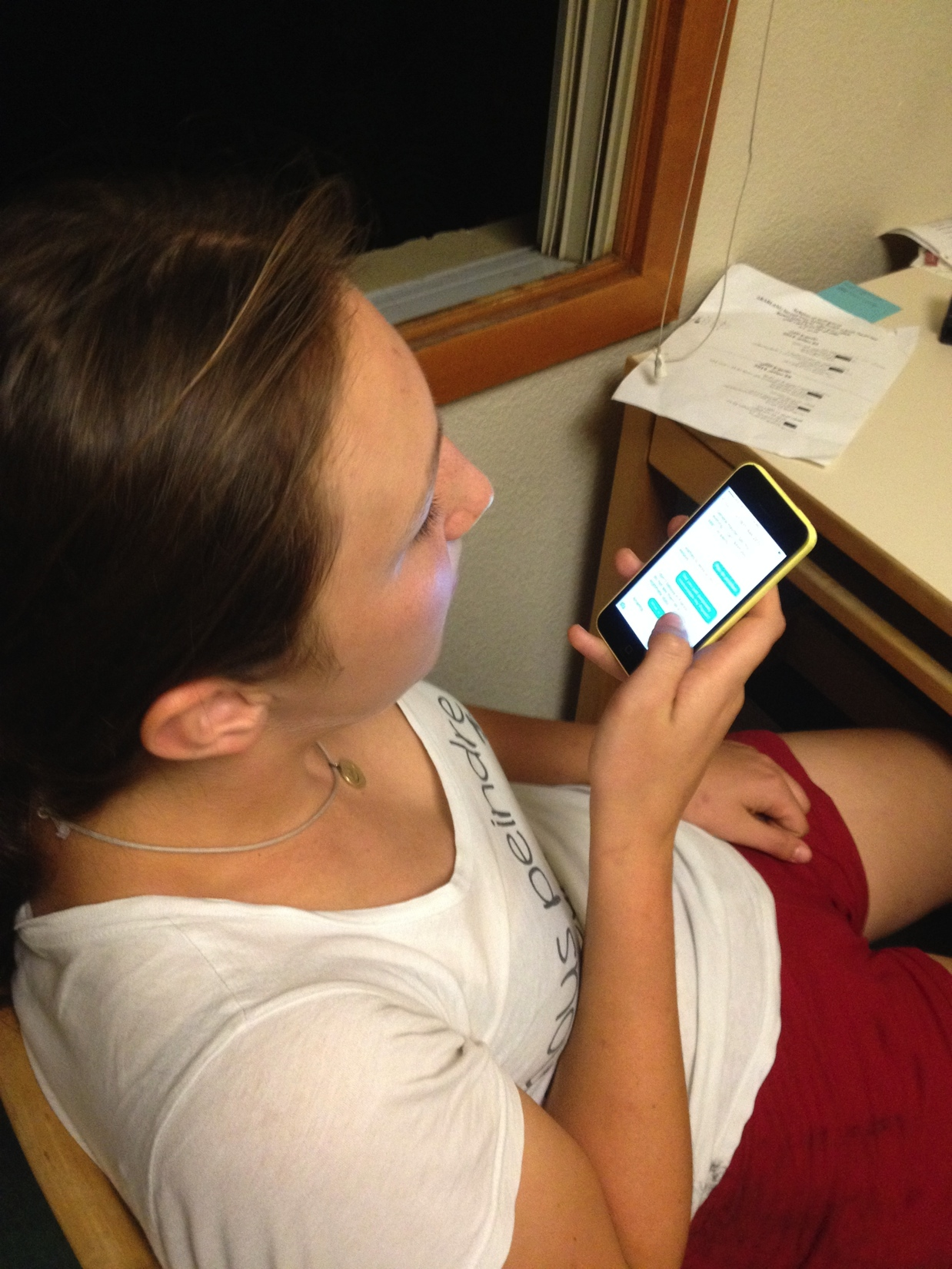
Research
Lara
Undergrad at Stanford
From London
20 years old
What she told us (about London)
Planning with friends is tedious
Sometimes prefers to be alone
Transportation is important

Slide 10
Research
Organized contextual interview data
Identified trends and commonalities
Determined and analyzed most important tasks

Slide 11
Task Analysis
We are looking at people who want to…
optimize small amount of free time
break out of a routine
spend time with friends
Currently, these customers…
search for local events
ask friends for recommendations
coordinate with friends
Notes:
TODO: Pictures for these slides?

Slide 12
Task Analysis
Customers wish they could…
sort events by logistical aspects
easily reach consensus with friends
consistently get exciting, quality events
These tasks will be “learned” through…
Observation
Google
Social Media

Slide 13
Task Analysis
Customers perform these tasks…
on phones, computers, and in-person
at home, work, or at the event
People regard the data as…
overwhelming in its quantity
scattered in its sources
difficult to search through unless you know exactly what you’re looking for

Slide 14
Task Analysis
Other tools at the customer’s disposal include…
online guides and reviews (Yelp, Zagat, etc.)
Facebook and Foursquare
printed guides, pamphlets, etc.
Users communicate with each other through…
social networks (i.e. Facebook)
texting, emails, instant messaging
phone calls and face-to-face meetings

Slide 15
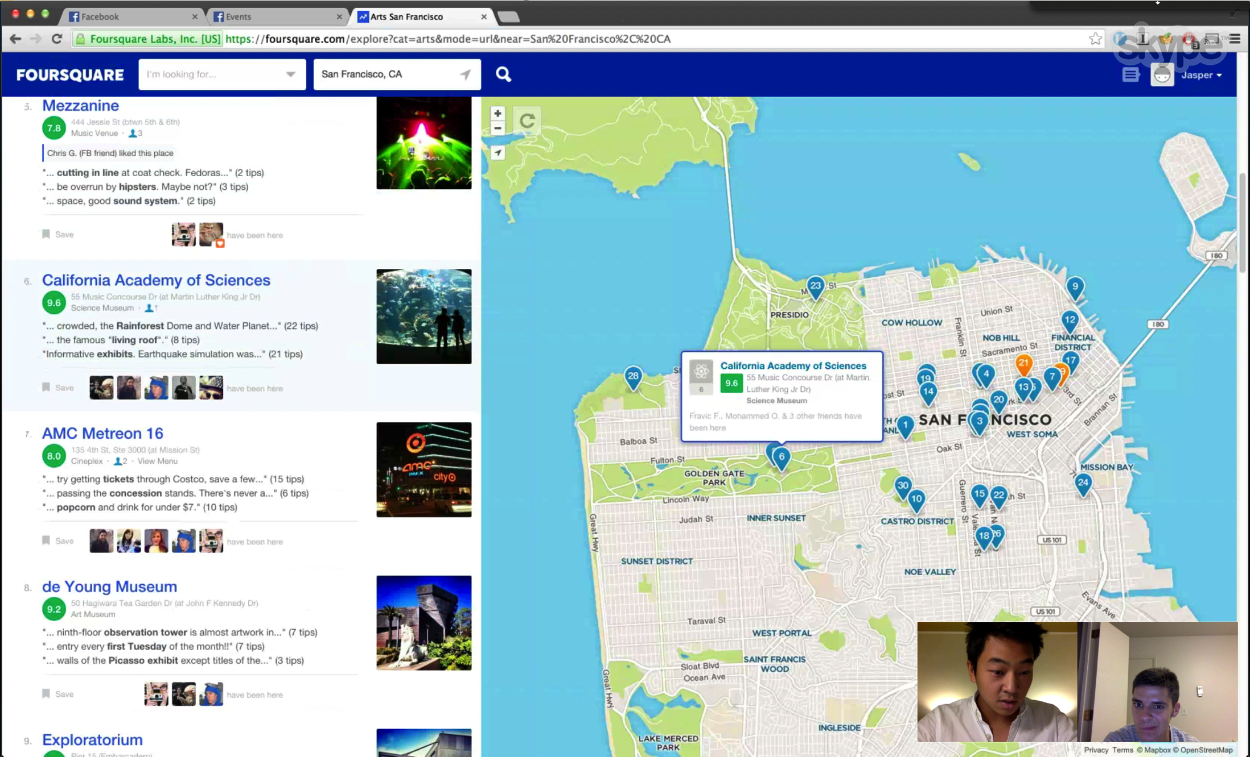
Task Analysis

Slide 16
Task Analysis
Customers tend to perform these tasks…
on a weekly cycle
leading up to the weekend
Customers face time constraints in the form of…
busy work-life
friends’ schedules
event timing

Slide 17
Task Analysis
When things go wrong, customers…
stay home
don’t enjoy the event
feel that their website/app/friend failed them
don’t coordinate well with friends

Slide 18
Applications
Brainstorming

Slide 19
Applications
Challenge/Competition
Compete against friends to see who can…
Attend the most events
Complete a set of events first
Go to the most consecutive “no-choice” events
Compete “against the clock”
Perform activity ‘x’ by this date
Complete set of events every month
Strong social media component to increase motivation

Slide 20
Applications
Computer-organized party (or Flashmob)
Algorithm decides where, when, and who (don’t necessarily need a “what”)
Computer can invite people in waves based on who else is going (encourage balanced or familiar crowd)
Customers instructed to bring items (food, music, etc.)

Slide 21
Applications
Combine “event-finding” and “friend-finding”
Allow user to cross reference events with friends’ schedules, location, etc.
Reach consensus more quickly
Organize logistics (transportation, timing) easily
Use time limit to force customers to commit ahead of time
Algorithm chooses optimal event for group of people (based on individual interests)

Slide 22
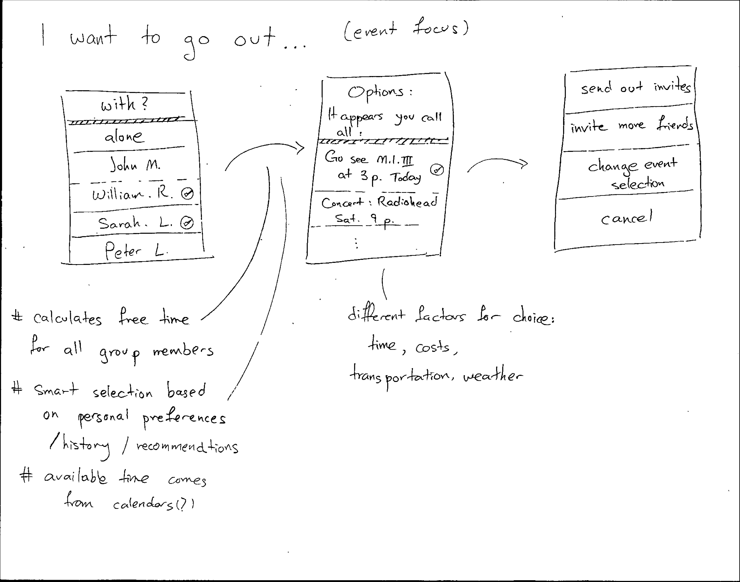
Sketches

Slide 23
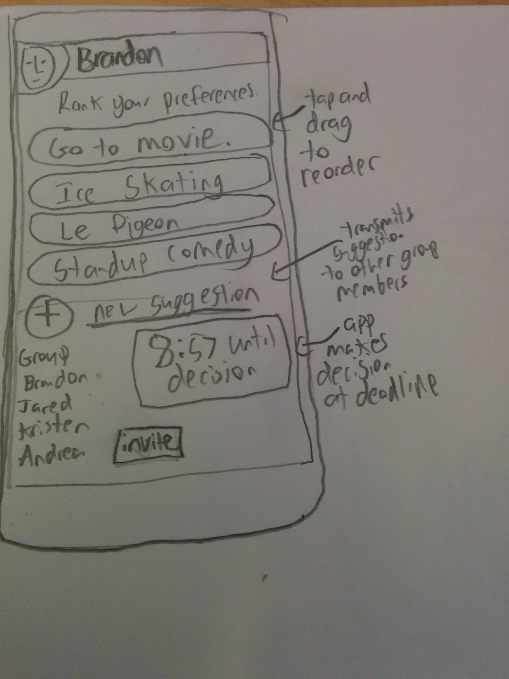
Sketches

Slide 24
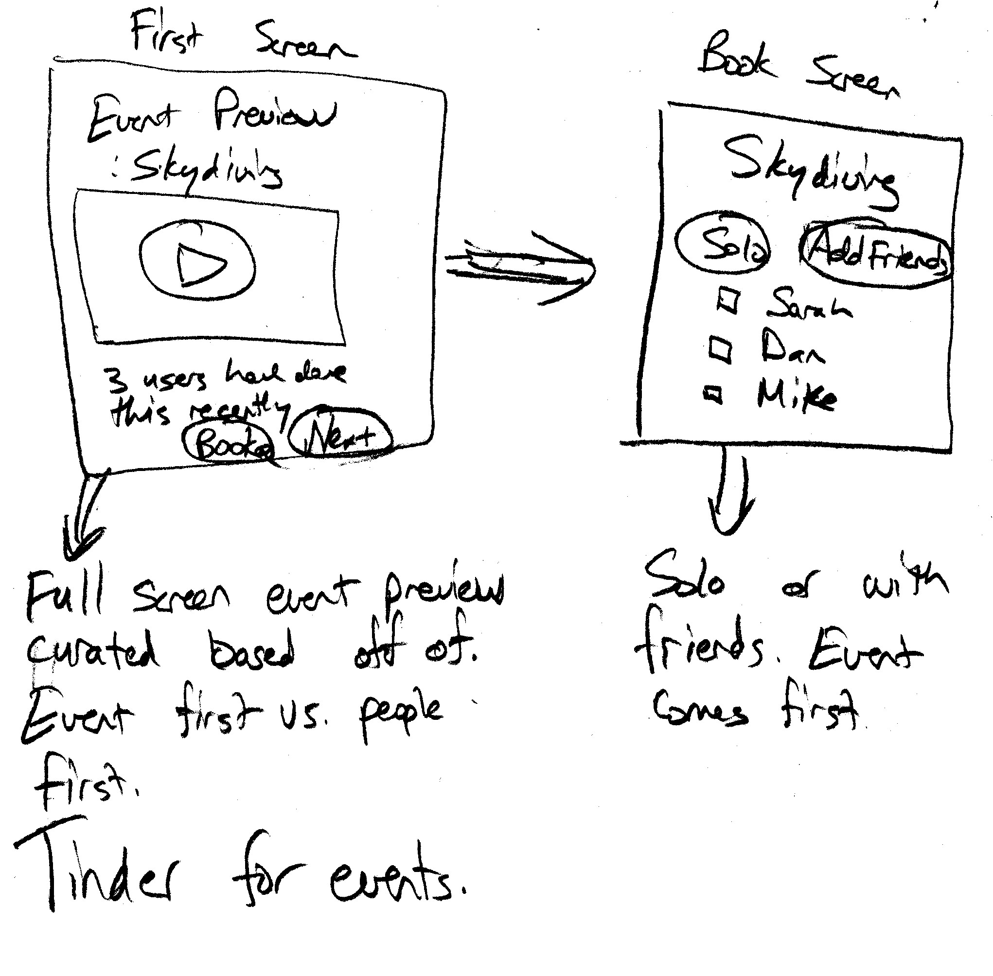
Sketches

Slide 25
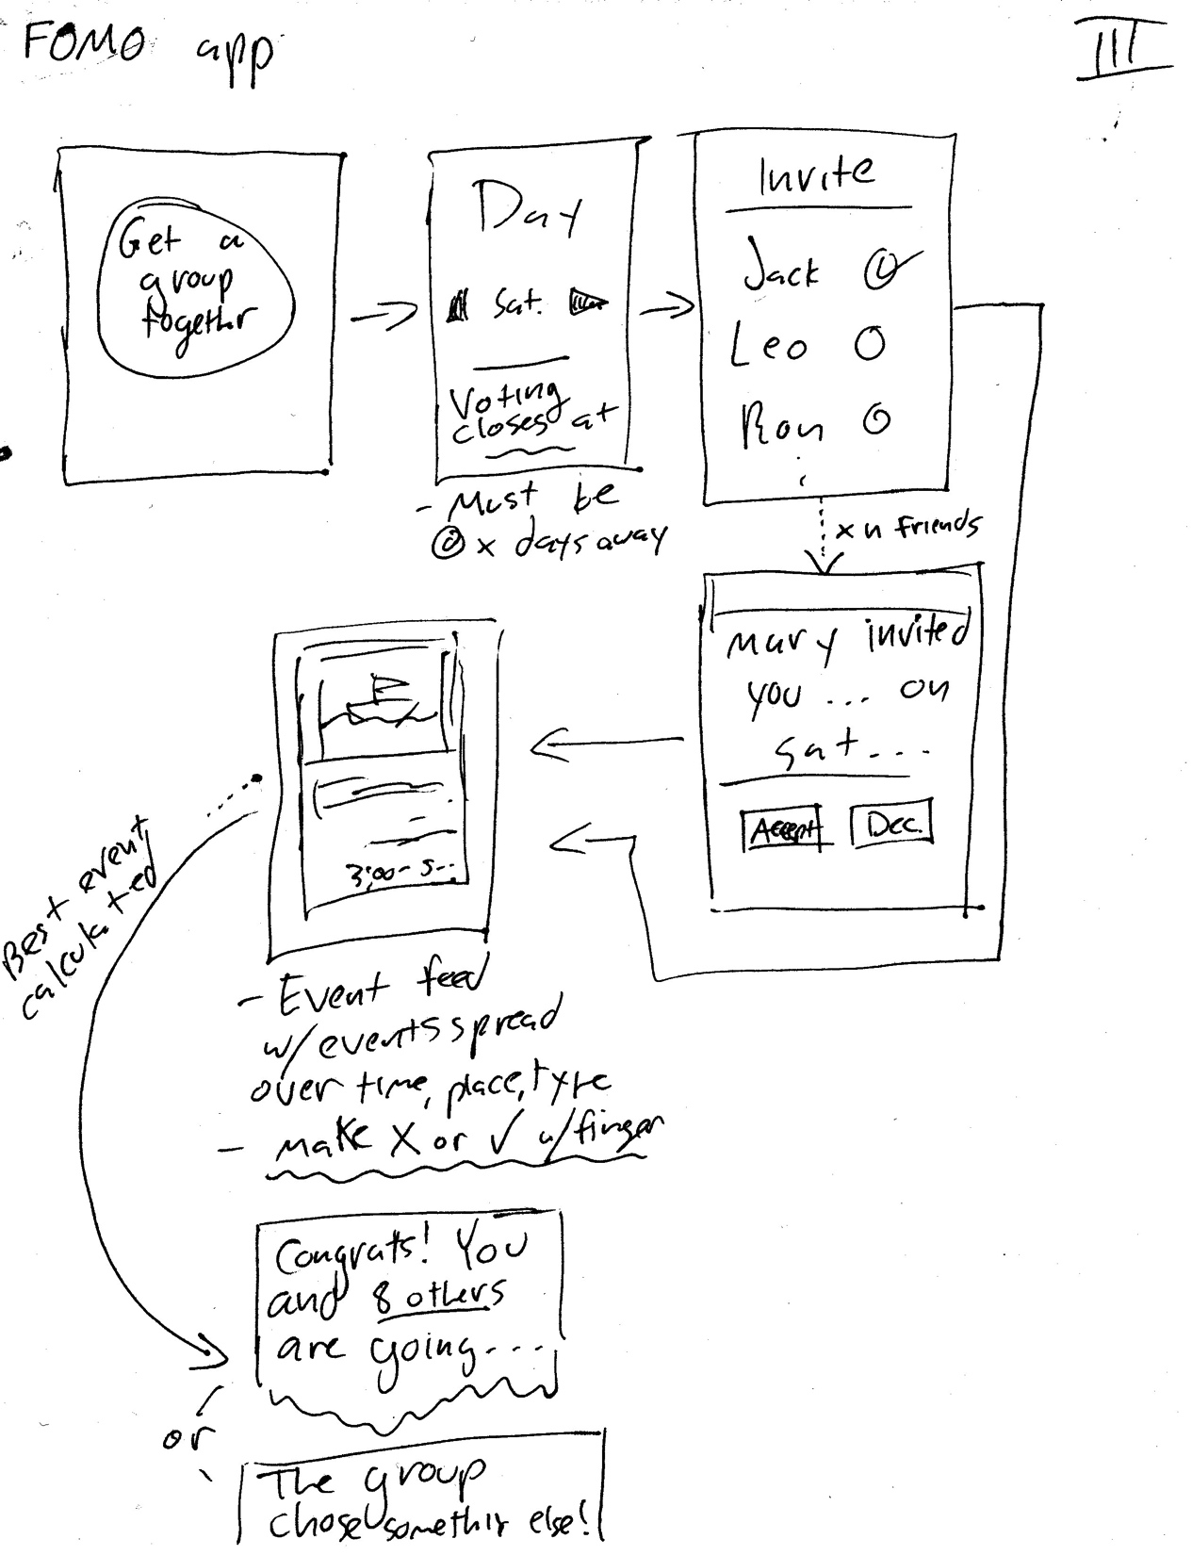
Sketches

Slide 26
Conclusion
Critical Problem: finding and planning events for groups.
Tasks that we hope to offer
filter or rank events based on friends
Encourage quicker decisions
Streamline planning process
Our end goal: Encourage consumers to embrace their adventurous sides by enhancing the social aspects of the searching for and planning outings with friends.

Slide 27
Appendix Slides

Slide 28
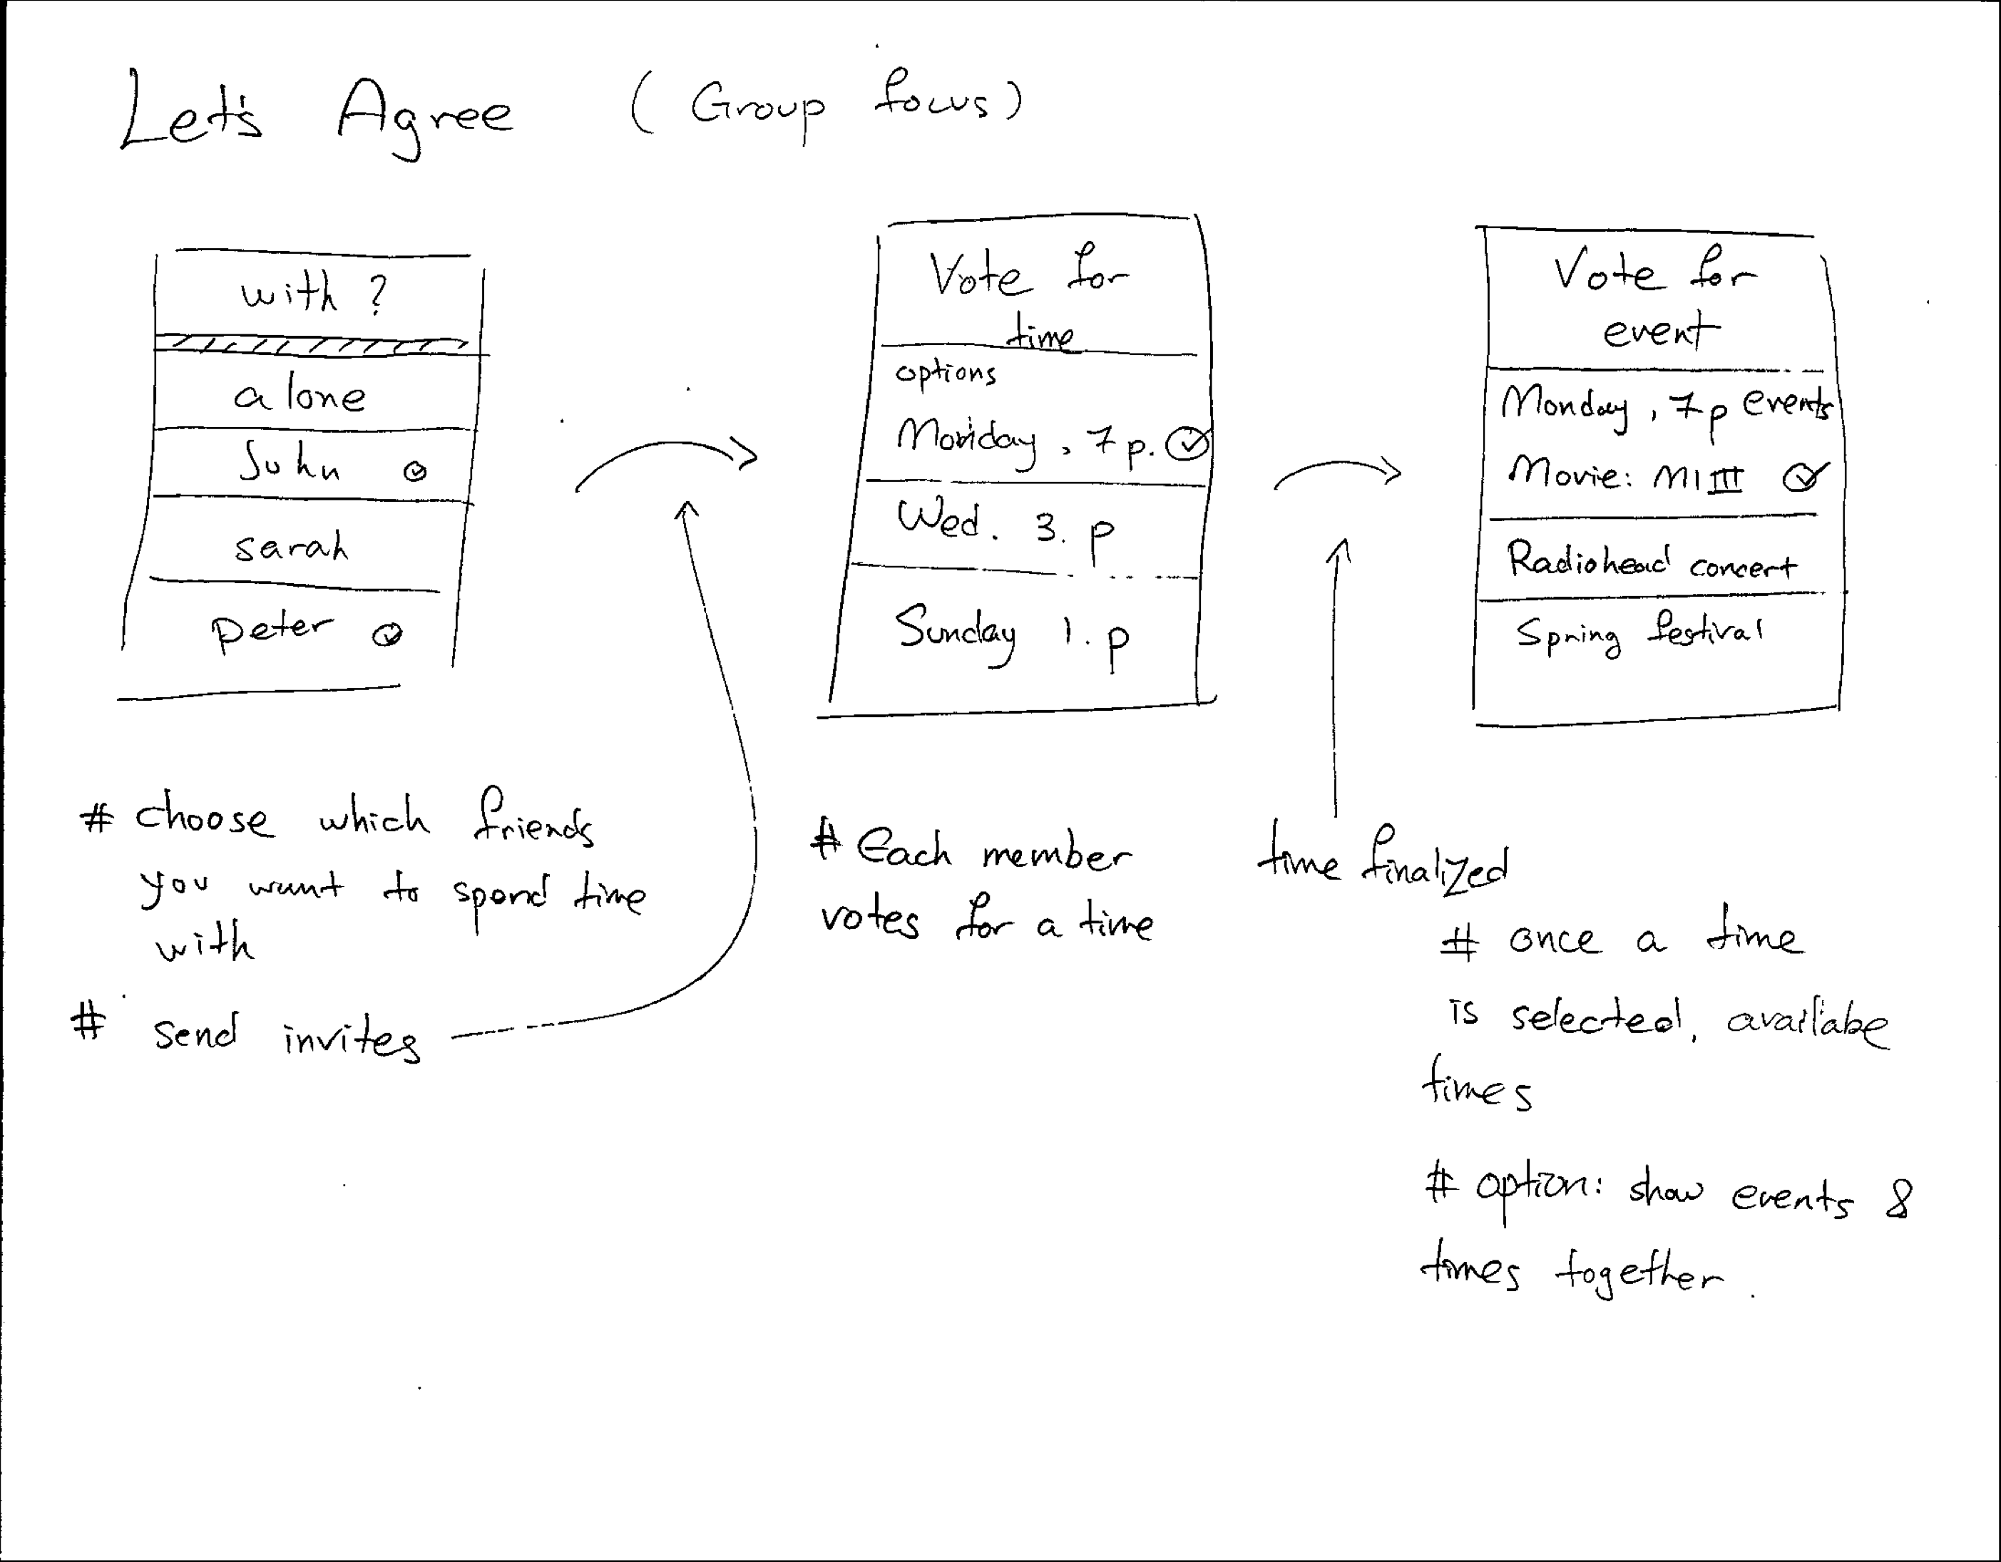
Sketches

Slide 29
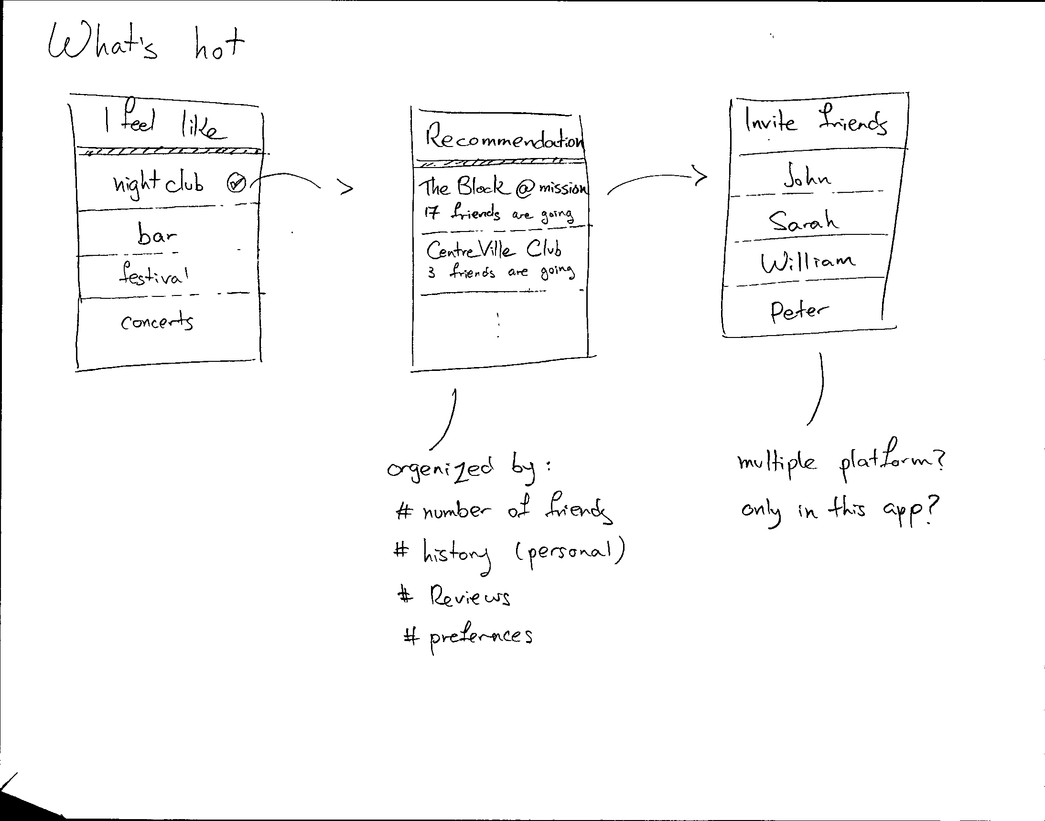
Sketches

Slide 30
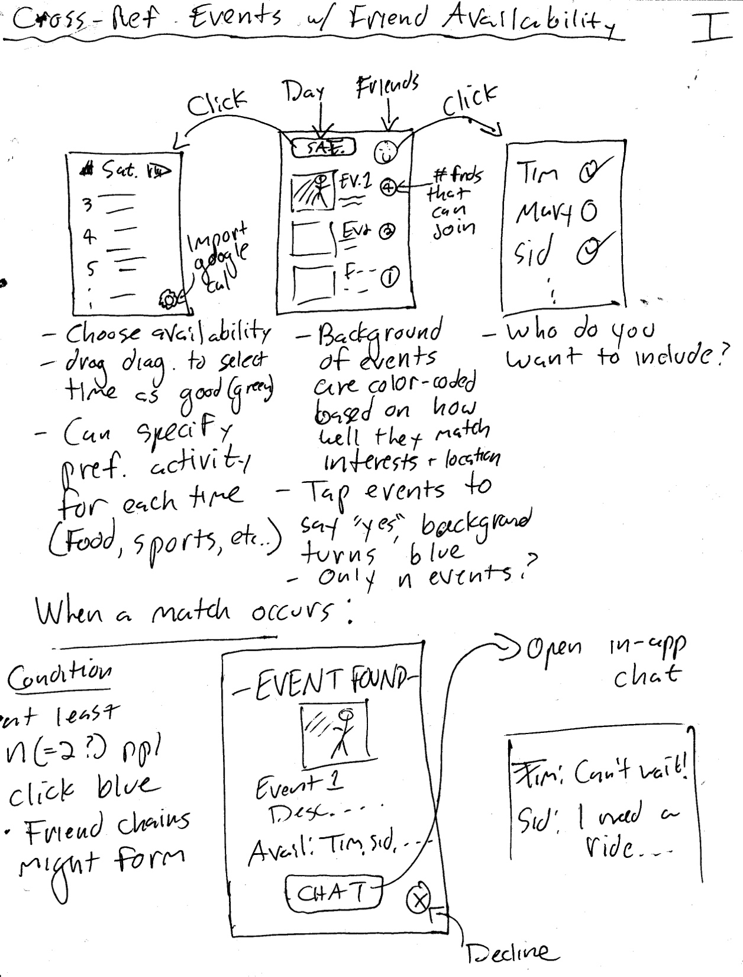
Sketches

Slide 31
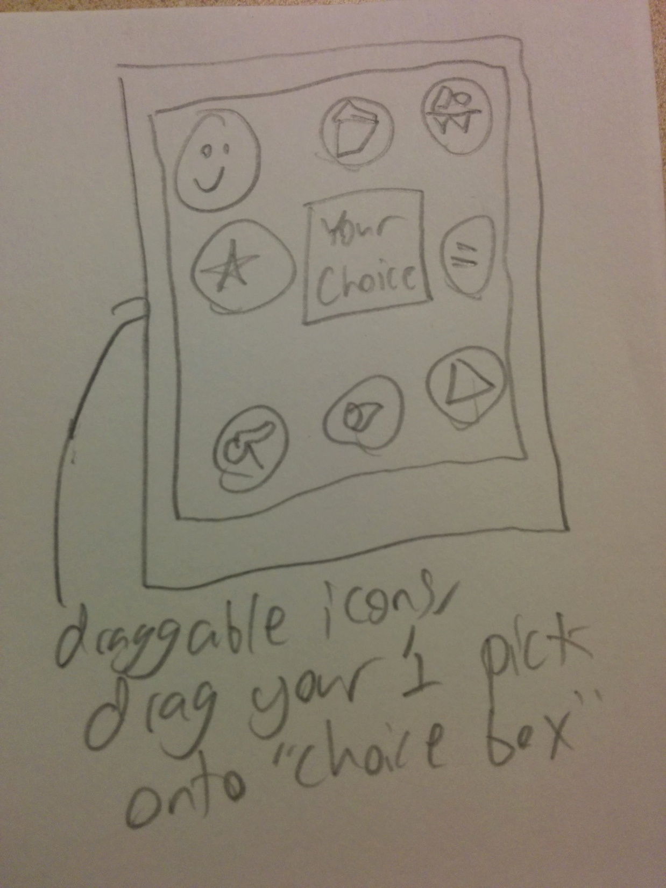
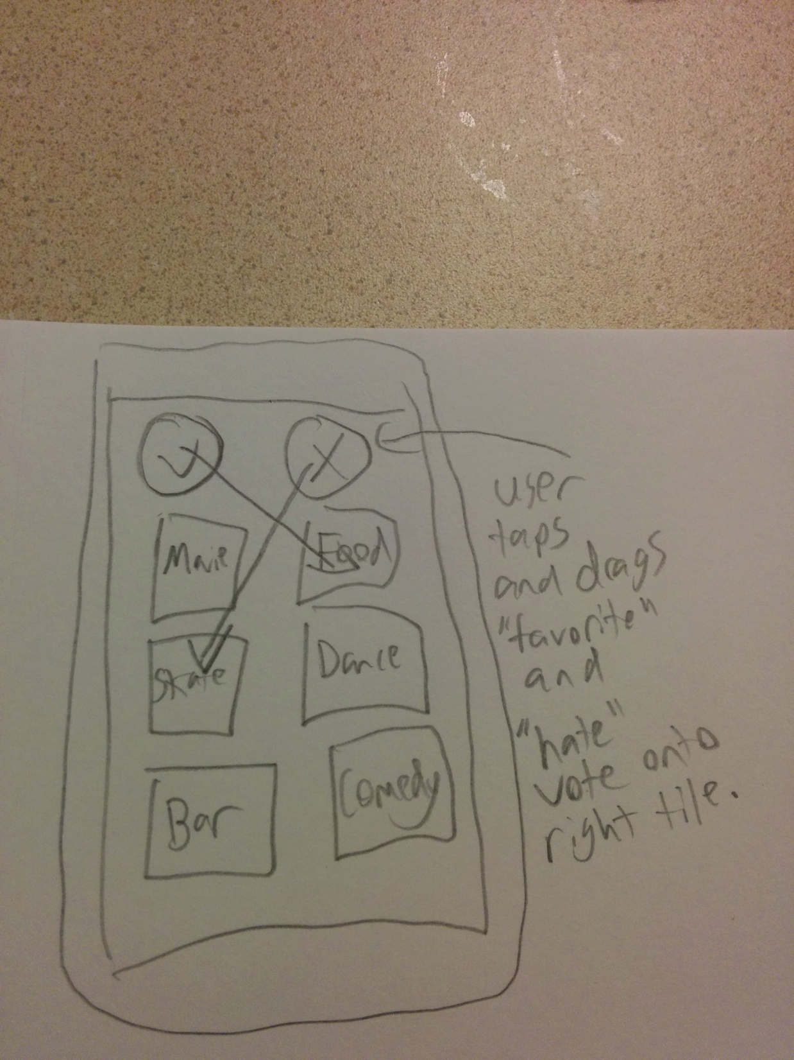
Sketches

Slide 32
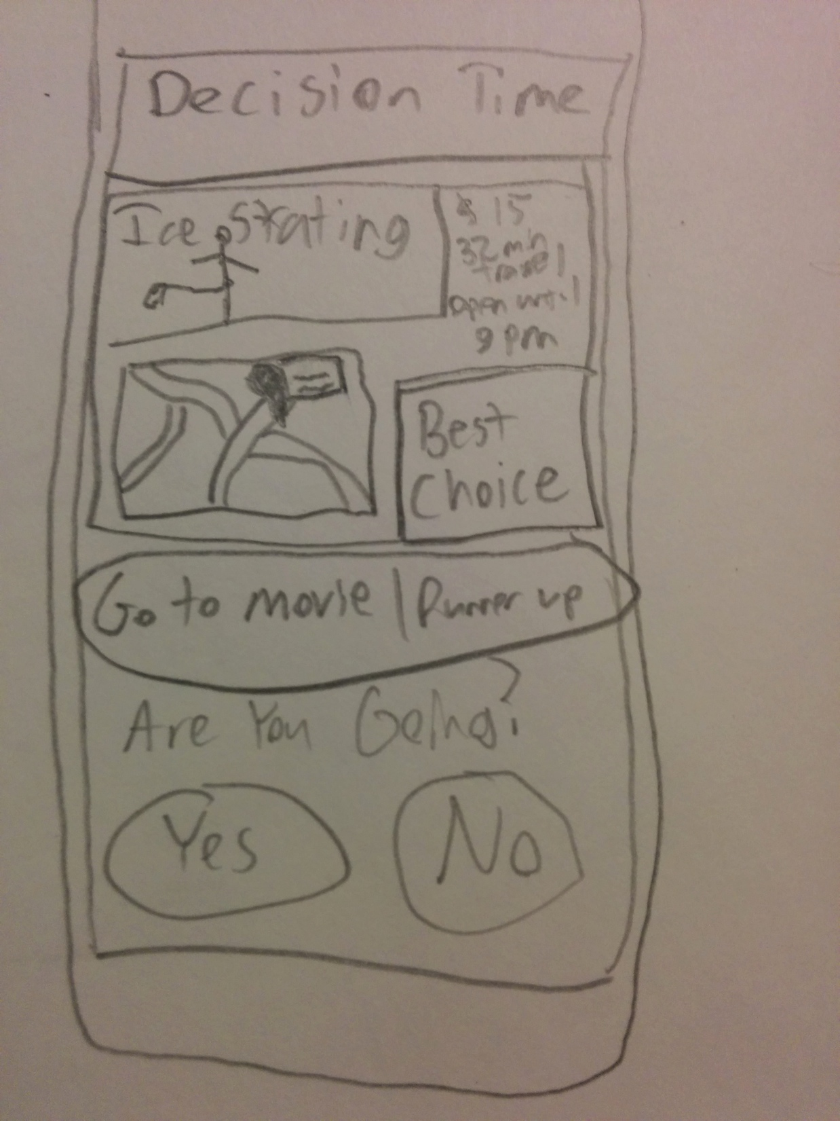
Sketches

Slide 33
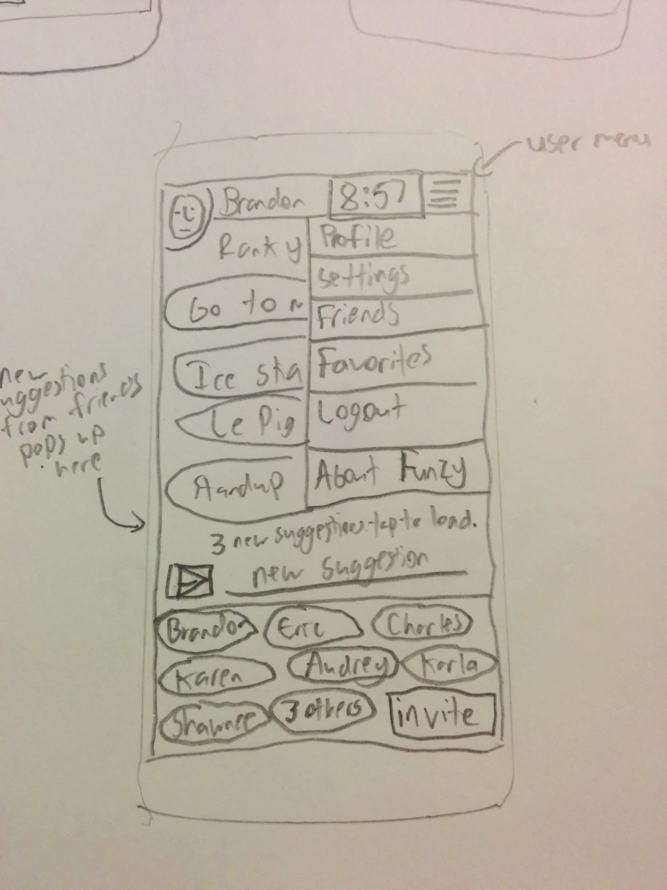
Sketches

Slide 34
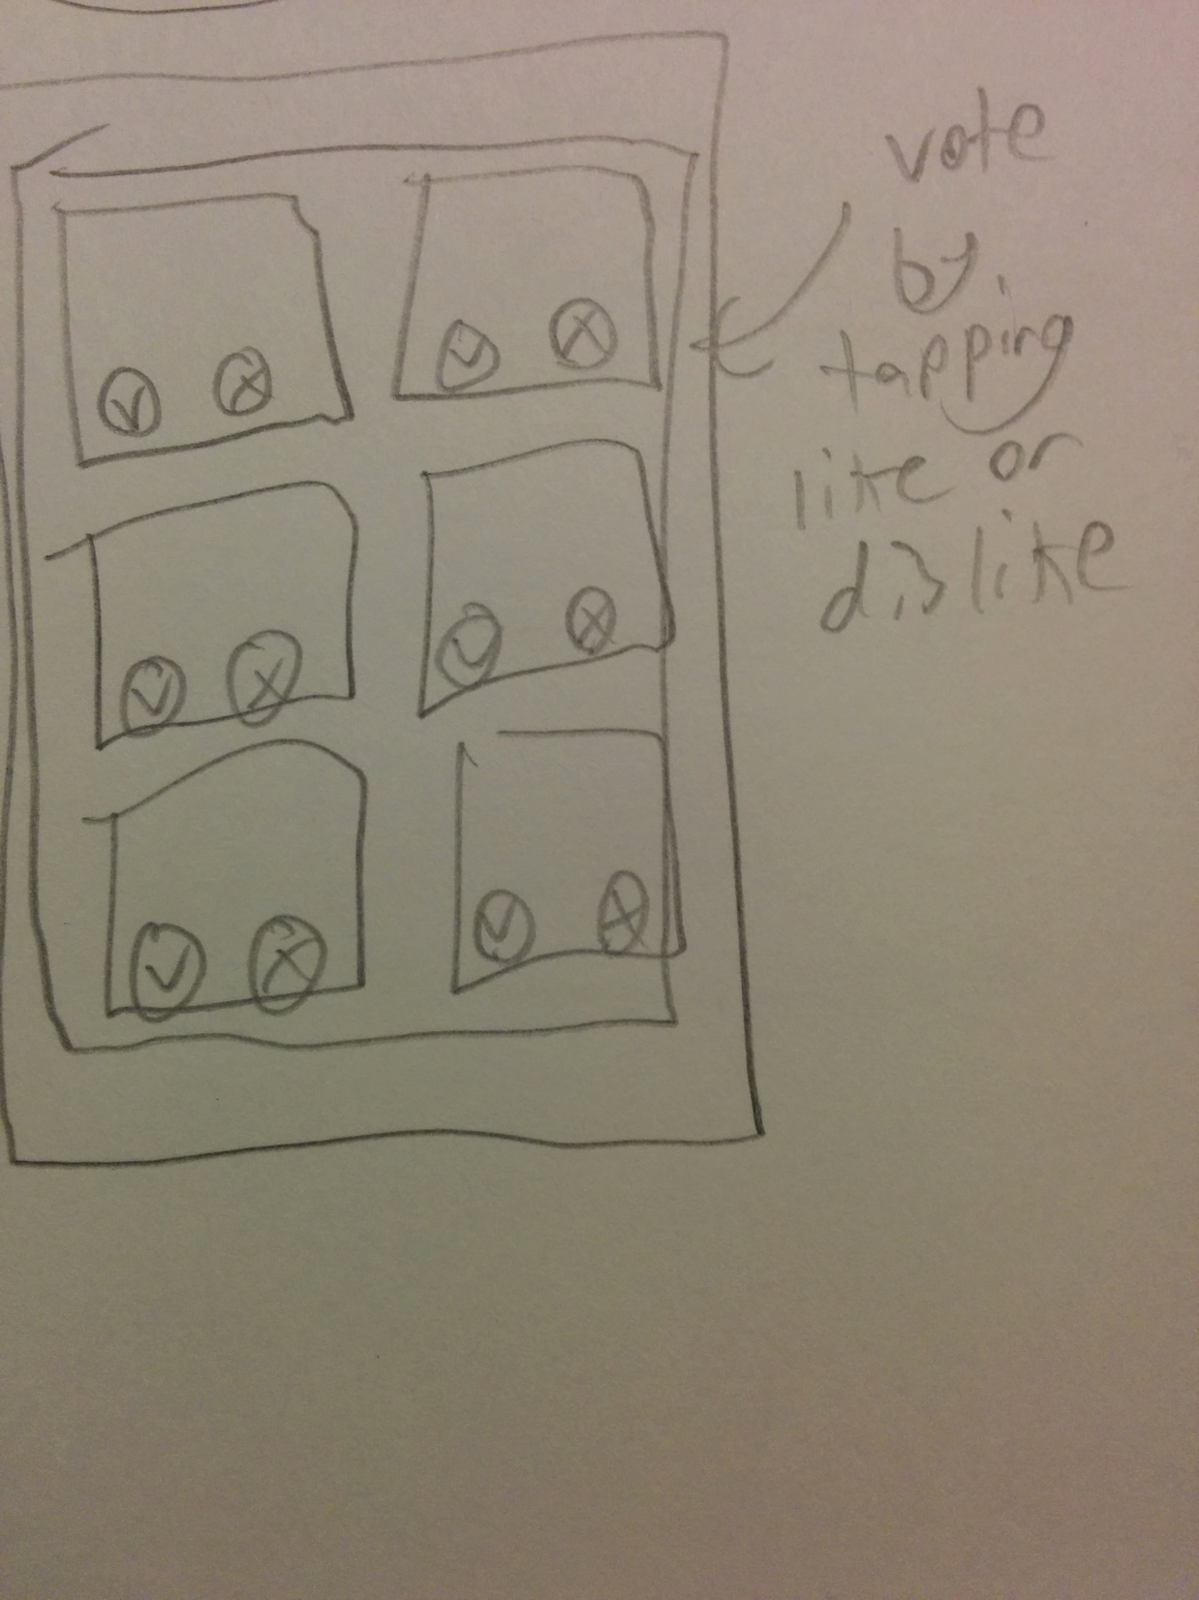
Sketches

