Slide 1
Medium-Fi Prototype
FLAVR
Alex Engel, Andrew Luo, Ben Ulmer and Onkur Sen

Slide 2
Overview
Representative tasks
Revised user-interface design
Medium-fidelity prototype demo
Methods and tools
Conclusion

Slide 3
Representative Tasks
Simple: Post a Food Event on FLAVR
Medium: Find and attend a food event
    Allow users to filter events according to preferences
Complex: Set push notifications for food events

Slide 4
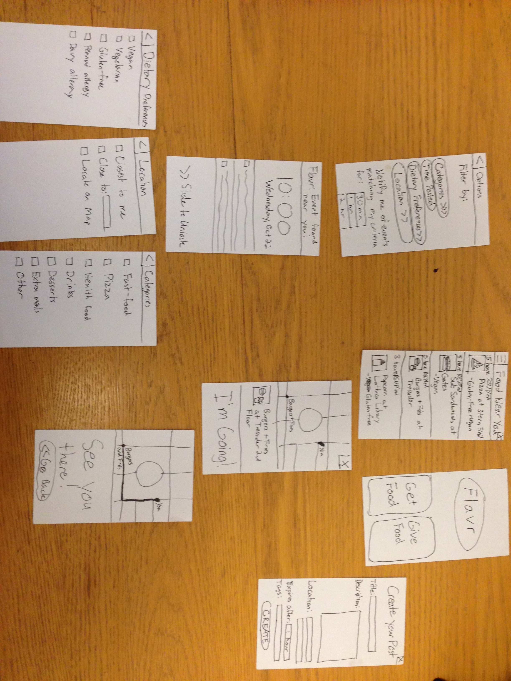
Original UI

Slide 5
Revised UI

Slide 6
Rationale for Changes
Orange is associated with healthy food and stimulates appetite
Buttons are more informative
Distance to each event

Slide 7
Rationale for Changes
Separate filters page from notifications
Save buttons for preferences

Slide 8
Rationale for Changes
Confirmation page for both giving and getting food

Slide 9
FLAVR: Live Demo

Slide 10
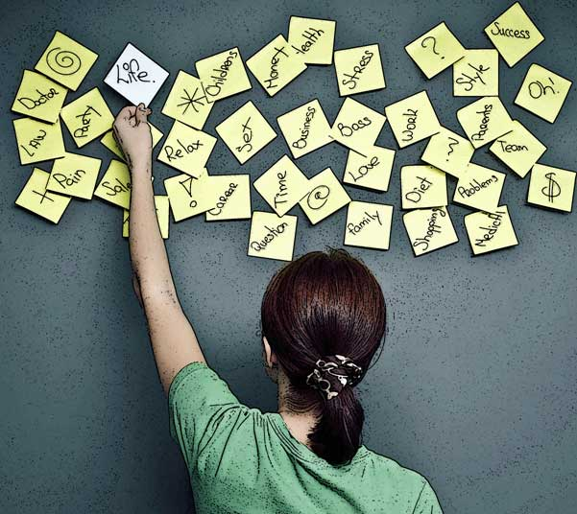


Tools and Methods
Brainstorm
Sketch 3
InVision

Slide 11
Conclusion and Moving Forward
Tasks
Design
Methods
Finalize design
Heuristic Evaluation
Coding

Slide 12
Questions?

