Slide 1
Flavr Low-Fi
Andrew Luo, Onkur Sen, Ben Ullmer, Alex Engel

Slide 2
Overview
Mission Statement
Tasks
Prototype Structure
Scenarios
Method
Results
Suggested UI changes
Summary
Notes:
Start with what we want to do (our mission)
Go through the things that we envision people will be able to do with our app
Step through some of the features and functionality of our app for different scenarios
Go over how we have tried to understand how users in real life will experience what we have envisioned
How we will change our envisioned product into something users like even more

Slide 3
Mission Statement
“Instantly connecting hungry students with food while reducing food waste”
Flavr
Notes:
First, what we want to do
Instantly connecting hungry students with food while reducing food waste
Ensure a fast and quick user experience, get connected with food
Reducing food waste – giving away excess food to students to want it

Slide 4
Tasks Overview
Post a Food Event to Flavr
Find and Attend a Food Event
Filter for food events specific to the user
Set Up Notifications for Food Events
Notes:
These are our 3 representative tasks of a user on Flavr
Post a food event to Flavr (easiest)
Find and Attend a Food event (medium)
Filtering and Setting up Notifications ( hard)

Slide 5
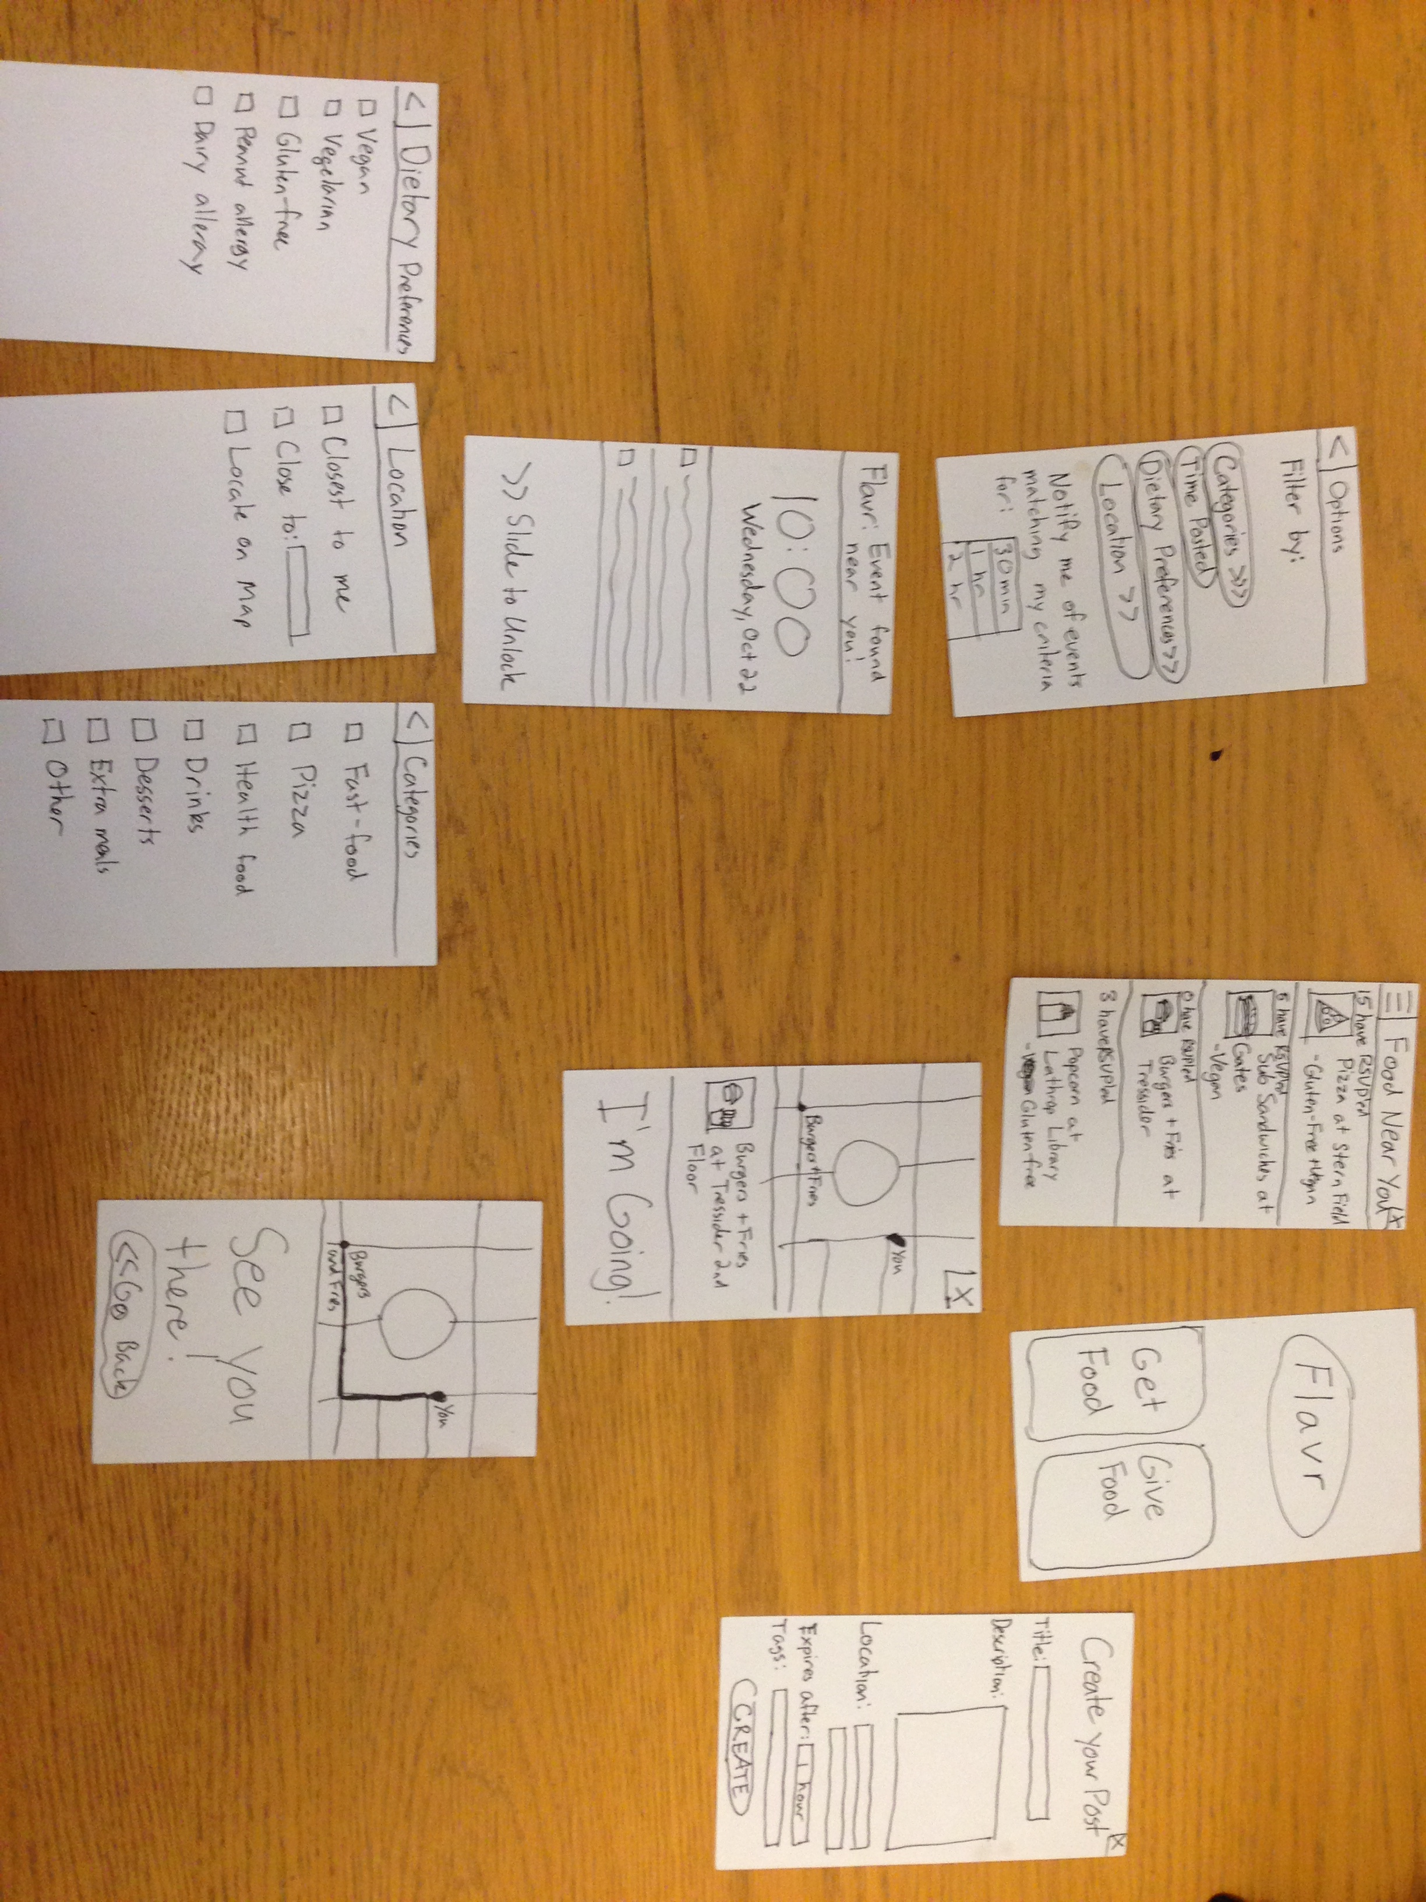
Prototype Structure
Notes:
This is the overall structure of the prototype with all of the screens
At the top right is the home screen Flavr with a get food, give food button
Clicking each button leads you into a different flow
In the Get Food flow, clicking the options button in the top- left gives you access to the options flow
Which contains screens for filtering and notifications

Slide 6
Giving Food Through Flavr
Notes:
Free Pizza at Stern Scenario
Click the Give Food button in the bottom left

Slide 7
Giving Food Through Flavr
Notes:
You see a form with a bunch of open fields with a create button on the bottom

Slide 8
Giving Food Through Flavr
Free Pizza Stern
Free Pizza at
Stern Dining,
5 pizzas leftover
in the west wing
618 Escondido Rd
Stanford, CA
Pizza, Stern, Free
Notes:
Fill in the fields, click the create button DONE! The simplest of the three tasks

Slide 9
Finding Food through Flavr
Notes:
Click the Get Food button to find food

Slide 10
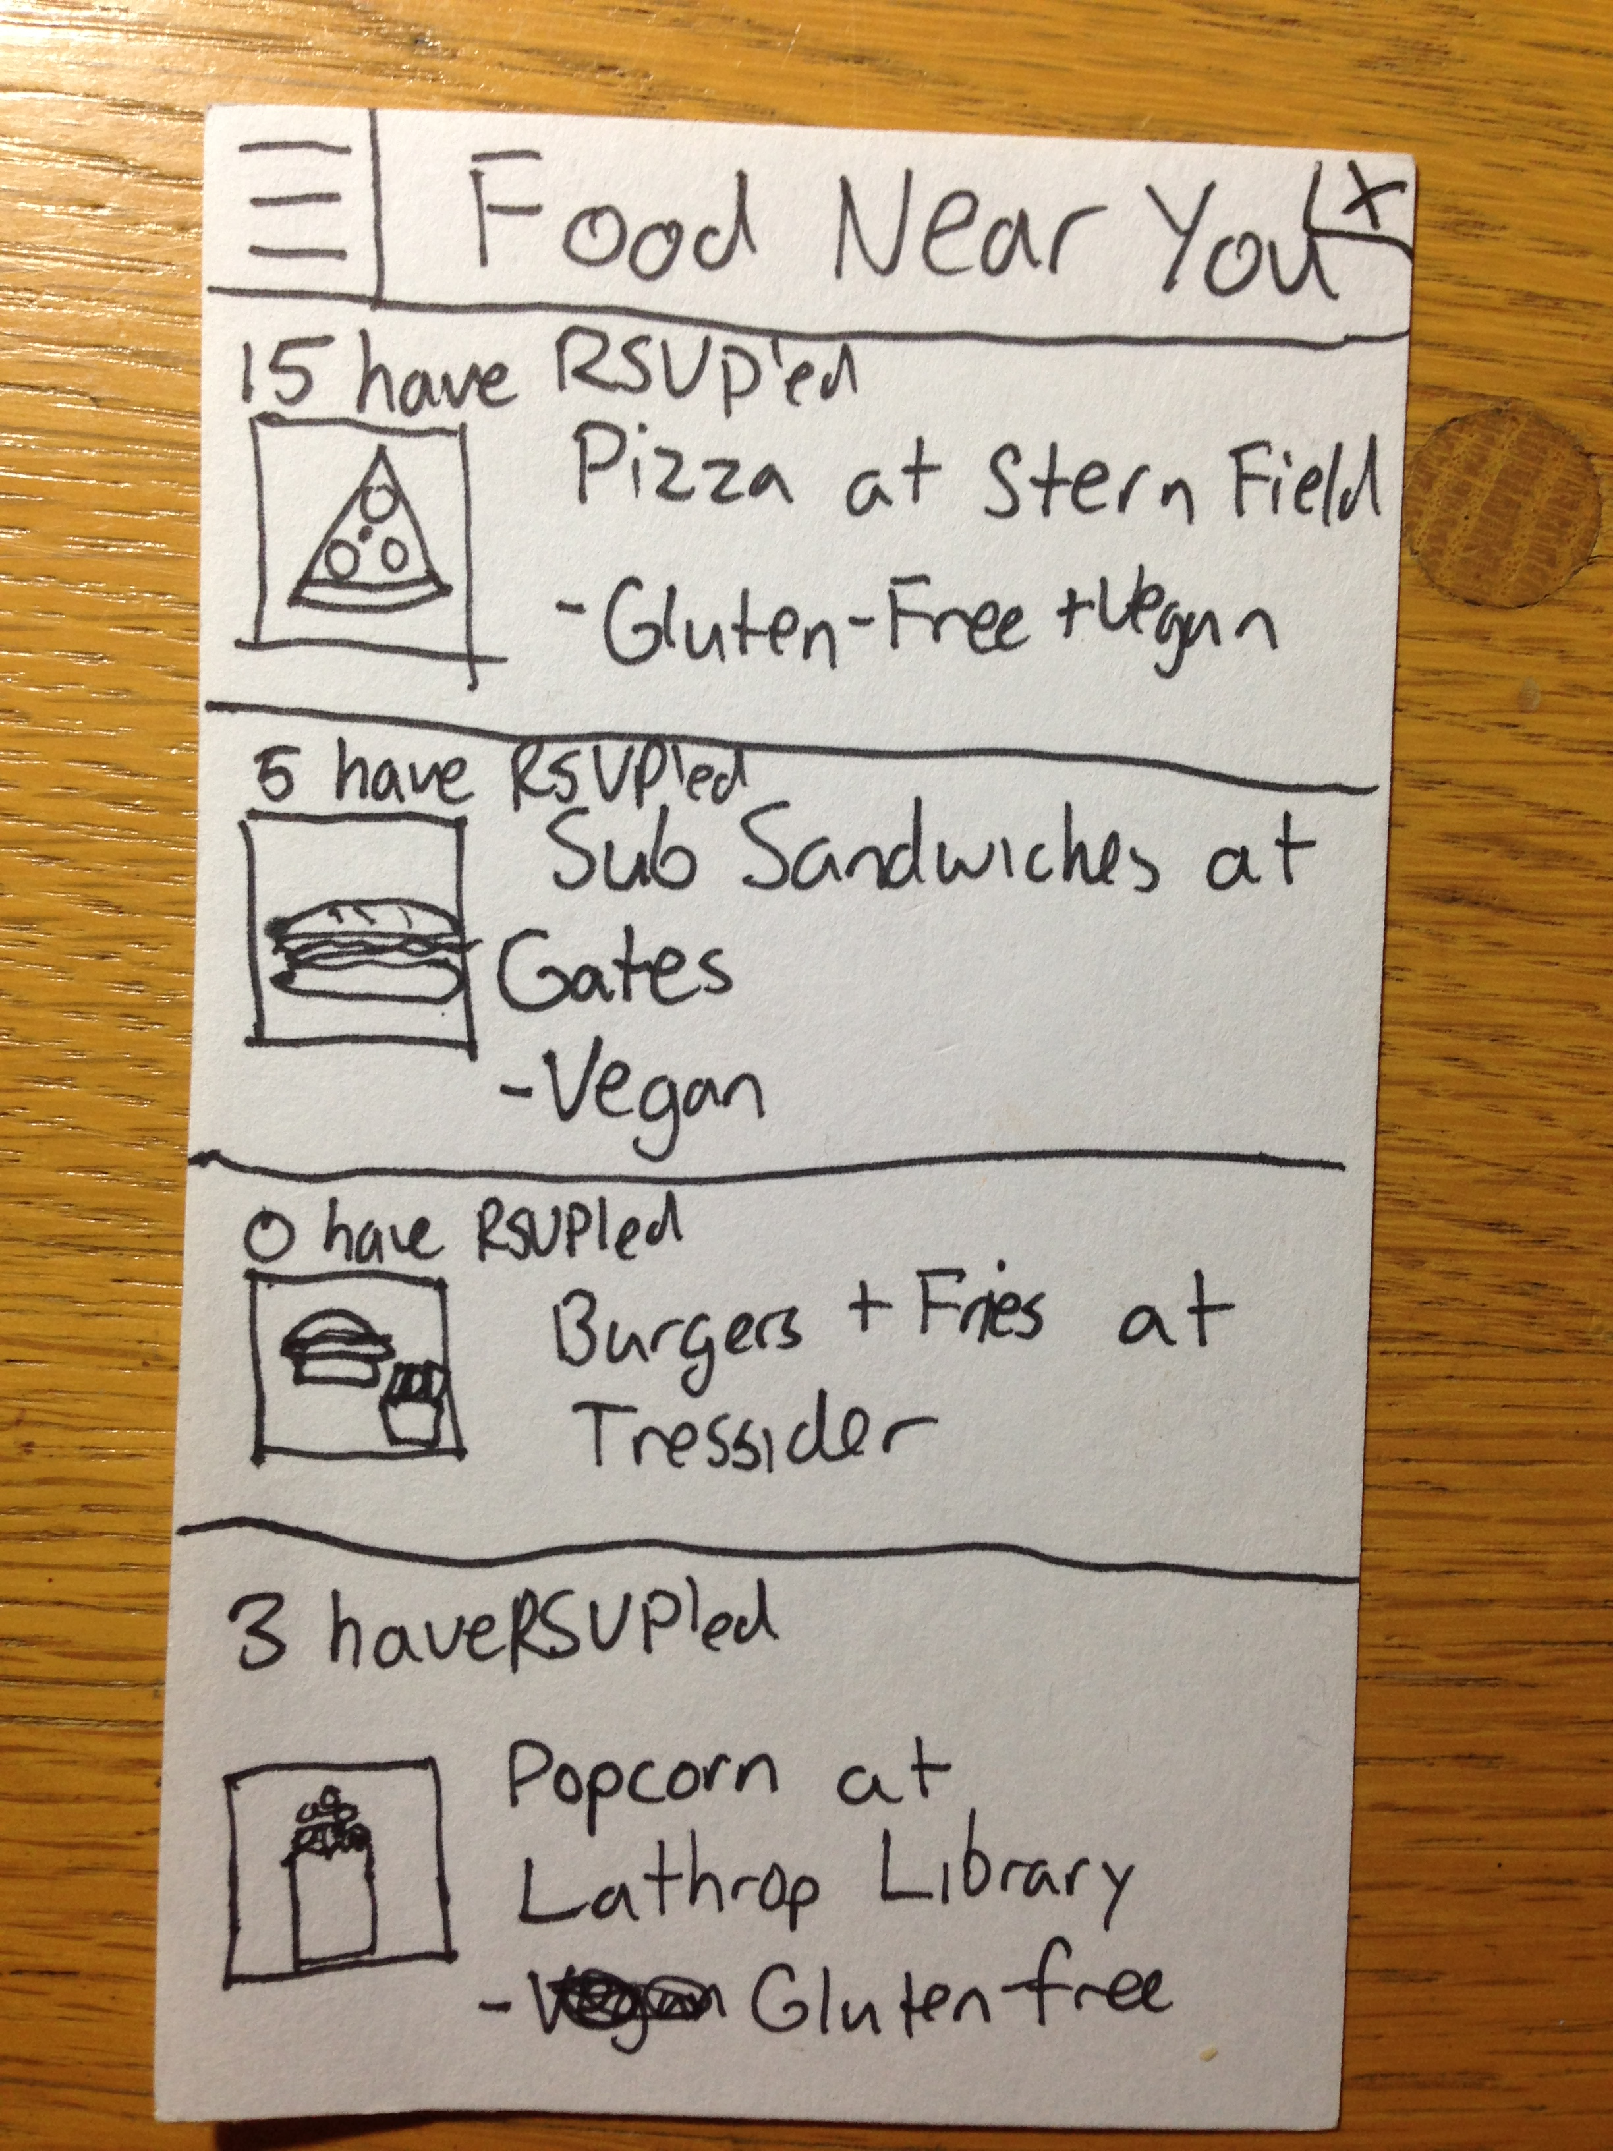
Finding Food through Flavr
Notes:
Most users will be able to just scroll up and down on this screen and find whatever food option they want and click it
Let’s say I want burgers and fries at tressider because nobody has RSVP’d yet
I click that

Slide 11
Finding Food Through Flavr
Notes:
It takes me to a screen where there’s a map with me and the location of the burger and fries marked
I think hmm that’s pretty close, and I click I’m Going

Slide 12
Finding Food Through Flavr
Notes:
The map proceeds to give me directions to the burger and fries with a path marked on the map now
This is a medium-level task.

Slide 13
Finding Food through Flavr
Notes:
Now if we step back in the flow a bit, Finding Food through Flavr has a sub-task which is much harder
Which is how do you filter results if you don’t see the things you like or there is simply too much information?
This task is usually done only once because once you have set your filters, you don’t need to set them over and over,
They will be saved.
So we are now back at the Food near you screen which you got to by tapping the Get Food button You click the options button in the top-left corner

Slide 14
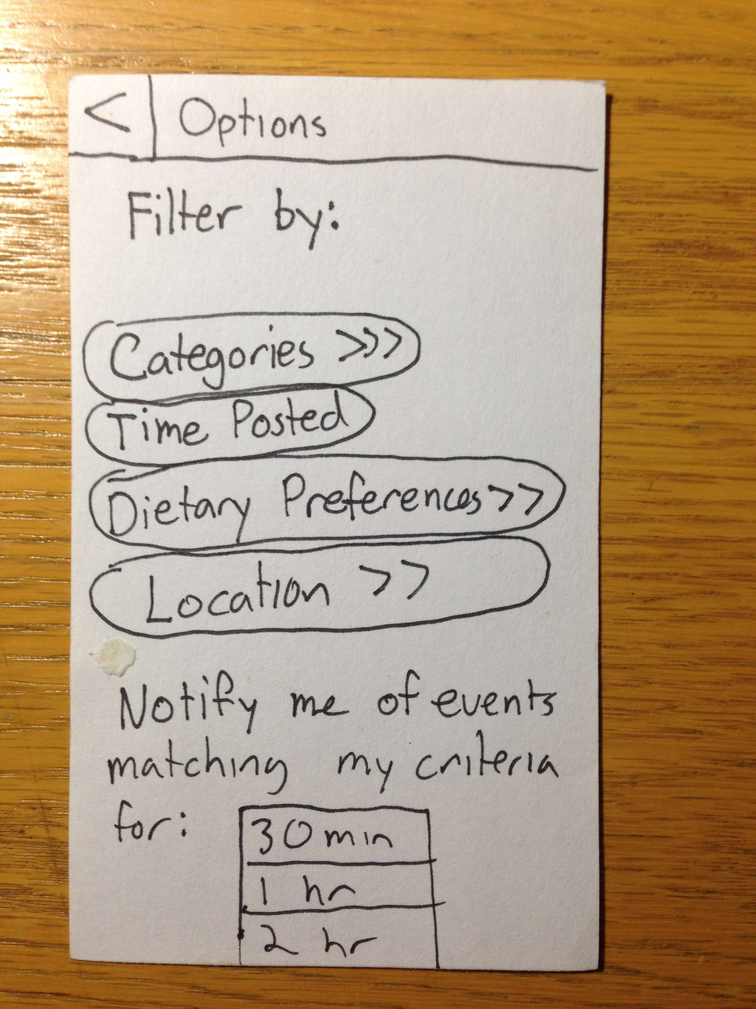
Finding Food through Flavr
Notes:
You are brought to this options screen
Let’s pretend that you only eat gluten-free food
You tap the dietary preferences button

Slide 15
Finding Food Through Flavr
Notes:
Here there are listed a bunch of dietary preferences you can check

Slide 16
Finding Food Through Flavr
✔
Notes:
You are gluten-free so you check gluten-free
And then you can tap the back button to return to your results
So I tap back

Slide 17
Finding Food through Flavr
Notes:
Tap back again

Slide 18
Finding Food through Flavr
Gluten Free
Gluten Free
Gluten Free
Gluten Free
Notes:
And now all my results are gluten free! (Although, the actual app will make your results filtered)
Burgers, fries, pizza, and subway sandwiches are not changed to be gluten free
Cool, so now I want gluten free burgers and fries so I tap that

Slide 19
Finding Food Through Flavr
Notes:
And now I’m brought to the same point in the flow as before where I see a map of myself and the burgers/fries
I tap I’m going

Slide 20
Finding Food Through Flavr
Notes:
And now I’m on my way

Slide 21
Getting Notifications from Flavr
Notes:
The third and most complex scenario is if you are hungry and for example going to class, and you want
Flavr to tell you if anything you are interested in for the filters that you have already set has a new event that is formed
So once again, you are trying to get food so you click the get food button

Slide 22
Getting Notifications from Flavr
Notes:
You are brought to the same food results screen
You tap the options button in the top left corner

Slide 23
Getting Notifications from Flavr
Notes:
And you already have your filters set, but you want a notification for let’s say 1 hour, because you are going to a 1 hour class
You tap 1 hour and you go to class and study like a good student.

Slide 24
Getting Notifications from Flavr
Notes:
After class is over, you’re really hungry and you look at your phone
A notification is on your screen and you smile as you see that Flavr has found an event near you
You click on that notification

Slide 25
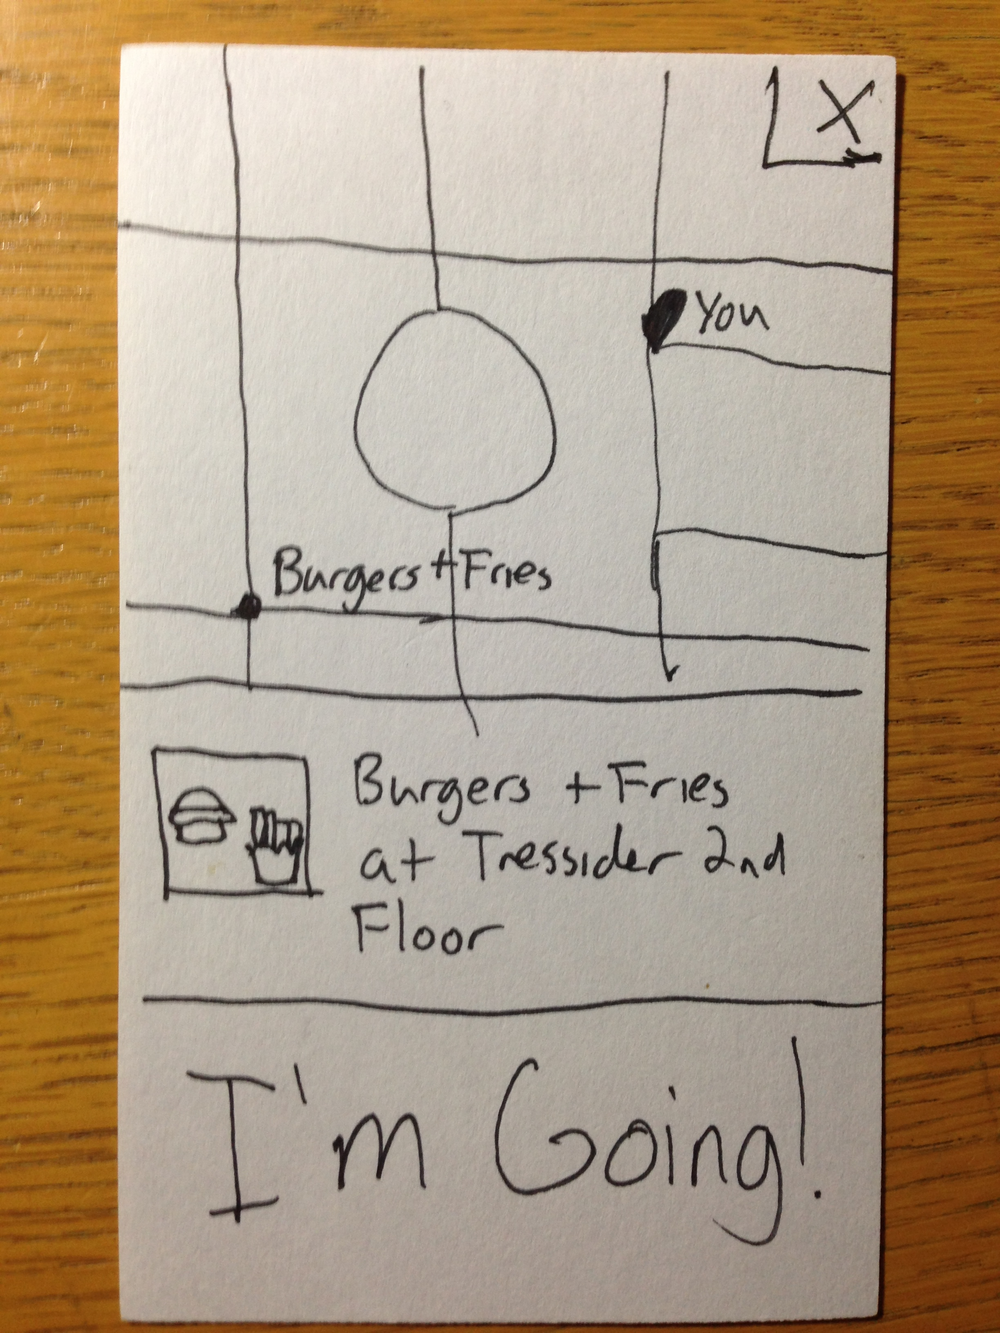
Getting Notifications from Flavr
Notes:
It brings you to the map once again and asks you if you want to go
You click I’m Going

Slide 26
Getting Notifications from Flavr
Notes:
And you are off, without even searching, Flavr has told you about a cool event you might like that was
Recently posted while you were in class.

Slide 27
Experimental Method
Participants
3 chosen randomly from Arrillaga Dining Hall
Diverse genders, ages, technical background
Found participants while they were eating, asked for a few minutes of free time
Began with a quick demo showing a few screens
Asked users to go through each of the scenarios and provide live commentary on their thoughts
Looked for signs of confusion, speed of use, number of errors, number of questions asked, overall joy of use
Notes:
So How did we test our application?
Found participants in Arrillaga, asked them for a few minutes of free time while eating
Two females one male
One male was a sophomore, highest technical background described himself between 7-10
One female was a freshman, medium technical background, described herself as between 4-6
One female was a senior, lowest technical background, described herself as between 1-3
Showed a few quick demo screens and explained the process
Then asked users to go through each of the scenarios, provide live stream of consciousness thought as for what they are feeling
Laid out one screen at a time and made users physically touch the paper as if it was a touch screen
Then, laid out a different screen on top of the first screen to simulate a screen changing
Looked for signs of confusion, speed of use, number of errors, number of questions asked, overall joy of use

Slide 28
Highly Technical User
Notes:
Had no problems going through all of the screens
Even though he was an android user, he found the notification bar on the iPhone screen easily understandable
Assumed that the top left had filtering options for Food Near You without even asking
Thought that the reminder seemed a bit hidden and the notification could be moved to a separate modal from filtering
All together, took about 1 minute to complete all tasks
Overall thought the flow was very smooth and had a great user experience

Slide 29
Somewhat Technical User
✔
Notes:
Though giving food was smooth and intuitive
Asked if she had to filter by everything or only one at a time (confused)
Didn’t know what needed to be filled out
Didn’t know whether results would be saved after exiting out of the preferences screen
Wanted to separate the notify and the filter screens
Took around 1:30 - 2 minutes to finish all scenarios
Overall thought that the app looked good and thought it was intuitive

Slide 30
Not Very Technical User
Notes:
Confused as to whether I’m going was a button. Need to style it to make it look more button like
Wasn’t sure whether the top-left was an options menu
Wanted to know if filters were saved, and wanted a save button
Wanted the back button to be more arrow like instead of just a <
Thought that it would be nice to know how far each thing was in the food near you for people new on campus
Took around 3-4 minutes to finish all scenarios
Overall experience: Thought it was straightforward overall

Slide 31
Suggested UI Changes
Aesthetically
Change the back button to look more like an arrow
Change the options button to be more intuitive for non technical users
Better organize data into separate screens
Add more confirmation screens to tell users that what they have done has succeeded
Add more information to food results detailing either how they were found (for the technical user) or their distance away (for the non-technical user)
Notes:
Change some of the aesthetics of different buttons for non-technical users specifically
Buttons and icons for options must be clearly communicated to non-technical users
More confirmation screens are necessary as well in order to reassure users that what they have done will not disappear
More information for food results is helpful as well for letting users make informed decisions on food

Slide 32
Suggested UI Changes
Notes:
Split the Filters from the notification modal
Suggested by almost all of our users, this feature was vital because the notifications and the filters together were confusing
Having a clear UI with just filters and just Notifications would greatly improve user experience and make the options screen less confusing

Slide 33
Suggested UI Changes
200 m.
300 m.
100 m.
Notes:
Add distances to the Food Near You screen for the non-technical user or the new user at Stanford
While the food near you was being sorted, without distances, users couldn’t really tell the difference as for just
What the difference was between food distances
In this way, users will actually be able to make an informed decision especially if new on campus

Slide 34
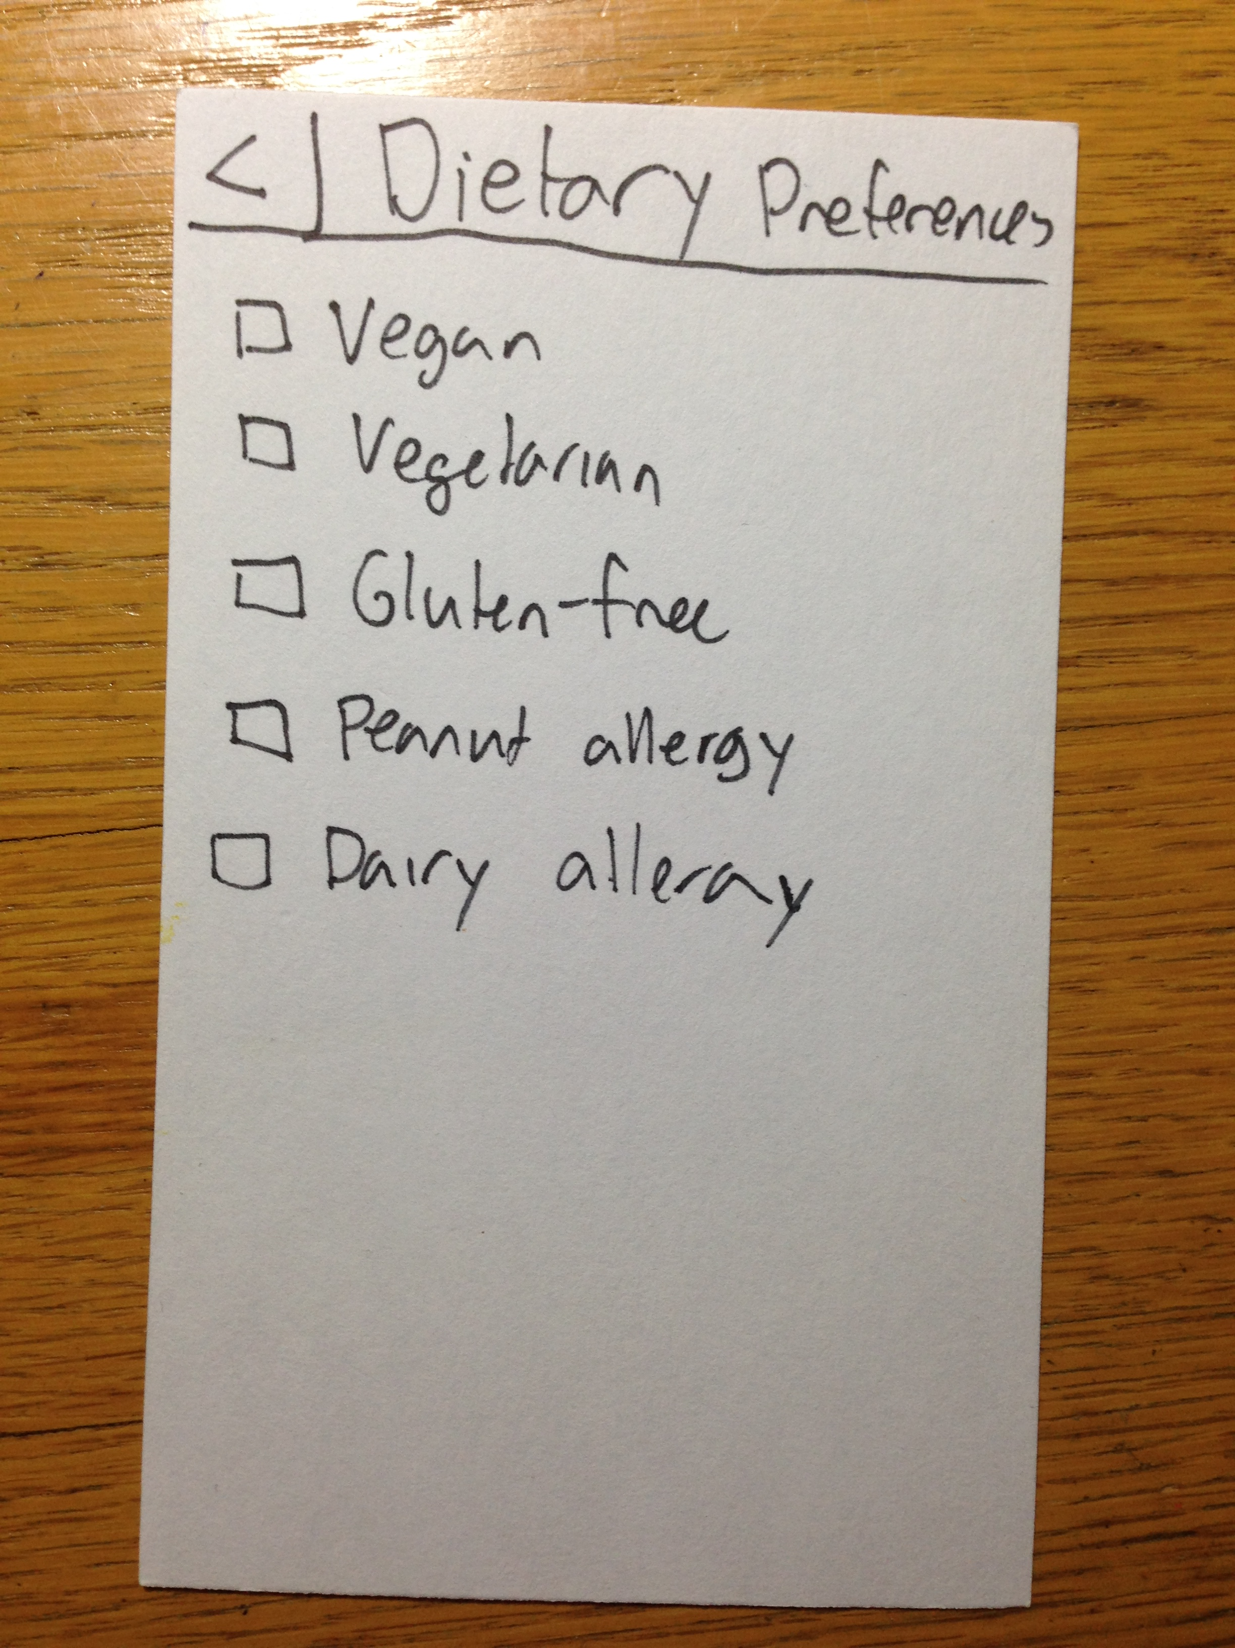
Suggested UI Changes
Save
Notes:
Add a save button to any changes in preferences in order to confirm for the user their preferences will still be there
This way, users won’t have to click the back button and click into the preferences again to check that they still exist

Slide 35
Summary
Low-fi prototype appears to be on-track to a good user-experience
Able to serve a wide range of our target users with both technical and non-technical backgrounds
Enable users to give food away, find food they want, and let the app tell them when food is available
Lessons learned – modularize different features, add confirmation feedback for users

