Slide 1
Flavr
Andrew Luo, Ben Ulmer, Alex Engel, Onkur Sen
CA: Negar Rahmati, Time: 10am
Notes:
Andrew Luo: design/development
Ben Ulmer: documentation/development
Alex Engel: user testing/development
Onkur Sen: manager/development

Slide 2
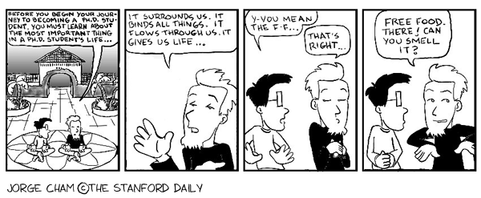
Problem
http://www.phdcomics.com/comics/archive.php?comicid=39
Notes:
http://www.phdcomics.com/comics/archive.php?comicid=39

Slide 3
Solution
Flavr
Instantly connecting hungry students with food while reducing waste

Slide 4
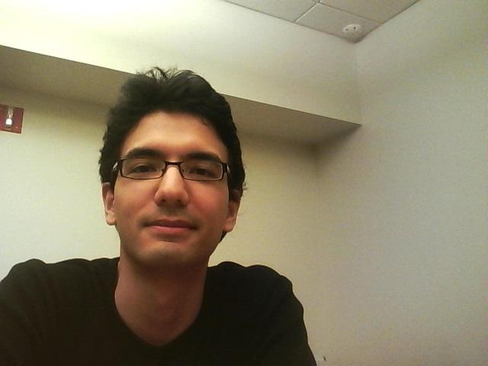
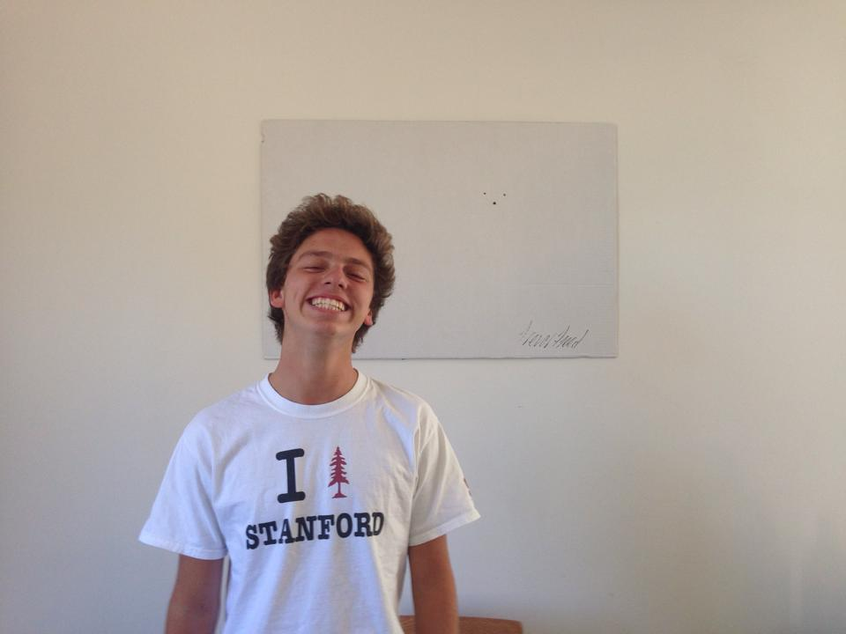
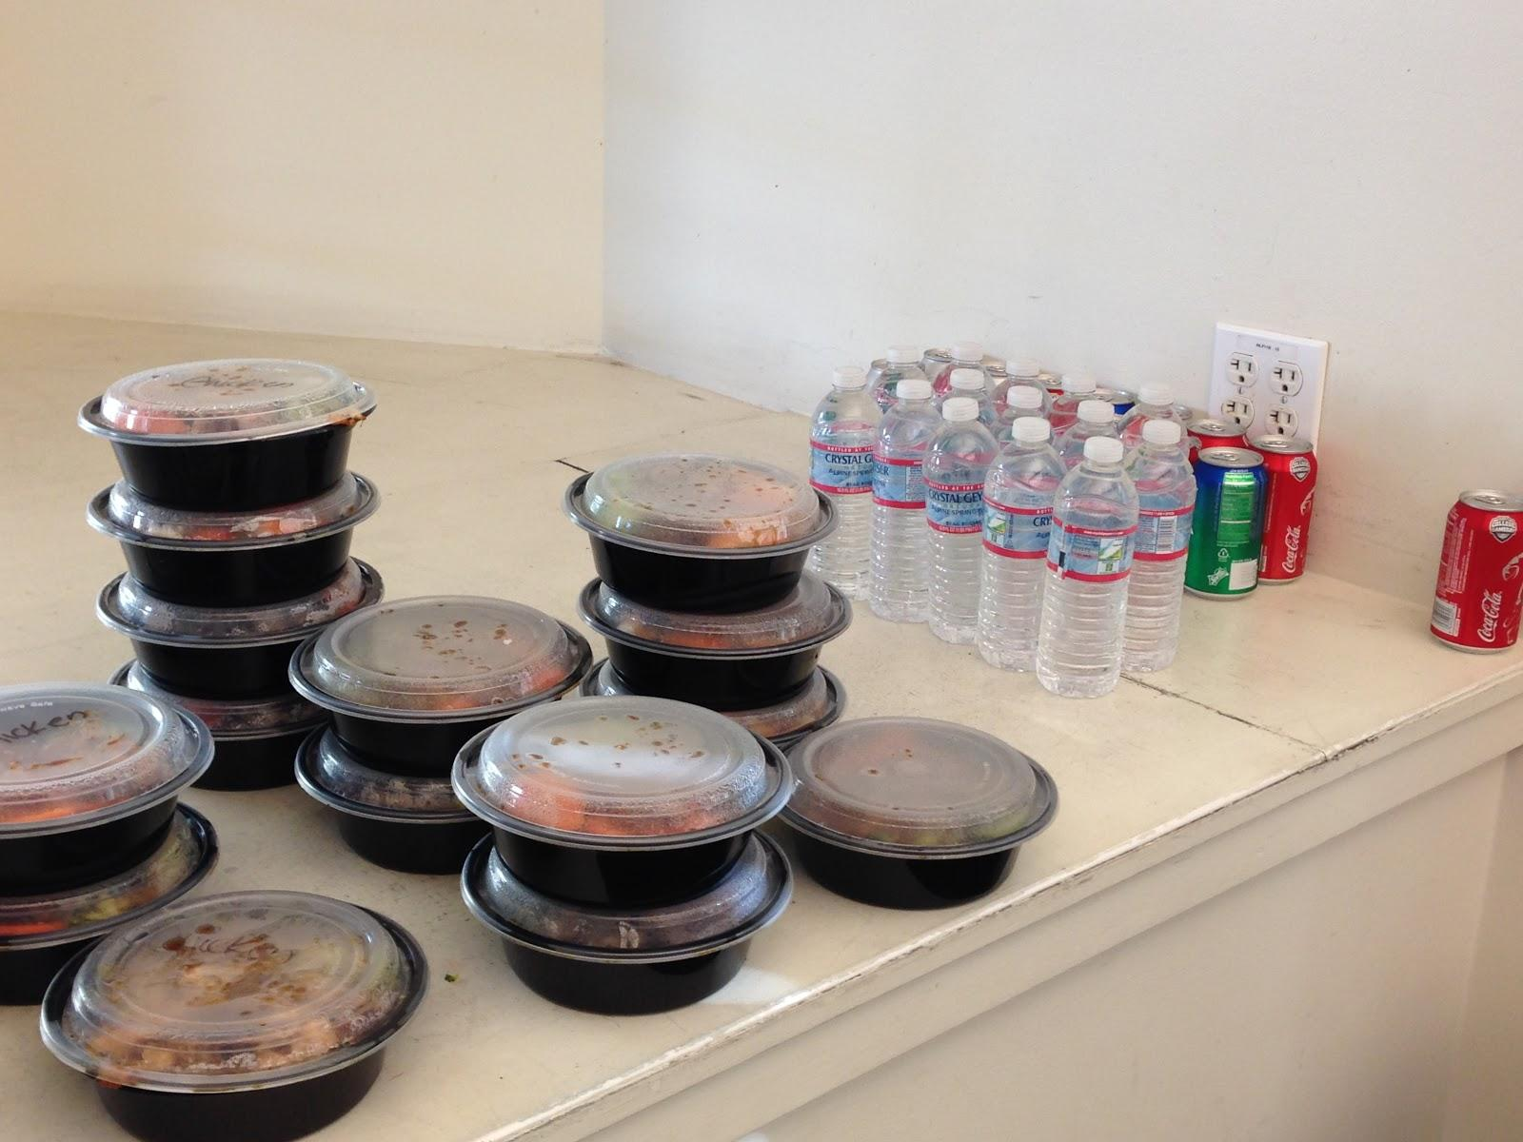
Who’s Involved?
Notes:
who your participants were, why chosen, how recruited, & where interviewed

Slide 5
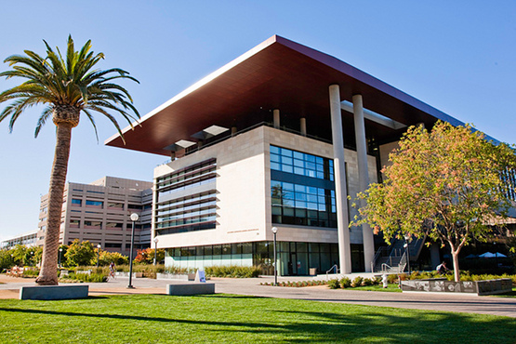
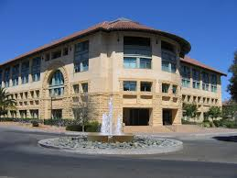
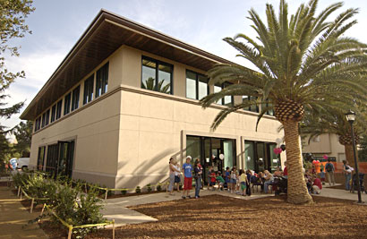
Where Did We Interview?

Slide 6
Task Analysis Results-Student
New Insight
Gluten Free
Access
Utensils
Current system: systemic, reactionary, word of mouth
Notes:
1. Who is going to use the system?
2. What tasks do they now perform?
3. What tasks are desired?
4. How are the tasks learned?
5. Where are the tasks performed?
6. What’s the relationship between customer & data?
7. What other tools does the customer have?
8. How do users communicate with each other?
9. How often are the tasks performed?
10. What are the time constraints on the tasks?
11. What happens when things go wrong?

Slide 7
Task Analysis Results-Organizer
Use food as an advertisement for an event
Buys more food than necessary
Gives away food for free afterwards
Exceptions
Notes:
1. Who is going to use the system?
2. What tasks do they now perform?
3. What tasks are desired?
4. How are the tasks learned?
5. Where are the tasks performed?
6. What’s the relationship between customer & data?
7. What other tools does the customer have?
8. How do users communicate with each other?
9. How often are the tasks performed?
10. What are the time constraints on the tasks?
11. What happens when things go wrong?

Slide 8
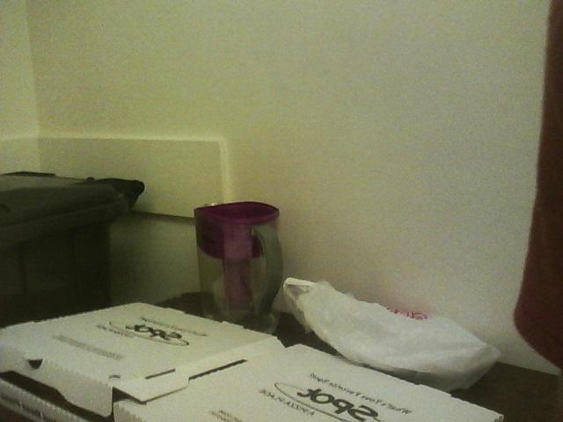
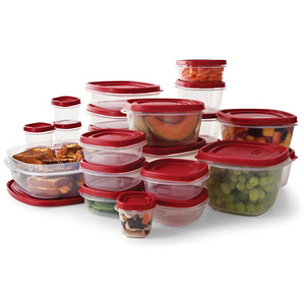
Task One: Finding Food

Slide 9
Task Two: Organizing Groups

Slide 10
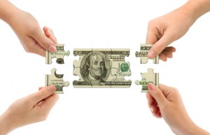
Task Three: Splitting Costs

Slide 11
Application 1:
Broadcast availability of food
Notes:
Significance, feasibility, interest

Slide 12
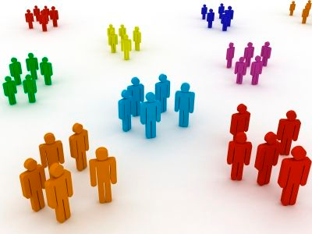
Application 2:
Group formation

Slide 13
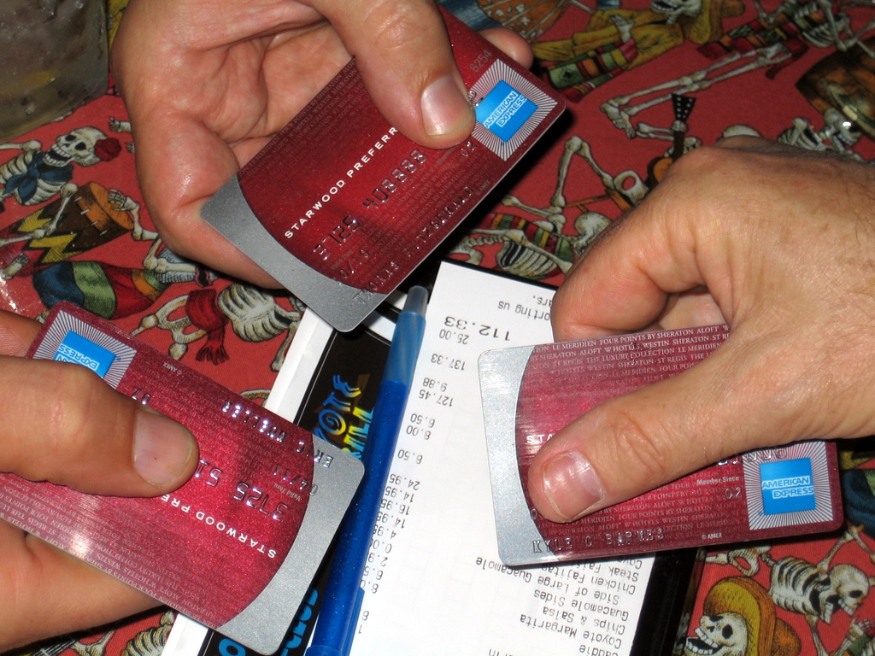
Application 3:
Crowdsourcing the process of getting food

Slide 14
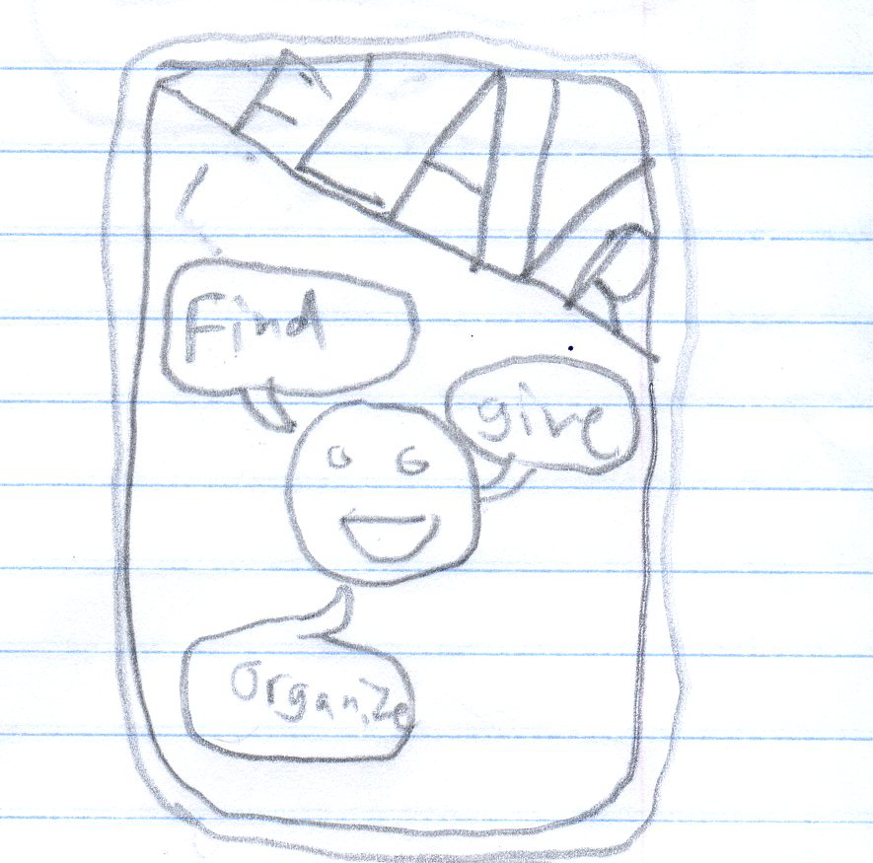
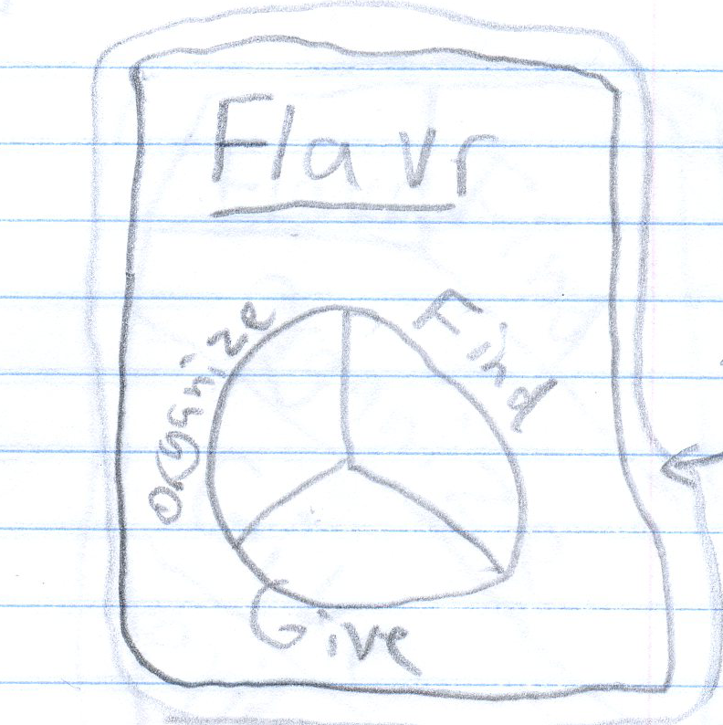
Sketches

Slide 15
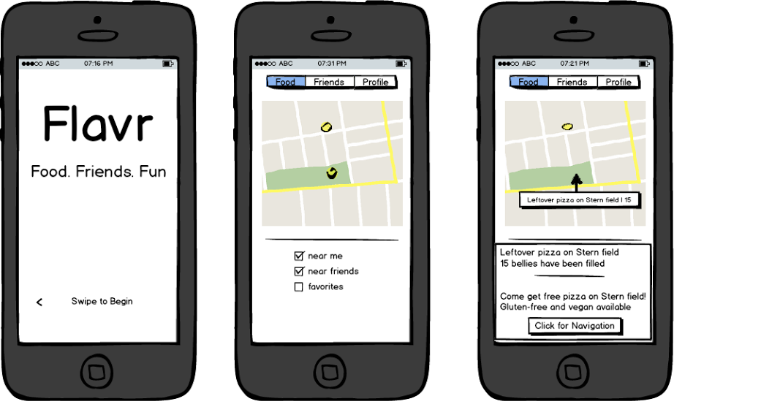
Sketches

Slide 16
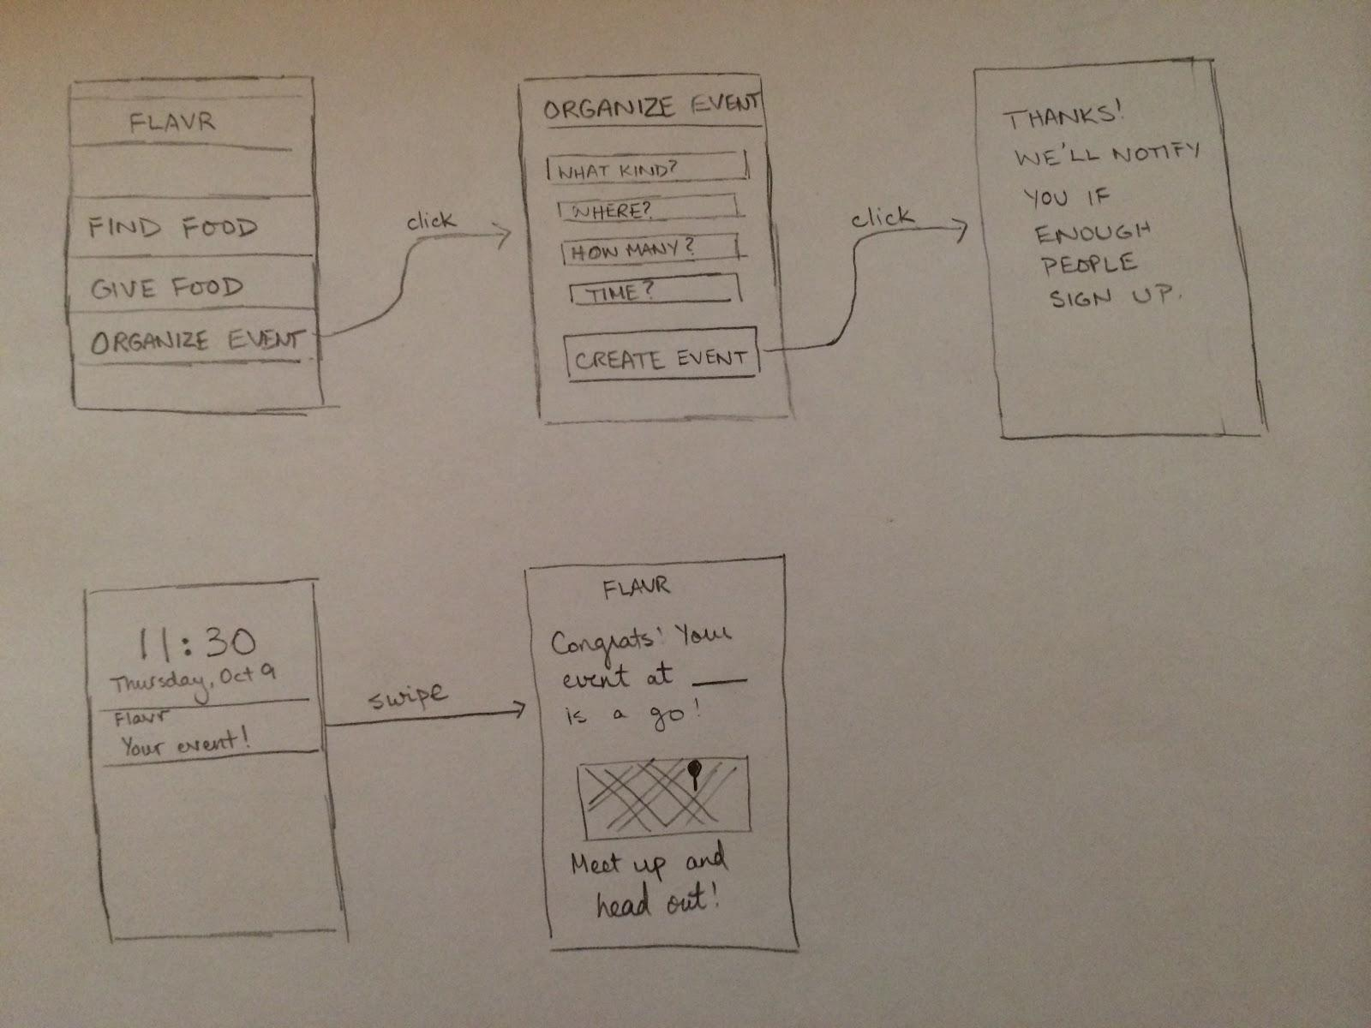
Sketches

Slide 17
Summary
Flavr helps with food organization
CI findings
Applications

