Slide 1
@Home The fastest and quickest way to solve problems at home
Laila Chima, Adam Khorakiwala, Gavin Nelson

Slide 2
Overview
Tasks
Lo-fi prototype
Participant backgrounds
Testing method
Results
Questions?

Slide 3
Mission Statement
“Solve people’s home problems in the most seamless way possible. By creating a powerful and easy-to-use network of users and problem solvers, we hope to connect these problems with the problem-solvers and create value for everyone in this space.”
Notes:
Quickly have a home service provider come to their home and fix the issue in front of them

Slide 4
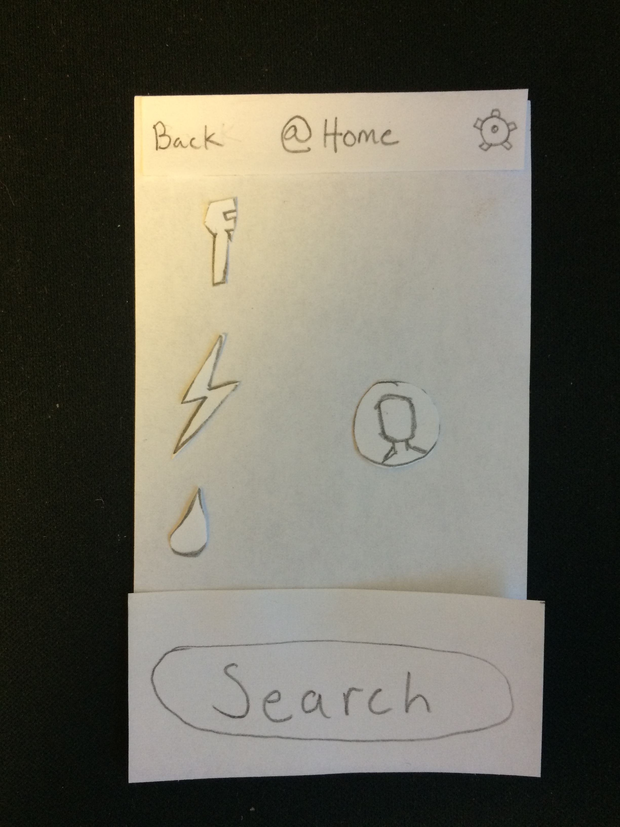
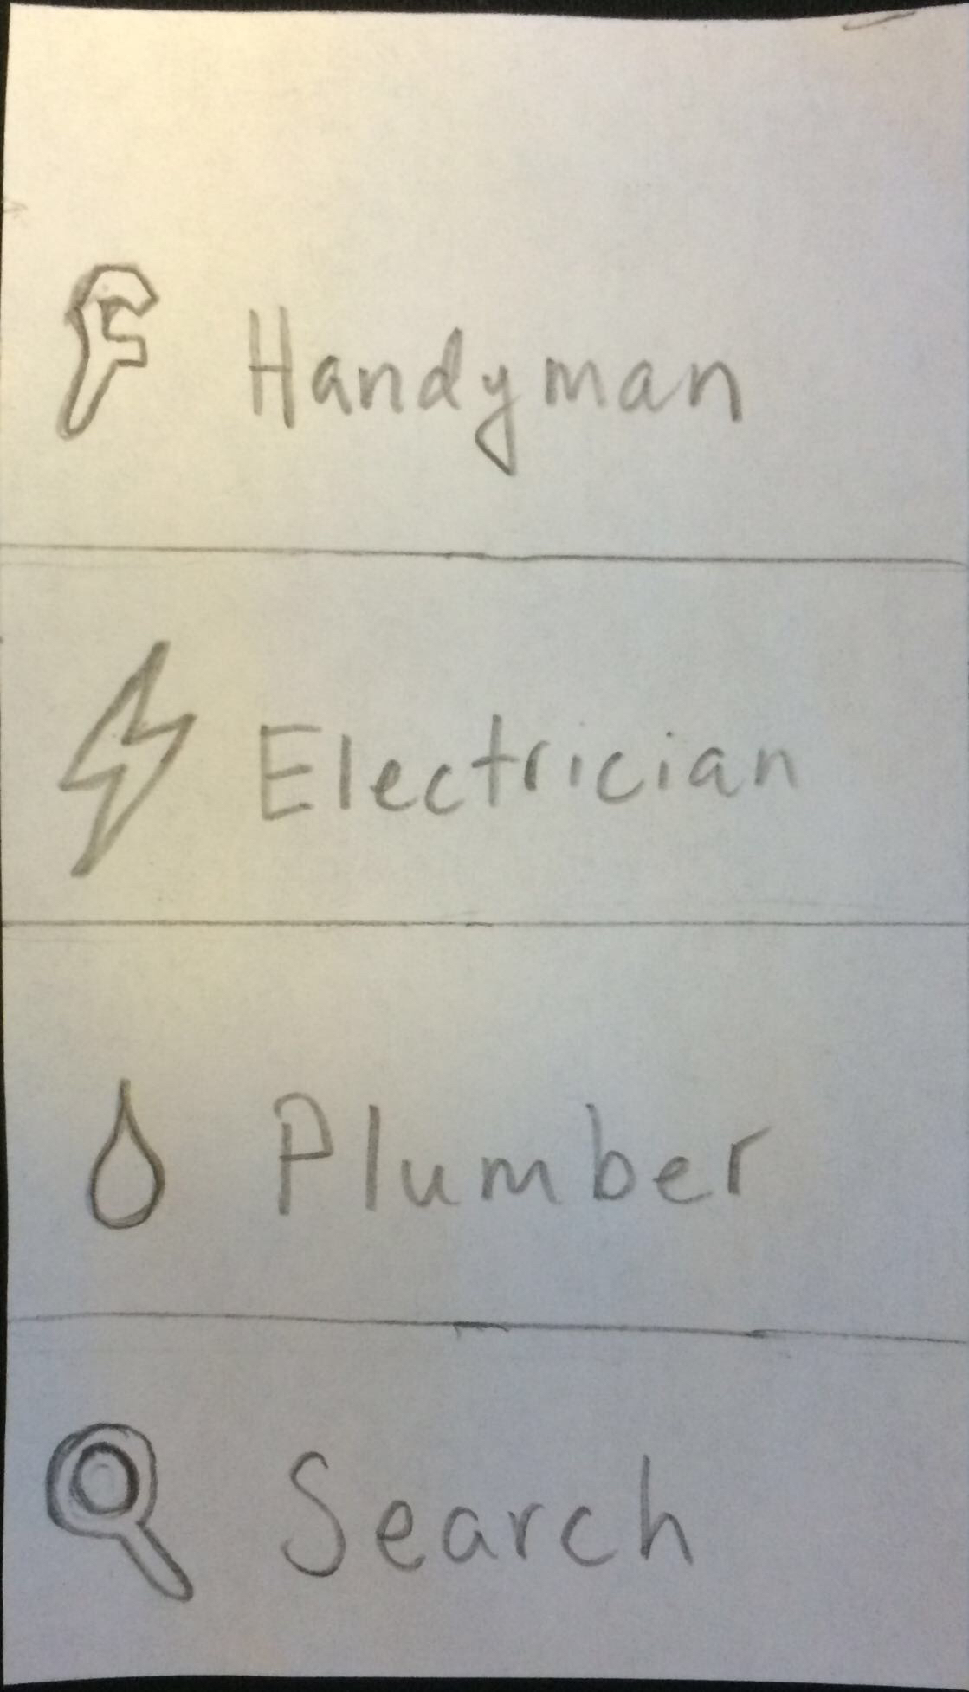
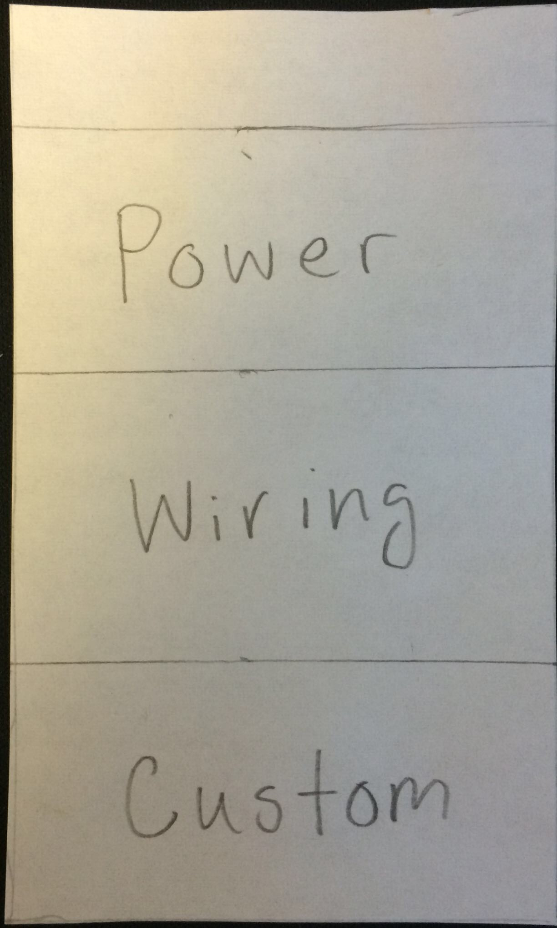
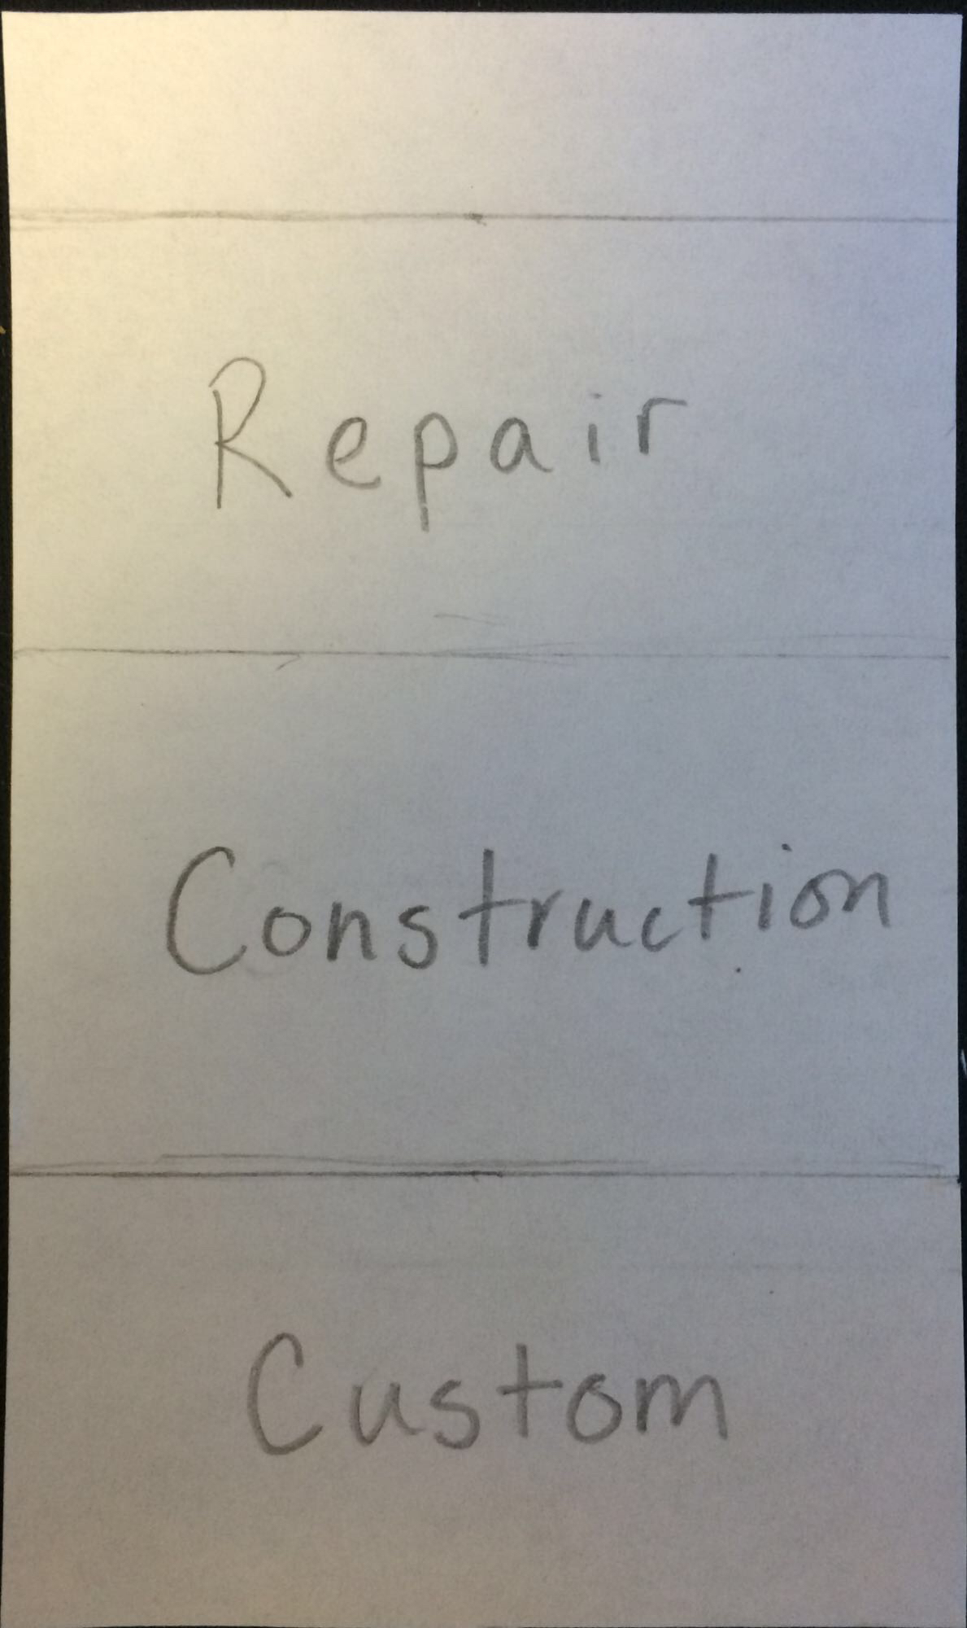
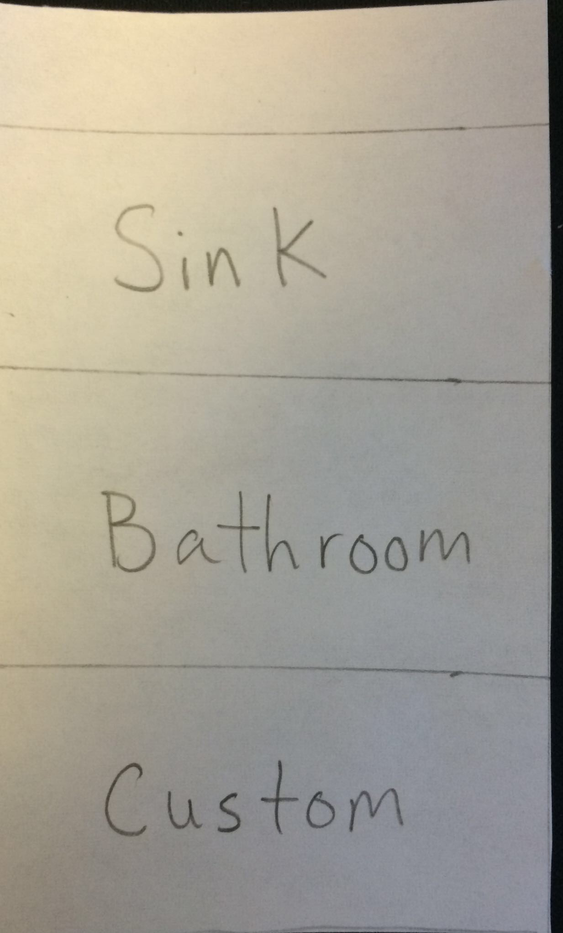
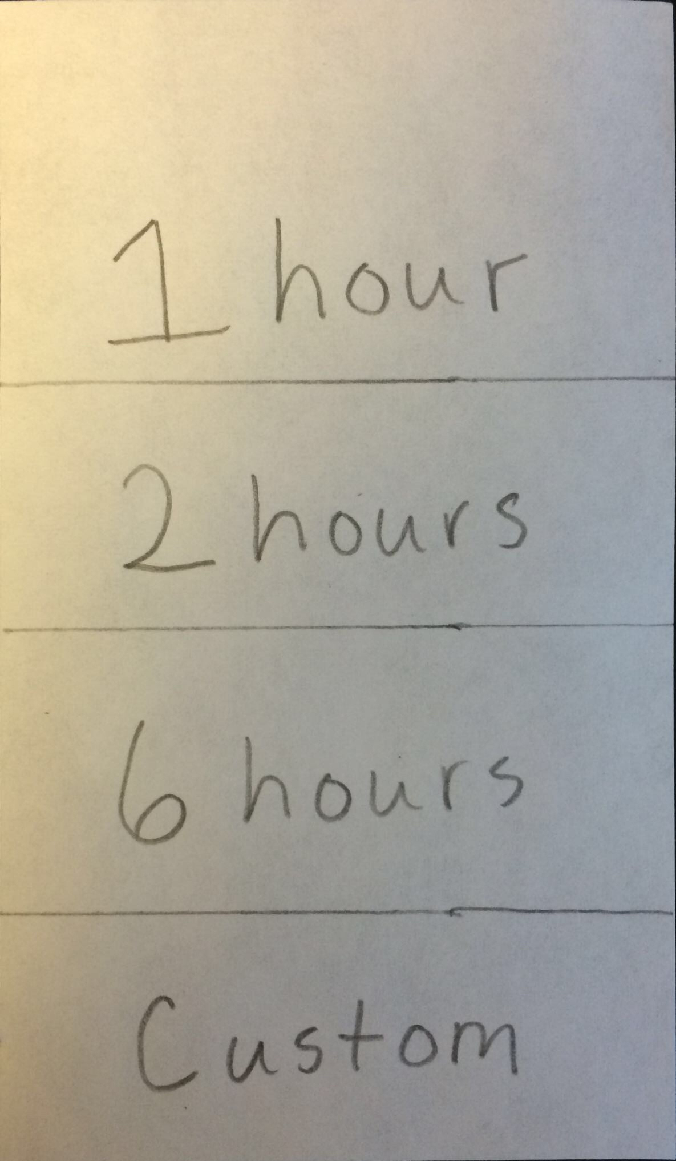
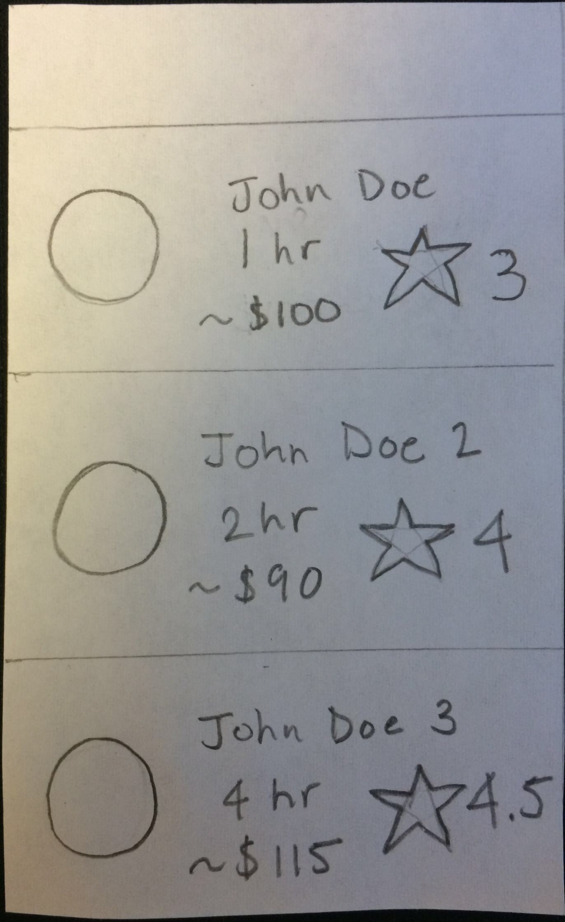
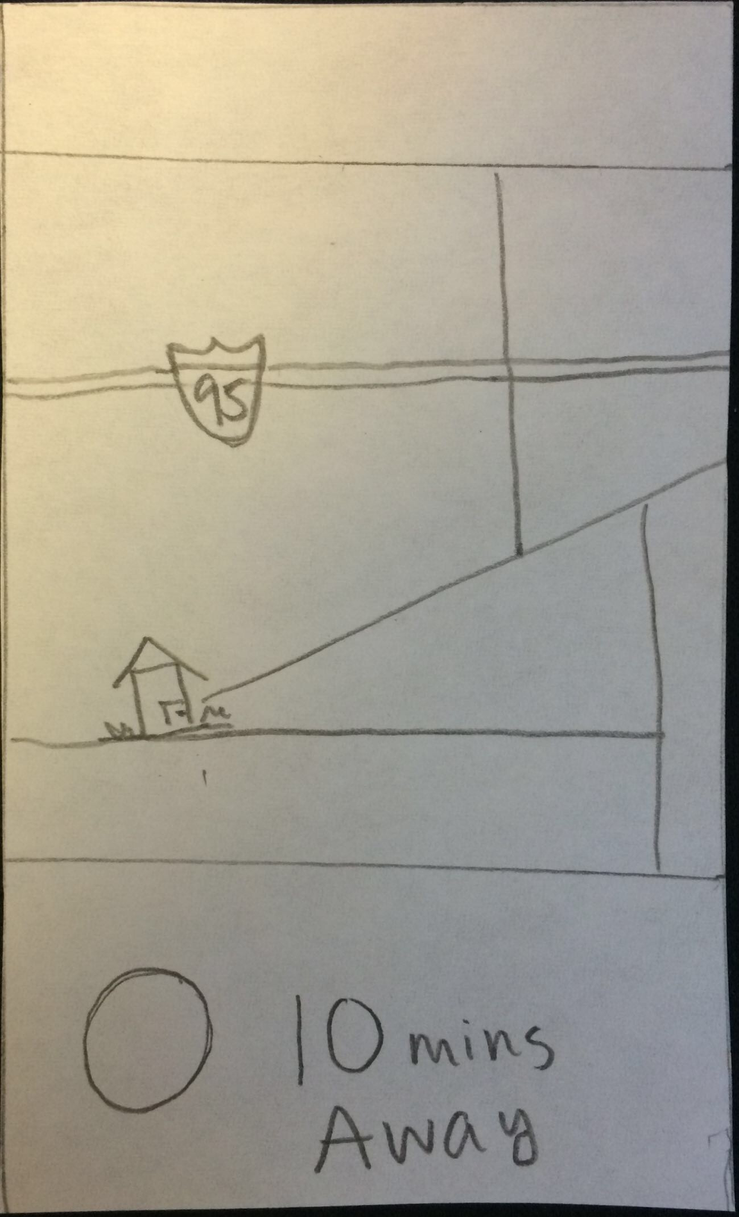
Task 1: Send a help request

Slide 5
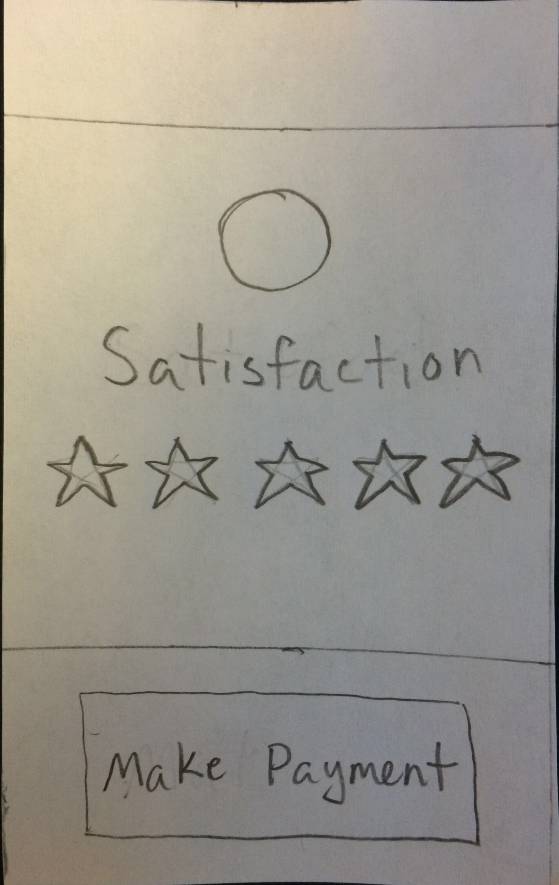
Task 2: Pay for help

Slide 6
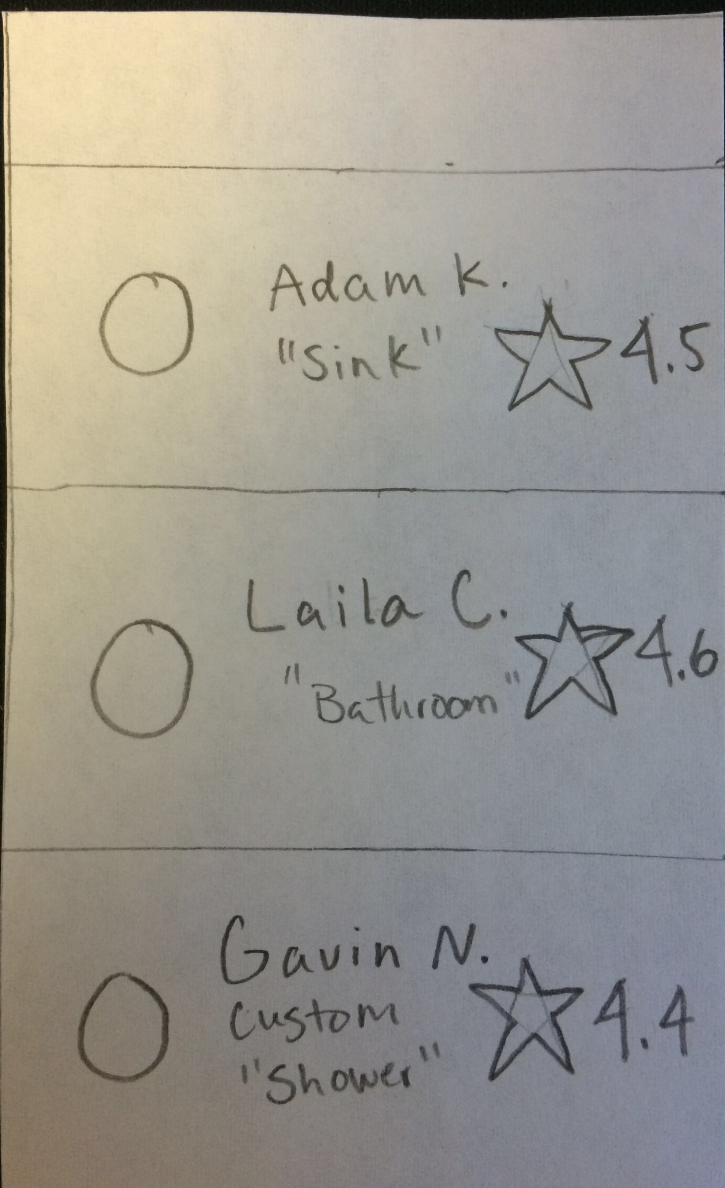
Task 3: Respond to help request

Slide 7
Experimental method
User backgrounds
Person 1: Dorm Custodian
Person 2: Senior living off campus
Person 3: Palo Alto resident
Testing areas
Dorm lounge
History corner
Café on University Avenue
Protocol
Notes:
Broke up users into two categories
Tested one custodian for help, two users as customers
Custodian interviewed in dorm lounge
Palo Alto resident interviewed in Café on University ave
Senior interviewed at the History Corner
Make them sign a consent form, tell them time commitments,
Introduce them to our idea
Give them paper prototype
Ask them to do the tasks
Record all things they said with their permission
Ask them to fill out a questionnaire with feedback

Slide 8
Experimental results – Person 1 (Stanford Custodian)
Performed very well
Some confusion because of paper prototype
Some curiosities
Scheduling tools
How he could get work
Setting price
Notes:
Curiosities: scheduling tools, how he could get work, how he could set price to make sure he got work

Slide 9
Experimental Results – Person 2 (Senior living off campus)
Fast in going through the workflow
Confusion over payment screen
Notes:
If I press rating, does the payment automatically go through?

Slide 10
Experimental Results – Person 3 (Palo Alto Resident)
Debate on which service provider to choose
Wanted to be able to pay first and then rate the person in private

Slide 11
Questions?

