Slide 1
@Home
The fastest and easiest way solve problems @Home
Team Manager Development Design
Adam Khorakiwala Laila Chima Gavin Nelson

Slide 2
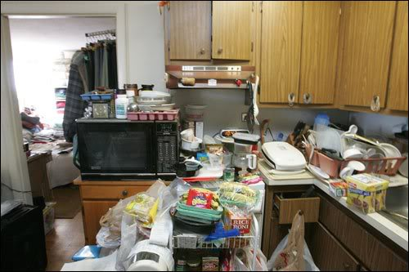
Home Services = inefficient
Problems at home!

Slide 3
Home Services = inefficient
Home Services = efficient
@Home

Slide 4
Contextual Inquiry
Problem Scenario: disposal just got clogged, circuit just shorted… what do you do?
Questions related to:
What’s most important?
How frequent? How urgent?
How’s your home now?
Price sensitivity?

Slide 5
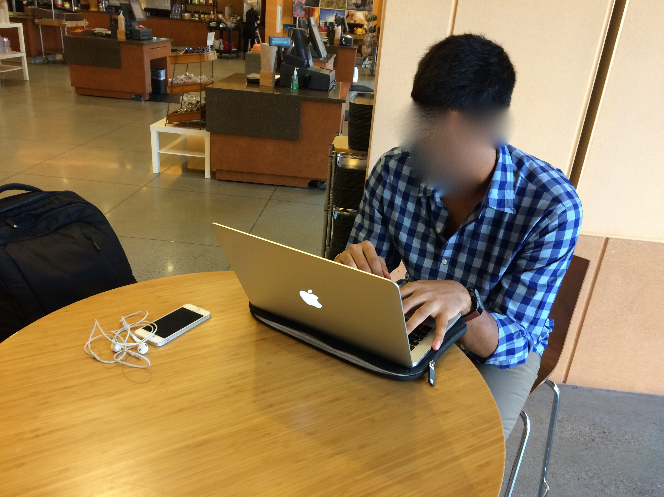
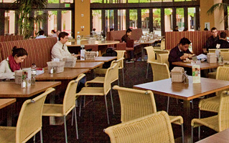
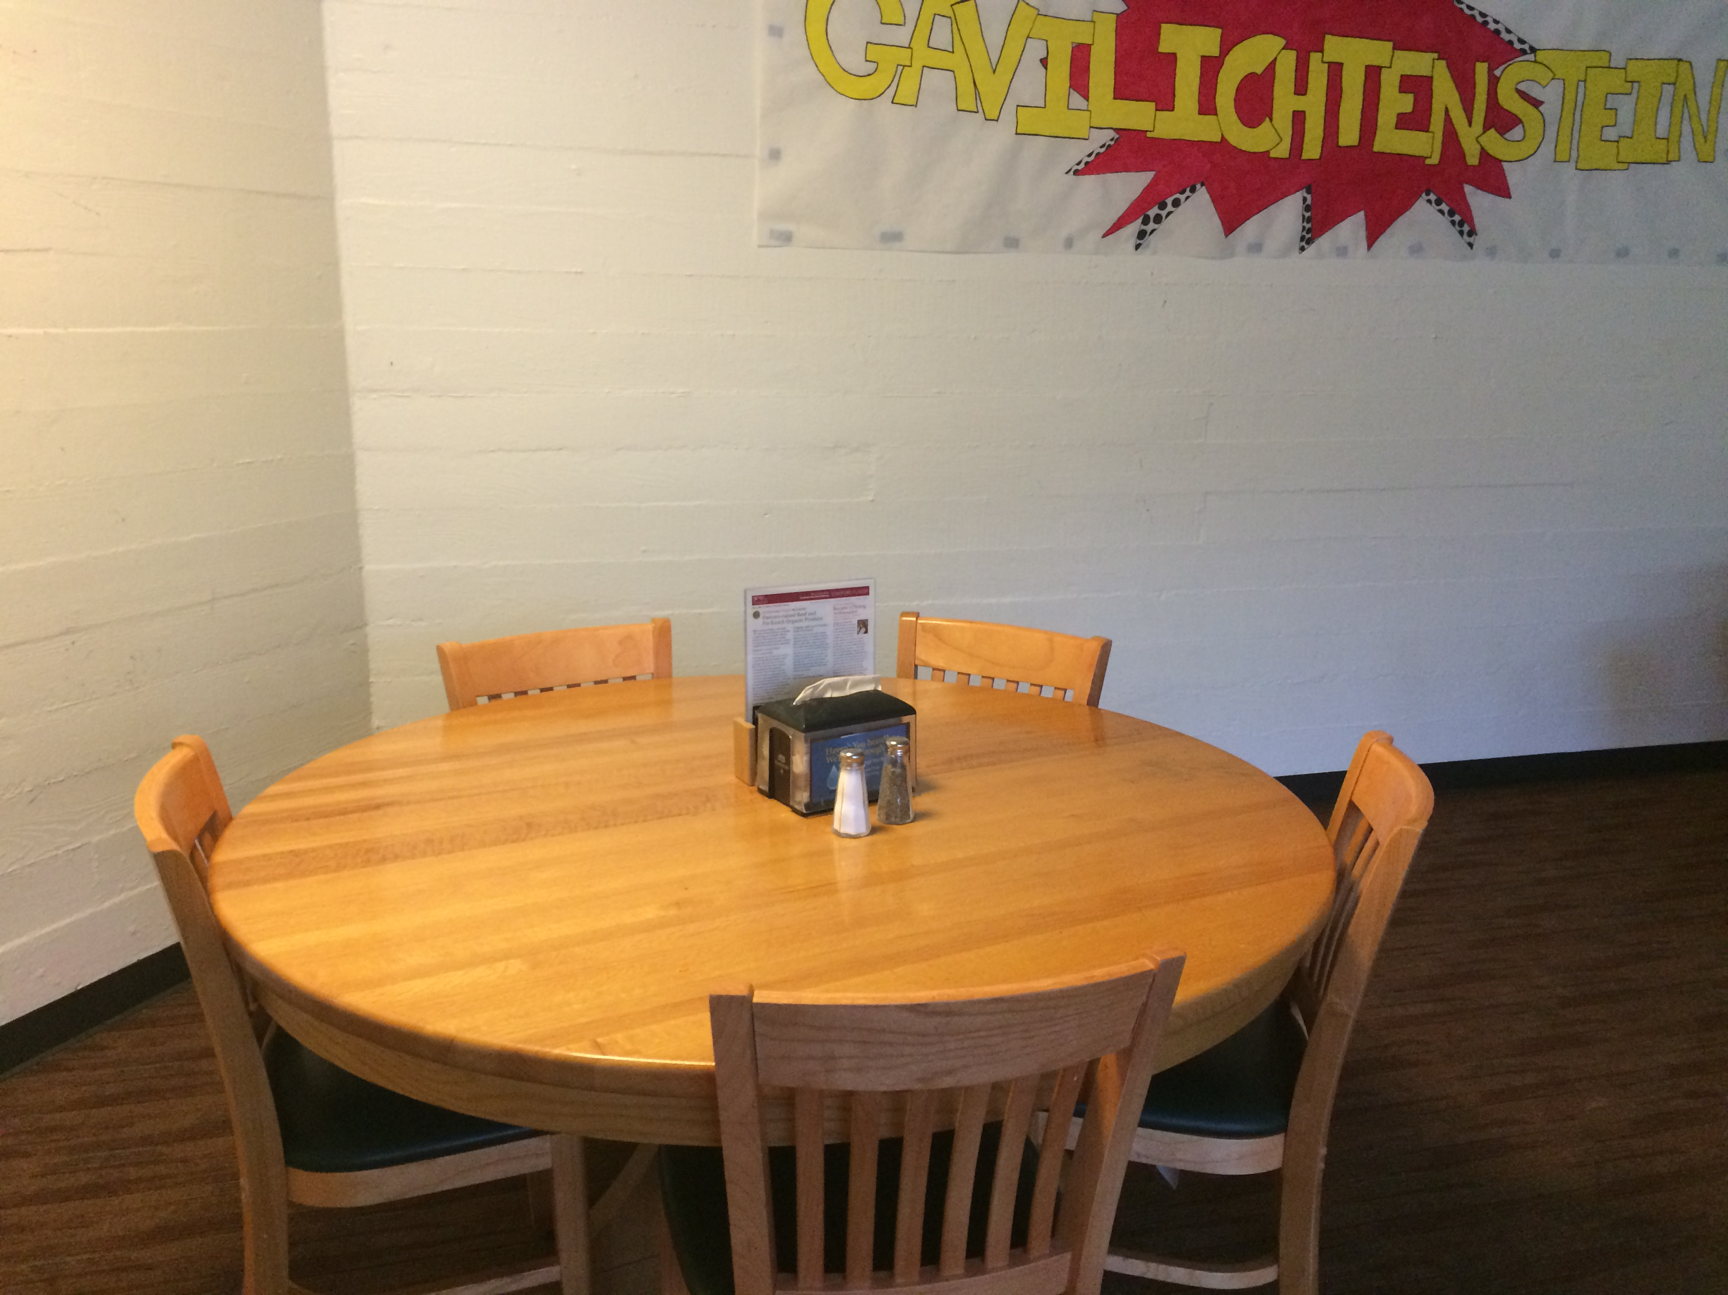
Participants
A.R.
21, lives off campus, techie
Y.K.
21, lives off campus, non-techie
J.B.
50s, long time PA resident

Slide 6
The Results - Trends
Speed is very important—end to end—but dependent on task urgency
Sometime things just don’t get done—price, time, inconvenience
No ease of use in current system
Everyone has similar process of going about the problem
Avg 2-3 minutes to find first provider to call
Everyone used ratings
Everyone recognized that this can be made better

Slide 7
The Results - Differences
Price important for both, but much more for youth
J.B. willing to pay for speed and quality
J.B. called plumber friend for optimal speed (not in scenario)
Apartment complexes can have in-house services
A.R. was much quicker in finding a service than Y.P.

Slide 8
Task Analysis – Who and What
Who: everyone who needs home services—which is most people!
What: They find service providers on the internet, call them, and try to find a price-skill-time fit

Slide 9
Task Analysis – How and When
Communication: Phone, Ratings
They do these tasks when they have problems!
But not all problems—inefficiency makes people not even try
Only pressing problems get people to go through the tasks

Slide 10
Task 1: Sign-up
@Home will support the ability to sign up and create an account and profile so the user can
leave ratings and reviews
are able to store their payment info
Low Frequency
High Importance
Simple

Slide 11
Task 2: Finding a Service P.
Previously, you have to go through the trouble of looking up a company that is open and calling to discuss time and pay only to find out they don’t meet your needs
@Home streamlines that process by conducting the search for you and presenting all the information up front.
High Frequency (on app)
High Importance
Previously complexity moderate, now simple

Slide 12
Task 3: Requesting a Service
Once the user has found a service and a person they like, @Home provides the ability to view times of when the person can come and set up a request for their assistance.
Compare this to having to call the provider and making sure that all requirements are met
High Frequency (on app)
High Importance
Previously quite complex, now simple

Slide 13
Task 4: Payment
Once the job is done the user is able to make a payment through @Home and leave a star rating and a review of the job for other consumers to see.
No cash exchange, all through the app (including tip)
Moderate Frequency
High Importance
Previously simple, now simpler

Slide 14
App Idea #1: Search
A search product for home services and problems.
Helps people find tutorials for problems at home and find people/organizations nearby that can be hired to solve those problems in a listings format
Significance: Low
Feasibility: High
Interest: Low

Slide 15
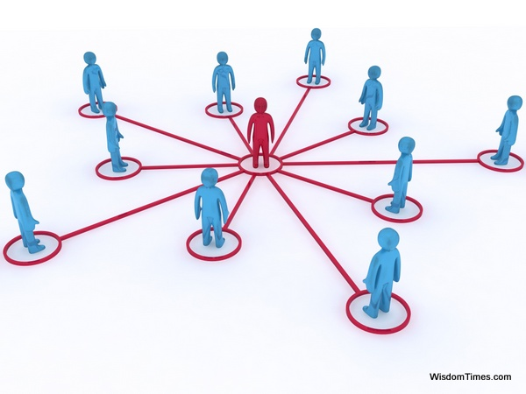
App Idea #2: Social Network
A social network for home services.
Uses your social network to find people who can help solve problems at home, or helps you find people in your network who need home services that you can provide.
Significance: Moderate
Feasibility: Moderate/High
Interest: Moderate

Slide 16
App Idea #3: @Home
A mobile app that connects people with home service providers to help them solve problems at home.
Matching a person’s need with an individual who is free and trained to solve the problem.
Fast. Easy. Transparent. End-to-end solution.

Slide 17
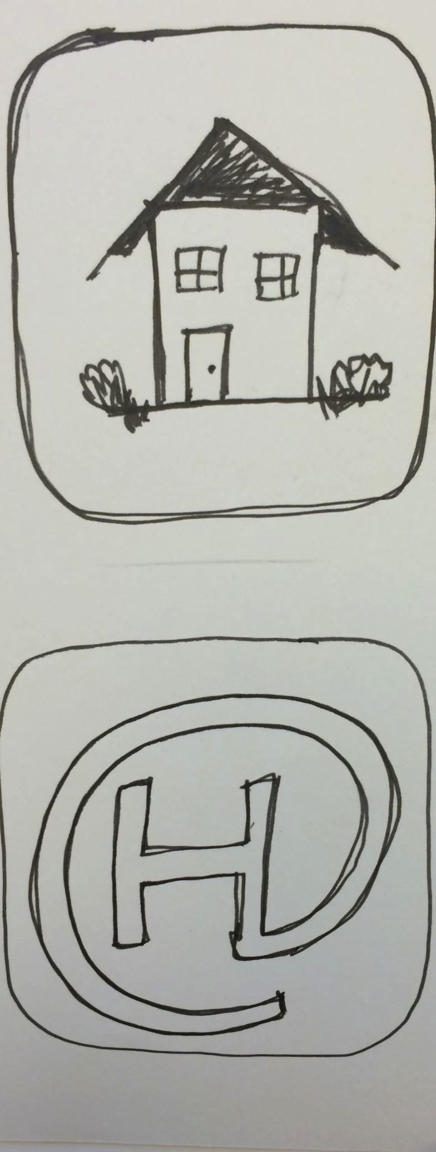
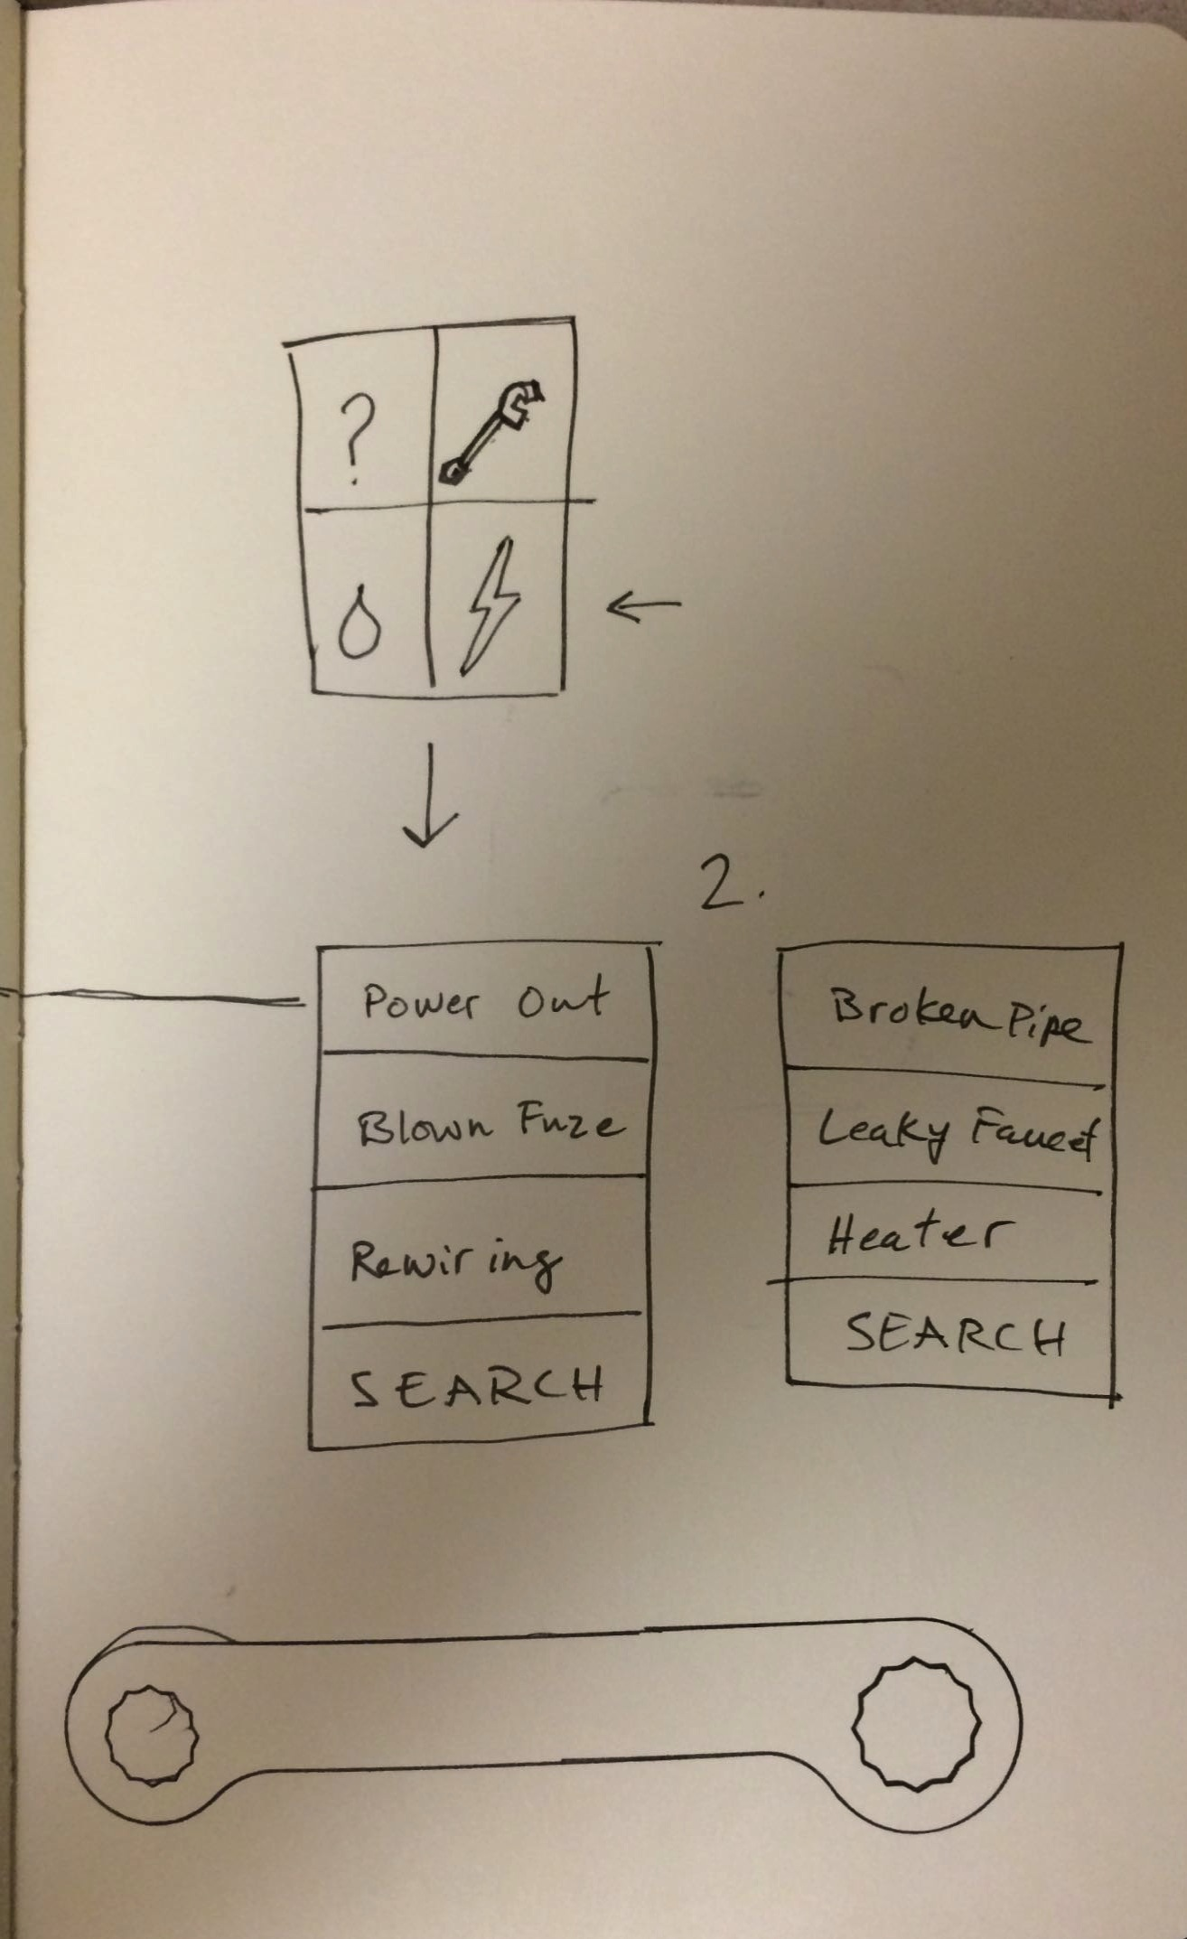
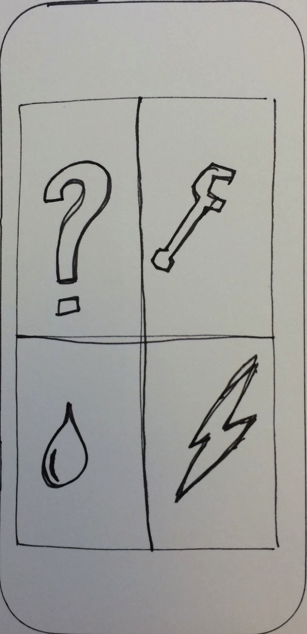
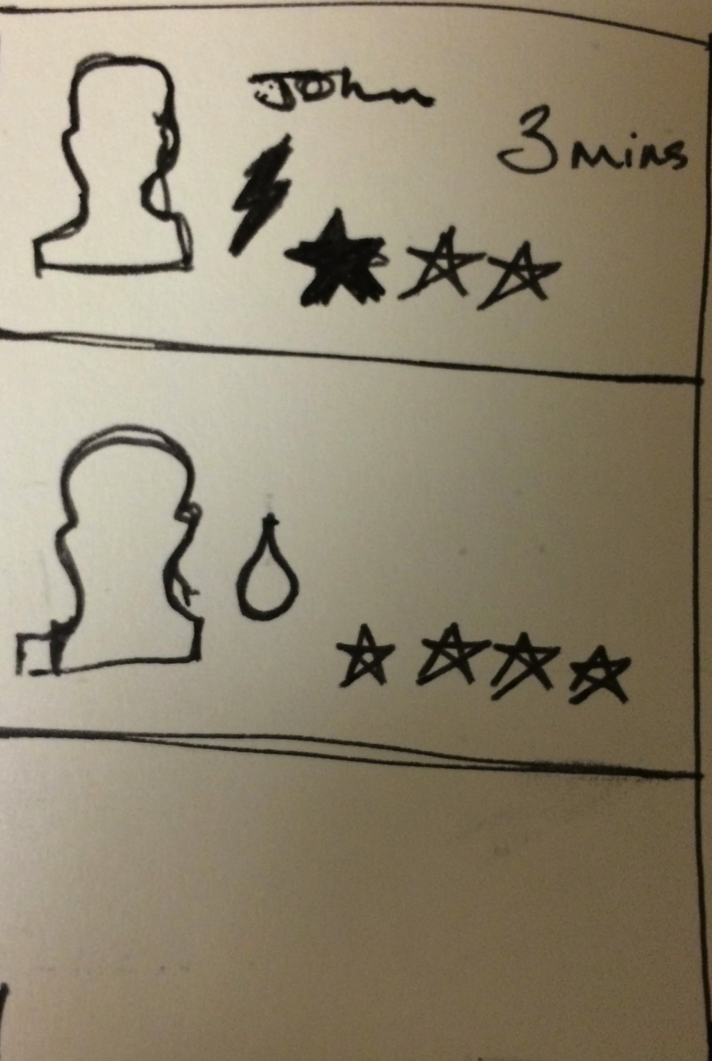
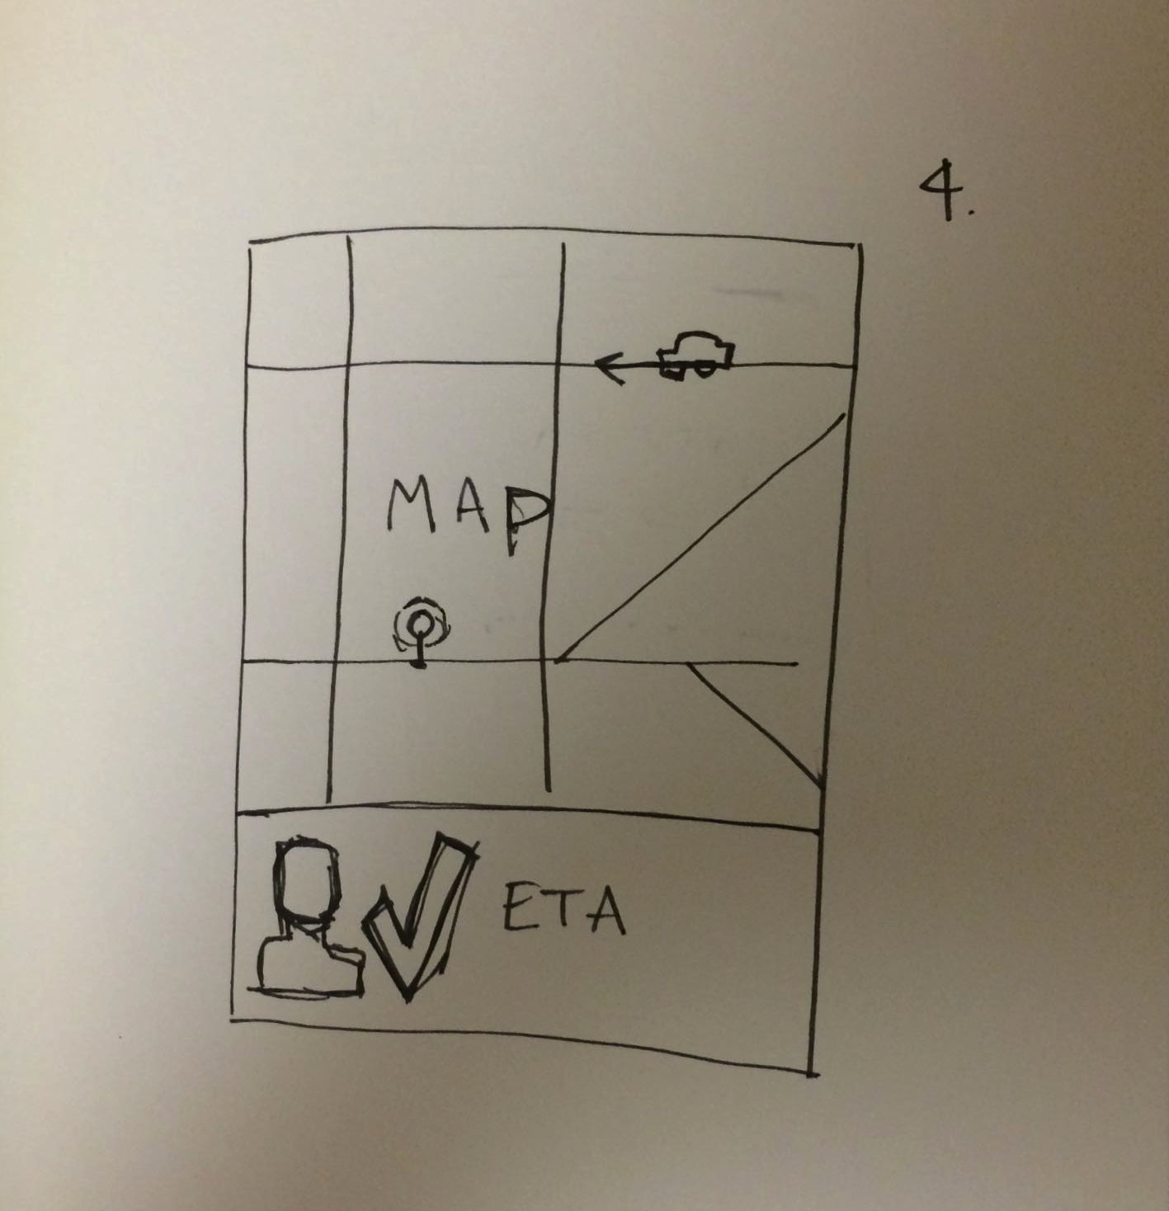
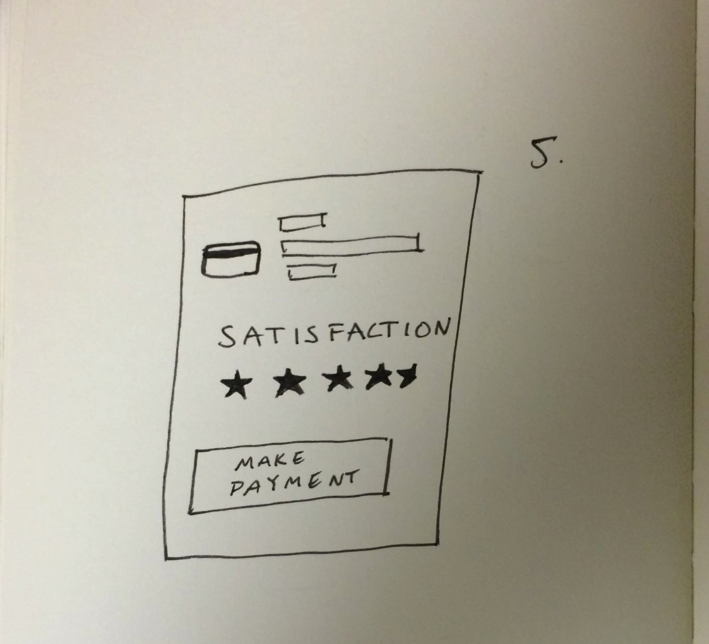
Early Sketches

Slide 18
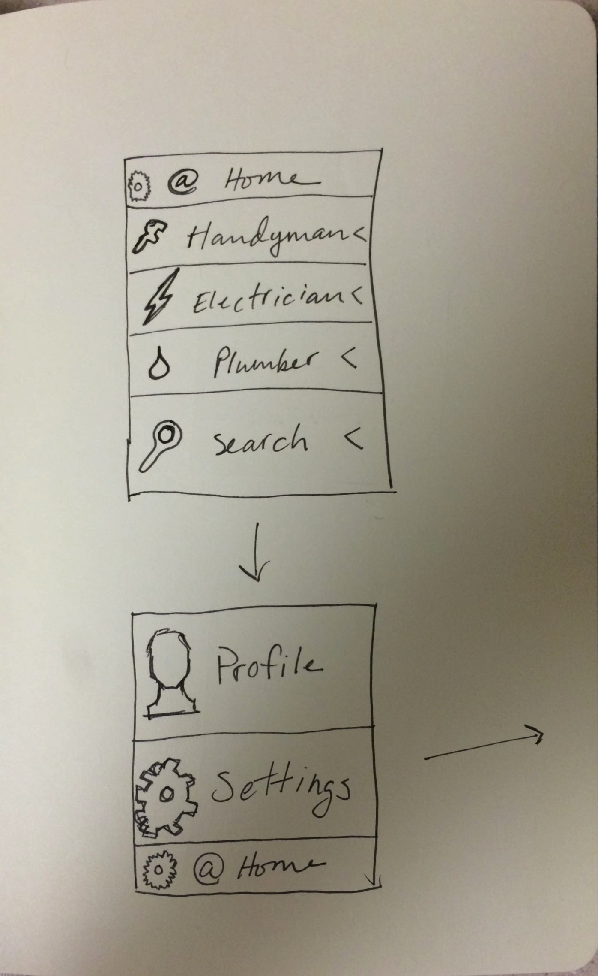
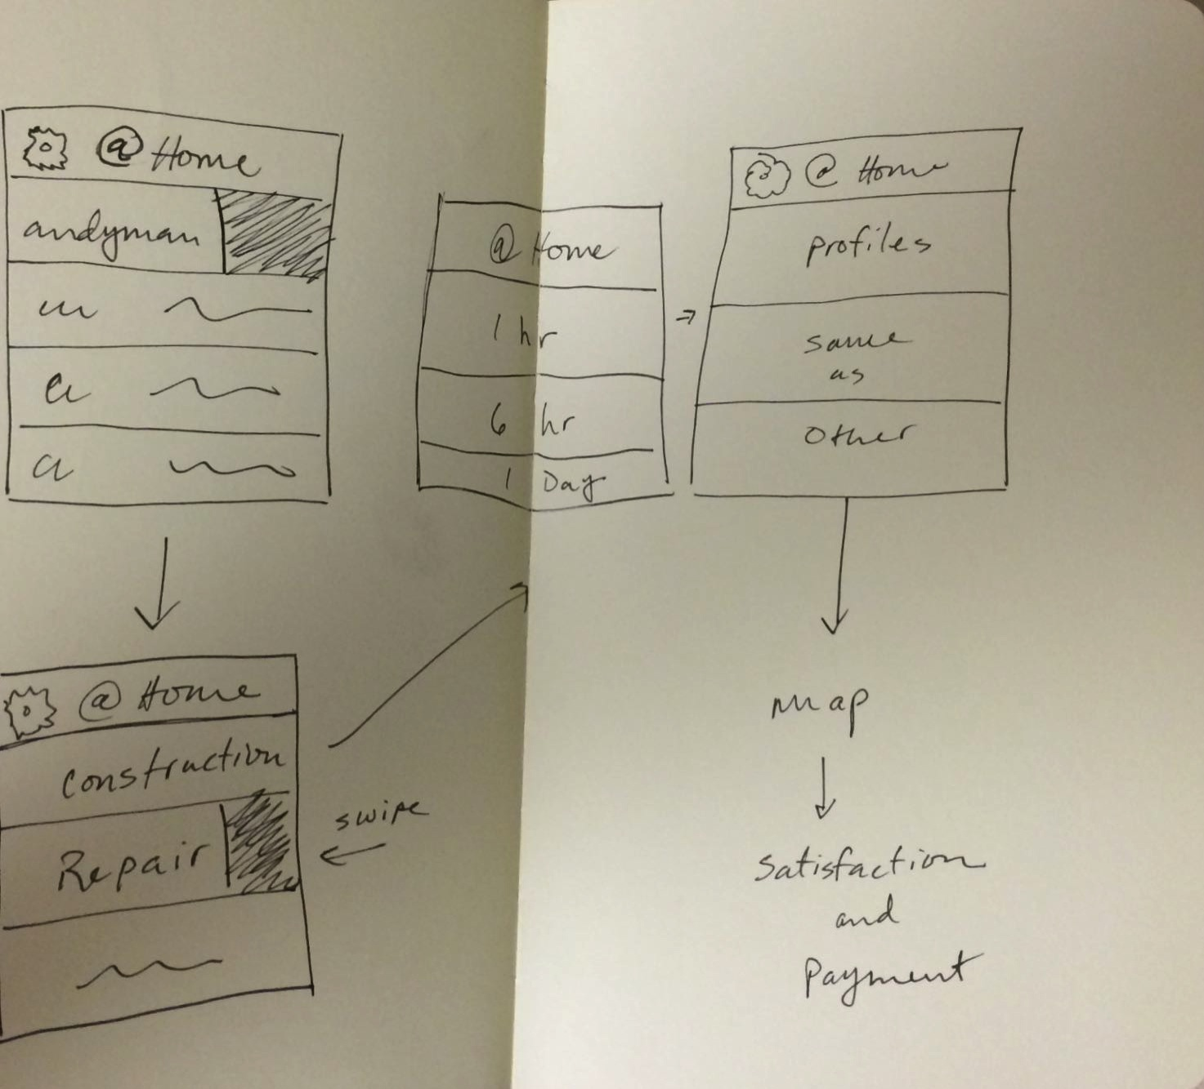
Early Sketches

Slide 19
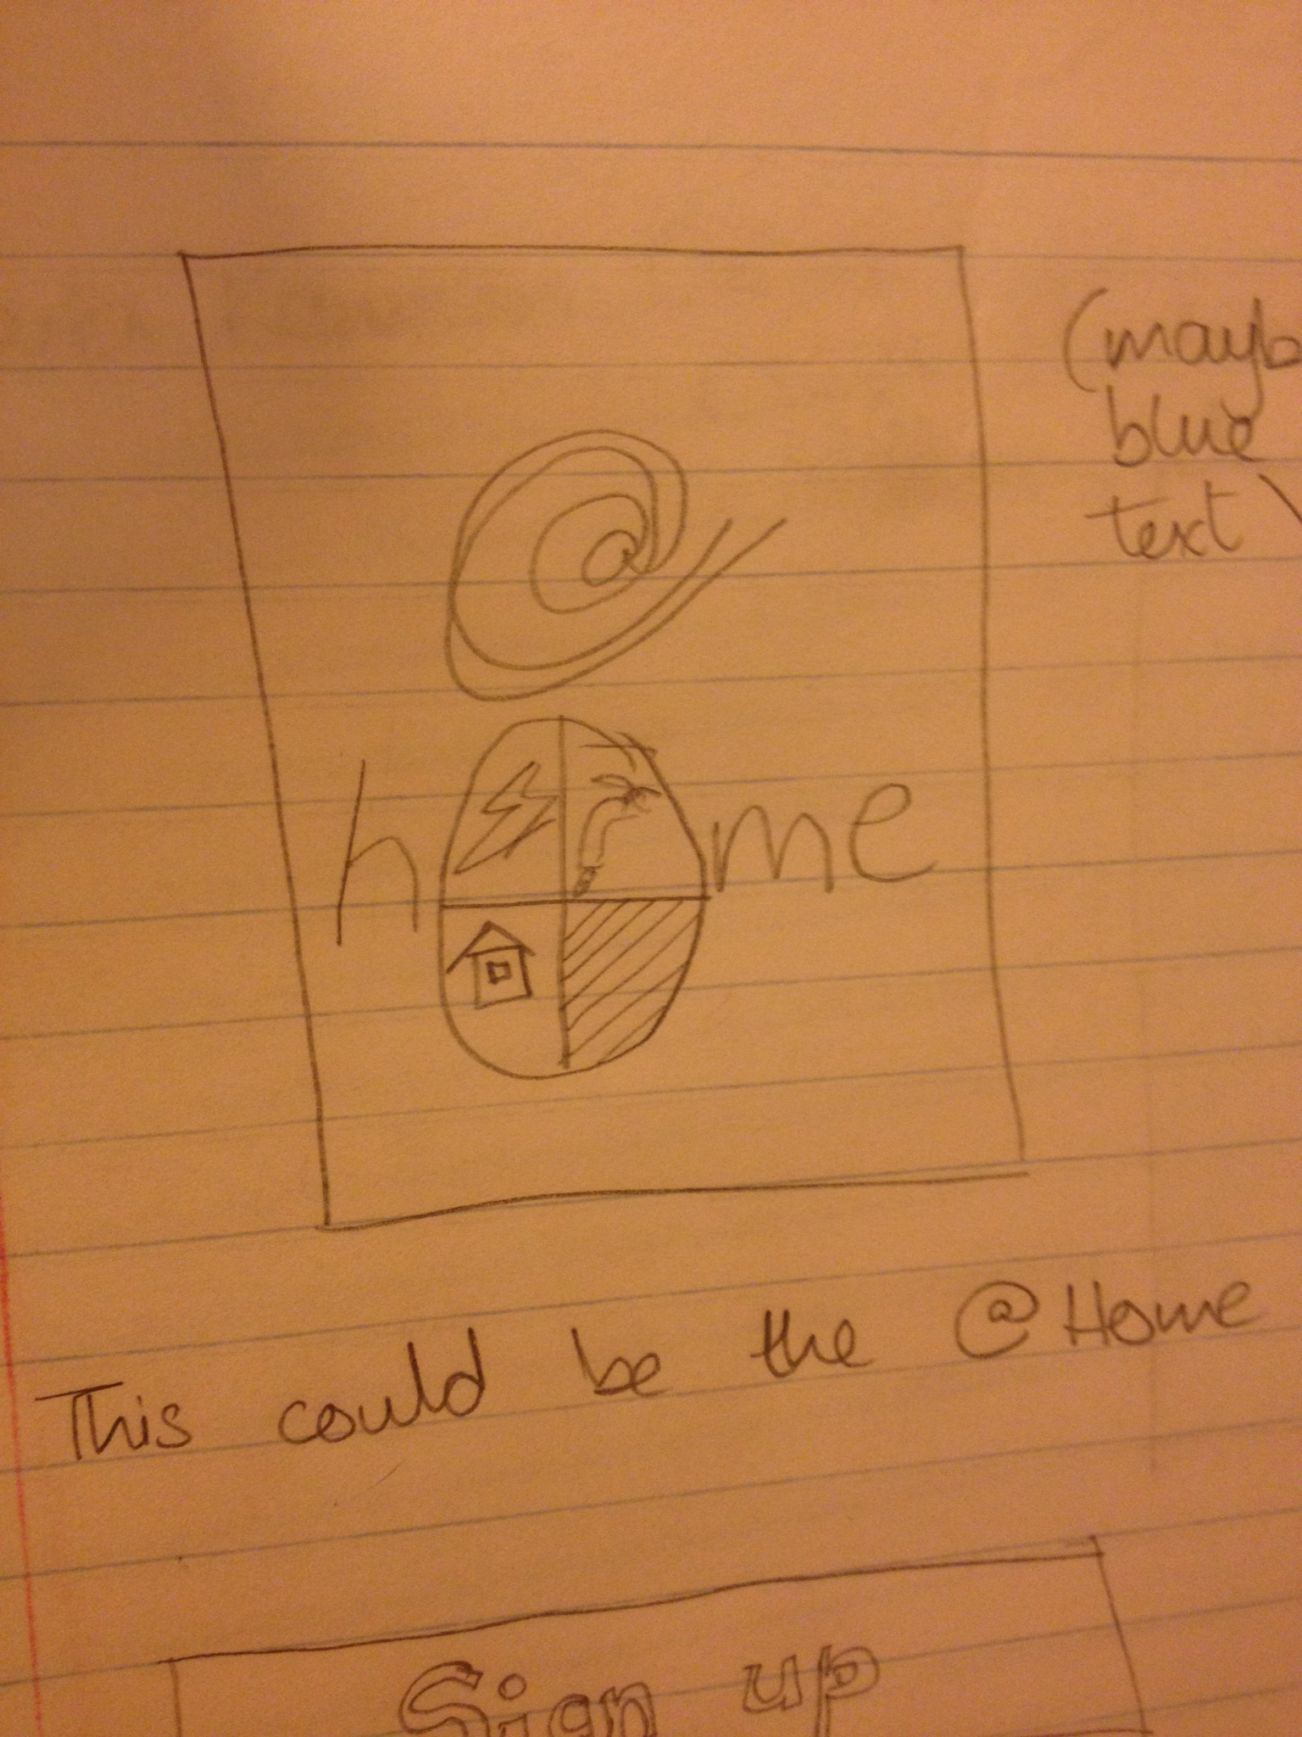
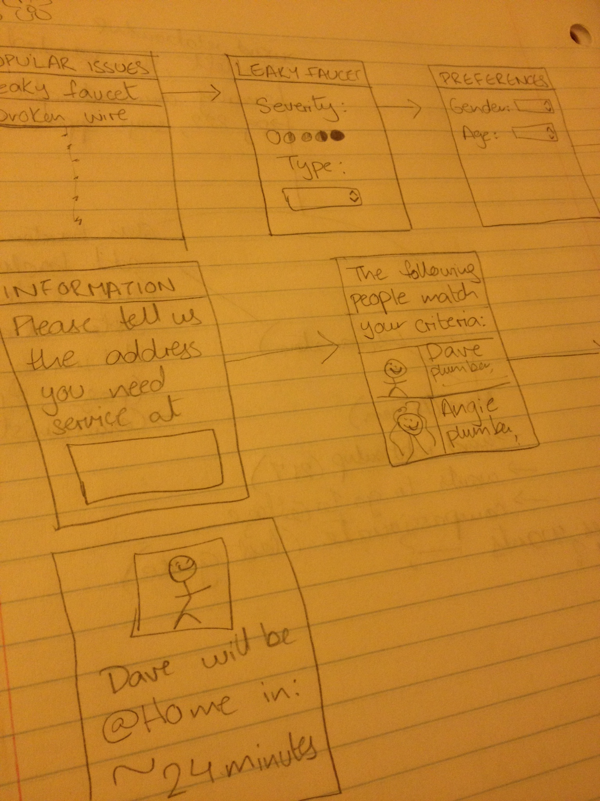
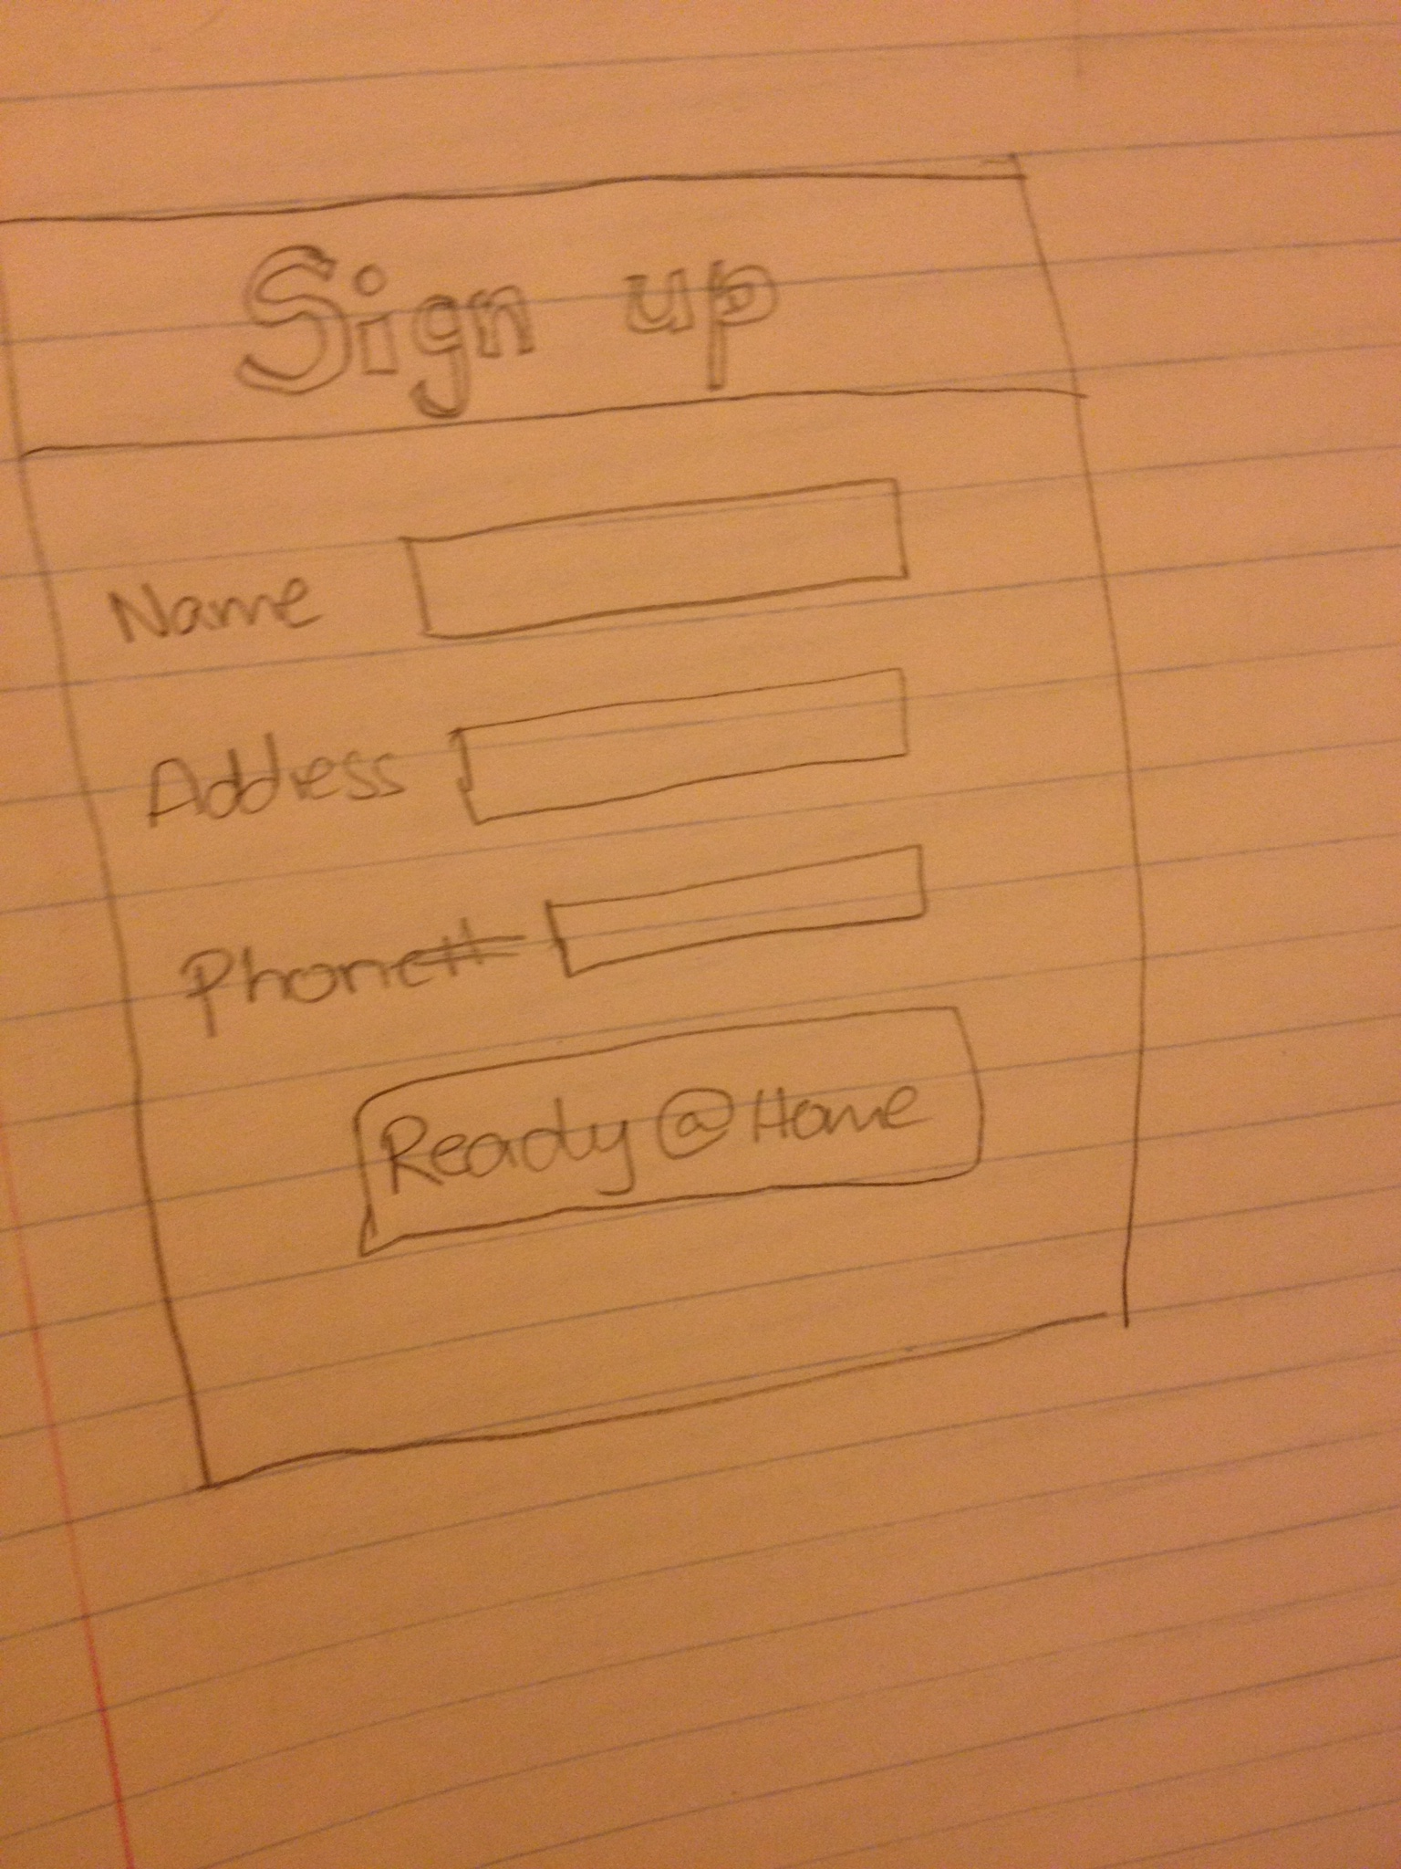
Early Sketches

Slide 20
@Home

