Slide 1
Medium-Fi Prototype
By LoveStep

Slide 2
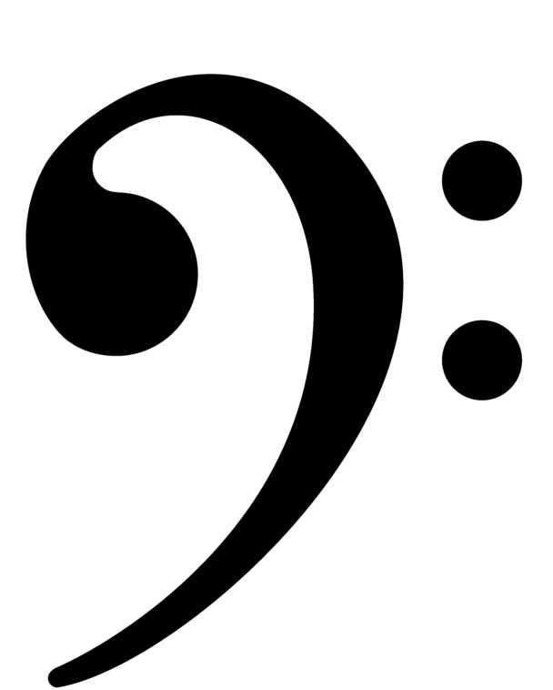
Problem

Slide 3
Solution

Slide 4
Representative Task #1
Easily synthesize beats, melodies, and sounds.

Slide 5
Representative Task #2
Create music collaboratively.

Slide 6
Representative Task #3
Share music they have made.

Slide 7
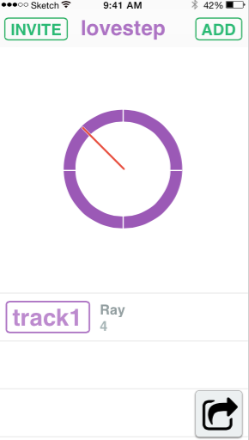
Changes
Added in ticker (removed number in the center)
Changed final export button

Slide 8
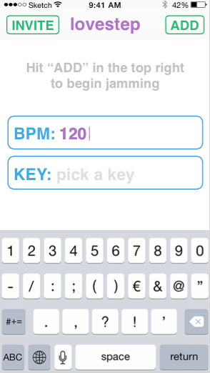
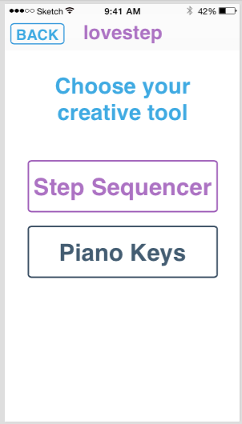
Changes
Step Sequencer / Piano Keys
More choices (BPM / Key)

Slide 9
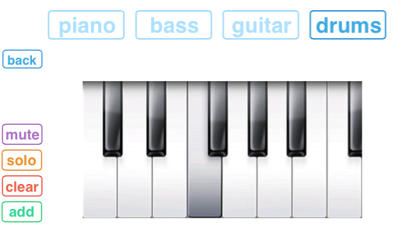
Piano option

Slide 10
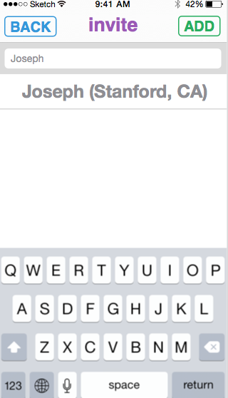
Changes
New user interface for inviting people.

Slide 11
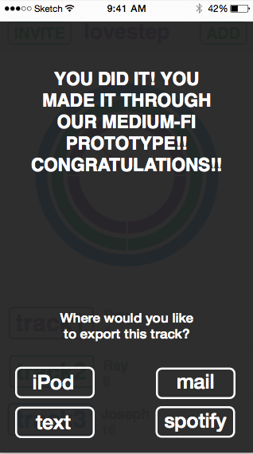
Changes
Lastly we added a export page

Slide 12
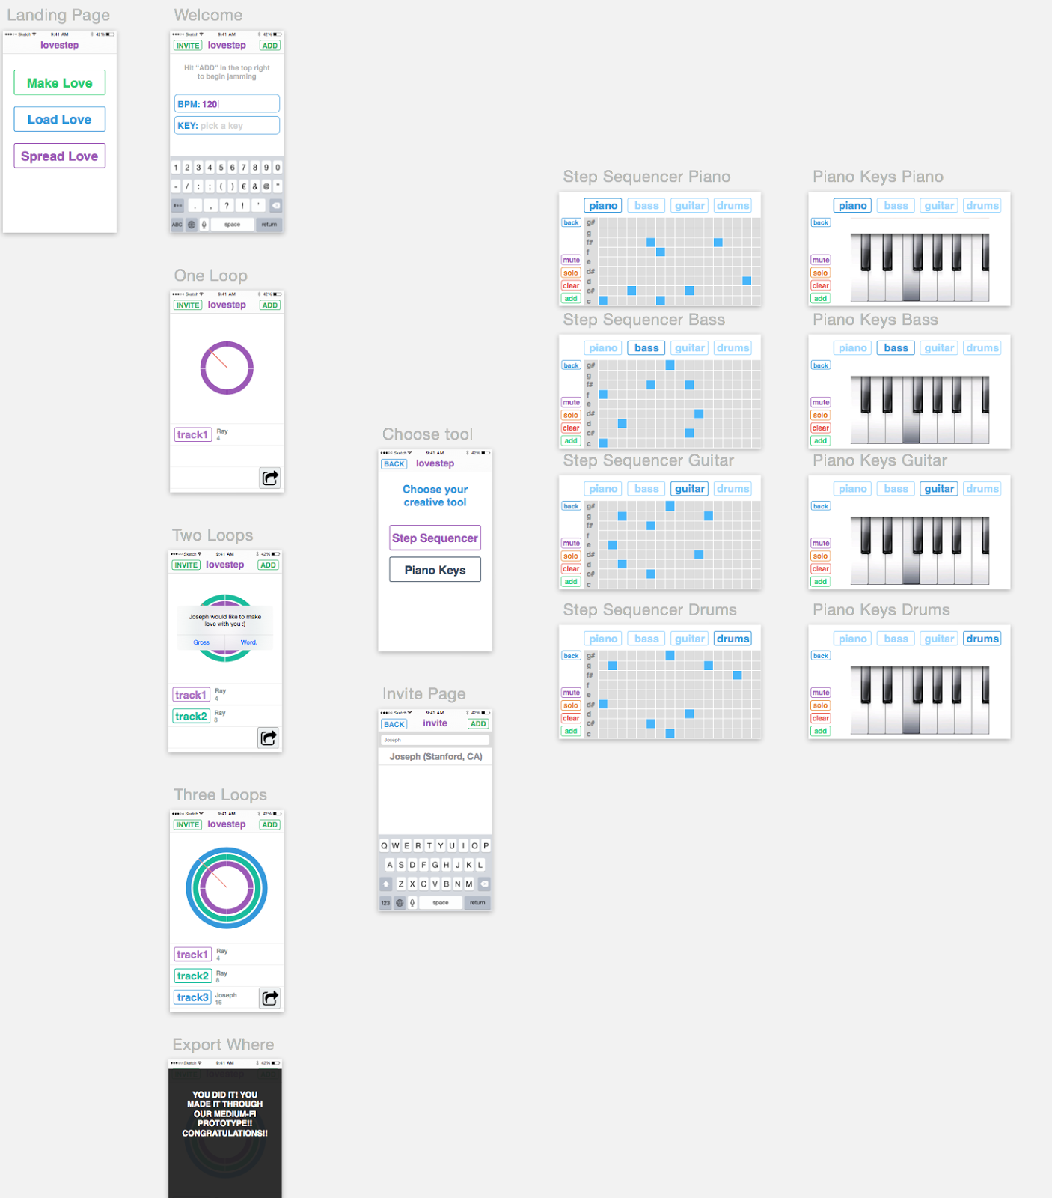

Slide 13
Basic - One Loop

Slide 14
Intermediate - Two Loops

Slide 15
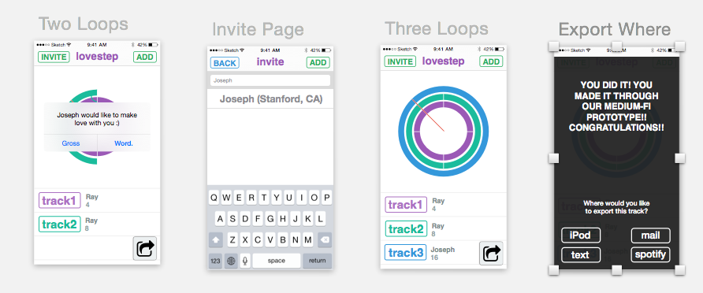
Advanced - Multiplayer

Slide 16
Tools
To build our mockups images
we used sketch
Marvel was used to build the mockup

Slide 17
Summary

