Slide 1
Lovestep
Joey Hernandez George Kennedy Igor Berman Scott Buckstaff

Slide 2
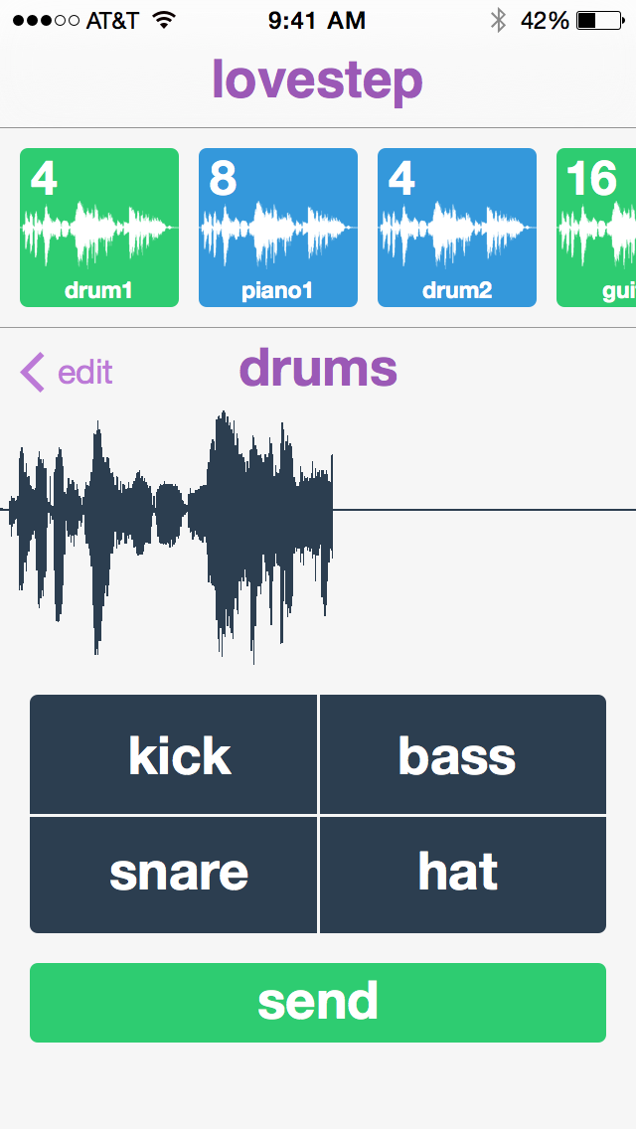
Overview
Lovestep is an application designed for the collaborative development of digital music.

Slide 3
Problem

Slide 4
Solution

Slide 5
Contextual Inquiry
Seek perspectives from:
variety of musical proficiencies
mobile-enabled audience
variety of musical tastes
Asked about:
compositional musical experience
collaborative musical experience

Slide 6
Interview #1: Abi
Musical proficiency: LOW
Has never played music with others.
Prefers that musical details are abstracted away from her, but still wants the power to create unique tracks.

Slide 7
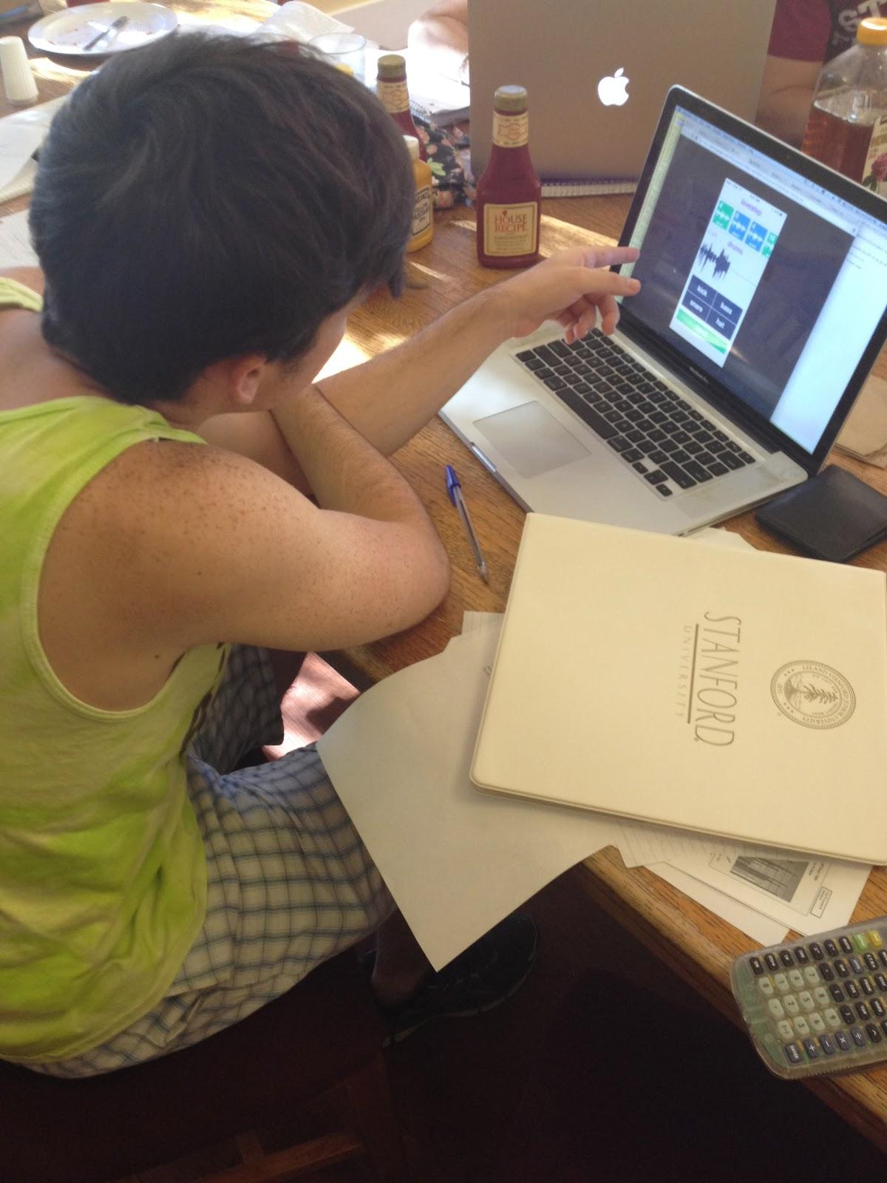
Interview #3: Joel
Musical proficiency: HIGH
Plays drums and sings in a band.
Would prefer to be a power user, but is excited about the music he could make if his creative expression were limited.

Slide 8
Task Analysis Results
Who is going to use this system?
People with the desire to make music with friends.
What tasks do they now perform?
Some already play an instrument and are familiar with recording and playing with others. Some release their music. Some play no music at all. Almost all are avid music listeners.
What tasks are desired?
The ability to make music. Enjoying music in a group.
How are the tasks learned?
Experimentation.

Slide 9
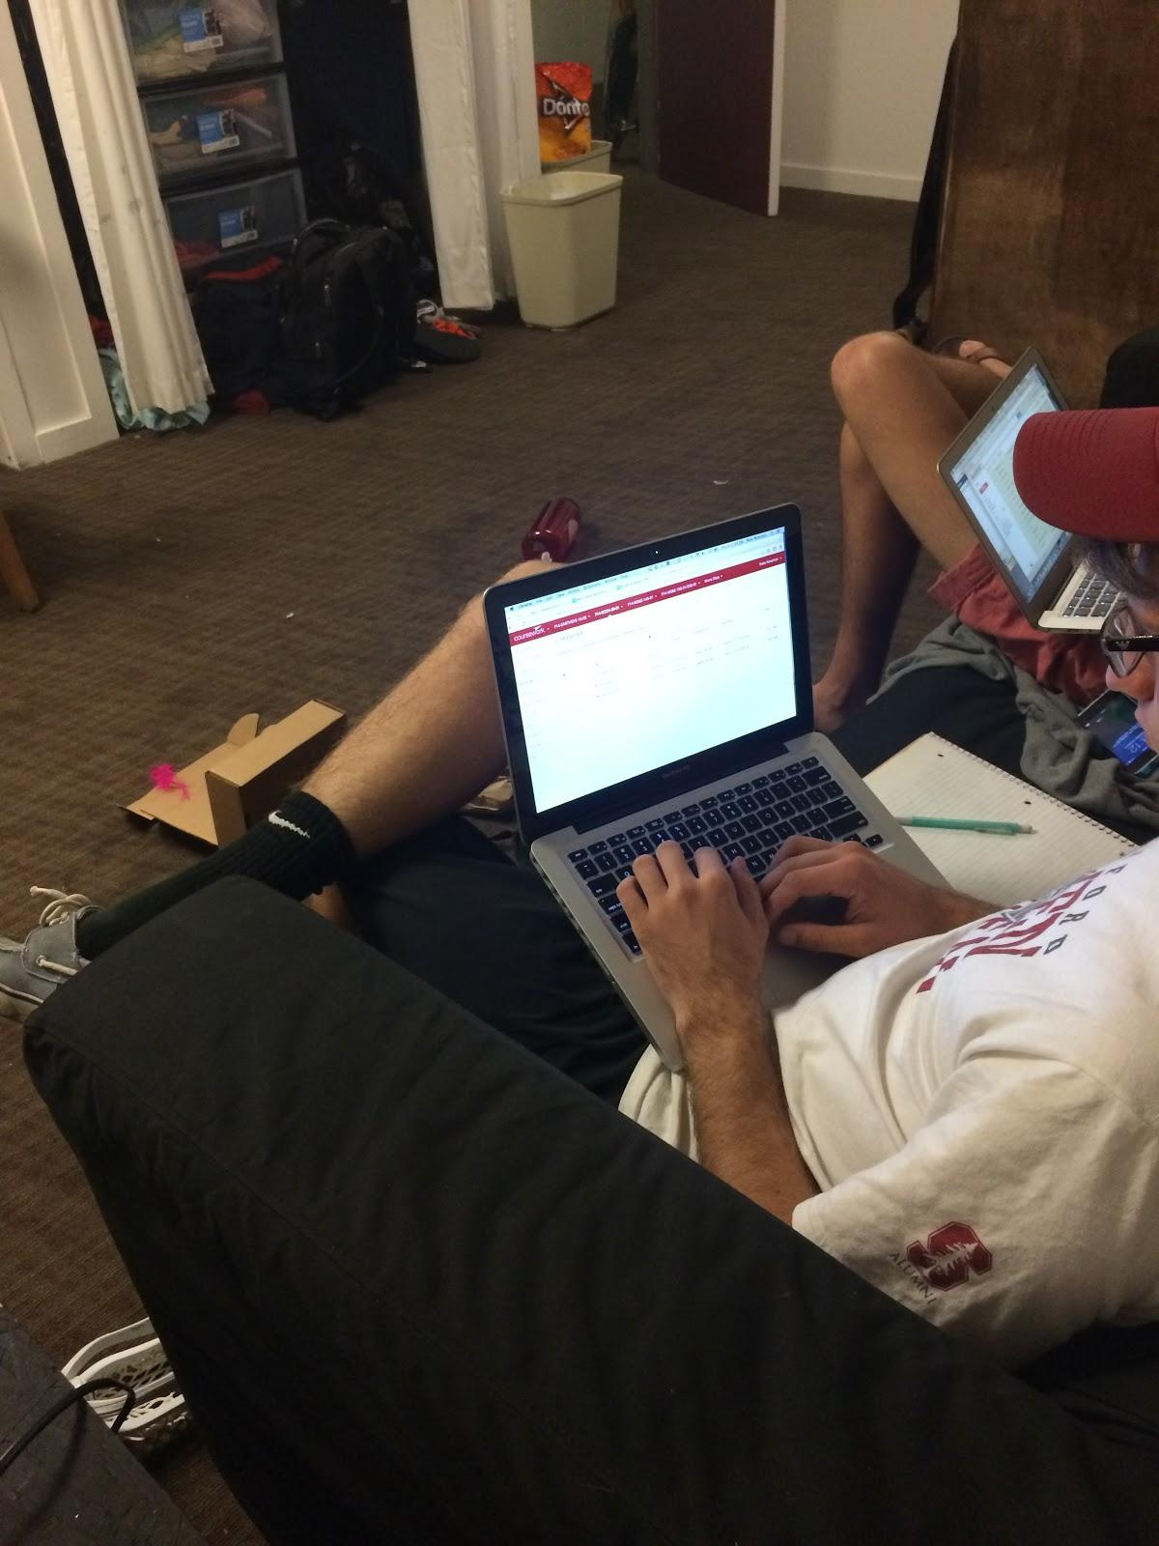
Interview #2: Daniel
Musical proficiency: MEDIUM
Listens to music socially.
Supports the abstraction of tedious musical details, but wants the option to have free reign over minutiae.

Slide 10
Task Analysis Results cont.
Where are the tasks performed?
Dorm rooms, friends’ houses, recording studios, parties.
What’s the relationship between customer & data?
Customers create and consume sound data.
What other tools does the customer have?
Messaging services or sites like SoundCloud to share their music. Recording software. Services like Spotify to find music.
How do users communicate with each other?
Send music directly or post it for anyone to see.

Slide 11
Task Analysis Results cont.
How often are the tasks performed?
Leisure times. Most people listen to music every day. Musicians play a couple of times a week.
What are the time constraints on the tasks?
People can only create music in their leisure time. Most can also only listen to music in their leisure time.
What happens when things go wrong?
Users stop having fun.

Slide 12
Representative Task #1
Easily synthesize beats, melodies, and sounds.

Slide 13
Representative Task #2
Create music collaboratively.

Slide 14
Representative Task #3
Share music they have made.

Slide 15
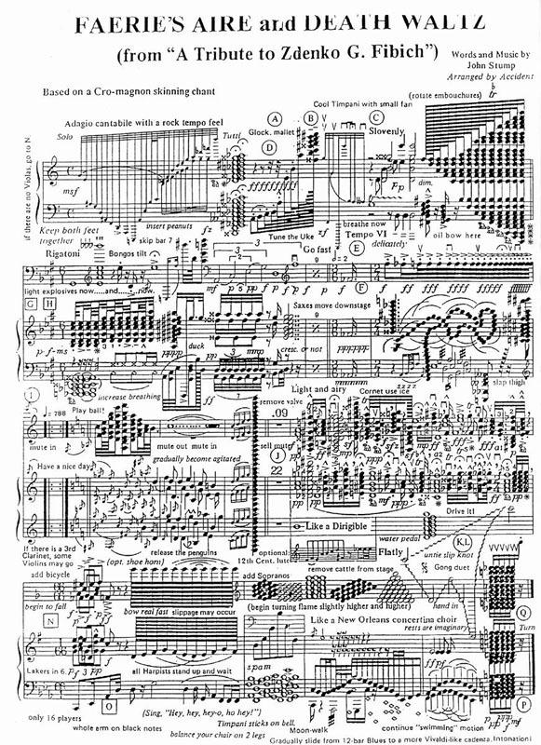
App Idea #3
Gear the app more towards advanced musicians.
Allow fine control of beats, melodies, and everything else.
Users work on a persistent workspace (not in real time).

Slide 16
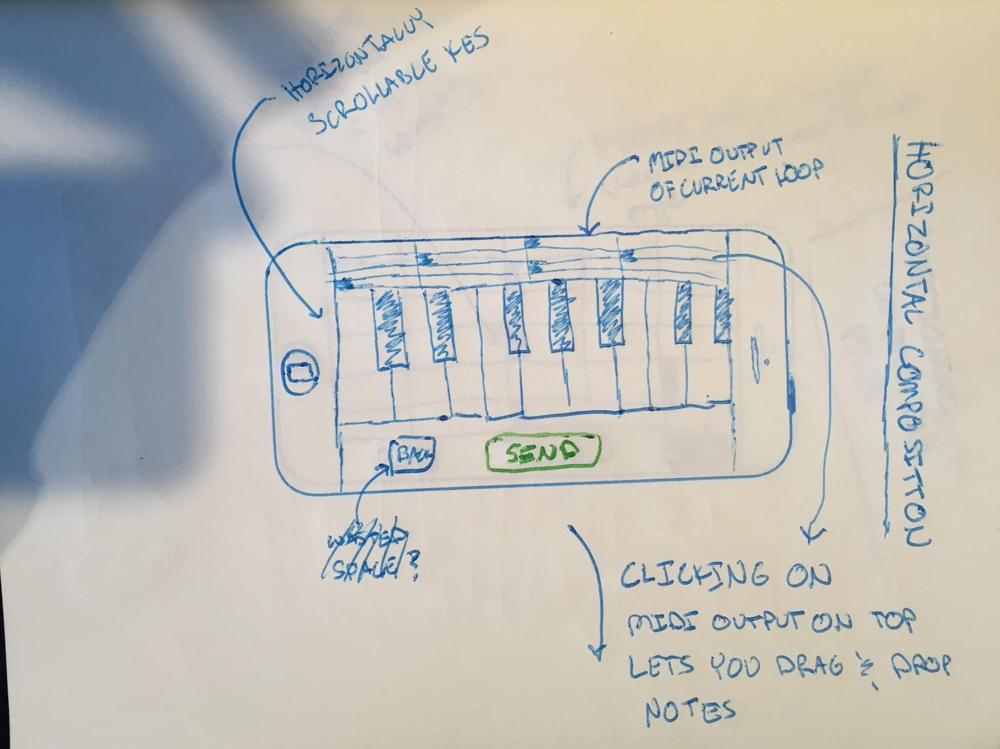
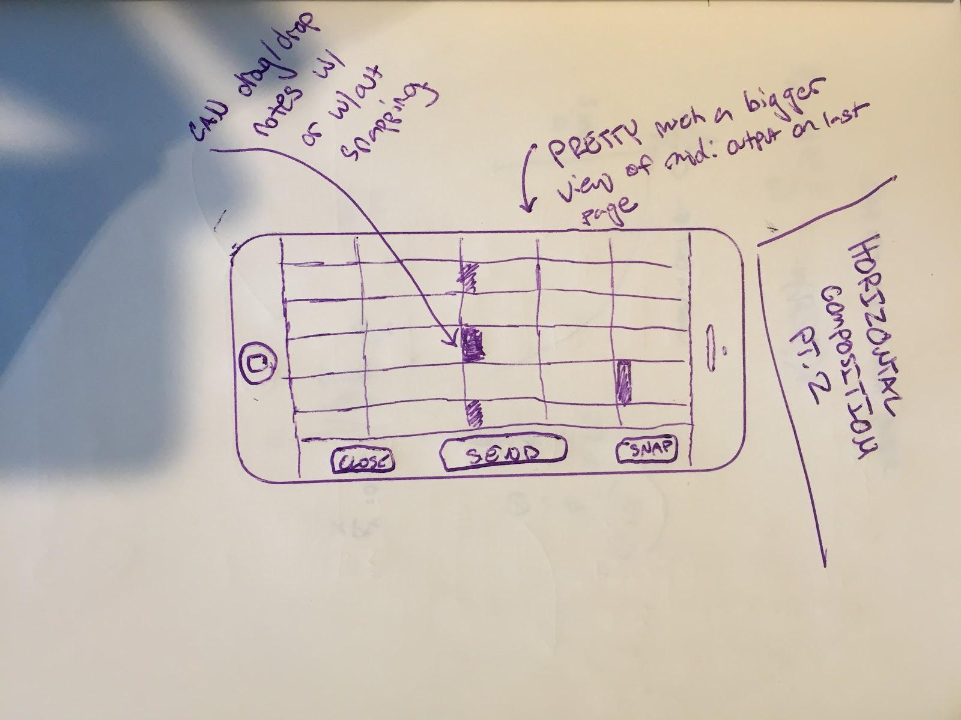

Slide 17
App Idea #2
Gamify the music collaboration process.
Time pressure and competition force the users to make highly dynamic music.

Slide 18
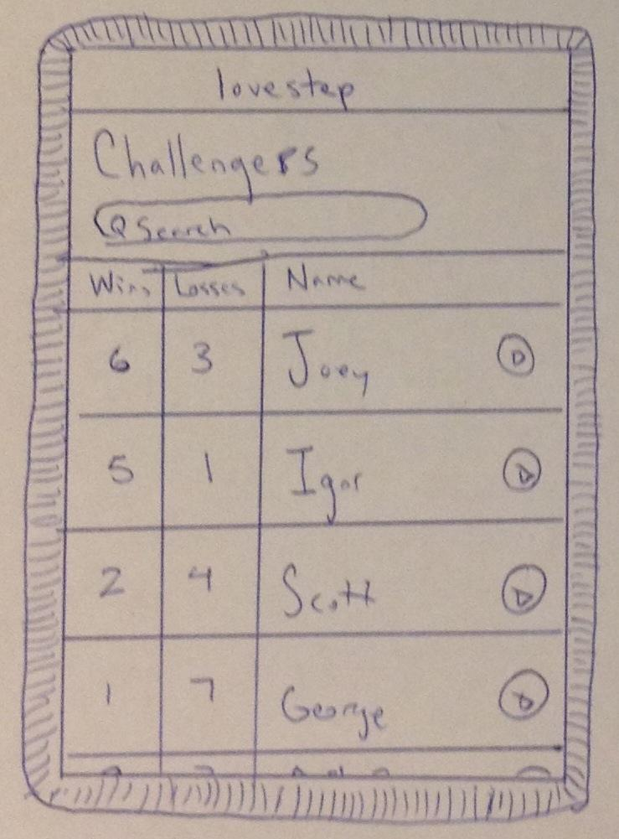
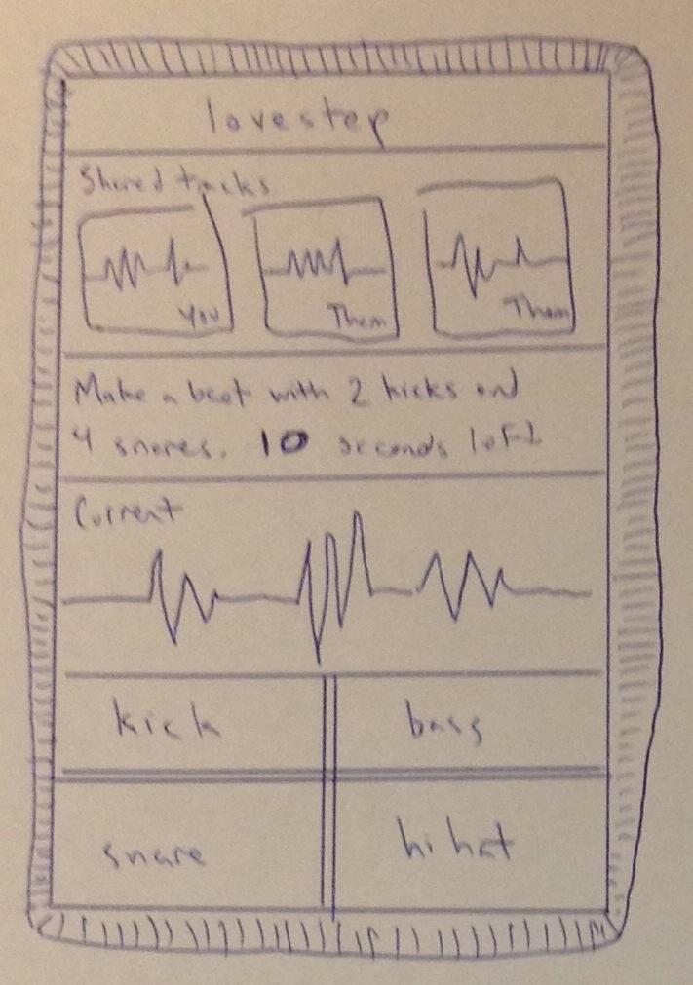
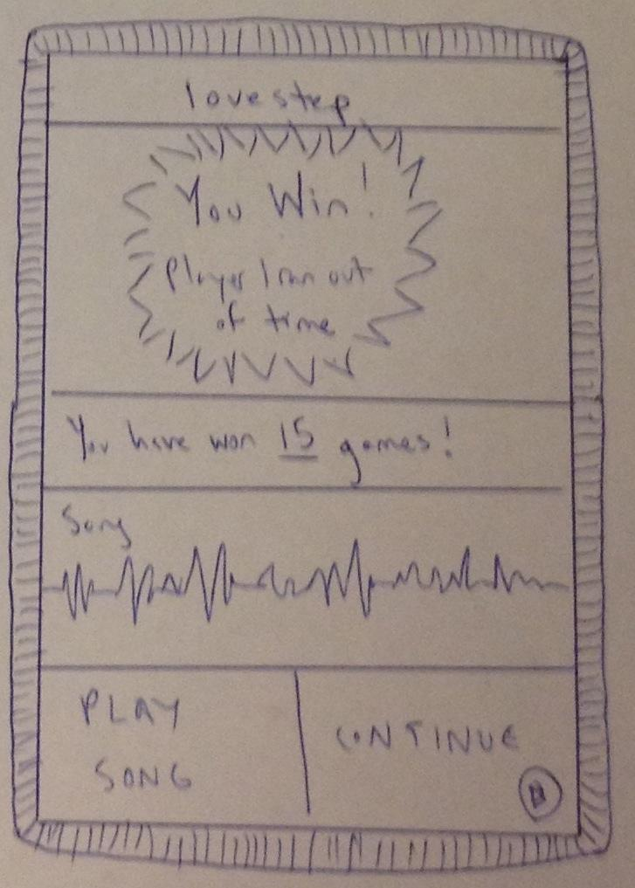

Slide 19
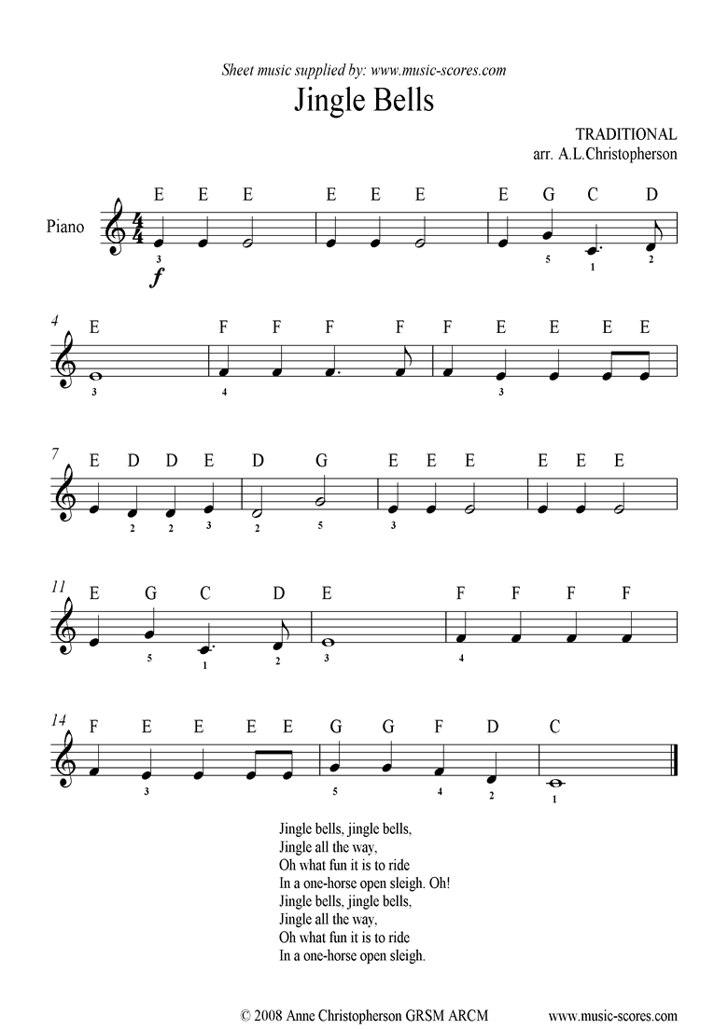
App Idea #1
Gear the app more towards basic users.
Make it as easy as possible to produce pleasant music.
Users work simultaneously on the same song, writing in real time.

Slide 20
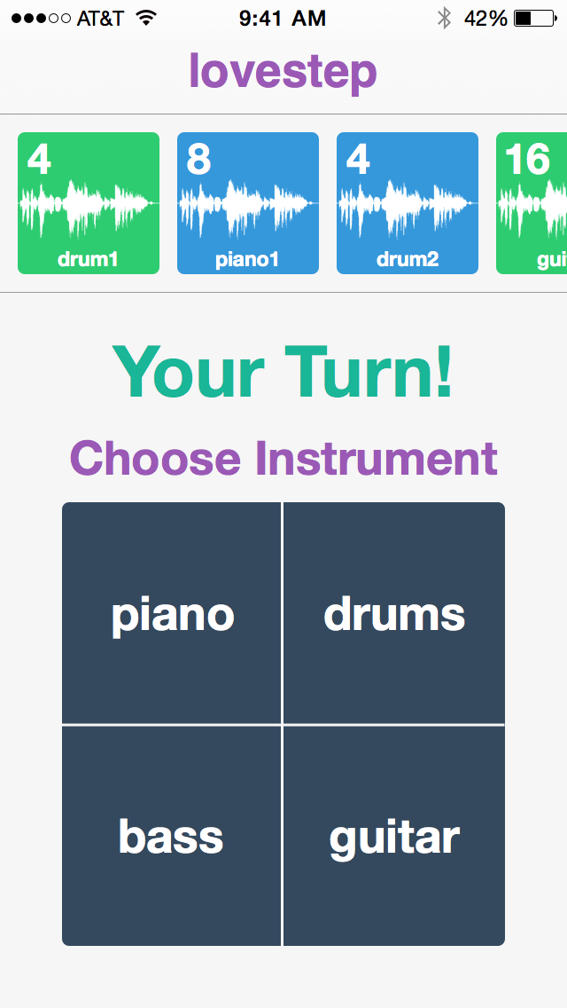
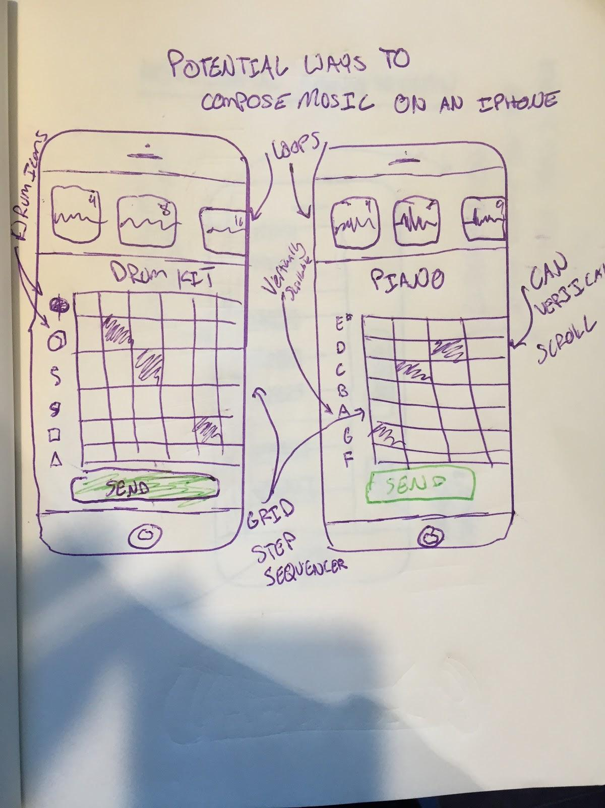

Slide 21
Summary

Slide 22
Stolen Images
http://www.spanishflytv.com/resources_mod/VideoImage108_culberson-wejebe-jam-.png
http://img.freepik.com/free-photo/man-sitting-on-office-desk-working-in-front-a-monitor-of-computer_318-63618.png?size=318&ext=png
http://lakotawestbands.org/wp-content/uploads/2012/11/colored-musical-staff-3b.jpg
http://www.legalimperium.com/wp-content/uploads/2012/03/Female-Placeholder1.jpg
http://www.music-scores.com/graphics/jingle_easy.gif
http://images4.fanpop.com/image/photos/16300000/O-o-Complicated-piano-music-music-16392873-581-800.jpg
http://upload.wikimedia.org/wikipedia/commons/thumb/b/b6/Gnome-joystick.svg/1024px-Gnome-joystick.svg.png
http://www.nothingbuttreble.com/Images/nav/clef.png
http://i219.photobucket.com/albums/cc273/adron75/funk%20stuff/bassclef.jpg

