Slide 1
SpringBoard
Personal Success enabling social good

Slide 2
Overview
SpringBoard mission statement
Lo-fi prototype overview
Three experimental tasks
Experimental method
Experimental results
Future changes

Slide 3
SpringBoard Mission
SpringBoard encourages users to meet their daily goals by magnifying personal success into positive social impact.

Slide 4
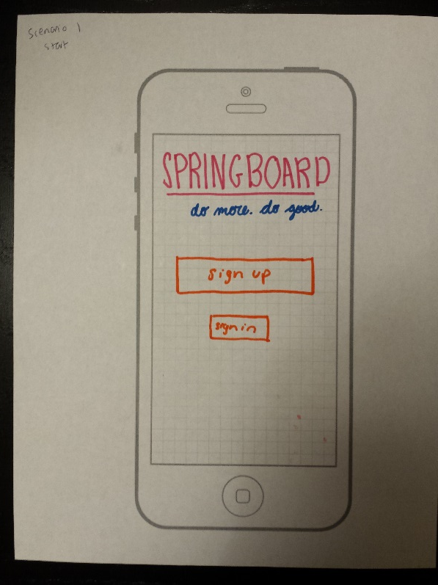
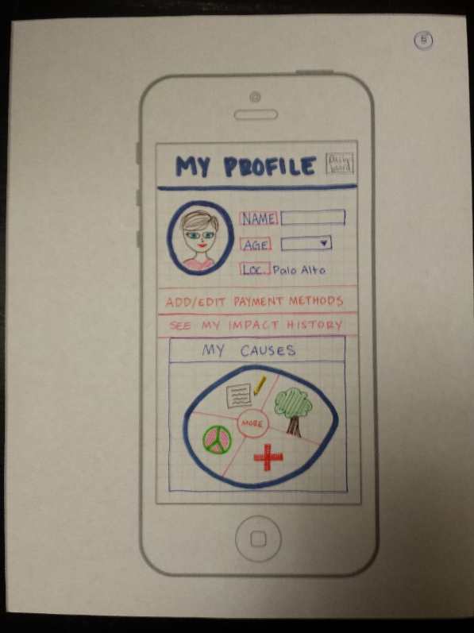
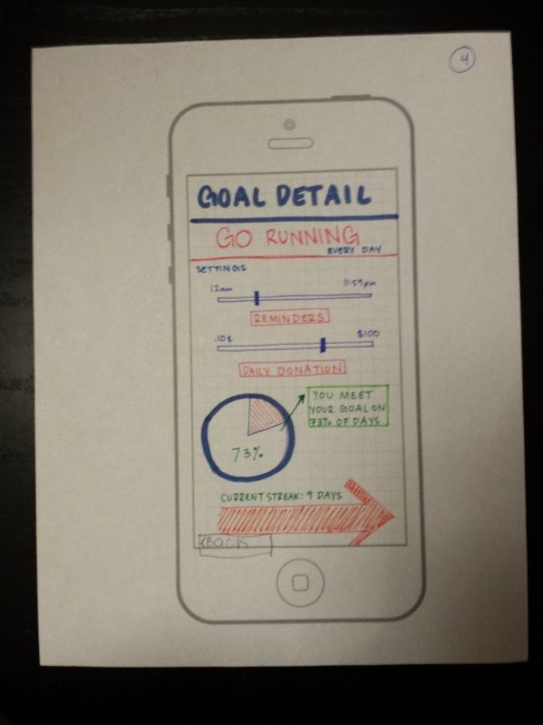
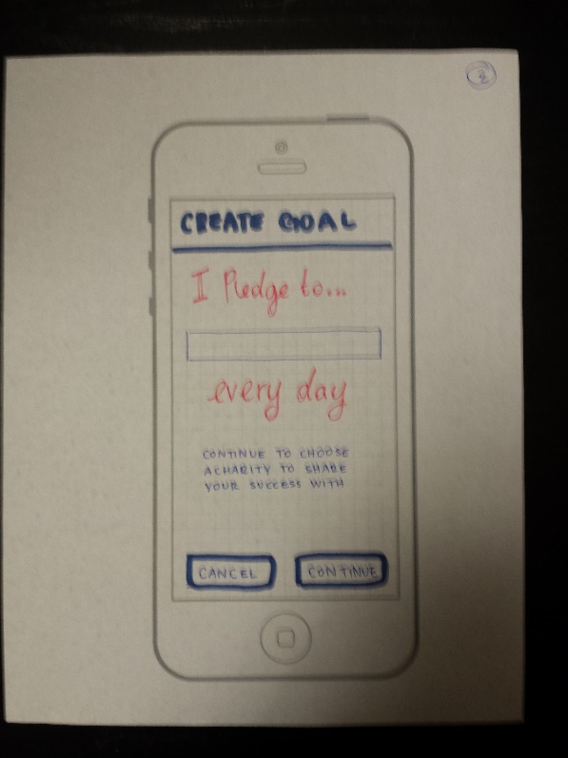
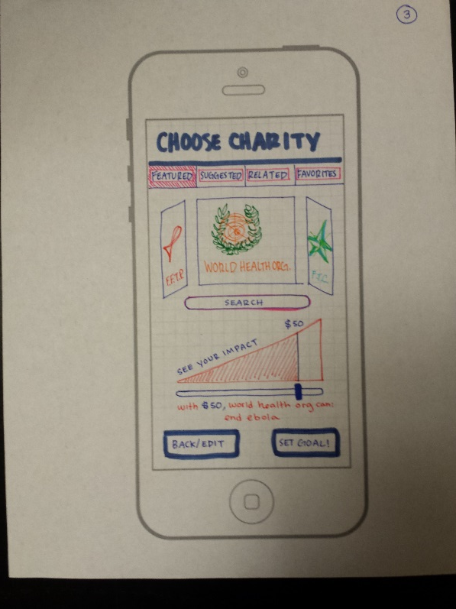
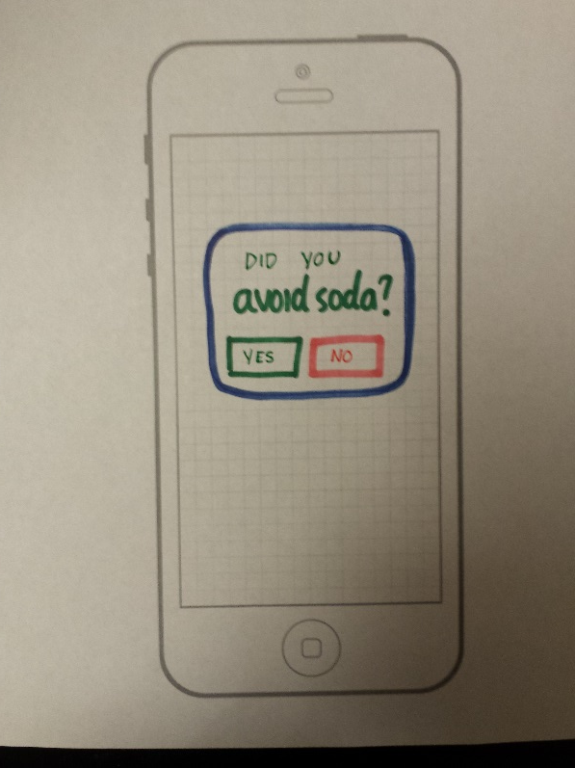
Lo-fi Prototype

Slide 5
Scenario One: Set Up Create a SpringBoard profile and a goal

Slide 6
Scenario One: Set Up Create a SpringBoard profile and a goal

Slide 7
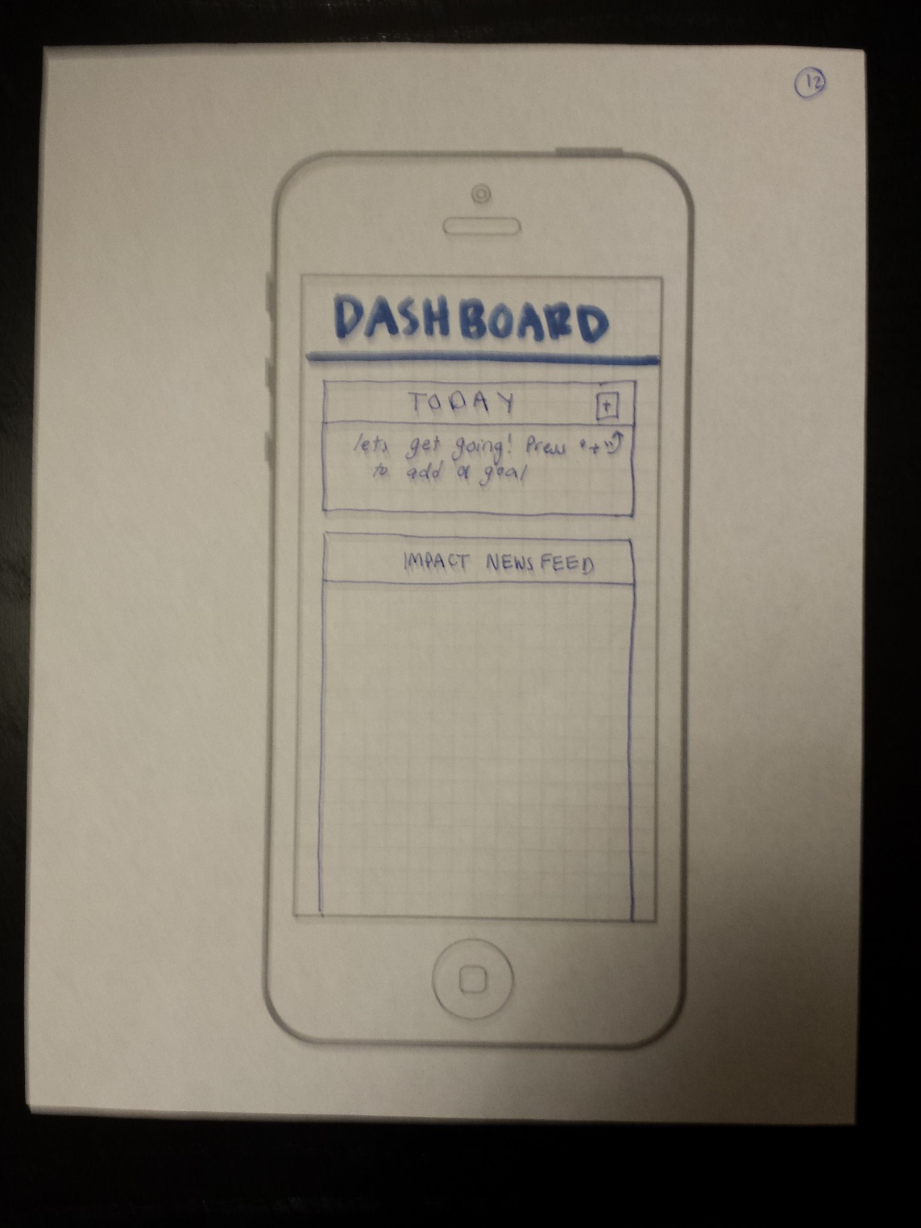
Scenario One: Set Up Create a SpringBoard profile and a goal

Slide 8
Scenario One: Set Up Create a SpringBoard profile and a goal

Slide 9
Scenario One: Set Up Create a SpringBoard profile and a goal

Slide 10
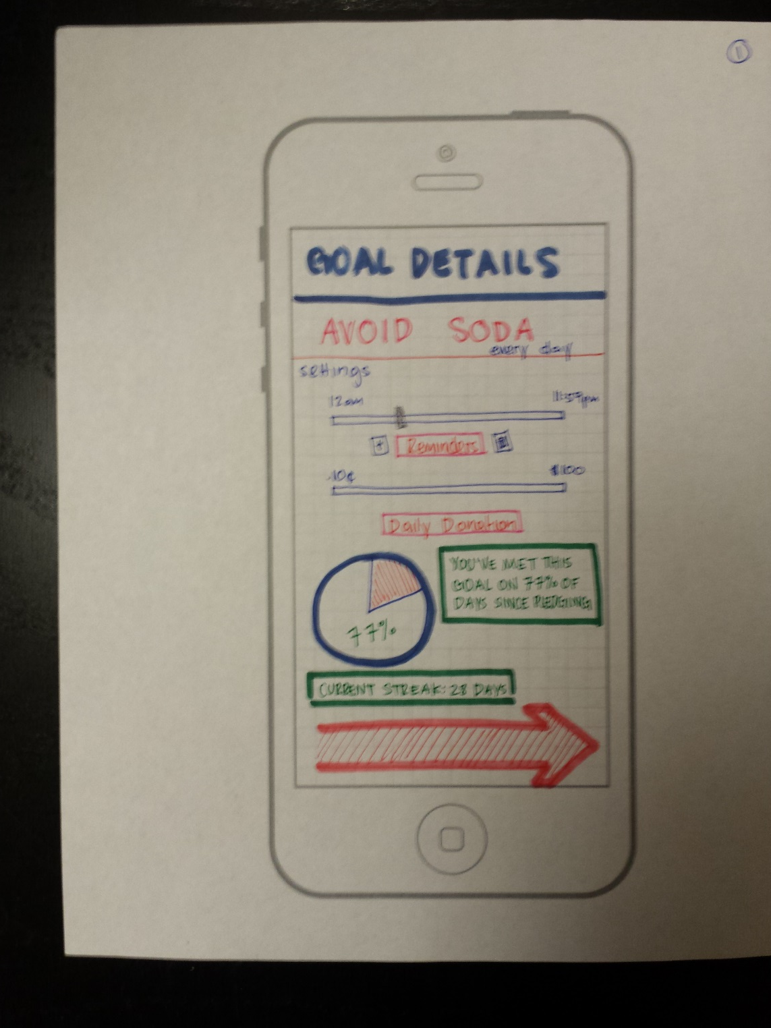
Scenario One: Set Up Create a SpringBoard profile and a goal

Slide 11
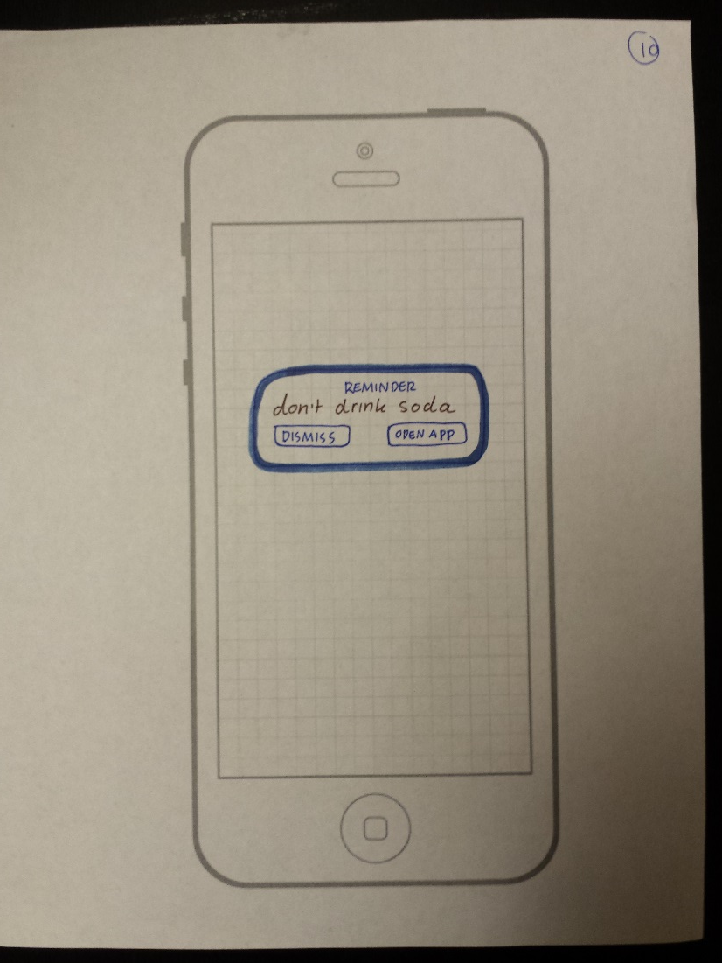
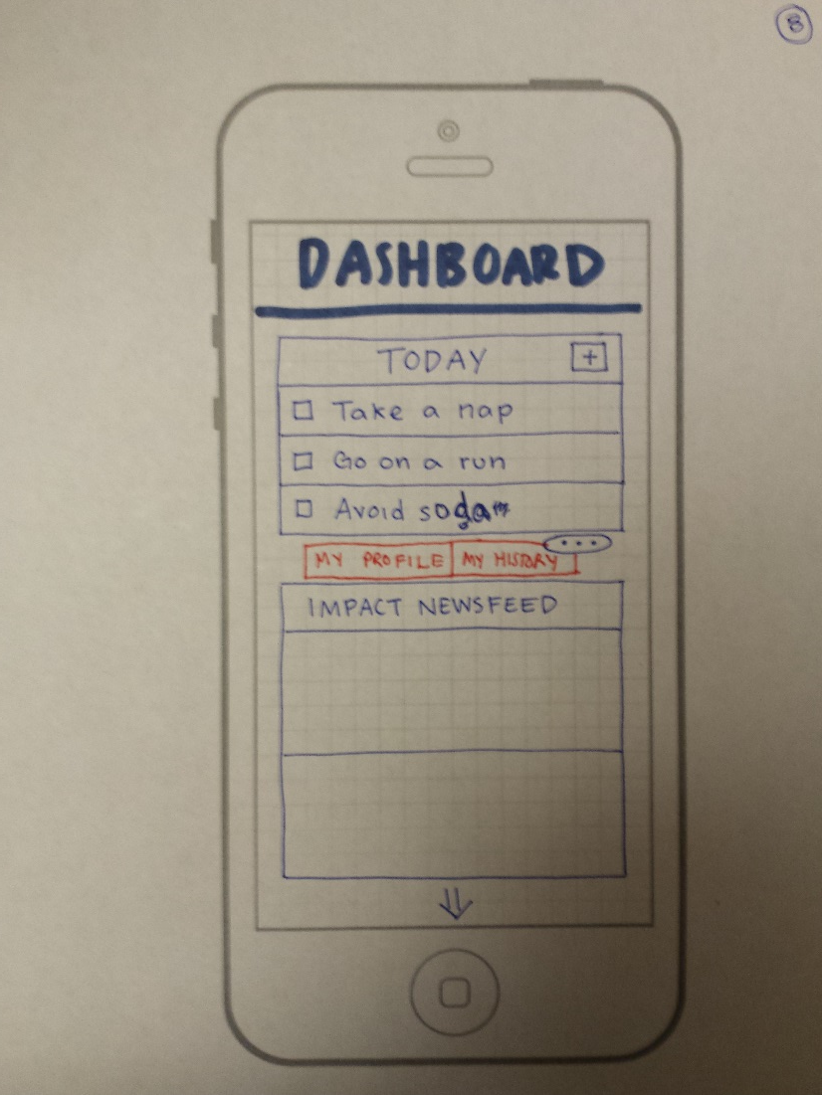
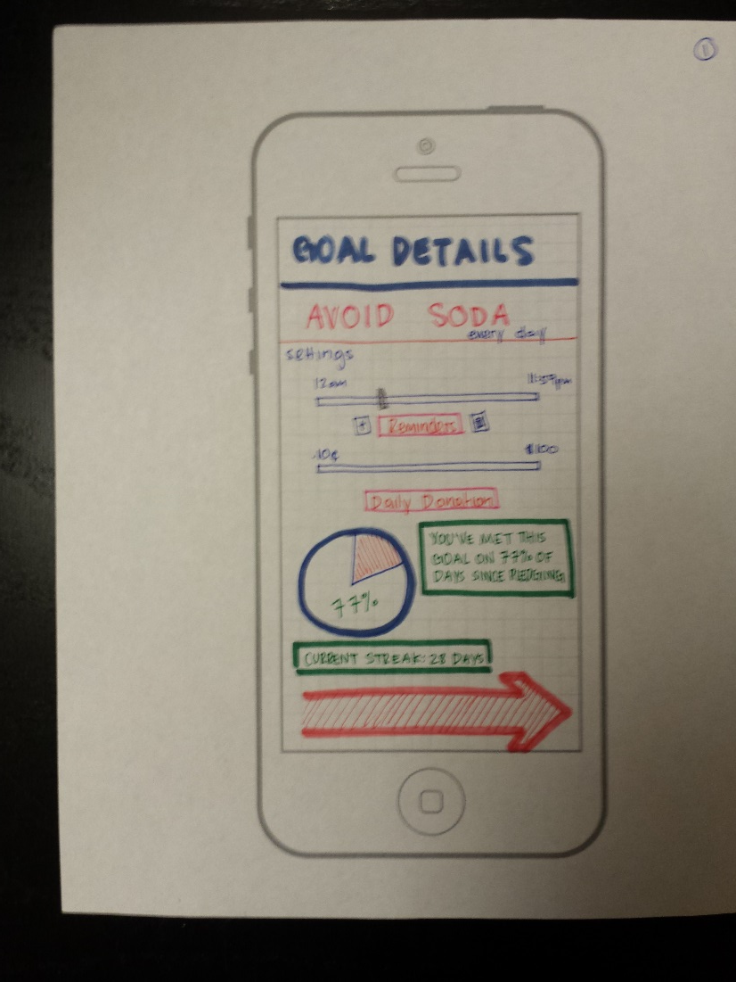
Scenario Two: Maintenance Enter goal progress and edit goal settings

Slide 12
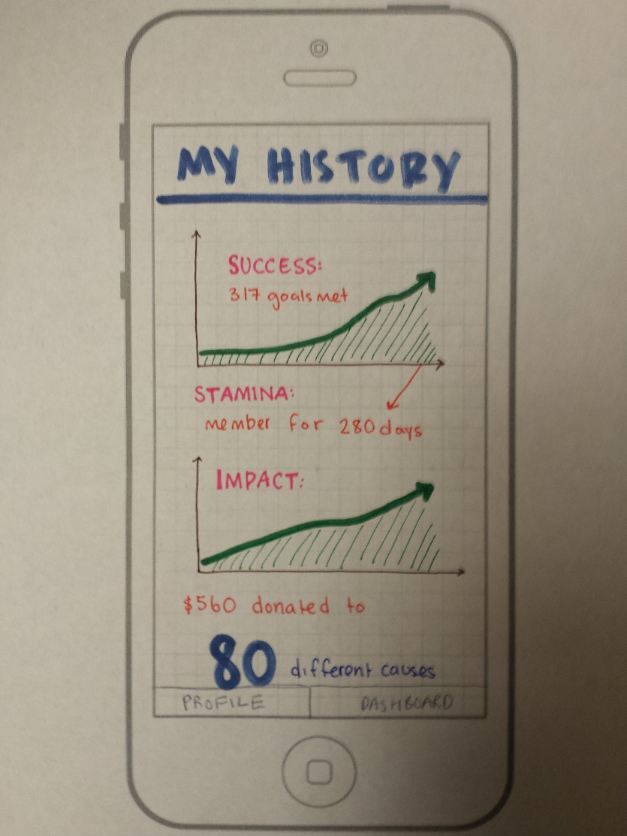
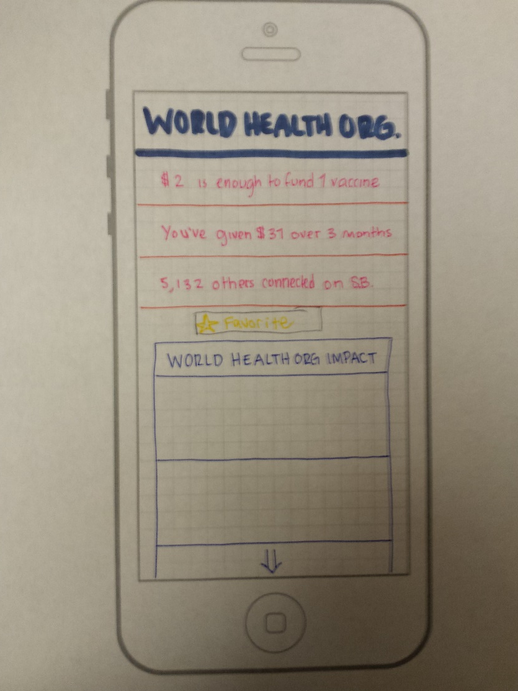
Scenario Three: Review View goal adherence and charitable progress over time

Slide 13
Experimental Setup
Participant
Table
Proto-type
Note Taker
Computer
Interviewer

Slide 14
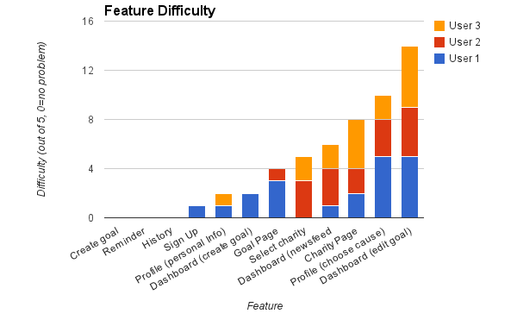
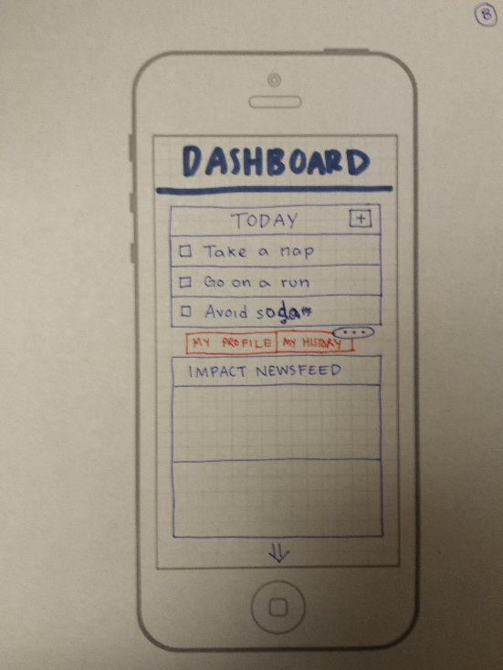
Results:Data

Slide 15
Results: Feedback
Use of the word “Featured” implied “Sponsored”
A list would be better than the pie chart for “My Causes”
Confusion about amount donated, and a desire to be given more information
Unclear where “Related”, “Suggested”, and “Featured” charities are coming from

Slide 16
Possible Iterations
Update cause selection and charity selection to increase user comprehension
Utilize more conventional interface for cause selection
Rename “Featured Charities”
Provide users with more information on spending
Add consistent navigation

Slide 17
Questions?

