Slide 1
SpringBoard
Personal Success enabling social good

Slide 2
Problem
Positive habit forming is difficult without external motivation
People want to help charitable causes but can’t find the time

Slide 3
Solution: SpringBoard
Tie positive habit forming
to accomplishing social good

Slide 4
Contextual Inquiry

Slide 5
Contextual Inquiry: Tyler

Slide 6
Contextual Inquiry: Kimiko

Slide 7
Contextual Inquiry: Paul and Andrea

Slide 8
Contextual Inquiry: Kendall

Slide 9
What did we learn?
Giving to charitable causes
Forming Positive Habits
Importance of Personal Connections
Reward Systems
Guilt as a Motivator
Regularity and Habit Building
Availability and Visibility

Slide 10
Task Analysis

Slide 11
Task Analysis: Goal Setting
Set personally beneficial goals and stick with them
Track performance and adherence to goals

Slide 12
Task Analysis: Advancing Social Good
Vet charitable causes and identify causes which users want to help
Regularly give aid to chosen causes
View results of charitable actions

Slide 13
Application Ideas
Help users to meet goals by magnifying personal success into positive social impact

Slide 14
Application Idea: Save for Social Good
Savings Account
$$$
User
$
Charitable Cause

Slide 15
Application Idea: Sponsored Group Goals
Sponsor
Meet Goals
User
User
User
$$$
User
Charitable Cause
User

Slide 16
Application Idea: Springboard
User
Meet Goals
Charitable Cause
$$$

Slide 17
Application Tasks

Slide 18
Configure Goals

Slide 19
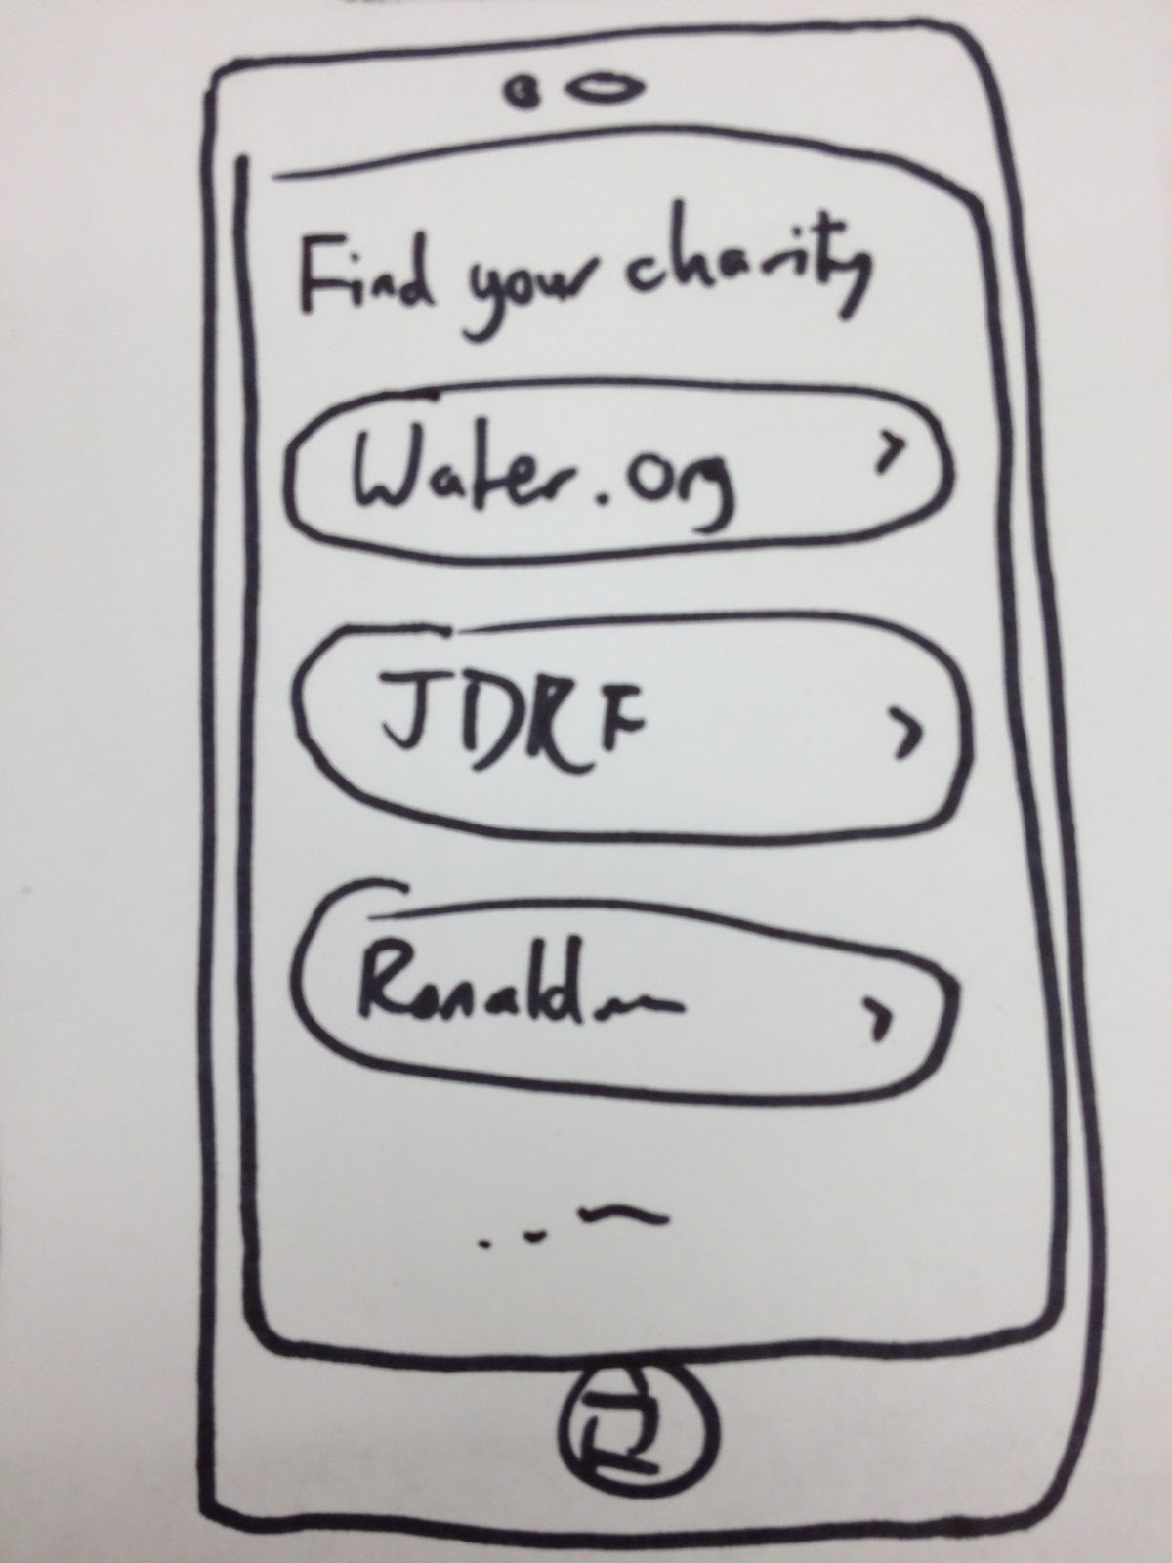
Select Causes

Slide 20
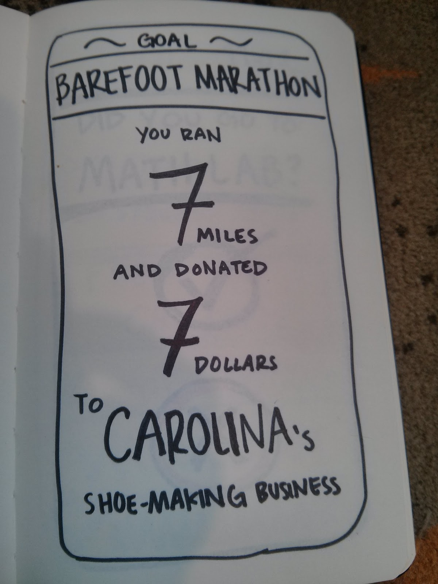
View Progress

Slide 21
Questions?

