Slide 1
Notes:
6 weeks ago, Tim Cook introduced a new device – the apple watch, which he claims “is the most personal device we have ever created”
The lead developer said it was 4 steps ahead of everything else out there and it will be 20 steps ahead once app developers start working on it.

Slide 2
Civility
Lorena Huang Liu || Steven Qian || Kate Stockdale || Jessica Xu
Notes:
And Civility will be one of those steps.
Today, we will reveal an essential tool developed for the smartwatch that will enhance everyday conversations.

Slide 3
Mission Statement
Through unobtrusive monitoring, Civility strives to decrease the number of conversational conflicts that get out of hand (due to loss of temper) by helping people maintain composure during frustrating interactions

Slide 4
The Plan of Attack
Mission Statement
Representative Tasks
Lo-fi Prototype Structure
Scenarios
Experimental Method
Experimental Results
Suggested UI Changes
Summary

Slide 5
RT #1: Personal Feedback

Slide 6
RT #2: Keep Calm (and use Civility)

Slide 7
RT #3: Identify Fruitless Conversations

Slide 8
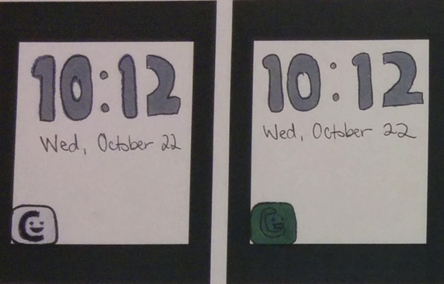
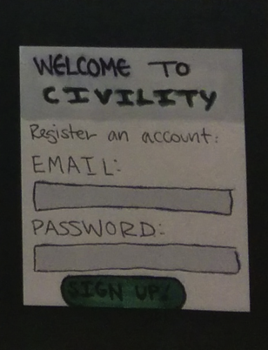
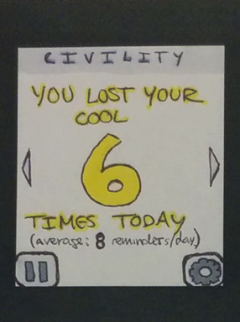
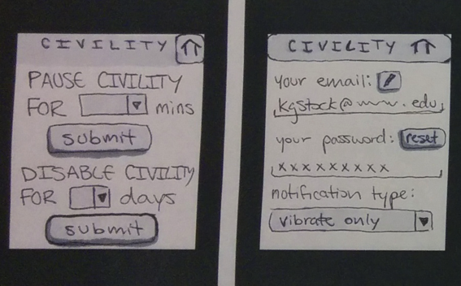
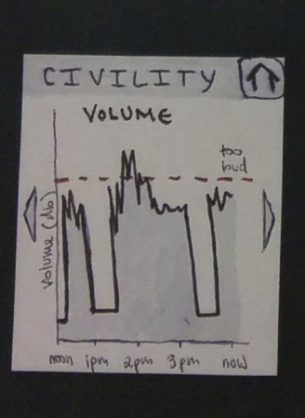
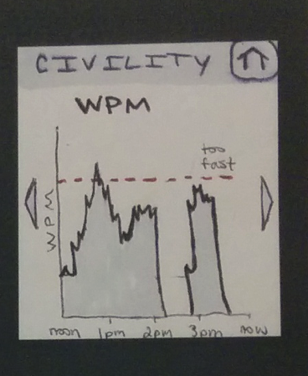
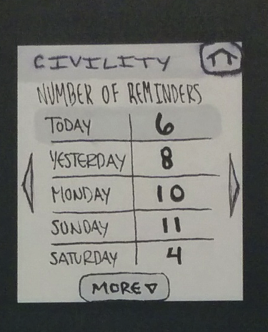
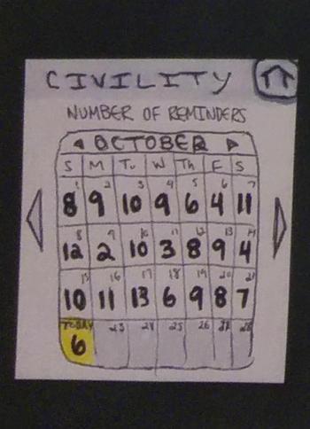
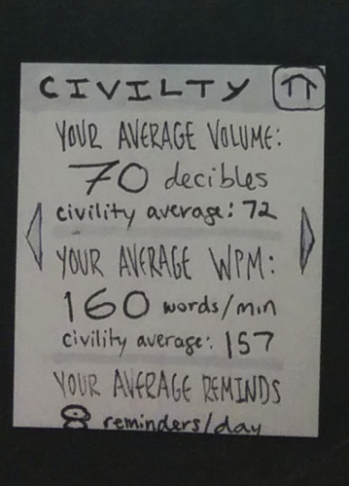
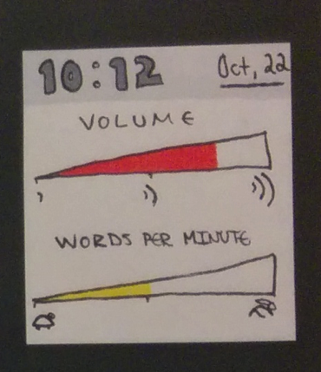
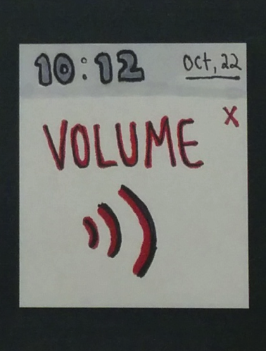
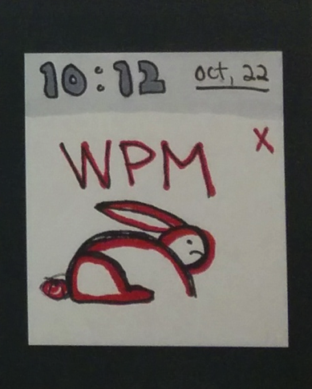
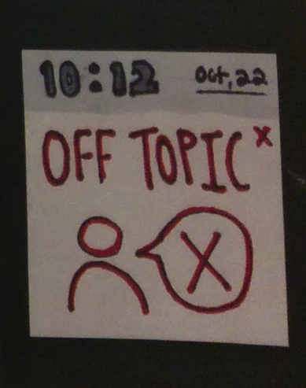
Lo-fi Prototype Structure

Slide 9
Scenarios
Find your average words per minute

Slide 10
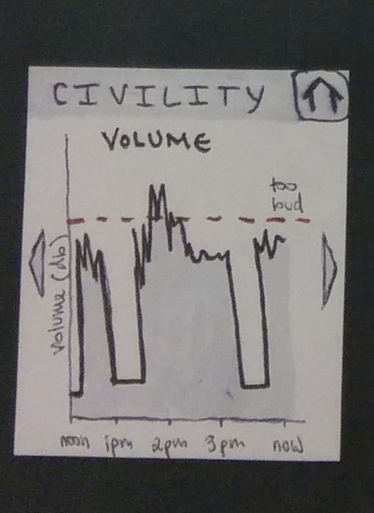
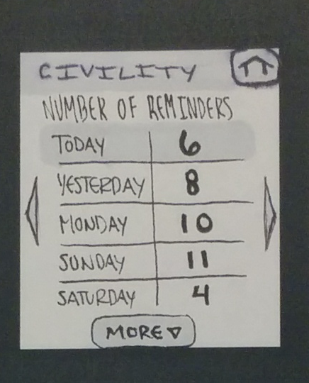
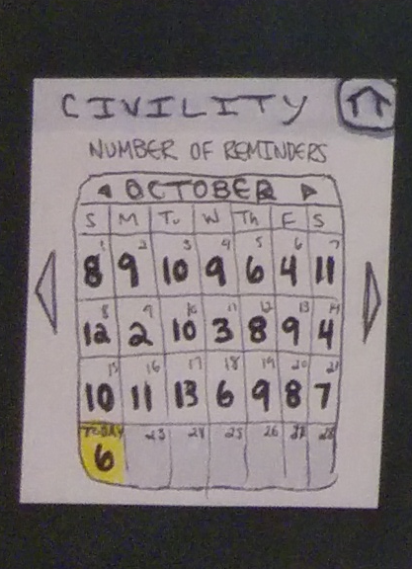
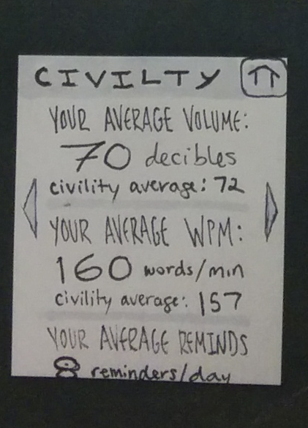
Scenarios

Slide 11
Scenarios
Get riled up in a conversation

Slide 12
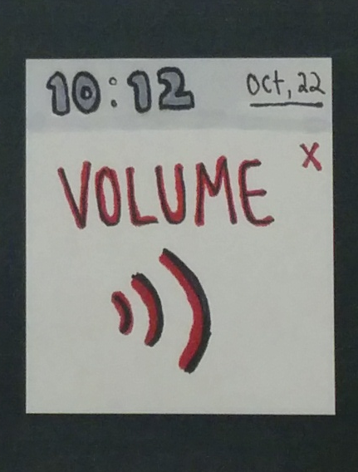
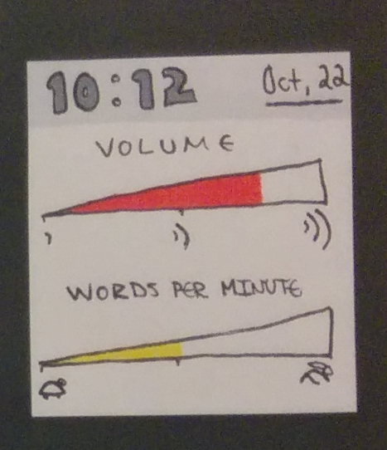
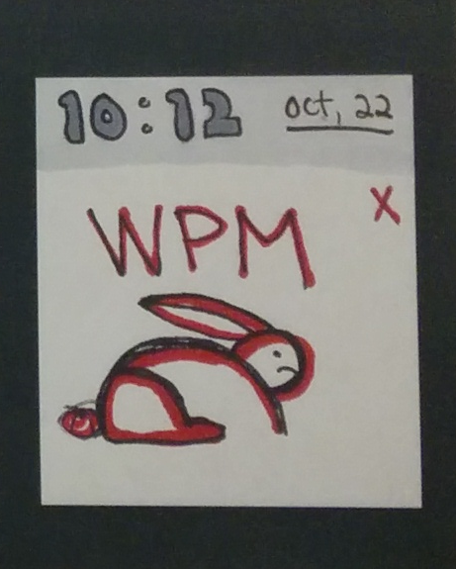
Scenarios

Slide 13
Scenarios
Get off topic in a conversation

Slide 14
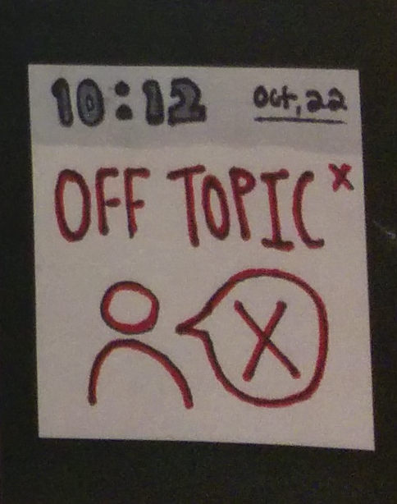
Scenarios

Slide 15
Experimental Method

Slide 16
Experimental Results
Most of our tasks were completed with no problem
Generally an intuitive interface

Slide 17
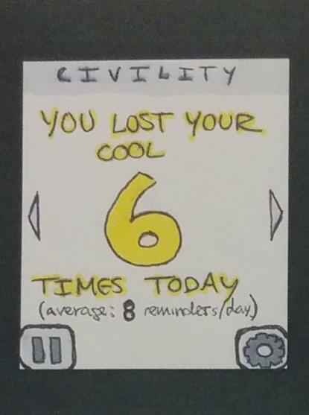
Experimental Results
“Do I tap or do I swipe?”

Slide 18
Experimental Results
Slight awkwardness with “volume” notification
Positive feedback regarding “off topic” notification

Slide 19
Suggested UI Changes
Remove completely?

Slide 20
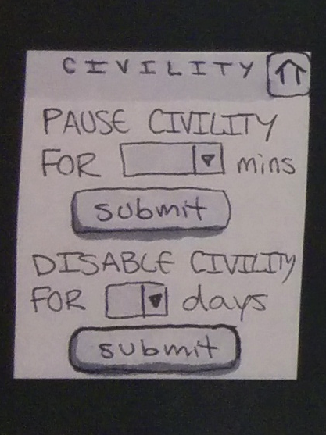
Suggested UI Changes
Preset Option?

Slide 21
Key Takeaways
Exciting?
Cool?
Attractive?

