Slide 1
Usability Testing
November 4, 2014
Notes:
12:10 (70 minutes until got to the break – go faster?)
4 minutes over – 2-4 minutes late starting due to sound issues (cut a little repetitive info)`

Slide 2
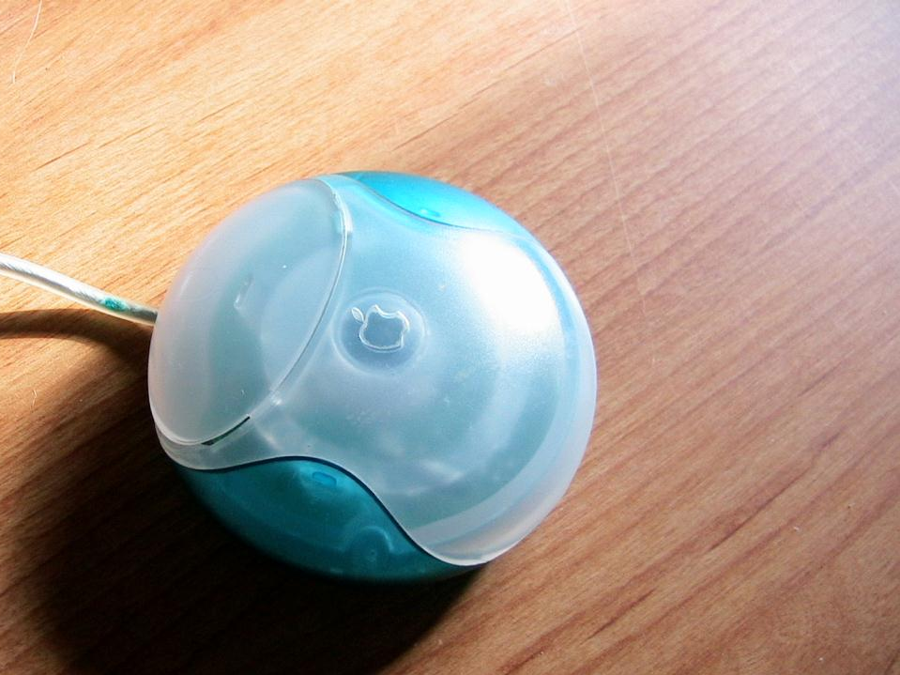

Hall of Fame or Shame?
Apple One Button Mouse

Slide 3

Hall of Shame!
How to hold this?
No tactile clue that you were holding the mouse in the correct orientation
Later designs added a dimple in the button yet remained ergonomically difficult to use

Slide 4

Hall of Fame or Shame?
Apple Remote
courtesy Alexander W.

Slide 5

Hall of Fame!
Sleek, clean & easy to understand
Reduced to 3 key controls
  menu button
  play/pause button
  navigation pad
Buttons easy to press one-handed
Simple color scheme

Slide 6
Usability Testing
November 4, 2014

Slide 7
Outline
Review Heuristic Evaluation
Why do user testing?
Choosing participants
Designing the test
Collecting data
Team Break
Analyzing the data
Experimental Details

Slide 8
Review Heuristic Evaluation
Usability method that relies on who?
  experts
Ask evaluators to see if UI complies with heuristics
  note where it doesn’t, say why, & suggest fix
Combine the findings from 3 to 5 evaluators ?
  different evaluators find different problems
  adding more won’t be worth the cost
Cheaper or more expensive than user testing ?
  cheaper than user testing (time/cost)
False positives ?
  HE may find problems that users may never encounter
Alternate with user testing

Slide 9
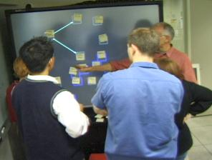

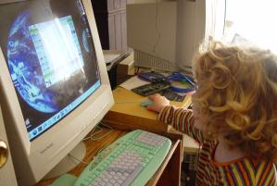
Why do User Testing?
Can’t tell how good UI is until?
  people use it!
Expert review methods are based on evaluators who?
  may know too much
  may not know enough (about tasks, etc.)
Hard to predict what real users will do

Slide 10
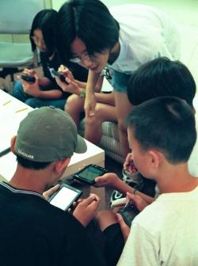
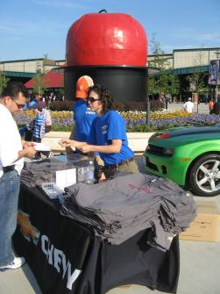
Choosing Participants
Representative of target users ?
  job-specific vocab / knowledge
  tasks
Approximate if needed
  system intended for doctors?
    get medical students or nurses
  system intended for engineers?
    get engineering students
Use incentives to get participants
  T-shirt, mug, free coffee/pizza

Slide 11

Ethical Considerations
Usability tests can be distressing
  users have left in tears
You have a responsibility to alleviate
  make voluntary with informed consent (form)
  avoid pressure to participate
  let them know they can stop at any time
  stress that you are testing the system, not them
  make collected data as anonymous as possible
Often must get human subjects approval

Slide 12
User Test Proposal
A report that contains
  objective
  description of system being testing
  task environment & materials
  participants
  methodology
  tasks
  test measures
Get approved & then reuse for final report
Seems tedious, but writing this will help “debug” your test

Slide 13

Selecting Tasks
Tasks from analysis & design can be used
  may need to shorten if
    they take too long
    require background that
    test user won’t have
Try not to train unless that will happen in real deployment
Avoid bending tasks in direction of what your design best supports
Don’t choose tasks that are too fragmented ?
  fragmented = do not represent a complete goal someone would try to complete with your application
  e.g., phone-in bank test
Check if your friend has called, find out what time he will be goin o the club.

Slide 14


Two Types of Data to Collect
Process data
  observations of what users
  are doing & thinking
  qualitative
Bottom-line data
  summary of what happened
    time, errors, success
  i.e., the dependent variables
  quantitative
http://allazollers.com/discovery-research.php
http://www.fusionfarm.com/content/uploads/2012/10/analyzing-data.jpg

Slide 15

Which Type of Data to Collect?
Focus on process data first
  gives good overview of where problems are
Bottom-line doesn’t tell you ?
  where to fix
  just says: “too slow”, “too many errors”, etc.
Hard to get reliable bottom-line results
  need many users for statistical significance
http://netbreak-ph.blogspot.com/2012/09/Hitleap-get-traffic-views-on-site.html

Slide 16

The “Thinking Aloud” Method
Need to know what users are thinking, not just what they are doing
Ask users to talk while performing tasks
  tell us what they are thinking
  tell us what they are trying to do
  tell us questions that arise as they work
  tell us things they read
Make a recording or
take good notes
  make sure you can tell what
  they were doing
I’ll click on the checkout button

Slide 17
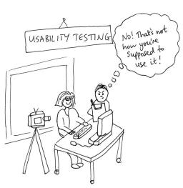
Thinking Aloud (cont.)
Prompt the user to keep talking
  “tell me what you are thinking”
Only help on things you have pre-decided
  keep track of anything you do give help on
Recording
  use a digital watch/clock
  take notes, plus if possible
    record audio & video (or even event logs)
http://jennycham.co.uk/wp-content/uploads/2011/08/200911221250225481.jpg

Slide 18
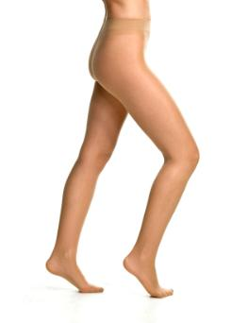
Will thinking out loud give the right answers?
Not always
If you ask, people will always give an answer, even it is has nothing to do with facts
  panty hose example
→Try to avoid specific questions
Notes:
Did an experiment: had someone sit outside a supermarket with 2 pairs of pantyhose and asked which was more sheer
There was a statistically significant different between the one on the right and left
…but they were the same product!
Moral: be careful what you ask – people will try to give you the answer they think you want

Slide 19
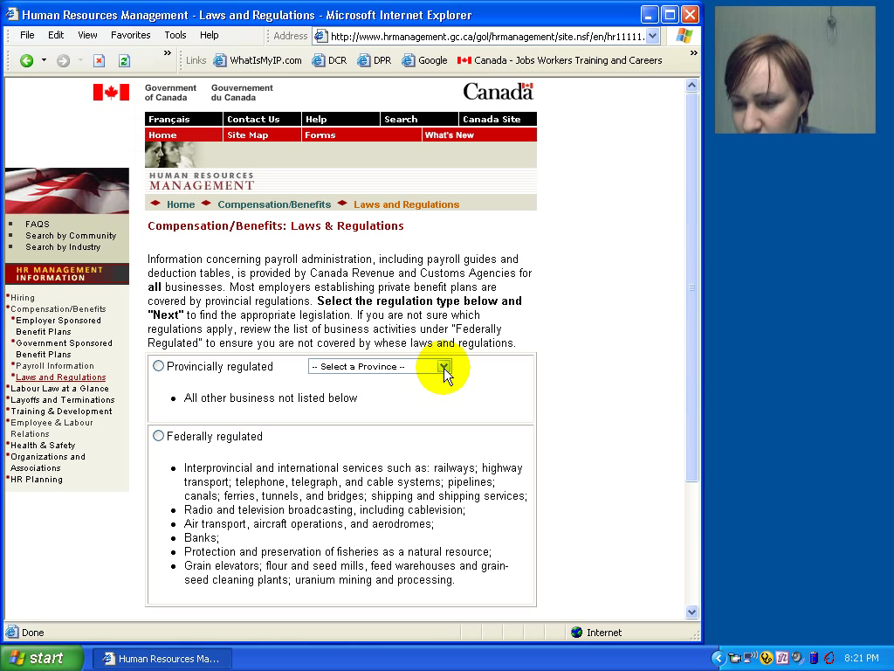

Slide 20

Using the Test Results
Summarize the data
  make a list of all critical incidents (CI)
    positive & negative
  include references back to original data
  try to judge why each difficulty occurred
What does data tell you?
  UI work the way you thought it would?
    users take approaches you expected?
  something missing?
http://www.hhs.gov/ocr/privacy/hipaa/enforcement/data/index.html

Slide 21
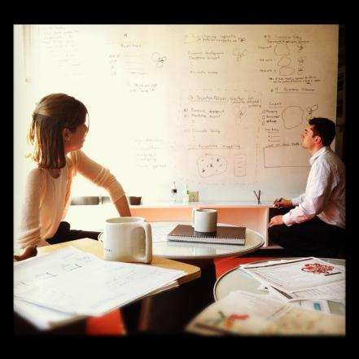
Using the Results (cont.)
Update task analysis & rethink design
  rate severity &
  ease of fixing CIs
  fix both severe problems & make the easy fixes
http://www.thetomorrowplan.com/exchange/policies-prairie-chickens-and-parking/

Slide 22
Administrivia
Poll on Piazza for potential class times for CS 147B (course number to change)
  final approval is imminent, but not done
  will be able to count as Senior Project course (right now by petition – clarifying)
Questions on HE assignment?
CAs sending you email with HE team assignments
  complete reports individually
  bring your report on paper & computer/USB to class
  in class you will combine reports using template
Web sites
  all teams received email on AFS space
  put simple page up with all your assignments
    recommend put video in prominent position
  see examples for how to do it well (not hard)
  try to get something up (at least basic) this week

Slide 23
team break
(20 minutes)
discuss web sites

Slide 24
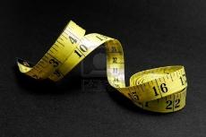
Measuring Bottom-Line Usability
Situations in which numbers are useful
  time requirements for task completion
  successful task completion %
  compare two designs on speed or # of errors
Ease of measurement
  time is easy to record
  error or successful completion is harder
    define in advance what these mean
Do not combine with thinking-aloud. Why?
  talking can affect speed & accuracy

Slide 25
Analyzing the Numbers
Example: trying to get task time ≤ 30 min.
  test gives: 20, 15, 40, 90, 10, 5
  mean (average) = 30
  median (middle) = 17.5
  looks good!
Did we achieve our goal?
Wrong answer, not certain of anything!
Factors contributing to our uncertainty?
  small number of test users (n = 6)
  results are very variable (standard deviation = 32)
    std. dev. measures dispersal from the mean

Slide 26
Analyzing the Numbers (cont.)
This is what statistics is for
Crank through the procedures and you find
  95% certain that typical value is between 5 & 55
Notes:
95% (or alpha=5%) is the standard confidence interval used in HCI

Slide 27
Analyzing the Numbers (cont.)

Slide 28
Analyzing the Numbers (cont.)
This is what statistics is for
Crank through the procedures and you find
  95% certain that typical value is between 5 & 55
Usability test data is quite variable
  need lots to get good estimates of typical values
  4 times as many tests will only narrow range by 2x
    breadth of range depends on sqrt of # of test users
  this is when online methods become useful
    easy to test w/ large numbers of users

Slide 29
Measuring User Preference
How much users like or dislike the system
  can ask them to rate on a scale of 1 to 10
  or have them choose among statements
    “best UI I’ve ever…”, “better than average”…
  hard to be sure what data will mean
    novelty of UI, feelings, not realistic setting …
If many give you low ratings → trouble
Can get some useful data by asking
  what they liked, disliked, where they had trouble, best part, worst part, etc.
  redundant questions are OK

Slide 30
Comparing Two Alternatives
Between groups experiment
  two groups of test users
  each group uses only 1 of the systems
Within groups experiment
  one group of test users
    each person uses both systems
    can’t use the same tasks or order (learning)
  best for low-level interaction techniques
    e.g., new mouse, new swipe interaction, …
B
A

Slide 31
Comparing Two Alternatives
Between groups requires many more participants than within groups
See if differences are statistically significant
  assumes normal distribution & same std. dev.
Online companies can do large AB tests
  look at resulting behavior (e.g., buy?)

Slide 32
Experimental Details
Order of tasks
  choose one simple order (simple → complex)
    unless doing within groups experiment
Training
  depends on how real system will be used
What if someone doesn’t finish
  assign very large time & large # of errors or remove & note
Pilot study
  helps you fix problems with the study
  do two, first with colleagues, then with real users

Slide 33
Instructions to Participants
Describe the purpose of the evaluation
  “I’m testing the product; I’m not testing you”
Tell them they can quit at any time
Demonstrate the equipment
Explain how to think aloud
Explain that you will not provide help
Describe the task
  give written instructions
  one task at a time
Check if your friend has called, find out what time he will be goin o the club.

Slide 34
Details (cont.)
Keeping variability down
  recruit test users with similar background
  brief users to bring them to common level
  perform the test the same way every time
    don’t help some more than others (plan in advance)
  make instructions clear
Debriefing test users
  often don’t remember, so demonstrate or show video segments
  ask for comments on specific features
    show them screen (online or on paper)

Slide 35
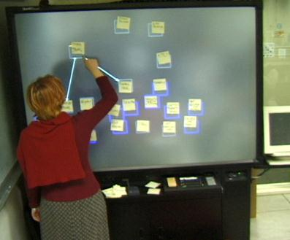
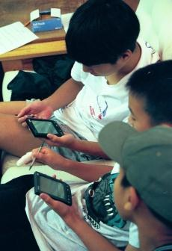
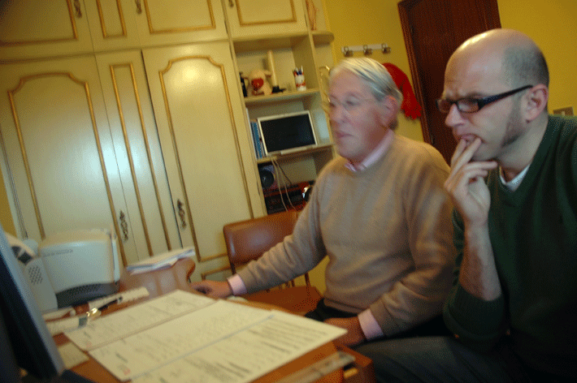
Reporting the Results
Report what you did & what happened
Images & graphs help people get it!
Video clips can be quite convincing

Slide 36
HE vs. User Testing
HE is much faster
  1-2 hours each evaluator vs. days-weeks
HE doesn’t require interpreting user’s actions
User testing is far more accurate (by def.)
  takes into account actual users and tasks
  HE may miss problems & find “false positives”
Good to alternate between HE & user testing
  find different problems
  don’t waste participants

Slide 37
Summary
User testing is important, but takes time/effort
Use ????? tasks & ????? participants
  real tasks & representative participants
Be ethical & treat your participants well
Want to know what people are doing & why? collect
  process data
Bottom line data requires ???? to get statistically reliable results
  more participants
Difference between between & within groups?
  between groups: everyone participates in one condition
  within groups: everyone participates in multiple conditions

Slide 38
Next Time
Design Patterns
Read
  The Design of Sites, by van Duyne, Hong, & Landay
  1) “Making the Most of Web Design Patterns” (Ch 2)
  2) “Up-Front Value Proposition” (Pattern C2)
  3) “Process Funnel” (Pattern H1)
  4) “Meaningful Error Messages” (Pattern K13)

