Slide 1
Visual Information Design
October 28, 2014
* Based on slides by Luke Vink
Notes:
finished 15 minutes early INCLUDING a 25 minute team break. Could add a video about design?

Slide 2
Hall of Fame or Shame?
iFitness
iOS App
Notes:
Non-standard interactions for date and weight (over a number of days)

Slide 3
Hall of Shame!
Non-conventional design is a waste resources—iOS has better defaults
Know your users! 99% of users will want to enter today’s weight
‘Record’ button almost invisible

Slide 4
Hall of Shame!
Possible Re-design
¼ of the controls
Saved space can be used for statistics
Date and time can be recorded automatically
Source: smashingmagazine.com/2009/07/21/iphone-apps-design-mistakes-overblown-visuals/

Slide 5
Hall of Fame or Shame?
Virgin America Website
Courtesy Andrea S.
https://www.virginamerica.com/book
Notes:
Defaults to your city but easy to change and then gives the list of direct cities you can fly to

Slide 6
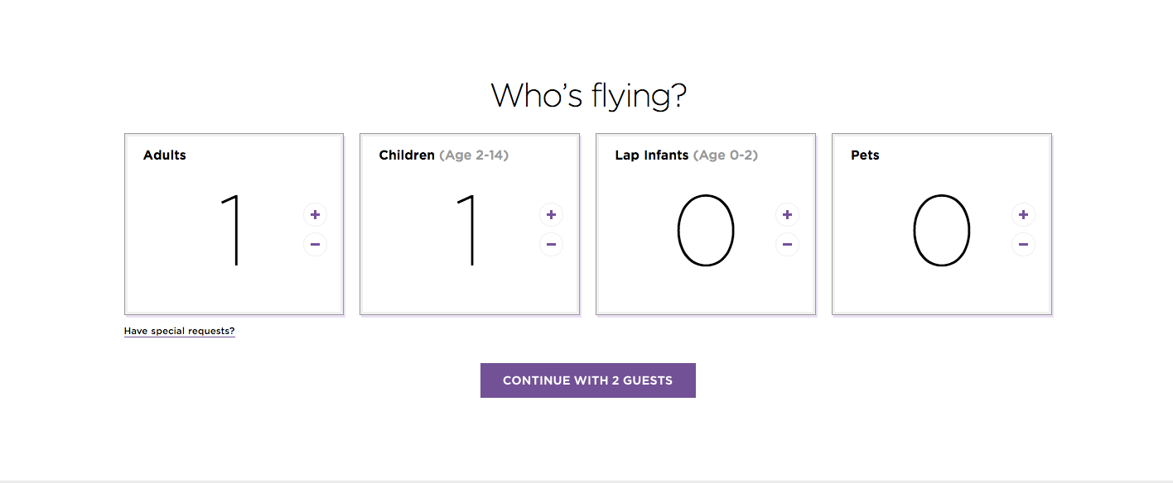
Hall of Fame or Shame?
Virgin America Website
Courtesy Andrea S.
https://www.virginamerica.com/book
Notes:
Selecting number of passengers

Slide 7
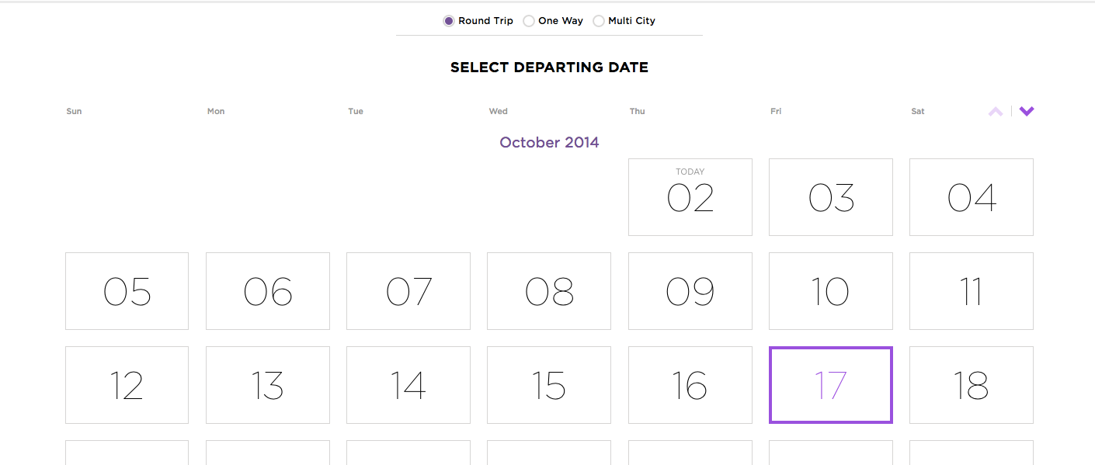
Hall of Fame or Shame?
Virgin America Website
Courtesy Andrea S.
https://www.virginamerica.com/book
Notes:
Departure date

Slide 8
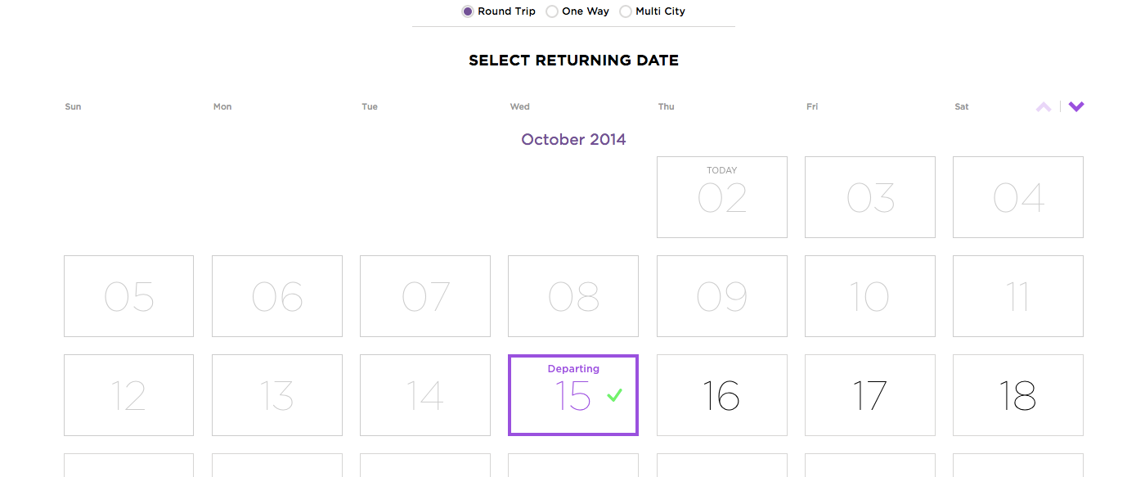
Hall of Fame or Shame?
Virgin America Website
Courtesy Andrea S.
https://www.virginamerica.com/book
Notes:
Return date

Slide 9
Hall of Fame!
Virgin America Courtesy Andrea S.
https://www.virginamerica.com/book
Minimalist design w/ large & simple instructions
Automatic location setting
Large calendar for easy/fast date selection (Fitts’ Law)

Slide 10
Visual Information Design
October 28, 2014
* Based on slides by Luke Vink

Slide 11
Outline
Review of Conceptual Models & Metaphors
Good Form
layout, proximity, small multiples, space, grids, & icons
Team Break
Color
Interesting Design

Slide 12
Review
Conceptual models ?
mental representation of how the object works & how interface controls effect it
Design model should equal customer’s model ?
mismatches lead to errors
use customer’s likely conceptual model to design
Design guides ?
make things visible
map interface controls to customer’s model
provide feedback
Design Model
Customer Model
System Image

Slide 13
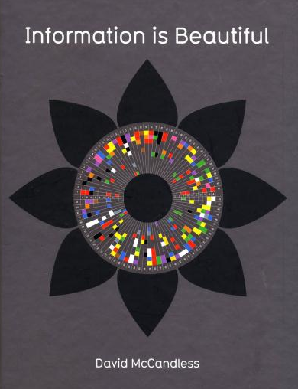
Information is Beautiful
A collection of intriguing visualizations that strike a balance between art and data representation
David McCandless
Notes:
A lot of what I will talk about comes from this guy – David McCandless who published a book filled with incredible visual designs.

Slide 14
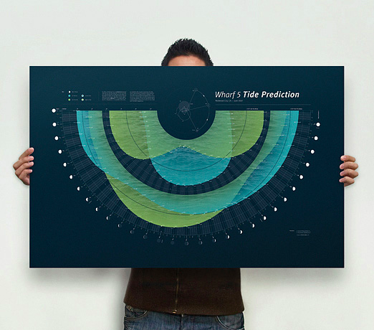
Wilfred Castillo: Tide Prediction: http://www.wilfredcastillo.com/Tide-Prediction
Notes:
Wilfred Castillo: Tide Prediction
http://www.wilfredcastillo.com/Tide-Prediction

Slide 15
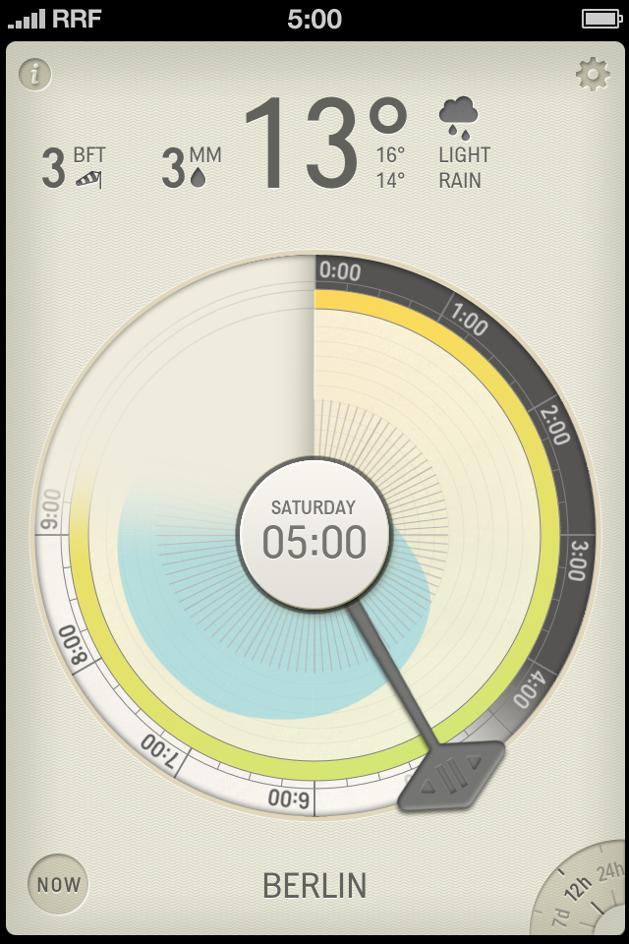
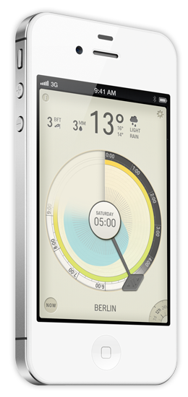
Partly Cloudy
iOS App

Slide 16
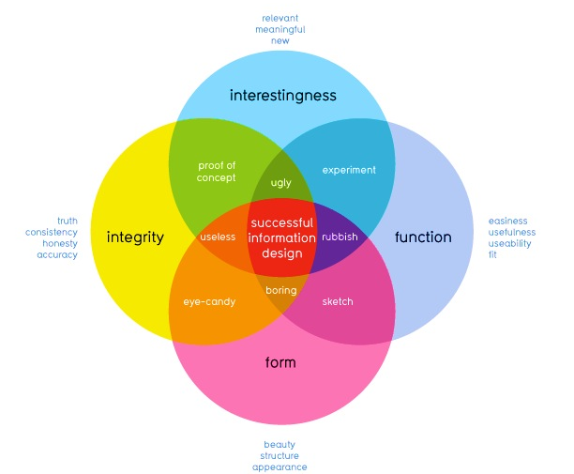
How well does it communicate?
How well does it work?
David McCandless
http://www.informationisbeautiful.net
Notes:
This graphic illustrates what should be balanced to achieve a design that can convey useful information to `its observers by creating desire in the information itself.
This part refers to the information itself, whether the data is accurate or useful. Arguably you are all rather talented at this part.
So today Im going to talk about the other two – some guidelines as to how to achieve designs that successfully allow the user to perform such functions without having to force themselves to do so

Slide 17
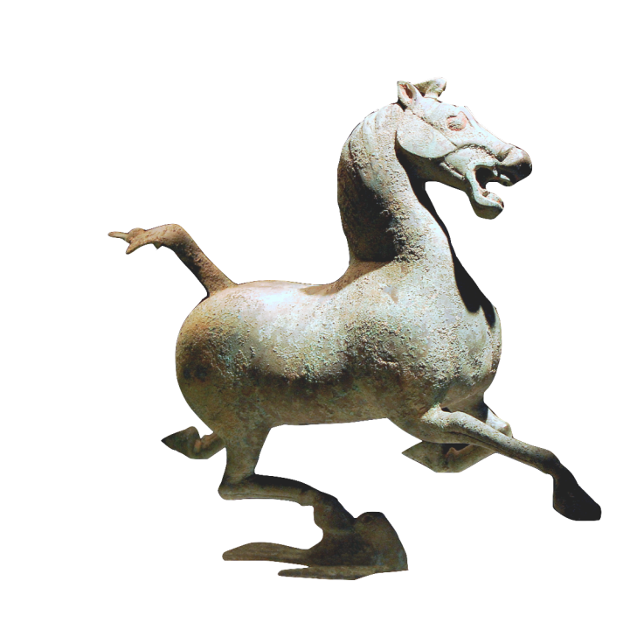
Notes:
Once again we come back to balance.

Slide 18
The Art of Balance
Promotion & demotion of important objects
First Question for any design
What are the most important things?
Information should be prioritized based on its importance to the user
Notes:
I’ve mentioned several times before that good design is about balance – visual design is no exception.
Information should be prioritized based on its importance or relationship to other information
: color, size, position and the other things we have discussed are methods to suggest this.
If we look at objects on a scale of importance, we can decide best how to use those techniques.

Slide 19
Visual Design that has
Good Form
(Purpose)
Notes:
I am going to mention several techniques.
I’d like to stress one very important point.
Don’t use them all at once.

Slide 20
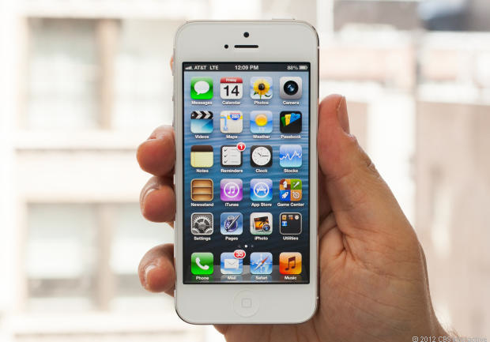
Using Context to determine layouts
Know Thy Users! (Design Discovery)
Context is extremely important to how much “Stuff” should be visible
Notes:
Different physical devices REQUIRE different user interactions and thus the layout of elements should be different across platforms.
Traditionally the more space available, the more objects can be both viewed and interacted with.
Luckily this also parallels with the nature of the need for smaller sized objects for better mobility.

Slide 21
Using Context to determine layouts
Screen Space
Time for tasks
decreases
UI Elements
Mobility
increases
Importance of Information Hierarchy
Notes:
The more mobile an object Is, the less space there is to put stuff, the less time people will want to spend on tasks and therefor the less elements we should display.
This also means for mobile interfaces, we need to be extremely selective about which information we actually display.
This is why mobile applications often do a lot less than desktop equivalents, but the successful ones need to do it a lot better to succeed.

Slide 22
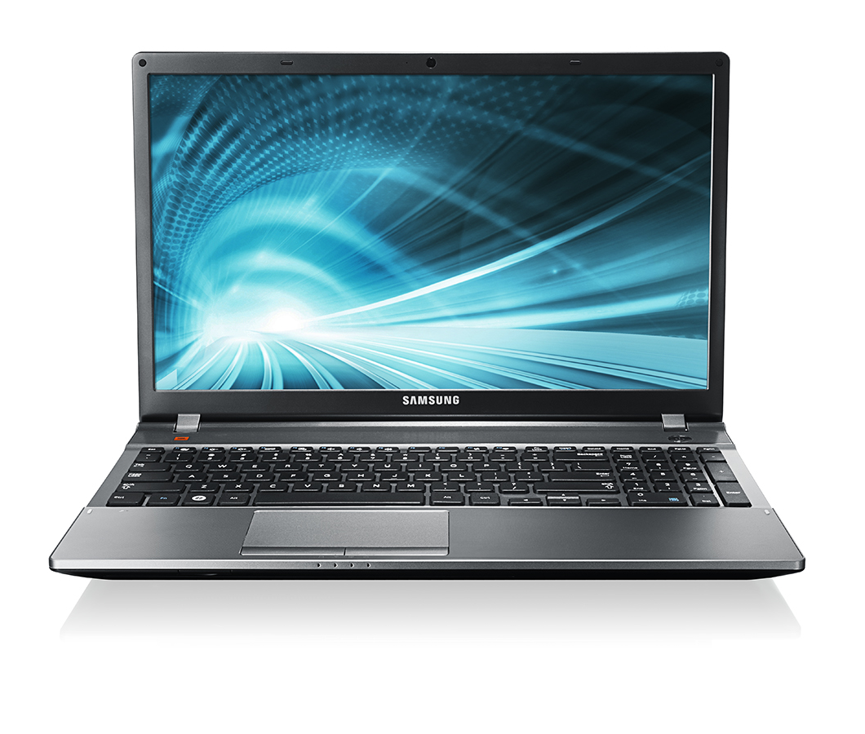
Responsive Layout Design for Web
Notes:
Now a practical standard, web designers tried to alleviate the more recent issue of multiple devices with “Responsive Content”.
Responsive layouts adjust the layout of the elements on a page appropriately to the device which is using the layout.
Now that we understand the context the information will be viewed in, we can consider how to position elements.

Slide 23
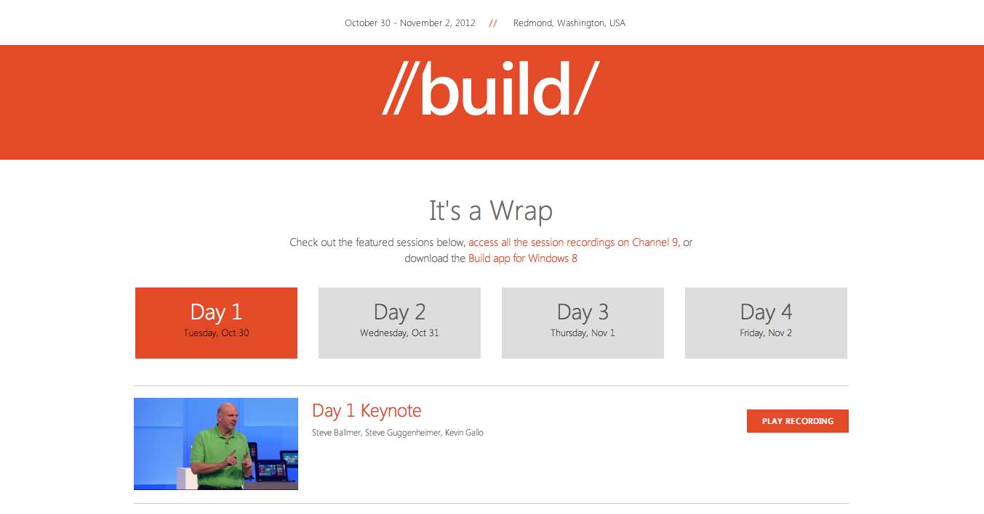
Responsive Layout Design for Web
Notes:
See how this…. changes to

Slide 24
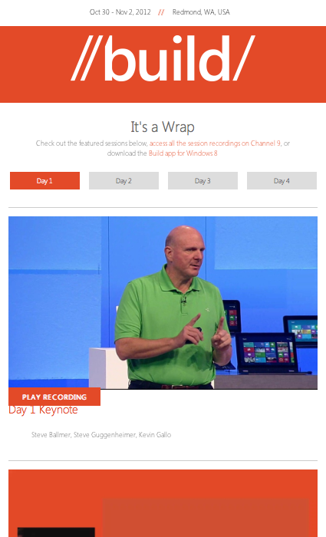
Responsive Layout Design for Web
Notes:
this!

Slide 25
Using Proximity to Indicate Relationships
“The whole is greater than the sum of the parts.” – David Hothersall
Gestalt Psychology in information design
Information blocks should be grouped together if related, but unrelated elements should be located at some distance from each other.
Notes:
The principles of Gestalt psychology are based on the humans’ ability to perceive and generate visual forms.
One of the six Gestalt Principles, “The Proximity principle” is often used in information design.
We can use proximity to describe how elements are related to each other.

Slide 26
Using Proximity to Indicate Relationships
Notes:
As we divide a blank space into a layout, we can prioritize a groups importance by just its size. As with any hierarchy, our eyes are drawn towards the largest sized objects and eventually down to the smaller. In many cases it’s a good idea to prioritize the placement of these in that order as well.

Slide 27
Using Proximity to Indicate Relationships

Slide 28
Using Proximity to Indicate Relationships
Notes:
Positioning can here be more powerful than colour, fonts or any other arguably "obvious” methods of suggesting importance. A good layout can remove the need for other confusing and intruding elements such as labels or popups.

Slide 29
Using Proximity to Indicate Relationships
Notes:
Even without colour, we can tell these elements are grouped simply by where they are positioned and how similar they are to each other.

Slide 30
Small Multiples
Economy of line
Similarities enable us to notice differences
IMAGE REMOVED
Images from Edward Tufte’s Envisioning Information
Notes:
Japanese book for children on t-shirt colors that match
The person is gray… just enough to tell us there is a person. The important thing is that they are holding lights and what they are doing with the lights (the important information is bright – red & yellow)

Slide 31
International Women’s Day
S M A L L M U L T I P L E S
Echeverria, Heriberto 1971 March 8 - International Women’s Day
Diaz, Estela 1974 March 8 - International Women’s Day
Cuban Poster Art Gallery, http:///www.sims.berkeley.edu/~lcush/GenCat.html/
Notes:
Small multiples convey the important information:
multi-racial society & everyone is included (same exact form – the only data is the different colors!)
The woman is the same – but different professions. A woman can be anything she wants! Everyone is included.

Slide 32
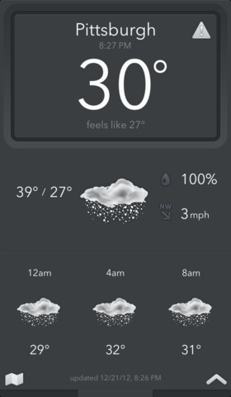
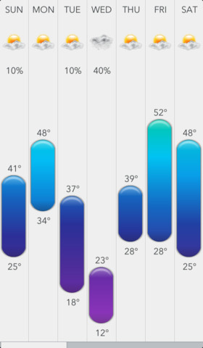
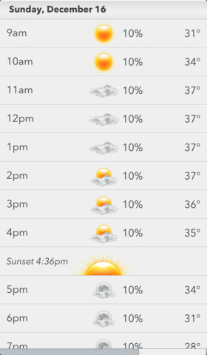
Proximity and Small Multiples in use
Today Weather iOS App
Notes:
These elements are grouped together really well

Slide 33
Proximity and Small Multiples in use
Today Weather iOS App
Notes:
The interface also uses Small Multiples (repetition) of colors and imagery to make groups even more identifiable.

Slide 34
Proximity and Small Multiples in use
Today Weather iOS App
Notes:
The viewers can SEE that these are the most important – no one has to tell us. This means the design of this information is successful. If we look deeper we can see a good balance of layout where size is the biggest indicator of importance, followed by color.

Slide 35
Using blank / white space as an object
White space can be used to suggest importance or prestige
The more space around a group, the more valuable it should be for the user
Think of whitespace as an “element” so as to consider its positioning
Notes:
Treat blank space as an object. This is a good way to avoid clutter. Designs with a lot of white space suggest the information within is more important: read: Apple. As mentioned before, the more objects you have, the less relevant they may be.

Slide 36
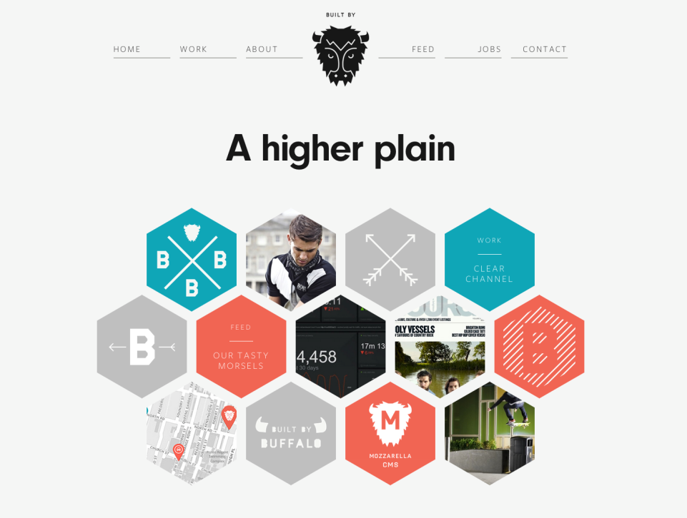
http://builtbybuffalo.com/
White Space = Value
Notes:
Web design provides good examples of the proximity rule where good layouts will organize related items into groups such as seen here with the menu and project elements grouped together.

Slide 37
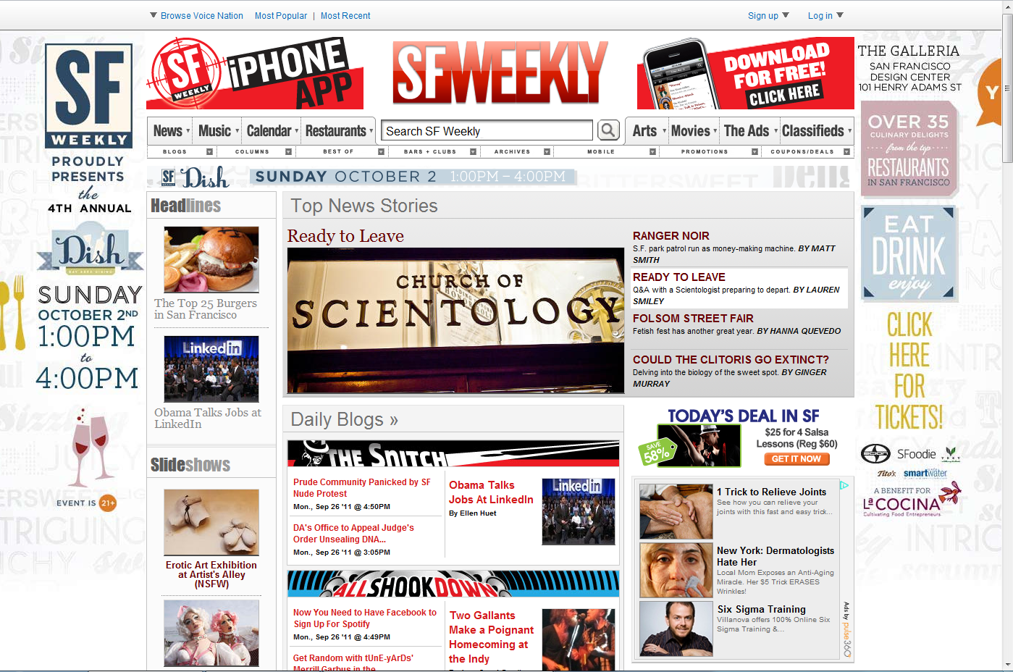
What are the important things here?
Notes:
We often sacrifice proximity to fit more things in a page. Mistaken idea that the more we offer, the more people will find the need for our solution.

Slide 38
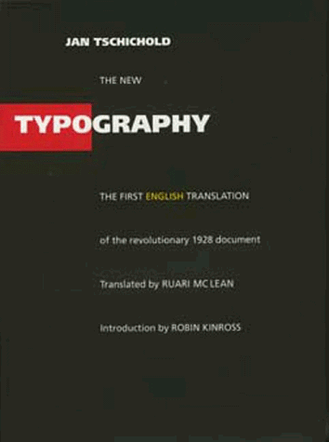
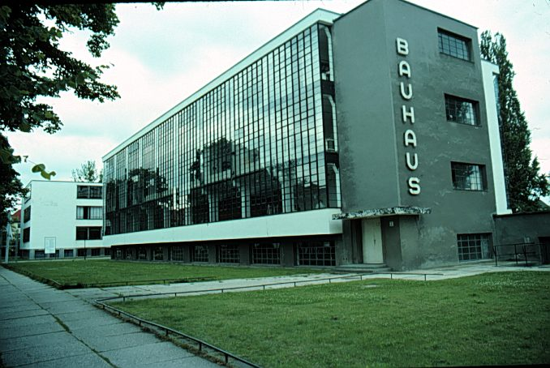
Jan Tschichold’s Revolution
Champion of Modernist Typography
Die Neue Typographie Berlin, 1928
Bauhaus school Dessau, 1925-26
Notes:
Graphic design as we know it today started with the Bauhaus
Jan Tschichold (CHEE-HOLD) was the lead graphic designer in the Bahuaus and pioneered modernist design principles.

Slide 39
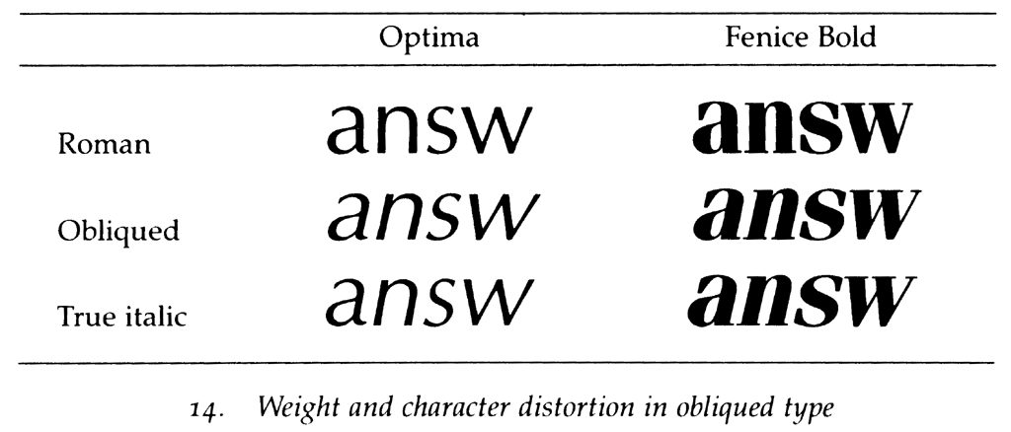
Type Classifications
Typeface (Arial) vs Font (Arial Bold)
Serifs: Structural details in letters that help the reader connect them
Sans Serif
Serif
Notes:
Simple place to start is the difference between Sans Serif and Serif typefaces
Until 1900, all type faces were Serif type faces. Most modernist are Sans Serif,
Both are useful, depends on what you are trying to use them for.
German type faces were original straight up and the Italians had a slant to it. At some point in the 18th & 19th century, people figured out they could make 2 versions of the same typeface and use the difference to convey information.
Oblique is bad. That is the automatically transformed typeface you get if you don’t own the Italic version.

Slide 40
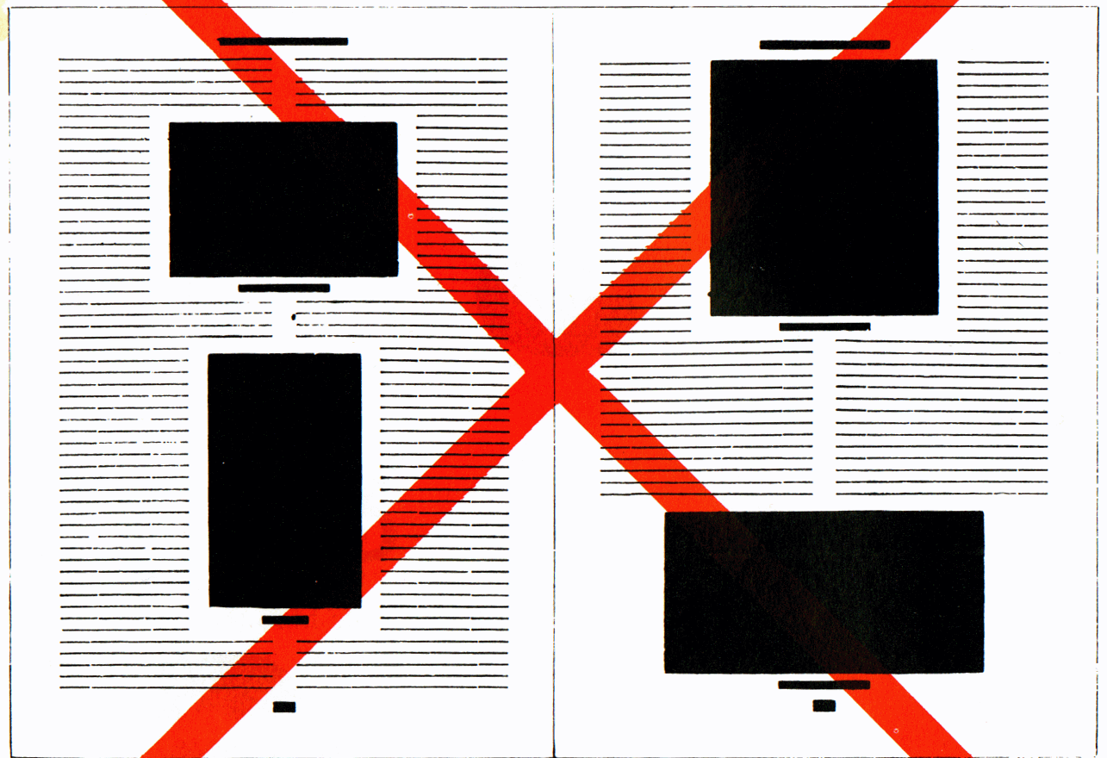
Asymmetric Typography
J A N T S C H I C H O L D
How blocks used to be arranged in magazines. Schematic, thoughtless centering of blocks (= ugly).
The same blocks, correctly arranged in the same type-area. Constructive, meaningful, and economical (= beautiful).
Notes:
Main tenant of modernist design
In books before the Bauhaus, everything was centered.
Harder to read.
Asymmetric: 1) feels more dynamic (energy to the type), 2) don’t have difficult to read narrow columns around the figures.

Slide 41
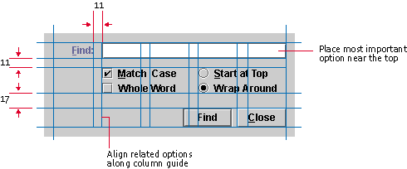
Grid Systems
A key pattern for implementing rationality, modernism, asymmetry
Note that no elements are “centered”
Java Look and Feel Design Guidelines
Notes:
One take-away on how to design a lot of information on a page, a grid system is a good place to start.
Using the grid gives you consistency and if you use someone else's grid, you get to take advantage of professional designed system.
Find is easy to see since it is in a column all by itself.
Space is consistent between the buttons.
Things that are similar are closer (i.e., radio buttons).
Bigger space to the buttons at the bottom – there different.

Slide 42
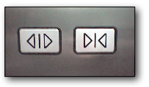
Iconography: Differences that Make a Difference
www.jensondesign.com/1+1=3.pdf
Notes:
Left has same symbols. Only flipped.
Right has greater iconic differences. Also size and color.
Radical change? ...Get rid of the close button entirely.

Slide 43
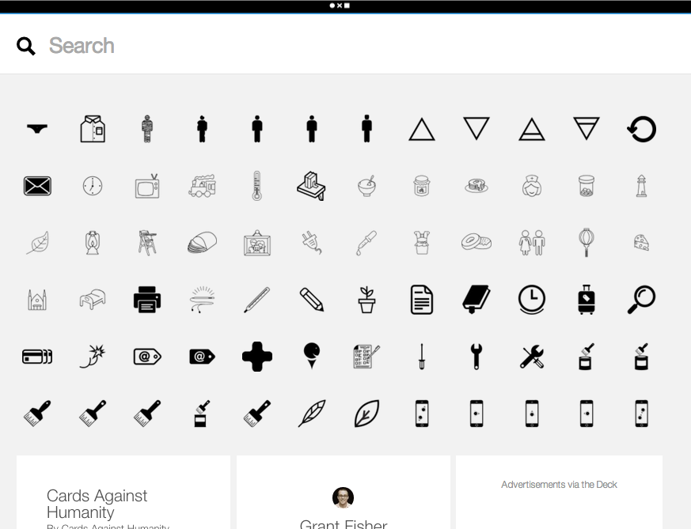
The Noun Project
A “Language” of icons
Notes:
An extremely useful tool for those (including myself) lacking in the creative capacity to think of metaphors, the noun project is a great tool for translating words into icons that you can then use in your interface. The key is to pick icons appropriately and test if they mean the same thing to you as others.

Slide 44
Announcement: Contemplation by Design
CBD: Mindfulness and Design Thinking
Mon 11/03
5:15 pm-6:30 pm
Location: Institute of Design, d.school Atrium
This panel discussion will illuminate how design thinking relates to and incorporates mindfulness and contemplation. The panel will include Professor Bill Burnett from the d.school (Institute of Design at Stanford), a professional who integrates design thinking and mindfulness/contemplation in their professional work, as well as a mindfulness teacher.
https://healthimprovement.stanford.edu/classes/register/hipClasses.php?t=1cce34dfd3cbss383d348a508b1be48cc821&cbd=1

Slide 45
team break
(25 minutes)

Slide 46
Team Exercise
What are your goals/deliverables?
Are you on track to meet your team goals/deliverables?
If no, why not? What can you change?

Slide 47
Color
Notes:
Color is often difficult to get right. It plays a major role in stimulating a person’s reaction or attitude which may vary from individual to individual and yet across cultures, colors have different meanings.

Slide 48
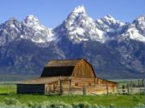
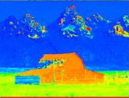
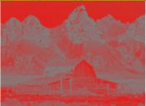
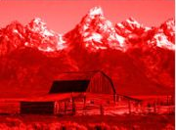
Color
Hue is gradation of color
Saturation is intensity/purity of the hue
Luminance is the brightness in an image
Photo Hue Saturation Luminance

Slide 49
Color: Edward Tufte – by hue
IMAGE REMOVED
Notes:
While it is certainly true that hues have a physical order via their wavelength, and that every kindergartener knows the rainbow ordering, our visual system has a very difficult time treating hue in an ordered way. As we see in this image, it is clear that each area is *different*, but none of the areas have an intuitive relationship between each other. This is supposed to convey height above sea level.
Where is above ground? Where is below? What’s the highest point? These questions are hard to answer. (Saturation as a cue is nearly impossible to handle.)
This is how most computer scientist would design a map.

Slide 50
Color: Edward Tufte – by luminance
IMAGE REMOVED
Notes:
Color sets that vary primarily by luminance are much easier for us to order. This image uses two color sets: browns for above ground, blues for below. The questions I mentioned before are now much easier to answer. The much more muted colors also much easier to read the information.
[Eastern Sea, not Japan Sea]
Cartographers have been doing this for 2000 years.
The key is to know: under water or not under water? Then, how far for each case? Our perception system can’t use hue for how much! But, we can use intensity. As I go deeper, the color gets darker. Intensity is a great axis for presenting quantitative info.

Slide 51
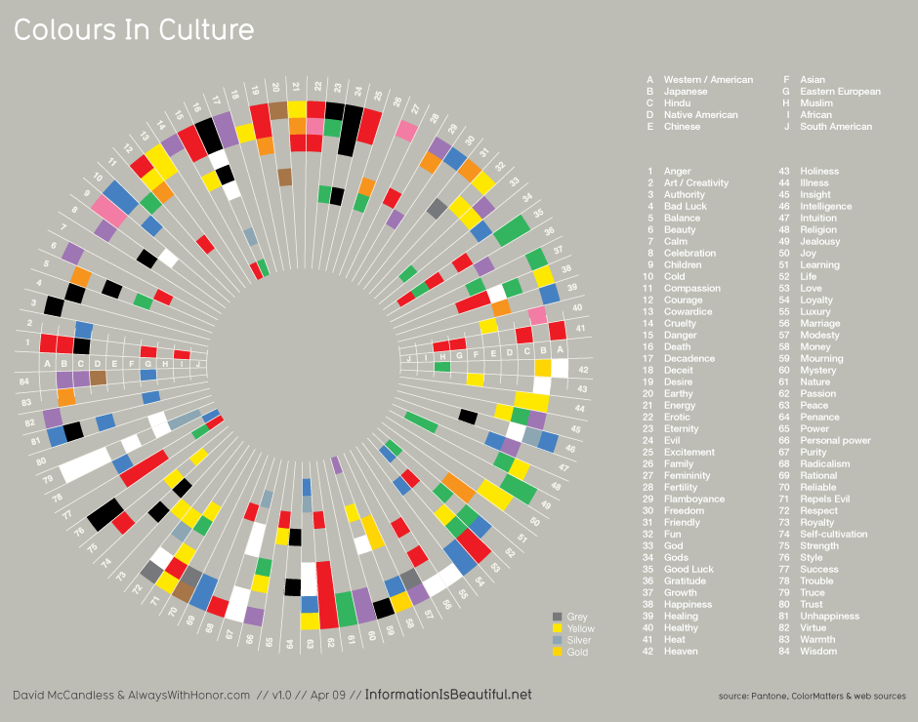
Notes:
This is a diagram of what colors mean for different cultures again from Dave McCandless’ Information is Beautiful.
key to note is the set of colors & their order in each slice differ!

Slide 52
Notes:
Aside from the fact that it has an interesting layout, one thing becomes scarily apparent – colors don’t represent the same thing for everyone. At its most basic, this means don’t make a button with “yes” on it green

Slide 53
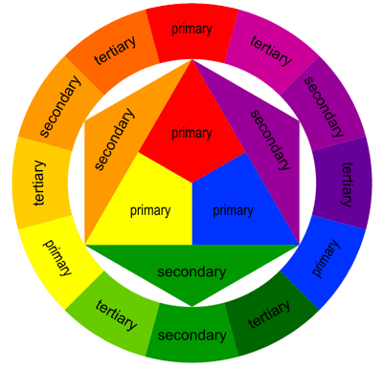
The Basics of the Color Wheel
WARM
COOL
Notes:
One thing is similar across cultures with color at its most basic level. We can separate color into “warm” and “cool” colors which have a very similar emotional response to all people as the theory is based on our innate understanding of the natural world.

Slide 54
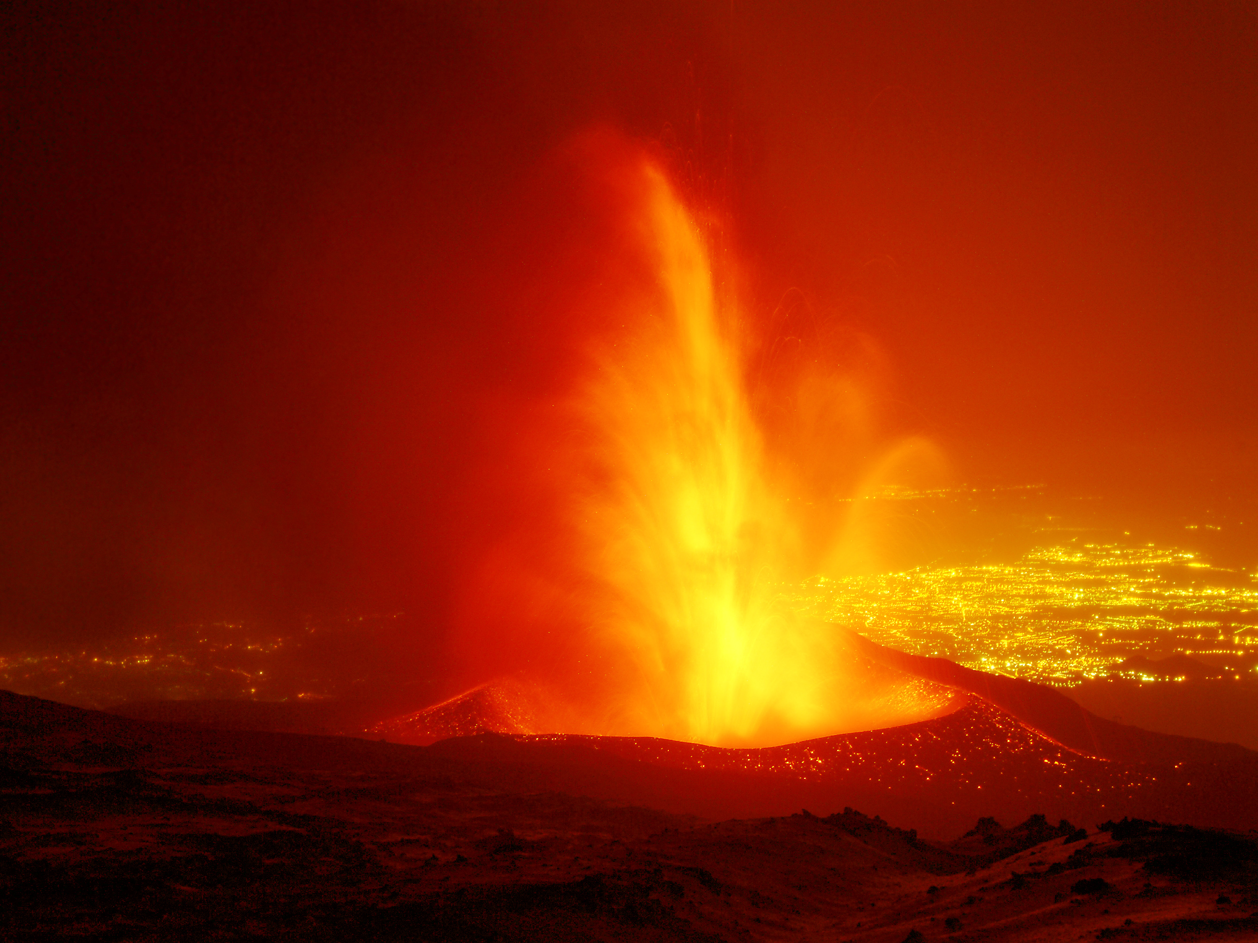
Warm Colours : Triggering / Sensual
Notes:
Colors like yellow, orange and red and its variations are all called as warm colors. These colors are in the sunrises and sunsets, fallen leaves, fire and these colors are denoted as sensual, positive and triggering.

Slide 55
Cool Colours : Conserved / Relaxing
Notes:
Purple, blue and green are all called as the cool colors and are generally less intense than the warm colors. They are connected with relaxation, serenity and conserved and because of which they are associated with nature, water and night.

Slide 56
Color Harmonies
“A pleasing arrangement of parts, whether it be music, poetry, color, or an ice cream sundae.”

Slide 57
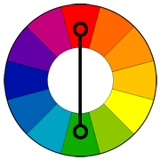
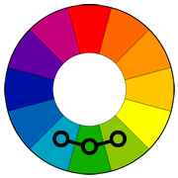
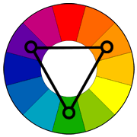
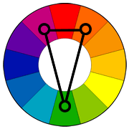
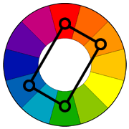
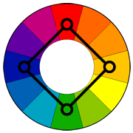
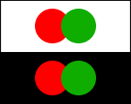
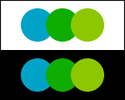
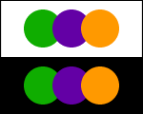
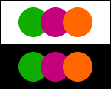
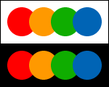
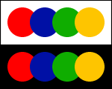
Using Appropriate Color “Harmonies”
Complementary
Analogous
Triad
Split Complementary
Rectangle
(Tetradic)
Square
Notes:
So how to we pick the right colors?
While my suggestion for beginners is to stick to one color or “monochrome” pallets, there is the odd occasion where information must have multiple colors to be distinguishable, such as in graphs. In these cases, Color harmonies are particularly useful. They involve picking a primary color and using a color wheel to determine the best colors to go along with it.
For beginners, I suggest using these two as they are hard to get wrong and tend to work with lots of designs.
see: http://www.tigercolor.com/color-lab/color-theory/color-harmonies.htm

Slide 58
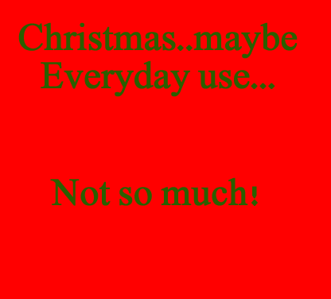
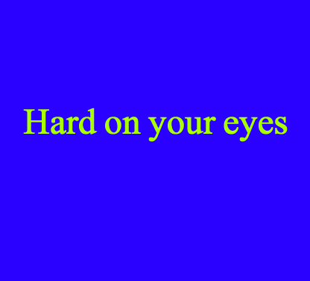
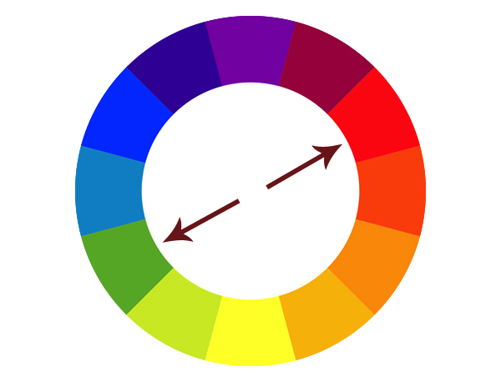
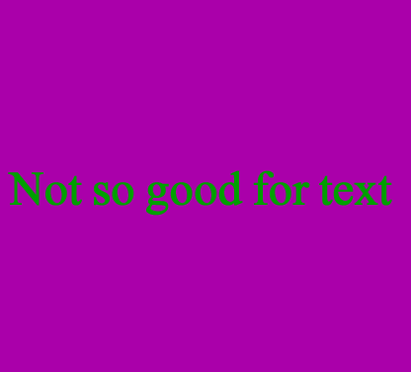
Complimentary
This color scheme must be managed well so it is not jarring. Bad with Text!!
Notes:
Complimentary colors provide extreme contrast. This high creates a vibrant look especially when used at full saturation.
Complementary colors are tricky to use in large doses, but work well when you want something to stand out.
Complementary colors are really bad for text.

Slide 59
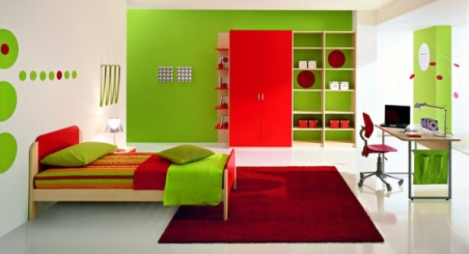
Complimentary Eg: Children’s Bedroom
Notes:
We often use complimentary colors in childrens products and services. The high contrast makes things easier to distinguish though makes it hard to discern what is actually important.

Slide 60
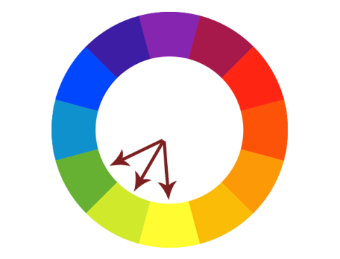
Analogous
Always easy on the eyes,
This type of color scheme
Always looks “natural”
Notes:
Analogous colors tend to relate closely to what we find in nature and thus are easiest on the eyes. Visual designs using these colors are always pleasant to look at yet have enough difference in color to be distinguishable in terms of priority.

Slide 61
Analogous Eg: Beyond Oil
Notes:
BP, who propose that they are a company beyond oil choose an analogous scheme as it invokes nature. The mixture of green and yellow here, not to mention its flower like shape, is comforting and rather powerfully suggests a oil company cares about the environment.

Slide 62
Split Complimentary
Often a good choice for beginners, because it is difficult to mess up.
Notes:
Split complimentary colors are often used when the elements of a design have a need for stronger need for distinction. This color scheme has the same strong visual contrast as the complementary color scheme, but has less tension.

Slide 63
EG Split Complimentary

Slide 64
EG Analogous

Slide 65
EG : Monochromatic
Notes:
Regardless of what color you are going to use, its always best to begin designs in gray scale

Slide 66
Start with Greyscale
… then accent or enhance with color
Notes:
The high contrast of greyscale allows you to really focus on getting the best layout and hierarchy of elements to then be accented or enhanced with color.

Slide 67
Notes:
The noun project is a very good example of an interface without any color. Here, the layout design and discovery is done so well that color is not needed at all to navigate. In fact this web interface feels to me better than many others using color
Also has good use of SMALL MULTIPLES

Slide 69
Action + Passive Colors
Notes:
A recent trend in design, most noticeable in things like Windows Phone and iOS is the use of the isolation effect. In this example, color harmonies are near irrelevant. These types of designs are so focused in their layouts that color is only used to describe an element that is “actionable”. It turns out that more often than not, this results in a user experience that is very easy to understand.

Slide 70
Poor Use of Color
Notes:
This is an example of poor color use. The colors don’t match to any particular task or function and as a result, it is near impossible to figure out what to do – and as a result, a horrible user experience perhaps more hindering than any functionality.

Slide 71
Redesigned to Use 3 Actionable Colors
Notes:
Luke’s goal was to pick a color harmony that was relaxing while only ever using 3 colors. Anything that is colored is actionable (tappable, important). Anything grey is a “passive” color and requires the user to explore this information.

Slide 72
Action
Immediate

Slide 73
Tools that help with color selection
http://colorschemedesigner.com/
http://kuler.adobe.com/
http://www.colourlovers.com
Notes:
These tools are useful for both exploration of colors and for figuring out harmonies. Tools like photoshop, illustrator and most interface designers also include built-in tools for choosing color harmonies.

Slide 74
Visual Design that is
Interesting
[the wow factor]
Notes:
This is perhaps the most difficult thing to achieve. It’s very easy to use templates for data graphs, websites and applications – and for the most part they do very well. The following techniques for most are difficult to do right, but when done well create interest.

Slide 75
Why making information Interesting?
Differentiation from similar work
Creates “willful” interaction as opposed to “forced”
With an interesting interface that is simple to learn, the user will teach themselves

Slide 76
Non Conventional Layouts
Hard to get right & easy to overdo!
Try new shapes:
Circular charts
Hexagonal Objects
Like all techniques (color, etc) – restrict unconventional layouts to the most important information

Slide 77
Non Conventional Layout
Notes:
This is a diagram of what colors mean for different cultures and is exciting enough that no matter the subject, you want to know what it’s about.
We can create “Interest” by using non standard layouts such as circles. Here the layout itself is so interesting, that the designer has chosen to reduce the text size knowing that the reader will gladly look closer.

Slide 78
Dynamic Movement
Hard to get right & easy to overdo!
Animation is best used to connect information & create “flow”
Like size, color & unusual shapes, animation draws attention to the eye & suggests importance
Notes:
Having information change dynamically has taken off recently and again, is difficult to do correctly. The best way for me to consider animation is to only use it to connect an input to a display of the information the input is modifying.
This connects to a usability principle that will be discussed in the next lecture “Heuristic Evaluation” where information that adapts instantly gratifies the user that the system is working for them, not against them.

Slide 79
Dynamic Movement
Notes:
This is sokanu.com , a website for discovering careers through simple engaging questioners.
In this case, as you answer questions, its career suggestions theoretically get better and better. Having this information change dynamically connects the information to your interaction and is both interesting, and informative.

Slide 80
Metaphors (using the real world to describe info)
Hard to get right & easy to overdo!
Very useful to provide meaning and connect information to logic
As you have seen before, the more direct or specific a metaphor, the more contextually relevant it is to a generation or time
Notes:
Metaphors are perhaps one of the hardest “interesting techniques” to get right. In information graphics, metaphors are very useful however in interfaces they can often cause more confusion than success.

Slide 81
Metaphors
Notes:
This shows changes in global emissions of CO2 and uses the metaphor of clouds of smoke coming out of a factory
http://awesome.good.is/transparency/web/0911/globalemissions/flat.html

Slide 82
The best designs balance the techniques you have seen
and
The less techniques used, the easier it is to balance them
Notes:
We have discussed now what may seem is an overwhelming amount of techniques designers use all the time.
This is how it should seem – Overwhelming. It is exactly the way customers will feel if they see too many being used at once.
Again we are brought back to the number one skill – Balance.
The hardest part is knowing what to remove and the only way to really get a good feel for these techniques is to practice with them repetitively.

Slide 83
Overwhelming use of Different Techniques

Slide 84
In other words,
Keep it Focused
Notes:
We have discussed now what may seem is an overwhelming amount of techniques designers use all the time.
This is how it should seem – Overwhelming. It is exactly the way customers will feel if they see too many being used at once.
Again we are brought back to the number one skill – Balance.
The hardest part is knowing what to remove and the only way to really get a good feel for these techniques is to practice with them repetitively.

Slide 85
David McCandless
http://www.informationisbeautiful.net

Slide 86
Form
Interestingness
Integrity
Function

Slide 87
Summary
Start with Context, what is the nature of the information? What is the most important?
Design first in gray scale to focus on hierarchy
Small changes help us see key differences (e.g., small multiples)
Avoid clutter, focus on the essence of your tasks
Use color properly – not for ordering!
Only use one or two colors at a time, unless absolutely necessary

Slide 88
Further Reading
Kevin Mullet and Darrell Sano, Designing Visual Interfaces
Edward Tufte’s books and course
Anne Spalter, The Computer in the Visual Arts
Robin Williams, The Non-Designer’s Design Book
Typography
Jan Tschichold, The New Typography
Robert Bringhurst, The Elements of Typographic Style
http://www.adobe.com/type/

Slide 89
Further Reading
Color: Charles Poynton, A Technical Introduction to Digital Video
also his SIGGRAPH course
web http://www.inforamp.net/~poynton/
Typography on the web
http://www.pemberley.com/janeinfo/latin1.html
http://www.microsoft.com/typography/

Slide 90
Next Time
Heuristic Evaluation
Reading
How to Conduct a Heuristic Evaluation by Jakob Nielsen
Next individual assignment
Simple Heuristic Evaluation

Slide 91
Activity:
Essential Design
Notes:
You have heard from James about a bunch of techniques people use in information design. Id like to stress one very important point. Don’t use them all.

Slide 92
Essential Design Activity
Take a screen design from your project (I suggest the most important screen.. Home screen, first screen etc)
Figure out the most important elements on the screen. (What do users need to see most?)
Design a layout with this hierarchy in mind
Select a color scheme of one or two colors MAX
Apply color again with a focus on hierarchy

