Slide 1
huddler: convening stable and familiar crowd teams despite unpredictable availability
Niloufar Salehi, Andrew McCabe, Melissa Valentine, Michael S. Bernstein
@niloufar_s niloufar@cs.stanford.edu STANFORD HCI
Notes:
Support distributed, online crowds- to get together to work on complex tasks that require collaboration in stable and familiar teams

Slide 2
microtask workflows
[Little et al. 2010, Dai et al. 2010, Bernstein et al. 2010, Kittur et al. 2011]
Notes:
Traditionally Crowdsourcing techniques → guide distributed, independent crowd workers -> through workflows, -> goals -> summarizing text
Research in organizational b has found ->
Complex goals ->need

Slide 3
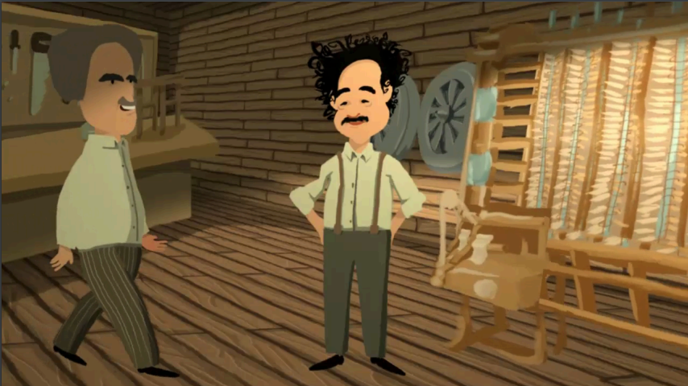
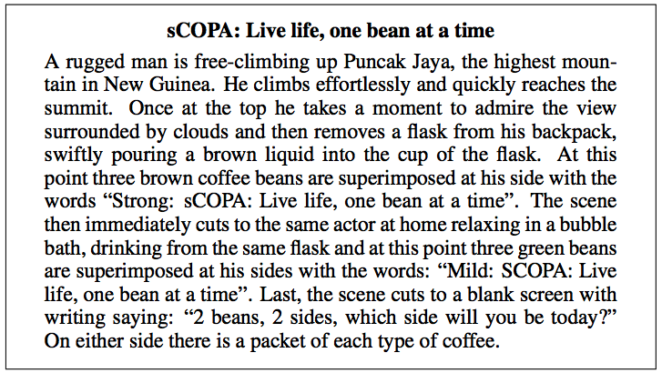
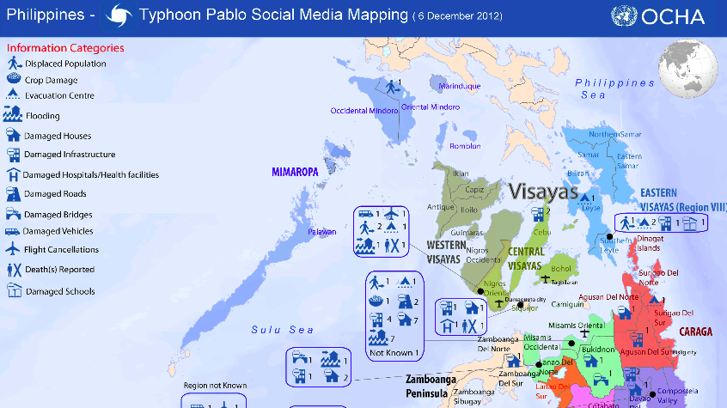
teams of collaborators with complementing expertise
[Argote 1984, Van De Ven et al. 1976, Hackman 2002]
[Retelny et al. 2014, Lykourentzou et al. 2016, Mao et al. 2016, Retelny et al. 2017]
Notes:
-> teams of collaborating workers with complementing expertise
More recently -> Building on this -> researchers have hired -> ad-hoc teams of crowd workers -> animations, and ads and annotated maps with information about disasters

Slide 4
Familiarity
Fundamental condition for effective teams
Crowd work
Flexible and on-demand, making it difficult to recruit familiar teams
[Argote 1984, Van De Ven et al. 1976, Hackman 2002]
Notes:
We know that in order to be effective, team members need to know and trust each other — in other words, they need to be familiar with each other.
But this stands in contrast with -> flexible on-demand nature -> come and go as they want

Slide 5
Crowd work can be flexible, rapid, and creative without losing the social fabric that makes team-work work.
Notes:
[slow]
I’m going to demonstrate -> crowd work can be flexible, rapid, creative -> without loosing the social fabric and common ground that make team work work
To do this -> Designed methods -> assemble highly familiar teams, quickly

Slide 6
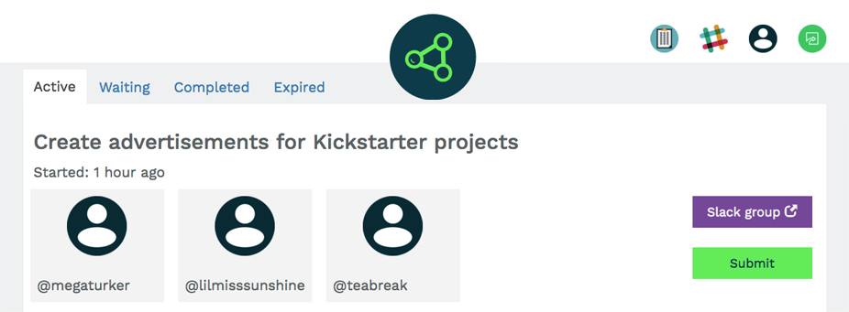
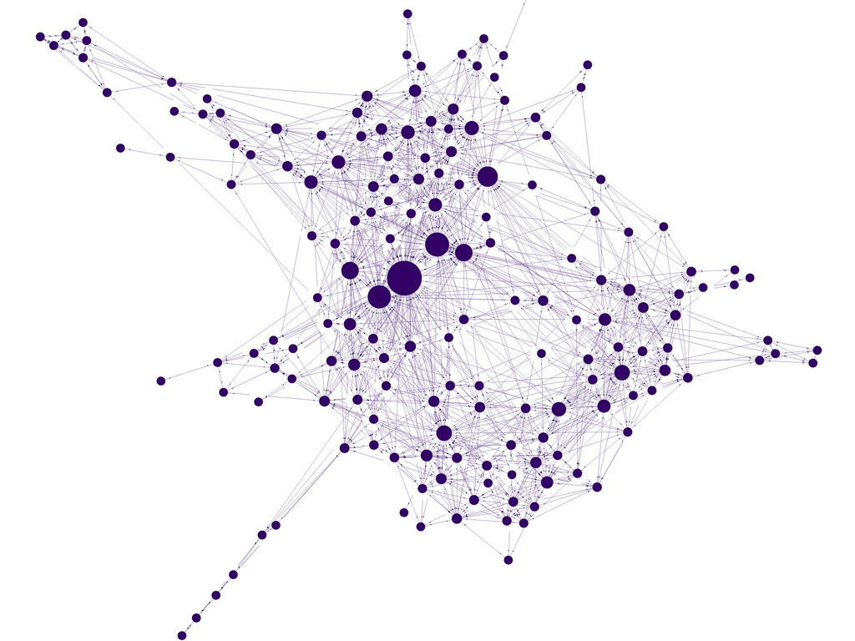
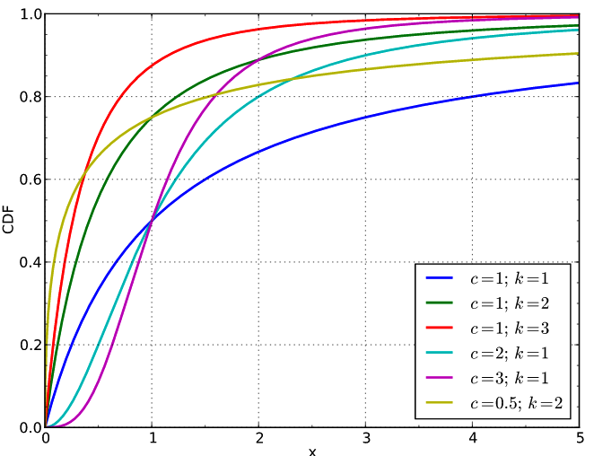
huddler
hours to respond
network of worker collaborations
model worker availability
Notes:
Implemented -> Huddler -> workers can use to assemble familiar teams [pause]
Huddler ->
keeps track of the network of past worker collaborations & models each worker’s availability,
When huddler needs to assemble a new team ->
We can then use these -> Essentially -> turn the problem into an optimization problem

Slide 7
optimization problem
Maximize:
expected familiarity
subject to:
Notes:
Maximize the familiarity of a team, while -> staying within a fixed time limit
I’ll explain how this works through the talk and I’ll show that

Slide 8
Convene highly familiar teams about as quickly as a system that ignores familiarity.
Notes:
this approach convenes highly familiar teams about as quickly as a system that tries to get anyone it can.
Which means that we can have online platforms that enable creative team-based work

Slide 9
familiarity huddler evaluation discussion
Notes:
[[2]] First -> familiarity in teams, why it’s important
-> introduce huddler
Then -> present two studies that show the benefit of familiarity and that huddler’s algorithm was able to recruit highly familiar teams in a real world setting
End -> discussing implications of this research and future work

Slide 10
familiarity huddler evaluation discussion
Notes:
Familiarity how many times two ppl have worked together in the past -> explain why we should care about it

Slide 11
familiarity
Structured workflows are fundamentally incompatible for complex work.
Teams establish a course of action, execute it, and reflect and revise.
[Argote 1984, Van de Ven et al. 1976]
[Van De Ven et al. 1976, Hackman 2002]
Notes:
So far -> crowdsourcing techniques mostly -> microtask workflows
Seminal research organizational design -> established that
Work complex face uncertainty and interdependence among roles-> team based coordination-> complementing skills and interact continuously to create and execute a course of action go back strategy
Fundamental condition For this to work

Slide 12
familiarity
Successful team based coordination requires that team members build familiarity.
Familiar teams gain performance benefits
situated knowledge
strengths and weaknesses
psychological safety
knowledge sharing
[Argote 1984, Van De Ven et al. 1976, Hackman 2002, Gruenfeld et al. 1996, Harrison et al. 2003, Huckman et al. 2009]
Notes:
-> members build familiarity -> working together over time
Controlled experiments ->studying -> long term real world orgs -> software firm -> research
More effective team work
Group -> team -> learn each others’ -> enables act as a coordinated whole
Team beliefs -> increase -> knowledge sharing
it would be great if we could -> keep these benefits for online crowds

Slide 13
form familiar teams while preserving the distributed, flexible nature of online work
Notes:
[slow]
Big challenge -> forming familiar teams while preserving the distributed, flexible nature of online work
I’m going to show you -> that we can create a system that convenes teams from the crowd extremely quickly that know each other very well, even when we can’t know a priori who might show up!

Slide 14
familiarity huddler evaluation discussion
Notes:
[[4]]

Slide 15
huddler
Notes:
Huddler -> system -> crowd workers -> use -> assemble a familiar team -> complete a project with
When we need to assemble a new team, since we don’t know who is going to be available

Slide 16
huddler creates a schedule
1 2 3 4 5
Notes:
huddler needs to create a schedule of a list of people and time limits,
it then starts at the beginning of the list and sends invitations telling them that they have half an hour to respond, moving on to the next
Huddler wants to create this schedule in a way that maximizes the final team’s familiarity
While staying within an overall time limit

Slide 17
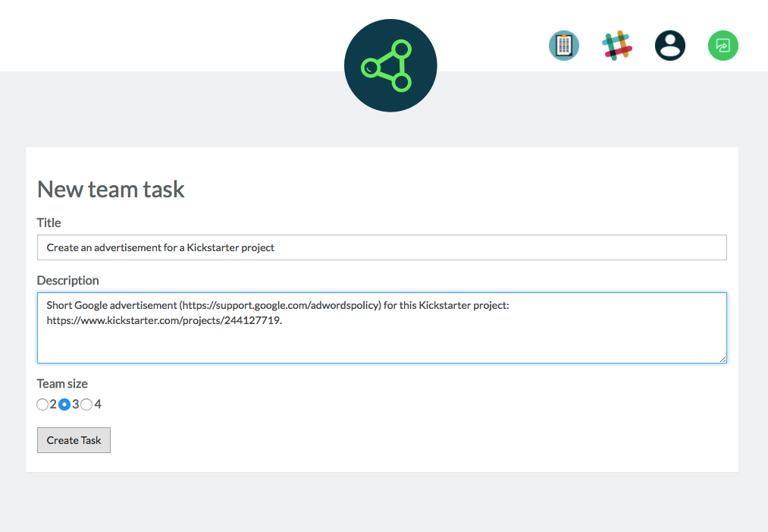
Notes:
How huddler works -> walk you through a scenario
First -> requester uses huddler to create a task

Slide 18
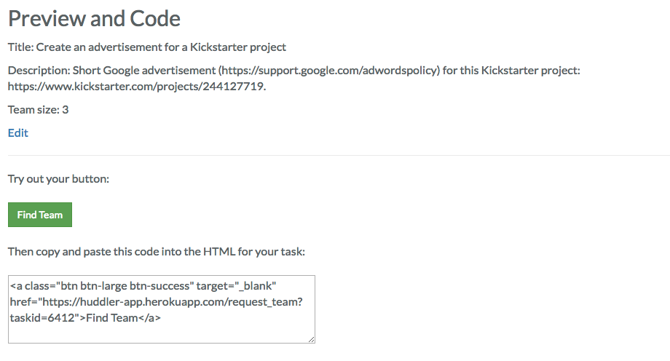
Notes:
Then they get a button, that they can copy paste into their task

Slide 19
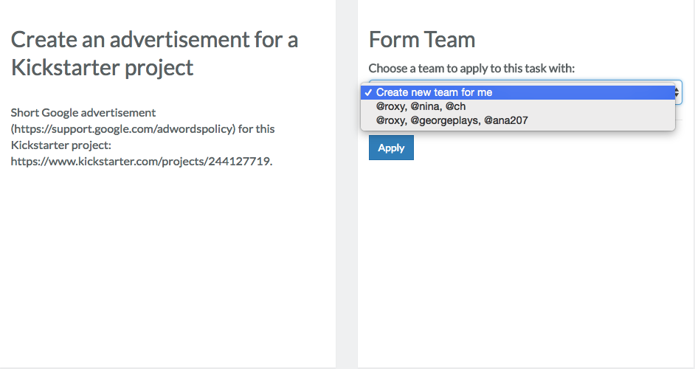
Notes:
A worker comes and needs a new team to apply to the task with
Huddler needs to assemble a familiar team

Slide 20
Notes:
Crowd worker who started -> huddler is going to try to convene a team around p

Slide 21
Notes:
Many people in our database to invite to this new team

Slide 22
how can we quantify the value?
Notes:
Have very different past experiences working with p -> different values associated with inviting each to ps team
quantify the value of adding a person to a team?

Slide 23
for every pair of people:
and
the number of times that the two have worked together, weighted by their mutual ratings.
Notes:
Rely on prior work -> Define -> familiarity as -> the number of times -> more leverage -> after
-1 … 1
-1 -> do not want
1 -> would like to work

Slide 24
Notes:
Rely on prior work -> Define -> familiarity as -> the number of times -> more leverage -> after

Slide 25
Notes:
Rely on prior work -> Define -> familiarity as -> the number of times -> more leverage -> after

Slide 26
do we invite them? how long do we wait?
Notes:
Now we have -> Value score
make a decision, do we invite this person? Yes? How long?
So we might have this person, who has very high familiarity but is unlikely to be available, and this other person, who is lower familiarity but very likely to be available. How do we trade these off? In probability theory, this is often captured through a notion of Expected Value — the value of the event multiplied by the probability of the event happening
So we introduce a technique of

Slide 27
Expected value of inviting them and waiting t hours
Notes:
Calculates the expected value of inviting someone and waiting for them for t hours

Slide 28
probability that p will respond within the next t hours if we invite them now.
Notes:
Expected value defined-> probability of something happening * value
Define Availability -> probability that .. -> records of past invites -> empirical CDF
* value
So now we have -> expected value, inviting one person and waiting for a specific amount of time

Slide 29
Notes:
Back to our example -> we can not calculate expected value
For half an hour

Slide 30
Notes:
Eg -> 50 -> 0.2
There’s a 20% chance that this person will say yes within the next 30 minutes

Slide 31
Notes:
Eg -> 50 -> 0.2

Slide 32
Maximize:
subject to:
Notes:
Now that we’ve defined that expected value for a single team, problem becomes maximizing the sum of the expected value over our whole list

Slide 33
Notes:
Let’s say we have
Global Time constraint T -> 2h-> allocate
the algorithm has to decide to wait for 1.5hr, 1hr, or 30min, and here it’s exploring the 1hr option

Slide 34
Notes:
Expected value of 59

Slide 36
Notes:
+ we have 1.5 hours left to allocate among the remaining people

Slide 37
Notes:
Let’s say we want to wait for the next person for 1 hour
Calculate the expected values -> choose

Slide 39
Notes:
Now we have half an hour left
And we choose our best option for the rest of the half hour

Slide 41
Notes:
So this is one solution that gives us an expected value of 95
You’ve probably noticed that the total number of possible schedules is exponentially large
Let’s say we want to try another schedule

Slide 42
dynamic programming approach polynomial time
Notes:
The problem -> half an hour to allocate among these people -> but we already solved it
Solve -> Sub problem -> Cache our answers -> not worry about it again
Dynamic programming approach
Polynomial time
We found an even better solution

Slide 43
Notes:
Algorithm goes through and tries all the different schedules to find the optimal one

Slide 46
Notes:
And whenever it reaches a problem it’s solved before it just uses that answer

Slide 47
Maximize:
subject to:
Notes:
huddler solves this optimization problem to balance familiarity with availability
Edge cases -> declines an invite, Preference, skill sets -> tweak this algorithm to deal with these
even without knowing exactly who is available, this approach can form a familiar team around a seed member, very quickly

Slide 48
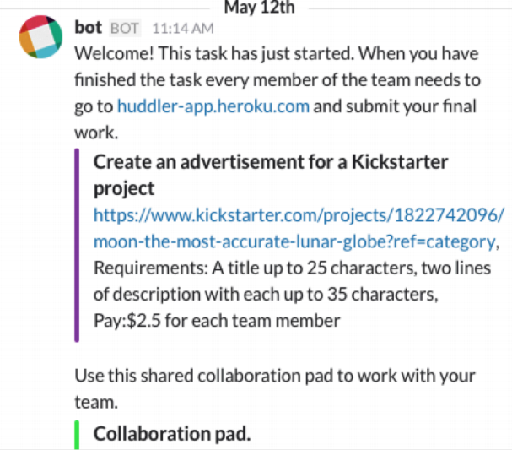
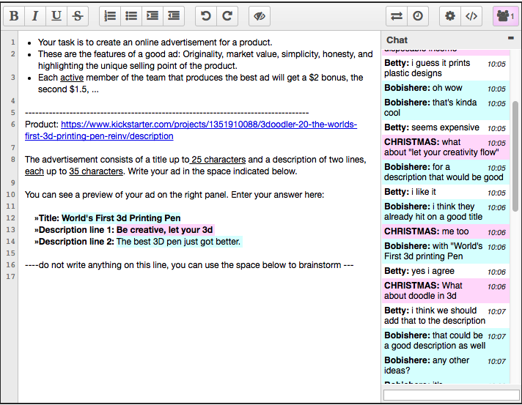
Notes:
confirmed
Invites -> sending emails -> slack channel
Instance of etherpad
Choose how to use these tools

Slide 49
familiarity huddler evaluation discussion
Notes:
[[11]]
How huddler works
2 study -> evaluate it

Slide 50
do familiarity benefits generalize to crowd teams?
200 crowd workers, teams of 3-4
Create a Google ad for a Kickstarter project
Notes:
Expect -> familiarity
Empirically -> not clear
Do not see each other face to face, lack shared organizational context
2 conditions
Re-randomized
193 ads -> Google ads

Slide 51
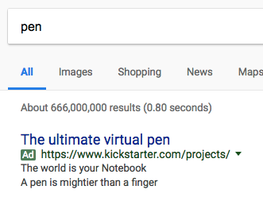
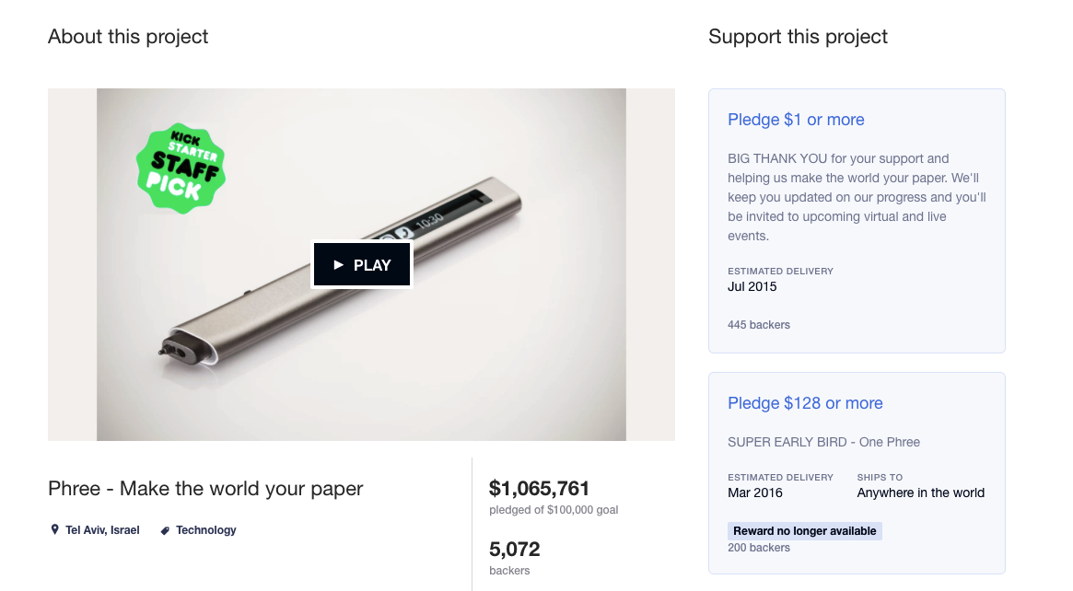
google ad for a kickstarter project

Slide 52
do familiarity benefits generalize to crowd teams?
200 crowd workers, teams of 3-4
Create a Google ad for a Kickstarter project
Familiar condition vs. Ad-hoc condition
Series of 5 tasks
Measure: CTR on Google
Notes:
Expect -> familiarity
Empirically -> not clear
Do not see each other face to face, lack shared organizational context
2 conditions
Re-randomized
193 ads -> Google ads

Slide 53
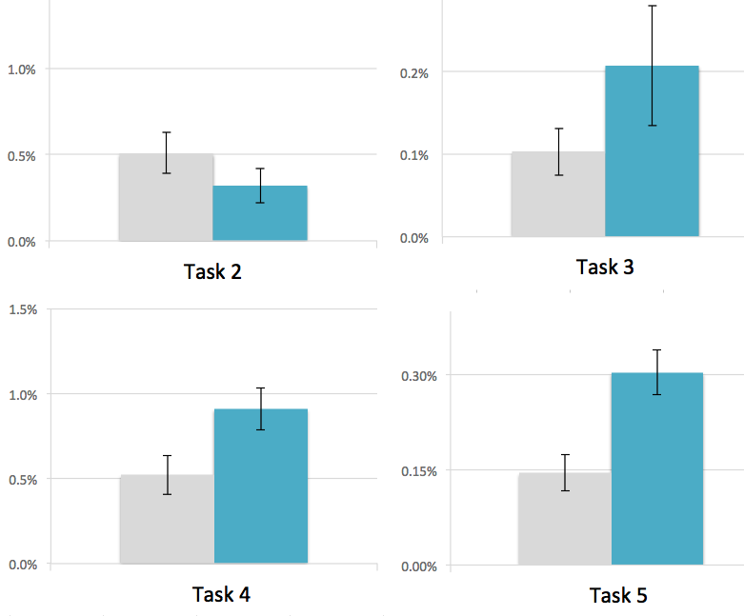
click-through rates for teams in the familiar condition were twice as high as those in the ad-hoc condition
ad-hoc
familiar
t-test:
Notes:
Familiarity -> enabling condition -> even -> distributed crowd workers

Slide 54
can huddler assemble familiar teams within a real world crowd work setting?
280 crowd workers, teams of 3
Create a Google ad for a Kickstarter project
2 week long study
4 conditions
Notes:
AMT real world setting

Slide 55
study conditions
availability
control (ad-hoc) | availability only
familiarity only | huddler
familiarity
Notes:
2x2 study
Huddler -> solves optimization problem -> tradeoff

Slide 56
can huddler assemble familiar teams within a real world crowd work setting?
280 crowd workers, teams of 3
Create a Google ad for a Kickstarter project
Two week long study
4 conditions
Measure: familiarity scores and time
Notes:
AMT real world setting
Posted tasks on week days

Slide 57
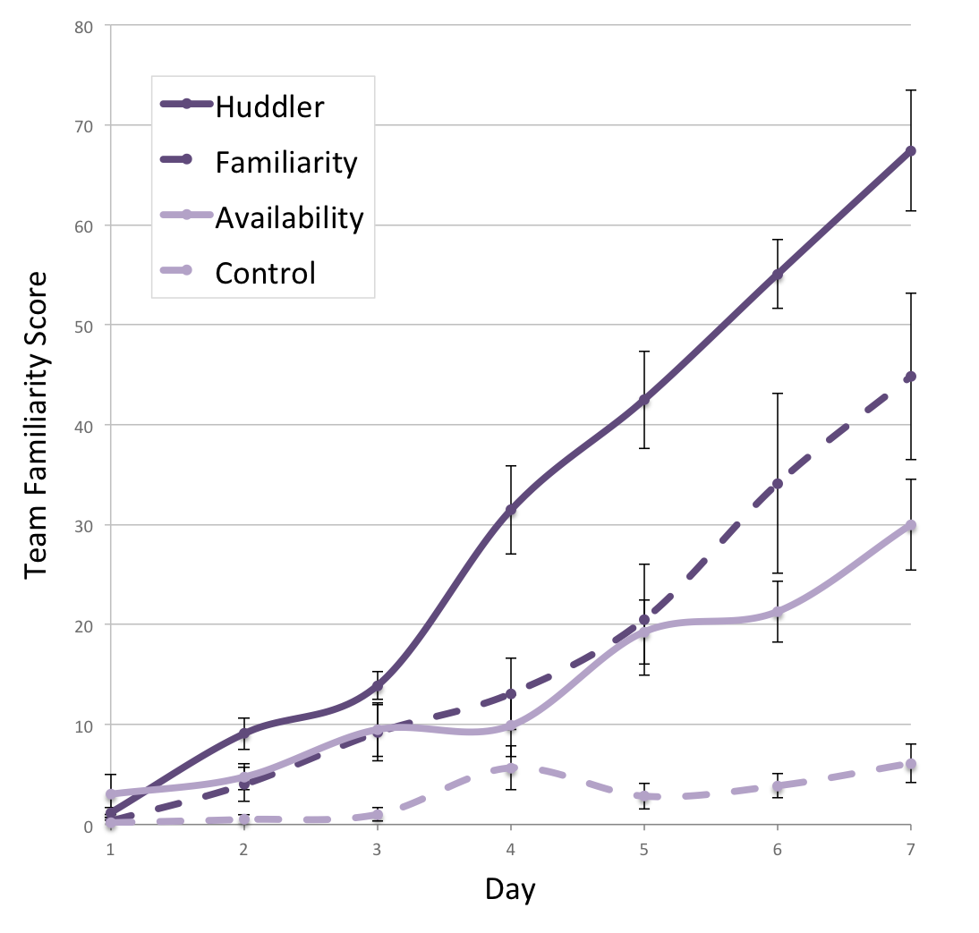
teams in the huddler condition had significantly higher familiarity scores
Two-way ANOVA found significant effect of familiarity and availability
Notes:
No interaction
Familiarity & availability
Side effect

Slide 58
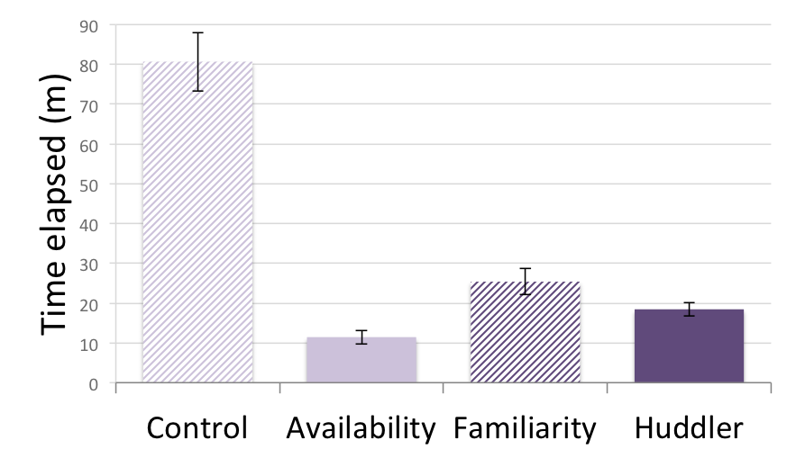
conditions that factored availability for each worker were faster to form
Notes:
Control -> 80 min
Availability -> 11.4 minutes
Huddler condition was still relatively fast ~ 18 minutes
2 way anova, 0.01
Huddler -> form familiar teams, fast
TODO: explain stats

Slide 59
familiarity huddler evaluation discussion
Notes:
[[15]]

Slide 60
limitations & future work
one type of task & short time limit
algorithm maximizes familiarity greedily
Notes:
Rely prior work -> same effects for month long projects
Nature of the system is greedy ->
There are reasons why we might not want the most familiar team all the time ->
Proactively create familiarity between new people -> area for future work

Slide 61
Computation can support complex networks of skilled workers who build long-term connections and work together in teams that improve over time.
http://guidelines.wearedynamo.org
Niloufar Salehi, Andrew McCabe, Melissa Valentine, Michael S. Bernstein
@niloufar_s niloufar@cs.stanford.edu STANFORD HCI
Notes:
Crowdsourcing -> shared many characteristics of traditional models of organizing work -> emphasize workflows, top-down control ->
achieve efficiency -> relying on certainty -> predictability -> objective measures of indiv performance
Envision a future -> crowd work characterized -> complex networks of skilled workers -> build long-term connections -> work together in teams -> improve over time
Thank my co-authors and the crowd workers who participated in this research. All of the tasks in this project were in accordance with the Dynamo guidelines for ethical research on MTurk

Slide 62
Process Knowledge Spectrum
complexity, interdependence, and uncertainty
Routine Operations
Based on well-developed and precisely codified process knowledge.
Complex Operations
Embody uncertainty and require problem solving and interrelated roles.
Independent Workflow
e.g. tagging images
Sequential Workflow
e.g. Find-fix-verify
Reciprocal Workflow
e.g. MonoTrans2
Team Workflow
Huddler
[Edmonson 2012]
Notes:
Amy C. Edmondson Teaming: How organizations learn, innovate, and compete in the knowledge economy. John Wiley & Sons, 2012.

Slide 63
teams of collaborators with complementing expertise
[Argote 1984, Van De Ven et al. 1976, Hackman 2002]
Notes:
-> teams of collaborating workers with complementing expertise

Slide 64
teams of crowd workers
[Retelny et al. 2014, Lykourentzou et al. 2016, Mao et al. 2016, Retelny et al. 2017]
Notes:
More recently -> Building on this -> research -> ad-hoc teams of crowd workers -> animations, MOOC videos, text based ads and annotated maps with information about disasters

Slide 65
for each team and potential new team member
and time
Expected value of inviting person p to team m and waiting for time t
for list of n people L
Expected value of optimally inviting members of list L to team m over a time period of t
Notes:
Optimal -> This doesn’t necessarily mean inviting every single person.

Slide 66
for each potential new team member
And team
Notes:
Simple ways to adjust this approach to take into consideration certain skills that we may need on the team, or to prioritize new comers -> on boarded
We have a definition -> pairwise fam -> expand

Slide 67
for each team and potential new team member
and time
Expected value of inviting person p to team m and waiting for time t
for list of n people L
Expected value of optimally inviting members of list to team m over a time period of t
Notes:
This is exactly what we were looking for -> solution to this -> solve this

Slide 68
recursive solution:
Notes:
Dynamic programming look up table -> previously computed subvalue -> use -> produce optimal solution

