Slide 1
Crowd-Powered
Systems
Michael Bernstein
MIT CSAIL
Notes:
[Enter with energy!] What I'm going to talk about today are *crowd-powered systems*, which are interactive systems that embed human intelligence from crowds of people online.

Slide 2

Help with complex
cognition and manipulation tasks
- layout
- spelling
- grammar
Less support for the core activity: editing
Notes:
To set the stage for why we might want that, I’ll start with the word processor. That’s because the word processor is one of the most heavily designed, most used interactive systems ever. At its core, the word processor and many other interfaces are supporting the cognitive process and helping offload tasks. For example, it takes over problems of layout, spell check, and grammar checking from the user. But at some level what we would really like out of a writing tool is help with _writing_, editing. Think about questions of expressiveness, of phrasing, clarity, or...

Slide 3
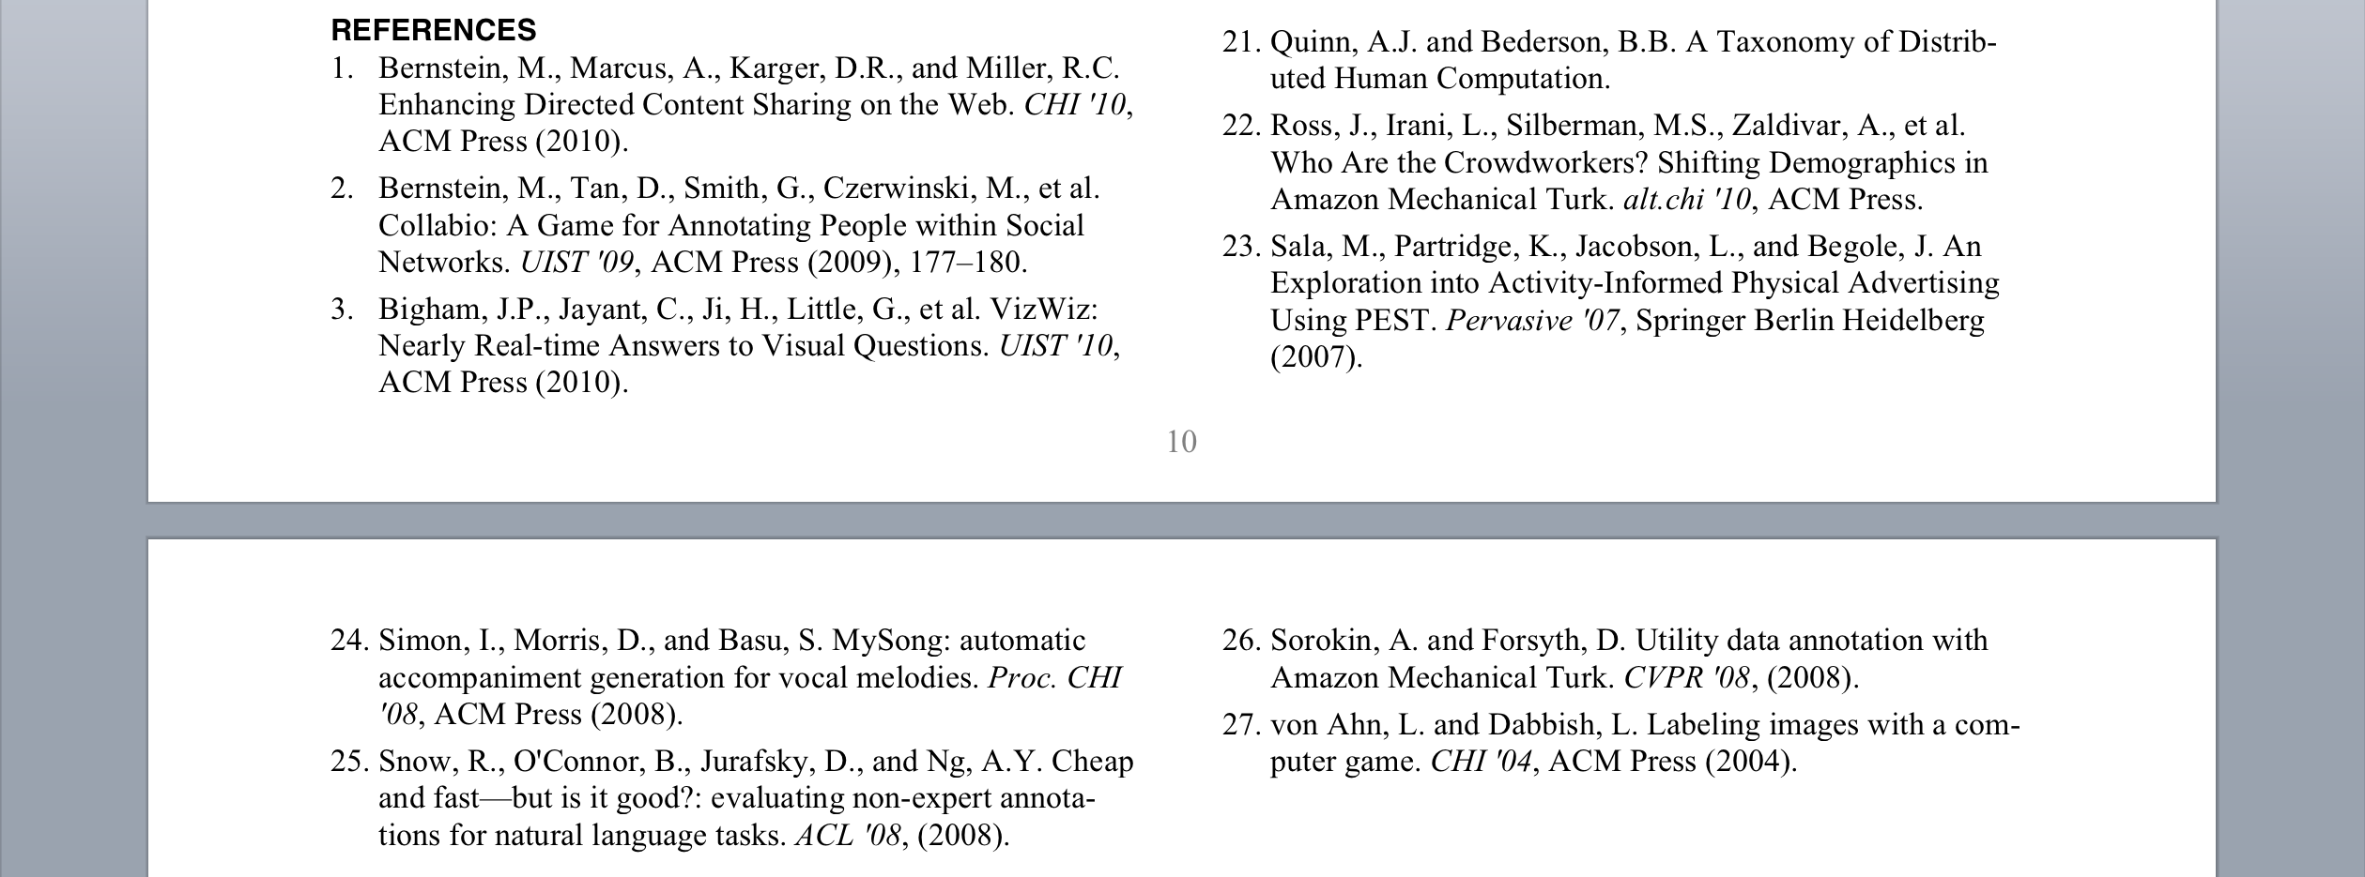
Shortening a paper
Supported by human editors
Notes:
cutting your text? How much time have we all spent cutting words and phrases to get a paper to fit in a word or page limit? Word processors can't support this task well yet. But at the same time, it's not the most fundamental part of the creative act — say, vs. marshaling evidence or constructing arguments — and we could use some support with it.
Historically, tasks like this that technology couldn’t support were outsourced to other humans: in this case, editors. It wasn't always the authors who did it. Editors supported the author by cutting, and suggesting better grammar and phrasing. Editors used to be critical parts of the writer’s toolbox.
But this was never a part of the toolbox that we could wire into our software, because we would need to have that editor, or at least someone who has a basic knowledge of english, available at any time. This just hasn’t been possible.

Slide 4
Crowdsourcing
Related Work
: A Batch Platform
Data collection, machine learning training,
user studies, social science experiments
[Ipeirotis 2010, Heer et al. 2010, Kittur et al. 2008]
Games with a purpose
[von Ahn and Dabbish 2004, Cooper et al. 2011]
Collective action
[Wikipedia, Polymath Project, Search for Jim Gray]
Historical roots: distributed calculation
of mathematical tables
[Grier 2007]
Notes:
But NOW we have crowds of people online all the time! This is known as crowdsourcing, which tasks crowds, large groups of people, with tasks. They train machine learning algorithms by labeling images or transcribing audio, they help execute studies and economics experiments, they fold proteins, they write encyclopedias, and much more. This goes all the way back to the 1700s, when the British Royal Astronomer distributed through the mail arithmetic calculations to create nautical charts, and reached its height during the great depression, when a WPA project enlisted 450 so-called “human computers”: the origin of the term computer we use today.
But what I’d like to point out is that this lineage of distributed human computation focused on batch processing tasks: you put out a lot of work, wait for it all to come back, and run some statistics or train an algorithm on the result.

Slide 5
Shortening a paper
Supported by human editors
Notes:
I’m going to show ways we can turn crowdsourcing into a platform that can support interactive systems. So, instead of relying on individual editors…

Slide 6

Shortening a paper
Supported by crowds
Notes:
…that we could recruit tens or hundreds of people to help read your document — a kind of on-demand editorial room — and then computationally identify the best of their suggestions, and use them to help you cut down that paper, all within your word processing interface.

Slide 7
Crowd-powered system
Interactive computing system
supported by human intelligence
Notes:
This is what I call a crowd-powered system: interactive systems that combine crowd and machine intelligence.
I’m going to show how this can reconfigure some of the core interactive systems we use: writing, photography, feedback, voting. Others have taken the idea since and applied it to many other tasks like search, robotics, and health.

Slide 8
Challenge: Quality
1,000 participants on Amazon Mechanical Turk flip a coin and report “h” (heads) or “t” (tails)
65% heads
28% tails
Notes:
`If we want to embed this fundamentally human element in our interactive systems, we need to address a couple of challenges. The first is quality. I asked one thousand people online to flip a coin and type “h” if they got heads and “t” if they got tails. In this room, I’m sure we’d get 50-50, but it turns out that on the Internet there’s a 2-to-1 bias towards heads in what people will report. It’s not that the internet is a biased coin, it’s that people are satisficing and exhibit inherent biases.
Hopefully you’ve noticed already that this doesn’t actually add up to 100%. That’s because…

Slide 9
Challenge: Quality
1,000 participants on Amazon Mechanical Turk flip a coin and report “h” (heads) or “t” (tails)
65% heads
28% tails
7%
head, heads, Tail, tails, Tails., t for tails, talis, f
Notes:
Fully 7% of the respondents didn’t type “h” OR “t”. They went out of vocabulary, sometimes trying to be helpful by writing out the word, sometimes misspelling it: head, heads, tail, t for tails, and the enigmatic “f”.
These are the kinds of unexpected quality results you’ll get when you reach out to crowds, and we’ll need to build our systems to expect or take advantage of them.

Slide 10
Challenge: Speed
Interactive applications need faster responses than crowds can provide
“User response was extremely fast”: 48 hours
[Kittur et al. 2008]
“Cheap and fast”: 190 hours
[Snow et al. 2008]
Half-life for 2.5¢ reward is 2 days,
Half-life for $1 reward is 12 hours
[Wang et al. 2011]
Notes:
The second problem we’ll need to solve is speed. Suppose I wanted crowds to help me operate my digital camera, for example to fix up a picture right after I take it. We’d need responses within a few seconds.
Unfortunately, crowds simply don’t react that quickly. In fact, early papers using these tools remarked on how quick it was, but we’re really looking at 48-190 hours for large numbers nontrivial tasks. In fact, some work at Berkeley doing survival analysis found that the half life for most tasks is around two days, and paying much more brings it down just to twelve hours.
This is a huge gain over earlier approaches, but this is still orders of magnitude too slow for us.

Slide 11
Interactive systems that
embed crowd intelligence
Computational techniques that produce high-quality, fast results
Notes:
What I’m going to show today are a series of interactive systems that embed crowd intelligence to extend the reach of what’s possible with interactive computing.
In order to do it, I’m going to introduce computational techniques that lead to high-quality and fast results.

Slide 12
Paid Crowdsourcing
Pay small amounts of money for short tasks
Amazon Mechanical Turk: Roughly five million tasks completed per year at 1-5¢ each [Ipeirotis 2010]
Label an image
Requester: Matt C.
Reward: $0.01
Transcribe short audio clip
Requester: Gordon L.
Reward: $0.04
Population: 40% U.S., 40% India, 20% elsewhere
Gender, education and income
mirror overall population distributions [Ross 2010]

Slide 13


1
Soylent
A Word Processor
with a Crowd Inside
Outline
2
Adrenaline
Realtime
Crowdsourcing

Slide 14
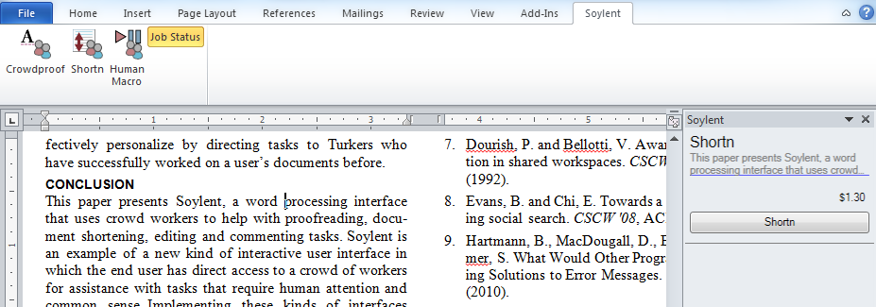
Soylent
Word processor that recruits crowds
to aid complex writing tasks
M. Bernstein et al. Soylent: A Word Processor with a Crowd Inside. UIST 2010.
Notes:
Uses TurKit

Slide 15
Soylent
Word processor that recruits crowds
to aid complex writing tasks
Embeds crowds as first-order
building blocks in a software system
Decomposes open-ended tasks
via a new design pattern
M. Bernstein et al. Soylent: A Word Processor with a Crowd Inside. UIST 2010.
Notes:
Uses TurKit

Slide 16
demo
Notes:
"we're just a few references overlength" --> "we're just a few lines overlength”
Shortn: authors are bad at hacking their own text. Nobody hacks it in tiny bits. Say out loud that the user is specifying how "tall" the text should be.
Rob's reason why the authors missed the error -- we're tired by page 7. Fresh eyeballs looking at a small bit of text.

Slide 17
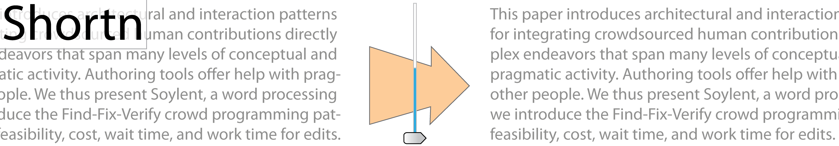
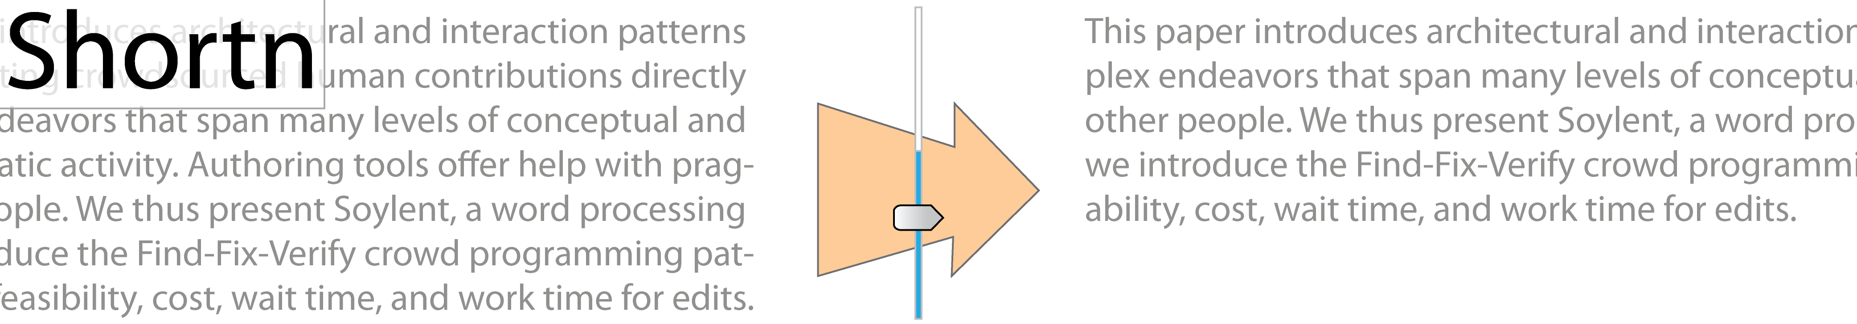
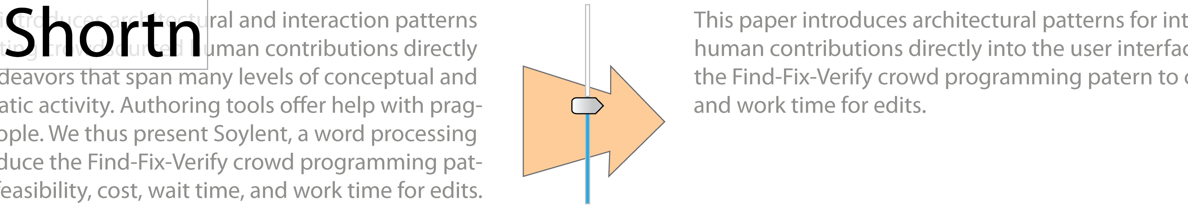
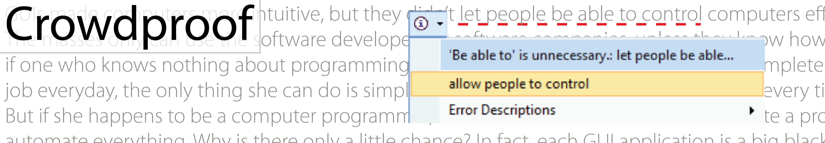
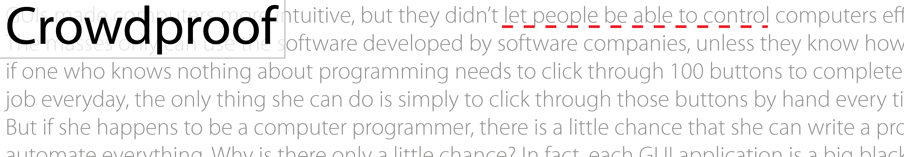
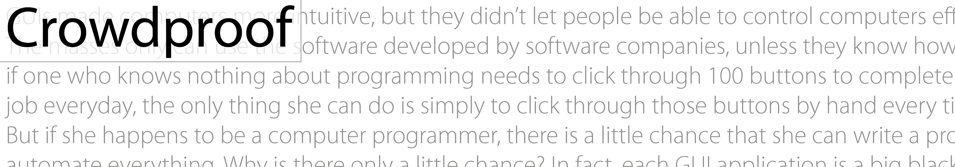


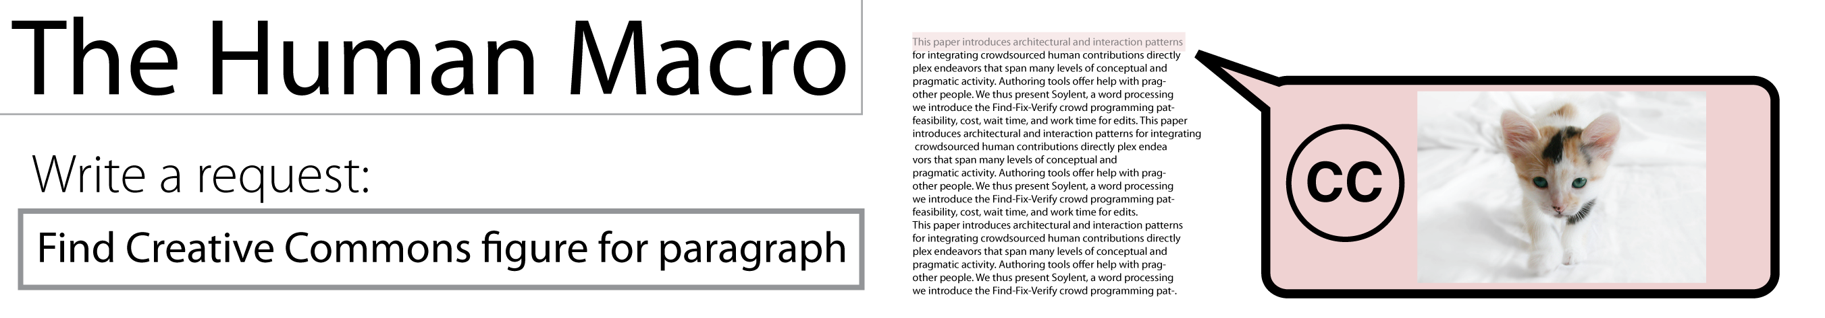
Soylent seeks out crowd contributions
to enable new interactive systems.

Slide 18
Challenges in Programming Crowds
Soylent has interacted with ~10,000 workers
on > 2000 different tasks
Key Problem: crowd workers often produce
poor output on open-ended tasks
30% Rule
~30% of the results
in open-ended tasks
will be unsatisfactory

Slide 19
Two Personas — An Example
Proofread and correct the following paragraph:
The theme of loneliness features throughout many scenes in Of Mice and Men and is often the dominant theme of sections during this story. This theme occurs during many circumstances but is not present from start to finish. In my mind for a theme to be pervasive
is must be present during every element of the story. There are many themes that are present most of the way through such as sacrifice, friendship and comradship. But in my opinion there is only one theme that is present from beginning to end, this theme is
pursuit of dreams.
Notes:
Go FAST

Slide 20
Two Personas — An Example
Proofread and correct the following paragraph:
The theme of loneliness features throughout many scenes in Of Mice and Men and is often the dominant theme of sections during this story. This theme occurs during many circumstances but is not present from start to finish. In my mind for a theme to be pervasive
is must be present during every element of the story. There are many themes that are present most of the way through such as sacrifice, friendship and comradship. But in my opinion there is only one theme that is present from beginning to end, this theme is
pursuit of dreams.

Slide 21
Persona One: The Lazy Worker
Does as little work as necessary to be paid
The theme of loneliness features throughout many scenes in Of Mice and Men and is often the dominant theme of sections during this story. This theme occurs during many circumstances but is not present from start to finish. In my mind for a theme to be pervasive
is must be present during every element of the story. There are many themes that are present most of the way through such as sacrifice, friendship and comradship. But in my opinion there is only one theme that is present from beginning to end, this theme is
pursuit of dreams.
Notes:
You can reject their work

Slide 22
Persona One: The Lazy Worker
Does as little work as necessary to be paid
The theme of loneliness features throughout many scenes in Of Mice and Men and is often the dominant theme of sections during this story. This theme occurs during many circumstances but is not present from start to finish. In my mind for a theme to be pervasive
is must be present during every element of the story. There are many themes that are present most of the way through such as sacrifice, friendship and comradeship. But in my opinion there is only one theme that is present from beginning to end, this theme is
pursuit of dreams.

Slide 23
Persona Two: The Eager Beaver
Goes beyond task requirements to be helpful,
but introduces errors in the process
The theme of loneliness features throughout many scenes in Of Mice and Men and is often the dominant theme of sections during this story. This theme occurs during many circumstances but is not present from start to finish. In my mind for a theme to be pervasive
is must be present during every element of the story. There are many themes that are present most of the way through such as sacrifice, friendship and comradship. But in my opinion there is only one theme that is present from beginning to end, this theme is
pursuit of dreams.

Slide 24
Persona Two: The Eager Beaver
Goes beyond task requirements to be helpful,
but introduces errors in the process
The theme of loneliness features throughout many scenes in Of Mice and Men and is often the dominant theme of sections of this story. \n
This theme occurs during many circumstances but is not present from start to finish. \n
In my mind, for a theme to be pervasive it must be present during every element of the story. \n
There are many themes that are present most of the way through such as sacrifice, friendship and comradeship.\n
But in my opinion there is only one theme that is present from beginning to end: this theme is pursuit of dreams.

Slide 25
The Result: Low-quality Work
These personas exist in both paid
and volunteer crowds
Programming with crowds today is haphazard: we lack design patterns

Slide 26
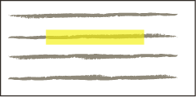
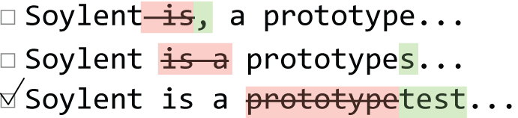
Solution: Find-Fix-Verify
Find-Fix-Verify is a design pattern
for programming with crowds in
open-ended tasks.
Find a problem
Fix the problem
Verify the quality of each fix
Soylent, a prototype...
Soylent, a prototype...
Soylent, a prototype...
Soylent, a prototype...

Slide 27
Find
“Identify at least one area that can be shortened without changing the meaning of the paragraph.”
Independent agreement to identify patches
Fix
“Edit the highlighted section to shorten its length without changing the meaning
of the paragraph.”
Soylent, a prototype...
Randomize order of suggestions
Verify
“Choose at least one rewrite that has style errors, and
at least one rewrite that changes the meaning
of the sentence.”

Slide 28
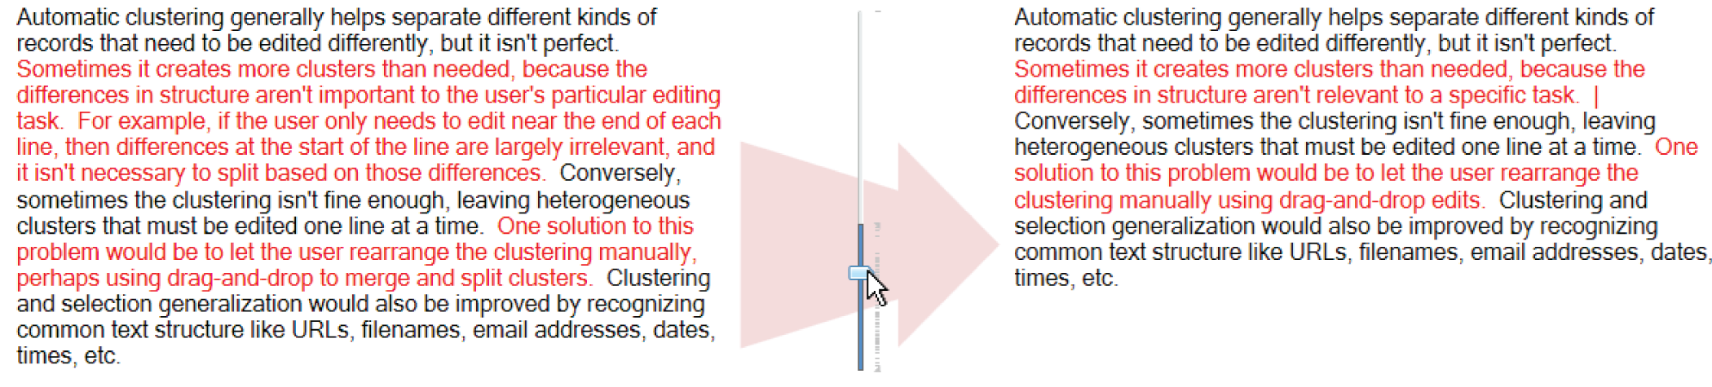
Keep suggestions that do not get voted out
Verify
“Choose at least one rewrite that has style errors, and
at least one rewrite that changes the meaning
of the sentence.”

Slide 29
Find-Fix-Verify Discussion
Why split Find and Fix?
Focus Lazy Workers on a problem of our choice
Group suggestions by core problem
Why add Verify?
Quality rises when Turkers are in productive tension
Crowds and Algorithms
[Little et al. 2010, Kittur et al. 2011, Shahaf & Horvitz 2010, Franklin et al. 2011, Marcus et al. 2011, Dai et al. 2010,
Parameswaran et al. 2011, Kulkarni et al. 2012]
Notes:
FAST FAST FAST

Slide 30
Evaluation Goals
Is Soylent’s approach of crowdsourced
interactive systems feasible?
How high is the quality?
How long is the delay?
How much does it cost?
1
2
3
Notes:
go faster through this. “We evaluated soylent, and we wanted to ask three questions: quality, delay, and cost.”

Slide 31
Blog
Print publishers are in a tizzy over Apple’s new iPad because they hope to finally be able to charge for their digital editions. But in order to get people to pay for their magazine and newspaper apps, they are going to have to offer something different that readers cannot get at the newsstand or on the open Web.
Classic HCI Paper
The metaDESK effort is part of the larger Tangible Bits project. The Tangible Bits vision paper introduced the metaDESK along with two companion platforms,
the transBOARD and ambientROOM.
Shortn
Draft HCI Paper
In this paper we argue that it is possible and desirable to combine the easy input affordances of text with the powerful retrieval and visualization capabilities of graphical applications. We present WenSo, a tool that uses lightweight text input to capture richly structured information for later retrieval and navigation.
Technical Writing
Figure 3 shows the pseudocode that implements this design for Lookup. FAWN-DS extracts two fields from the 160-bit key: the i low order bits of the key (the index bits) and the next 15 low order bits (the key fragment).
Rambling E-mail
A previous board member, Steve Burleigh, created our web site last year and gave me alot of ideas. For this year, I found a web site called eTeamZ that hosts web sites for sports groups. Check out our new page: […]

Slide 32
Blog – 83%
Print publishers are in a tizzy over Apple’s new iPad because they hope to finally be able to charge for their digital editions. But in order to get people to pay for their magazine and newspaper apps, they are going to have to offer something different that readers cannot get at the newsstand or on the open Web.
Classic HCI Paper – 87%
The metaDESK effort is part of the larger Tangible Bits project. The Tangible Bits vision paper, which introduced the metaDESK along withand two companion platforms, the transBOARD and ambientROOM.
Cut 15% of original paragraph length on average.
Shortn
Draft HCI Paper – 90%
In this paper we argue that it is possible and desirable to combine the easy input affordances of text with the powerful retrieval and visualization capabilities of graphical applications. We present WenSo, a tool thatwhich uses lightweight text input to capture richly structured information for later retrieval and navigation.
Technical Writing – 82%
Figure 3 shows the pseudocode that implements this design for Lookup. FAWN-DS extracts two fields from the 160-bit key: the i low order bits of the key (the index bits) and the next 15 low order bits (the key fragment).
Rambling E-mail – 78%
A previous board member, Steve Burleigh, created our web site last year and gave me alot of ideas. For this year, I found a web site called eTeamZ that hosts web sites for sports groups. Check out our new page: […]
Notes:
Cut more than a page from a CHI paper without touching figures or refs, and just removing fat from the writing.

Slide 33
Blog – 83%
Print publishers are in a tizzy over Apple’s new iPad because they hope to finally be able to charge for their digital editions. But in order to get people to pay for their magazine and newspaper apps, they are going to have to offer something different that readers cannot get at the newsstand or on the open Web.
Classic HCI Paper – 87%
The metaDESK effort is part of the larger Tangible Bits project. The Tangible Bits vision paper, which introduced the metaDESK along withand two companion platforms, the transBOARD and ambientROOM.
Focus on unnecessarily wordy phrases
But in order to get people to pay for their magazine and newspaper apps, they are going to have to offer something different that readers cannot get at the newsstand or on the open Web.
Shortn
Draft HCI Paper – 90%
In this paper we argue that it is possible and desirable to combine the easy input affordances of text with the powerful retrieval and visualization capabilities of graphical applications. We present WenSo, a tool thatwhich uses lightweight text input to capture richly structured information for later retrieval and navigation.
Technical Writing – 82%
Figure 3 shows the pseudocode that implements this design for Lookup. FAWN-DS extracts two fields from the 160-bit key: the i low order bits of the key (the index bits) and the next 15 low order bits (the key fragment).
Rambling E-mail – 78%
A previous board member, Steve Burleigh, created our web site last year and gave me alot of ideas. For this year, I found a web site called eTeamZ that hosts web sites for sports groups. Check out our new page: […]

Slide 34
Blog – 83%
Print publishers are in a tizzy over Apple’s new iPad because they hope to finally be able to charge for their digital editions. But in order to get people to pay for their magazine and newspaper apps, they are going to have to offer something different that readers cannot get at the newsstand or on the open Web.
Classic HCI Paper – 87%
The metaDESK effort is part of the larger Tangible Bits project. The Tangible Bits vision paper, which introduced the metaDESK along withand two companion platforms, the transBOARD and ambientROOM.
Shortn
Draft HCI Paper – 90%
In this paper we argue that it is possible and desirable to combine the easy input affordances of text with the powerful retrieval and visualization capabilities of graphical applications. We present WenSo, a tool thatwhich uses lightweight text input to capture richly structured information for later retrieval and navigation.
Merged sentences when patches crossed sentence boundaries
The metaDESK effort is part of the larger Tangible Bits project. The Tangible Bits vision paper, which introduced the metaDESK along withand two companion platforms, the transBOARD and ambientROOM.
Technical Writing – 82%
Figure 3 shows the pseudocode that implements this design for Lookup. FAWN-DS extracts two fields from the 160-bit key: the i low order bits of the key (the index bits) and the next 15 low order bits (the key fragment).
Rambling E-mail – 78%
A previous board member, Steve Burleigh, created our web site last year and gave me alot of ideas. For this year, I found a web site called eTeamZ that hosts web sites for sports groups. Check out our new page: […]

Slide 35
Blog – 83%
Print publishers are in a tizzy over Apple’s new iPad because they hope to finally be able to charge for their digital editions. But in order to get people to pay for their magazine and newspaper apps, they are going to have to offer something different that readers cannot get at the newsstand or on the open Web.
Classic HCI Paper – 87%
The metaDESK effort is part of the larger Tangible Bits project. The Tangible Bits vision paper, which introduced the metaDESK along withand two companion platforms, the transBOARD and ambientROOM.
Shortn
Draft HCI Paper – 90%
In this paper we argue that it is possible and desirable to combine the easy input affordances of text with the powerful retrieval and visualization capabilities of graphical applications. We present WenSo, a tool thatwhich uses lightweight text input to capture richly structured information for later retrieval and navigation.
Workers introduced style errors when
not part of the community of practice
Technical Writing – 82%
Figure 3 shows the pseudocode that implements this design for Lookup. FAWN-DS extracts two fields from the 160-bit key: the i low order bits of the key (the index bits) and the next 15 low order bits (the key fragment).
In this paper we argue that it is possible and desirable to combine the easy input affordances of text with the powerful retrieval and visualization capabilities of graphical applications.
Rambling E-mail – 78%
A previous board member, Steve Burleigh, created our web site last year and gave me alot of ideas. For this year, I found a web site called eTeamZ that hosts web sites for sports groups. Check out our new page: […]

Slide 36
Blog – 83%
Print publishers are in a tizzy over Apple’s new iPad because they hope to finally be able to charge for their digital editions. But in order to get people to pay for their magazine and newspaper apps, they are going to have to offer something different that readers cannot get at the newsstand or on the open Web.
Parallelism can introduce inconsistent changes
Classic HCI Paper – 87%
The metaDESK effort is part of the larger Tangible Bits project. The Tangible Bits vision paper, which introduced the metaDESK along withand two companion platforms, the transBOARD and ambientROOM.
FAWN-DS extracts two fields from the 160-bit key:
the i low order bits of the key (the index bits) and the next 15 low order bits (the key fragment).
Shortn
Draft HCI Paper – 90%
In this paper we argue that it is possible and desirable to combine the easy input affordances of text with the powerful retrieval and visualization capabilities of graphical applications. We present WenSo, a tool thatwhich uses lightweight text input to capture richly structured information for later retrieval and navigation.
Technical Writing – 82%
Figure 3 shows the pseudocode that implements this design for Lookup. FAWN-DS extracts two fields from the 160-bit key: the i low order bits of the key (the index bits) and the next 15 low order bits (the key fragment).
Rambling E-mail – 78%
A previous board member, Steve Burleigh, created our web site last year and gave me alot of ideas. For this year, I found a web site called eTeamZ that hosts web sites for sports groups. Check out our new page: […]

Slide 37
Blog – 83% 3 para., 158 people, $1.52/para
Print publishers are in a tizzy over Apple’s new iPad because they hope to finally be able to charge for their digital editions. But in order to get people to pay for their magazine and newspaper apps, they are going to have to offer something different that readers cannot get at the newsstand or on the open Web.
Classic HCI Paper – 87% 7 para., 264 people, $1.06/para
The metaDESK effort is part of the larger Tangible Bits project. The Tangible Bits vision paper, which introduced the metaDESK along withand two companion platforms, the transBOARD and ambientROOM.
Shortn
Draft HCI Paper – 90% 5 para., 284 people, $1.49/para
In this paper we argue that it is possible and desirable to combine the easy input affordances of text with the powerful retrieval and visualization capabilities of graphical applications. We present WenSo, a tool thatwhich uses lightweight text input to capture richly structured information for later retrieval and navigation.
Technical Writing – 82% 3 para., 188 people, $1.61/para
Figure 3 shows the pseudocode that implements this design for Lookup. FAWN-DS extracts two fields from the 160-bit key: the i low order bits of the key (the index bits) and the next 15 low order bits (the key fragment).
Rambling E-mail – 78% 6 para., 362 people, $1.62/para
A previous board member, Steve Burleigh, created our web site last year and gave me alot of ideas. For this year, I found a web site called eTeamZ that hosts web sites for sports groups. Check out our new page: […]
Notes:
Cost works out to $1.40 per paragraph

Slide 38
How Fast Is Shortn?
Results
Soylent Posts Task
Wait time is the longest:
Median 18.5 minutes
Summed medians across Find, Fix and Verify
q₁=8.3 minutes, q₃=41.6 minutes
Worker
Accepts Task
Actual work time is shorter:
Median 2.0 minutes
Summed medians across Find, Fix and Verify
q₁=60 seconds, q₃=3.6 minutes
Worker
Submits Task
Notes:
"our next step is to find ways to reduce wait time"

Slide 39
ESL: English as a Second Language
However, while GUI made using computers be more intuitive and easier to learn, it didn’t let people be able to control computers efficiently. Masses only can use the software developed by software companies.
Passes Word’s Grammar Checker
Marketing are bad for brand big and small. You Know What I am Saying. It is no wondering that advertisings are bad for company in America, Chicago and Germany.
Wikipedia
Dandu Monara (Flying Peacock, Wooden Peacock), The Flying machine able to fly. The King Ravana (Sri Lanka) built it. Accorinding to hindu believes in Ramayanaya King Ravana used "Dandu Monara" for abduct queen Seetha from Rama. According to believes "Dandu Monara" landed at Werangatota.
Crowdproof
Notes
Blah blah blah—argument about whether there should be a standard “nosql sto- rage” API to protect developers storing their stuff in proprietary services in the cloud. Probably unrealistic.
Draft HCI Paper
Many of these problems vanish if we turn to a much older recording technology---text. When we enter text, each (pen or key) stroke is being used to record the actual information we care about---; none is wasted on application navigation or configuration.

Slide 40
ESL: English as a Second Language
However, while GUI made using computers be more intuitive and easier to learn, it didn’t allow people to let people be able to control computers efficiently. Masses only canThe masses can only use the software developed by software companies, unless they know how to write programs.
Word: found 30% of errors
Crowdproof: found 67% of errors
Crowdproof
Combined: found 82% of errors
Crowdproof fixed
88% of the errors it found.

Slide 41
Find BibTeX:
“Hi, please find the bibtex references for the 3 papers in brackets. You can located [sic] these by Google Scholar searches and clicking on bibtex.’’
Find Creative Commons Figures:
“Pick out keywords from the paragrah like Yosemite, rock, half dome, park. Go to a site which hsa CC licensed images […]’’
Human Macro
Blog Feedback:
“Please tell me how to make this paragraph communicate better. Say what's wrong, and what I can improve. Thanks!’’
Tense Change:
“Please change text in document from past tense to present tense”
Find and Format Addresses:
“Please complete the addresses below to include all informtion needed as in example below. [...]”
Notes:
note that they are misspelled and still worked

Slide 42
Find BibTeX:
“Hi, please find the bibtex references for the 3 papers in brackets. You can located [sic] these by Google Scholar searches and clicking on bibtex.’’
Duncan and Watts [Duncan and watts HCOMP 09 anchoring] found that Turkers will do more work, but quality is no higher.
Human Macro
@conference {
title={{Financial incentives […]}},
author={Mason, W. and Watts, D.J.},
booktitle={HCOMP ‘09},
[…]
}
The Human Macro executed
requests perfectly 71%
of the time, and had the right
intention 88% of the time.

Slide 43
Soylent
A Word Processor
with a Crowd Inside
Outline
New class of paid, on-demand crowd-powered systems
Find-Fix-Verify design pattern
Lazy Worker and Eager Beaver
Notes:
[wait for questions on this slide]

Slide 44
1
Soylent
A Word Processor
with a Crowd Inside
Outline
2
Adrenaline
Realtime
Crowdsourcing

Slide 45
Applications are constrained
by crowd latency.
Design [Yu and Nickerson 2011, Xu and Bailey 2011]
Health and nutrition [Noronha et al. 2011]
Open-world databases [Franklin et al. 2011, Marcus et al. 2010]
Crowd algorithms [Little et al. 2010, Parameswaran et al. 2011]
Assistive technology [Bigham et al. 2010]
Robotics [Sorokin et al. 2010, Lasecki et al. 2011]
Maps [Stranders et al. 2011]
Task decomposition [Kulkarni et al. 2012]
Machine vision [Rodriguez and Davis 2011, Yan et al. 2010]
Feedback and collaboration [Kittur 2010, Dow et al. 2012]
Notes:
The applications that we can build are constrained by how quickly we can recruit crowds to help.

Slide 46
One unverified response
in 56 seconds
[Bigham et al. 2010]
— but —
The user loses focus
after 10 seconds
[Nielsen 1993, Card et al. 1991]
Notes:
Because 56 seconds
We’re talking interactive systems, so we are limited by *user interface latency*.
“Ten seconds has gone by now.” Ten second limit
If we want to make these crowds integral part of user interfaces everywhere, we need to solve the problem of latency and create realtime crowdsourcing

Slide 47
Our goal is on-demand, realtime crowds.
Notes:
SLOW
The first technical component we’ll introduce addresses the question…
This is the challenge
This is our approach

Slide 48
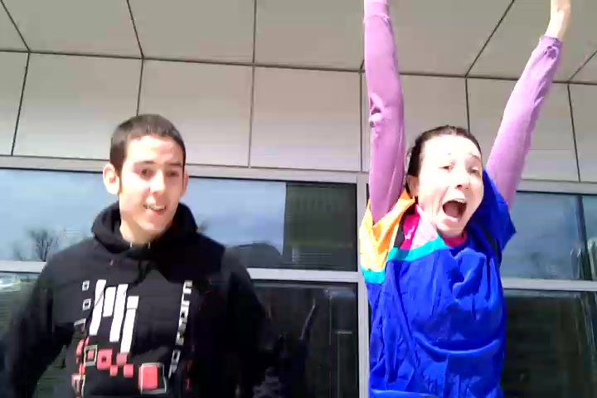
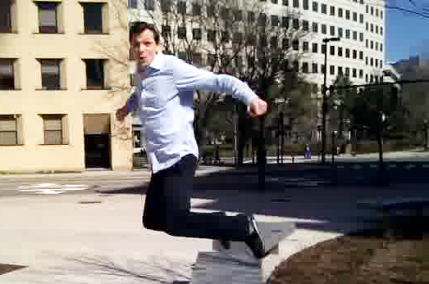
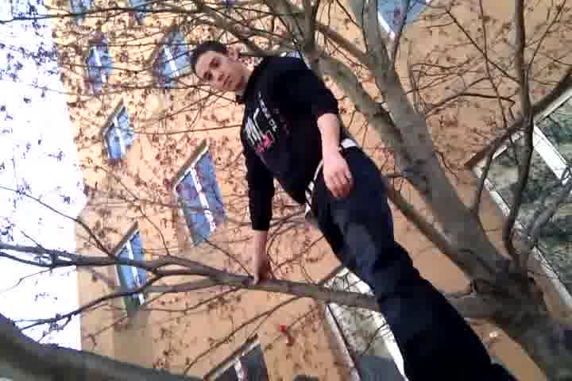
Adrenaline
Realtime Crowd-Powered Camera
M. Bernstein, J. Brandt, R. Miller, and D. Karger. Crowds in Two Seconds:
Enabling Realtime Crowd-Powered Interfaces. UIST 2011.
Notes:
SLOW
There are two technical components to achieving this, and I’ll introduce them both through this application called Adrenaline.
Adrenaline is a camera that crowdsources the selection of the best photo in realtime.

Slide 49

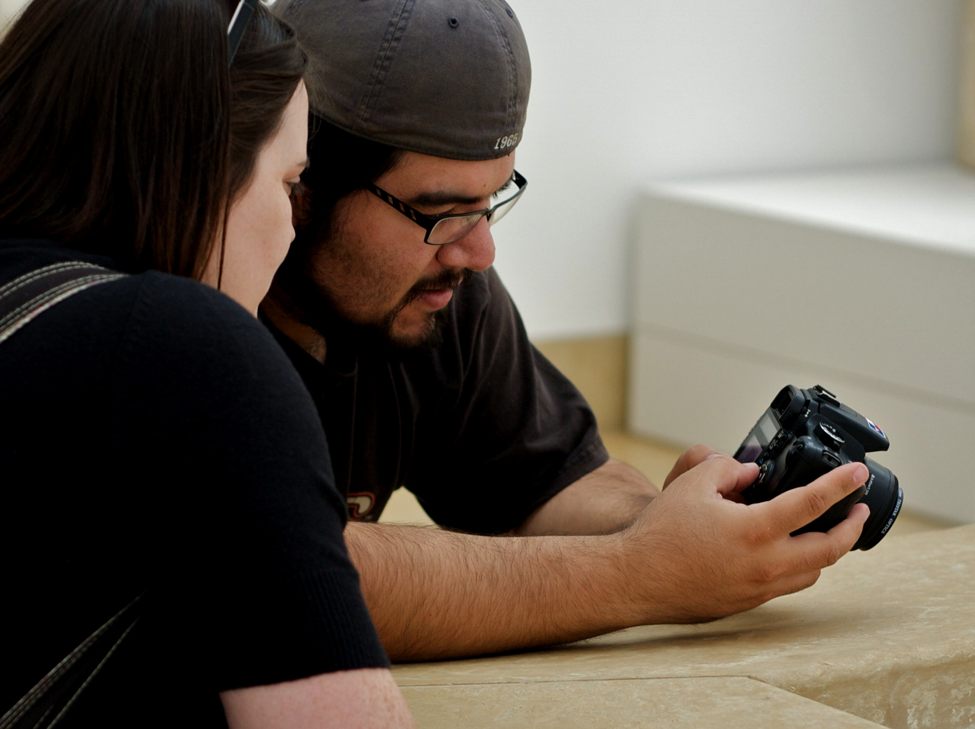
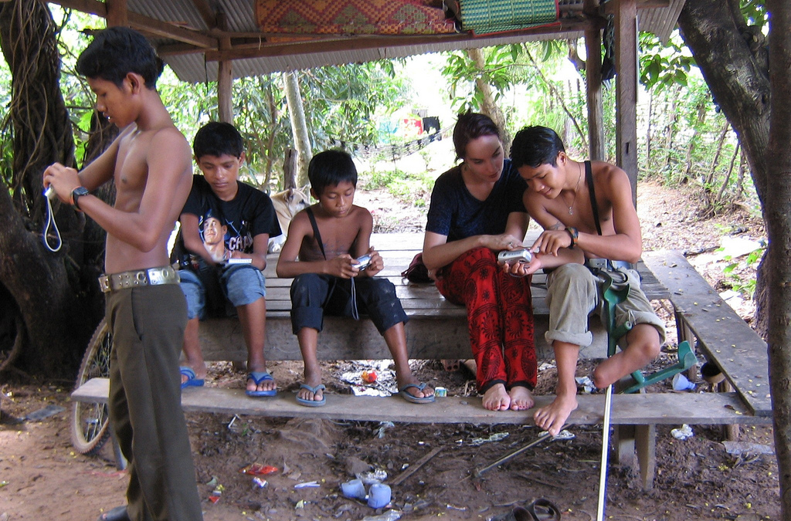
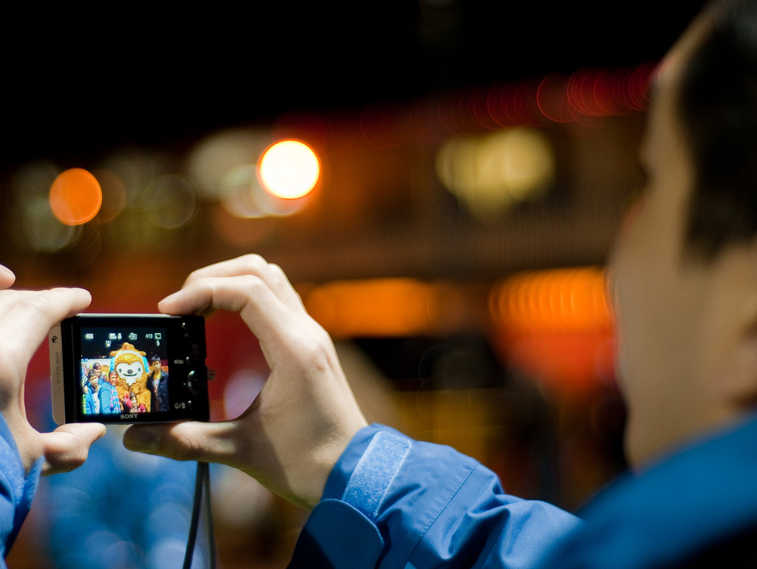
Notes:
FAST
Ever since IDEO introduced the first digital camera prototype, there has been a design focus on immediate feedback: from two days to develop film, to looking at your photo moments later. If we want to build a crowd-powered camera, and we want to preserve the users’ expectations, we need to decide on these pictures in realtime.

Slide 50
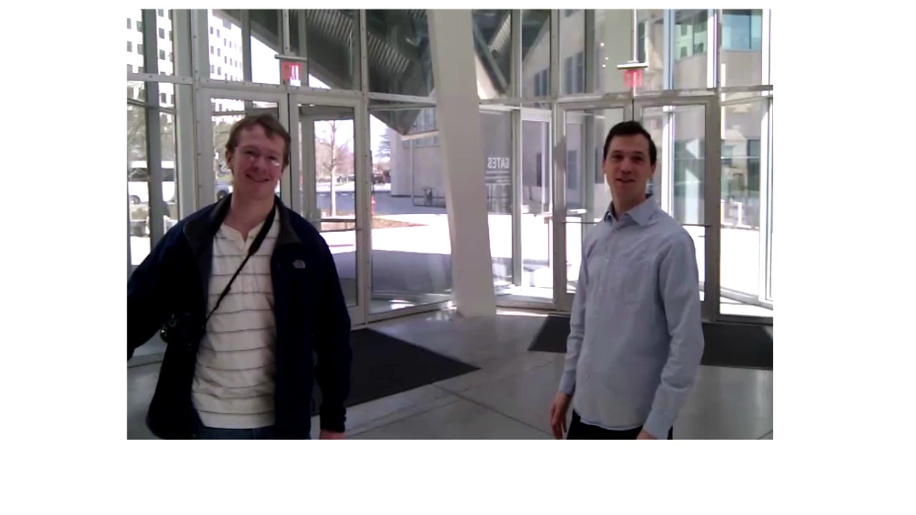
Notes:
Here are some examples of shots that people took with adrenaline.

Slide 51
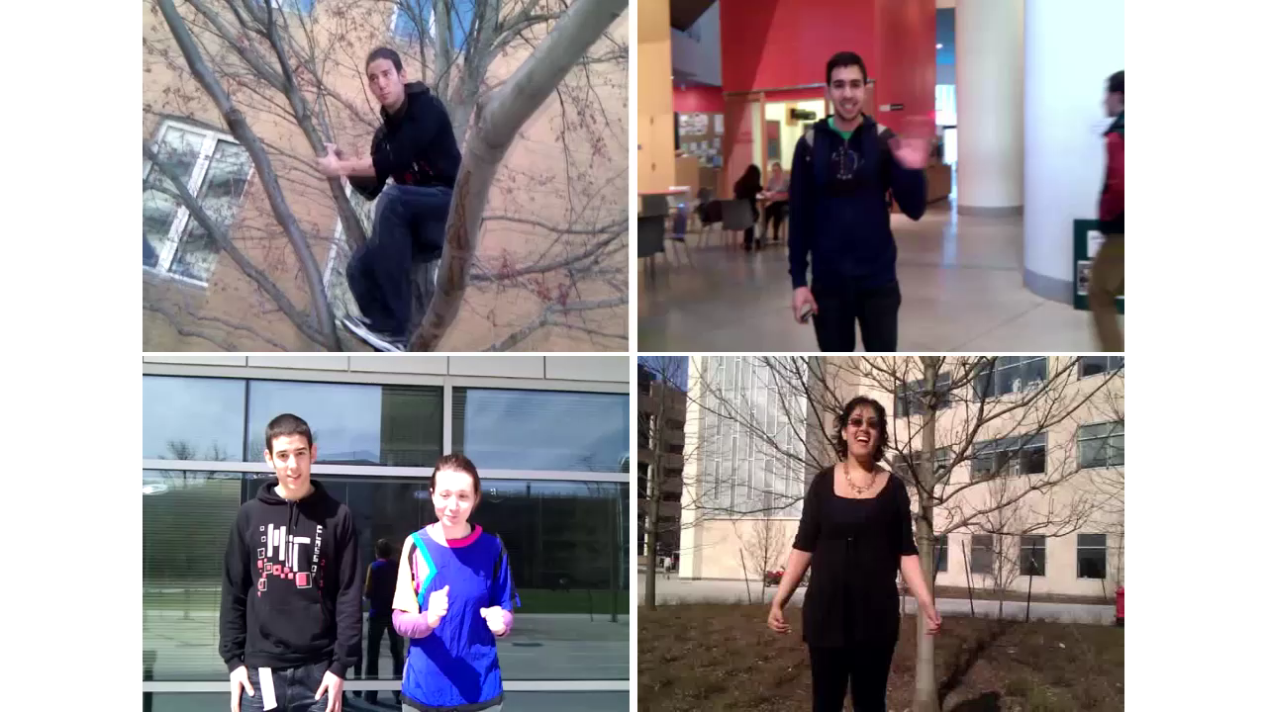

Slide 52
How do we
recruit crowds quickly?
Approach:
Retainer model
Notes:
SLOW
The first technical component we’ll introduce addresses the question…
This is the challenge
This is our approach

Slide 53
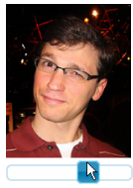
Retainer Model
Workers sign up in advance
Offer ½¢ per minute to remain on call
Alert when task is ready
Task:
Move the playback head
to find the best moment.
alert()
Start now!
OK
Wait at most:
5 minutes
Notes:
FAST
Modal alert that forced the job to be focused in their web browser.

Slide 54
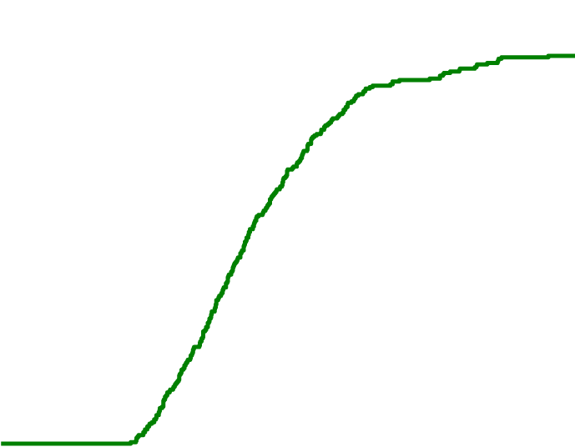
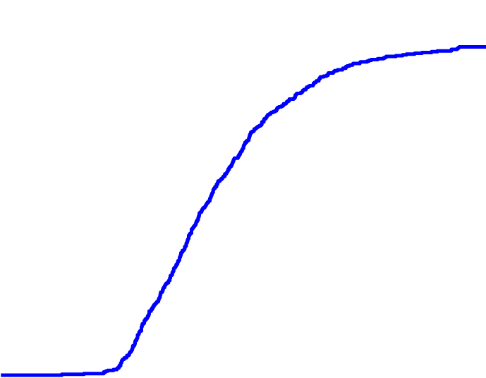
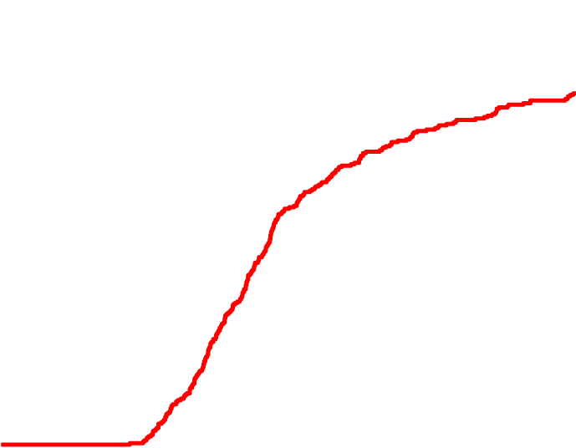

How quickly do retainer workers return?
Results: N=1545 tasks
1.0
0.9
0.8
0.7
0.6
0.5
0.4
0.3
0.2
0.1
0.0
30 sec
1 min
3 min
5 min
% returning in ≤ t
0.0 | 0.5 | 1.0 | 1.5 | 2.0 | 2.5 | 3.0 | 3.5 | 4.0
Time to dismiss alert t (seconds)
For retainer times under ten minutes,
46–61% within 2 seconds.
Notes:
FAST
These seems to be hitting limits on the cognitive recognize-act cycle and motor times, so let me give you a sense of how this works.
We ran an experiment, with 1500 tasks and 280 workers
The cumulative % of workers who have returned in time t or earlier
Now I’m going to show the lines for 30 seconds and 1 minutes
Now what if we have people wait around longer?
[say what’s coming before it appears]

Slide 55
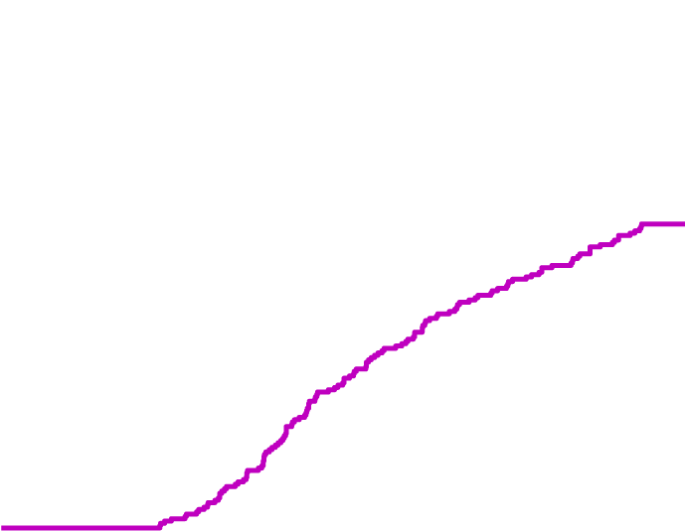

How quickly do retainer workers return?
Results: N=1545 tasks
1.0
0.9
0.8
0.7
0.6
0.5
0.4
0.3
0.2
0.1
0.0
30 sec
1 min
3 min
5 min
% returning in ≤ t
10 min
3¢ bonus
30 min
0.0 | 0.5 | 1.0 | 1.5 | 2.0 | 2.5 | 3.0 | 3.5 | 4.0
Time to dismiss alert t (seconds)
For retainer times under ten minutes,
69–84% within 3 seconds.
Notes:
FAST

Slide 56
How quickly do retainer workers return?
Results: N=1545 tasks
1.0
0.9
0.8
0.7
0.6
0.5
0.4
0.3
0.2
0.1
0.0
30 sec
1 min
3 min
5 min
% returning in ≤ t
10 min
30 min
0.0 | 0.5 | 1.0 | 1.5 | 2.0 | 2.5 | 3.0 | 3.5 | 4.0
Time to dismiss alert t (seconds)
One worker on retainer costs $0.30 / hour.
Notes:
SLOW

Slide 57


A|B: Instant Votes
Five votes in five seconds:
“Which font should I use?”
“Which tie matches better?”
“Which blog headline is catchier?”
Go
Notes:
Here’s an example of how long it actually takes.

Slide 58

A|B: Instant Votes
Five votes in five seconds:
“Which font should I use?”
“Which tie matches better?”
“Which blog headline is catchier?”
Go
Notes:
Here’s an example of how long it actually takes.

Slide 59
The retainer model:
crowds in two seconds
and votes in five seconds.

Slide 60
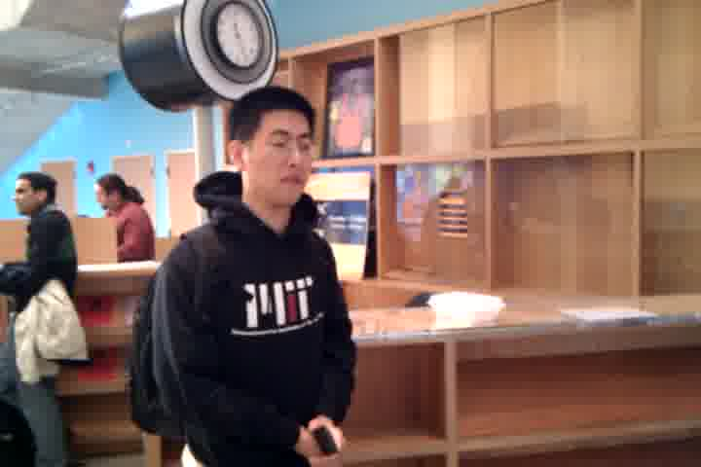
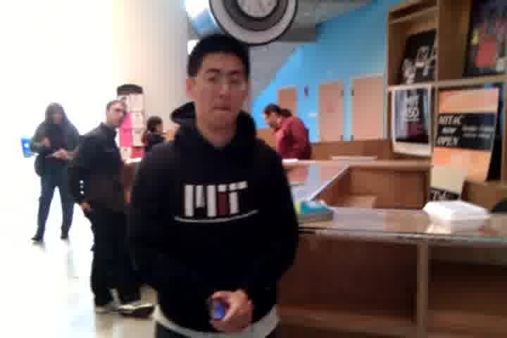
Notes:
FAST

Slide 61






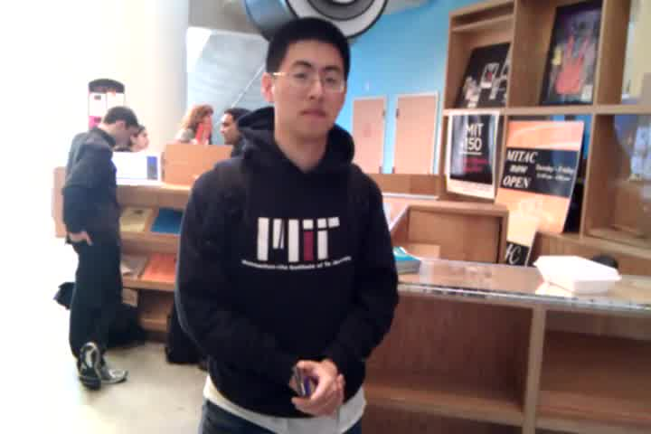
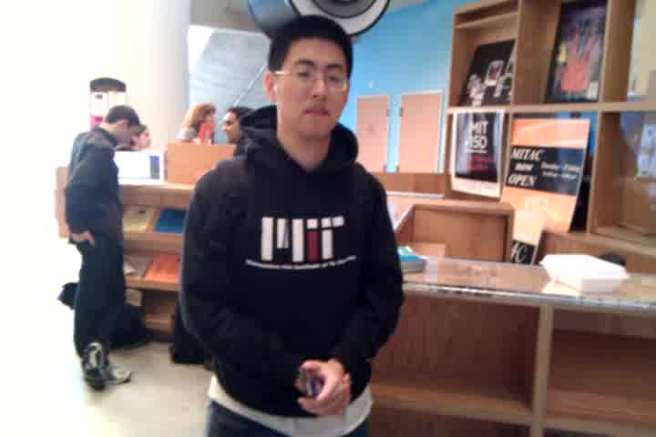
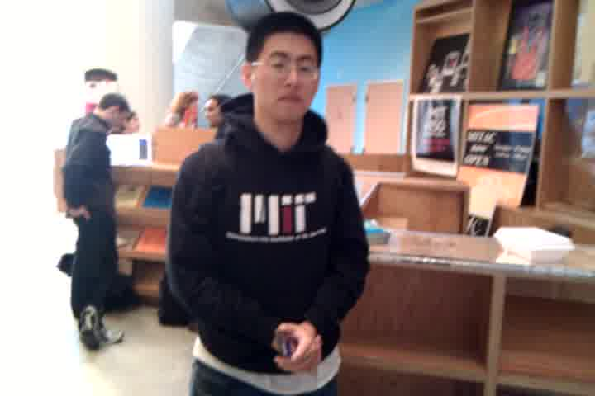
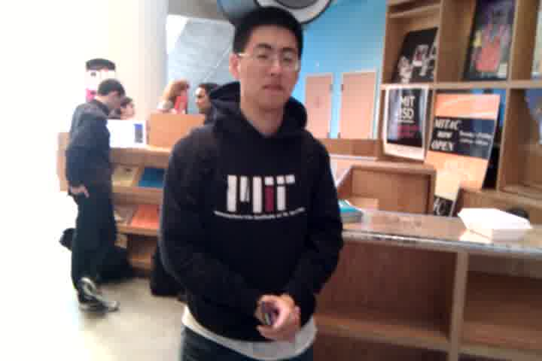
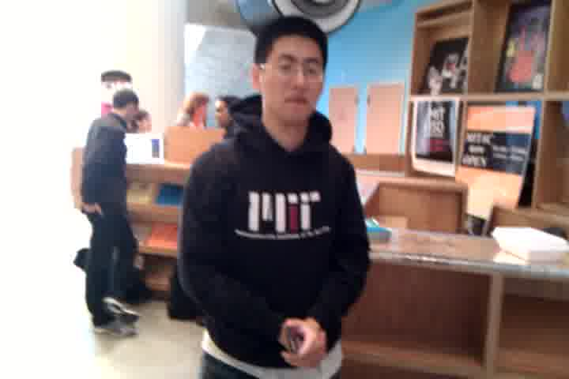

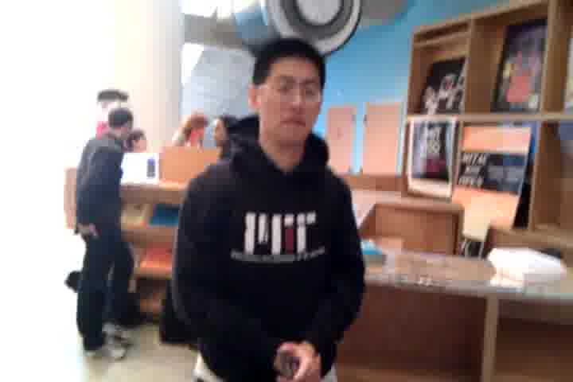
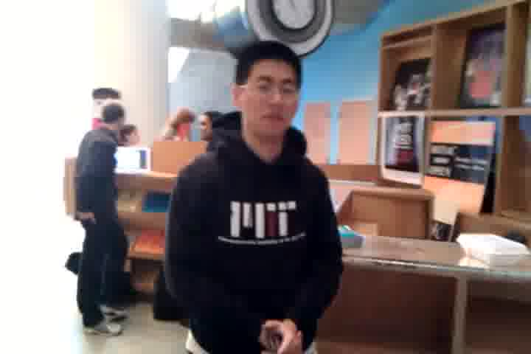


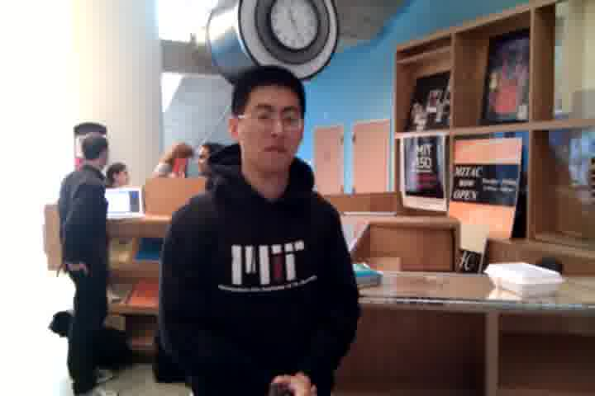
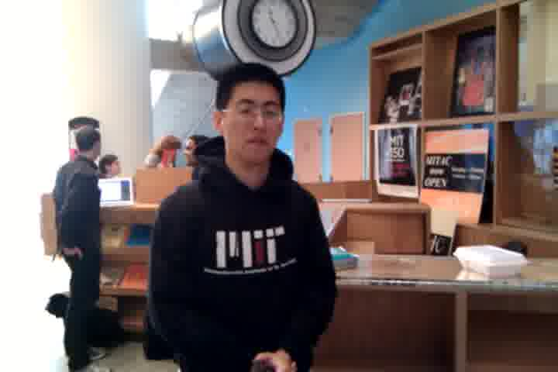
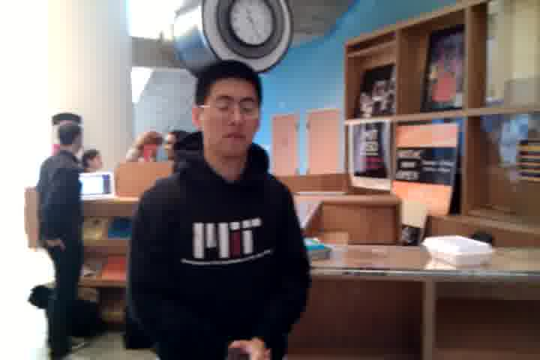
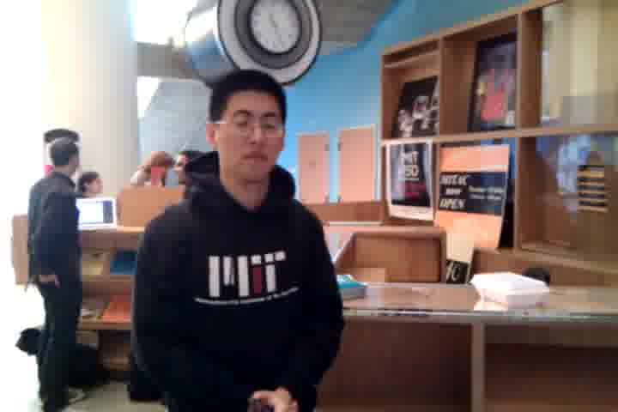
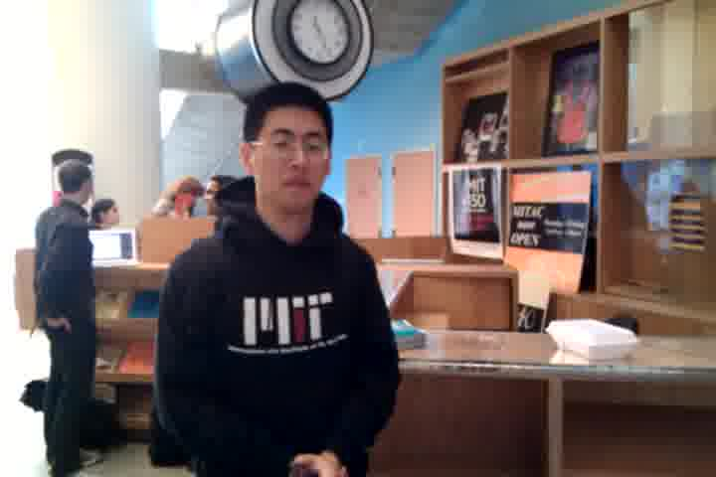
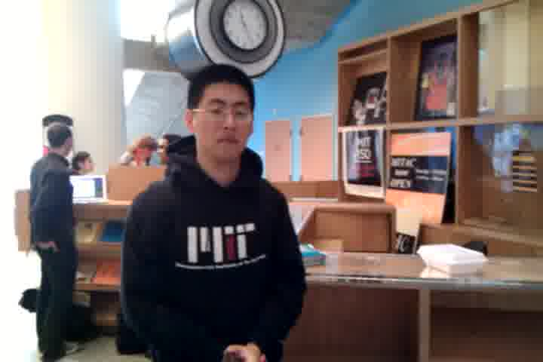
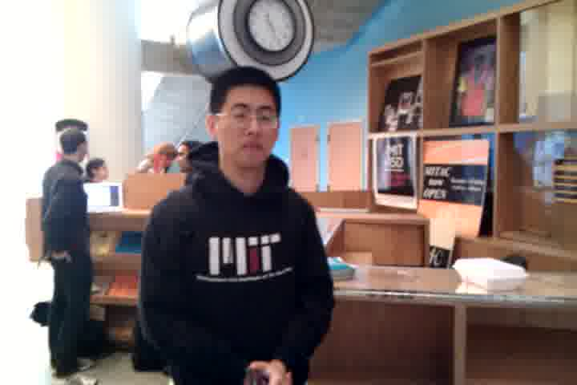
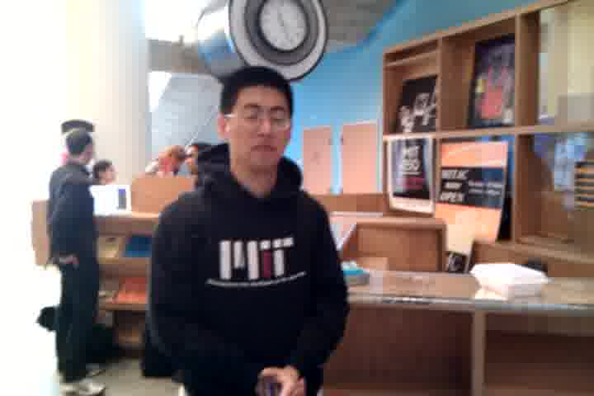
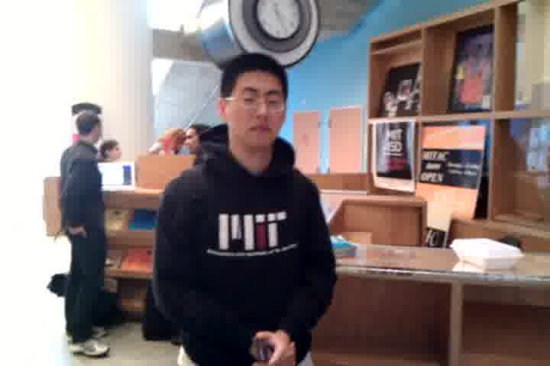
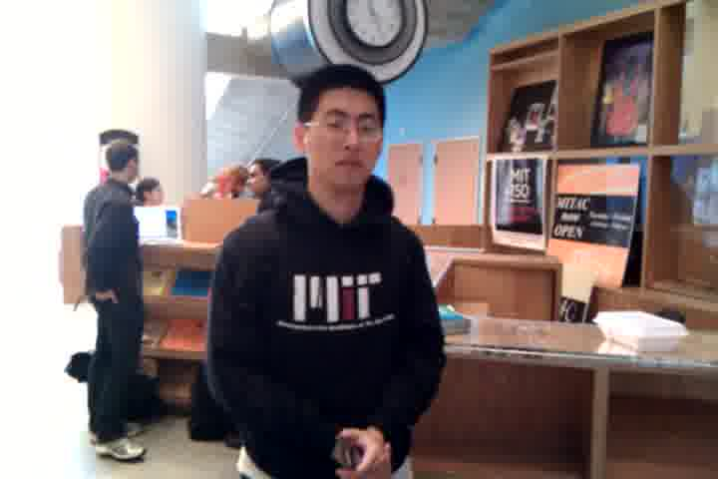
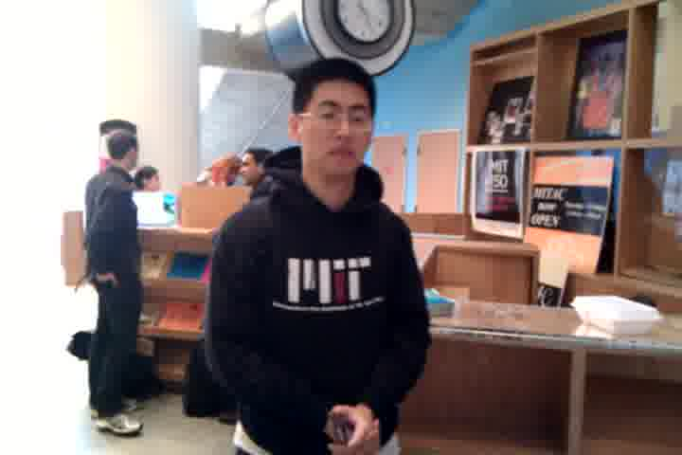
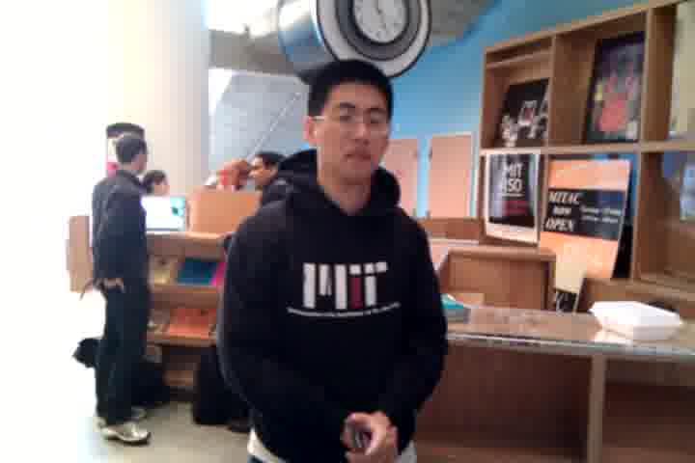
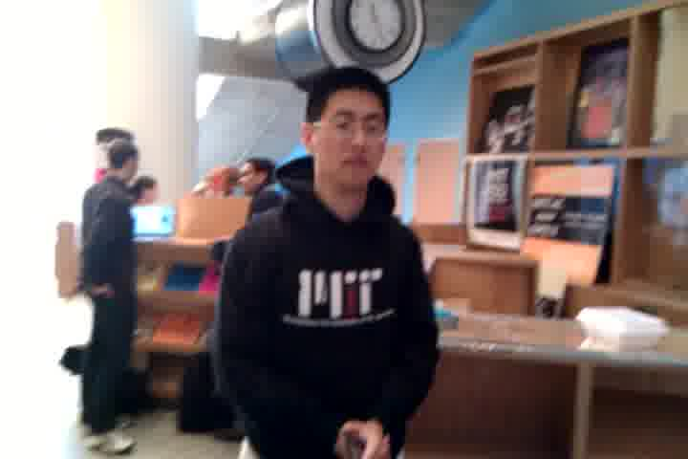
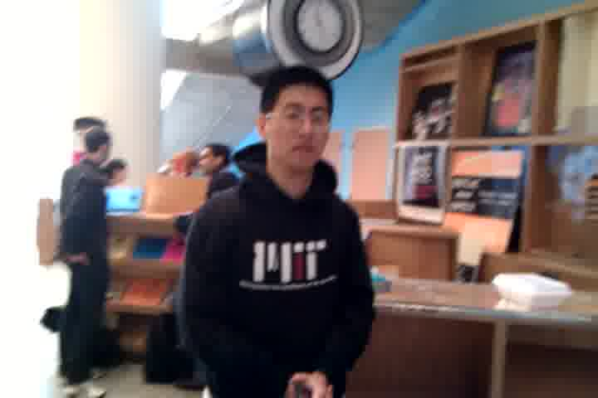
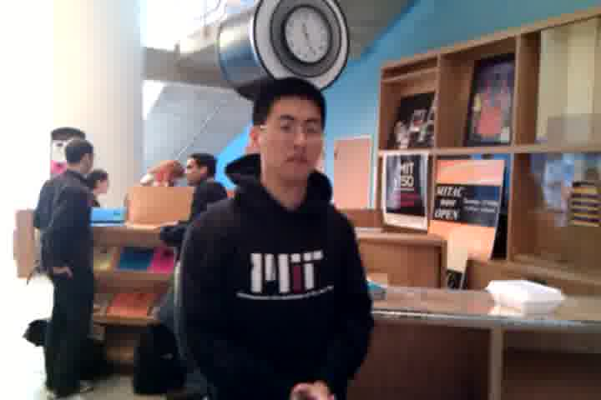
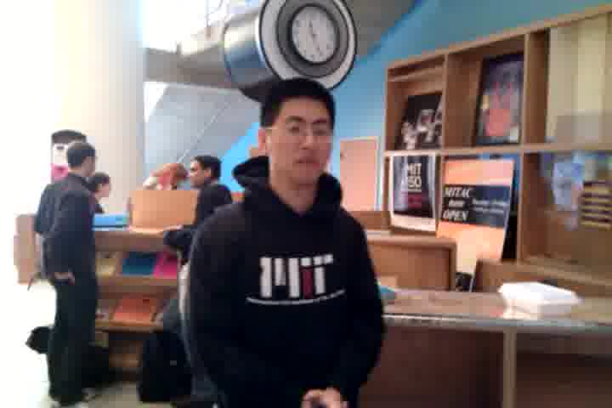























































Work time is slow.

Slide 62
How do we overcome
slow work time?
Notes:
Our second technical challenge, now that we can recruit crowds quickly.
Work time is still too long to return responses in realtime.

Slide 63
How do we overcome
slow work time?
Synchronous crowds
Crowds can be faster than
any individual member
Notes:
The retainer model, for the first time, allows us to recruit _synchronous crowds_. On MTurk, workers arrive and leave at different points. But, the retainer model is the first to allow us to get these workers to arrive all at the same time. With the right algorithm behind it, we might be able to get the entire crowd to work faster than any individual member.

Slide 64

Rapid Refinement
Recognize potential agreement early, then use it to reduce a continuous search space quickly.

Slide 65

Rapid Refinement
Worker 1
Worker 2
Worker 3
Notes:
FAST FAST

Slide 66
Rapid Refinement
Worker 1
while (searchArea.size > 1):
a = calculateAgreement(workerPositions,
searchArea,
refinementRatio)
# a.percent = 0.00
if (a.percent > 0.30):
if (a.duration >= 2):
searchArea.left = a.left
searchArea.right = a.right
Worker 2
Worker 3

Slide 67
Rapid Refinement
Two
Seconds
Worker 1
while (searchArea.size > 1):
a = calculateAgreement(workerPositions,
searchArea,
refinementRatio)
# a.percent = 0.66
if (a.percent >= 0.66):
if (a.duration >= 2):
searchArea.left = a.left
searchArea.right = a.right
Worker 2
Worker 3

Slide 68





Rapid Refinement
Worker 1
Worker 2
Worker 3

Slide 69


Slide 70
Evaluation
Do the retainer model and rapid refinement produce realtime results?
What are their failure modes?
Notes:
We will use Adrenaline as a benchmark task to understand how these approaches perform.
100 frames per video

Slide 71
Choosing and Rating Photos
Method
Measured speed and participant-rated quality
Five photograph selection algorithms:
1
Rapid Refinement
2
Professional Photographer
3
Computer Vision [Ižo and Yagnik 2009]
4
Generate-and-Vote
crowd
5
Generate-One

Slide 72
Rapid Refinement
Computer Vision
Photographer
μ=5.8, σ=2.2
μ=4.9, σ=2.2
μ=6.4, σ=2.3
9 point Likert scale on self-rated quality
ANOVA p < .001
Notes:
Biggest challenge: too-fast agreement in late stages

Slide 73
Rapid Refinement
Computer Vision
Photographer
μ=5.8, σ=2.2
μ=4.9, σ=2.2
μ=6.4, σ=2.3
Good Photos
Typical Photos
Notes:
Biggest challenge: too-fast agreement in late stages

Slide 74
Rapid Refinement
Computer Vision
Photographer
μ=5.8, σ=2.2
μ=4.9, σ=2.2
μ=6.4, σ=2.3
Good Photos
Typical Photos
Agreement misfire
Bad Photos
Notes:
Biggest challenge: too-fast agreement in late stages

Slide 75
Rapid Refinement Fastest, with Smallest Time Variance
Results
Algorithm | Histogram of Execution Times N=72 photos
Rapid Refinement
Generate One
Generate and Vote
μ=12.6 sec, σ=2.2 sec
22¢
μ=16.3 sec, σ=9.8 sec
22¢
μ=45.3 sec, σ=14.0 sec
53¢
ANOVA with pairwise posthoc tests p < .05

Slide 76
Tradeoffs in Rapid Refinement
Strengths:
- Quick preliminary results (10 sec)
- Combines work and verification
Weaknesses:
- Sacrifices quality for speed
- Stifles individual creativity
Generalizability:
- Any continuous search space
(e.g., parameter tuning)

Slide 77
The retainer model
and rapid refinement
execute large searches
in roughly ten seconds.

Slide 78

Notes:
These techniques are useful for other applications as well. Suppose we wanted to embed crowds in a graphic design program to help generate realistically varying art assets.

Slide 79

With eight workers on retainer:
First movement: 2.1 seconds
First figure complete: 25.0 seconds
New figure completed: every 3.3 seconds
Notes:
With 8 workers on retainer: out to 300 total

Slide 80
Mathematical modeling
to optimize realtime crowdsourcing
M. Bernstein et al. Analytic Methods for Optimizing Realtime Crowdsourcing.
Collective Intelligence 2012.
Notes:
now that we're systematizing the processes, it becomes possible to apply mathematical modeling and using that to optimize our systems.

Slide 81

Queueing Theory Model
Cast the retainer model as an M/M/c/c queue
Formal framework for understanding arrival and
service processes with c servers and Poisson arrival rates
Worker recruitment rate λ, task arrival rate μ,
traffic intensity ρ = λ/μ
Probability of non-realtime service
with c workers on retainer, π(c)
Cost = c − ρ(1 − π(c))

Slide 82
Queueing Theory
Optimizing Realtime Crowdsourcing
Minimize c such
that π(c)≤p_{max}
Median feedback in 0.50
seconds (3x improvement)
Other benefits: globally shared retainer pool, task routing, predictive recruitment
Other benefits: globally shared retainer pool, task routing, predictive recruitment
Notes:
.5 seconds is below the threshold to maintain uninterrupted flow

Slide 83
Adrenaline
Realtime
Crowdsourcing
Outline
Enabling interactive
crowd-powered systems
Techniques for fast, synchronous crowds:
1
Retainer Model
Rapid Refinement
2

Slide 84
1
Soylent
A Word Processor
with a Crowd Inside
Outline
2
Adrenaline
Realtime
Crowdsourcing

Slide 85
Interactive systems that
embed crowd intelligence
Computational techniques that produce high-quality, fast results
Notes:
What I’m going to show today are a series of interactive systems that embed crowd intelligence to extend the reach of what’s possible with interactive computing.
In order to do it, I’m going to introduce computational techniques that lead to high-quality and fast results.

Slide 86
Social Computing Approaches
1
Pay crowds
Microtask markets
Create new crowds
Design of social computing systems
Mine past crowd activity
Interactive crowd data
2
3

Slide 87
Social design can
create specialized crowds.

Slide 88




Designing Social Computing Systems
Friendsourcing
UIST 2009
TOCHI 2010
Anonymity & archives
ICWSM 2011
Best Paper
Social filtering
CHI 2010
Microblog rating
CSCW 2012
Best Short Paper
Honorable Mention
Create and understand new kinds of social interactions
Gather crowds that can collect information
unknown to most people

Slide 89


Friendsourcing
Designing social applications to collect information known only to members
of a social network
Collabio gathered
over 29,000 tags on
thousands of people
FeedMe built user
models by helping
route news to friends

Slide 90

Friendsourcing
Designing social applications to collect information known only to members
of a social network
Does IUI research appear at UIST?
Collabio gathered
over 29,000 tags on
thousands of people
FeedMe built user
models by helping
route news to friends
Notes:
Finding missing edges in the social network graph [Guy et al. 2011]

Slide 91
Online Anonymity and Ephemerality
4chan /b/ online community
Anonymity and ephemerality support
community dynamics that drive internet culture.
Study of 5.5 million posts
Median thread: 5 seconds on the first page
5 minutes on the entire site
Over 90% of posts are completely anonymous

Slide 92
Social Computing Approaches
1
Pay crowds
Microtask markets
Create new crowds
Design of social computing systems
Mine past crowd activity
Interactive crowd data
2
3

Slide 93
Crowd data can enable a long tail of user goals

Slide 94




Interactive Crowd Data
Tail answers
CHI 2012
Best Paper
Honorable Mention
Microblog topic
browsing
UIST 2010
Microblog
timelines
CHI 2011
Crowd-powered
entertainment
ACE 2011
Integrate crowd activity traces into
user experiences
Aid exploration of social data

Slide 95

Answers: Direct Search Results
Manually constructed for popular queries
weather boston

Slide 96
Prevalence of Unpopular Searches
Limited resources mean that search engines cannot directly answer:
molasses substitutes
increase volume windows xp
dissolvable stitches speed
dog body temperature
CHI 2013 deadline
…
Notes:
Half of queries are unique [White, Bilenko, Cucerzan 2007]

Slide 97


Tail Answers
Direct results for queries in the long tail
molasses substitutes

Slide 98


Slide 99








Crowd Data in Tail Answers
75 million search trails, 13 million URLs
Destination probability
Question word queries
Paid crowds for extraction and authoring
Extract
Vote
Proofread
Vote
Title
Vote

Slide 100
Social Computing Approaches
1
Pay crowds
Microtask markets
Create new crowds
Design of social computing systems
Mine past crowd activity
Interactive crowd data
2
3

Slide 101
Integrate social and crowd intelligence as core parts of interaction, software, and computation.
Notes:
Scale up the difficulty and complexity of crowd-powered systems

Slide 102
Research Agenda
Crowds training machine learning systems, machine learning systems aiding crowds
Platforms: scale, expertise, learning, benchmarks and complexity
Goal: combine machine and social intelligence to complete complex,
high-level tasks
Notes:
Roughly 600 signups so far, no advertising

Slide 103
Ethics, Privacy and Attribution
Cyber-Taylorism and the crowd worker as API call
Embed human-human contract ethics
Expected wages and living wages
When software has goals and dreams
Design opportunity: participants interact socially
Education, reputation, career advancement
Who gets attribution? Who gets ownership?
When everyone helps, who gets credit?
Work-for-hire vs. future opportunities

Slide 104







Meanwhile…
Adoption of Find-Fix-Verify
Image segmentation [Noronha et al. 2011]
Map labeling [Stranders et al. 2011]
Formal crowd languages [Minder et al. 2011]
The rise of crowd-powered systems
VizWiz, Legion, Turkomatic, MonoTrans,
CrowdDB, Qurk, Deco, Appsheet, Shepherd, TaskGenie, Platemate, CollabMap, CrowdSight

Slide 105
Contributions
Design
  Interactive systems that draw on crowds to support high-level commands and natural interaction
Crowd Computing
  Find-Fix-Verify task decomposition workflow
  Realtime crowdsourcing via the retainer model and synchronous crowd algorithms
Social Computing
  Structuring or designing new interactions between contributors to accomplish complex tasks

Slide 106
Crowd-powered systems enable experiences that neither crowd
nor machine intelligence can
support alone.
Computation will be critical to the wisdom of crowds.
Notes:
Computer science is about constructing complex computational systems. Systems biology is about applying this thinking to complex biological systems...Quantum computing merges computational thinking with physics.......organizing large crowds of people to carry out a computation is yet another kind of computation. It's a systems building problem that requires HCI in the _back-end_, which is unusual.

Slide 107
Collaborators
Faculty and researchers
Rob Miller and David Karger
Björn Hartmann, Bongwon Suh, Desney Tan, Ed Chi, Eric Horvitz,
Hiroshi Ishii, Jaime Teevan, Joel Brandt, Lichan Hong,
Mark Ackerman, Mary Czerwinski, mc schraefel, Susan Dumais
Graduate students
Adam Marcus, Andrés Monroy-Hernández, Drew Harry, Greg Little,
Greg Vargas, Jilin Chen, Katrina Panovich, Kurt Luther, Max Van Kleek,
Paul André, Sanjay Kairam, Xiao Xiao
Undergraduate students
Curtis Liu, David Crowell, Kavya Joshi, Margaret Leibovec, Rajeev Nayak
Image Credit
Christine Daniloff (MIT News Office), David Alan Grier
Creative Commons: auntiep, jeffwilcox, jmpk, ebriel, jwl, takuhitosotome, d!zzy

Slide 108
> cat *.tex | grep -i –o crowd | wc -l
> 491

Slide 109
Crowd-Powered
Systems
Michael Bernstein
msbernst@mit.edu

Slide 111


Slide 112


Slide 113


Slide 114
Effect of Price on Wait Time
Paying more had no effect on early arrivals,
but sped up the latecomers
Notes:
Task: crowdproof, input was ESL first paragraph, separated Find from Fix+Verify so that Fix always had the same patches
All tasks had at least 3 workers in the first 10 minutes. After about 15 minutes, arrival time starts looking exponential.
So, you can get away with paying very little for interaction

Slide 115
Results: Cost
$0.08 per Find, $0.05 per Fix, and $0.04 per Verify
Average paragraph cost $1.41 to Shortn:
$0.55 to Find an average of two patches
$0.48 to Fix each patch
$0.38 to Verify each patch
Lower bound with $0.01 per task:
$0.30 per paragraph

Slide 116
Retainer Experiment
1545 tasks from 280 workers
Manipulate retainer time:
{0.5, 1, 2, 5, 10, 30} minutes
Sample wait time from [0, retainer time]
He leapt the fence and
dashed toward the door.
Measure: time to dismiss the alert
alert()
Start now!
OK
Notes:
“benchmark tasks”

Slide 117

Retainer Design Experiment
Four designs:
1
Baseline
(no alert)

Slide 118

Retainer Design Experiment
Four designs:
1
Baseline
(no alert)
playAudio(“alert_chime.mp3”);
alert(“Start now!”);
2
Alert

Slide 119

Retainer Design Experiment
Four designs:
1
Baseline
(no alert)
2
Alert
3
Game

Slide 120
Retainer Design Experiment
Four designs:
1
3¢ bonus
for dismissing
the alert
within 2 seconds
Baseline
(no alert)
2
Alert
3
Game
4
Reward
Between subjects, N=1913 tasks

Slide 121

Retainer Time Results

Slide 122
Results: Quality
Rapid Refinement had lower variance
than Generate-One.
(σ=2.2 vs. σ=2.6 on a 9-point Likert scale)
Generate-and-Vote matches the professional photographer.
(μ=6.6 vs. μ=6.4)
Cost:
Rapid Refinement and Generate-One: 22¢
Generate-and-Vote: 53¢
Notes:
Live system: closer to ten cents (use fewer workers)

Slide 123
Results: Delay

