Slide 1
Heuristic Evaluation
August 5, 2016
Notes:
[75 minutes – was Shooting for 60 minutes including 25 minute exercise – gave 15 minutes to do exercise and discussed for 10 minutes] – cut a little more
Lecture ended at 12:45, giving them 35 minutes for team work (shooting for 45-50 minutes)
Today I’m going to tell you about a useful technique in the evaluation of the DESIGN of software products…

Slide 2
Outline
Heuristic Evaluation Overview
The Heuristics
Exercise

Slide 3
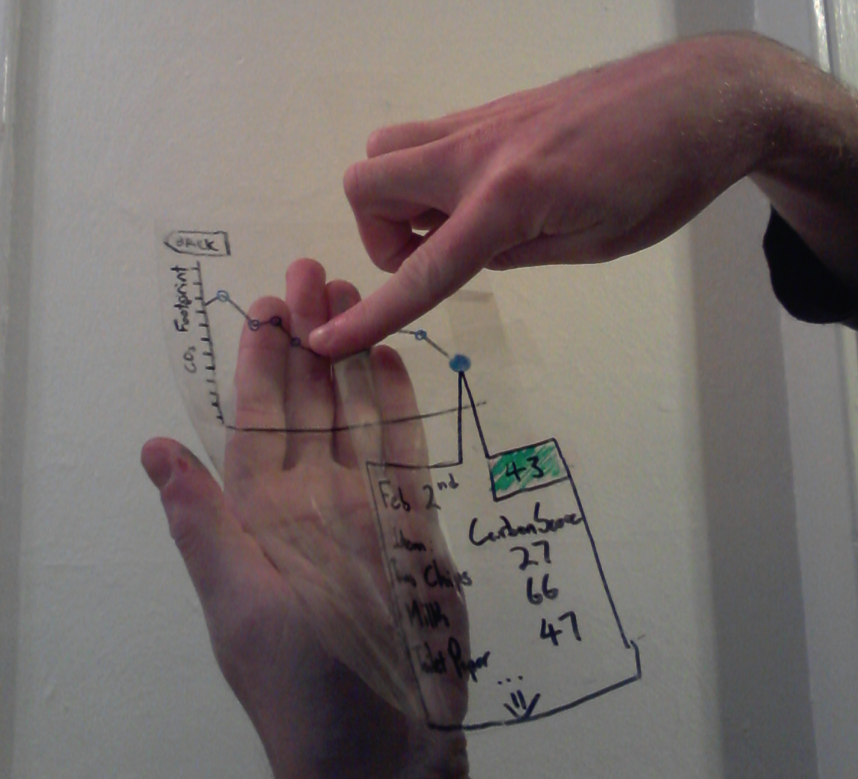
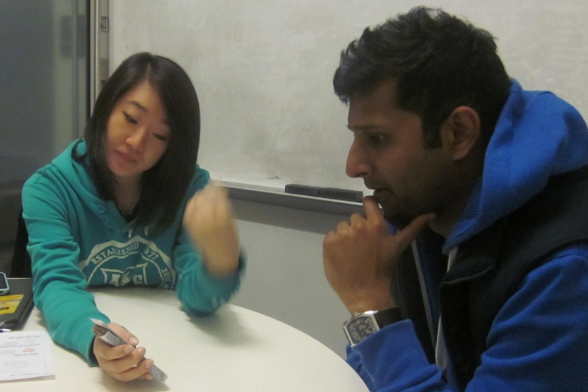
Evaluation
About figuring out how to improve design
Issues with lo-fi tests?
Notes:
Ask and THEN NEXT SLIDE

Slide 4
Evaluation
About figuring out how to improve design
Issues with lo-fi tests?
Not realistic
  visuals & performance
Not on actual interface
  can’t test alone
Need participants
  can be hard to find repeatedly
Notes:
Issues with lo-fi:
Not realistic
Not on actual interface
Need participants

Slide 5
Heuristic Evaluation
Developed by Jakob Nielsen
Helps find usability problems in a UI design
Small set (3-5) of evaluators examine UI
  independently check for compliance with usability principles (“heuristics”)
  evaluators only communicate afterwards
    findings are then aggregated
  use violations to redesign/fix problems
Can perform on working UI or on sketches

Slide 6
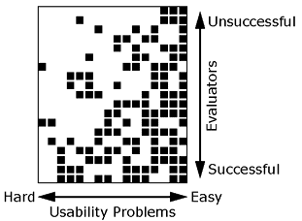
Why Multiple Evaluators?
Every evaluator doesn’t find every problem
Good evaluators find both easy & hard ones
Notes:
Meaning?
Need multiple evaluators because:
Every evaluator doesn’t find every problem
Good evaluators find both easy & hard ones

Slide 7
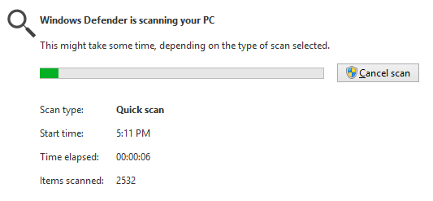


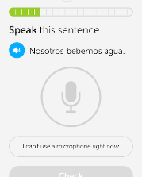
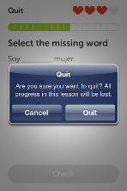
Heuristics
H2-1: Visibility of system status
H2-2: Match between system & real world
H2-3: User control & freedom
Notes:
DuoLingo – no way when practicing to ask to “test out” like in other parts of the UI. Need to quit & go select the function. (courtesy Armando Mota)

Slide 8
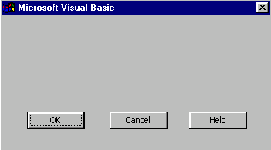
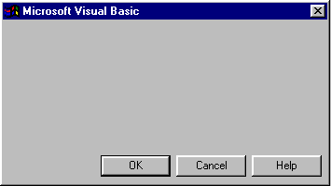
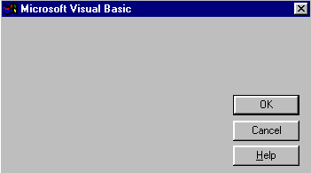
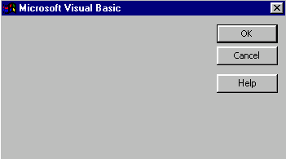
Heuristics (cont.)
H2-4: Consistency & standards
H2-5: Error prevention
H2-6: Recognition rather than recall
H2-7: Flexibility and efficiency of use
H2-8: Aesthetic & minimalist design
H2-9: Help users recognize, diagnose, & recover from errors
Notes:
These are all from the same UI… what’s the problem? Why? (-> consistency)

Slide 9
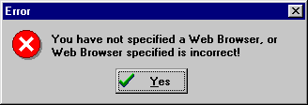
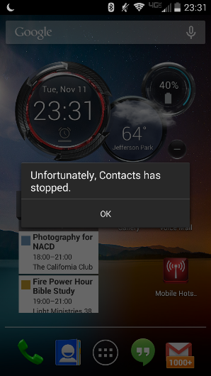
Heuristics (cont.)
bad
Notes:
Galaxy S4 message

Slide 10
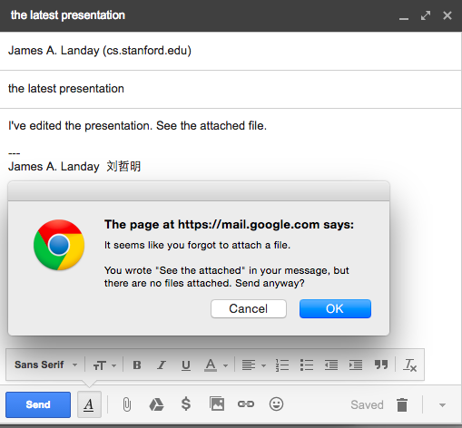
Heuristics (cont.)
good

Slide 11
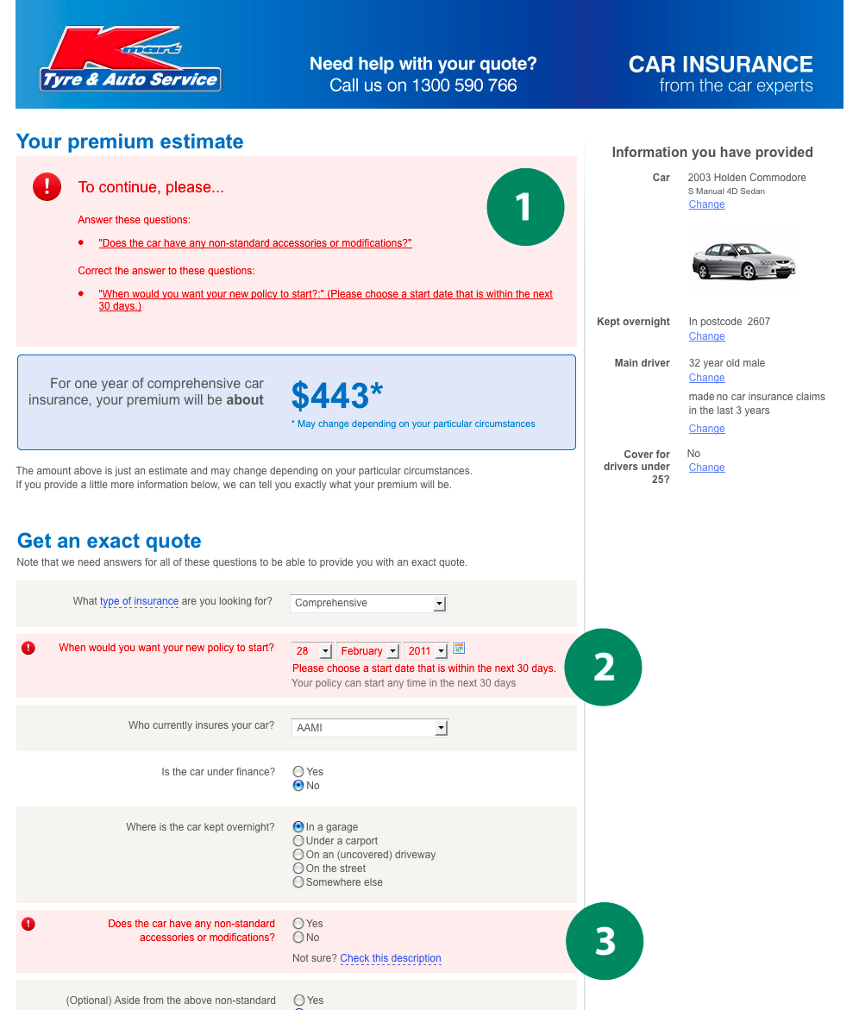
Good Error Messages
Clearly indicate what
has gone wrong
Human readable
Polite
Describe the problem
Explain how to fix it
Highly noticeable

Slide 12
Heuristic Violation Examples
[H1-3 Minimize the users’ memory load]
Can’t copy info from one window to another
  fix: allow copying
[H2-4 Consistency and Standards]
Typography uses different fonts in 3 dialog boxes
  slows users down
  probably wouldn’t be found by user testing
  fix: pick a single format for entire interface

Slide 13
Severity Ratings
0 - don’t agree that this is a usability problem
1 - cosmetic problem
2 - minor usability problem
3 - major usability problem; important to fix
4 - usability catastrophe; imperative to fix

Slide 14
Severity Ratings Example
1. [H1-4 Consistency] [Severity 3]
The interface used the string “Save” on the first screen for saving the user’s settings, but used the string “Store” on the second screen. Users may be confused by this different terminology for the same function.

Slide 15
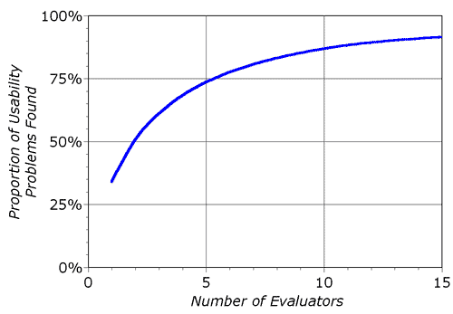
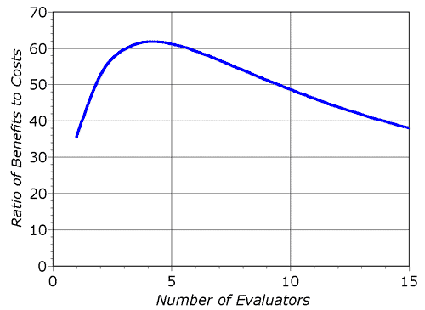
Decreasing Returns
problems found
benefits / cost
* Caveat: graphs for a specific example

Slide 16
Heuristic Evaluatoin Summary
Have evaluators go through the UI twice
Ask them to see if it complies with heuristics
  note where it doesn’t & say why
Combine the findings from 3 to 5 evaluators
Have evaluators independently rate severity
Alternate with user testing

Slide 17
e x e r c i s e

Slide 18
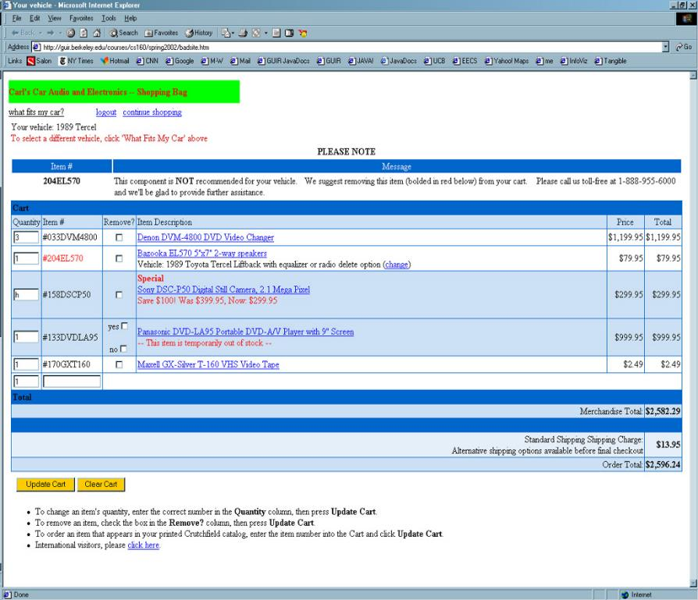
e x e r c i s e
Notes:
Let’s take 15 minutes

Slide 19
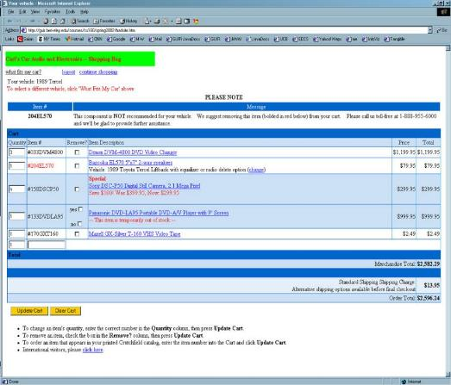
http://hci.stanford.edu/courses/cs147/2015/
au/assignments/simple-heuristic-evaluation.pdf
Find 12-15 Heuristic Violations
Notes:
Let’s take 15 minutes

Slide 20
Problems Found
H2-4 Consistency
remove column, 4th item is different w/ checkboxes. [150]
H2-9 Error prevention
non-numeric data in the quantity. Do not allow. [125]
H2-2 Match between system & real world
vehicle selection link not language I’d expect [100]
H2-1 Visibility of System Status
unclear which item to remove based on error message (“red/bold”). [150]
Notes:
Collect and discuss problems for 10 minutes

Slide 21
Further Reading
Heuristic Evaluation
Longer lecture
  https://drive.google.com/file/d/0BweiB6wu4sBaN2tfZGxKb2tuOTg/view
Books
  Usability Engineering, by Nielsen, 1994
Web site
  http://www.nngroup.com/articles/

Slide 22
Next Time
Lecture
  Heuristic Evaluation Group Exercise
Read
  How to Conduct a Heuristic Evaluation by Jakob Nielsen
Project
  Medium-fi Prototype & 3 Tasks due on Sunday 6 PM
  Sunday night you will do Heuristic Evaluation of other team (by yourself – write up report)

Slide 23
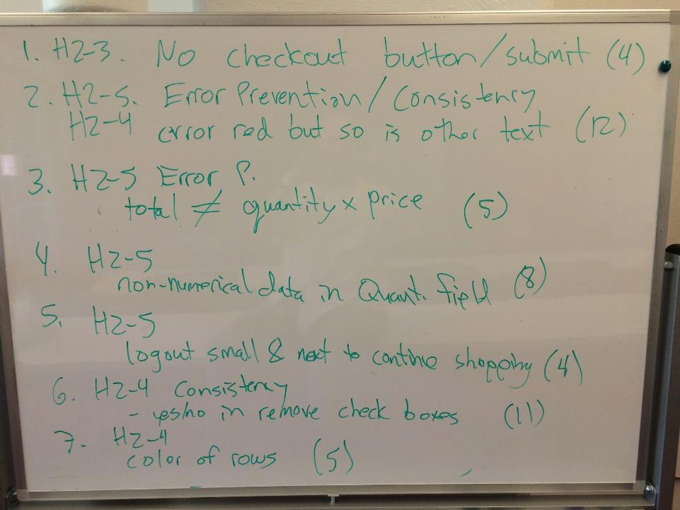
Notes:
Cornell class results with number having found that problem in parenthesis

Slide 24
