Slide 1
Medium-fi Prototyping
August 4, 2016
Notes:
SKETCH demo took 1:10 so there wasn’t much time for this (23 min plus 10 minute exercise – need 10-15 min more) – started 10 min late

Slide 2
Outline
Medium-fi prototyping
Designing with tasks
Exercise
Sketch / Marvel Overview

Slide 3
Fidelity in Prototyping: Instagator

Slide 4
Fidelity in Prototyping Task 1: Support Destination Polls

Slide 5
Selecting Tasks
Real tasks customers have faced / will face
collect any necessary materials
Should provide reasonable coverage
compare check list of functions to tasks
Mixture of simple & complex tasks
simple task (common or introductory)
moderate task
complex task (infrequent or for power customers)

Slide 6
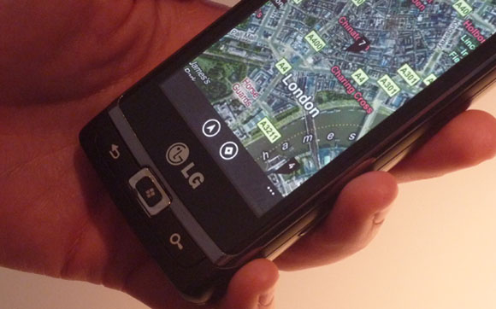
What Should Tasks Look Like?
Say what customer wants to do, but not how
allows comparing different design alternatives
Good
Bad
Notes:
Tony is visiting London and wants to find the pub that his friend told him about. He is walking down the street using his phone to navigate to the place that he has previously looked up (good) TASK
Vs.
Tony clicks on the Charing Cross Pub icon and selects “directions to” as he walks down the street (bad) TASK FLOW (used to call Scenario)

Slide 7
What Should Tasks Look Like?
Say what customer wants to do, but not how
allows comparing different design alternatives
Be specific – stories based on facts!
say who customers are (use personas or profiles)
design can really differ depending on who
name names (allows getting more info later)
characteristics of customers (job, expertise, etc.)
forces us to fill out description w/ relevant details
example: dentists forms
Some should describe a complete goal
forces us to consider how features work together
example: phone-in bank functions
Notes:
“Wixon and colleagues were developing an interface for a file management system. It passed lab tests with flying colors, but bombed as soon as customers got it. The problem was that it had a scrolling file list that was (say) twenty characters wide, but the file names customers used were very long, and in fact often identical for more than twenty characters (the names were made up by concatenating various qualifiers, and for many names the first several qualifiers would be the same.) Customers were not amused by needing to select from a scrolling list of umpty-ump identical entries that stood for different files. And this wasn't an oddball case, it was in fact typical. How had it been missed in the lab tests? Nobody thought it would matter what specific file names you used for the test, so of course they were all short.” – from Chapter 2 of TASK-CENTERED USER INTERFACE DESIGN A Practical Introduction by Clayton Lewis and John Rieman.

Slide 8
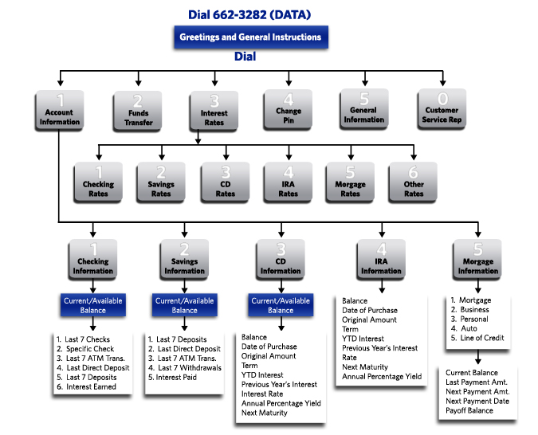
Tasks Describe a Complete Goal
Notes:
This design works fine when 1 “sub-task” is tried at a time, but when they are combined there is excessive up and down traversal of the phone tree

Slide 9
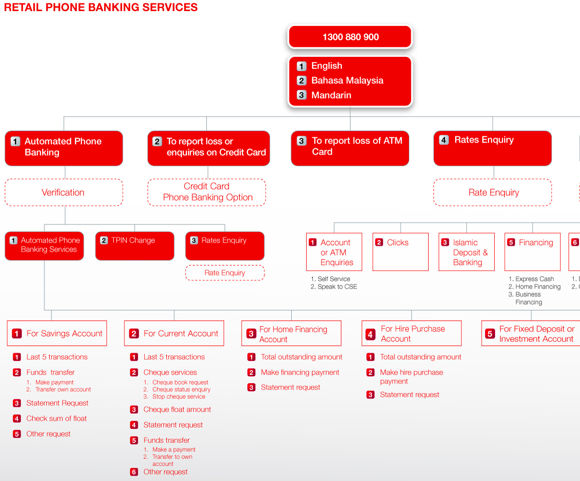
Tasks Describe a Complete Goal
Notes:
This design allows checking each account and then from an account, immediately transfer funds

Slide 10
Using Tasks in Design
Write up a description of tasks
formally or informally
run by customers and rest of the design team
get more information where needed
Check missed calls and call back Manny is in the city at a club and would like to call his girlfriend, Sherry, to see when she will be arriving a the club. She called from a friends house while he was on the subway, so he couldn’t answer the phone. He would like to check his missed calls and find the number so that he can call her back.

Slide 11
Using Tasks in Design (cont.)
Rough out an interface design
discard features that don’t support your tasks
or add a real task that exercises that feature
major screens & functions (not too detailed)
hand sketched
Produce task flows for each task
what customer has to do & what they would see
step-by-step performance of task
illustrate using storyboards
sequences of sketches showing screens & transitions

Slide 12
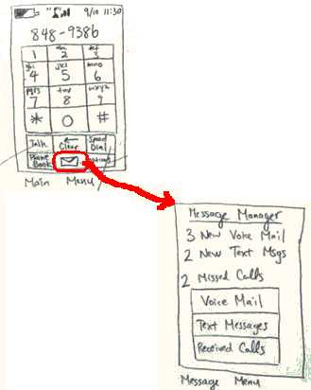
Task Flows Show How to Do the Task
Task Flows are design specific, tasks aren’t
Task Flows force us to
show how various features will work together
settle design arguments by seeing examples
only examples → sometimes need to look beyond
Show users storyboards of task flows to get feedback

Slide 13
Exercise: Task Definition
1 Easy task
1 Moderate task
1 Expert task

Slide 14
Next Time
Tour
Microsoft Research Asia (Friday, 10 AM-12 PM)
Lecture
Heuristic Evaluation
Read
Nielson on HE
Project
Define your tasks
Create rough draft medium-fi prototype by Thur at 4:30 PM
Final version w/ 3 tasks presented Friday at 2 PM

