Slide 1
Design Discovery
July 19, 2016
* some slides based on those of Julie Stanford, Sliced Bread Design
Notes:
Took 1.hour 45 mintues for lecture -- good

Slide 2
Hall of Fame or Shame?
Alessi Juicy Salif Citrus Juicer
By Philippe Stark

Slide 3
Hall of Shame!
Aesthetically pleasing but...
Does not perform it’s only function well: To make Juice.
Amazon review:
You’ll get almost as much juice on the wall and counter as you do in the glass since the juice will spray in every direction.
An example of where beauty can overpower purpose
Notes:
How could we fix this?

Slide 4
Design Discovery
September 24, 2015
Notes:
Took 1.5 hour for lecture Too long! (cut more lecture material)

Slide 5
Outline
Design Discovery
Needfinding

Slide 6
“ You Are Not the Customer”
Seems obvious, but…
different experiences
different terminology
different ways of looking at the world
Easy to think of self as typical customer
Notes:
Easy to make mistaken assumptions

Slide 7
Design Process: Discovery
Needfinding
characteristics of customers & tasks
understand client’s expectations
determine scope of project
evaluate existing practices & products
Discovery
Design Exploration
Design Refinement
Production
Notes:
To address this, we need to put our self in the customer's shoes.
To find empathy for their problems and needs.
This type of work starts at the "Design Discovery" stage of the design process.

Slide 8
Understanding the Customer
How do you learn how your customers work & live as well as interact with technology?
interviews, self report, logging/analytics & observation
How do you learn how your customers think?
understand human cognition
observe users performing tasks
Important to carry out in naturalistic settings
outside the lab → “ecologically valid”
study behaviors in real-life situations
Notes:
Naturalistic data collection methods
Key for places we will deploy contextually-aware and/or mobile apps

Slide 9
“You Can Observe a Lot Just by Watching”
—Yogi Berra
Notes:
As Yogi Berra supposedly said, you can observe a lot just by watching. What we’re going to talk about today is participant observation techniques for standing in someone else’s shoes. Of course, observing people isn’t the only way to begin designing an effective user interface. Great designs emerge through all sorts of approaches. That said, it’s often a good strategy to begin your design process by attuning yourself to your users.

Slide 10
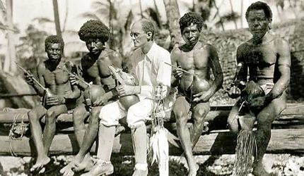
Image Courtesy Wikipedia: http://en.wikipedia.org/wiki/File:Wmalinowski_triobriand_isles_1918.jpg
Notes:
The techniques in this lecture are inspired by the fieldwork strategies that anthropologists use to learn about and document culture. In 1914, Bronislaw Malinowski traveled to Papua New Guinea), where he conducted fieldwork at Mailu and the Trobriand Islands. While he’s there, World War I breaks out. He has two options: hang out in the Trobriand islands or face internment since he’s Austrian. I think you can guess which option he picked. During this period, he developed the practices of participant observation, which remains a hallmark of ethnographic research to this day. In this photograph, Malinowski is being taught to play a string instrument.

Slide 11
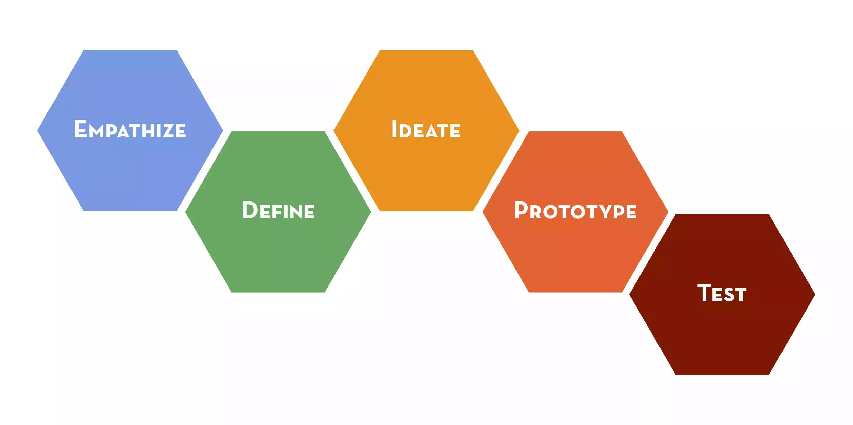
Design Thinking Process

Slide 12
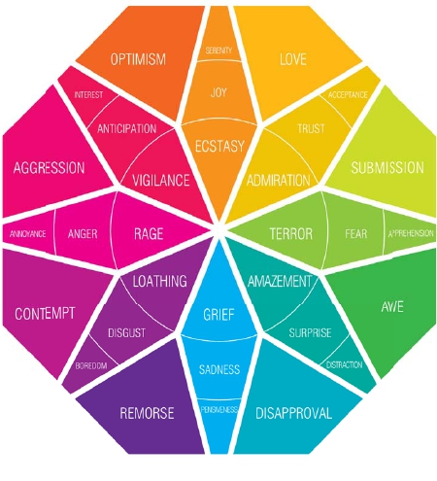
Empathy: Feel what they feel
Principles
Immerse
Observe
Engage
http://hci.stanford.edu/courses/cs147/2015/au/readings/FIELDGUIDE-Screen-DTBC-March-2015-V2.pdf

Slide 13
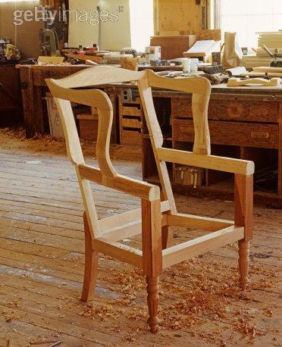
Needs: gaps within a system

Slide 14
Needfinding discovering opportunities by recognizing those gaps

Slide 15
Figure out the story of what and why…

Slide 16
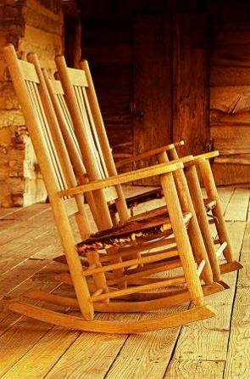
And tell a new one

Slide 17
Look for workarounds & hacks
Pay attention to all the artifacts
“Errors” are a goldmine
Notes:
“I am not a fan of undirected, explorative ethnography. This is an excellent procedure for developing our scientific understanding of human behavior, but it is too diffuse for practical application. I prefer directed observation: search out the workarounds, hacks, and clever improvisations of everyday life. That’s where the answers lie: someone else has already encountered the need, someone else has already hinted at a solution.”
- from Don Norman’s http://jnd.org/dn.mss/workarounds_-_leading_edge_of_innovation.html
A personal favorite of mine: post-it notes. Fax machines seem especially fond of growing these yellow cheat-sheets.

Slide 18
Getting to WHY
Needfinding starts with basic questions of everyday experiences
But moves from:
closed ended questions to open ended questions
“whats” to “whys”
actions to feelings
Engage people in their environment
Remember that people make sense

Slide 19
Choosing Participants
Representative of target users
May be current users of a similar system
Might also be the non-users
Notes:
job-specific vocab / knowledge, tasks; system intended for doctors; get medical students; system intended for engineers; get engineering students

Slide 20
Approximate if Necessary (may not be ideal, but better than nothing)

Slide 21
How to Interview? Have a Conversation
Anatomy of an interview
Explore
Emotions
Evoke
Stories
Build
Rapport
Follow-up
& Question
Statements
Thank &
Wrap-up
time
Adapted from Michael Barry
Intro
Project
Intro
Yourself
Notes:
Observe WHAT they are doing (facts)
HOW are they doing it?
WHY are they doing it the way they are?

Slide 22
How to Interview? Have a Conversation
Be human.
Seek stories.
Talk about feelings.
Anatomy of an interview
Explore
Emotions
Evoke
Stories
Build
Rapport
Follow-up
& Question
Statements
Thank &
Wrap-up
time
Adapted from Michael Barry
Intro
Yourself
Intro
Project
Ask “WHY?”
Notes:
Observe WHAT they are doing (facts)
HOW are they doing it?
WHY are they doing it the way they are?

Slide 23
Conducting An Interview
Introduce yourself, explain your purpose
The interview is about them, not you!
Begin with open, unbiased questions
Ask the question and let them answer

Slide 24
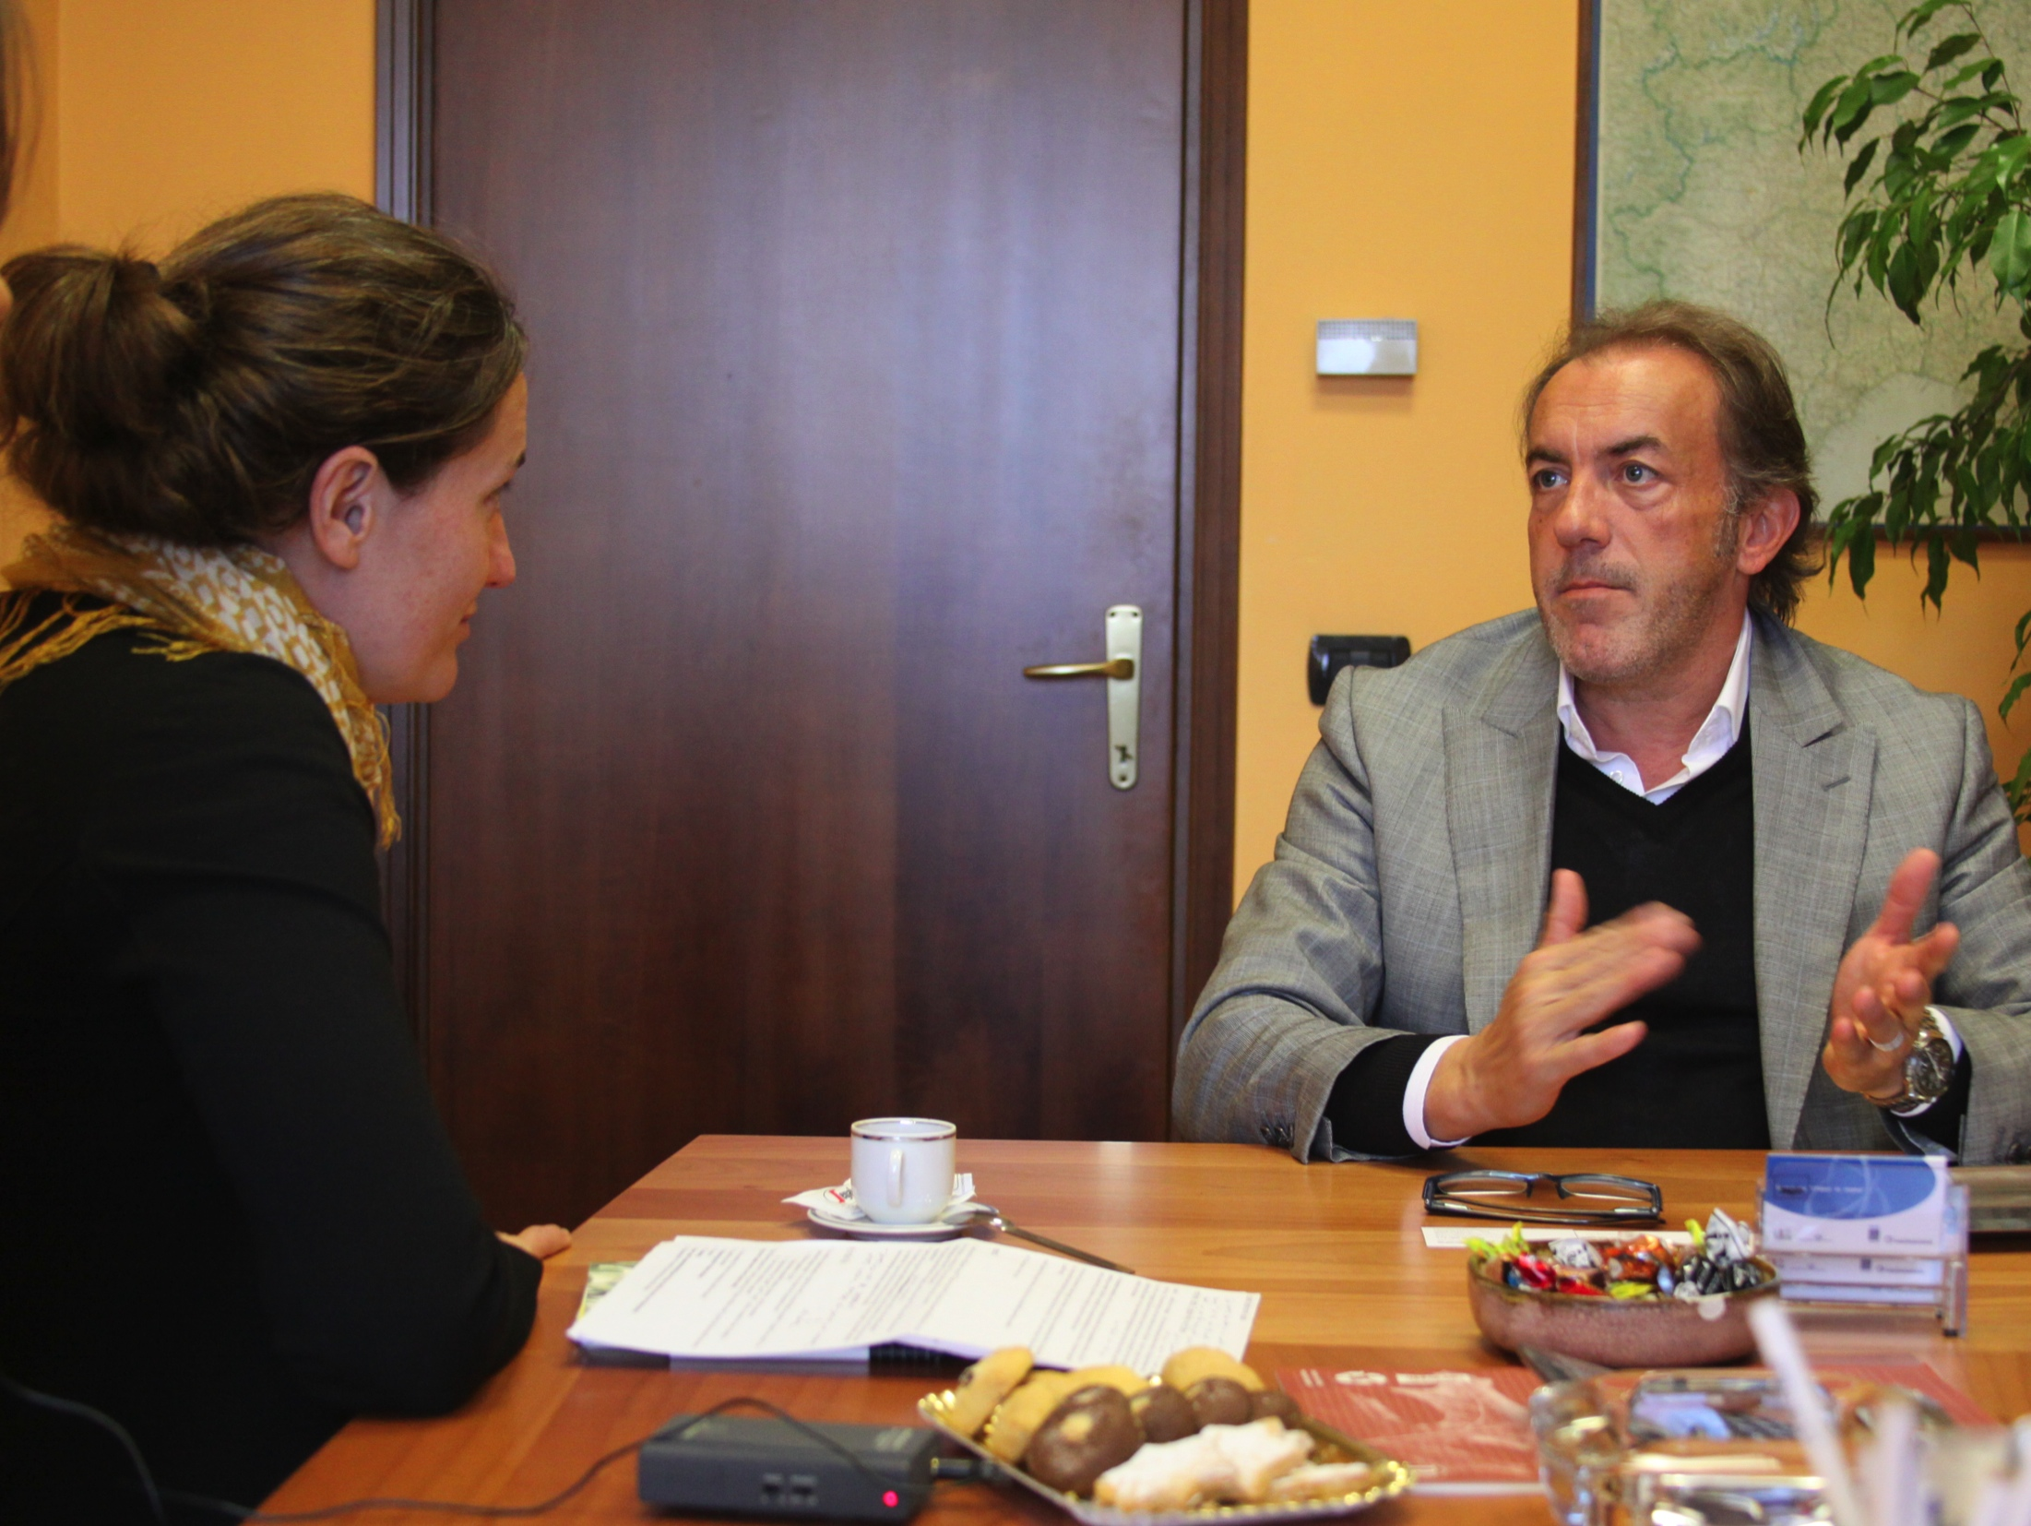
An needfinding interview is….
One in which the interviewee speaks 90% of the time.
More than data gathering. Be ready to hear something new and be changed by it.

Slide 25
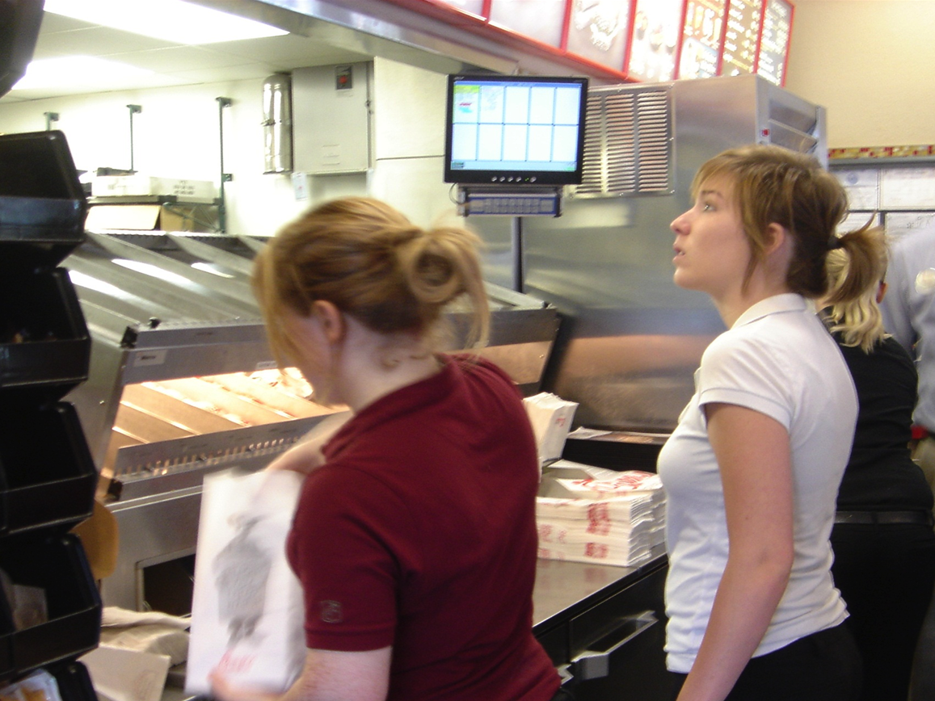
Defer your agenda and unlock their world Step into the interviewee’s shoes Be curious Have a “beginners mindset”

Slide 26
Interview
Our interviews typically share the same basic structure as a story.
Climax
Explore emotions
Denouement
Evoke stories
Reflection
Rising Action
Introduction
Wrap-Up
Build Rapport
Kickoff
Intro
time

Slide 27
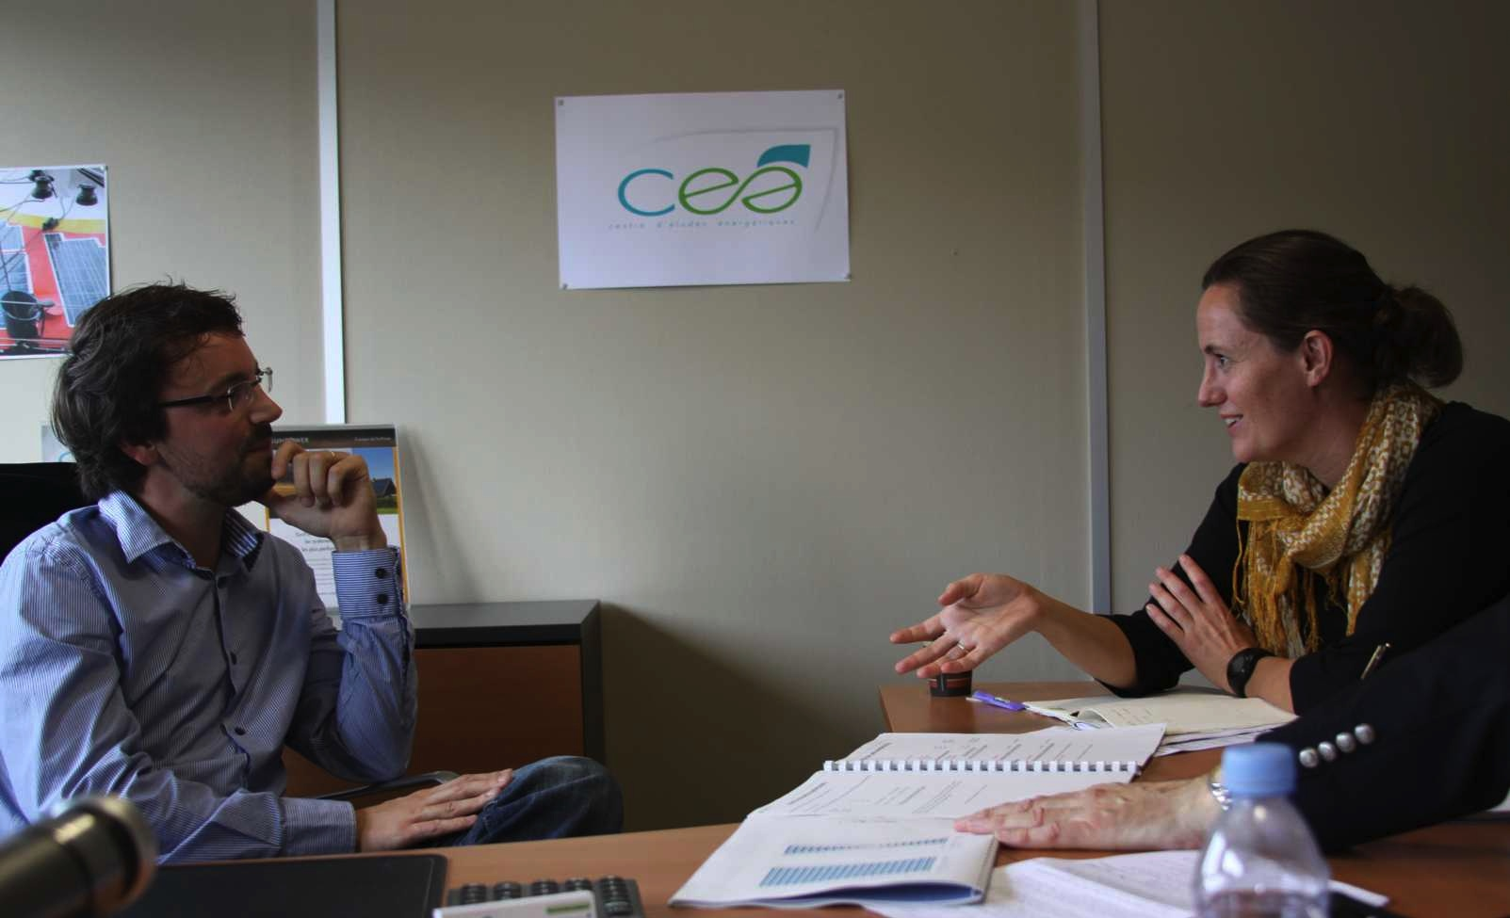
Interview
Good interviews require a broad repertoire of questions – but be prepared to veer.

Slide 28
Interview
Our interviews typically share the same basic structure as a story.
Climax
Explore emotions
Denouement
Evoke stories
Reflection
Rising Action
Introduction
Wrap-Up
Build Rapport
Kickoff
Intro
time

Slide 29
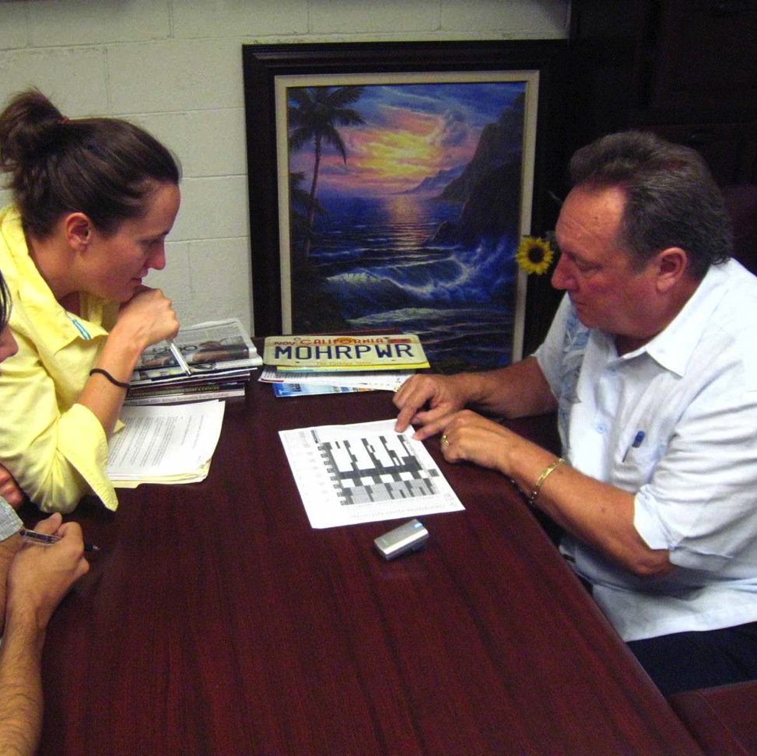
Interview Questions - Kickoff
Background— “Tell me about what you do here.”
Sequence — “Walk me through your day yesterday…then what do you do next?”
Physical tour — Take me on a tour of how you build the panels…”
Virtual tour — Walk me through your sales process from the beginning…“
Participation — “Can you show me exactly how you prepare a bid for a customer?”
Exhaustive List — “What are all the different municipalities where you sell?”

Slide 30
Interview
Our interviews typically share the same basic structure as a story.
Climax
Explore emotions
Denouement
Evoke stories
Reflection
Rising Action
Introduction
Wrap-Up
Build Rapport
Kickoff
Intro
time

Slide 31
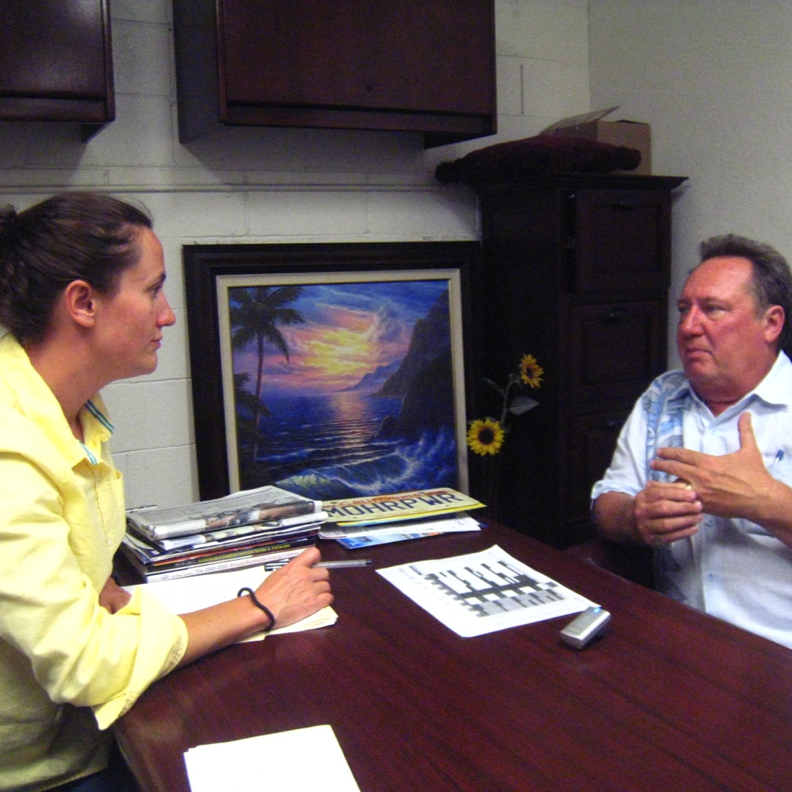
Interview Questions – Build Rapport
Naïve Outsider Perspective — “I’m not from Southern California, tell me how the housing market works here.”
Quantity — “How many of your competitors fall into that category?”
Changes Over Time — “How are things different than they were a year ago?”
Tasks and organizational structures — “Can you draw me a diagram of the organizational chart of your company?”
Native Language — “Why do you call your office ‘the command post’?”
Reflecting Back — “So, what I hear you saying is….. is that right?”

Slide 32
Interview
Our interviews typically share the same basic structure as a story.
Explore emotions
Climax
Denouement
Evoke stories
Reflection
Rising Action
Introduction
Wrap-Up
Build Rapport
Kickoff
Intro
time

Slide 33
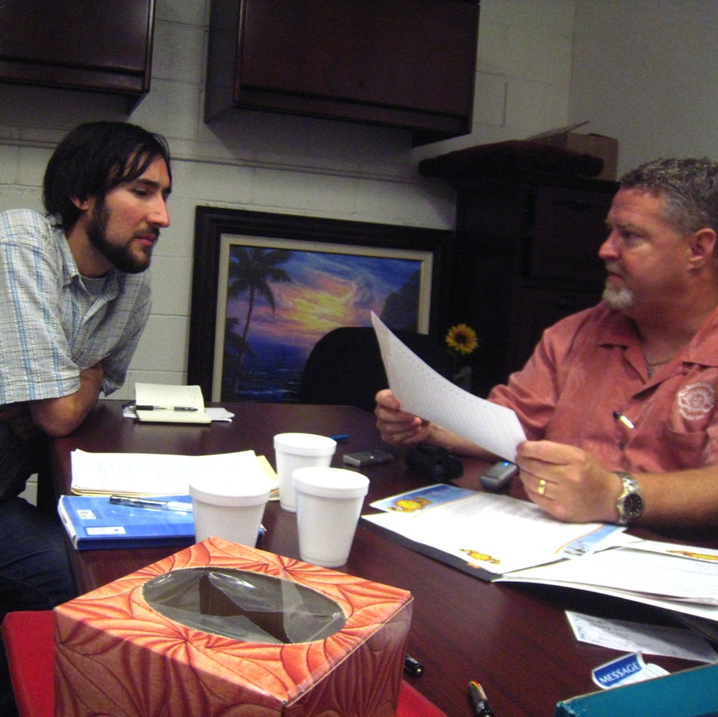
Interview Questions – Stories & Emotions
Peer Comparison - “Do your colleagues share your sales techniques?”
Other Viewpoint Comparison - “What would other solar owners think about that?”
Clarification - “…and when you say ‘I’m a closer,’ what do you mean exactly?”
Characterization and Comparison - “Could you characterize your sales style and compare it to Mike’s?”
Success and Failure – “Describe your most successful sales call. Now tell me about a sales call that was an absolute disaster.”

Slide 34
Interview
Our interviews typically share the same basic structure as a story.
Climax
Explore emotions
Denouement
Evoke stories
Reflection
Rising Action
Introduction
Wrap-Up
Build Rapport
Kickoff
Intro
time

Slide 35
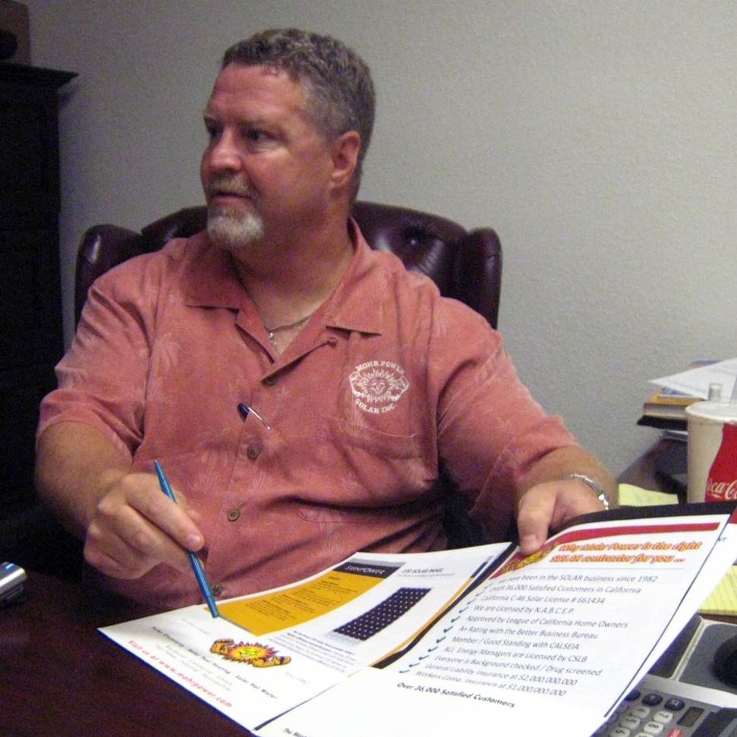
Interview Questions – Reflection
Point to Their Reaction - “Why do you roll your eyes when you say that?”
Suggestive Opinion - “Some people have very negative feelings about emotional, non-technical sales pitches in the solar industry. What are your feelings about it?”
Contradictions - “You tell me you can sell ice cubes to Eskimos but you also tell me you have a deep concern for your customers, how do these two work together?”

Slide 36
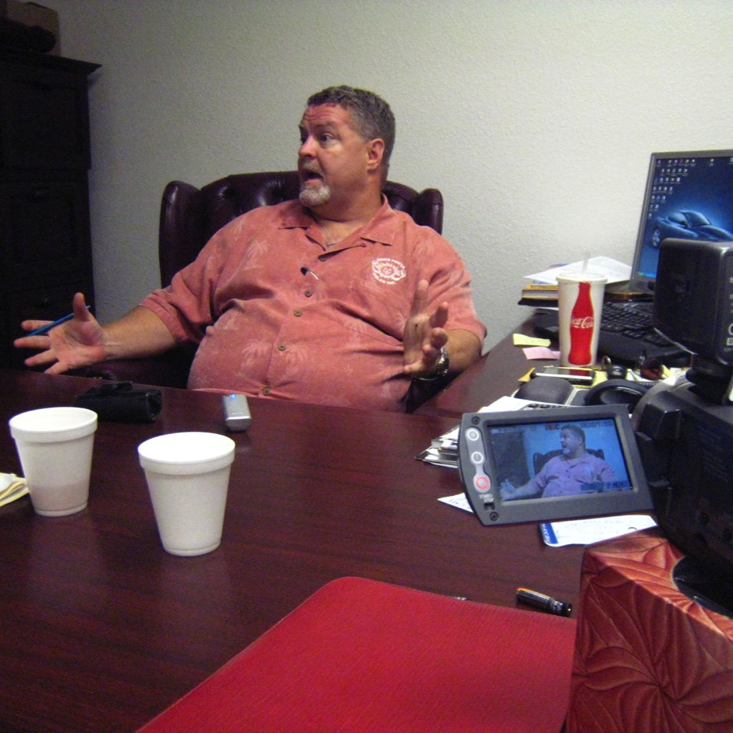
Common Pitfalls – Suggesting Answers
“How was that decision reached? Was there a big meeting? Did your boss decide without you?…”
Let the informant paint his or her own categories of meaning
Technique: Avoid suggested answers
Trust the question – ask it and and stop talking; Let there be silence

Slide 37
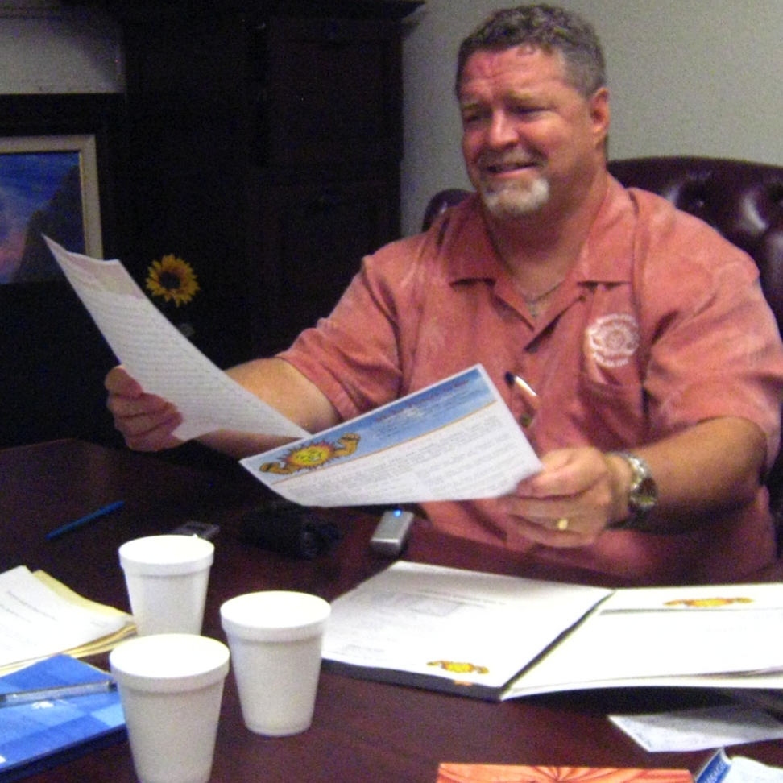
Common Pitfalls – You are talking too much!
“Because I spent last summer working on my parents roof I noticed how hard it was to keep things from falling off and I saw that you guys have lots of complicated equipment with wires and breakable panels and mechanical stuff going on all at the same time so I bet you find that safety training is hard to keep top of mind for your employees?”
Ask succinct questions
Minimize the number of your clarifications, conditionals, and rationalizations

Slide 38
Common Pitfalls – Hypothetical Situations
“What if I designed something that wasn’t as round and soft and annoying as your current thing and instead bounced up and down. Would that work for you?”
“What about your friends? What would they do?”
Ask about events & things that actually happened/exist
Focus on getting the user’s point of view, not what they think someone else might do/think

Slide 39
There is More Than One Way to Ask “Why?”
Tell me more about that
Tell me what you mean you say XXX
… [last phrase the person said]?

Slide 40
Types of Questions to Avoid
What they would do / like / want in hypothetical scenarios
How often they do things
How much they like things on an absolute scale
Avoid binary questions
“Tell me a story about yourself”
Notes:
The last time they did something

Slide 41
Good Questions
Notes:
Especially at the beginning of an interview, I recommend open-ended questions.

Slide 42
(a little bit of)
Silence is Golden

Slide 43
Follow up
Adjust your questions to their previous answers
Ask questions in language they use / understand
Pick up on & ask for examples
Be flexible
Notes:
Prepare a set of questions, but don’t be constrained by them
Begin with Open-ended questions
Restate answers, follow up, and probe further
Don’t be afraid to call people out
Ground questions with artifacts and specific instances

Slide 44
Extreme Users
Behaviors & Feelings are amplified
Help you notice nuances & find insights
Examples for travellers
family w/ young children
fearful passenger
wheelchair user
commuter
CC : flickr/@Saigonphoto
Notes:
Email: some people get 1000 emails a day they need to deal with. Others only check their email once a month. Both can provide insights or inspire designs.
[[Question: what might Ms. Monthly lead you to? Possible answer: programs for people going on vacations and needing to catch up once back.]]
If possible, try to interview several different experts with different point of views
Remember that the real “experts” are the users you are designing for. Don’t ask experts for solutions, or take their ideas as a final solution

Slide 45
What are the gems?
You’ve uncovered a surprise or found what is missing
You can explain why people do unusual things
You want to tell others about what you have learned

Slide 46
Share with your team
Stories
Photos
Sketches
Quotes
Notes:
So what do you do? You have tons of notes, pictures, stories. How do you make sure you keep it in mind throughout the process?
We will talk about that more next lecture.

Slide 47
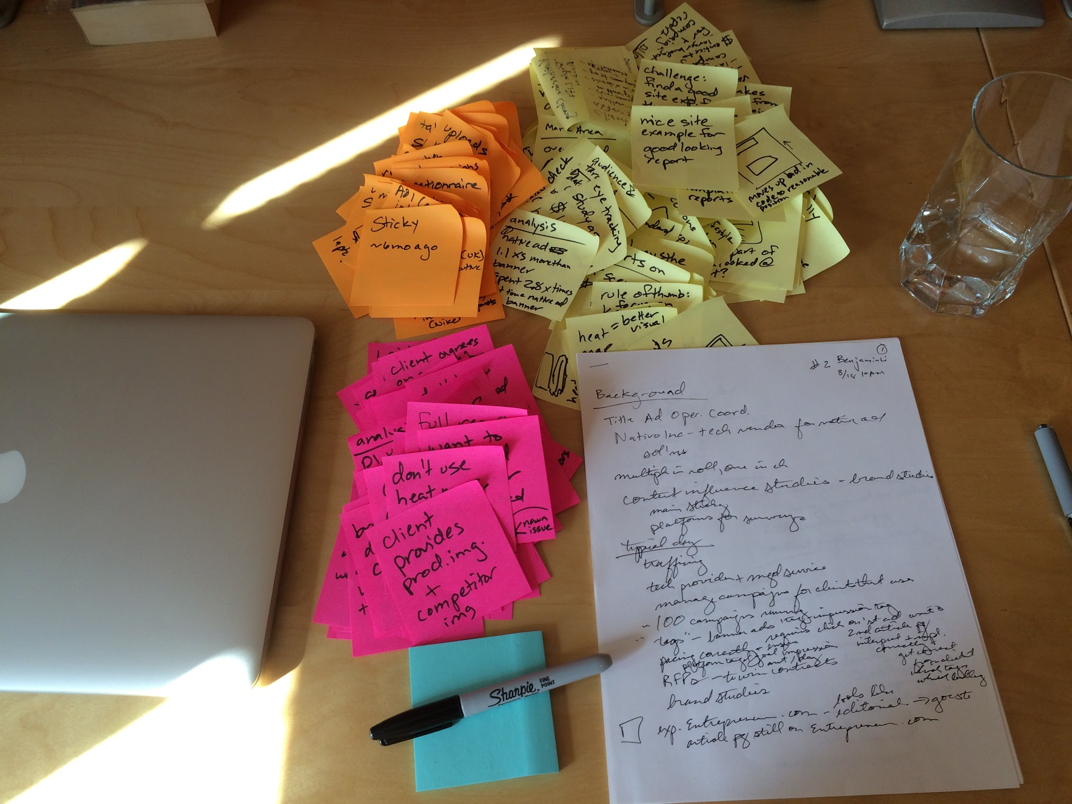
Getting Started on Unpacking
debrief after each interview on stickies
one color per participant, take notes with a sharpie

Slide 48
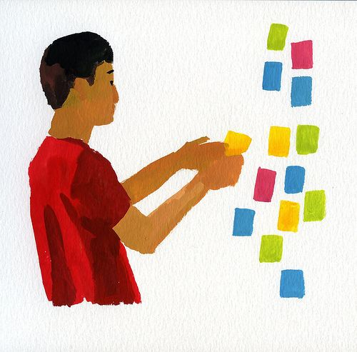
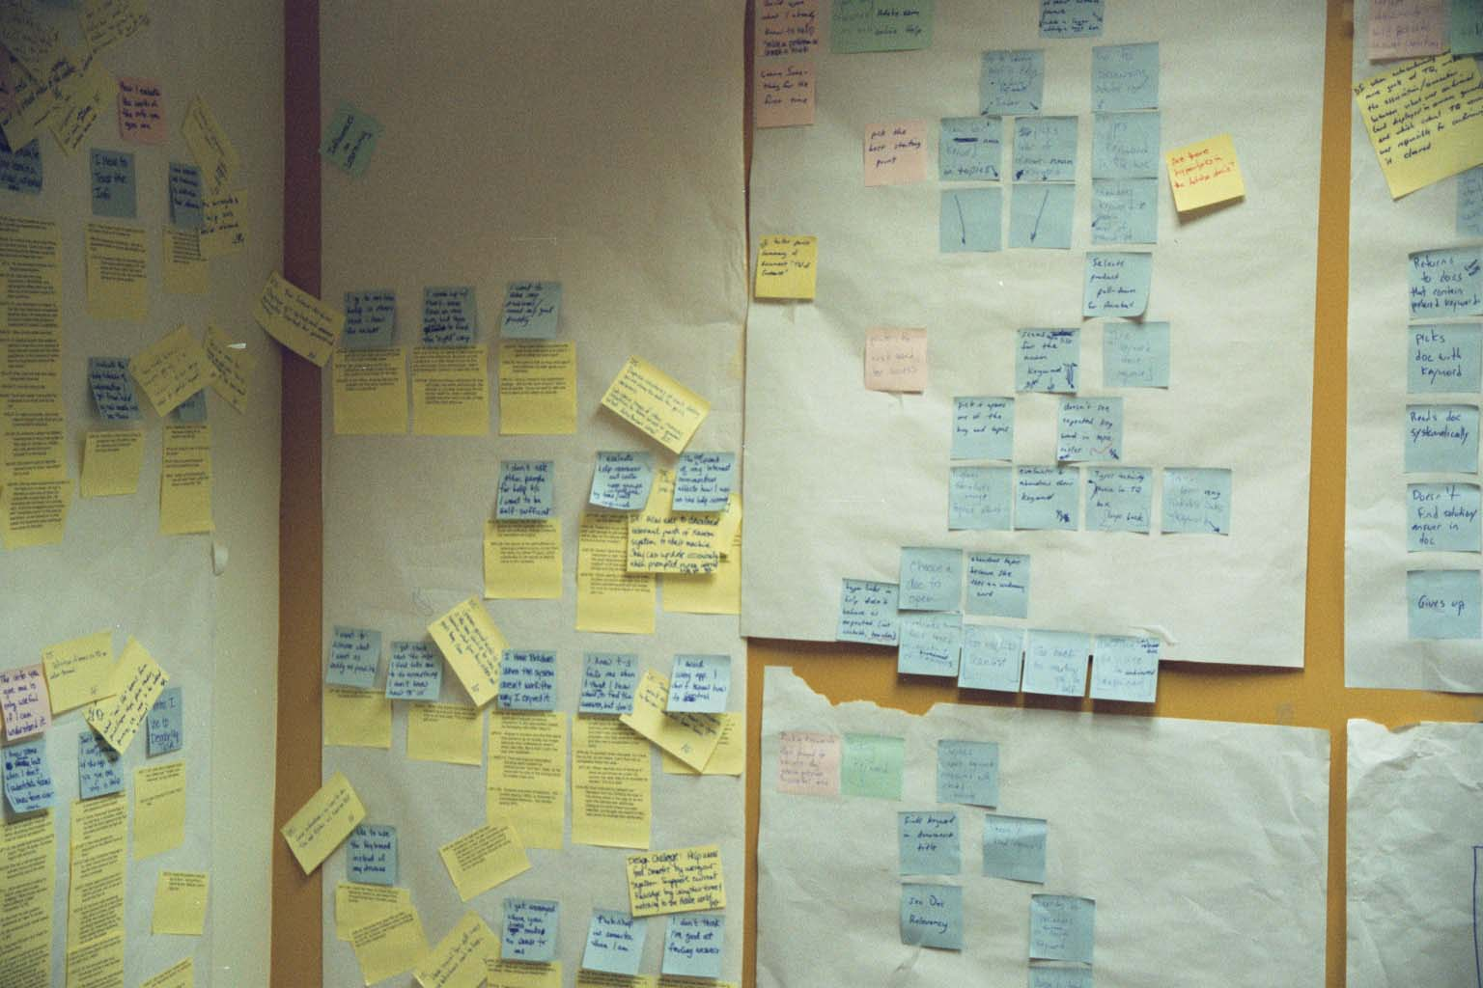
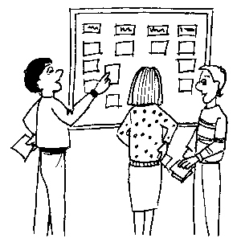
Using the Data Collected in the Field
Figure out what is important
Affinity diagramming
group info & find relations between groups
Post-Its on large surfaces
haptic UI
brainstorming
immersive
persistent
also used for creating web info architecture
Notes:
So what do you do? You have tons of notes, pictures, stories. How do you make sure you keep it in mind throughout the process?

Slide 49
Users: Unique or One of Many?
“Take the attitude that nothing any person does is done for no reason; if you think it’s for no reason, you don’t yet understand the point of view from which it makes sense. Take the attitude that nothing any person does is unique to them, it always represents an important class of customers whose needs will not be met if you don’t figure out what’s going on.” (p. 63, Contextual Design)

Slide 50
Thoughts on Interviews
Use recording technologies
notebooks, digital/phone recorders, still & video images
Structure
conventional interview (10 minutes)
introduce focus, deal with ethical issues, get summary data
transition (30 seconds)
state new rules – they work while you watch & interrupt
contextual interview (20-60 minutes)
take notes, draw, be nosy! (“who was on the phone?”)
wrap-up (15 minutes)
summarize your notes & confirm what is important

Slide 51
Your goal:
a point of view
Notes:
This is a term of art.
It’s your rallying cry: an actionable problem statement. Rather than trying to solve getting to Stanford, you are…making it easier for Stanford students and staff who live in SF to commute.
It encapsulates a specific person or set of people and how you can make a breakthrough in their lives.
What’s the most important, specific, problem that you can solve?

Slide 52
Flare, then focus.
Notes:
This is going to be the first time you’ll come across one of the themes of the course: flare, then focus. Generate as many observations as you can, then group them, extract higher-level themes, use those to lead to new ideas. And eventually pick the ones you like the best.
This idea will come back again, for example when we start talking about ideation and then again when prototyping.

Slide 53
Caveats of User-Centered Design
Politics
“agents of change” can cause controversy
important to get buy-in from all those involved
Customers are not always right
cannot anticipate new technology accurately
job is to build system customers will want
not system customers say they want
Design/observe forever without prototyping
rapid prototyping, evaluation, & iteration is key
Notes:
get a sense of organization & bond w/ interviewee
not system customers say they want
be very careful about this (you are outsider)
if you can’t get customers interested in your hot idea, you’re probably missing something

Slide 54
Further Reading
Books
User and Task Analysis for Interface Design by Joann T. Hackos, Janice C. Redish
The Inmates are Running the Asylum by Alan Cooper
Don Norman, The Design of Everyday Things
Kuniavsky, Observing the User Experience
Institute of Design at Stanford
lots of online materials at http://dschool.stanford.edu

Slide 55
Summary
Know thy user & involve them in design
Needfinding
build empathy with customers
listen to them to discover interesting insights
Notes:
CI is specific interviewing method used in needfinding

Slide 56
Next Time
Lecture
Define: Unpacking the needfinding results to better define the problem/domain of interest
Ideate: How might we solve the problem?
Readings
None
Watch
ABC News Nightline IDEO Deep Dive, July 1999 (22 minutes)
Bonus video: ABC News, IDEO Design Thinking, January 2013 (60 minutes)

