Slide 1
Kinect SDK Tutorial Skeleton and Camera (RGB)
Anant Bhardwaj

Slide 2
Skeleton Tracking
Getting skeleton data
Getting Joint positions
Scaling (uses coding4fun library)
Fine-tuning
Using TransformSmooth parameters

Slide 3
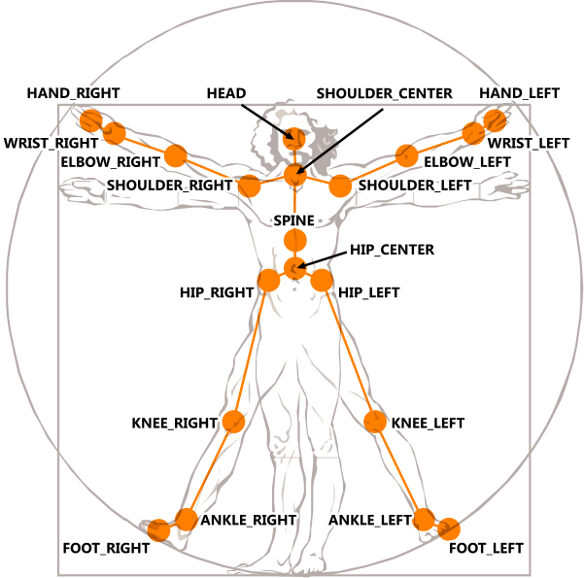
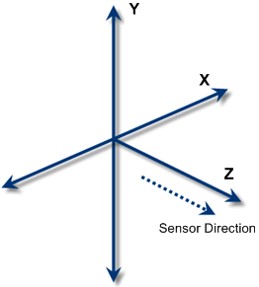
Skeleton Tracking
Skeleton Data

Slide 4
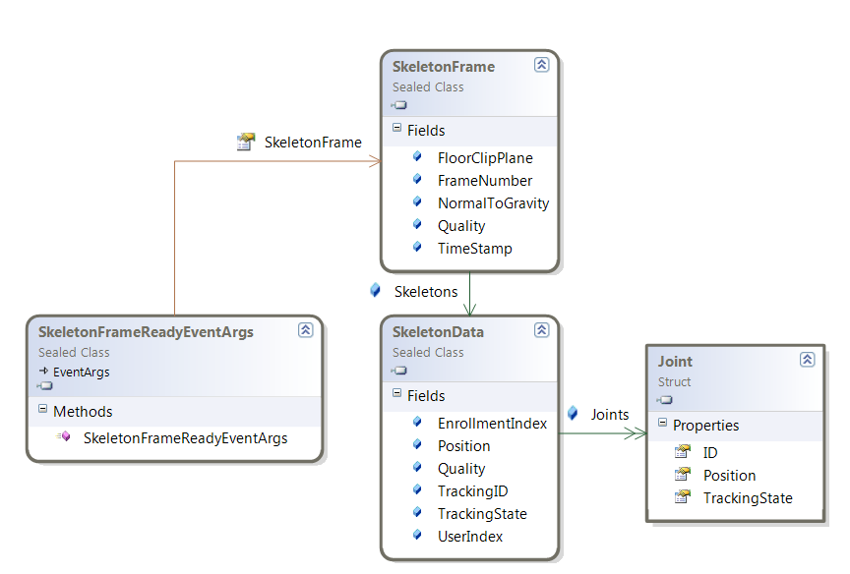
Skeleton API

Slide 5
Step 1: Register for SkeletonFrameReady event
//initialize
nui.Initialize(RuntimeOptions.UseSkeletalTracking);
//subscribe for the event
nui.SkeletonFrameReady += new EventHandler<SkeletonFrameReadyEventArgs>(nui_SkeletonFrameReady);

Slide 6
Step 2: Read the skeleton data
void nui_SkeletonFrameReady(object sender,
SkeletonFrameReadyEventArgs e)
{
SkeletonFrame allSkeletons = e.SkeletonFrame;
//get the first tracked skeleton
SkeletonData skeleton =
(from s in allSkeletons.Skeletons
where s.TrackingState == SkeletonTrackingState.Tracked
select s).FirstOrDefault();
}

Slide 7
Step 3: Get the joint data
Joint HandRight =
skeleton.Joints[JointID.HandRight].ScaleTo(640, 480);
Joint HandRight =
skeleton.Joints[JointID.HandRight].ScaleTo(640, 480, .5f, .5f);

Slide 8
Joint Data
Maximum two players tracked at once
Six player proposals
Each player with set of <x, y, z> joints in meters
Each joint has associated state
Tracked, Not tracked, or Inferred
Inferred - Occluded, clipped, or low confidence joints

Slide 9
Step 4: Fine-tune
nui.SkeletonEngine.TransformSmooth = true;
TransformSmoothParameters parameters =
new TransformSmoothParameters();
parameters.Smoothing = 0.7f;
parameters.Correction = 0.3f;
parameters.Prediction = 0.4f;
parameters.JitterRadius = 1.0f;
parameters.MaxDeviationRadius = 0.5f;
nui.SkeletonEngine.SmoothParameters = parameters;

Slide 10
Camera: RGB Data
Getting RGB camera data
Converting into image
Getting RGB values for each pixel

Slide 11
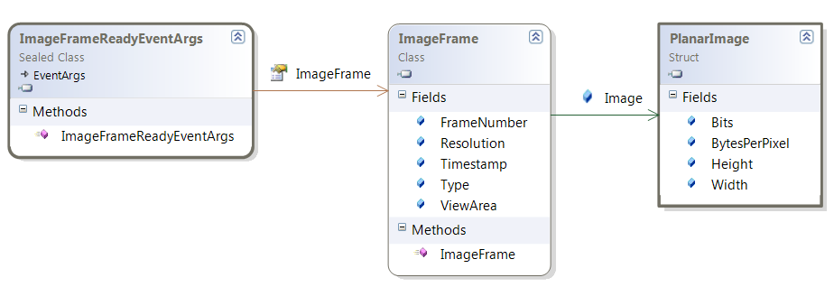
Camera Data

Slide 12
Step 1: Register for VideoFrameReady Event
//initialize
nui.Initialize(RuntimeOptions.UseColor);
//subscribe for the event
nui.VideoFrameReady += new EventHandler<ImageFrameReadyEventArgs>(nui_VideoFrameReady);
//open the video stream
nui.VideoStream.Open(ImageStreamType.Video, 2, ImageResolution.Resolution640x480, ImageType.Color); //poolsize is 2

Slide 13
Step 2: Read the camera data(image)
void nui_VideoFrameReady(object sender, ImageFrameReadyEventArgs e)
{
PlanarImage imageData = e.ImageFrame.Image;
//image1 is a static placeholder image
image1.Source = BitmapSource.Create(imageData.Width, imageData.Height, 96, 96, PixelFormats.Bgr32, null, imageData.Bits, data.Width * imageData.BytesPerPixel);
}
Easier way (With Coding4Fun Kinect Toolkit)
image1.Source = e.ImageFrame.ToBitmapSource();

Slide 14
Step 2: Read the camera data (color)
void nui_VideoFrameReady(object sender, ImageFrameReadyEventArgs e)
{
PlanarImage image = e.ImageFrame.Image;
int offset = 0;
Color[] bitmap = new Color[640 * 480];
for (int y = 0; y < 480; y++)
for (int x = 0; x < 640; x++)
{
Color c = new Color();
bitmap[y * 640 + x] = c;
c.R = imageData.Bits[offset + 2];
c.G = imageData.Bits[offset + 1];
c.B = imageData.Bits[offset];
c.A = 255;
offset += 4;
}
}
}

Slide 15
Questions

