Slide 1
Introduction & Course Overview CS 194H – User Experience Design Project
January 10, 2017

Slide 2
Outline
Survey
Who are we?
Course overview & schedule
Introductions
Teams

Slide 3
Survey
http://bit.ly/cs194h-survey-1

Slide 4
Who are We?

Slide 5
James Landay
Professor in Computer Science at Stanford
formerly professor at Cornell Tech, University of Washington & Berkeley
spent 3 years as Director of Intel Labs Seattle
Dec 2011 finished 2.5 year sabbatical at Microsoft Research Asia
PhD in CS from Carnegie Mellon ’96
HCI w/ focus on informal input (pens, speech, etc.), crowdwork, web design (tools, patterns, etc.) & Ubiquitous Computing
Founded NetRaker, 1st in web experience management (sold to Keynote)
Co-authored The Design of Sites with Doug van Duyne & Jason Hong
Office Hours: Tue. 4-5 PM / Thur 10-11 AM in 390 Gates (tentative)
Email: landay@[insert usual Stanford email domain]

Slide 6
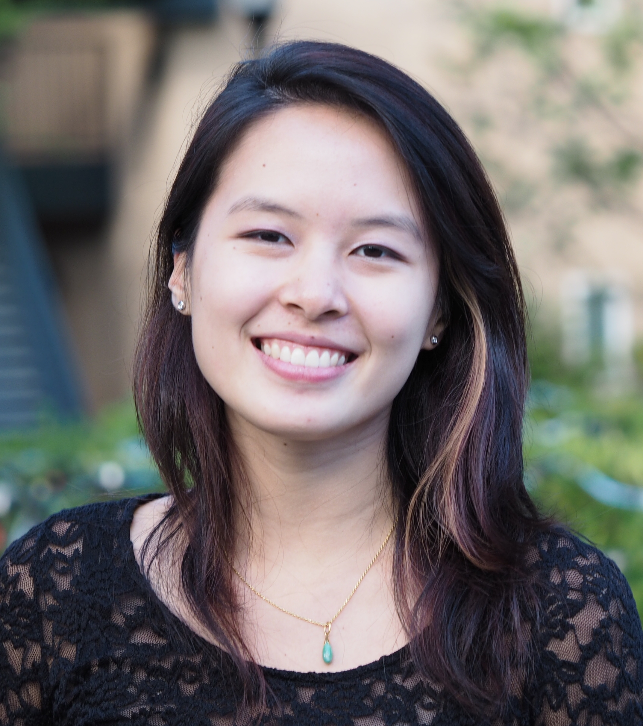
Emily Tang
CS & Psychology Undergrad, CS Masters
Interested in human behavior, educational equity, and diversity in STEM
I like corgis
Office Hours
TBD

Slide 7
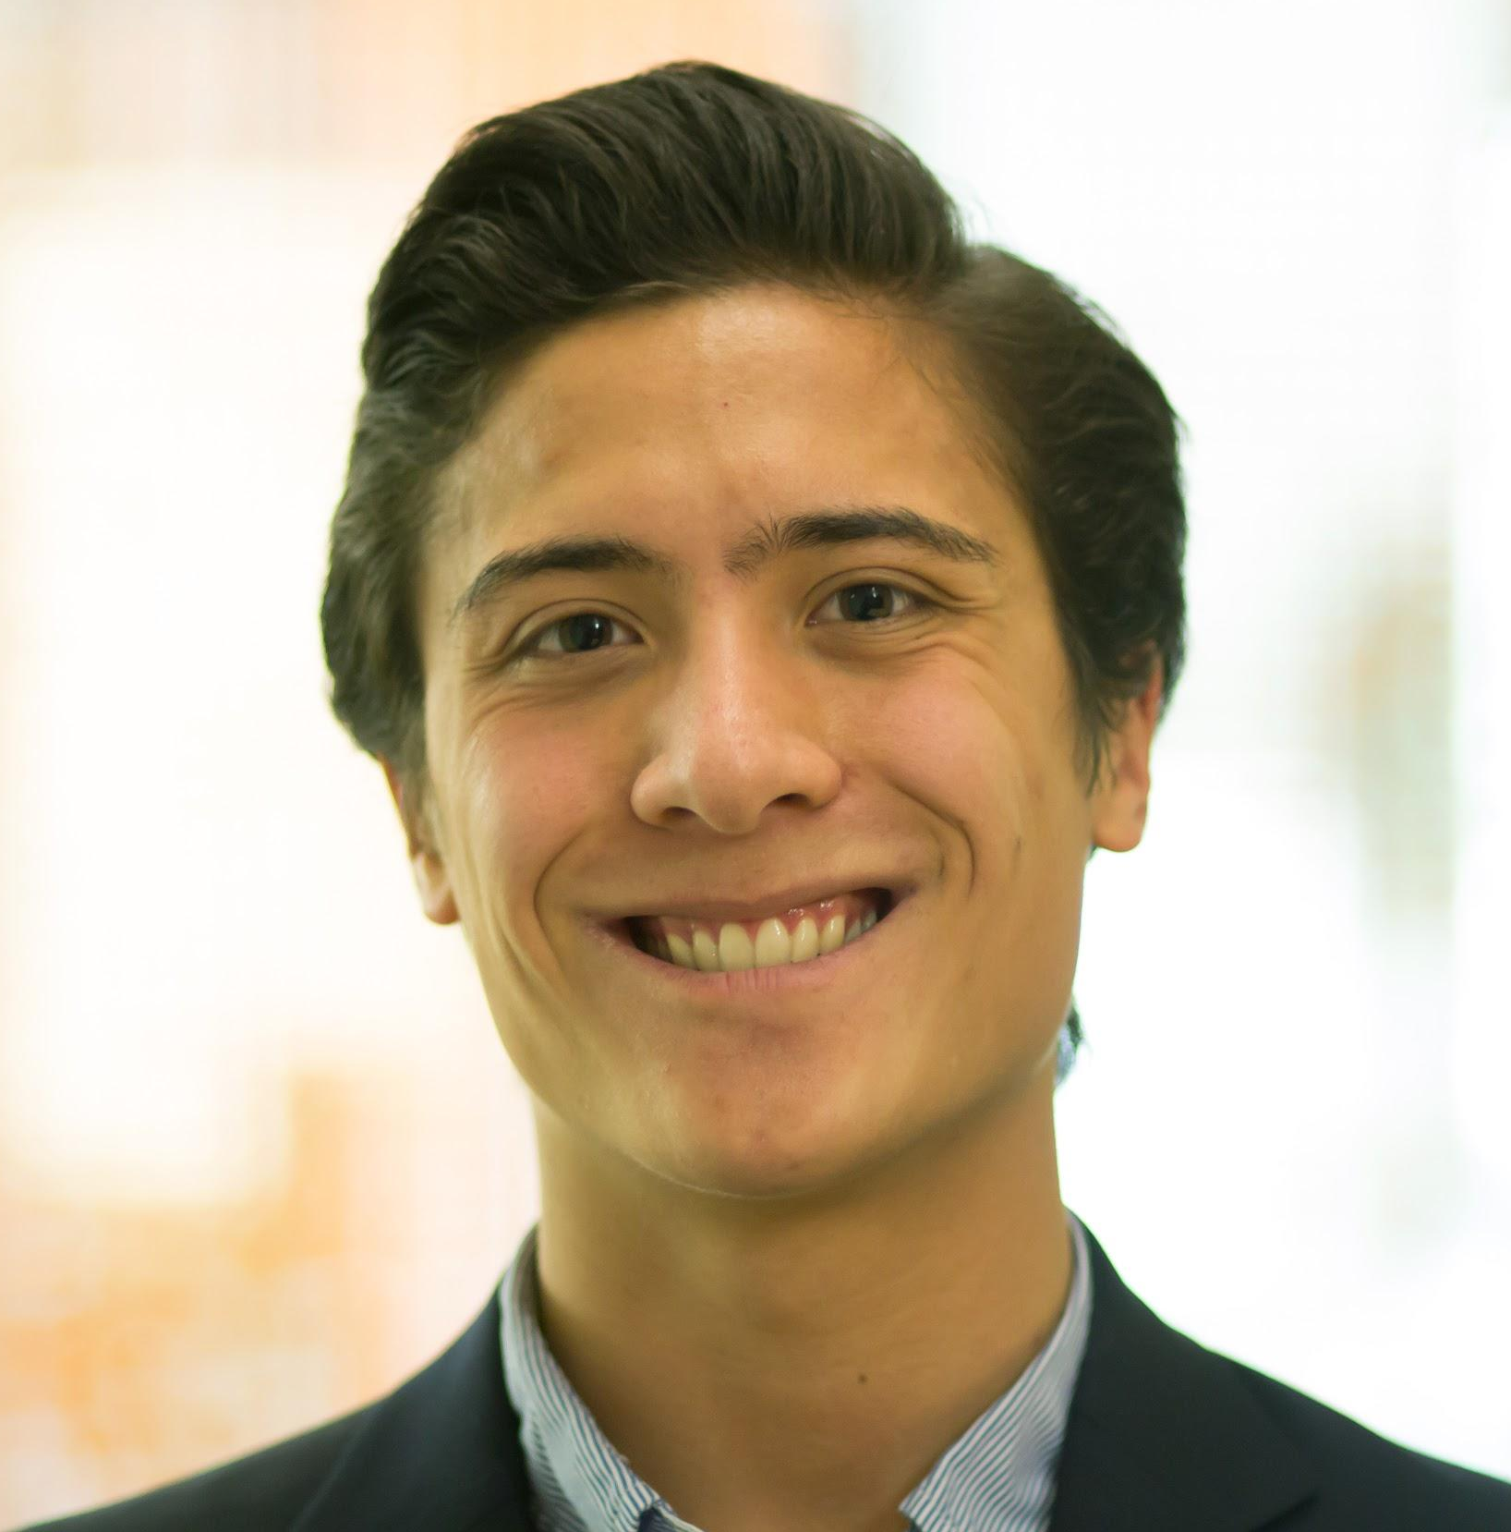
John Yang-Sammataro (YS)
BS CS Systems + MS CS HCI
Spent last year in Asia, a warzone, and an entourage
I like doing right, building teams, and exploring paths less traveled
Office Hours
TBD

Slide 8
How to Design and Build UIs
UI Development process
Usability goals
User-centered design
Need finding, task analysis & contextual inquiry
Rapid prototyping
Evaluation
Programming

Slide 9
Iteration
At every stage!
Design
Prototype
Evaluate

Slide 10
Goals of the Course
Learn to prototype, evaluate, & build UIs
the needs & tasks of prospective users
cognitive/perceptual constraints that affect design
technology & techniques used to prototype UIs
techniques for evaluating a user interface design
importance of iterative design for usability
how to work together on a team project
communicate your results to a group
key to your future success
Understand where technology is going & what UIs of the future might be like

Slide 11
Course Format
Quarter long project & individual homework
Interactive lectures / Project presentations (usually on Tuesdays)
Studio design critiques on Thursday (usually)
Readings (small number & short)
All material is (will be) online
slides, exercises, readings, schedule
http://hci.stanford.edu/courses/cs194h/
Have fun & participate!

Slide 12
Project Description
We will continue work on projects from CS 147
existing groups will stay intact
we will assign “new” students to teams
Groups
4 students to a group ➔ 4-6 groups
groups meet with teaching staff every week
often in class, but also regularly scheduled outside
Cumulative
apply several HCI methods to a single interface

Slide 13
Project Process Overview
Project Recap (next Tue)
Web Site
Lab Usability Study
Hi-Fi Prototype #2
Field Usability Test
Hi-Fi Prototype #3
Hi-Fi Video Prototype
Final posters/presentations & project fair with industry guests

Slide 14
Schedule
http://hci.stanford.edu/courses/cs194h/2017/wi/calendar.html

Slide 15
Books
Universal Principles of Design by Lidwell, Holden & Butler
“handout” ~8 chapters we will use
We will also hand out other papers, give you web links & refer to slides
Other recommended refs on web page

Slide 16
Assignments
Individual
5 short studio tasks + one individual talk
Team
8 team assignments including web site
4-5 team presentation/demos + with 1 write-up
video
poster
team web site graded
all work handed in online
team work on team web site
individual work shared w/ teaching staff on GDocs

Slide 17
Grading
No exams
Individual assignments (30%)
Group project (60%)
demos/presentation (team component)
project write-up
team web site
ratings given by other team members
In class participation (10%)
beyond simply attending

Slide 18
Tidbits
Late Policy
no lates on team assignments
individual assignments lose one letter grade/day
Cheating policy
Stanford honor code

Slide 19
Teams
Which 147 teams are represented?
How many team members?

Slide 20
Summary
Thursday
Studio assignment #1 – Hierarchy & Tagging
Read How to Survive a Critique by Karen Cheng
Read Hierarchy from Universal Principles of Design
Share with johnyangsam@gmail.com so we can access during class

