Slide 1
“Not All Those Who Wander Are Lost”¹
TripIt
Ryan Harber
Adam Abdulhamid
Seth Hildick-Smith
Eric Peter
1. Lord of the Rings

Slide 2
Overview
Mission Statement
Three Tasks
Revised Interface Design
Feedback Recap
Major Design Changes
Medium-Fi Prototype Task Flows
Prototype Overview

Slide 3
Overview
Mission Statement
Three Tasks
Revised Interface Design
Feedback Recap
Major Design Changes
Medium-Fi Prototype Task Flows
Prototype Overview

Slide 4
Seamlessly plan and book group travel
Mission Statement

Slide 5
Overview
Mission Statement
Three Tasks
Revised Interface Design
Feedback Recap
Major Design Changes
Medium-Fi Prototype Task Flows
Prototype Overview

Slide 6
Three Tasks
Create and share the trip (medium)
Vote on undecided features (complex)
Plan and book flights (simple)

Slide 7
Overview
Mission Statement
Three Tasks
Revised Interface Design
Feedback Recap
Major Design Changes
Medium-Fi Prototype Task Flows
Prototype Overview

Slide 8
Remarks From Testing
Make action items clearer about what they do
book, confirm, create, etc
Change opening screen so it’s clear what create trip does
Make the voting process clearer on how/where to vote

Slide 9
Remarks from Studio Feedback
Named actions are ambiguous
Is the advance input a button or a slider?
Location voting is undefined
“Home page” is too cluttered
Flight booking needs to be better defined

Slide 10
Synthesis
Clarification of Text/Action Items
Define location voting
Simplify home screen

Slide 11
Overview
Mission Statement
Three Tasks
Revised Interface Design
Feedback Recap
Major Design Changes
Medium-Fi Prototype Task Flows
Prototype Overview

Slide 12
Change #1: Clarification of Text/Actions
Rationale:
Users found it hard to parse meaning from prompts
Added clearer, more direct language

Slide 13
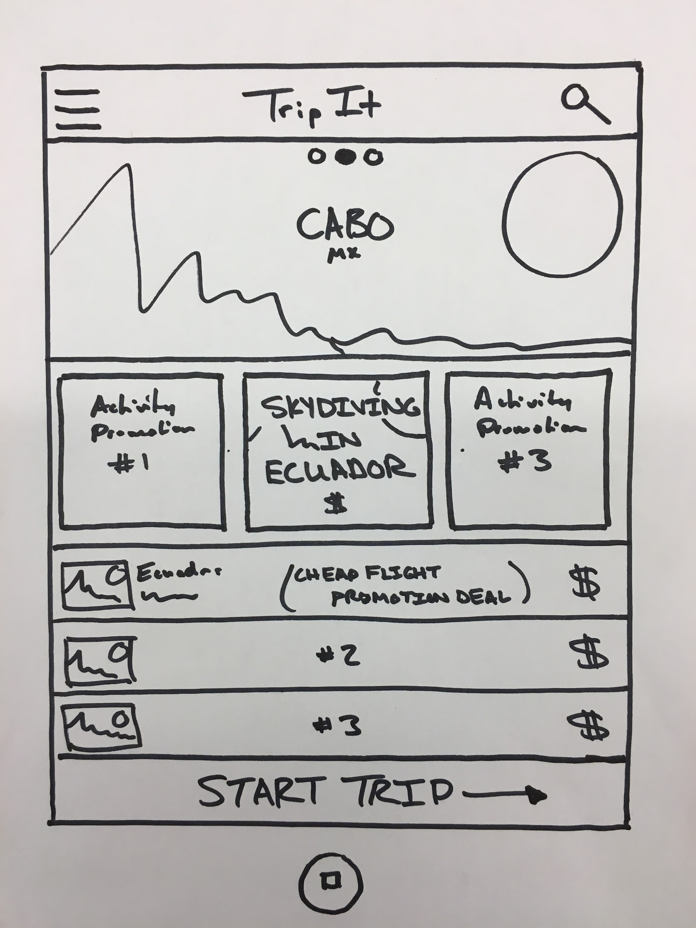
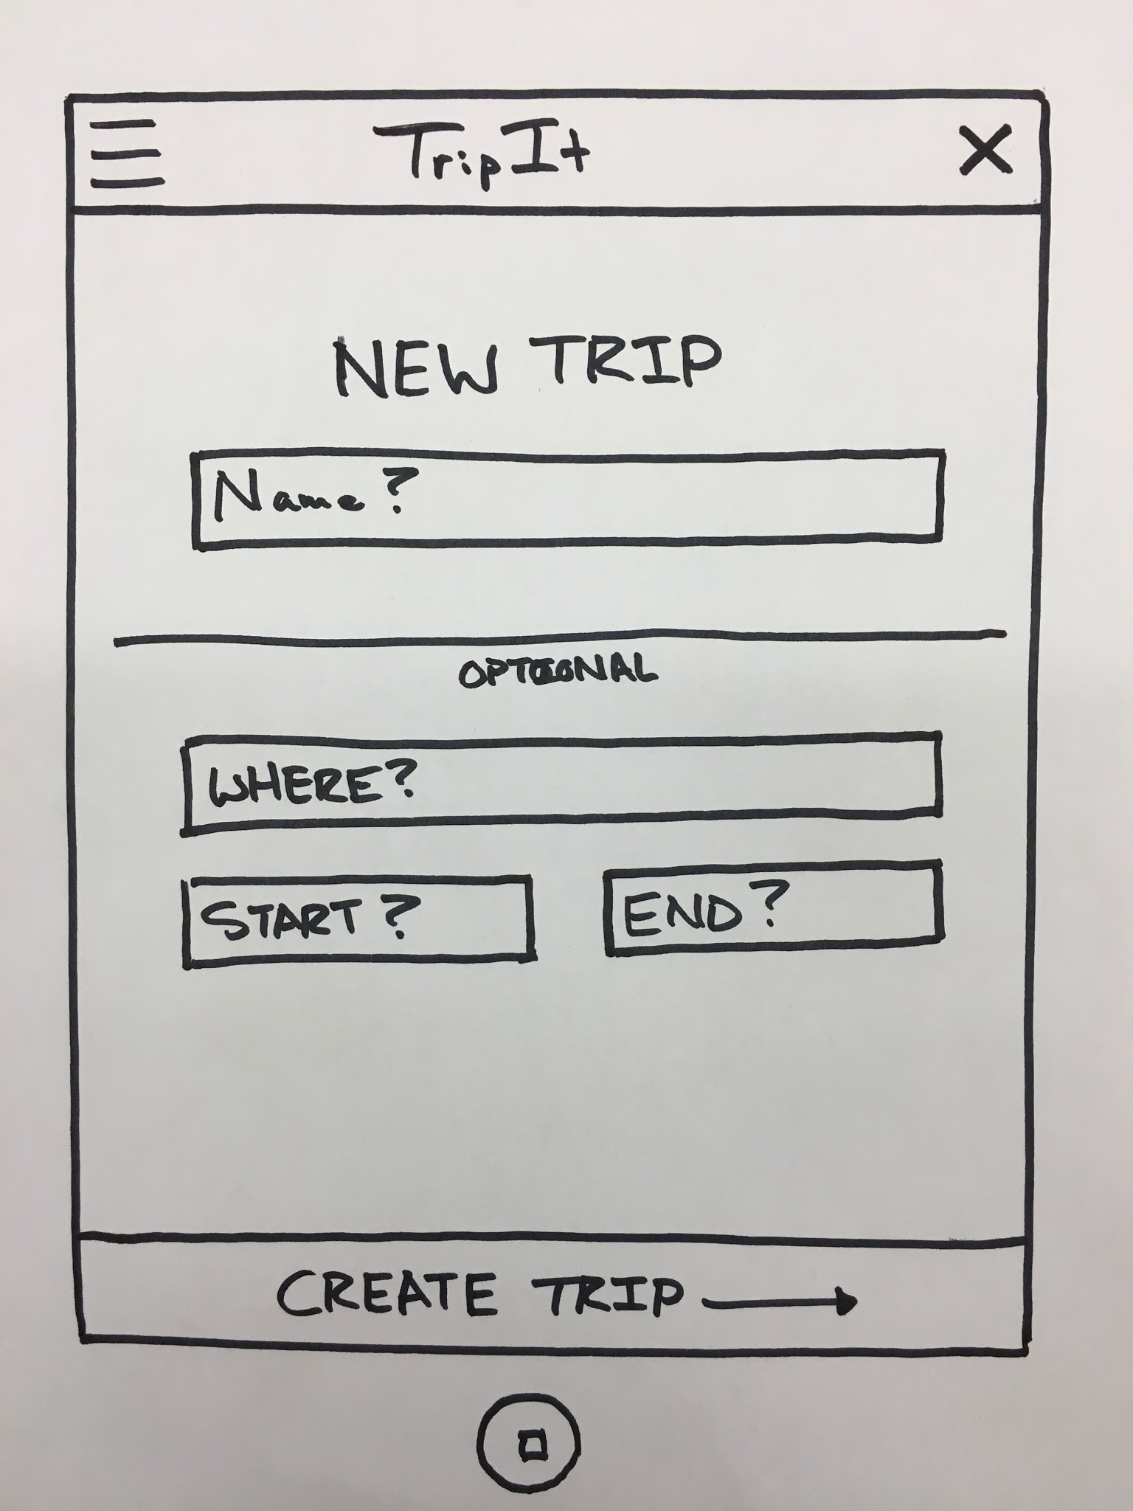

Slide 14
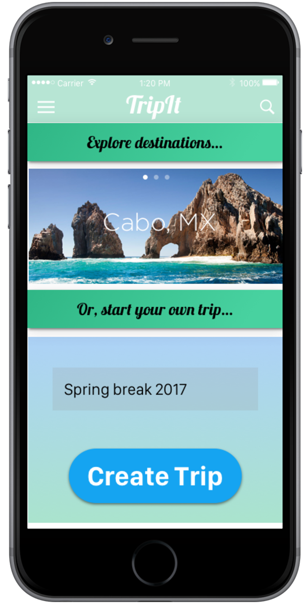

Slide 15
Change #2: Location Voting
Rationale:
Users couldn’t picture location voting
Defined voting process w/ 3 screens

Slide 16
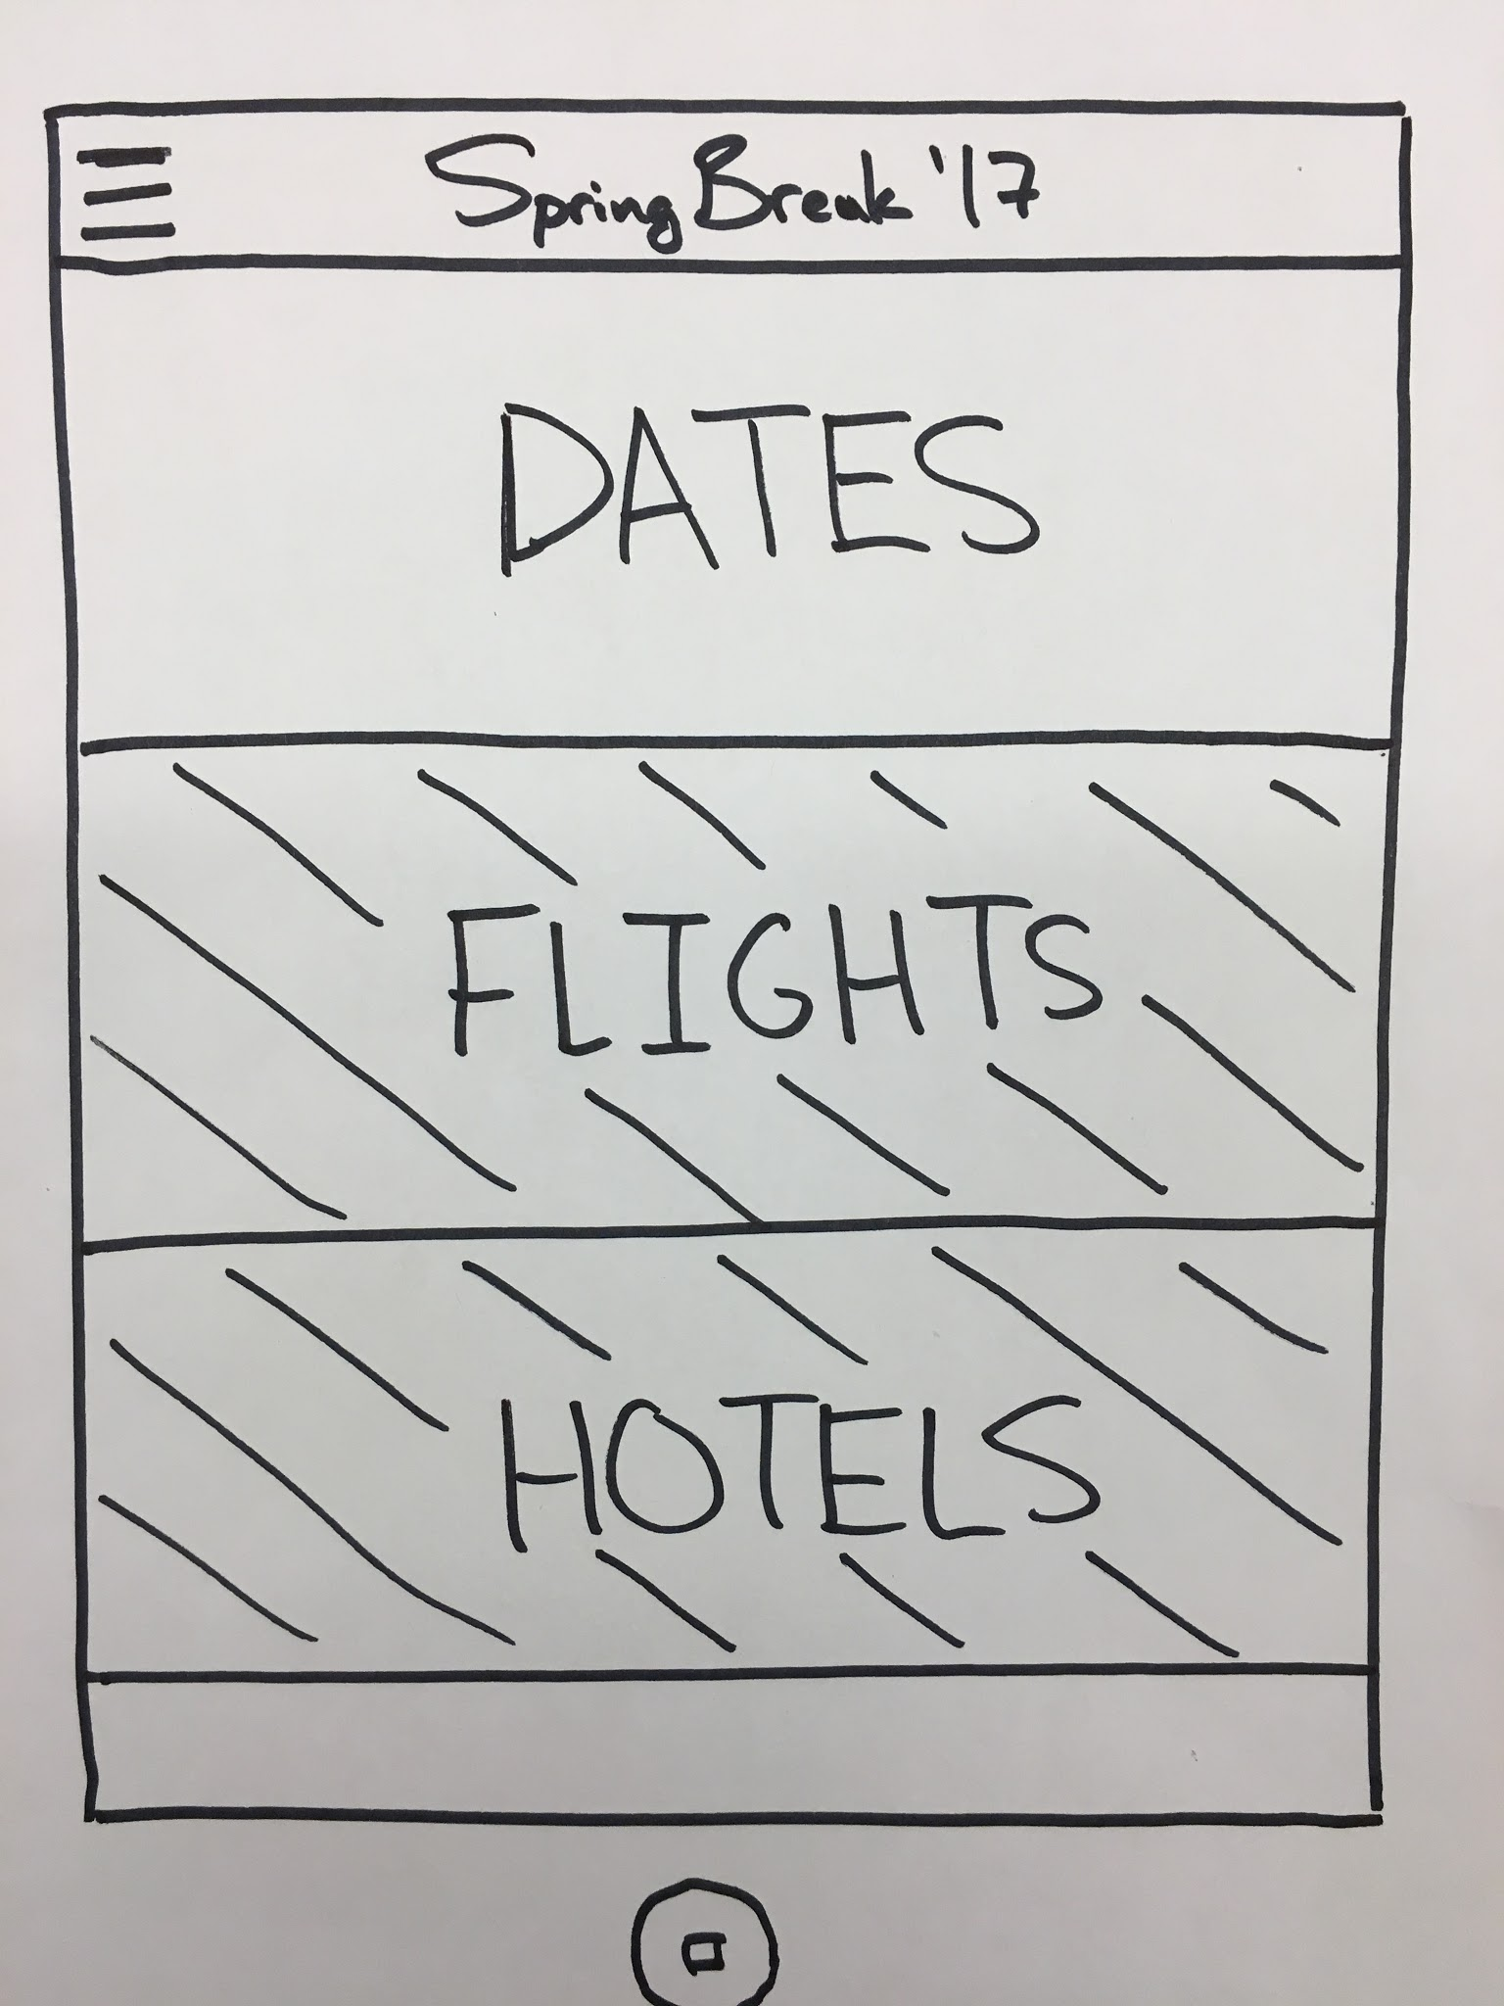
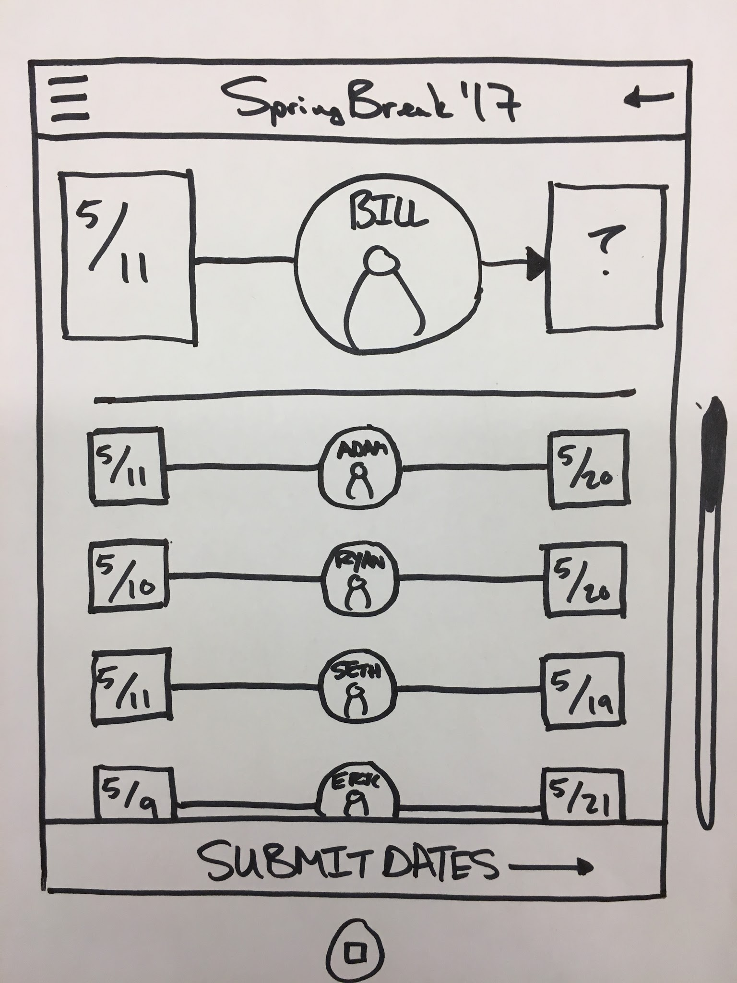

Slide 17
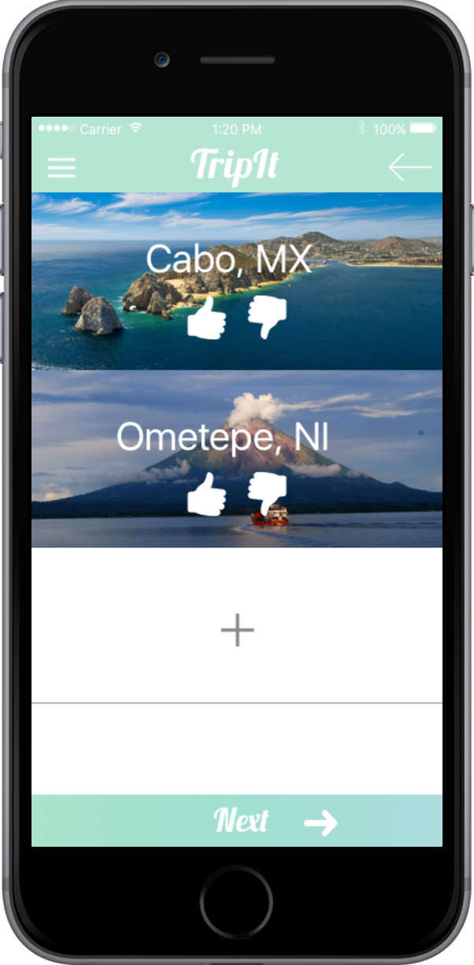
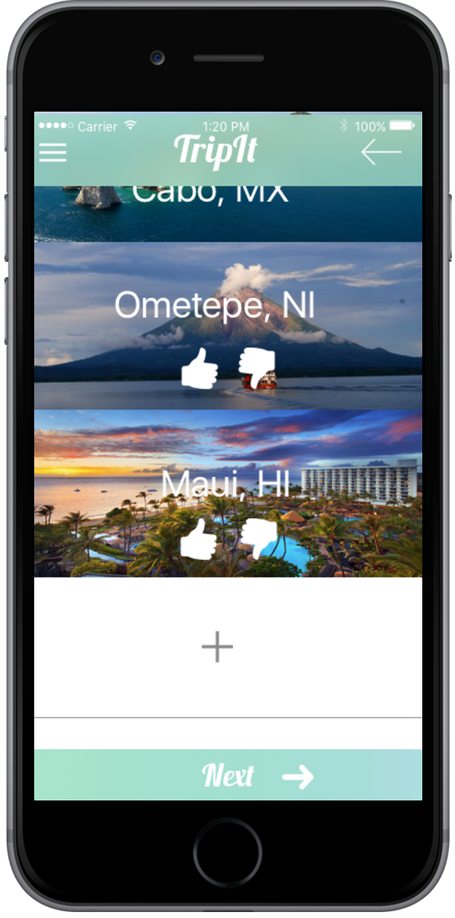

Slide 18
Change #3: Home Screen Simplification
Rationale
Users found home screen cluttered
Changed 2 screens to 1
Reduced Noise

Slide 21
Overview
Mission Statement
Three Tasks
Revised Interface Design
Feedback Recap
Major Design Changes
Medium-Fi Prototype Task Flows
Prototype Overview

Slide 22
Task 1: Create and share the trip

Slide 23
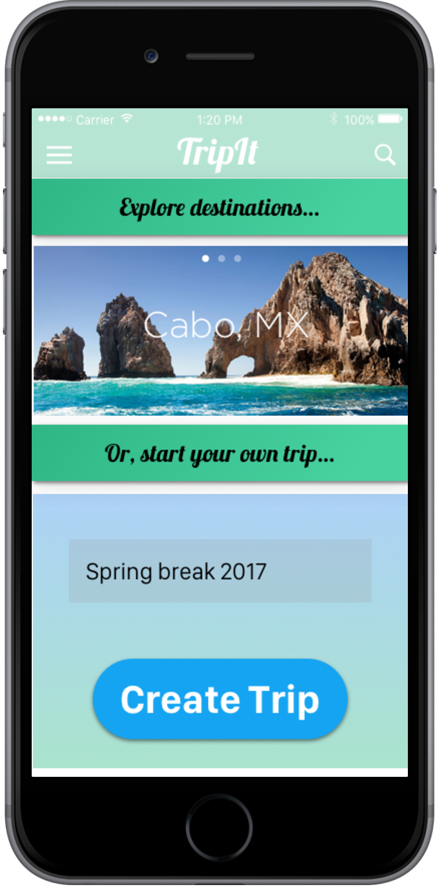
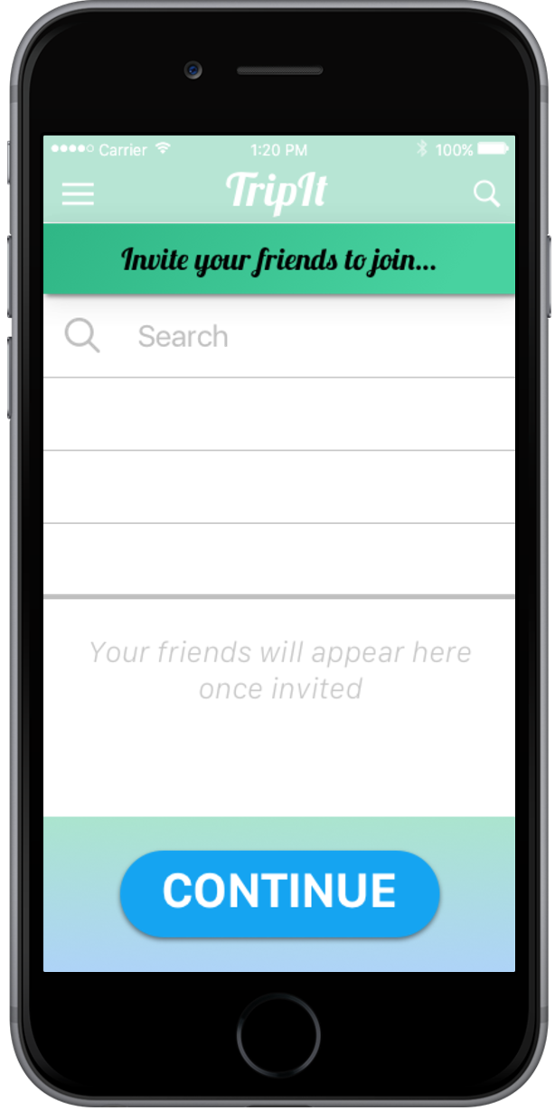

Slide 24
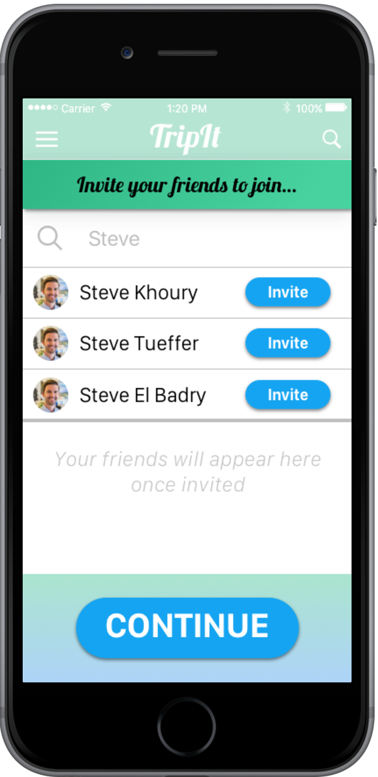
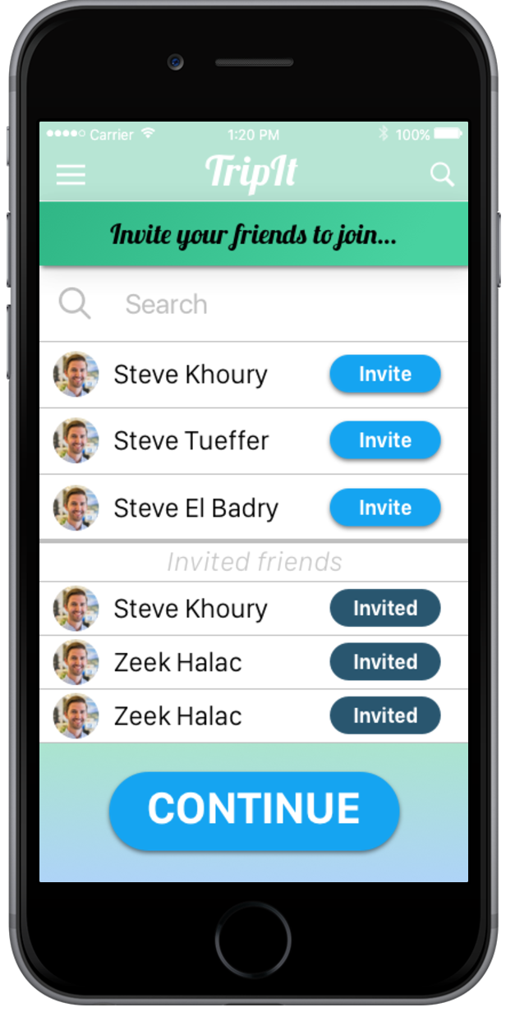

Slide 25
Task #2: Vote on undecided features

Slide 26
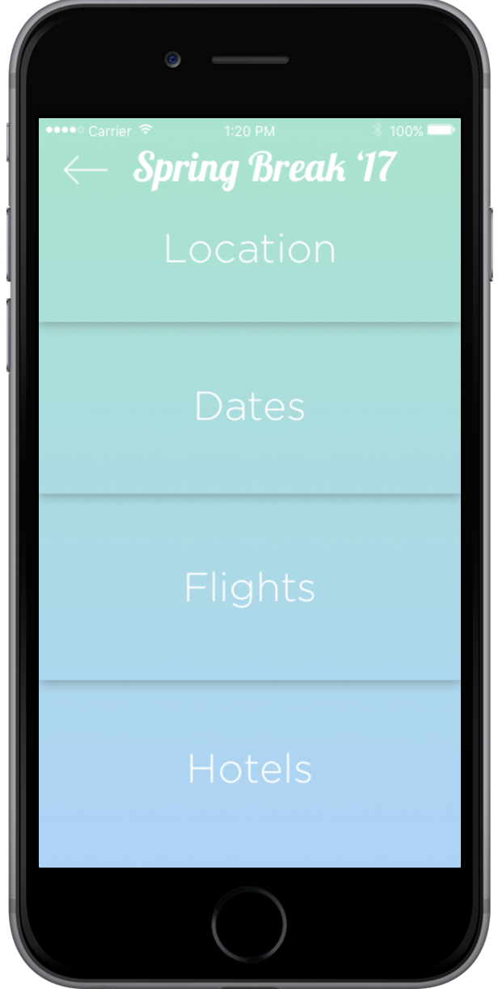

Slide 28
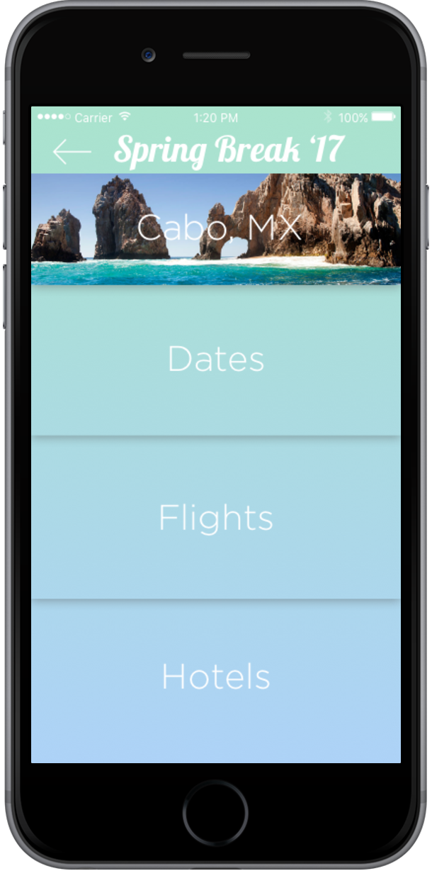
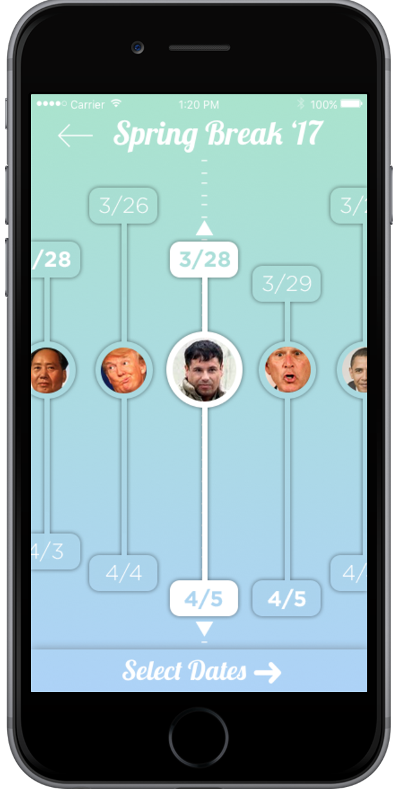
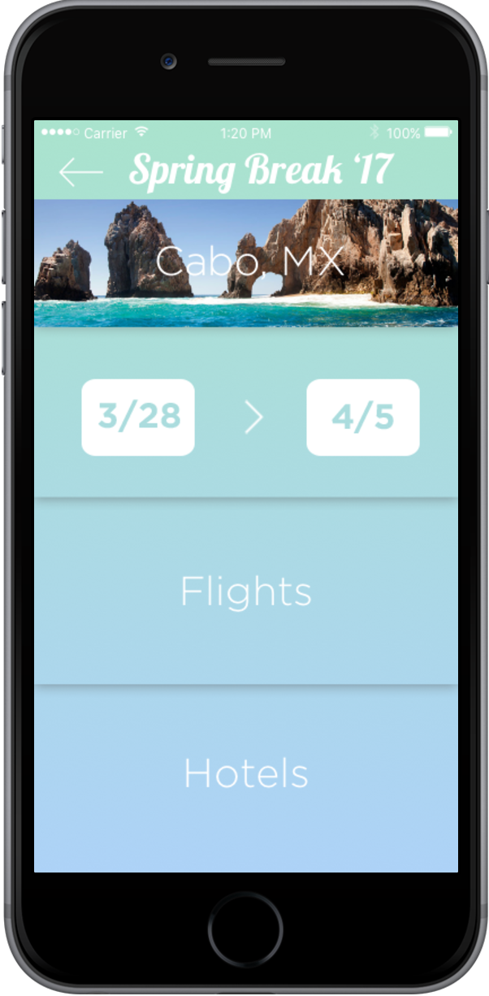

Slide 29
Task #3: Plan and book flights

Slide 30
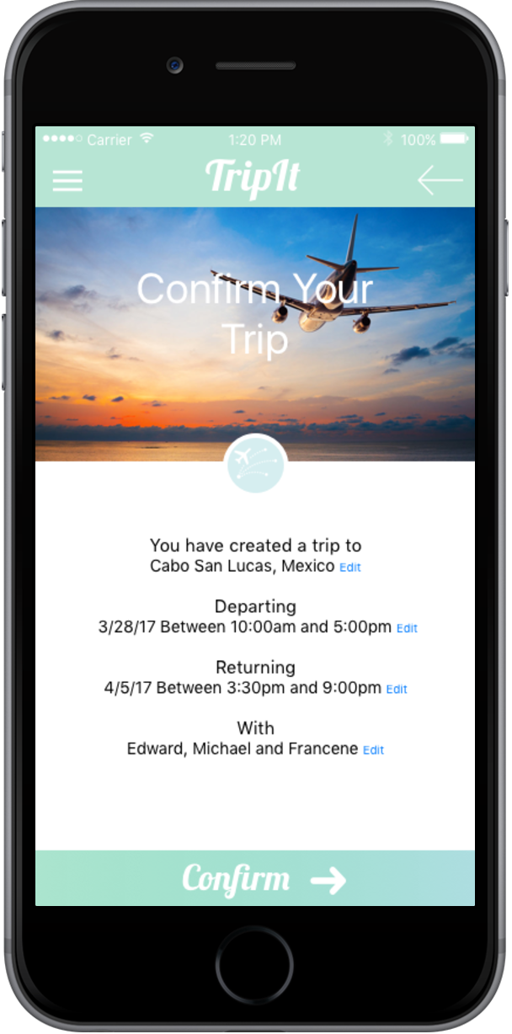
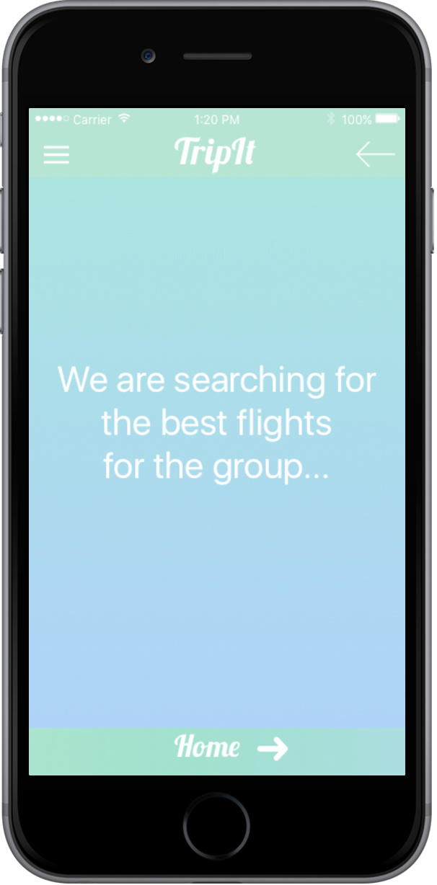
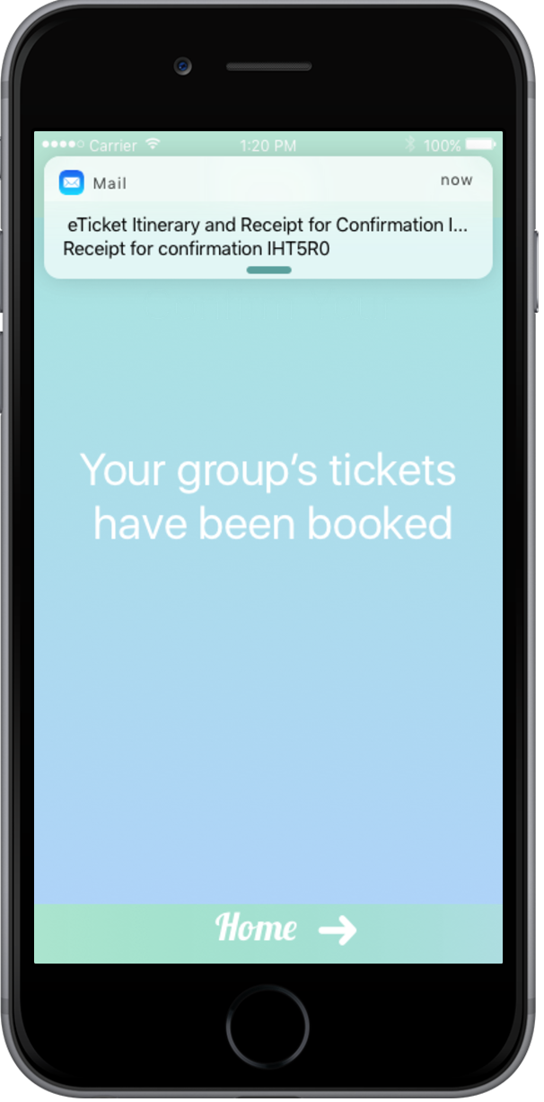

Slide 31
Overview
Mission Statement
Three Tasks
Revised Interface Design
Feedback Recap
Major Design Changes
Medium-Fi Prototype Task Flows
Prototype Overview

Slide 32
Prototyping Tools
Easy interface very poor content creation. No free download of content.
Significant learning curve. Several packages needed to make it useful

Slide 33
Limitations/tradeoffs of the current prototype
Hotels feature is a placeholder going forward
You can only upvote or downvote locations, no veto
Date range finds range that satisfies all, may not be possible
More or less everything is “Wizard of Oz’ed” real app requires complex input

Slide 34
Hard-coded features
Clearly all features hard coded here, going forward anticipate hard coding
Dates
Locations

Slide 35
Questions?

