Slide 1
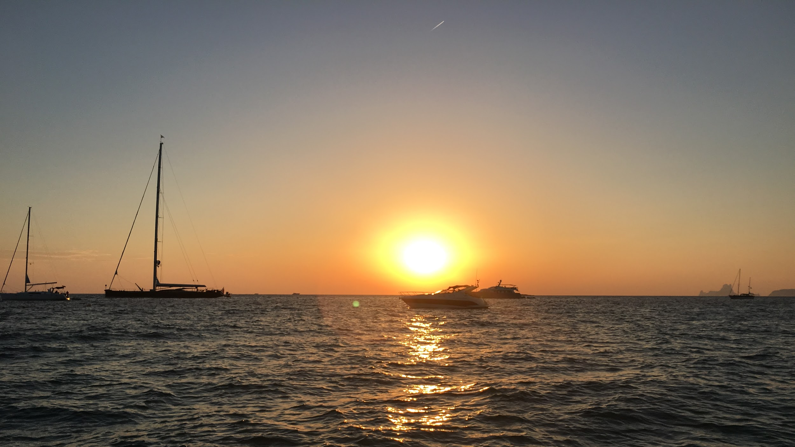
“Not All Those Who Wander Are Lost”¹
TripIt
Ryan Harber
Adam Abdulhamid
Seth Hildick-Smith
Eric Peter
1. Lord of the Rings

Slide 2
Overview
Mission Statement
Selected Interface
Low-Fi Prototype
Task Flows
Method
Results
UI Changes
Summary

Slide 3
Overview
Mission Statement
Selected Interface
Low-Fi Prototype
Task Flows
Method
Results
UI Changes
Summary

Slide 4
Seamlessly plan and book group travel
Mission Statement

Slide 5
Overview
Mission Statement
Selected Interface
Low-Fi Prototype
Task Flows
Method
Results
UI Changes
Summary

Slide 6
Mobile
Selected Interface

Slide 7
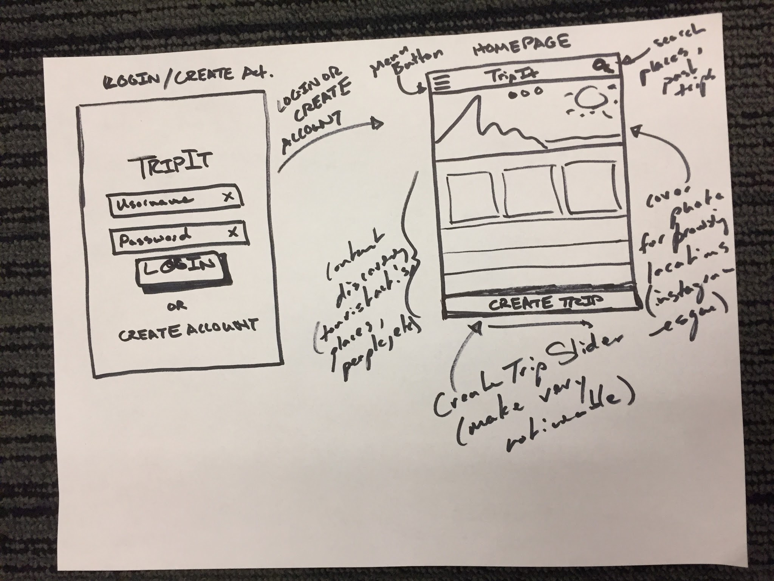

Slide 8
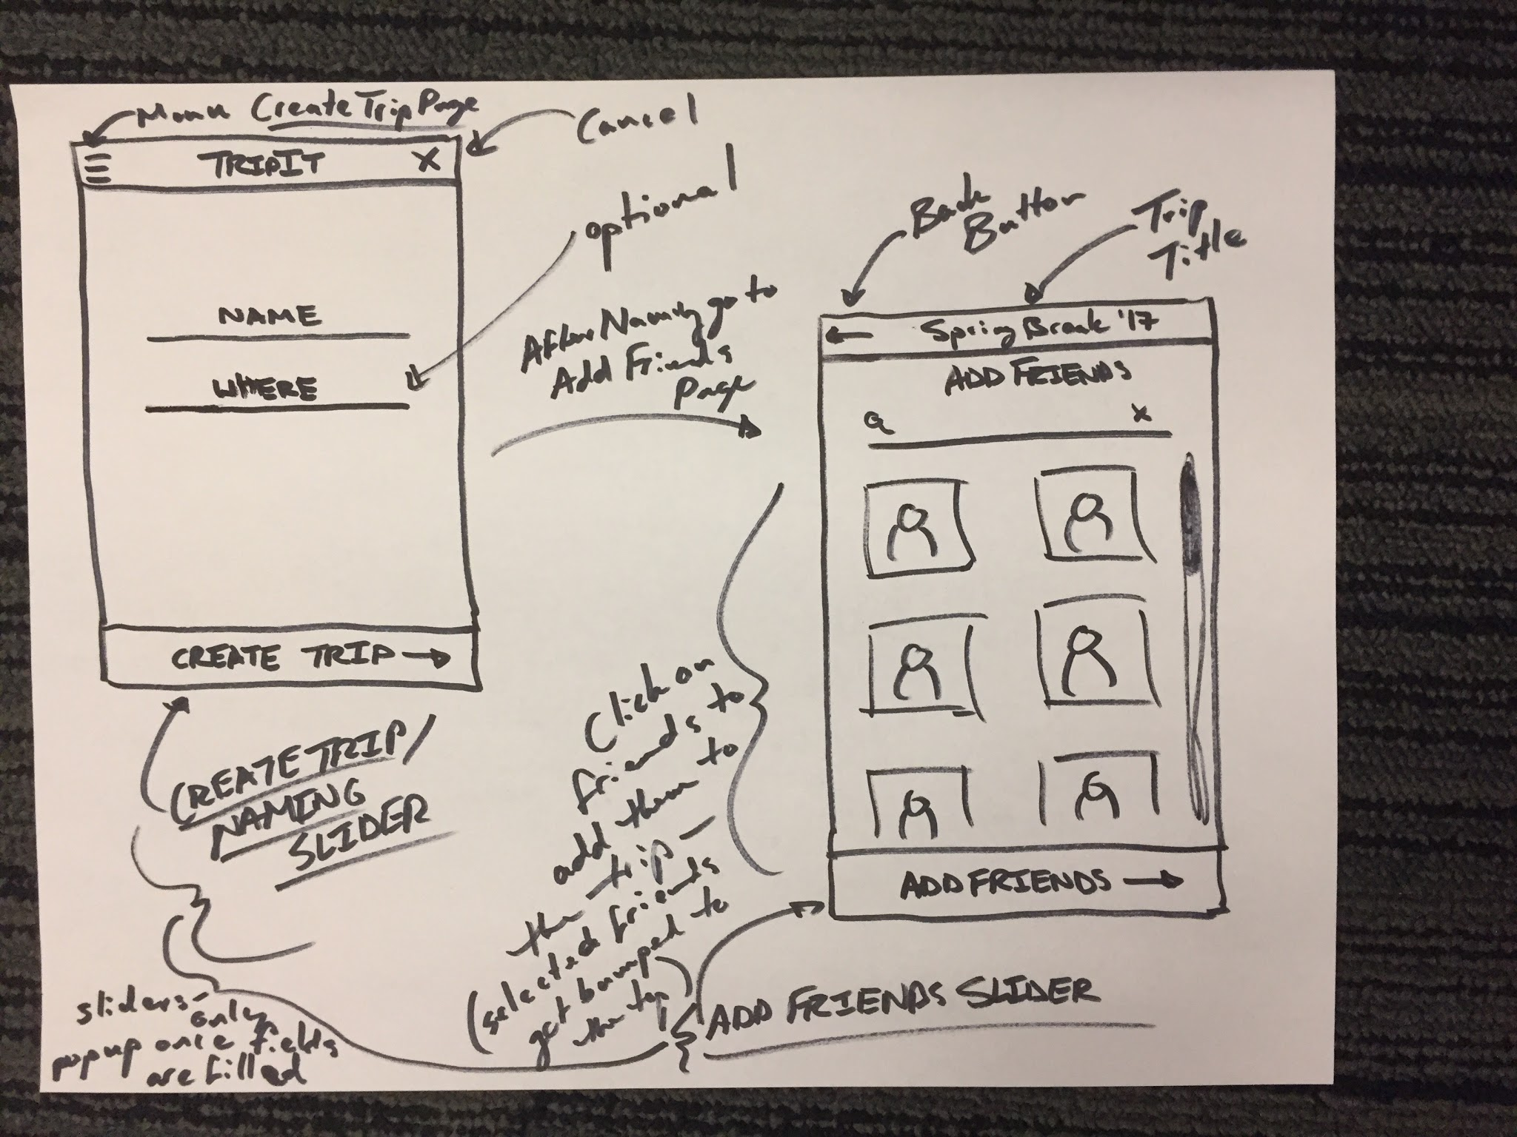

Slide 9
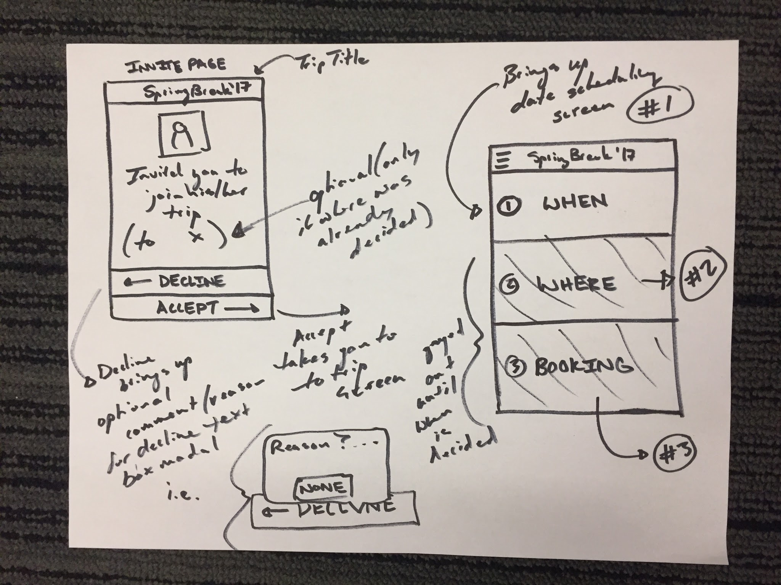

Slide 10
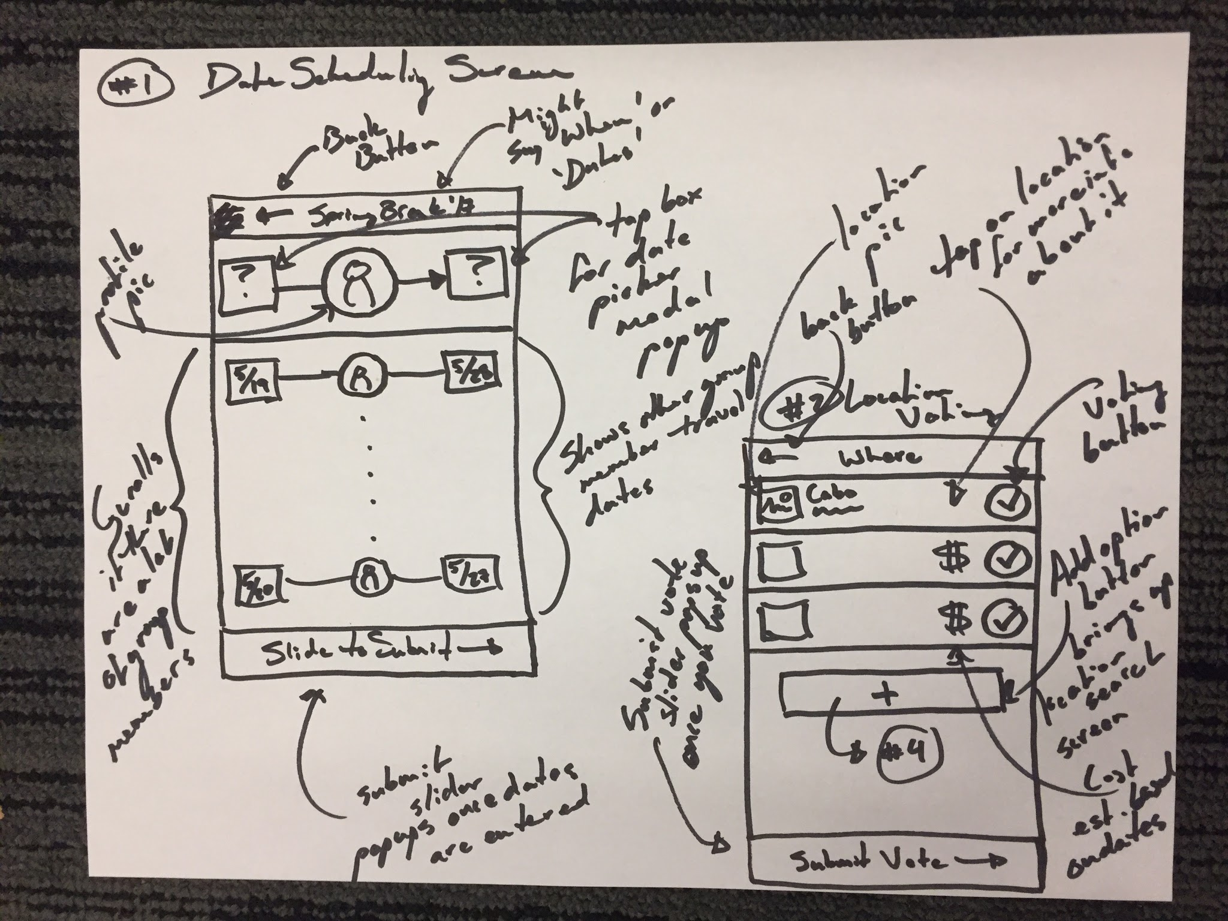

Slide 11
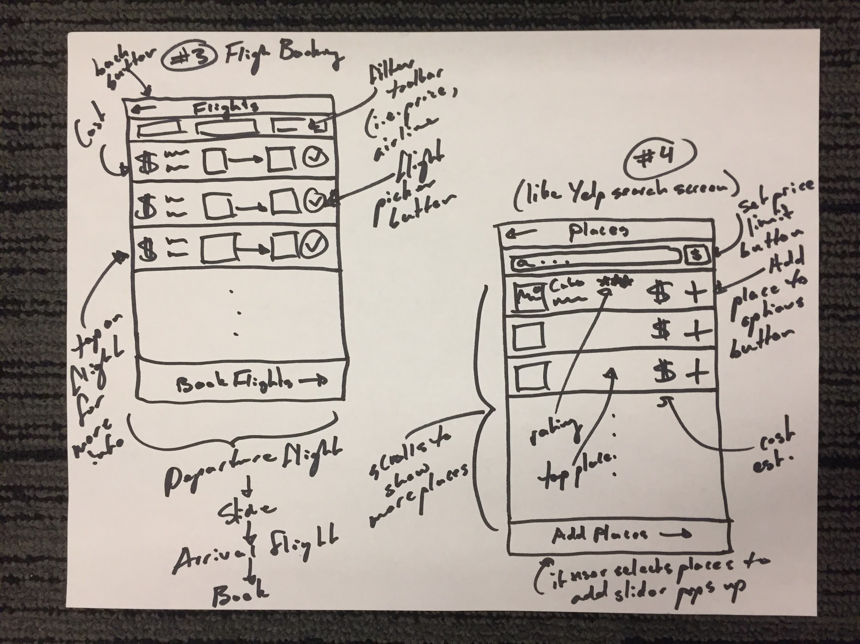

Slide 12
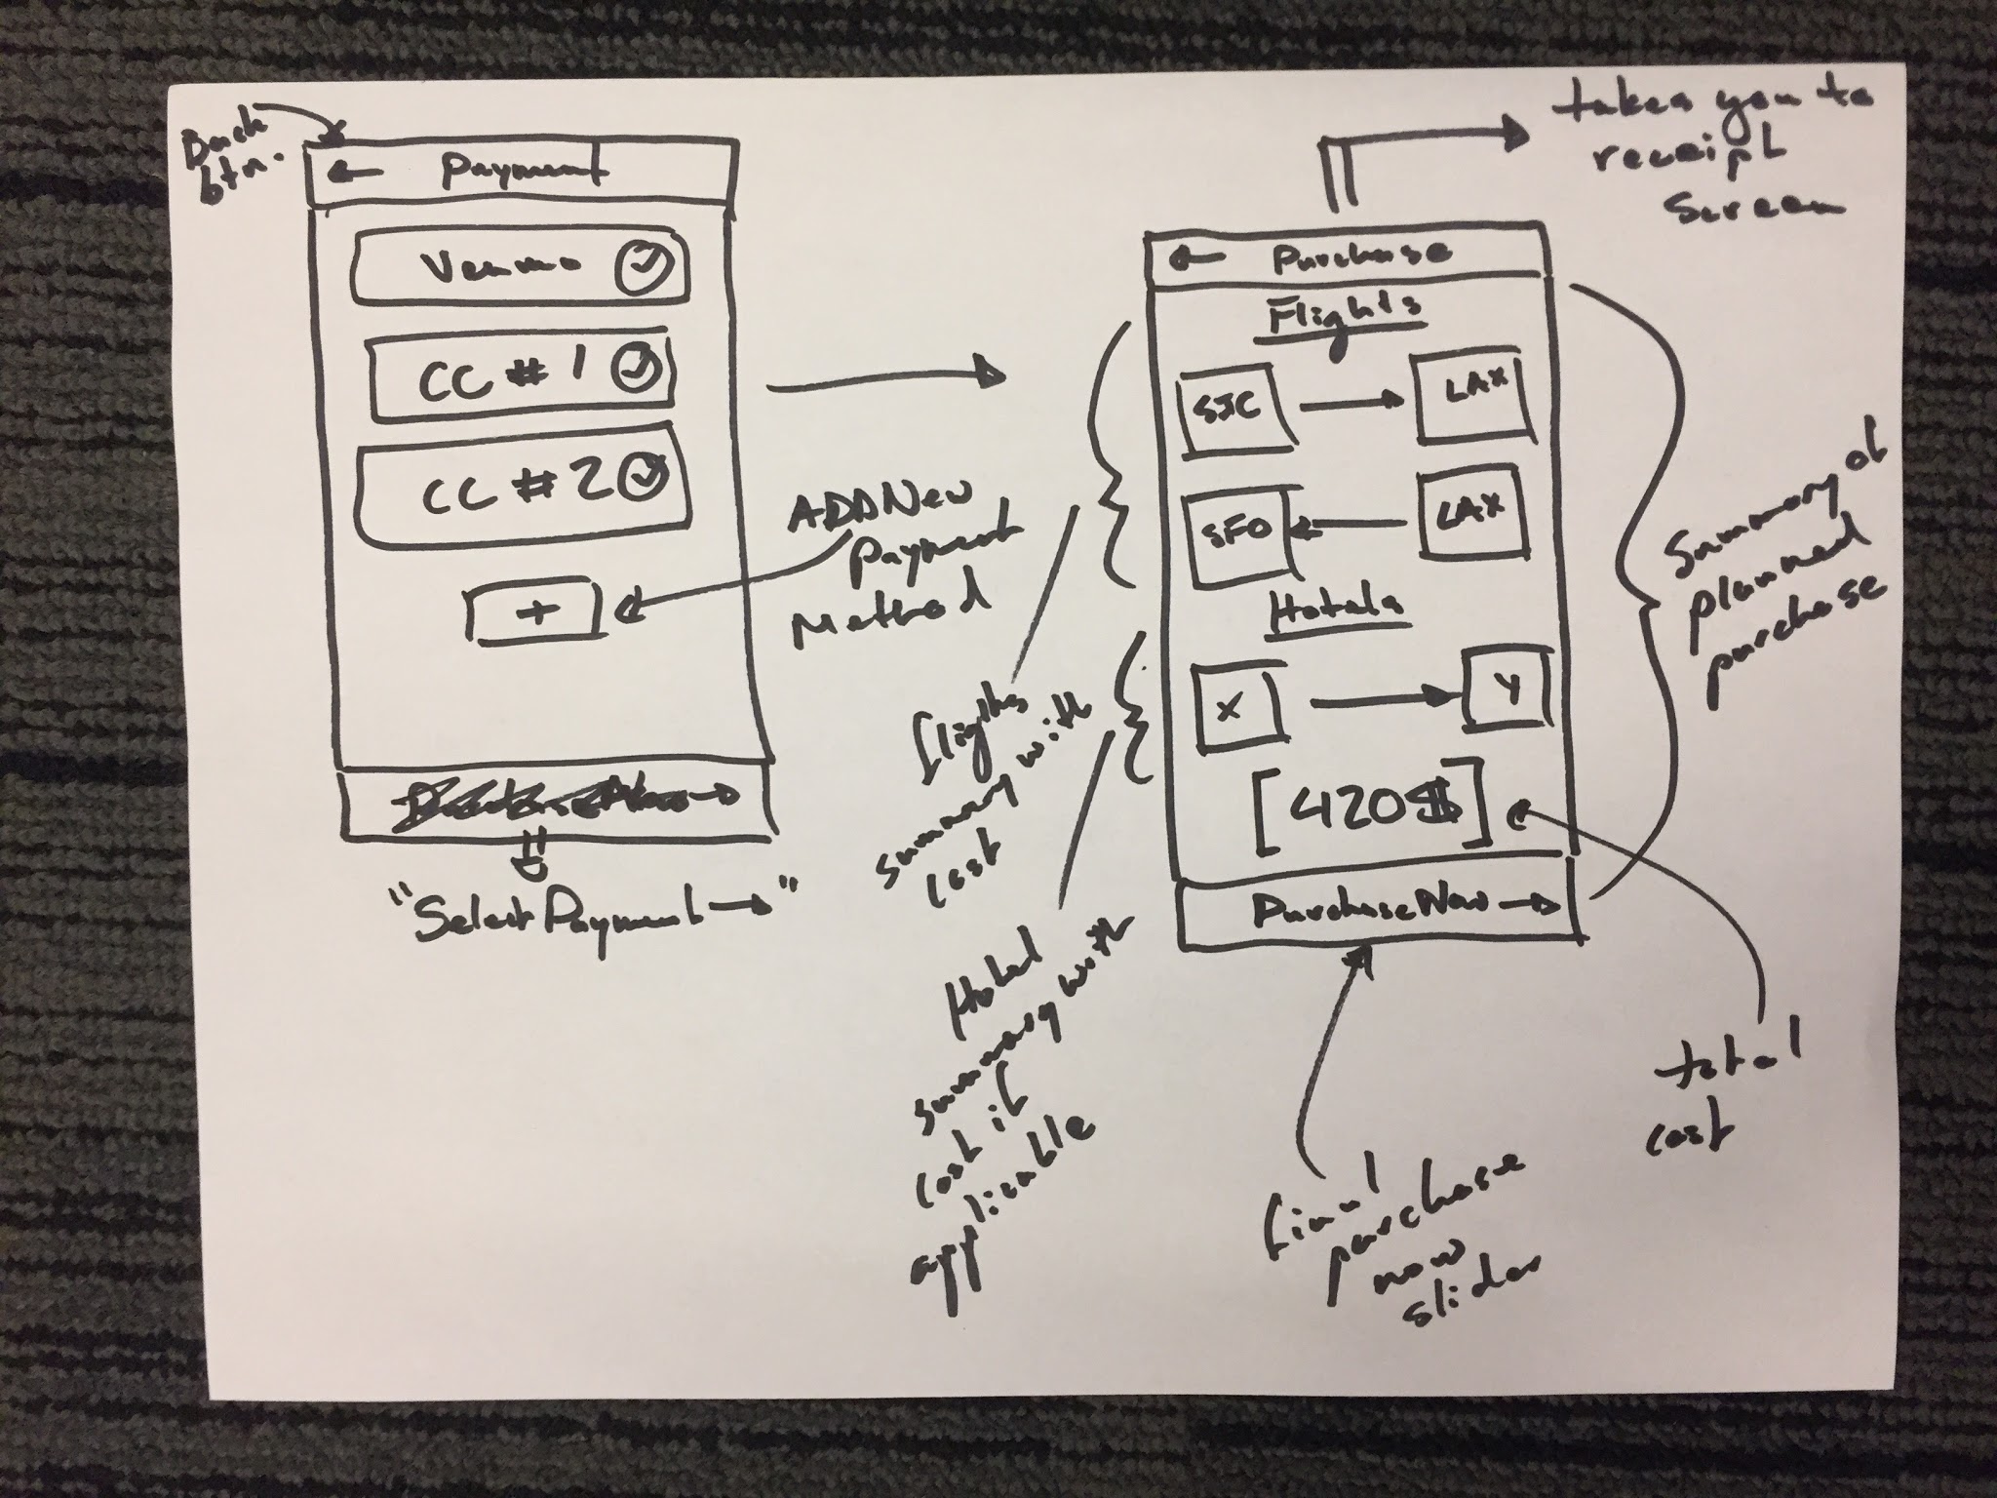

Slide 13
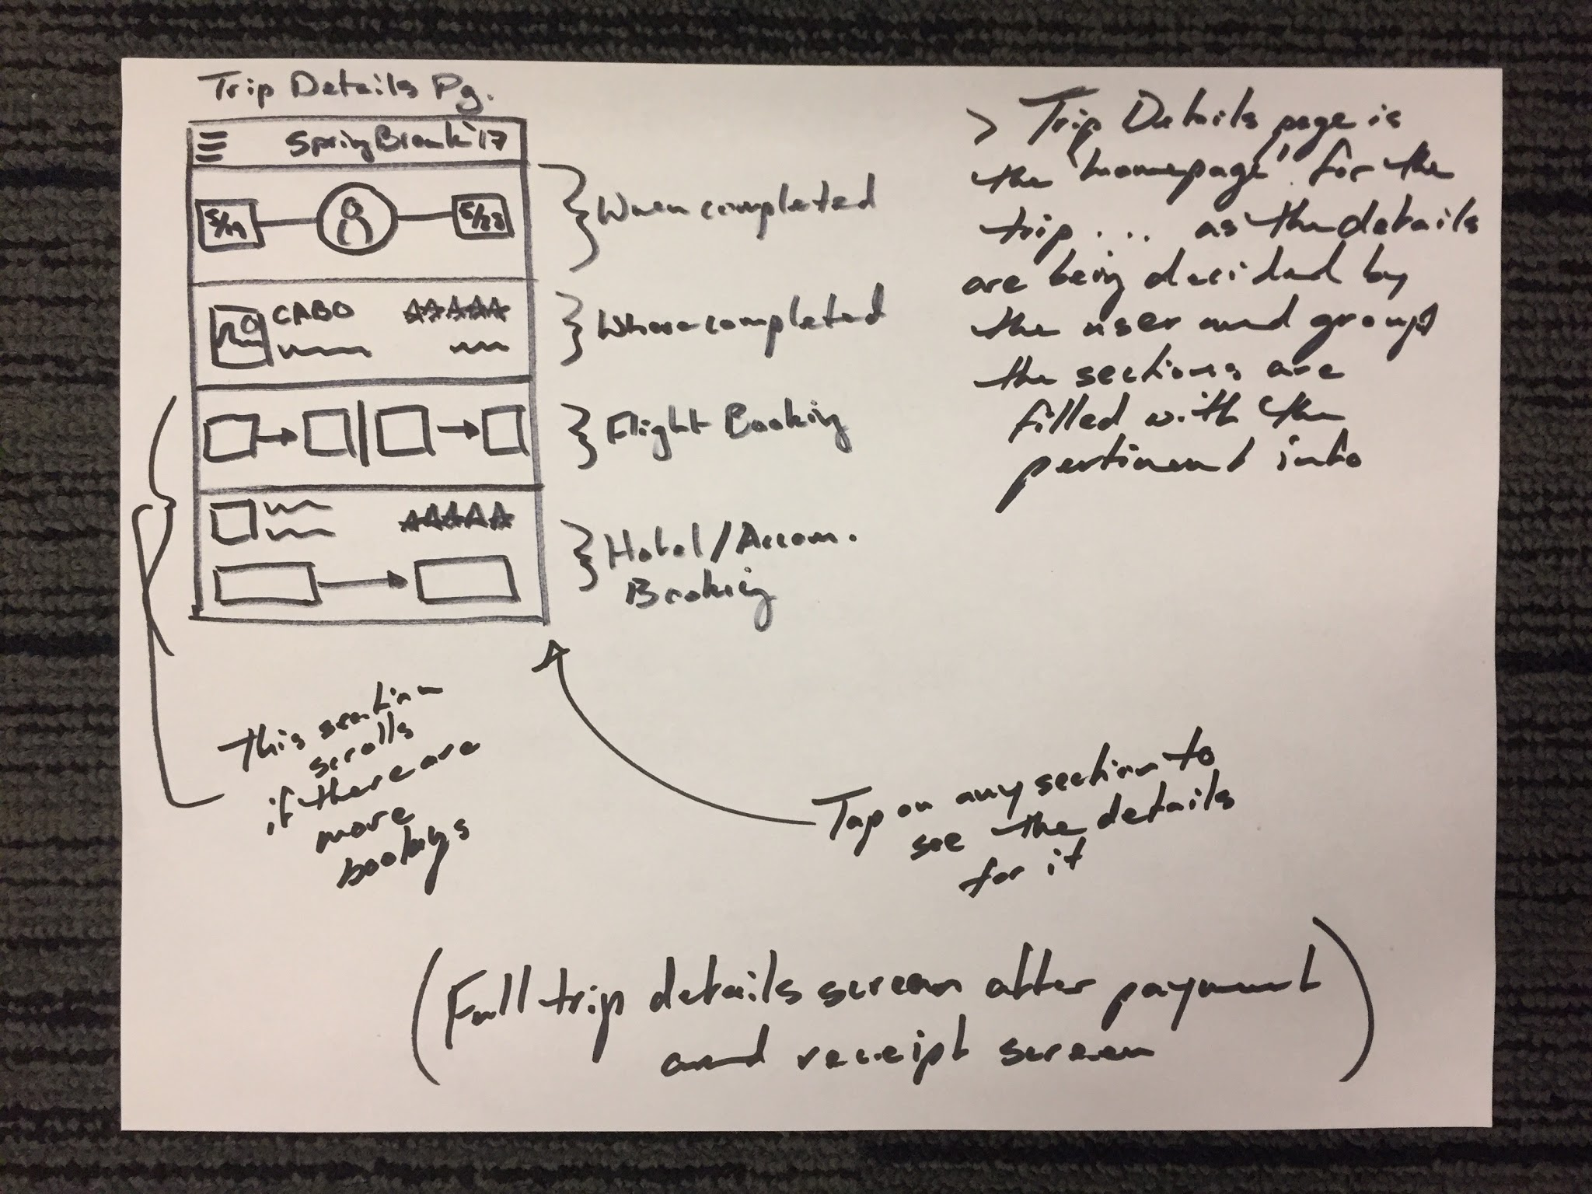

Slide 14
Rationale for this interface
Stepping in and out of mobile apps is easier than web
Required for collaboration/voting
Process should be so easy it’s comfortable to do from a phone
Since we have a lot of modal views, this fits well with mobile screen size
More and more apps are mobile first

Slide 15
Overview
Mission Statement
Selected Interface
Low-Fi Prototype
Task Flows
Method
Results
UI Changes
Summary

Slide 16
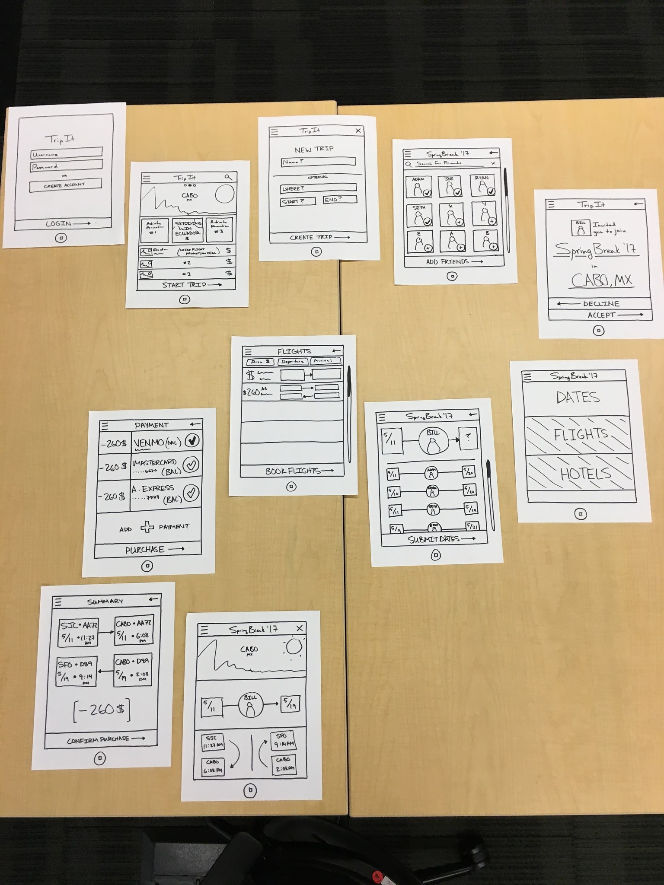

Slide 17
Overview
Mission Statement
Selected Interface
Low-Fi Prototype
Task Flows
Method
Results
UI Changes
Summary

Slide 18
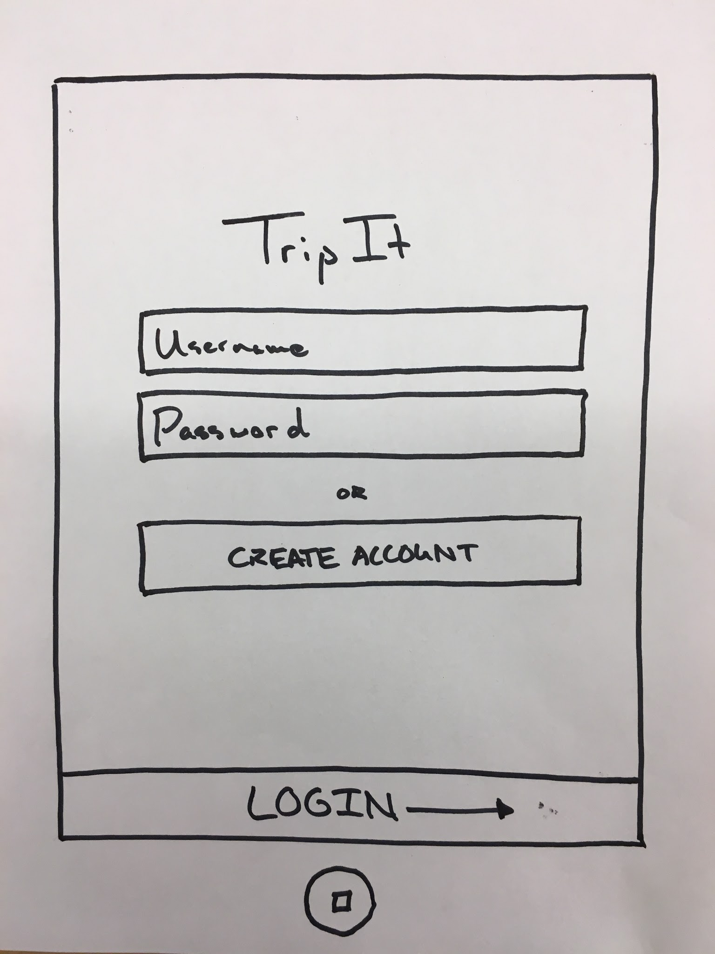
Task 1 - Create and share trip

Slide 19
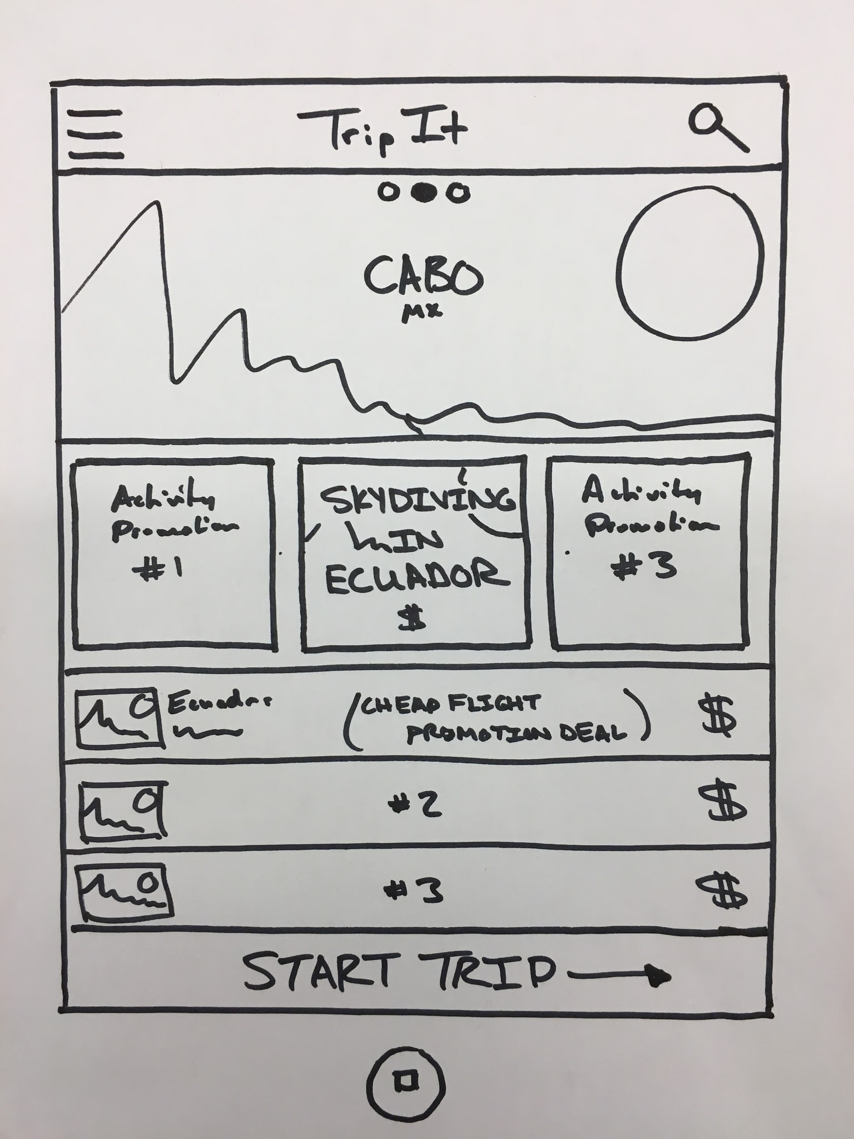
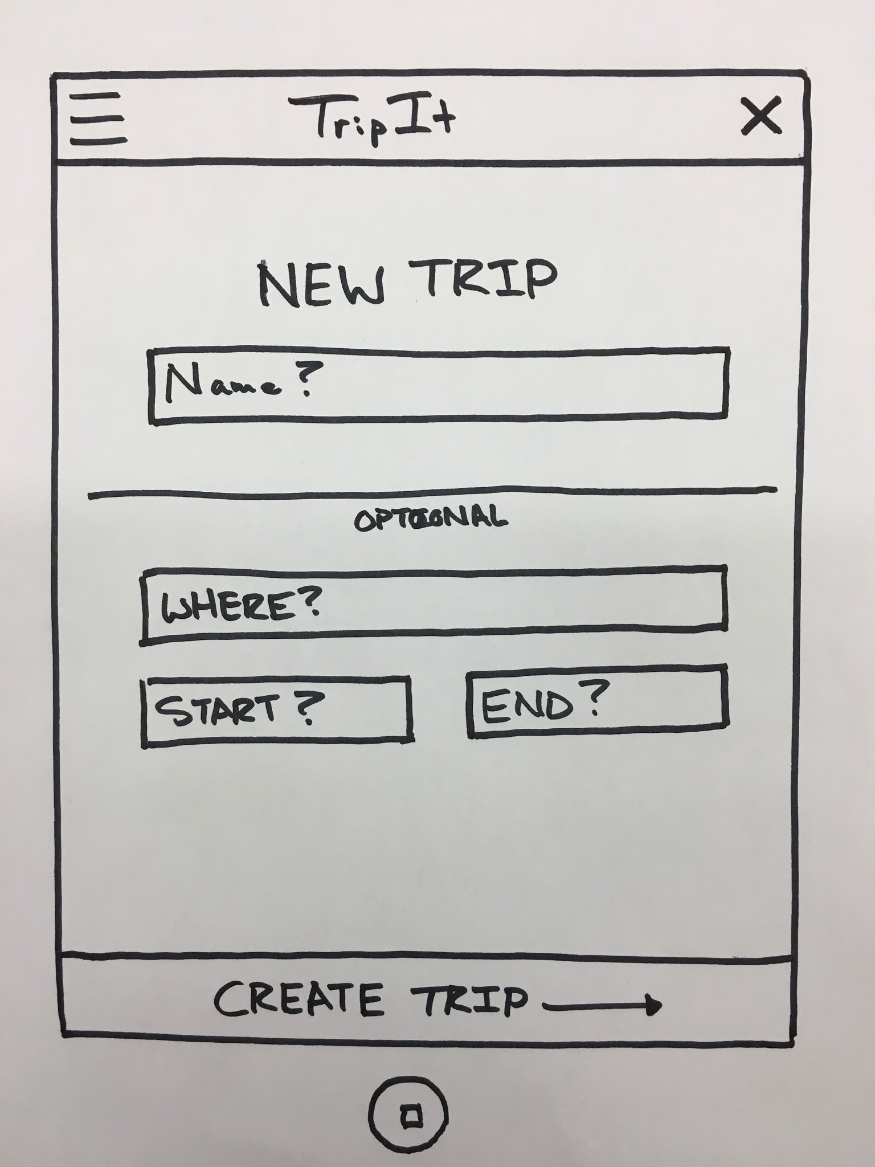

Slide 20
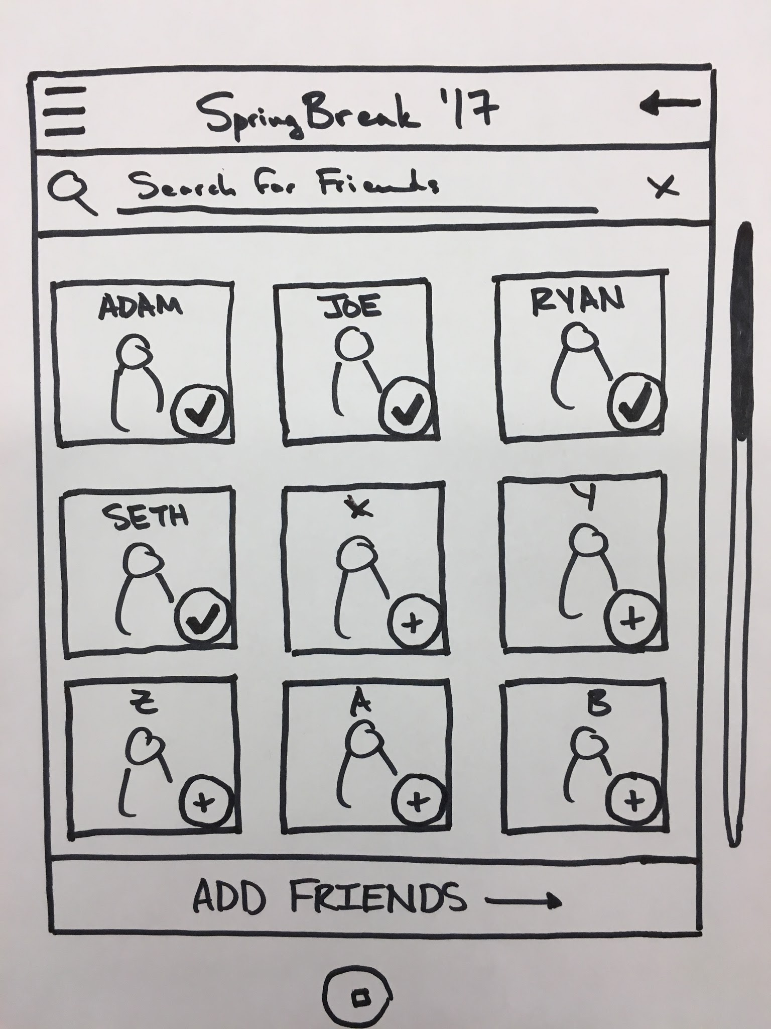

Slide 21
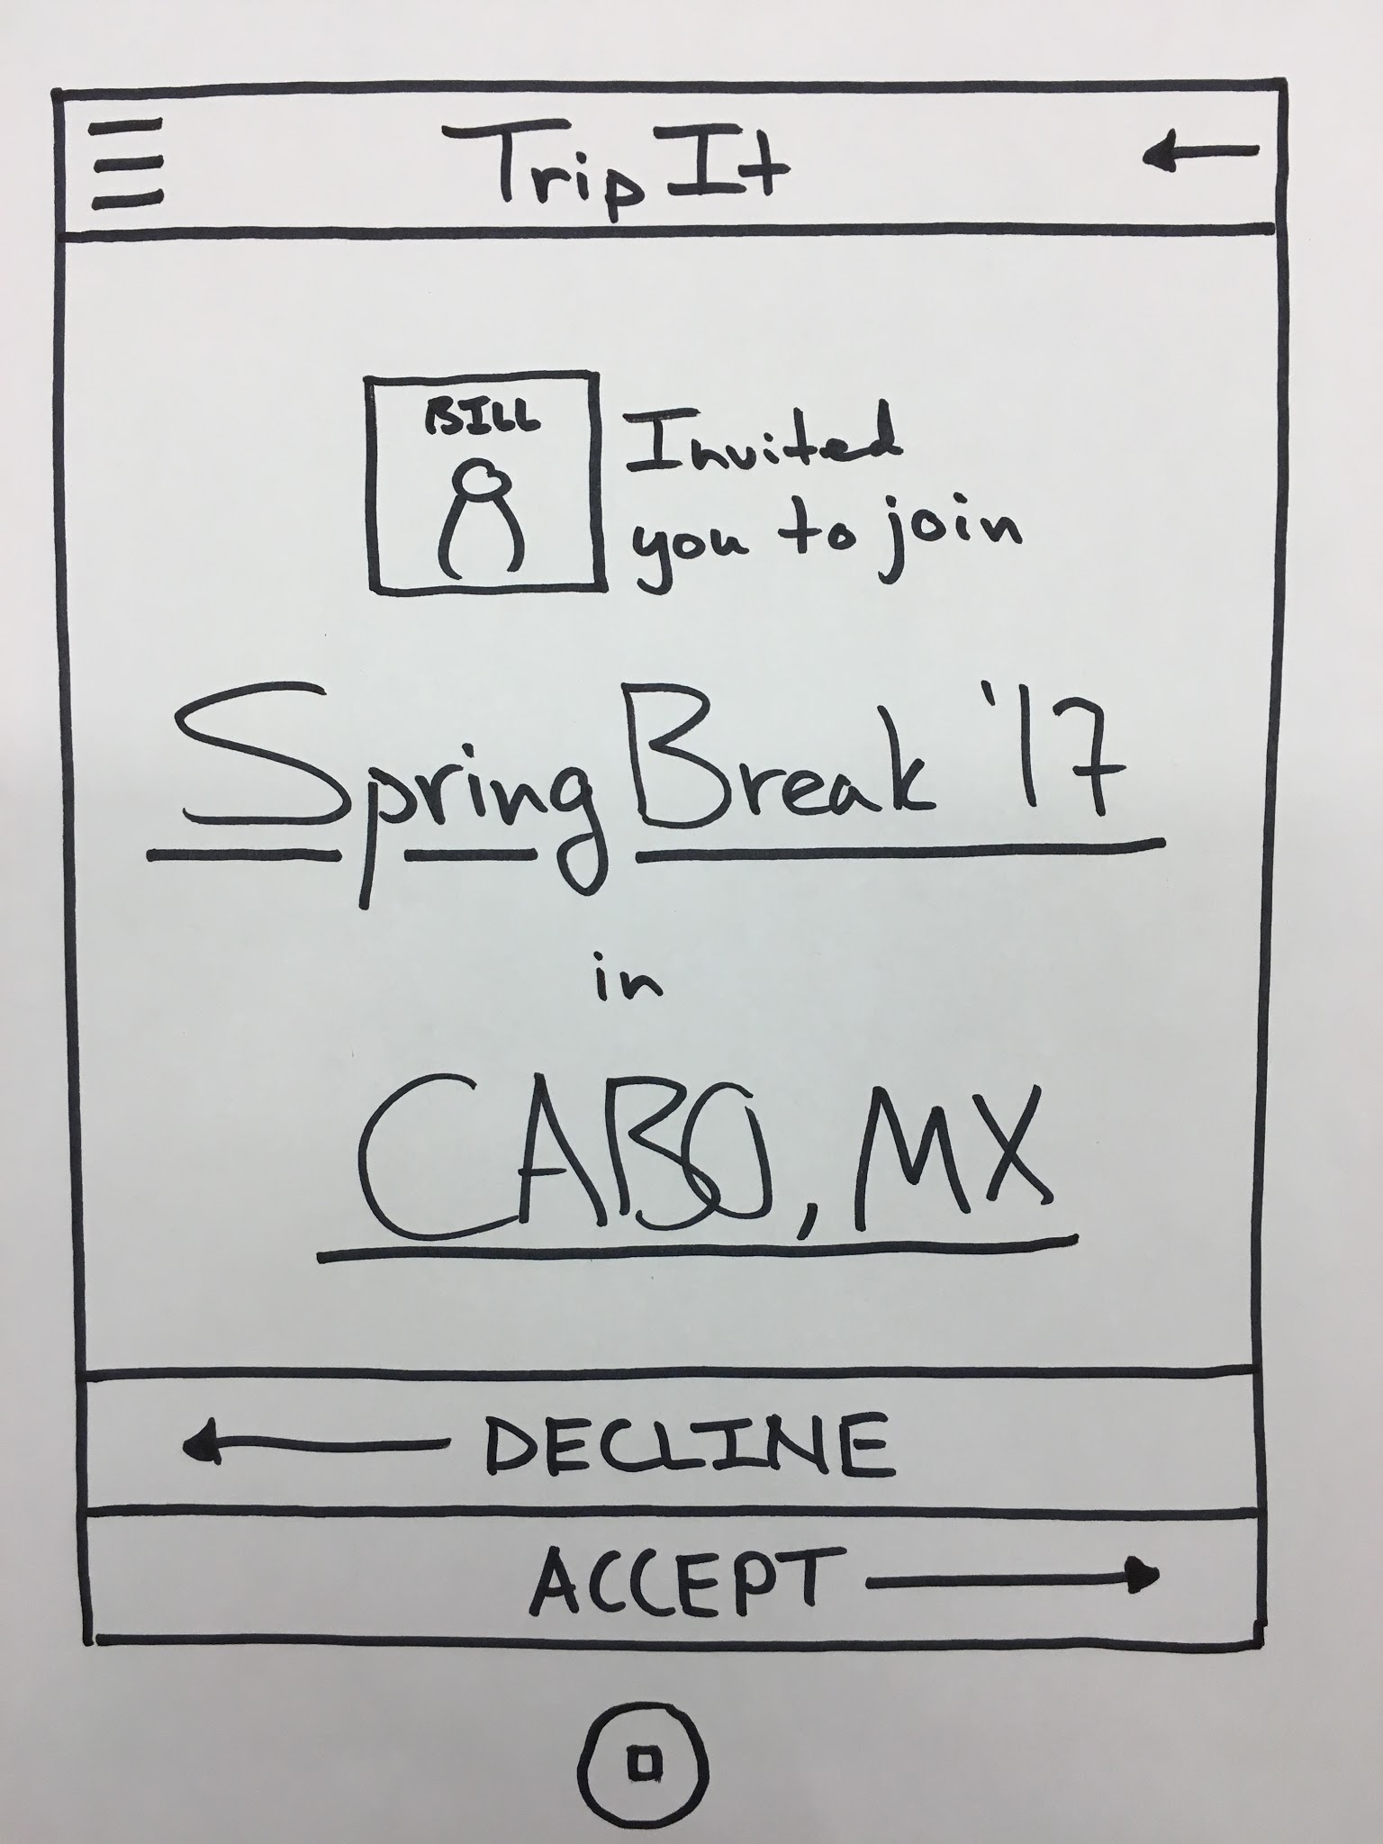
Task 2 - Vote on trip features

Slide 22
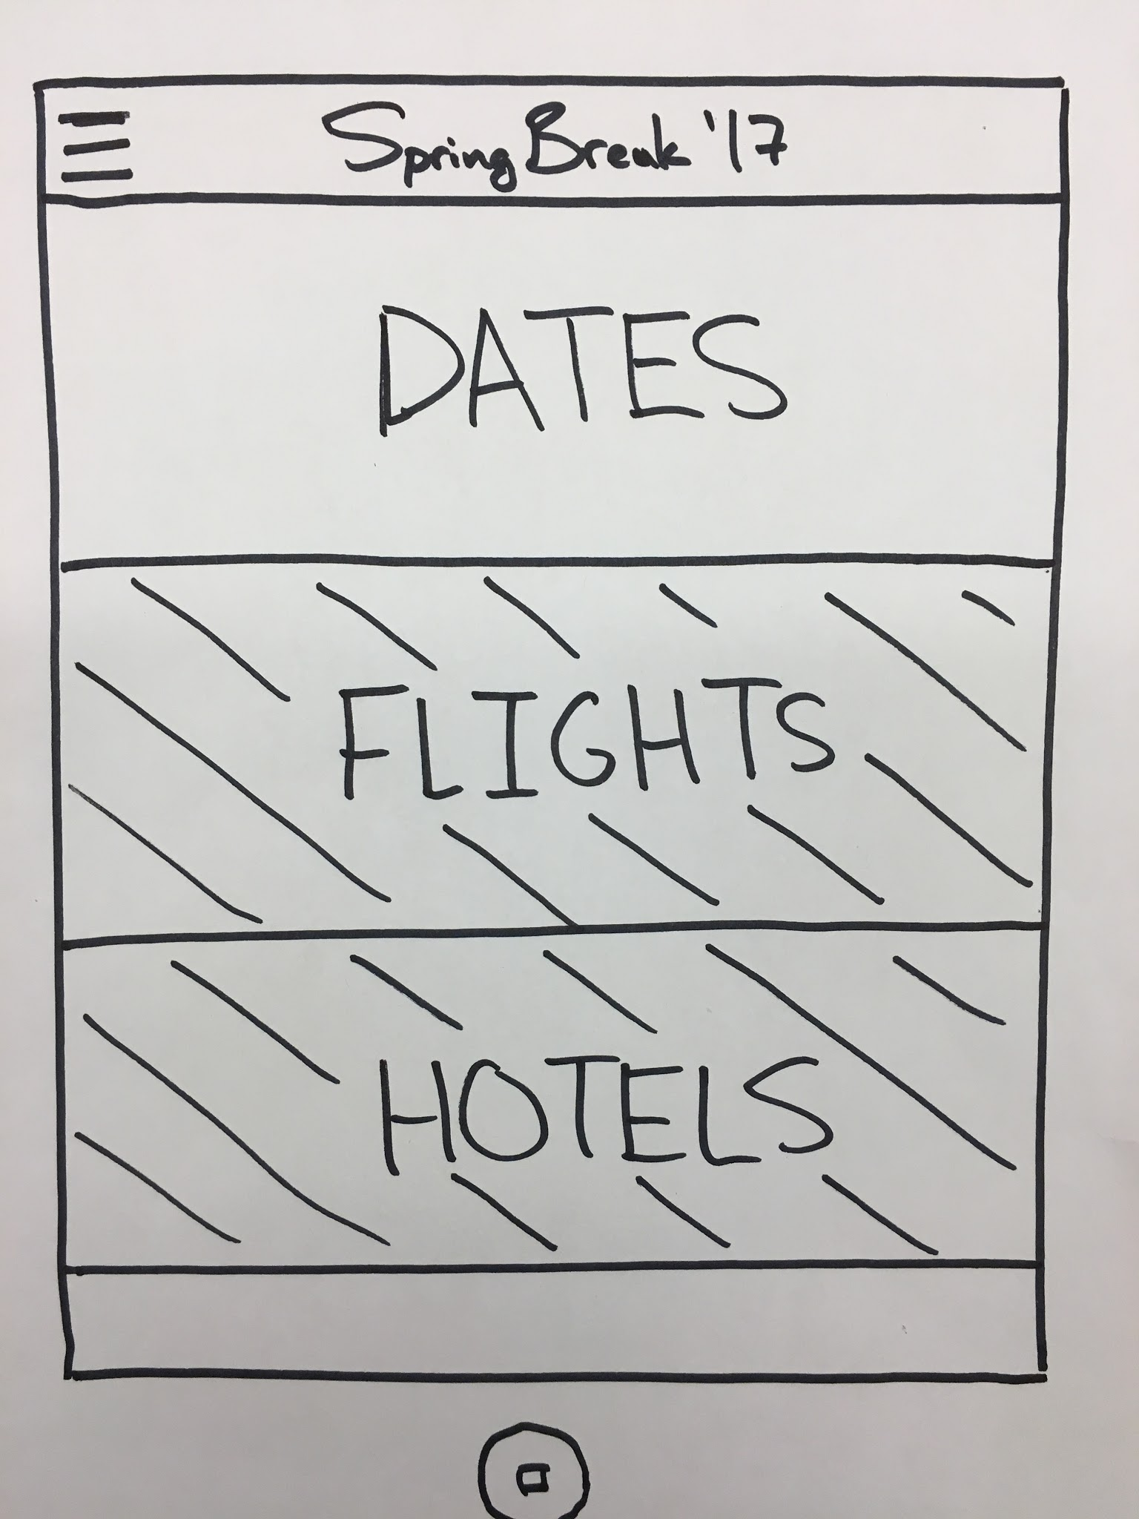
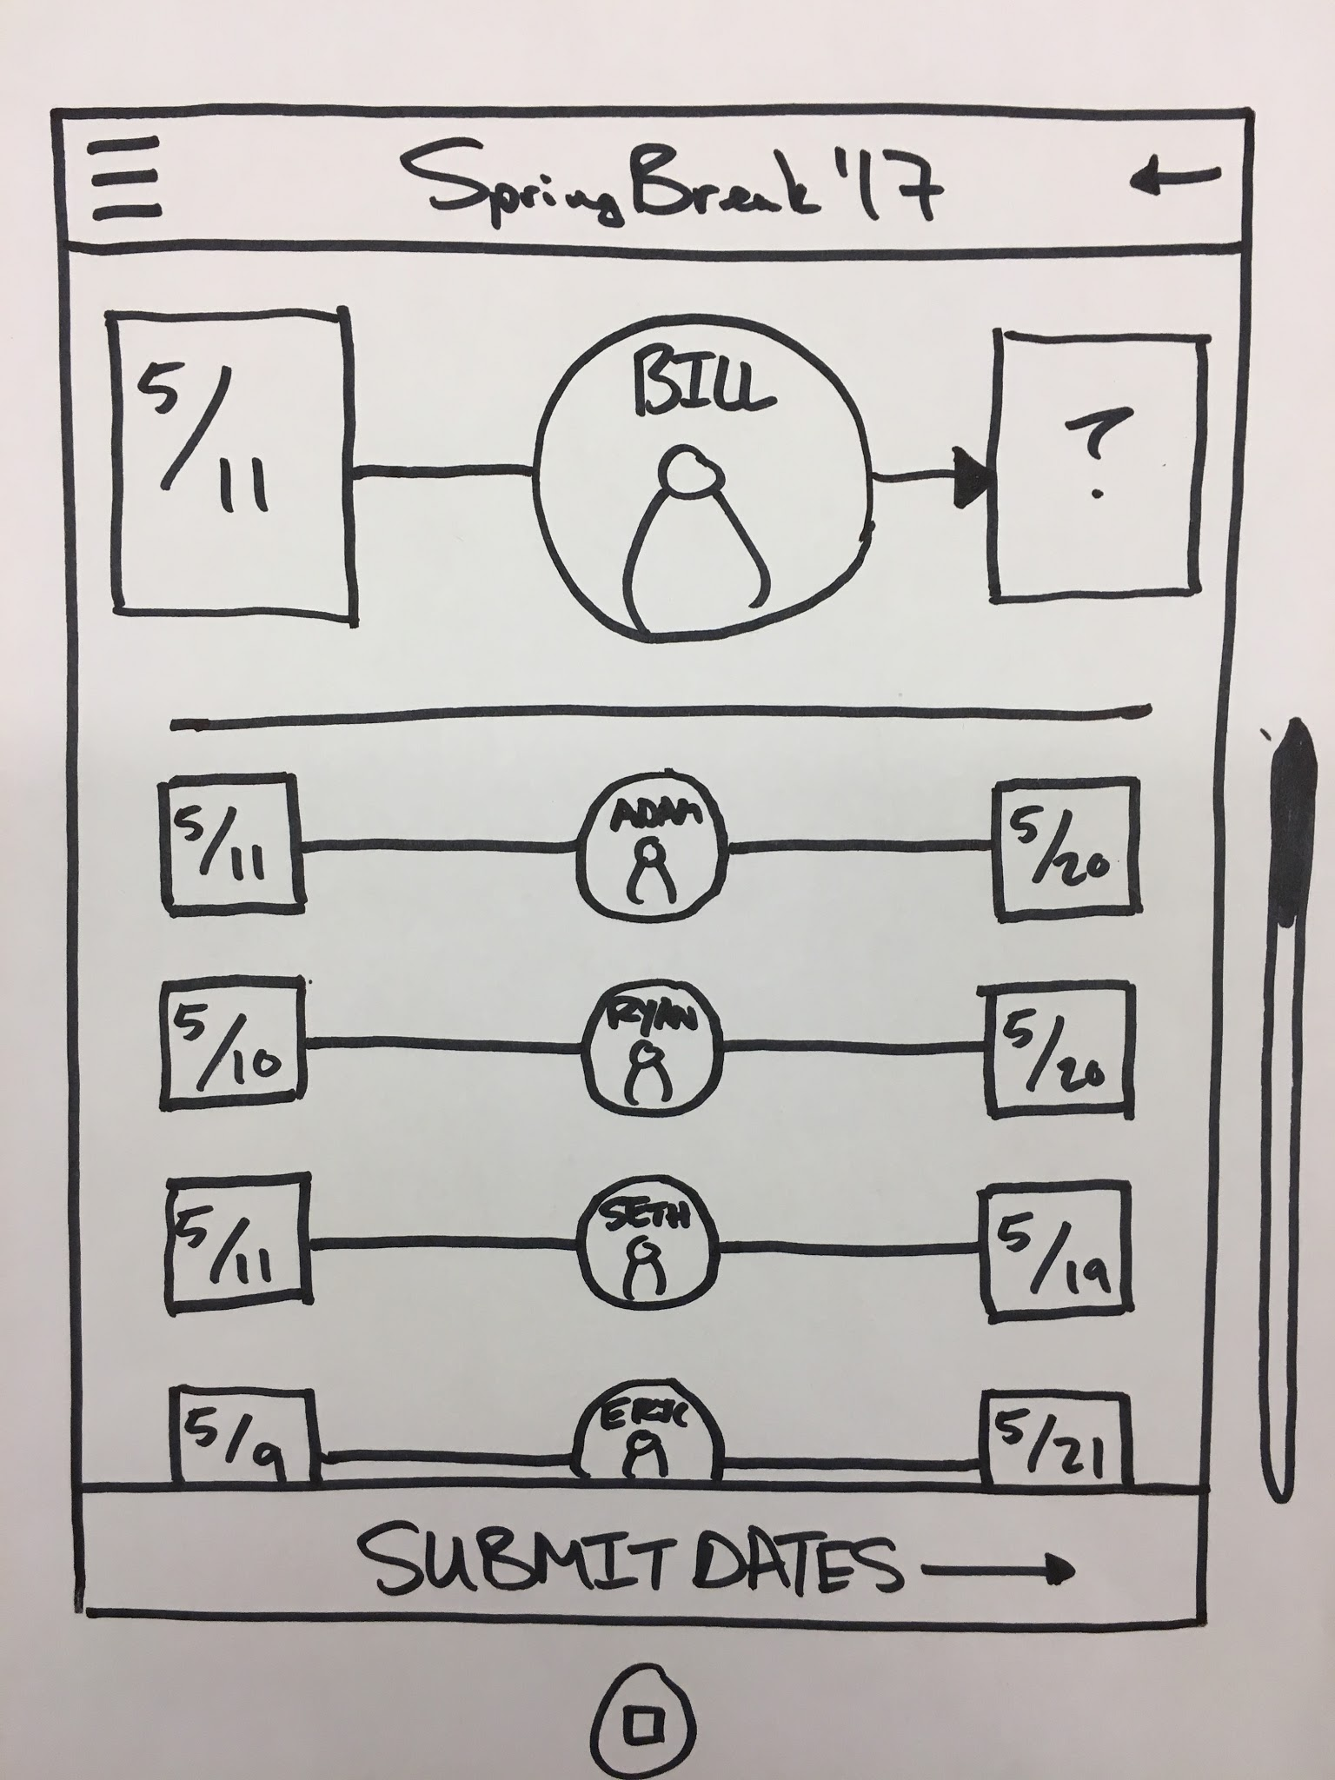

Slide 23
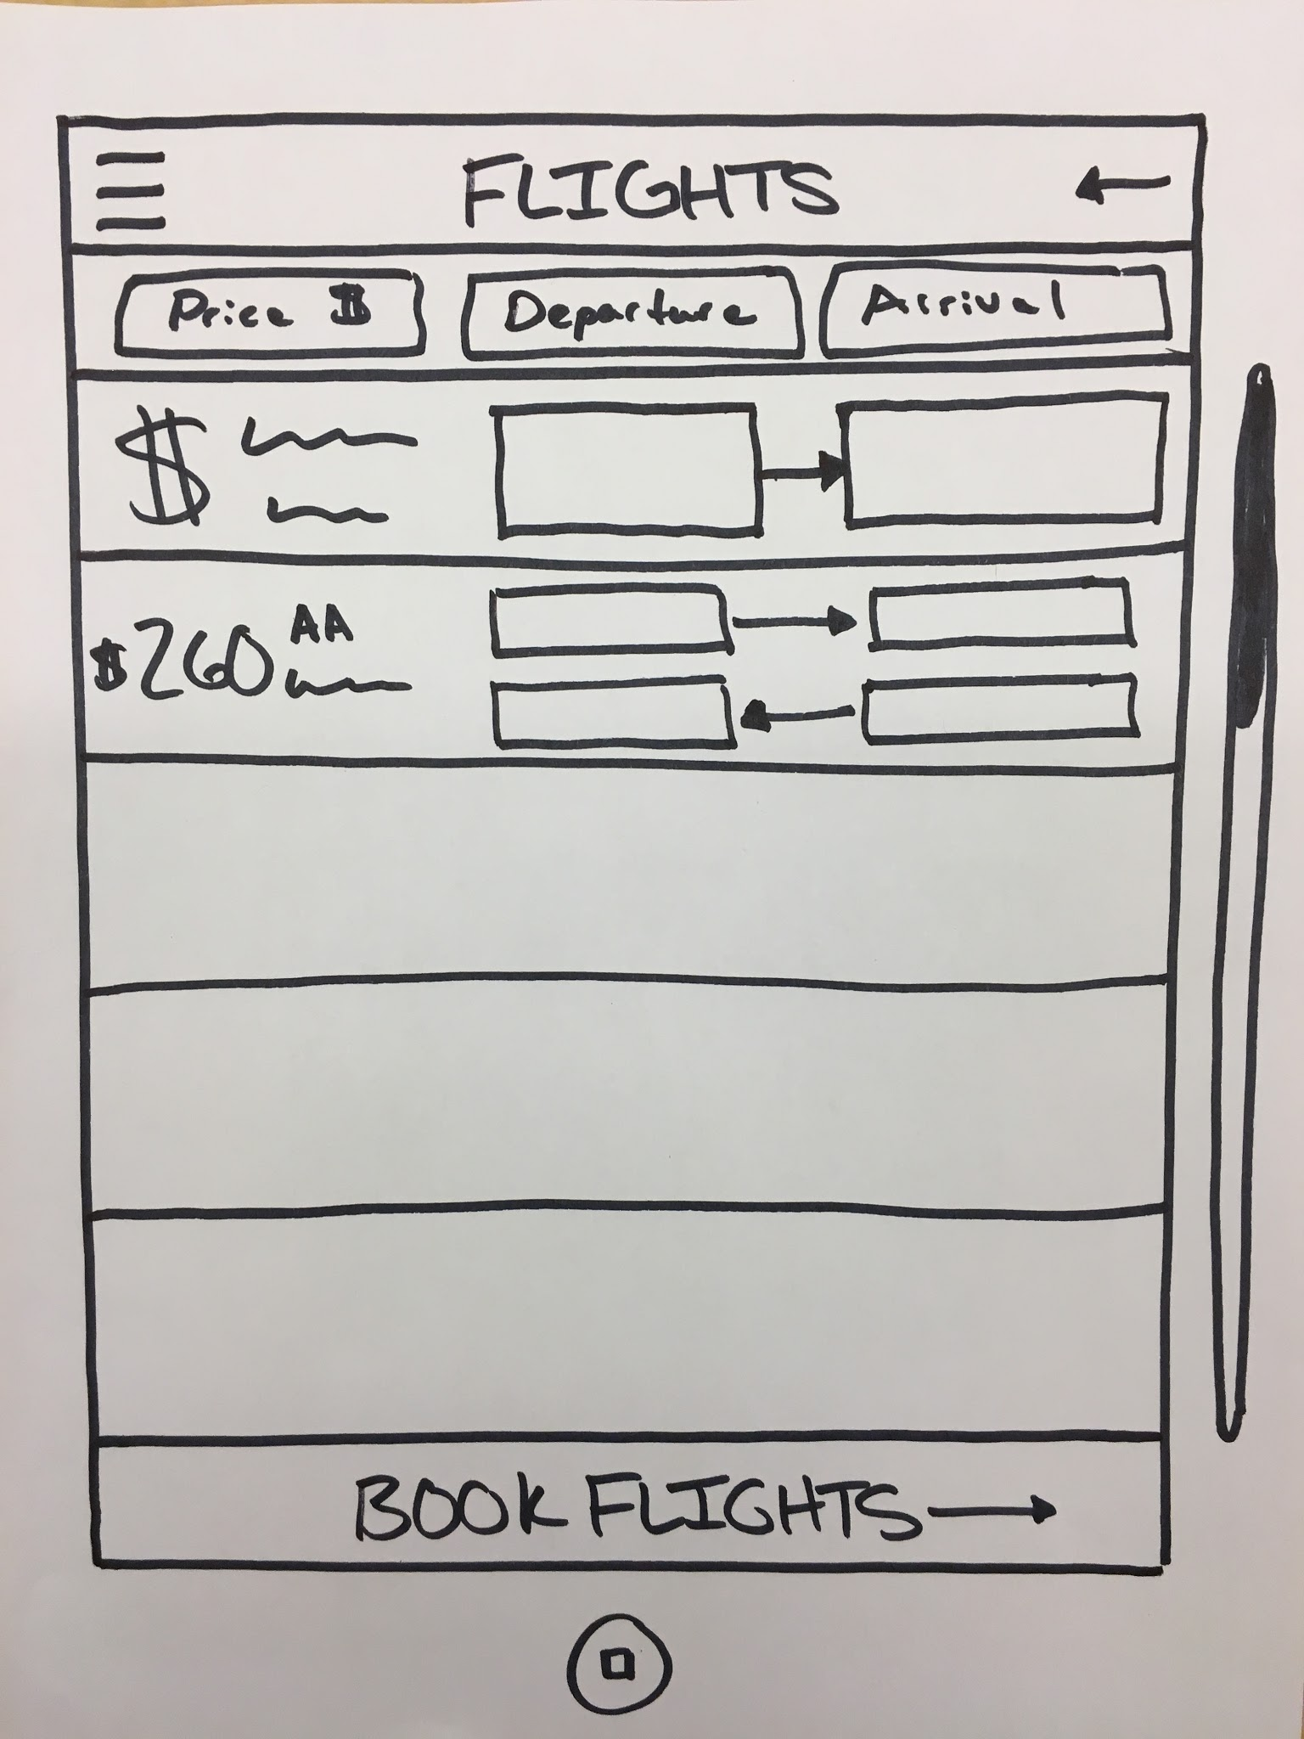
Task 3 - Plan and book flights

Slide 24
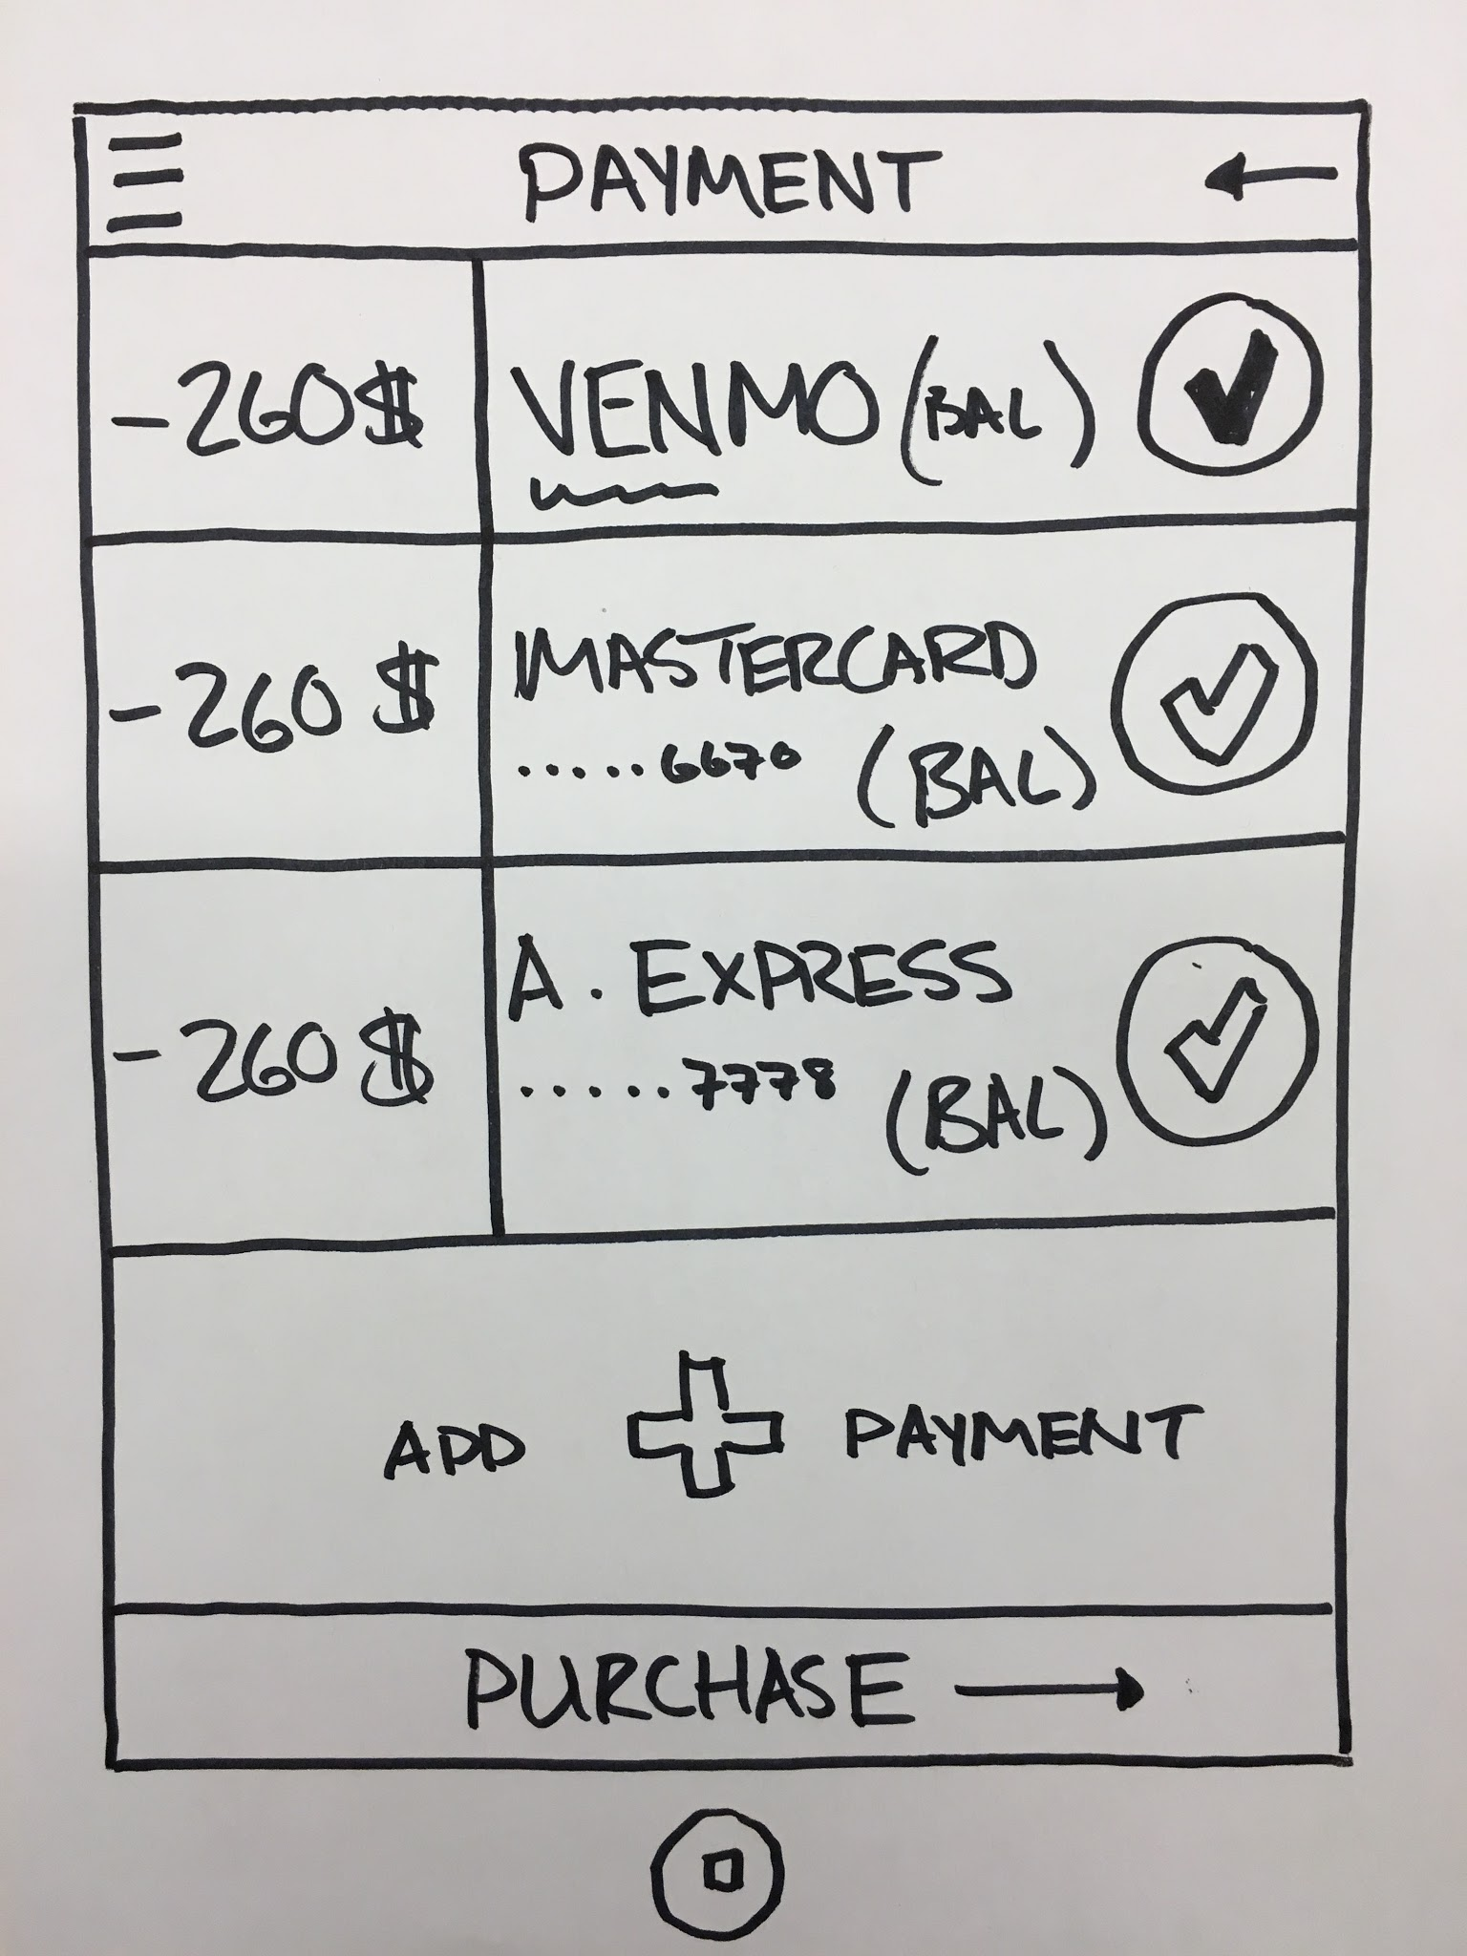
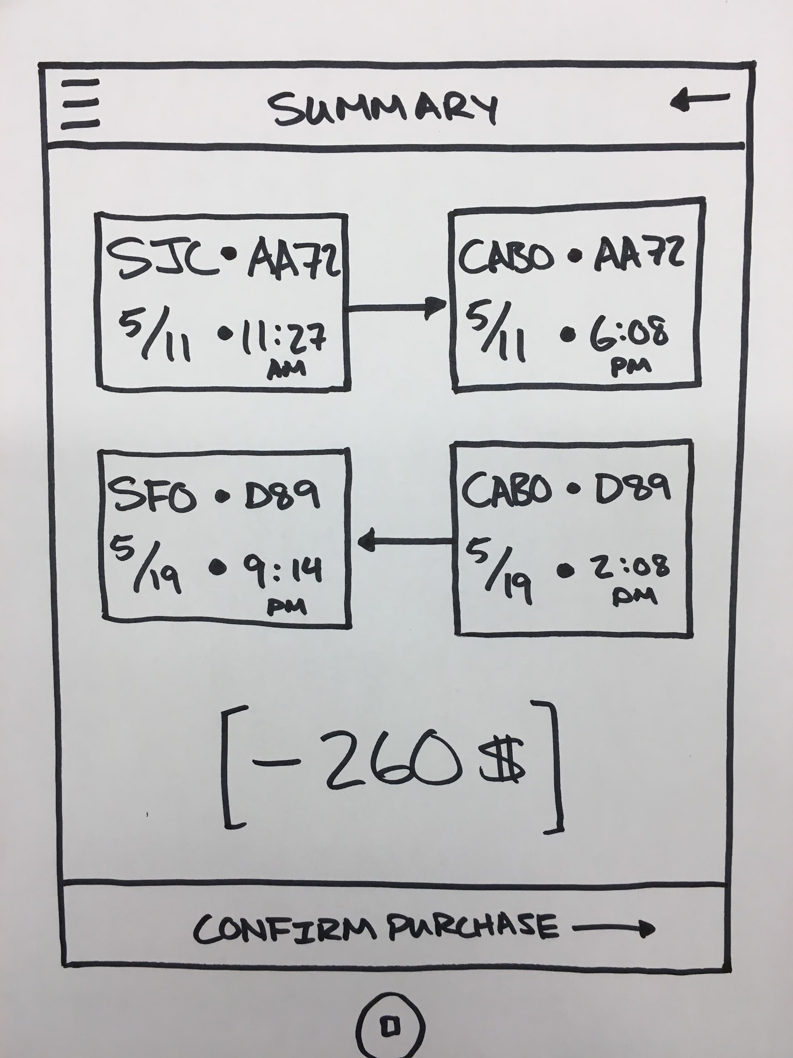

Slide 25
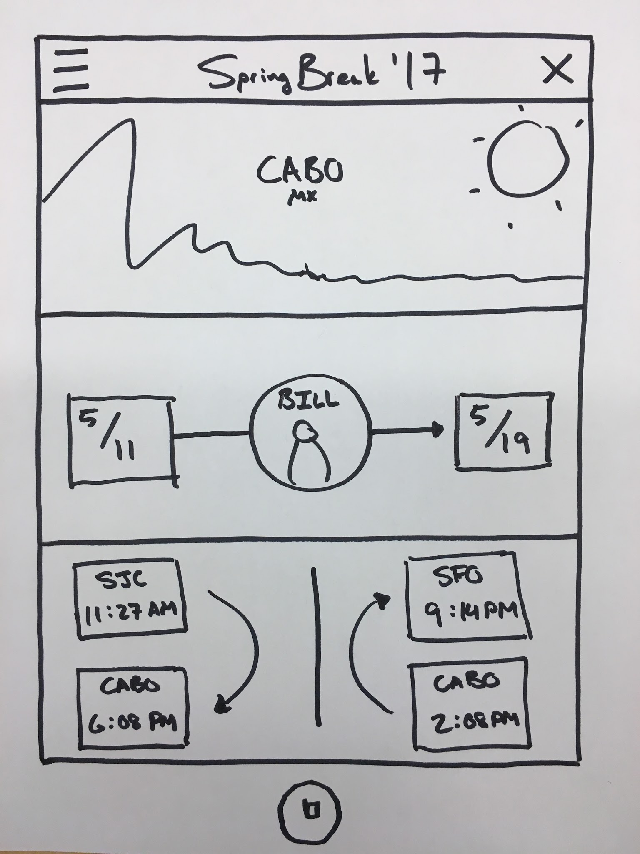

Slide 26
Overview
Mission Statement
Selected Interface
Low-Fi Prototype
Task Flows
Method
Results
UI Changes
Summary

Slide 27
Participants and Environment
Participant 1 GSB Mid 20’s - male Travels frequently Student

Slide 28
Participants and Environment
Participant 1 GSB Mid 20’s - male Travels frequently Student | Participant 2 Coffee shop Mid 30’s - female Travels during summer Grade school teacher

Slide 29
Participants and Environment
Participant 1 GSB Mid 20’s - male Travels frequently Student | Participant 2 Coffee shop Mid 30’s - female Travels during summer Grade school teacher | Participant 3 Apartment Complex Early 30’s - male Travels occasionally Works in tech

Slide 30
Overview
Mission Statement
Selected Interface
Low-Fi Prototype
Task Flows
Method
Results
UI Changes
Summary

Slide 31
Confusion about this screen
Do you select one of the existing
trips and move forward?
Can I create my own trip?
Is Cabo pre-selected?

Slide 32
People were confused about
creating
They thought maybe once they
create they can’t add friends

Slide 33
Felt like if they accepted they
were at owners mercy

Slide 34
A little unclear that this was the
menu for selecting these things
Some people said slashes were
confusing

Slide 35
People responded really well
to this screen in general
Felt very intuitive to users

Slide 36
Some were confused what was
going on. What were all the blanks?
People tended to like the filters
Thought that booking would buy
the actual flights

Slide 37
Realized here that you didn’t buy
previously
Didn’t need to repeat price
Screen was very intuitive

Slide 38
Once everyone got here, all the
previous screens made sense
Liked the display of flight info

Slide 39
Really liked the pictures and
graphics
Felt like it made all the previous
screens clearer

Slide 40
Overview
Mission Statement
Selected Interface
Low-Fi Prototype
Task Flows
Method
Results
UI Changes
Summary

Slide 41
UI Changes
Make action items clearer about what they do
book, confirm, create, etc
Change opening screen so it’s clear what create trip does
Make the voting process clearer on how/where to vote
Change payment selection screen to not include prices

Slide 42
Overview
Mission Statement
Selected Interface
Low-Fi Prototype
Task Flows
Method
Results
UI Changes
Summary

Slide 43
Summary
Mobile was best because we wanted ease of use
Overall, people had some confusion points
Everything was clear once they had finished the work flow
Need to redesign so it’s clear as they go through
Despite confusion, people felt the concept has a lot of potential

