Slide 1
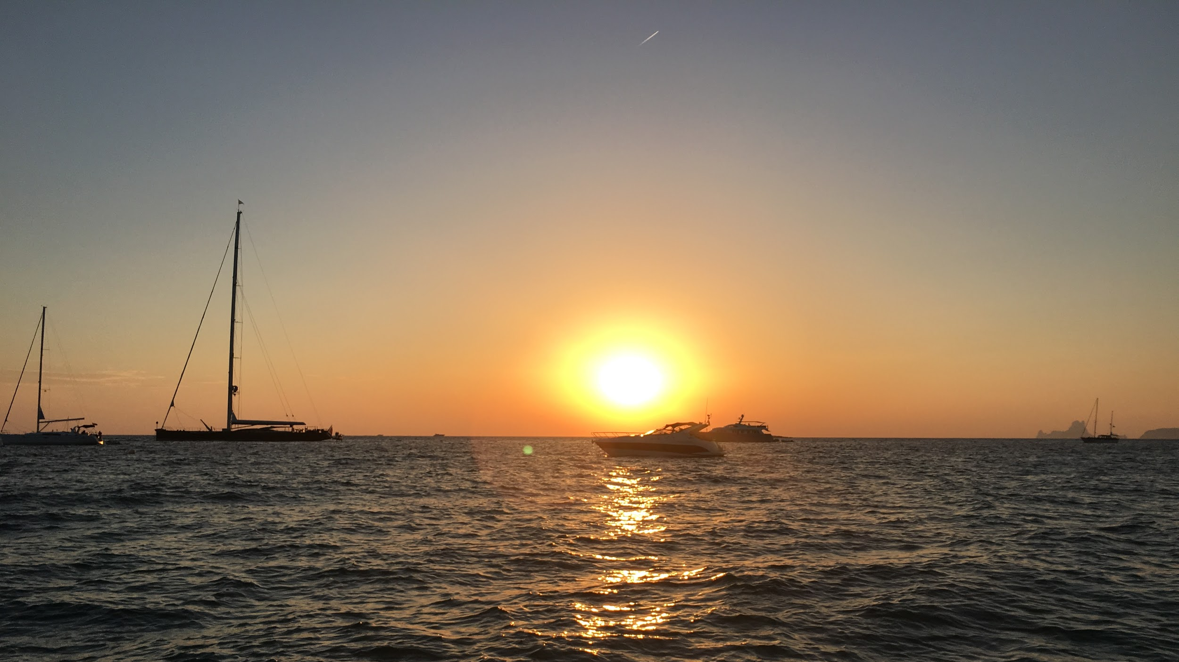
“Not All Those Who Wander Are Lost”¹
Studio Theme: Adventure
Problem Domain: Travel and Tourism
1. Lord of the Rings

Slide 2
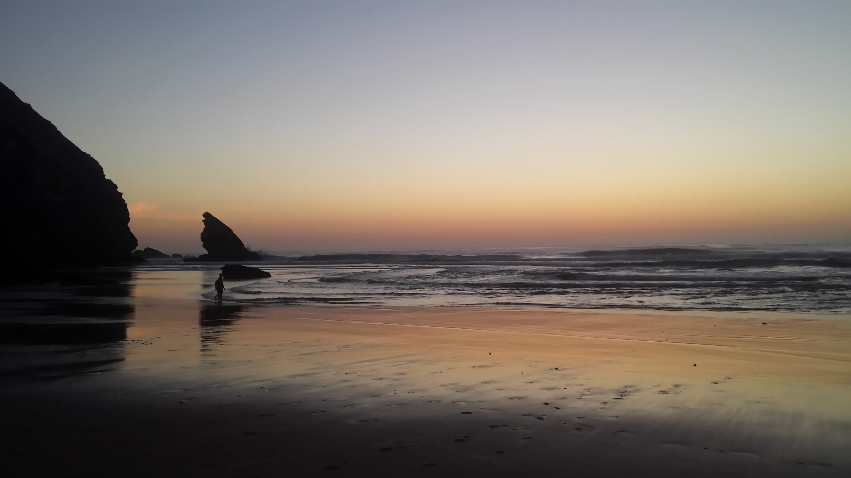
Introducing the team
Ryan Harber
Adam Abdulhamid
Seth Hildick-Smith
Eric Peter

Slide 3
Structure of today
Methodology
Introduce our interviewees
Share our analysis
Empathy map
Game changers

Slide 4
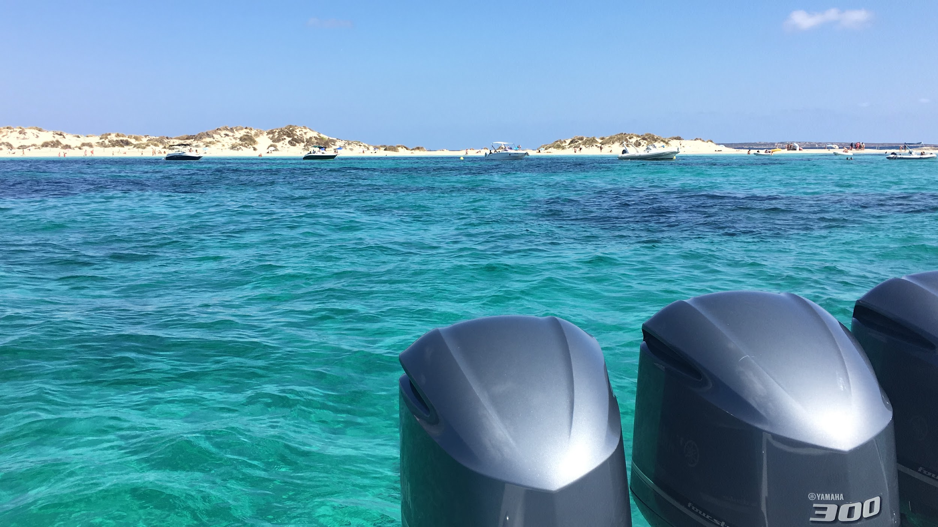
Multiple criteria to choose a diverse set of participants
Demographic diversity: age, gender, ethnicity
Amount of travel: never, sometimes, several times a year
Travel partners: spouse, family w kids, friends, solo
Type of trip: commute to work, short vacation, group trip, etc
Location of trip: one or multiple destinations, domestic, international
^{Friends vs. not friends}

Slide 5
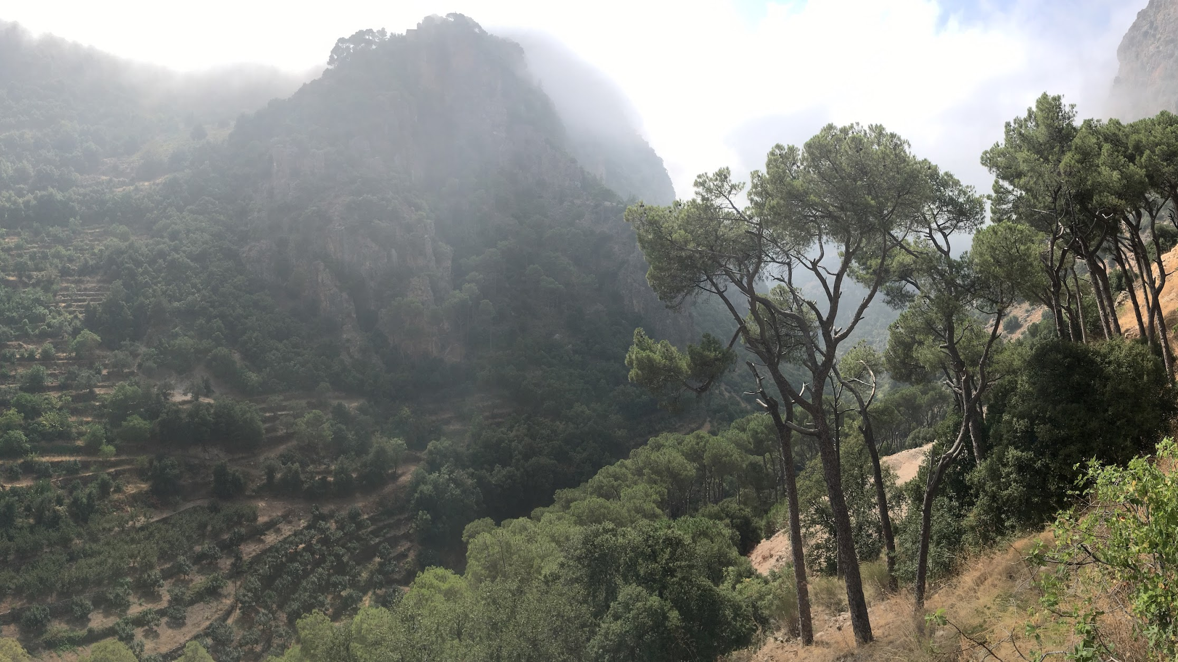
Interview focused on participant’s last trip...
Pre-travel
Planning
Booking
Budget
Logistics
Getting there
Getting around while there
Travel companions
Traveling with?
Met while there?
Destination and activities
How did you decide to do what?
Did you do any paid activities/tours?
How did you find/book them?
How did you find restaurants?
High points and challenges
Did you take pictures/videos?
When/how/where?
Notes:
Interviewed in their natur

Slide 6
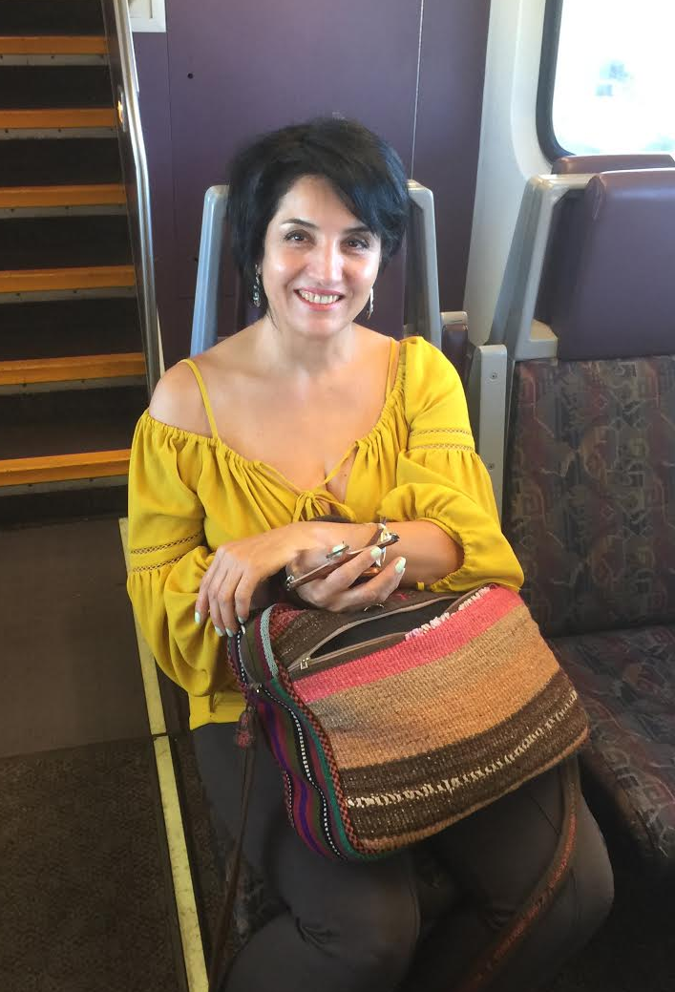
Interview 1: Maria
Middle aged female from Caltrain
What was her adventure?
Took a vacation trip to Rome and London with her husband
Lives in the area, was on her way up to SF to visit
her daughter
Why this adventure? Always wanted to travel to
“must see” places
Had very romanticized views of Rome in particular
Went to London for a friend’s celebration

Slide 7
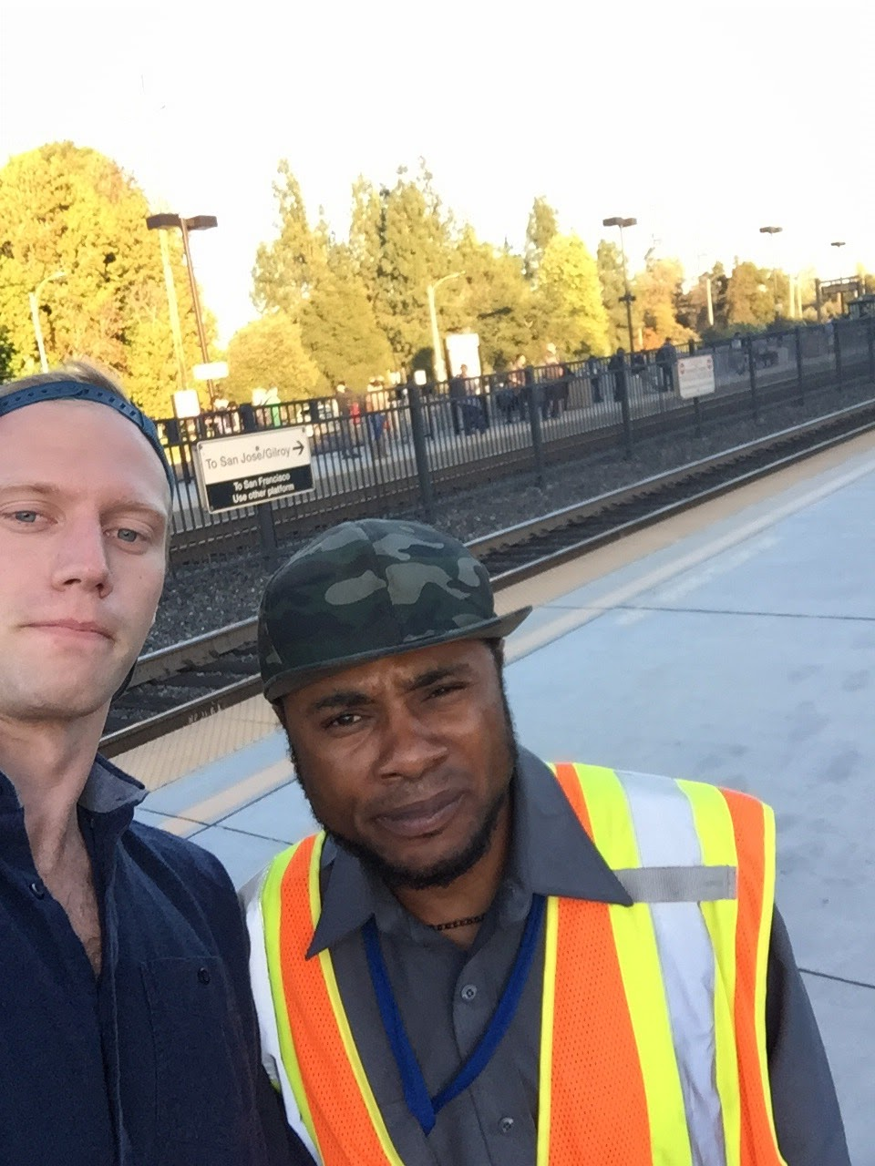
Interview 2: Bill
Male security guard @ train station
What was his adventure?
Recently left California for the first time to go to Cabo San Lucas Mexico
Lives in the south bay, works for the security firm contracted by Caltrain
Why this adventure?
Honeymoon!
He didn’t know what to expect from the international travel
Enjoyed interaction with a new culture

Slide 8
Interview 3: Bill from Shanghai
48 year old Male
Travels for business and pleasure all over the world
New York, Thailand, New Zealand, LA, Hong Kong, Venice
“It was hard to get around when the public transportation was on strike”
Uses airbnb and expedia
Uses yelp in most countries for restaurant reviews
“It’s hard to know if they are ripping you off.”
(In reference to a tourist he hired)
Had trouble getting around in Venice because his mother was in a wheelchair

Slide 9
Interview 4: Steve
28 year old Male @ Stanford GSB
What was his adventure?
Planned a trip to his home country, Lebanon, for 15 of his friends for 10 days
A self proclaimed “perfectionist” and “stressy” personality
Why this adventure? Breakdown stereotypes of his country!
“Let others develop their own view of the country that is different than the news media”
“See that it is a normal place to live”

Slide 10
Say
Think
Public transit language barrier
City transport = $$/burden
People don’t talk on the train
Wants a sense of community
Handicap accessibility is difficult
Hard to move around
Wants to be a good host
Hard to keep track of everyone
Does
Feel
Took cabs and ate the cost
Tries to find buddies to commute with
Bored and lonely
Frustrated and ripped off
Carries/pushes relative around
Looks worried, doesn’t drink as much, buys sim cards for people
Exhausted and frustrated
Tired and very stressed

Slide 11
Surprises: Interview 1
We met… Maria, a middle aged woman who traveled to Rome and London with her husband recently
We were amazed to realize… Navigating another country’s public transit system, especially with a language barrier, is too difficult, especially without internet like most travellers.
It would be game changing to… Have an easy way to plan public transportation routes in other countries and languages without having to plan so far in advance.
“Public transit was too confusing. So, we took cabs everywhere, but it was very expensive.”

Slide 12
Surprises: Interview 2
We met… Bill, a security guard who went to Cabo San Lucas, Mexico for his honeymoon
We were amazed to realize…
He drive to work and want to carpool but has a hard time finding carpool partners to drive with
He observes people everyday standing face to face and not interacting on the train
It would be game changing to…
It would be game changing to help Bill interact with new people by helping him get to work with a buddy
“Bringing people together is a big task”

Slide 13
Surprises: Interview 3
We met… Bill, a middle aged man from Shanghai who travels all over the world for business and pleasure
We were amazed to realize… There are no good systems in place overseas for handicap accessible navigation
It would be game changing to… Have an easy way to map and plan travel routes with a focus on handicap accessibility

Slide 14
Surprises: Interview 4
We met…Young man who planned a trip for 15 friends to his home country
We were amazed to realize… Vast majority of the stress he experienced was NOT in the planning process! Stress was…
Getting people to commit to actually going
DURING the trip itself (keeping people organized, ensuring activities went smoothly, people had a good time)
It would be game changing to… Provide a single interface to manage on the ground logistics and keep track of / in touch with his friends

Slide 15
Why were you stressed?

Slide 17
In the moment...

Slide 20
Summary / next steps?
People value travel because it allows them to make connections and experience new parts of the world.
But… logistics can often be difficult and travel can be costly.
How can we leverage technology to encourage people to explore the world and everything it has to offer?

