Slide 1
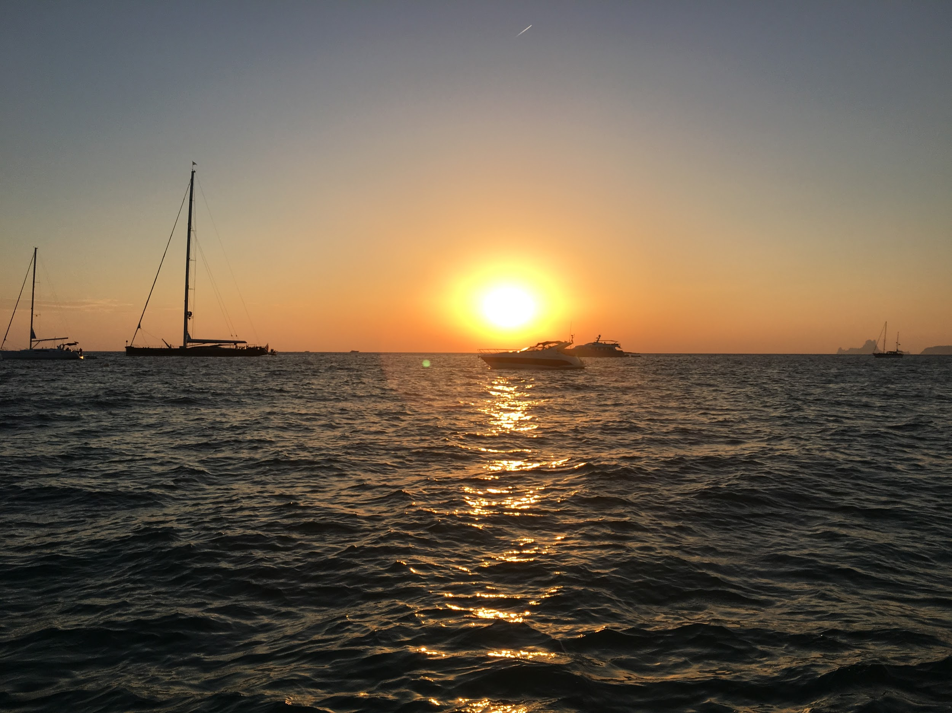
“Not All Those Who Wander Are Lost”¹
TripIt
Ryan Harber
Adam Abdulhamid
Seth Hildick-Smith
Eric Peter
1. Lord of the Rings

Slide 2
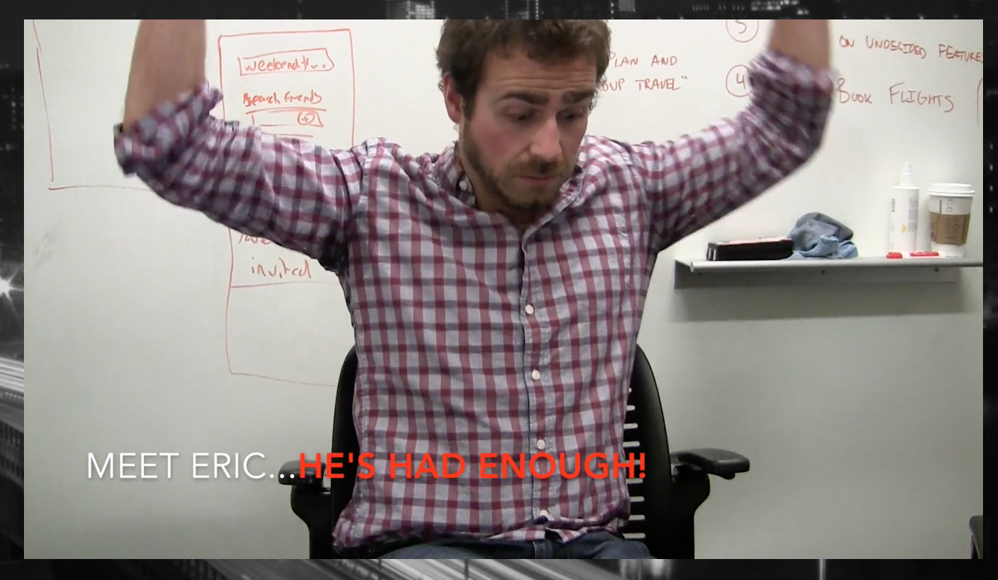
The Problem
Group travel is time consuming and challenging to coordinate even amongst the closest of friends.
It is often a logistical nightmare to decide when and where to travel, as friends rarely reach unanimous decision when it comes to travel decisions.

Slide 3
TripIt helps you seamlessly plan and book group travel

Slide 4
Overview
Heuristic Evaluation Results & Revised Design
Prototype Implementation Status
Demonstration of Prototype
Summary

Slide 5
Overview
Heuristic Evaluation Results & Revised Design
Prototype Implementation Status
Demonstration of Prototype
Summary

Slide 6
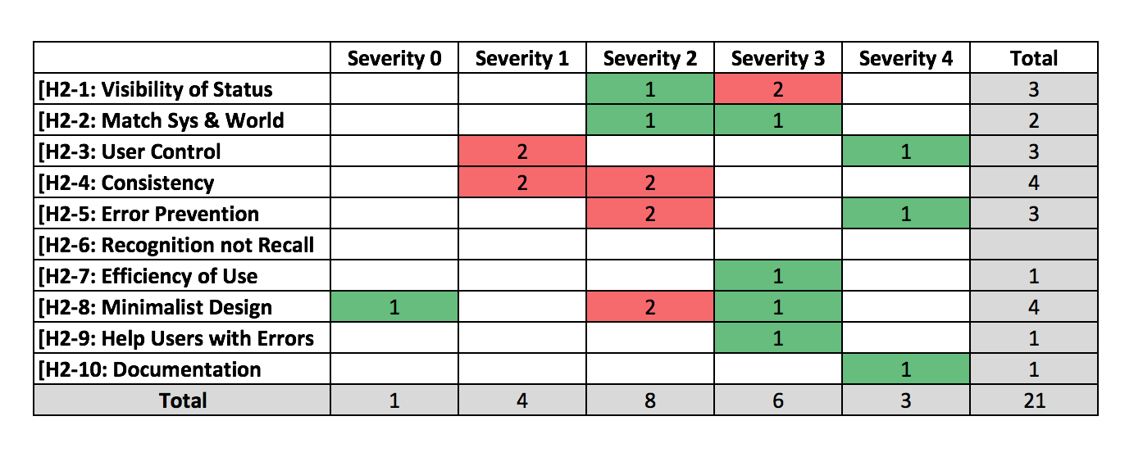
We focused on solving 9 severity 3 and 4 issues

Slide 7
We focused on solving 9 severity 3 and 4 issues
Problem identified | Solution implemented or planned
H2-1: Users do not know why they need to login | Added simple explanation: “Log in to create a trip”
H2-7: Users will struggle to enter an email address to login | Added ability to login through Facebook
H2-1: Unclear what the first page of the app does | Added wording to indicate photos were for inspiration Added description above “trip name” text field
H2-8: Add friends screen design is cluttered and hard to read | Simplified the design to only have one section and clear distinction between “invited” and “not invited”

Slide 8
We focused on solving 9 severity 3 and 4 issues
Problem identified | Solution implemented or planned
H2-2: Did not understand where contacts in “invite friends” came from | Will clarify in read me; in actual app would be their contacts list
H2-3: No way to go back and invite more people | Added ability to go back and add additional friends
H2-10: No help or documentation on location & date screens | Will add help and documentation
H2-8: Design of date selection screen is too “ambitious” | Working to improve design
H2-5: User gets confirmed to the trip without enough confirmation | Clarify in readme that this is Wizard-Of-Ozed

Slide 9
Overview
Heuristic Evaluation Results & Revised Design
Prototype Implementation Status
Demonstration of Prototype
Summary

Slide 10
Revised Design

Slide 11
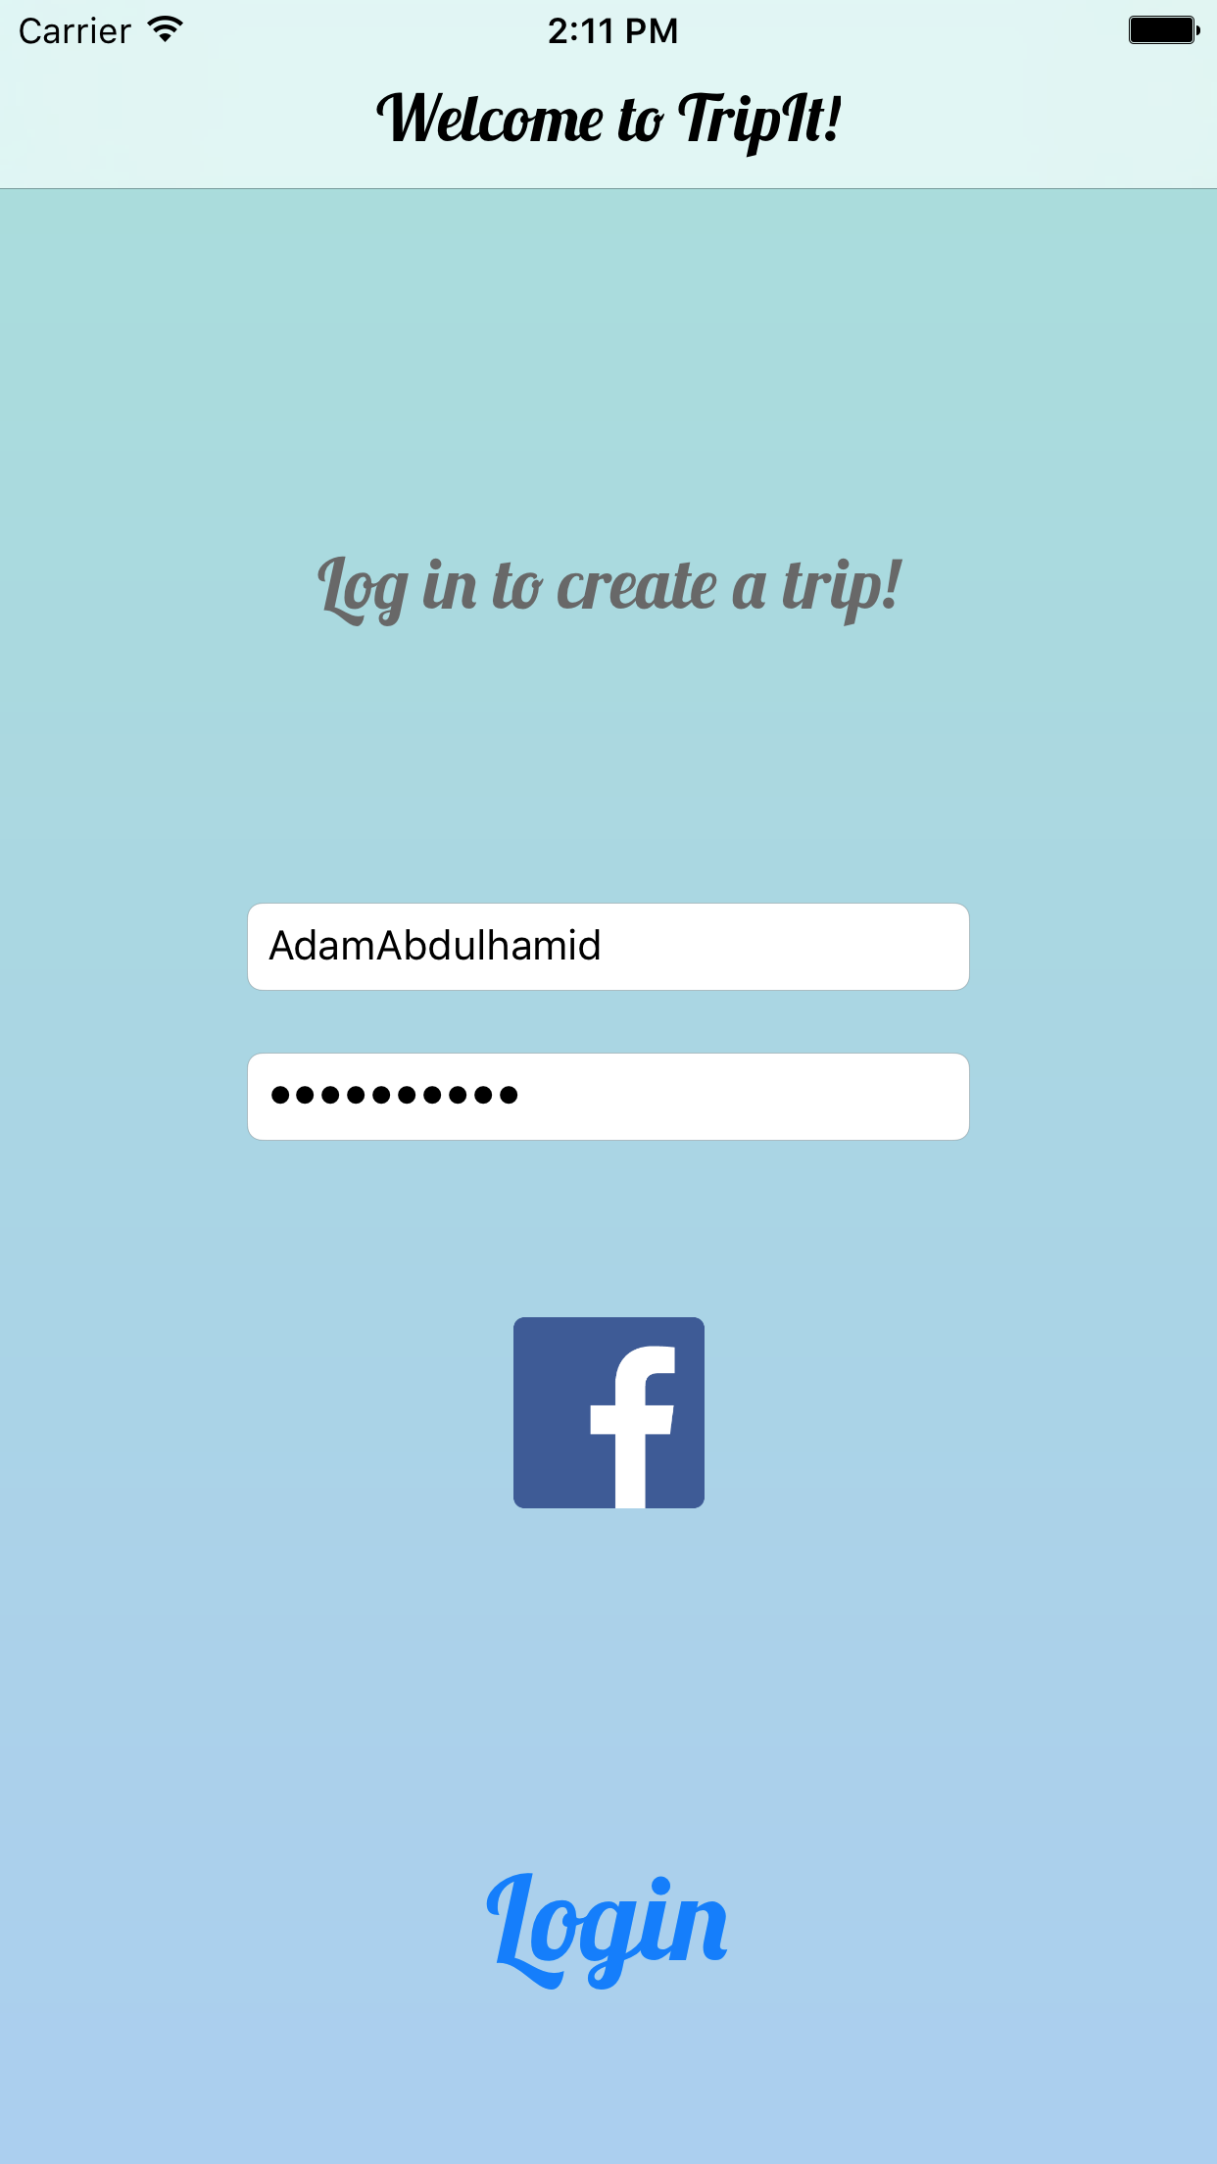

Slide 12
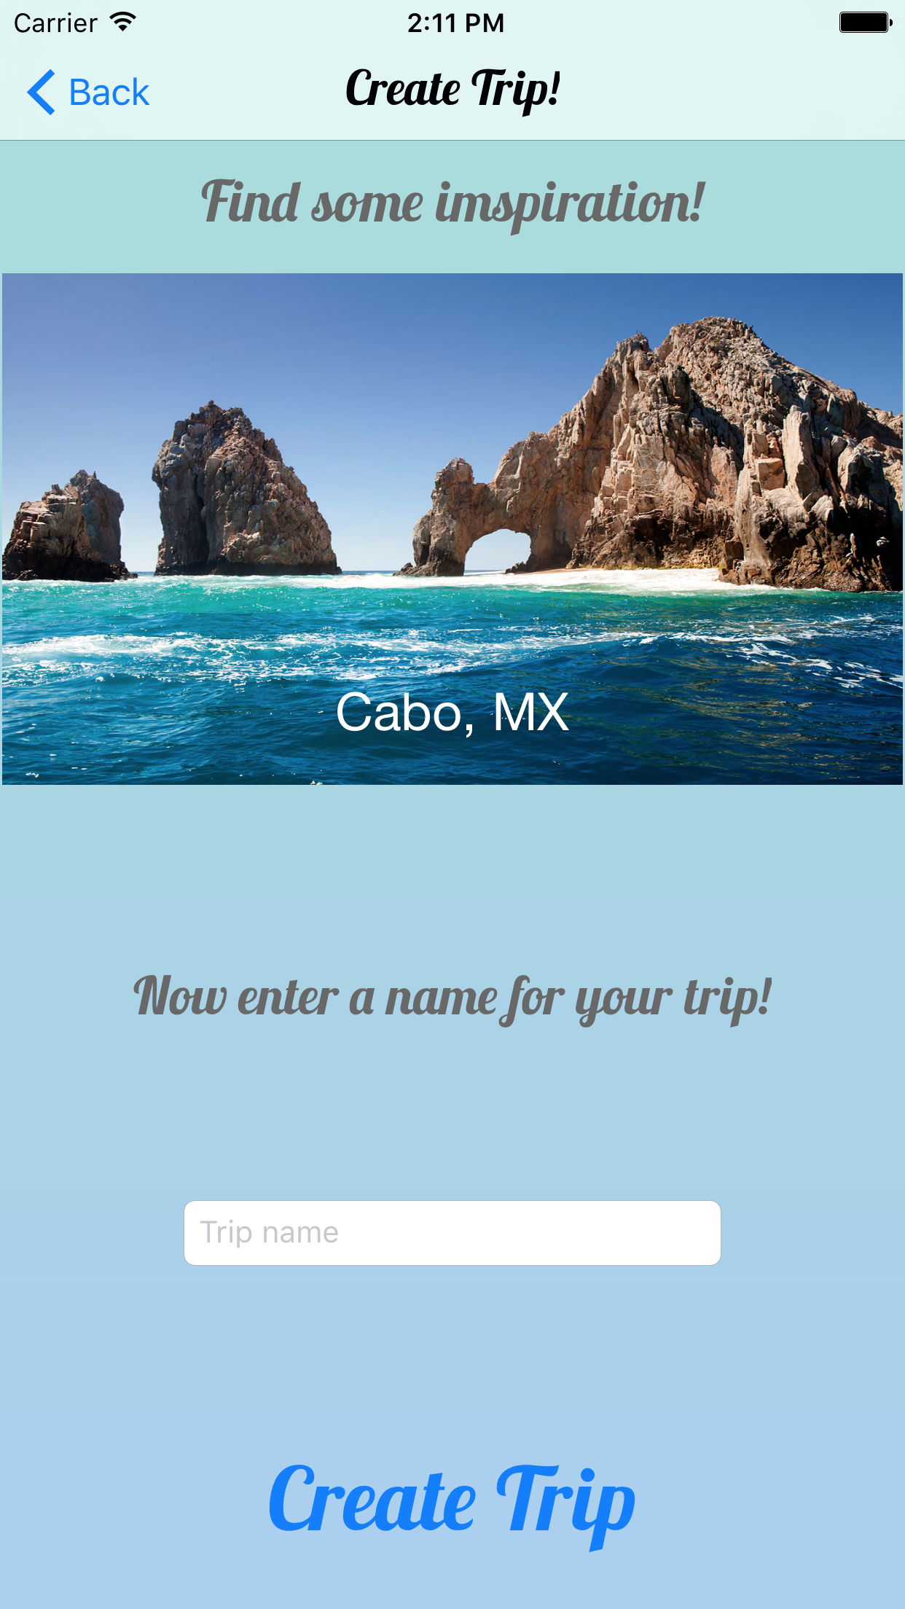

Slide 13
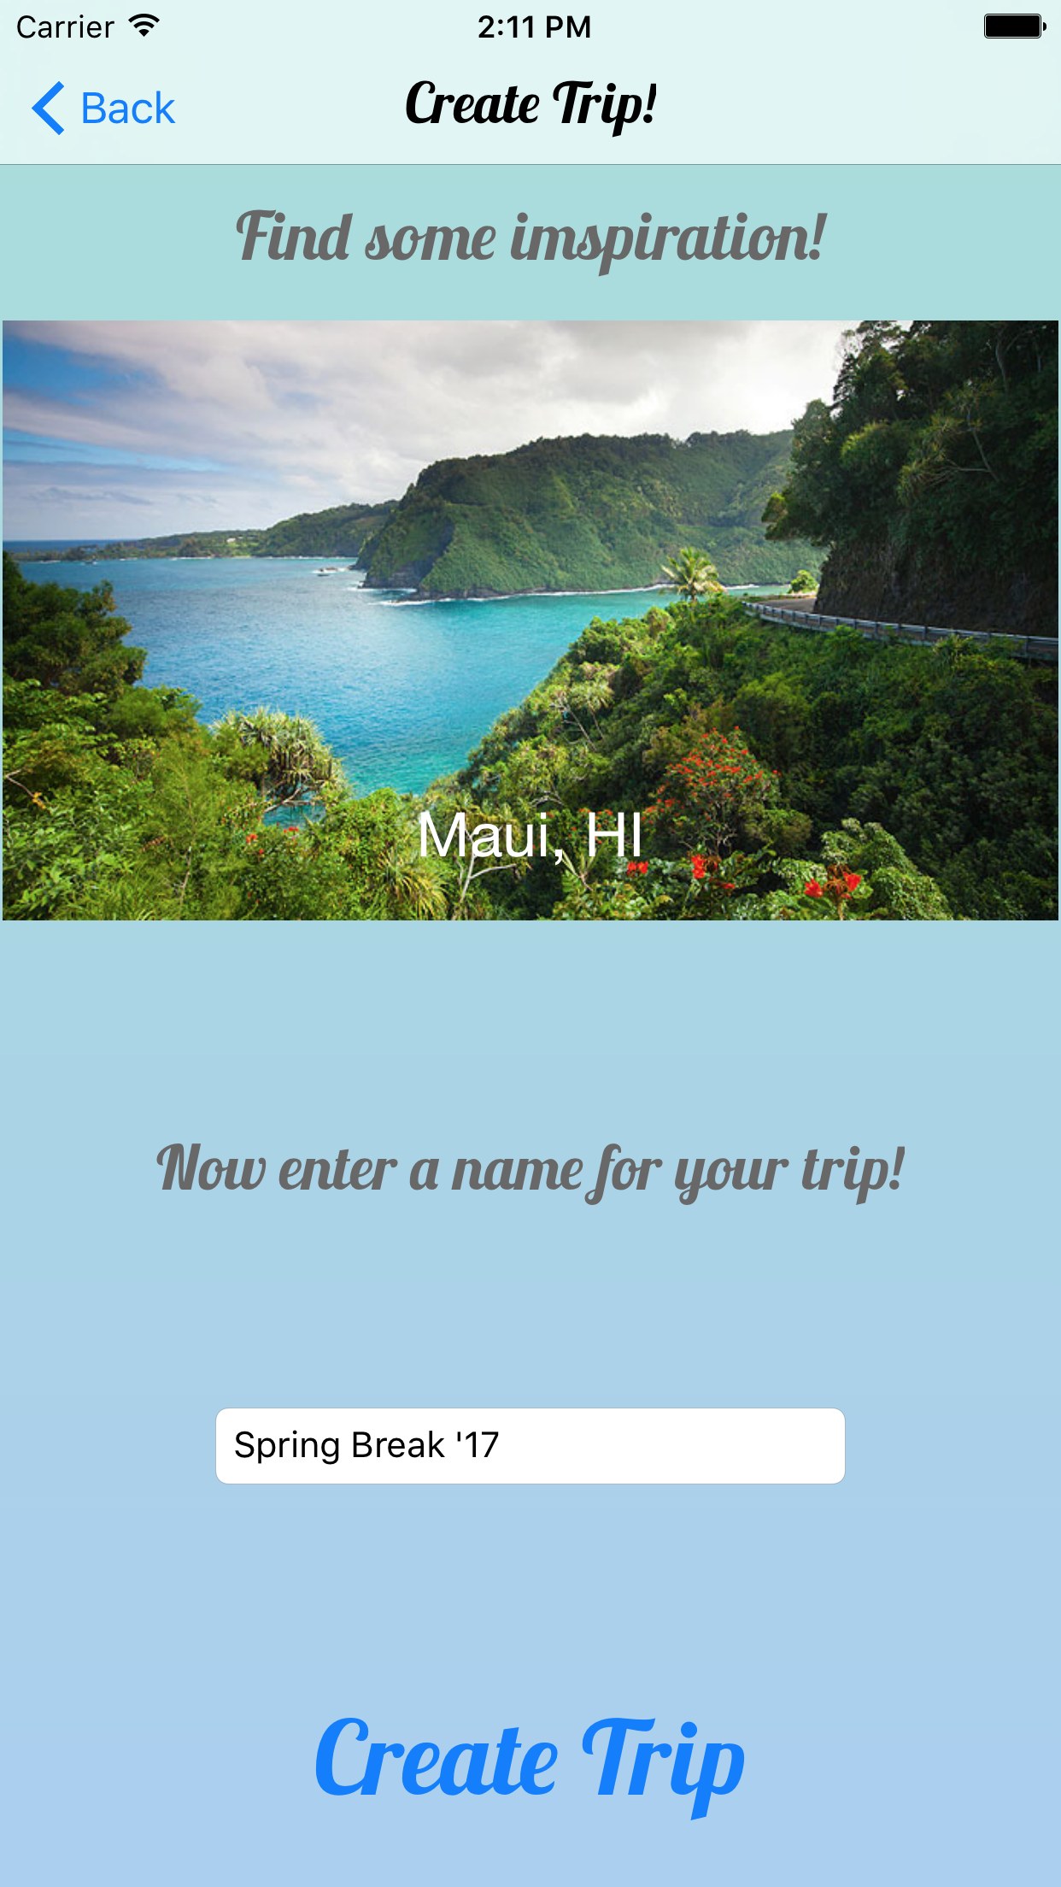

Slide 14
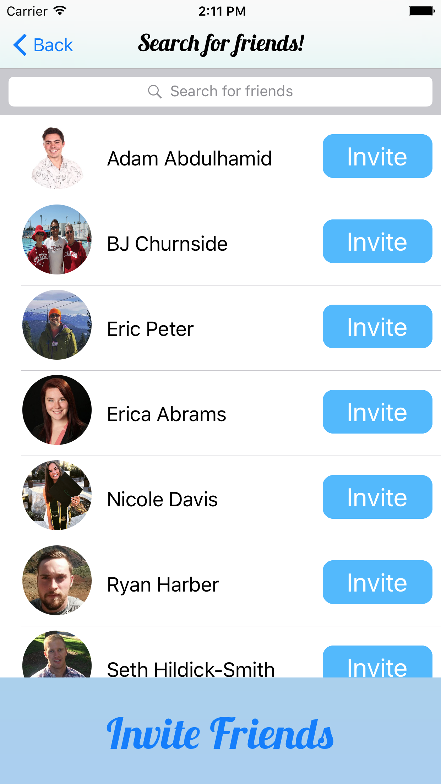

Slide 15
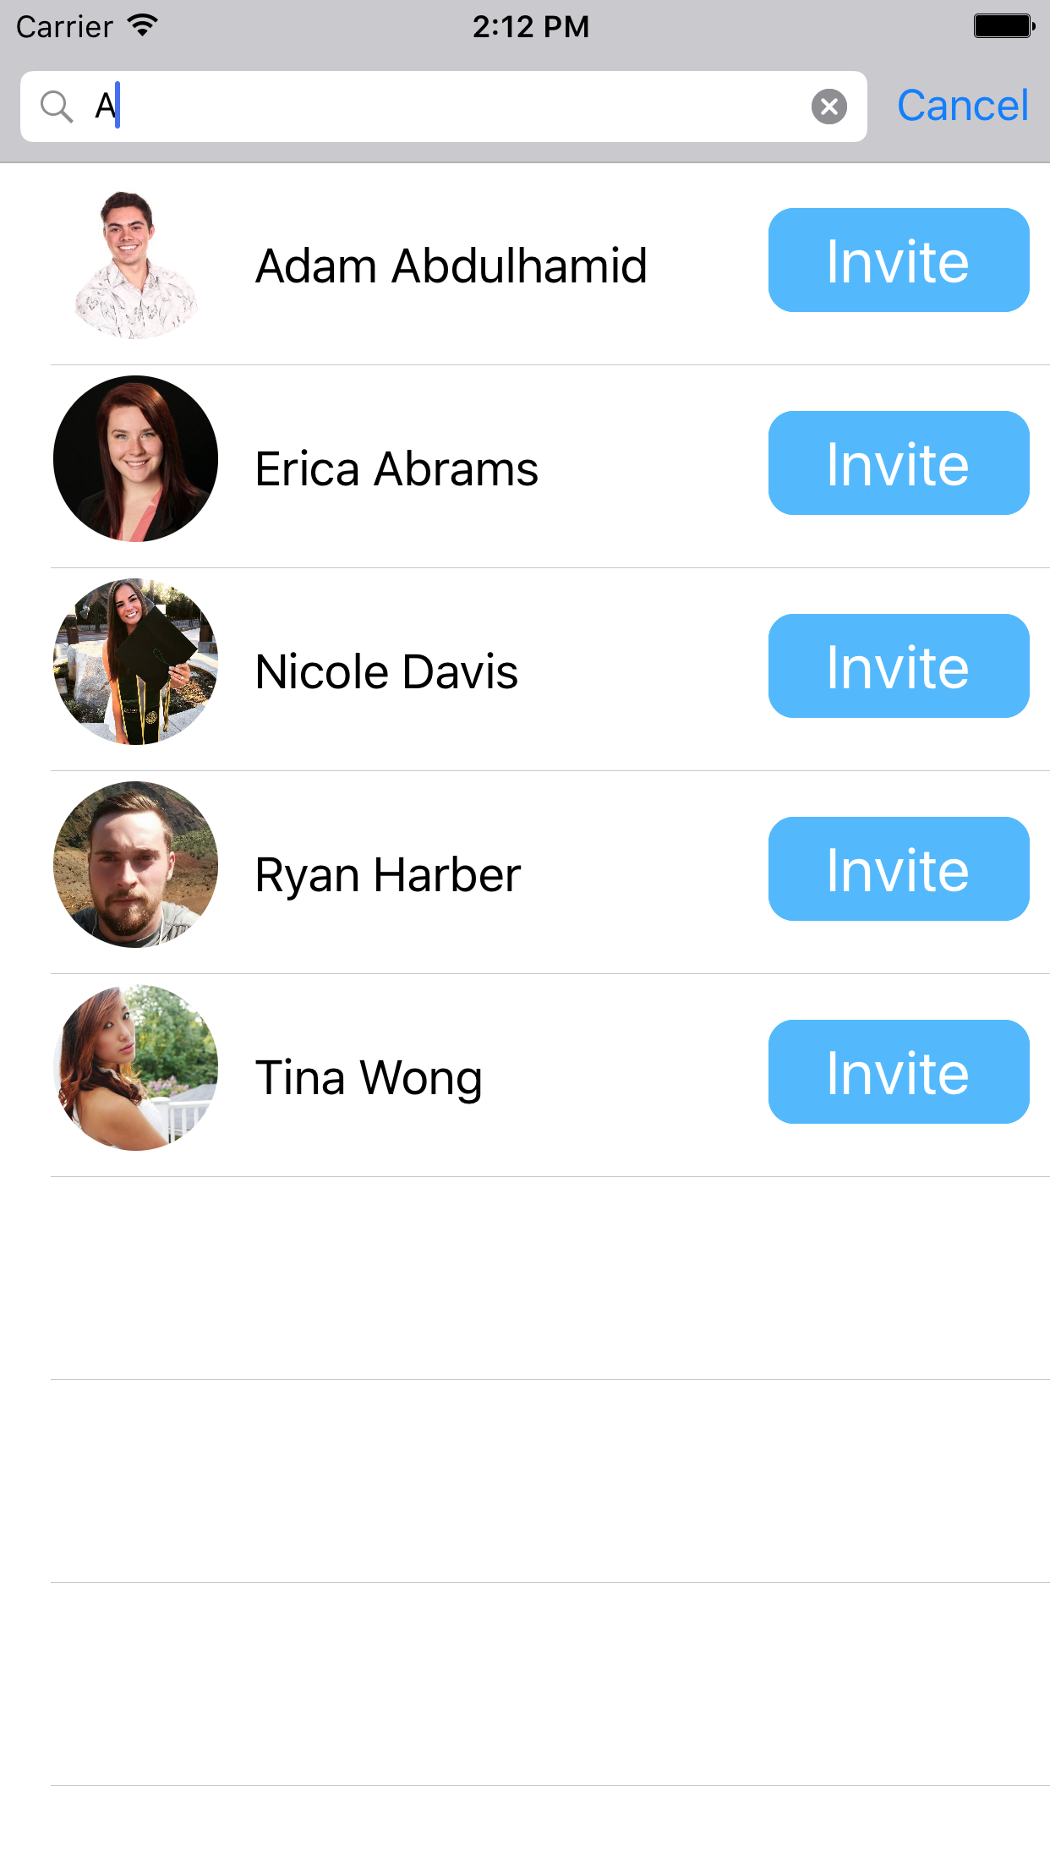

Slide 16
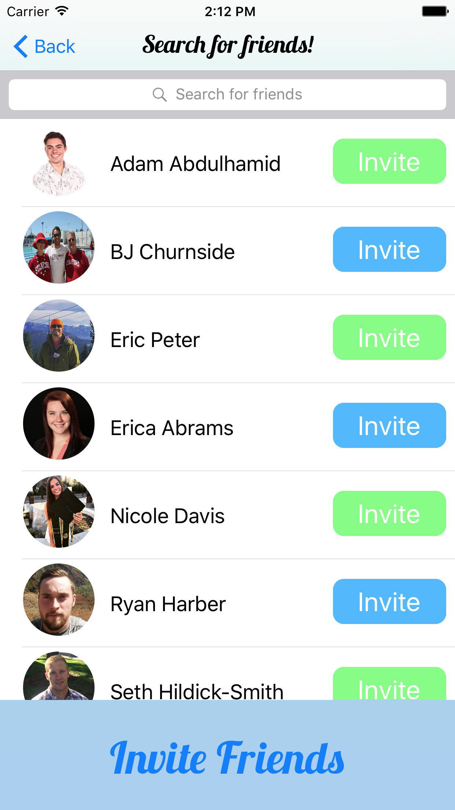

Slide 17
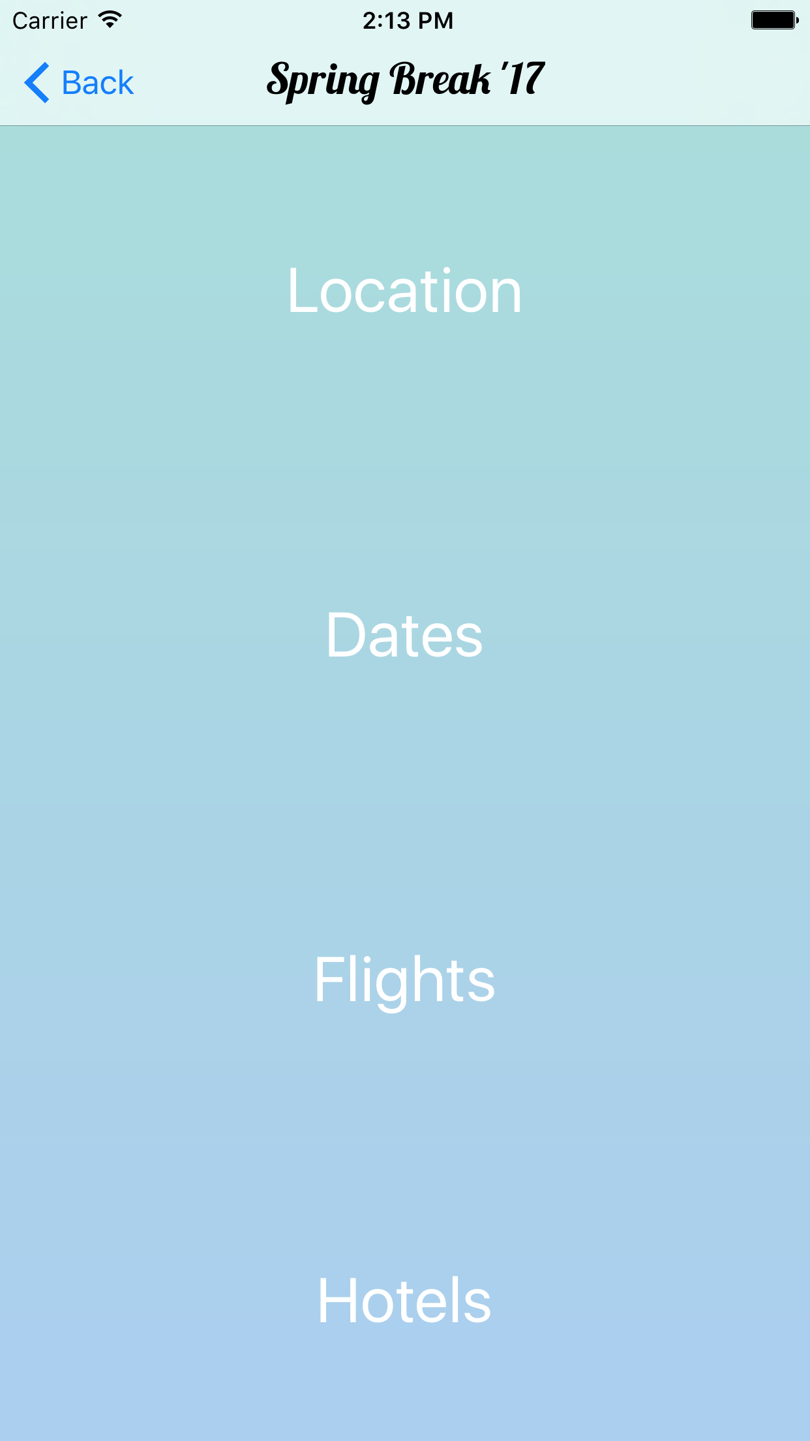

Slide 18
Overview
Heuristic Evaluation Results & Revised Design
Prototype Implementation Status
Demonstration of Prototype
Summary

Slide 19
Prototype Implementation Status
Task 1 -- Implemented
Task 2 -- Unimplemented
Task 3 -- Unimplemented

Slide 20
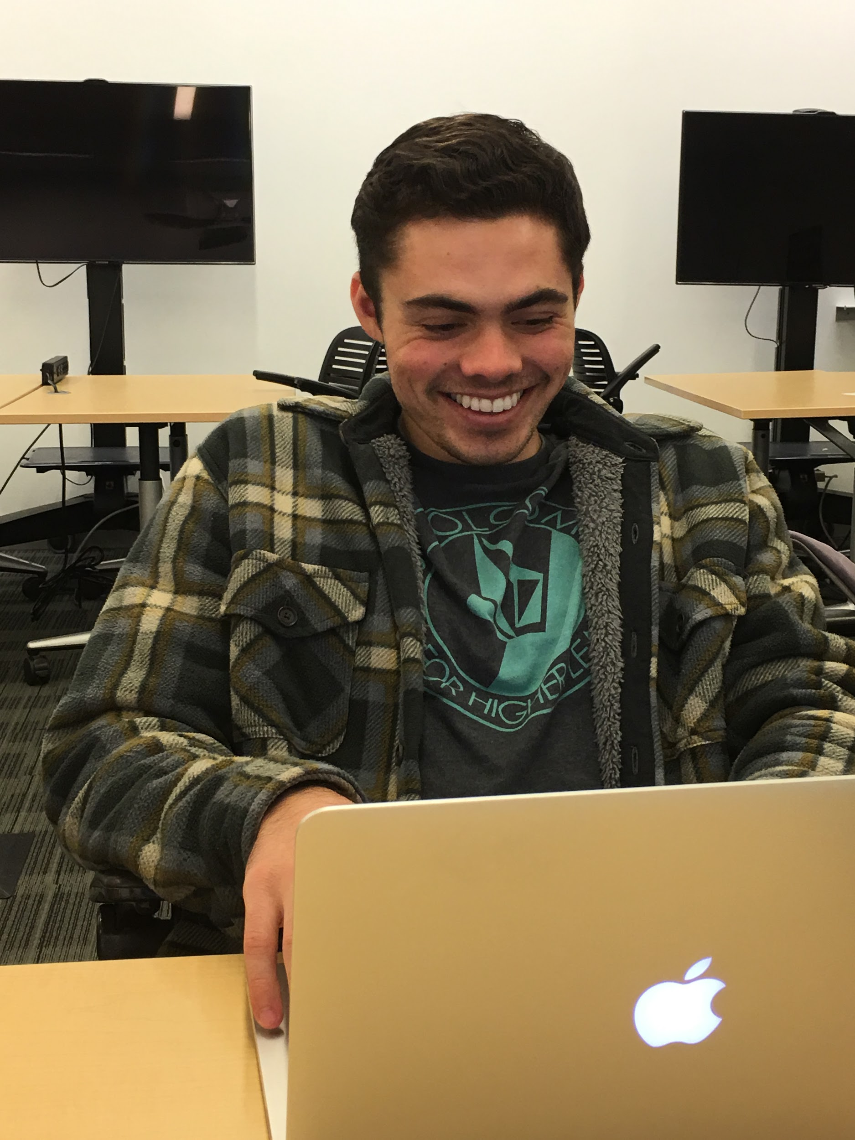
Tools Being Used
Xcode Interface Builder
Used storyboard to create UI’s and hooked everything up to custom subclasses
Github
Version control so everyone can contribute

Slide 21
Implemented Features
Task 1: Create and Share Trip
Allow the user to log in to platform
Create a trip with inspiration slider to boost engagement
Invite friends

Slide 22
Unimplemented Features & Plan
Unimplemented Features:
Task 2: Choose Trip Features
Task 3: Book Tip
Plan:
Iterative development over this weekend.

Slide 23
Wizard of Oz Techniques & Hard-coded features
Wizard of Oz:
Facebook login
Inviting friends
Hard Coded Data:
Contacts
Dates
Locations

Slide 24
Issues/Questions
No pagination dots in the inspiration slider.
Not sure why, UIPageViewController inside of another UIView
Inviting while inside of search isn’t persistent
iOS uses two separate tables - how do we pass information between the two?
How can we add explanation to location, dates, etc. without being too text heavy?
How can we redesign the date picker to be more aesthetically pleasing?

Slide 25
Overview
Heuristic Evaluation Results & Revised Design
Prototype Implementation Status
Demonstration of Prototype
Summary

Slide 26
Demonstration!

Slide 27
Overview
Heuristic Evaluation Results & Revised Design
Prototype Implementation Status
Demonstration of Prototype
Summary

Slide 28
Summary
Good heuristic evaluation feedback drove some insightful UI changes
We have implemented task 1 (create and share trip)
In the process we fixed all severity 3 and 4 issues
We have yet to implement tasks 2 and 3 (sharing and booking trip)
We plan to implement these tasks over the next few days

Slide 29
Questions?

