Slide 1
“Not All Those Who Wander Are Lost”¹
Studio Theme: Adventure
Problem Domain: Travel and Tourism
Ryan Harber
Adam Abdulhamid
Seth Hildick-Smith
Eric Peter
1. Lord of the Rings

Slide 2
Overview
Initial POV
Further Needfinding Results
Revised POVs
How might we?
Experience Prototypes

Slide 3
Initial POV
We met… Bill from Shanghai
Who needs… handicap accessibility
Because… his mother uses a
wheelchair
Game changer… mapping app for handicap accessibility

Slide 4
Overview
Initial POV
Further Needfinding Results
Revised POVs
How might we?
Experience Prototypes

Slide 5
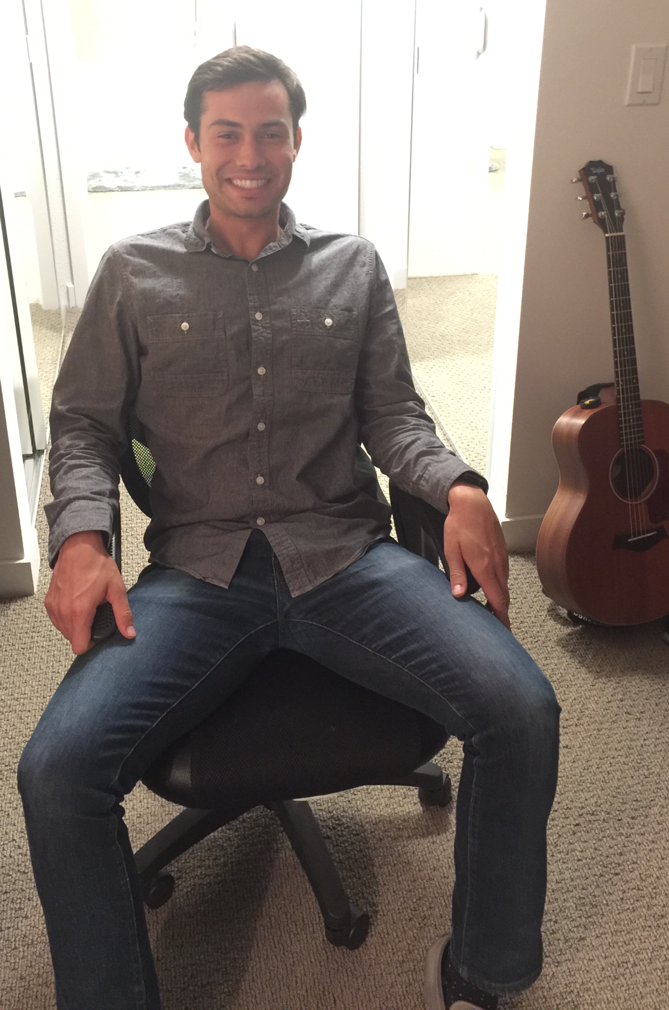
Interview: Ramsey
Ramsey is an employee at HP who moved here from Colorado

Slide 6
Interview: Ramsey
Ramsey is an employee at HP who moved here from Colorado
Took a vacation/business trip to Germany, Belgium, and Amsterdam for the Drupa trade show

Slide 7
Interview: Ramsey
Ramsey is an employee at HP who moved here from Colorado
Took a vacation/business trip to Germany, Belgium, and Amsterdam for the Drupa trade show
He explained how important data for navigation is, but complained that data is expensive abroad. He also had to be more careful about his phone battery

Slide 8
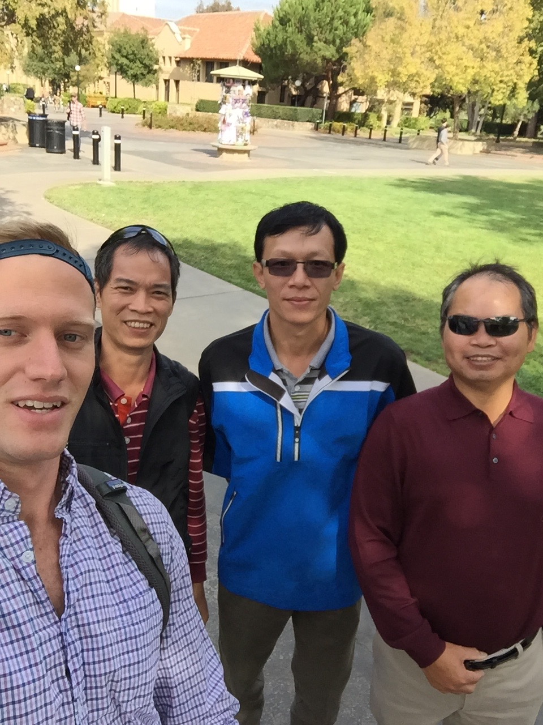
Interview: Mr. Ho and Mr. Huang
We met Mr. Ho, Mr. Huang and their translator Michael

Slide 9
Interview: Mr. Ho and Mr. Huang
We met Mr. Ho, Mr. Huang and their translator Michael
Traveling to visit friends who live in Seattle and the Bay Area.

Slide 10
Interview: Mr. Ho and Mr. Huang
We met Mr. Ho, Mr. Huang and their translator Michael
Traveling to visit friends who live in Seattle and the Bay Area.
Their greatest trouble when traveling was their reliance on their translator.

Slide 11
Overview
Initial POV
Further Needfinding Results
Revised POVs
How might we?
Experience Prototypes

Slide 12
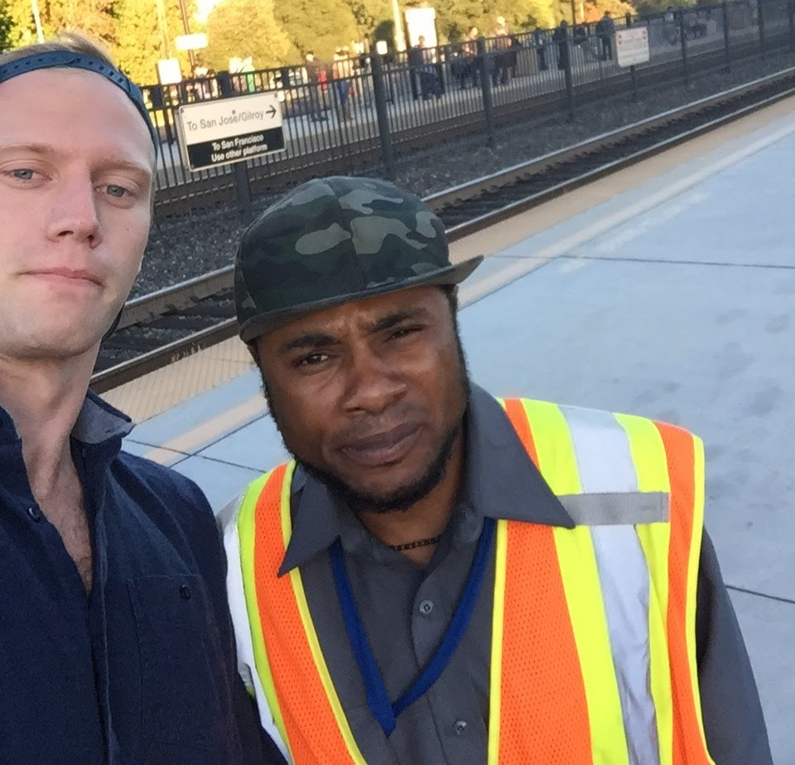
Revised POV #1
We met… Bill from CalTrain
Who needs… commuting friends
Because… he is lonely on commute
Game changer… help Bill socialize during commute

Slide 13
Revised POV #2
We met… Bill from CalTrain
Who needs… something to do on
commute
Because… he is bored on commute
Game changer… help Bill be productive during commute

Slide 14
Revised POV #3
We met… Steve from GSB
Who needs… help with group travel
Because… he was stressed while
hosting his friends in Lebanon
Game changer… help Steve track logistics/schedule for the group

Slide 15
Overview
Initial POV
Further Needfinding Results
Revised POVs
How might we?
Experience Prototypes

Slide 16
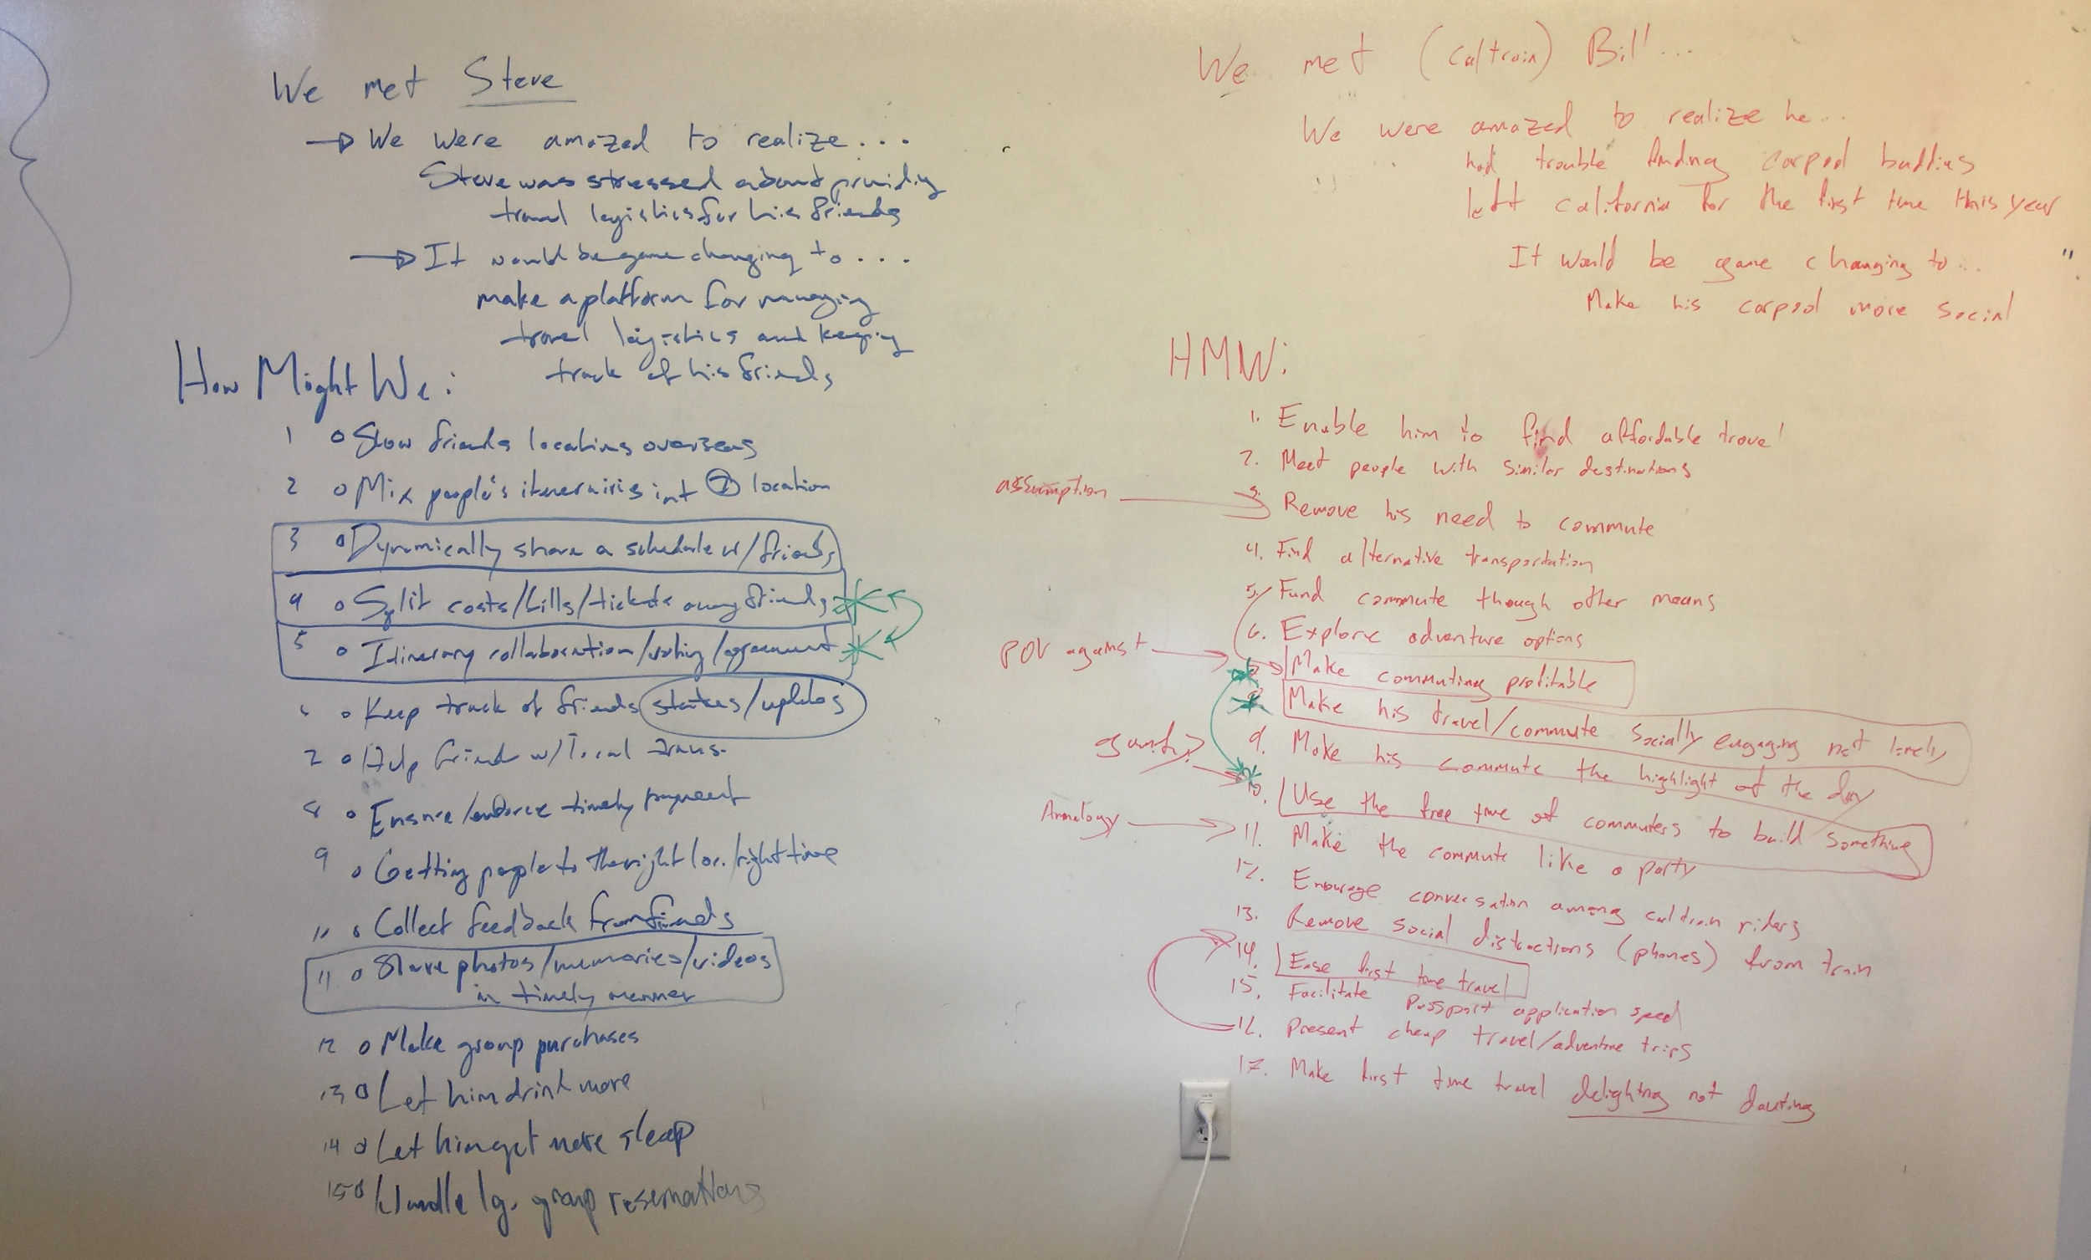

Slide 17
Game changer… help Bill socialize during commute
HOW MIGHT WE
Help Bill meet people with similar interests
Encourage conversation among passengers
Make Bill’s commute the highlight of his day

Slide 18
Game changer… help Bill be productive during commute
HOW MIGHT WE
Make commuting/traveling profitable for Bill
Allow riders to collaborate on projects
Help riders learn cool stuff from other passengers

Slide 19
Game changer… help Steve with group travel logistics
HOW MIGHT WE
Help Steve’s group collaborate on/share an itinerary
Help the group split bills and other travel costs
Help the group share photos and videos from trip

Slide 20
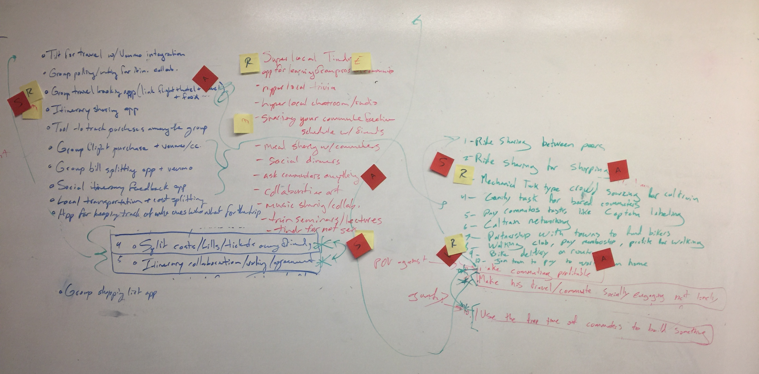

Slide 21
Overview
Initial POV
Further Needfinding Results
Revised POVs
How might we?
Experience Prototypes

Slide 22
EP #1: Uber for Packages
The Gist
Find and pay travelers (private carriers) to transfer your belongings safely from point A to point B

Slide 23
EP #1: Uber for Packages
Artifact #1

Slide 24
EP #1: Uber for Packages
Artifact #2

Slide 25
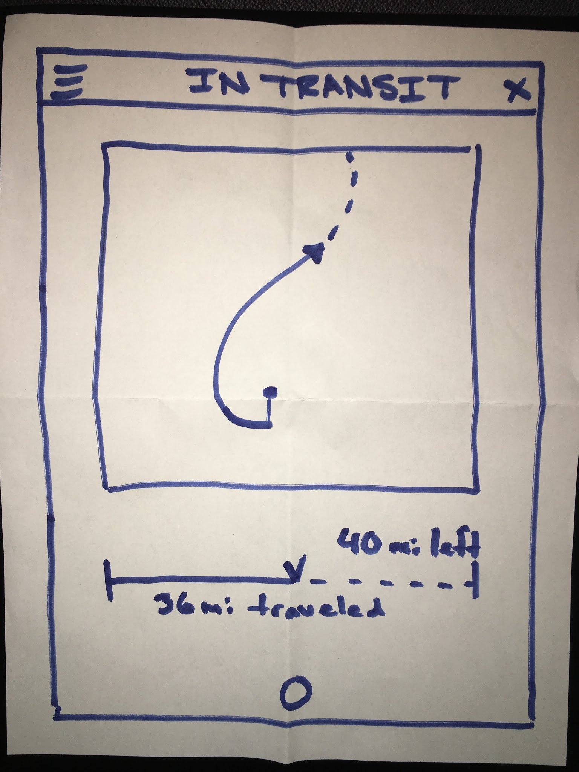
EP #1: Uber for Packages
Artifact #3

Slide 26
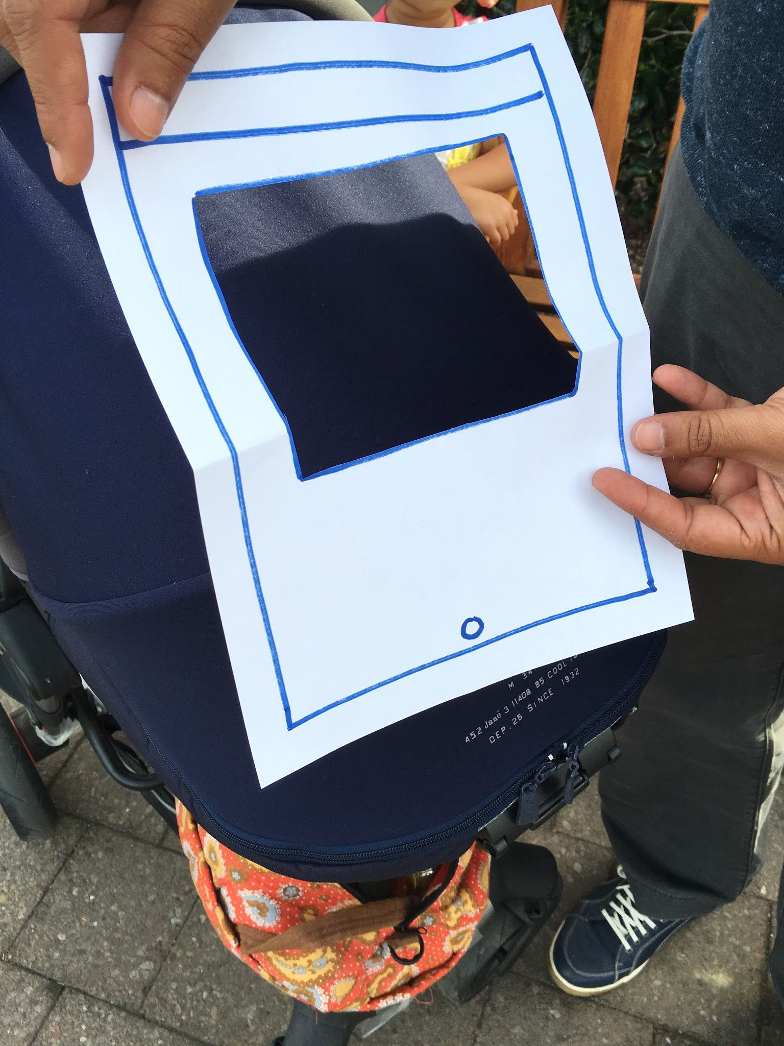
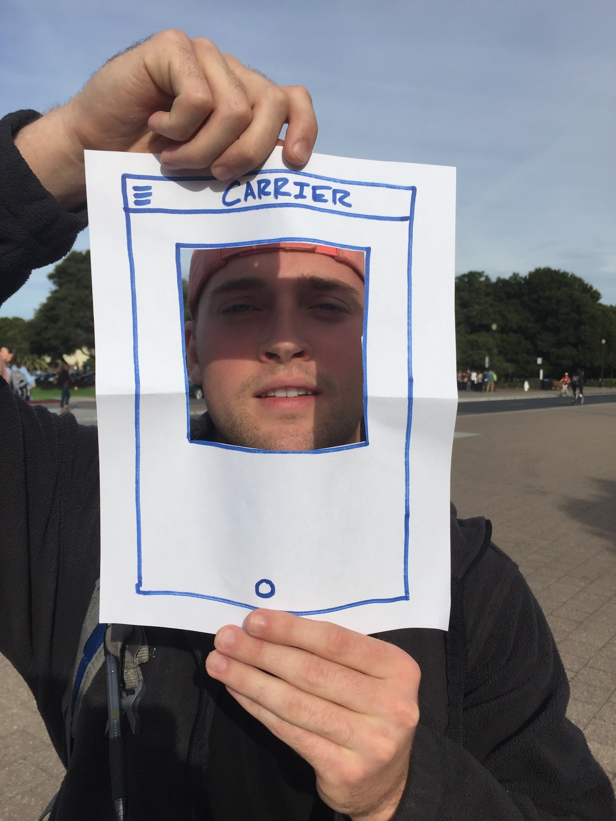
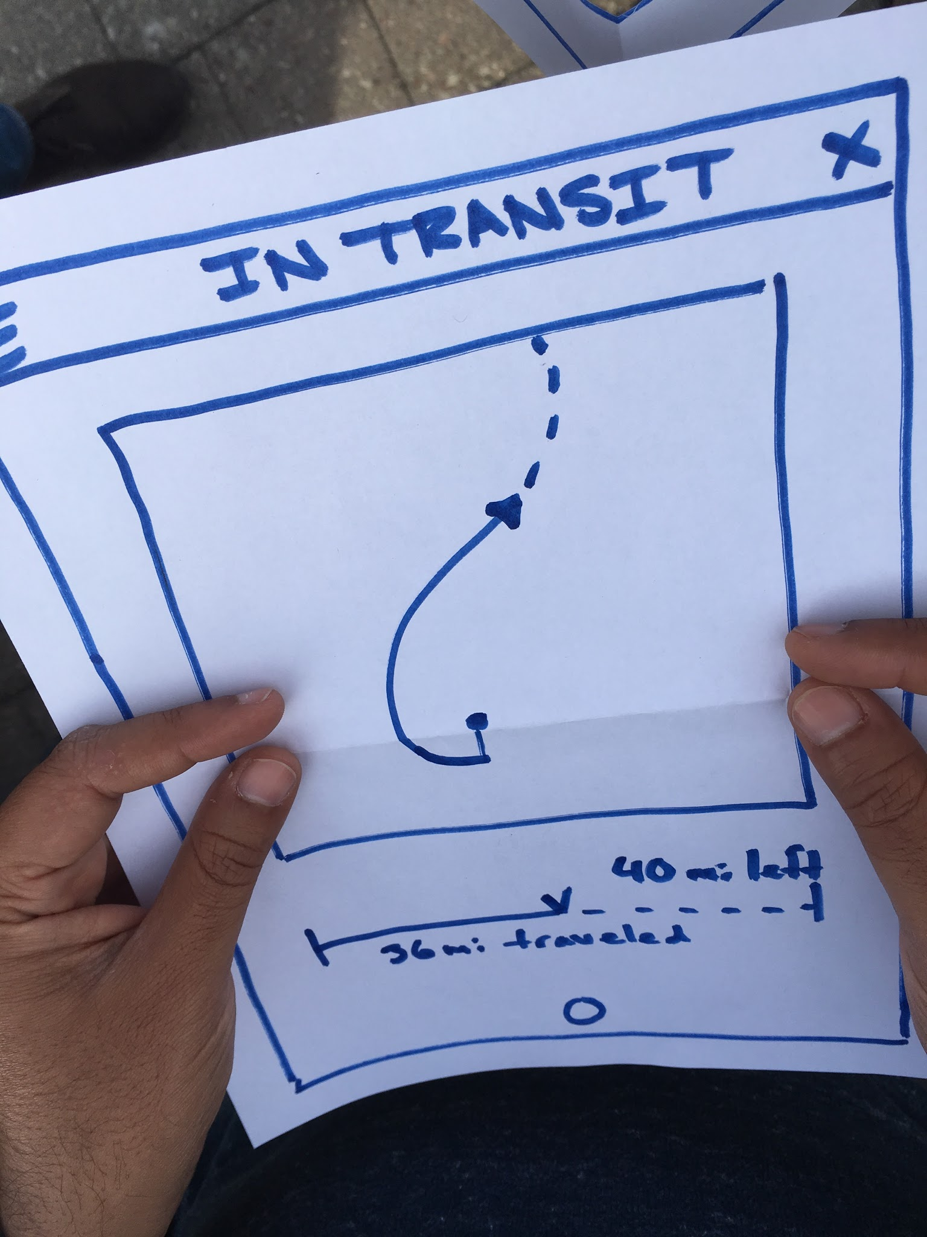
EP #1: Uber for Packages
Methods, Where, Who/Why
Testing

Slide 27
EP #1: Uber for Packages
What Went Well?
Tester liked carrier profiles/ratings

Slide 28
EP #1: Uber for Packages
What Went Well?
Tester liked carrier profiles/ratings
Not So Well?
Tester wanted to know the cost structure vs. UPS

Slide 29
EP #1: Uber for Packages
Surprises?
Tester would definitely use if cheaper than UPS

Slide 30
EP #1: Uber for Packages
Surprises?
Tester would definitely use if cheaper than UPS
New Learnings?
A package insurance protection policy would greatly increase Tester’s trust

Slide 31
EP #1: Uber for Packages
Validity?
Yes (if we prove cost benefit)
New assumption: Package insurance

Slide 32
EP #2: Bike Rewards
The Gist
Get rewards in exchange for commuting on your bike

Slide 33
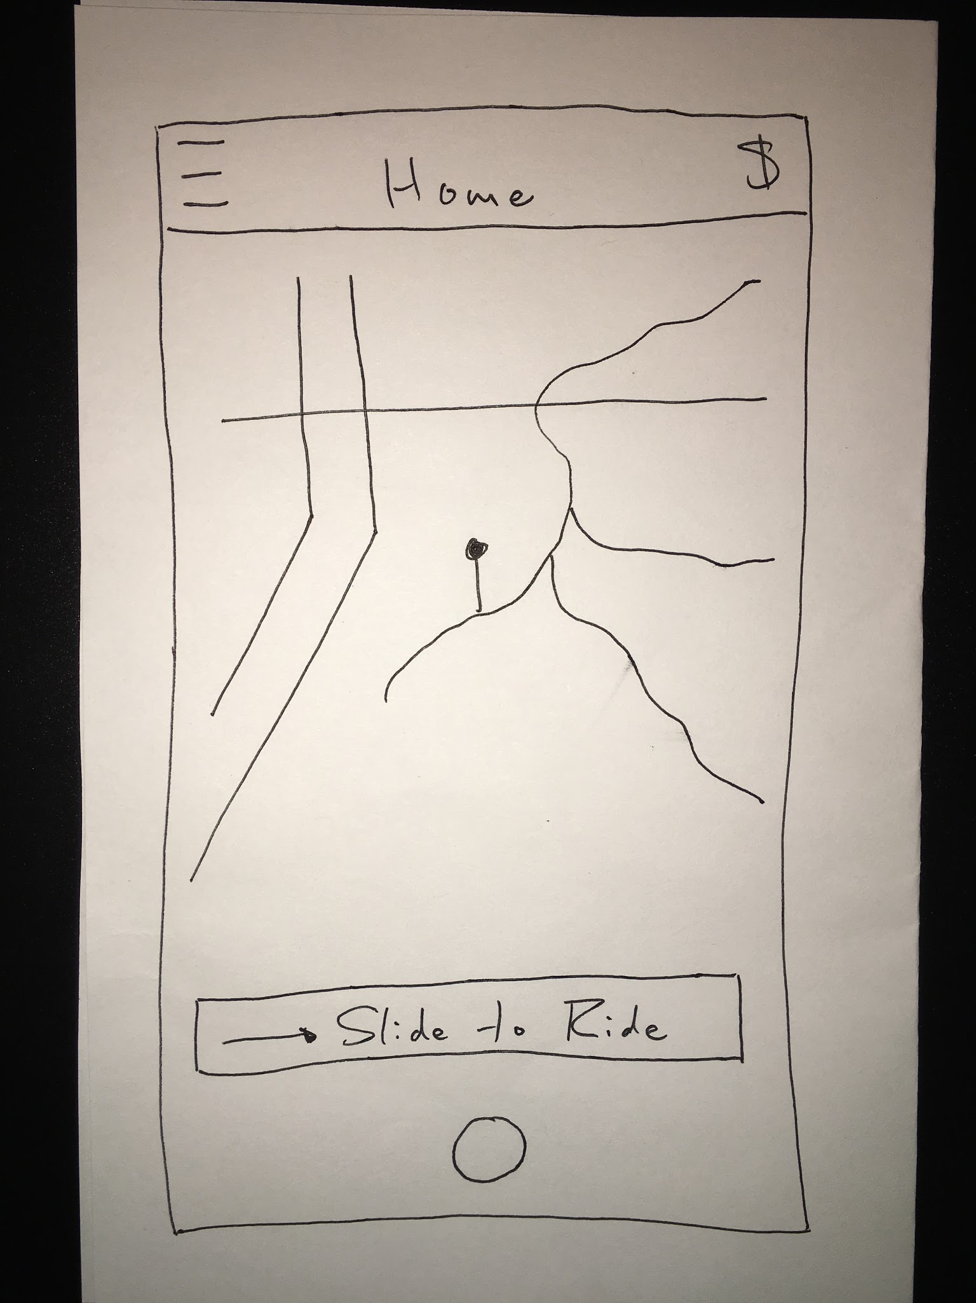
EP #2: Bike Rewards
Artifact #1

Slide 34
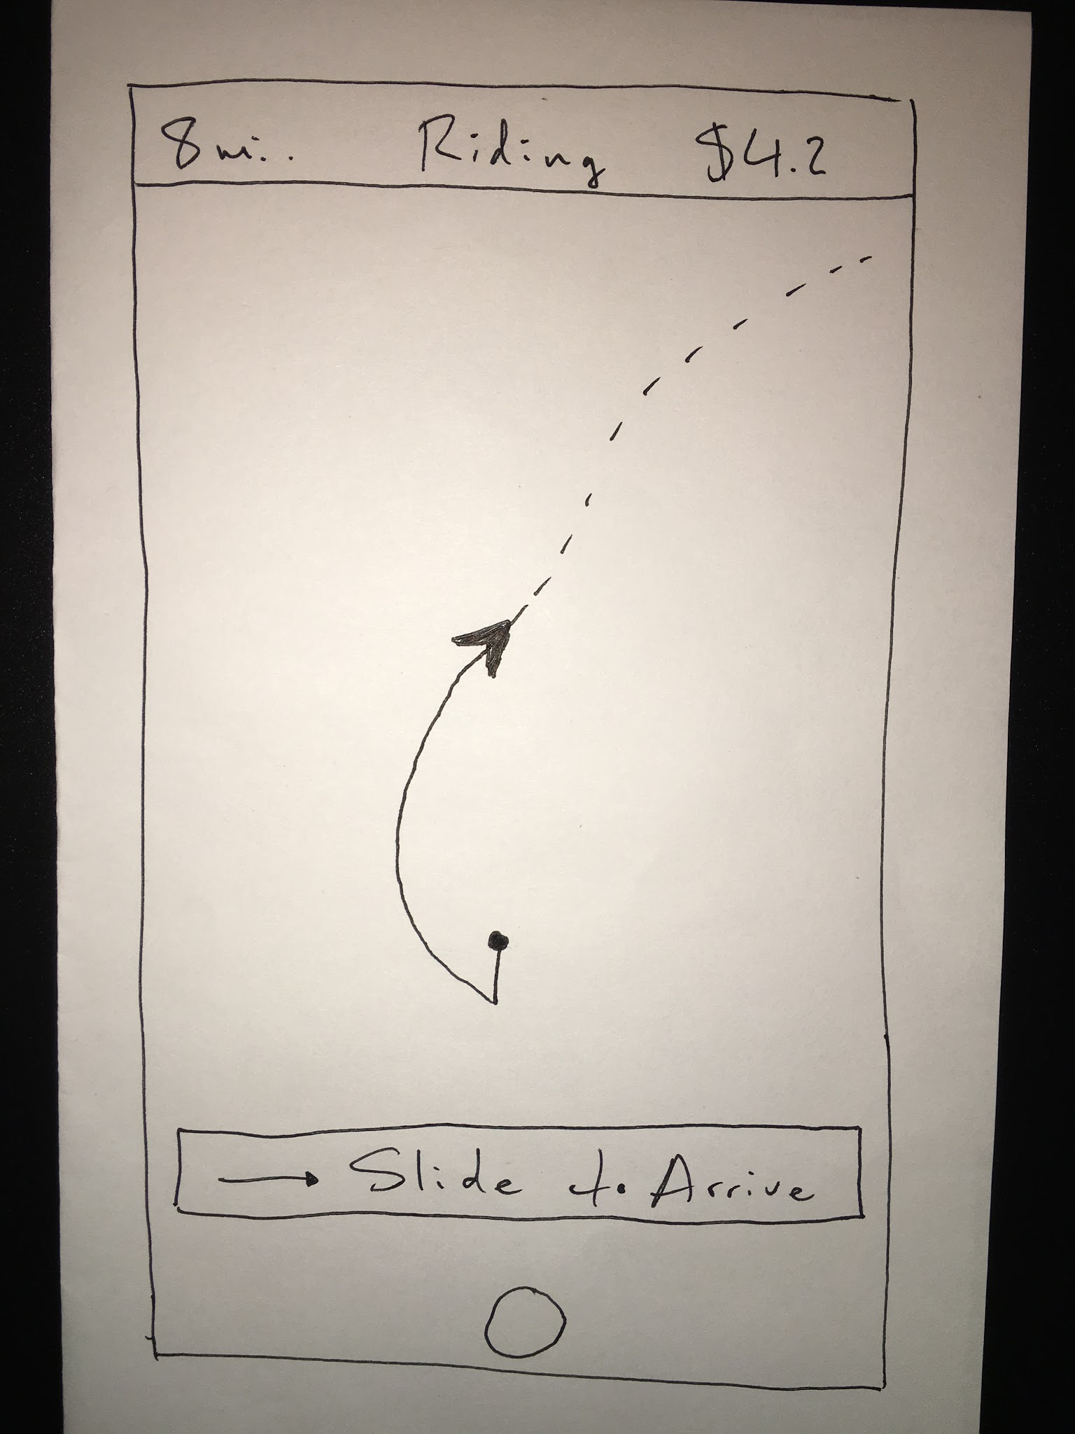
EP #2: Bike Rewards
Artifact #2

Slide 35
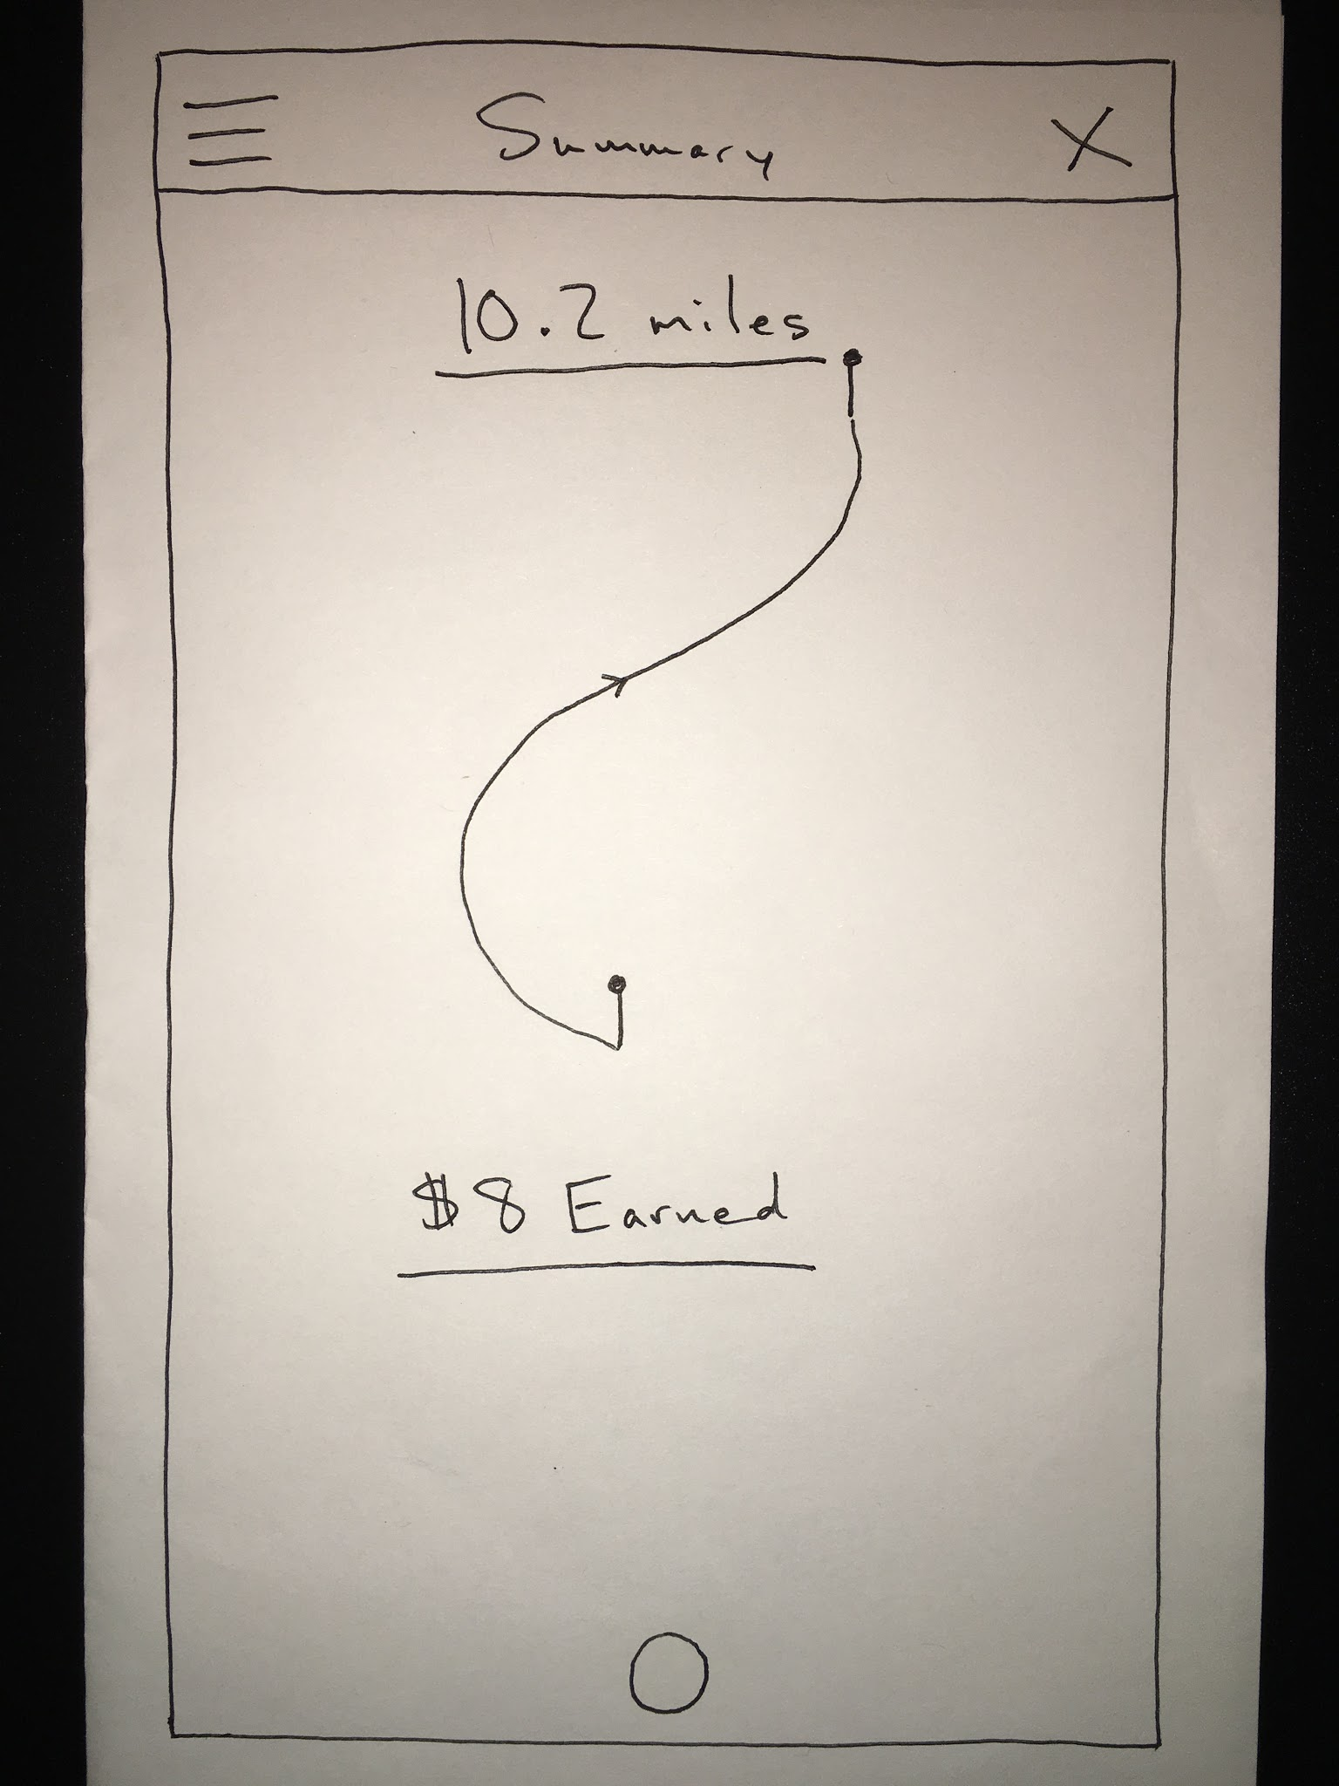
EP #2: Bike Rewards
Artifact #3

Slide 36
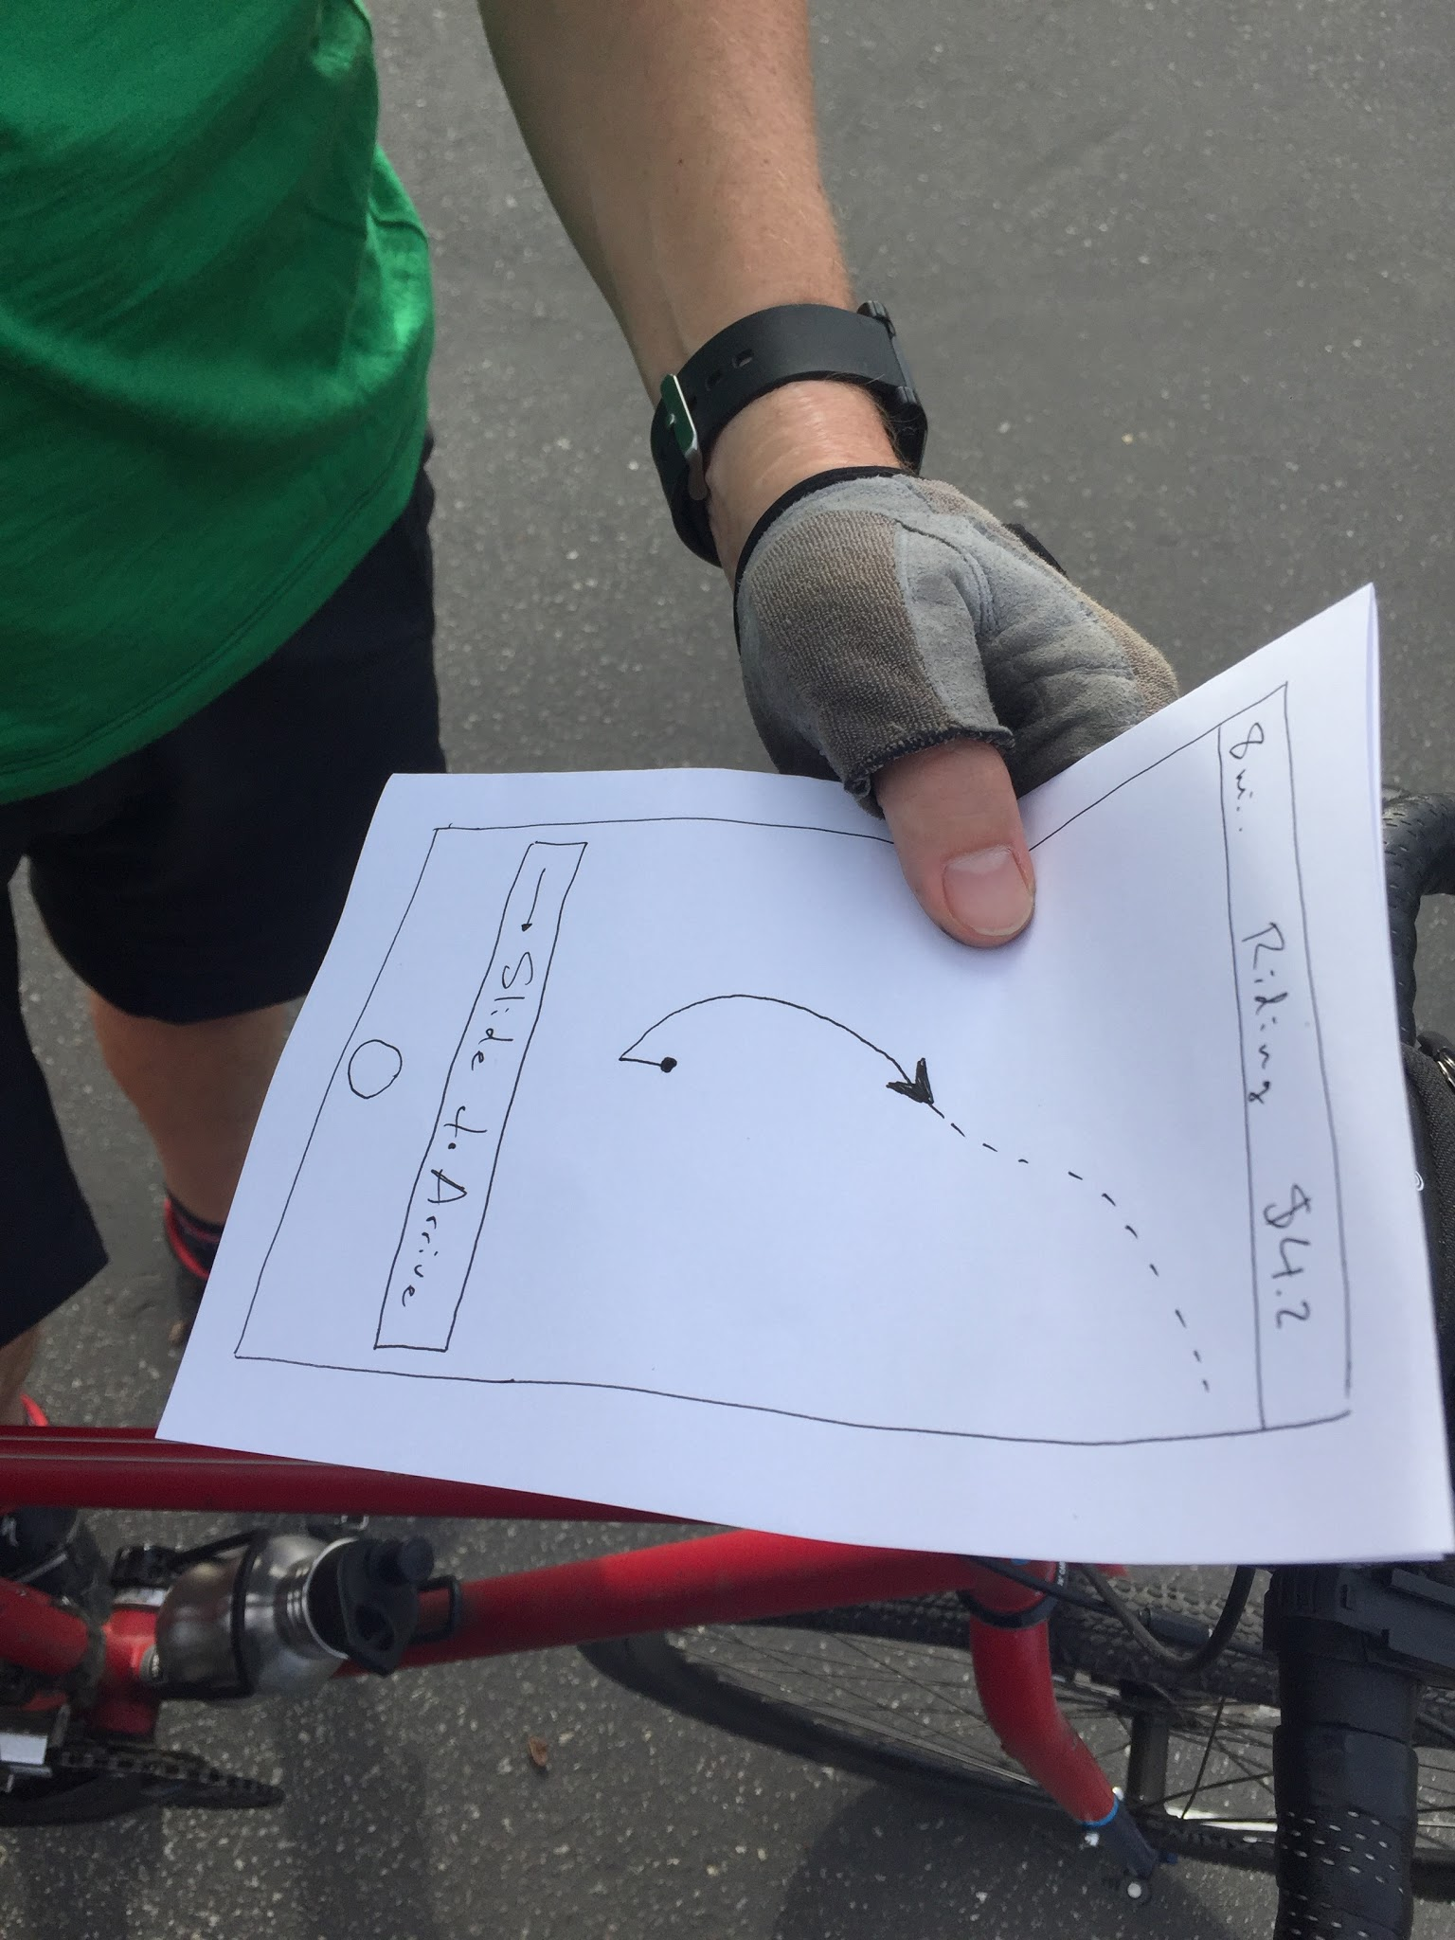
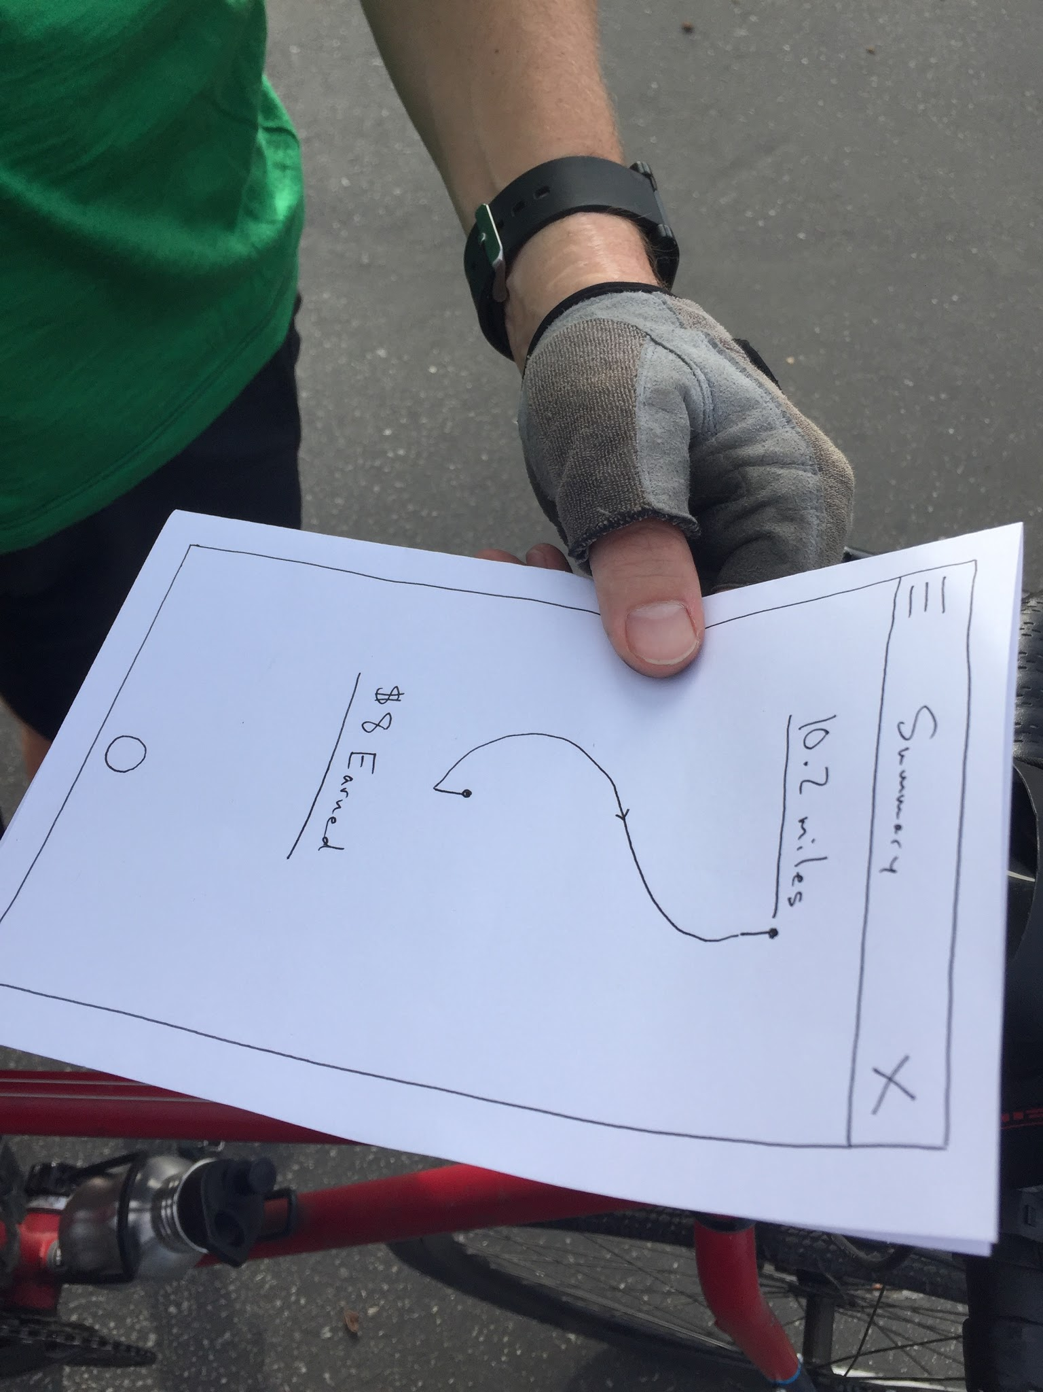
EP #2: Bike Rewards
Methods, Where, Who/Why
Testing

Slide 37
EP #2: Bike Rewards
What Went Well?
MapMyRide already has the infrastructure in place

Slide 38
EP #2: Bike Rewards
What Went Well?
MapMyRide already has the infrastructure in place
Not So Well?
Bike commutes aren’t feasible in some places

Slide 39
EP #2: Bike Rewards
Surprises?
Community Rewards

Slide 40
EP #2: Bike Rewards
Surprises?
Community Rewards
New Learnings?
Common commute big data

Slide 41
EP #2: Bike Rewards
Validity?
Yes (in some locations)
New Assumption: $ will incentivize?

Slide 42
EP #3: Virtual Travel Agent
The Gist
Organize group travel booking/payment and offer itinerary collaboration

Slide 43
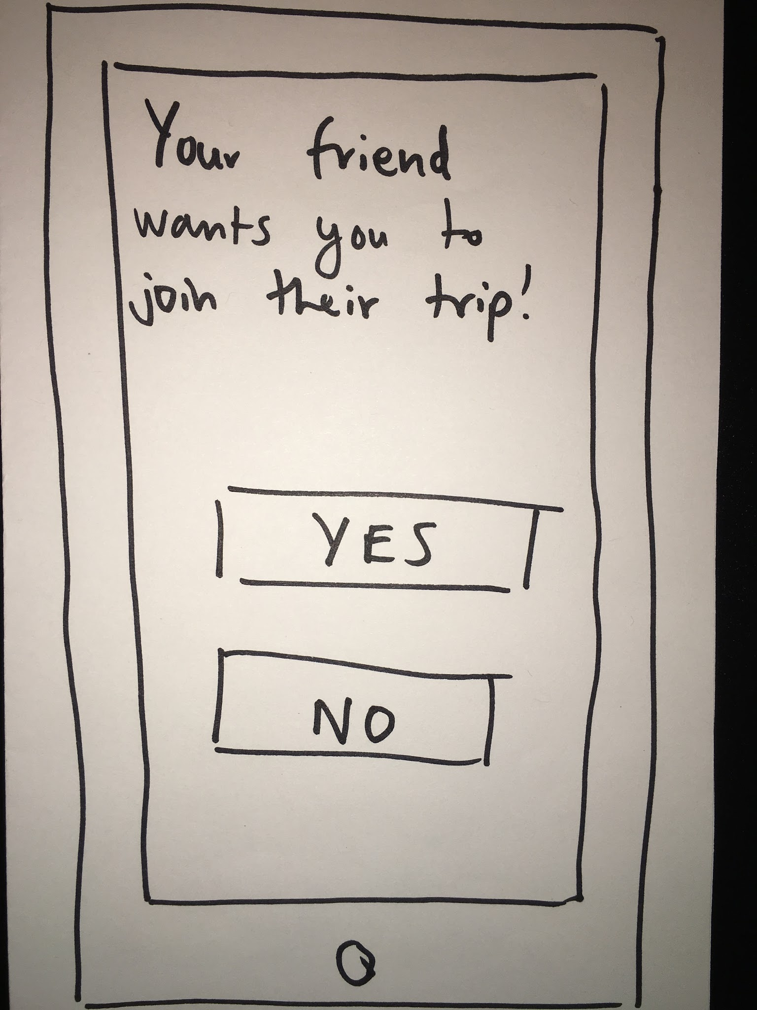
EP #3: Virtual Travel Agent
Artifact #1

Slide 44
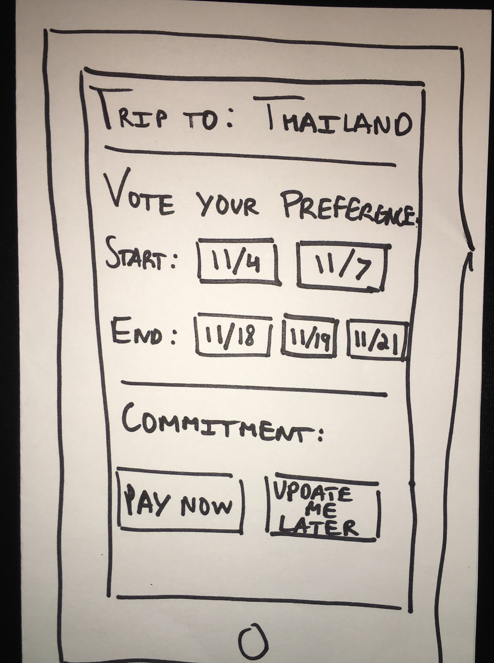
EP #3: Virtual Travel Agent
Artifact #2

Slide 45
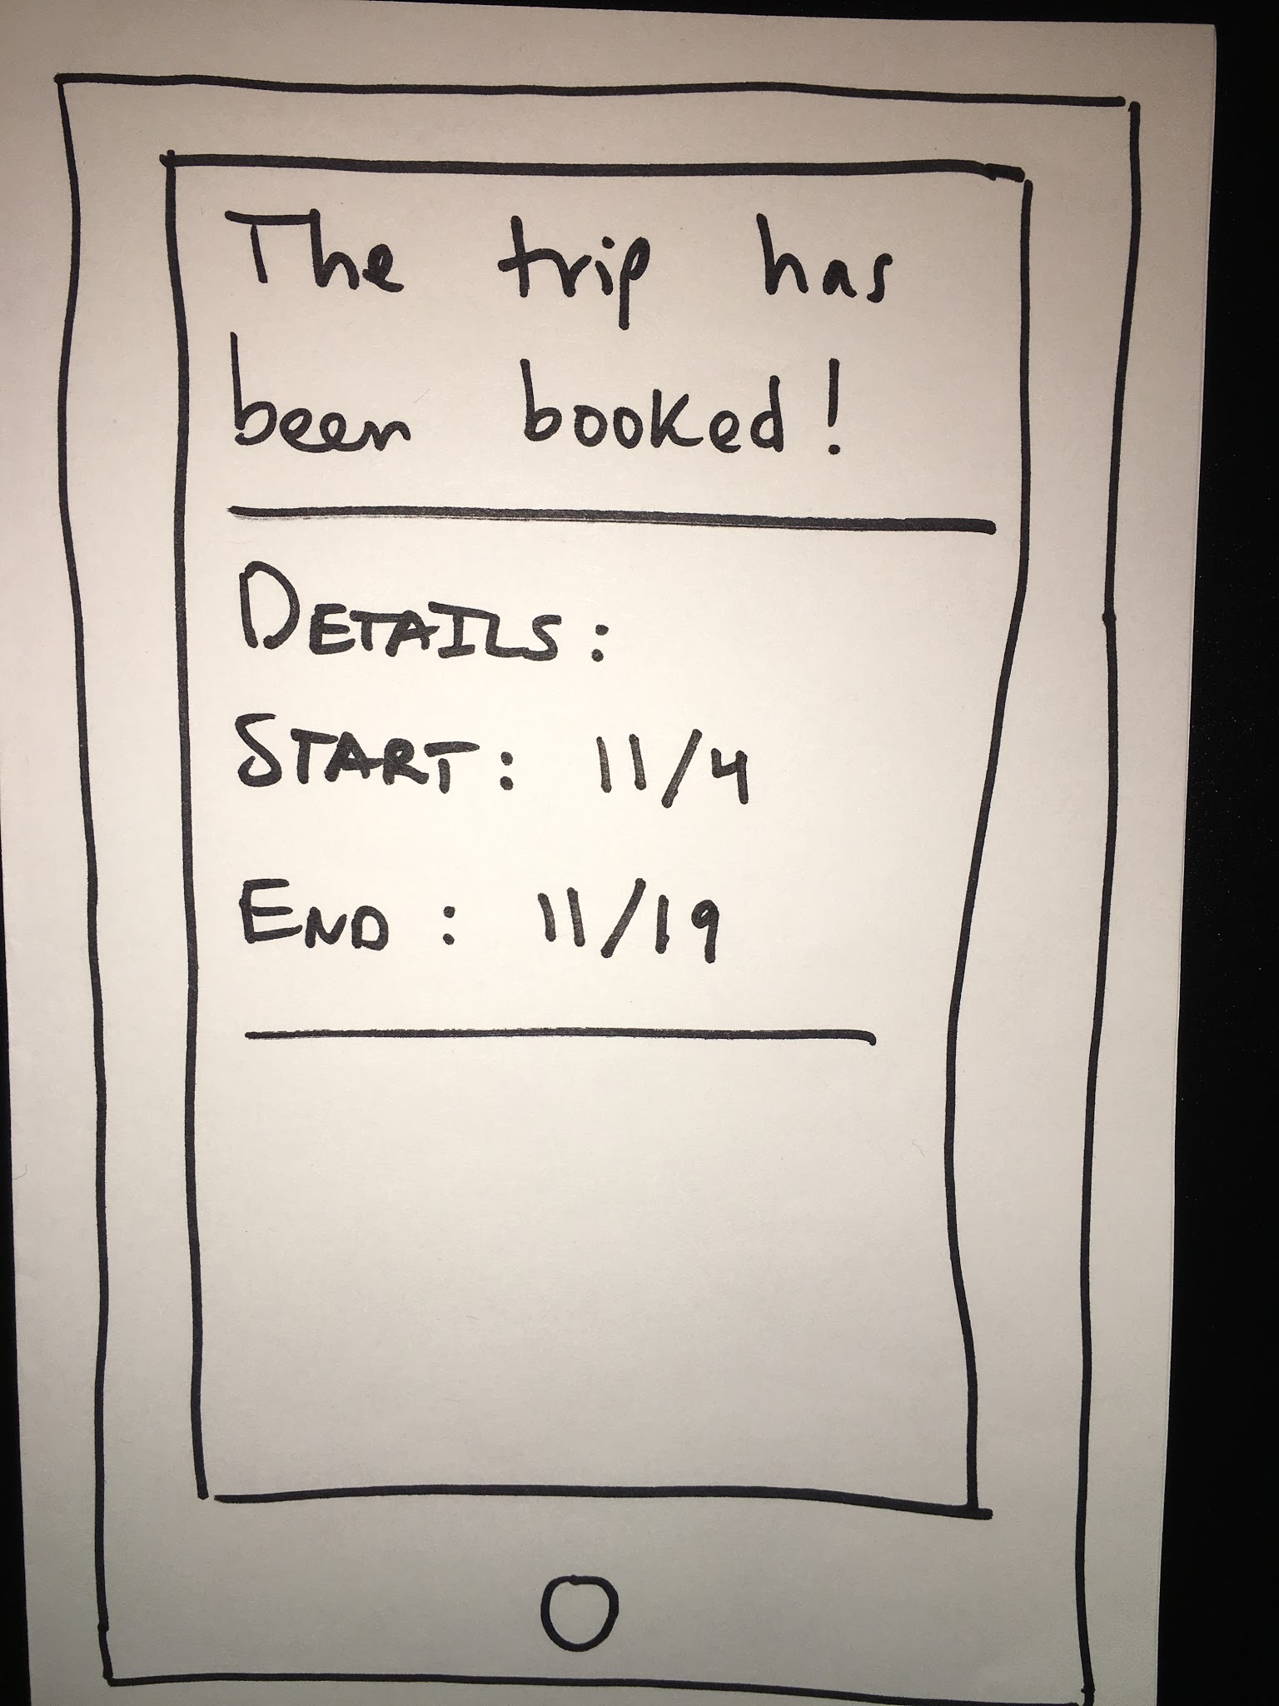
EP #3: Virtual Travel Agent
Artifact #3

Slide 46
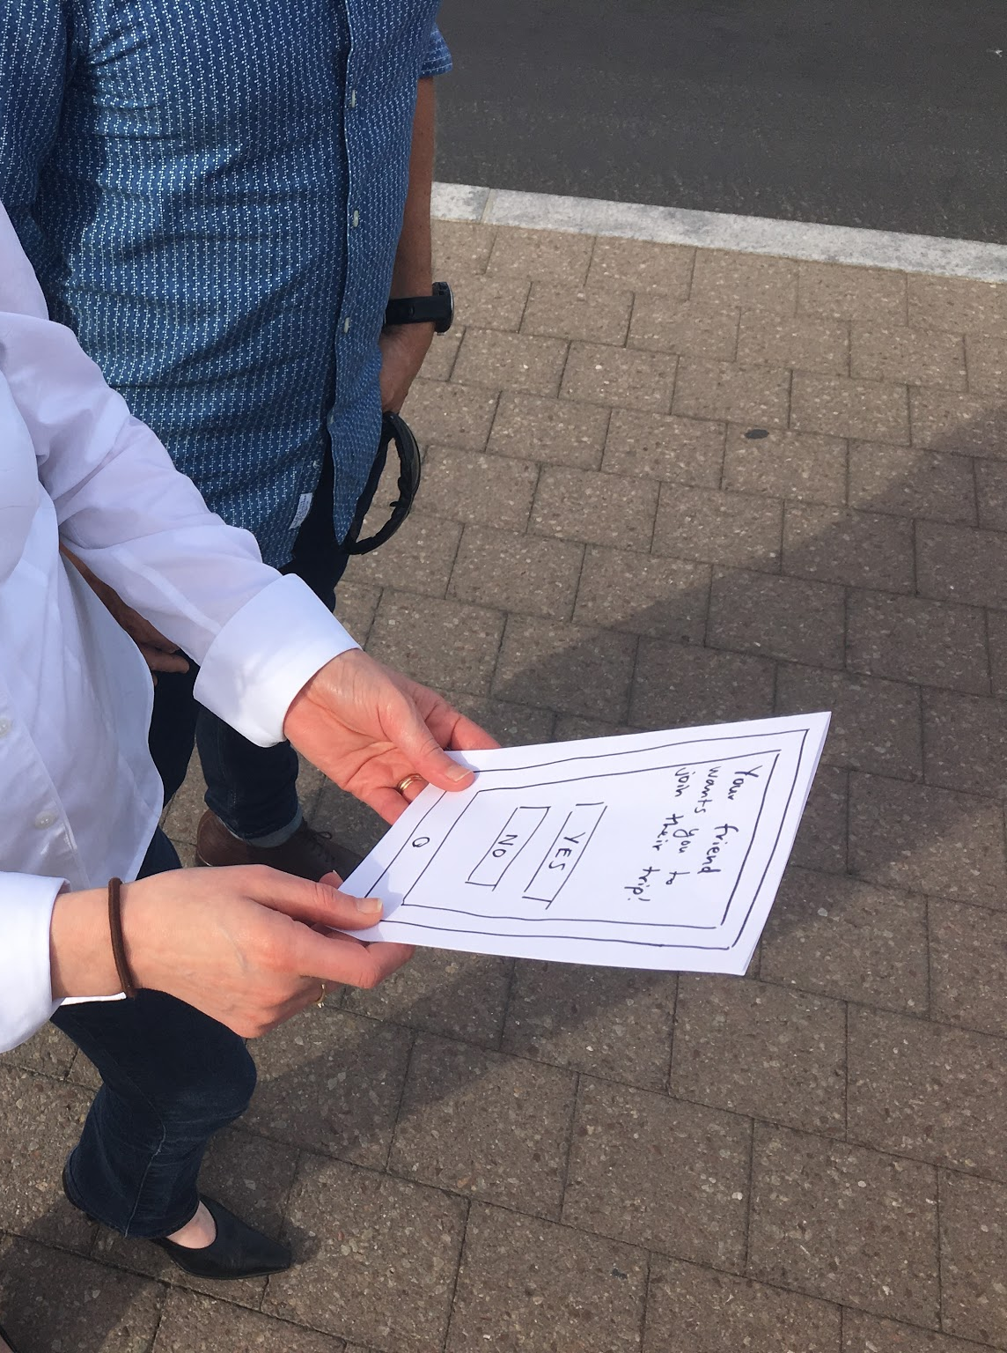
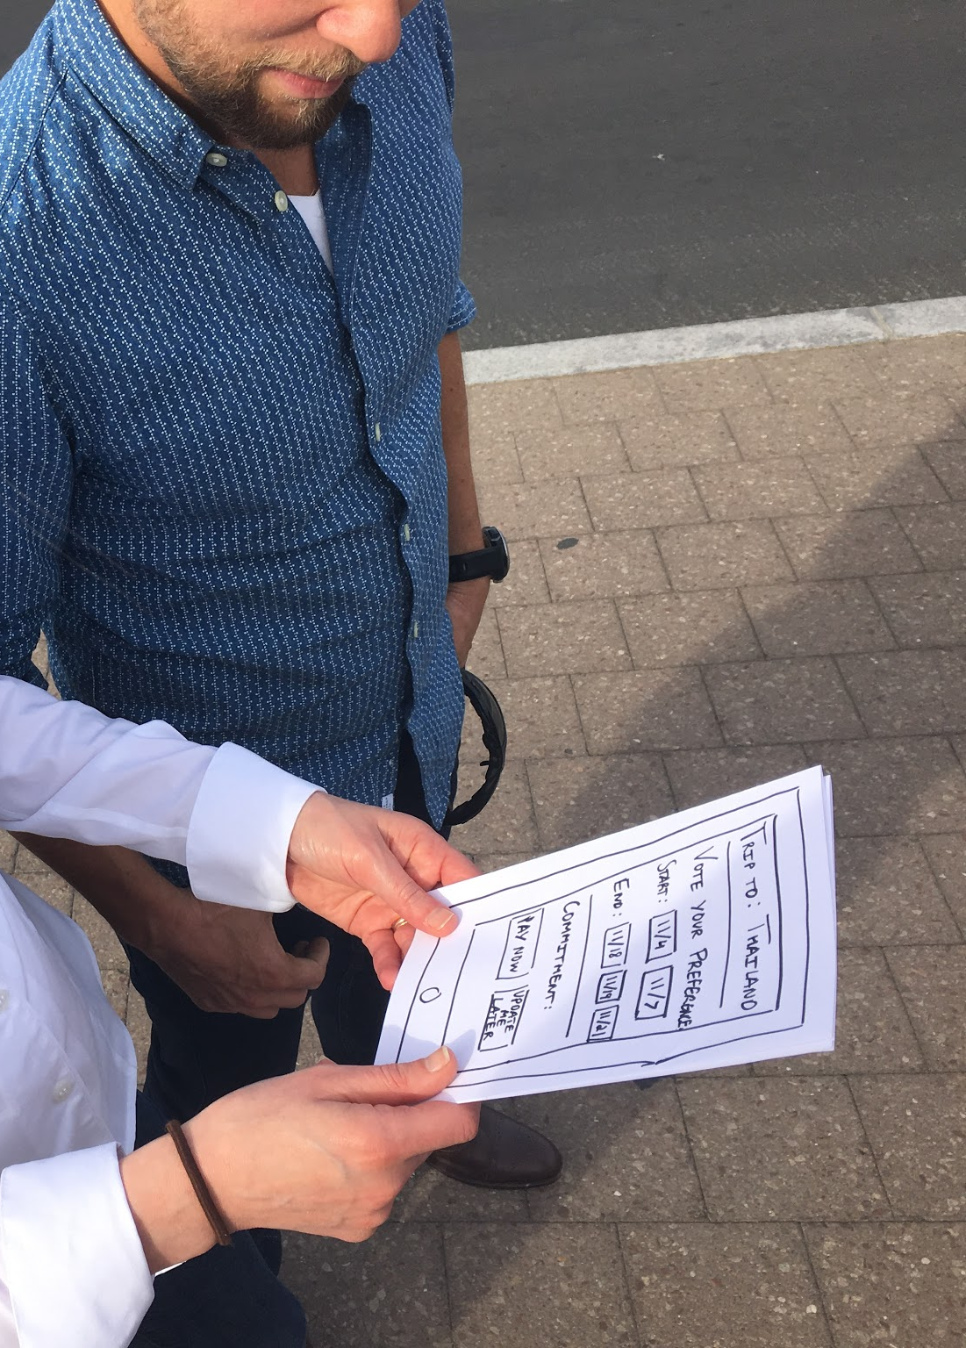
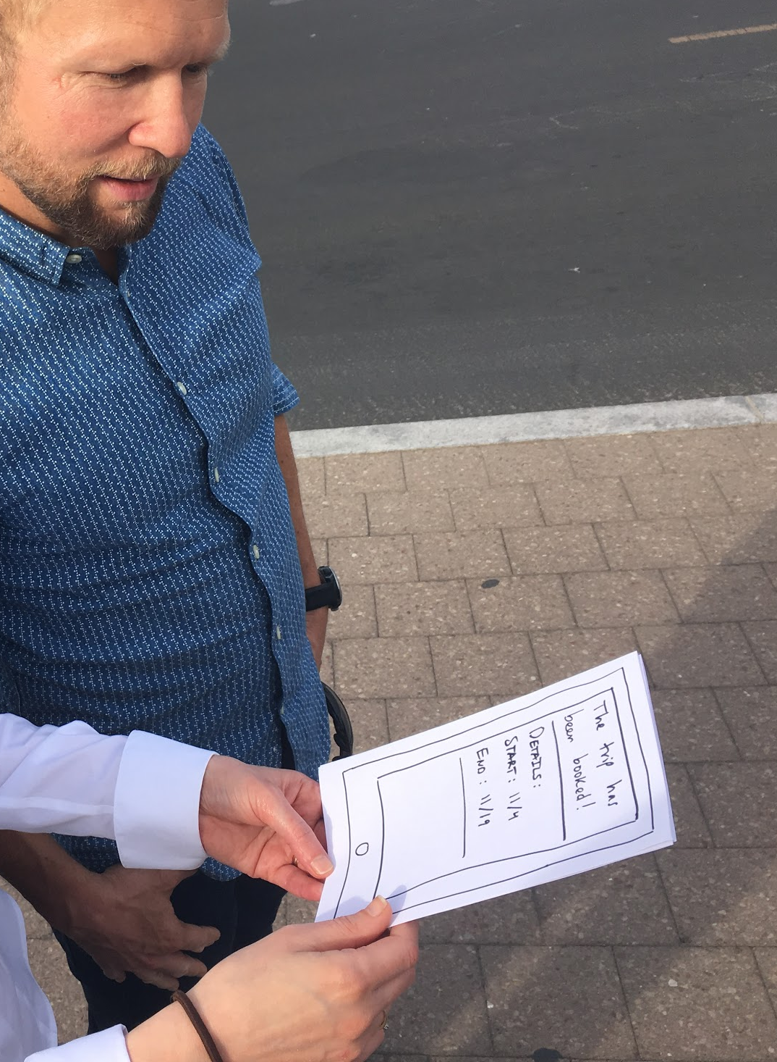
EP #3: Virtual Travel Agent
Methods, Where, Who/Why
Testing

Slide 47
EP #3: Virtual Travel Agent
What Went Well?
Voting for preferences (dates and other pieces)
Notes:
They liked voting for a preference - was a pain point for them - voting for prefs was way better than messaging back and forth
Re “pay now” - what if the trip isn’t what i like or the dates that are most popular don’t work for me - can it be “pay later” or “ready to pay”
More details - wanted to see hotels, what activities they could do, pictures of what is possible, etc --- neeed to show the itinerary

Slide 48
EP #3: Virtual Travel Agent
What Went Well?
Voting for preferences (dates and other pieces)
Not So Well?
“Pay Now” - what if I don’t like trip voted #1?
Wanted more itinerary details
Notes:
They liked voting for a preference - was a pain point for them - voting for prefs was way better than messaging back and forth
Re “pay now” - what if the trip isn’t what i like or the dates that are most popular don’t work for me - can it be “pay later” or “ready to pay”
More details - wanted to see hotels, what activities they could do, pictures of what is possible, etc --- neeed to show the itinerary

Slide 49
EP #3: Virtual Travel Agent
Surprises?
Wanted to use for their company
Notes:
Wanted to use for their company - each person always has different dates - this would be great for managing that (e.g., i can arrive thurs, i arrive fri - esp for longer intl trips)

Slide 50
EP #3: Virtual Travel Agent
Surprises?
Wanted to use for their company
New Learnings?
Details of itinerary must be present
Notes:
Wanted to use for their company - each person always has different dates - this would be great for managing that (e.g., i can arrive thurs, i arrive fri - esp for longer intl trips)

Slide 51
EP #3: Virtual Travel Agent
Validity?
Yes! Group coordination clear pain point - but need more detail on trip!

Slide 52
Thanks For Listening

