Slide 1
POVs and Experience Prototypes
Amy Bearman, Kevin Coelho, Hieu Minh Pham

Slide 2
Problem Domain
Music Creation
&
Composition

Slide 3
Initial POV
Music is hard.
We want to make music easier.

Slide 4
Last week..
Julio felt embarrassed & not confident about his music skills
Mike doesn’t have time to invest in learning music
Michael doesn’t have resources to take his music to the next level

Slide 5
Extreme Users
Additional
Needfinding

Slide 6
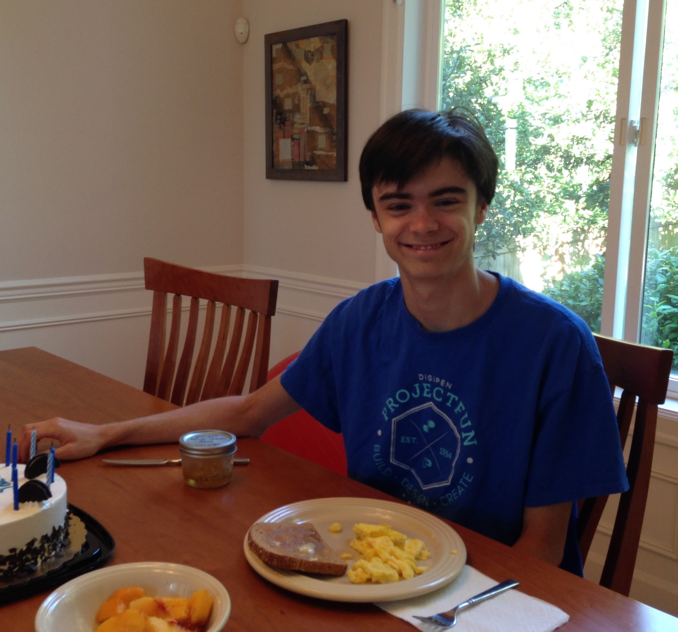
Jacob
17 y/old high school student
Loves video games and “vocaloid” music
On the autism spectrum and has ADHD
Tried to teach himself piano

Slide 7
Jacob’s Thoughts
Reading sheet music is hard, so are many apps.
“I was intimidated by the 88 keys on the piano until I realized that they repeat.”
Video games for music are not challenging enough. Less fun, more learning.
“High skill gap” from starting on music to continuing in music.

Slide 8
Jacob needs a way to learn music that is the right balance between fun and learning

Slide 9
Malcolm Campbell
Harvard / NEC
PhD in Neuroscience
Performed at Carnegie Hall, Montreux Jazz Festival

Slide 10
Malcolm’s Process
Gets peer reviews
Prefers composing away from piano
Doesn’t need playback software
Tends to overwork things

Slide 11
Malcolm needs an on-the-go tool to quickly jot down musical ideas.

Slide 12
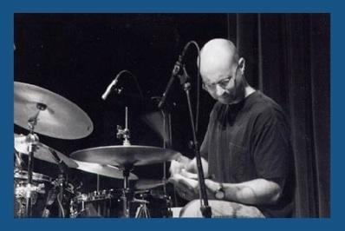
Jason Lewis
BA in music from SJSU
30+ years performance experience in Bay Area
Godfather 2 videogame, Ratatoille

Slide 13
Jason’s Process
Starts with strong idea / motif
Collaboration is important
Composition is a long process
Software playback is very important

Slide 14
Jason needs to accurately and quickly transcribe and play back his musical ideas.

Slide 15
Davorious Branimirius
Degrees in composition: BA from Graz, MA from Stuttgart, DMA @ Stanford
Studied with famous composers
Professional composer

Slide 16
Davorious’ Process
Takes inspiration from nature & objects
Methodically charts ideas into structures
Translating ideas into specific notes is frustrating
Collaboration is important

Slide 17
Davorious needs a tool to translate theoretical ideas into musical notation

Slide 18
How might we..
How might we build a tool for composers to record their ideas?
How might we make playing music easy and fun?
How might we visualize music other than traditional staff and notes?

Slide 19
Experience
Prototypes

Slide 20
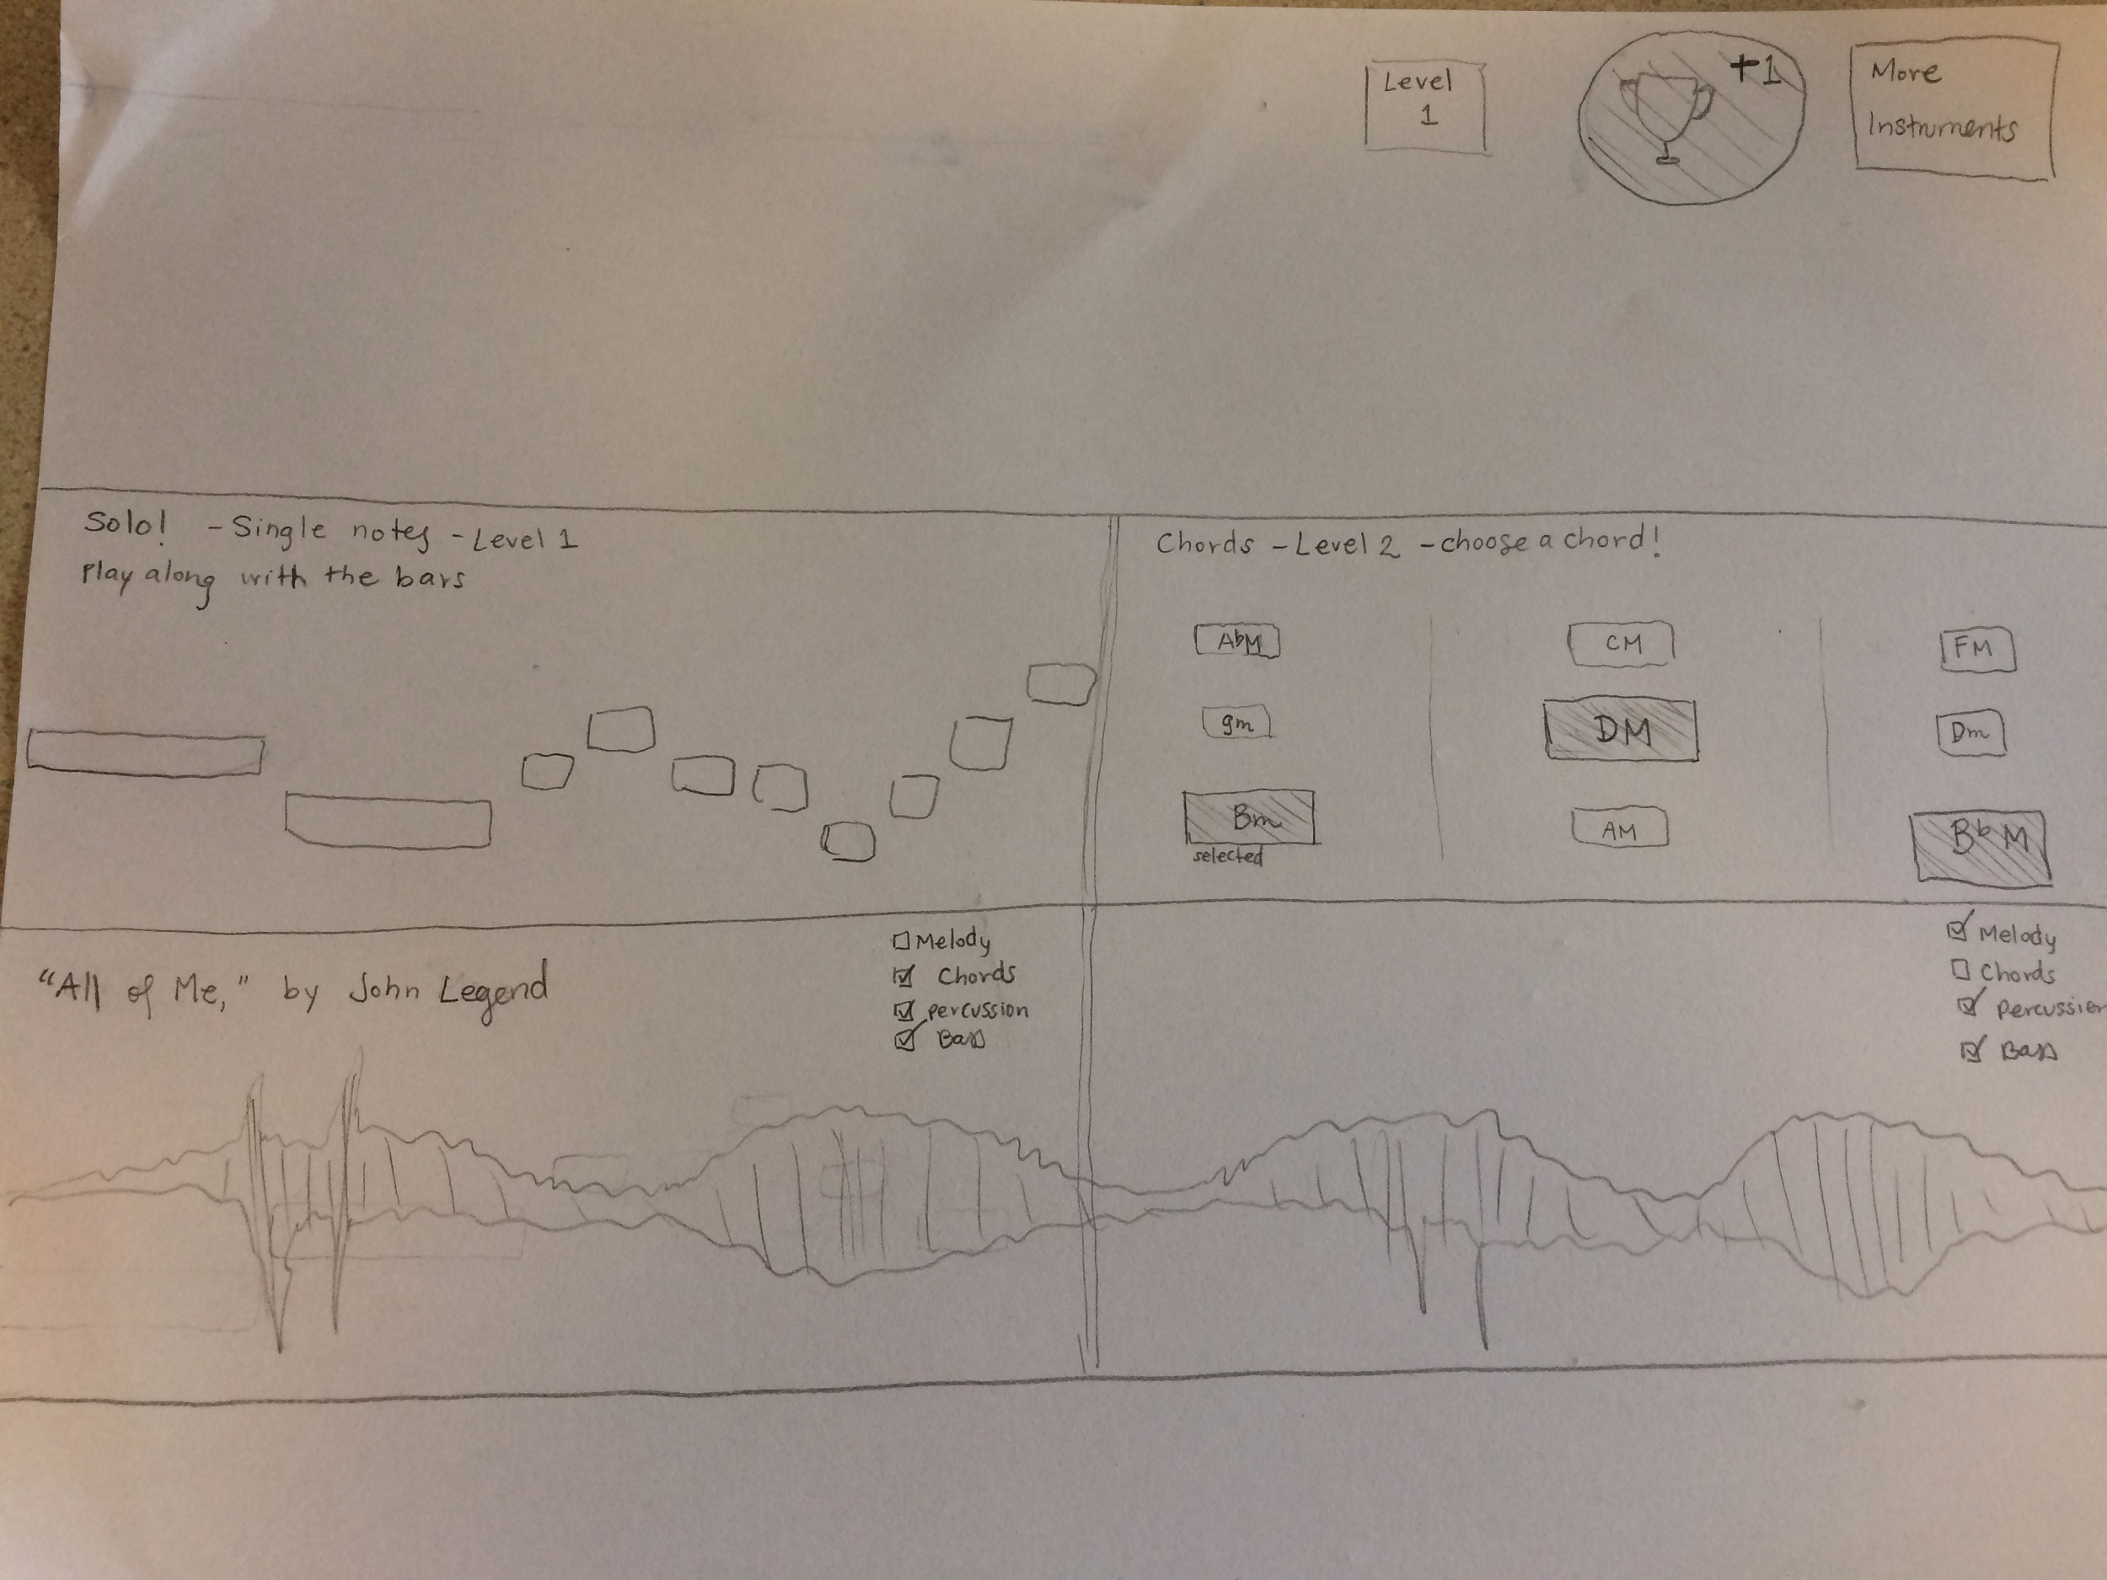
Prototype 1
Jacob needs a way to learn music that is the right balance between fun and learning

Slide 21
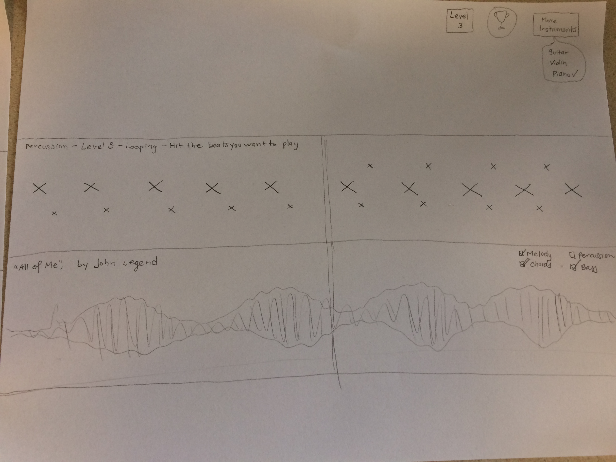

Slide 22
First level intuitive, people know Guitar Hero
Music symbols are confusing (chords + noteheads)
Color coding is good (like same notes in different octaves)
Assumption: prototype will help people learn music, valid: sort of
Skills may not transfer to real instruments, it’s still a game

Slide 23
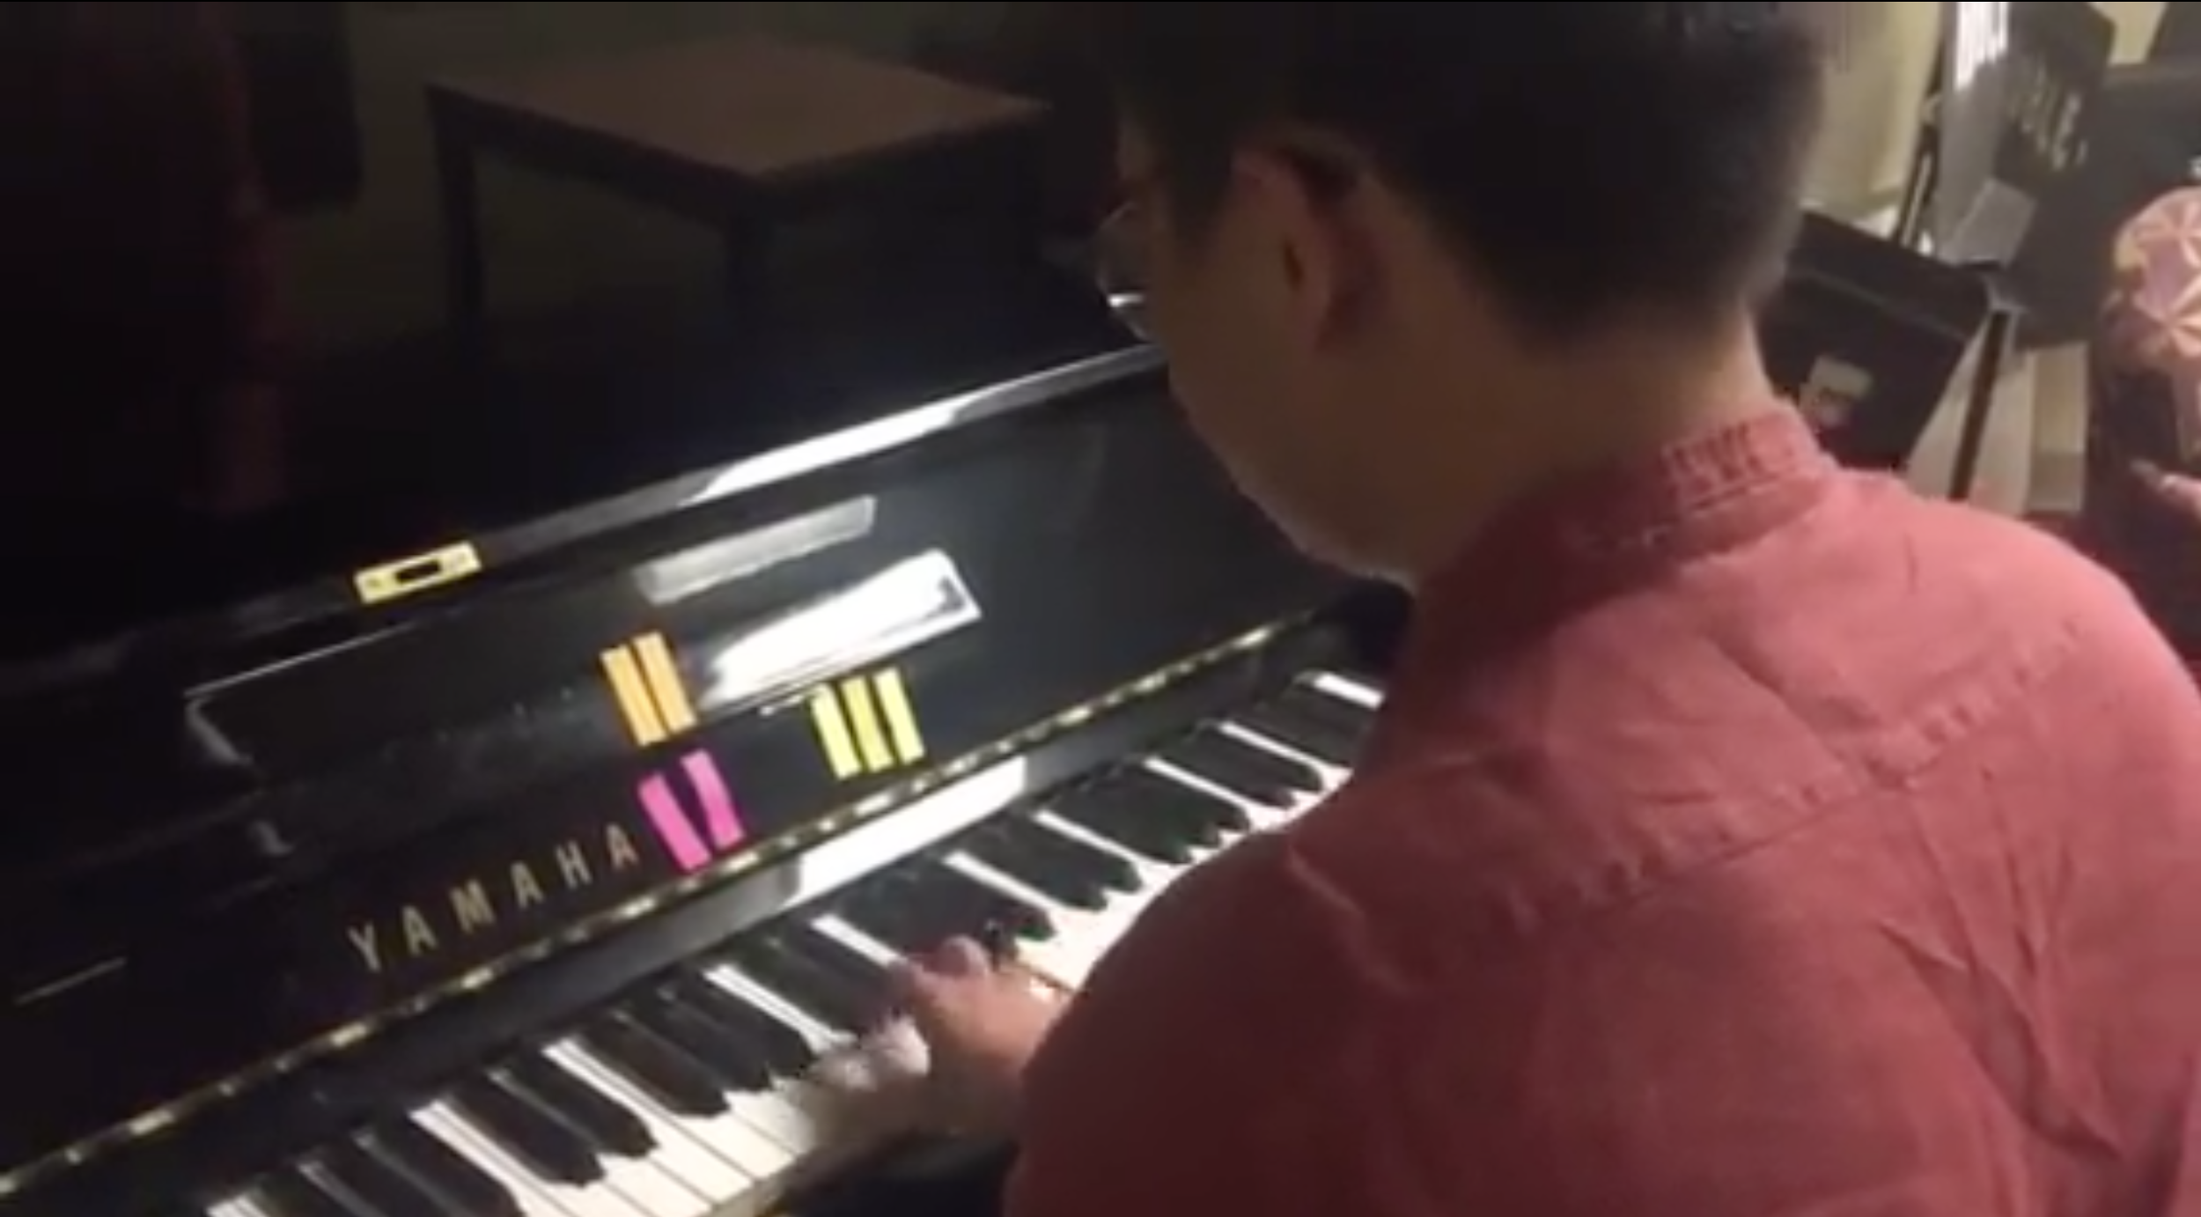
Prototype 2: AR Interface for playing music
Mike needs an easy and quick way to learn music.
Next notes
(Orange) - 2nd priority
The following notes (Green) - 3rd priority
Current notes
(Red)

Slide 24
Color coding helps recognize keys
Musician prefers sheet music, color blocks are slow. Not a serious tool.
Fun to do (like guitar hero / tap tap)
Assumption: fun and easy to learn basic notes, valid.
Assumption: useful for musicians, invalid.

Slide 25
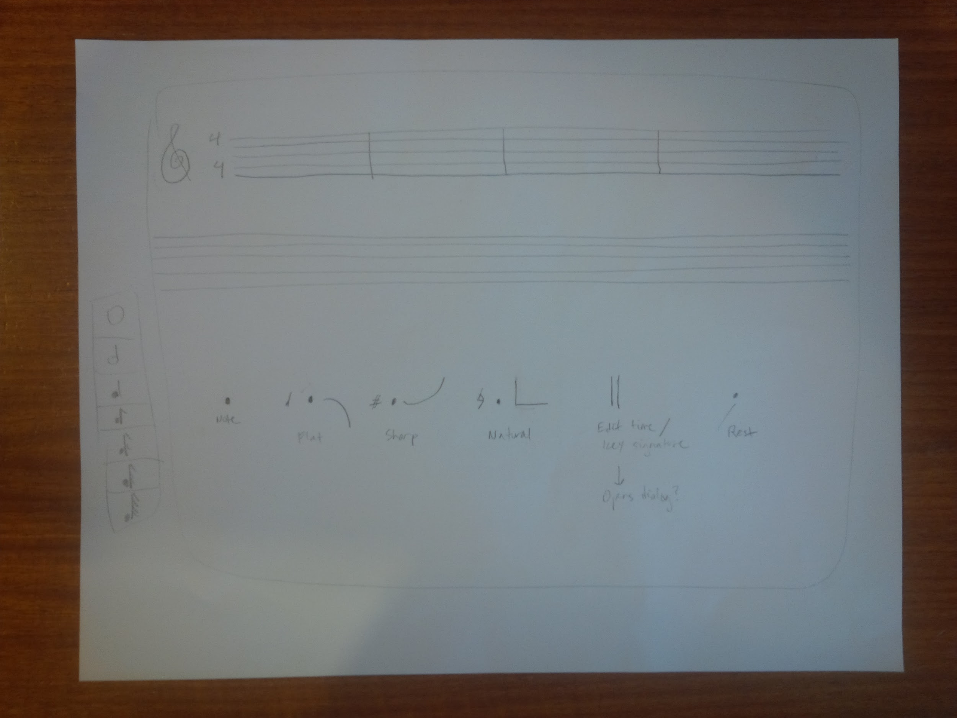
Prototype 3
Malcolm needs an on-the-go tool to quickly jot down musical ideas.

Slide 26
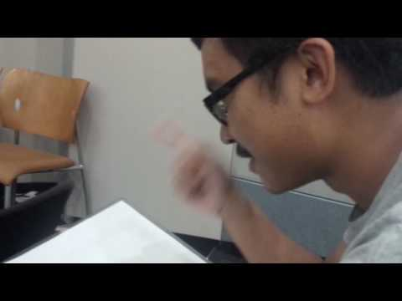

Slide 27
Very positive feedback about gestures
Needs a playback option
Will be difficult to implement larger scores / arrangements
Assumption: great for on-the-go ideas, valid.
Assumption: good for other things, invalid.

