Slide 1
Medium-Fi Prototype
Amy Bearman, Kevin Coelho, Hieu Minh Pham

Slide 2
Roadmap
Mission Statement & Value Proposition
Tasks
Revised Interface Design
UI Changes
Medium-Fi Task Flows
Prototype Overview

Slide 3
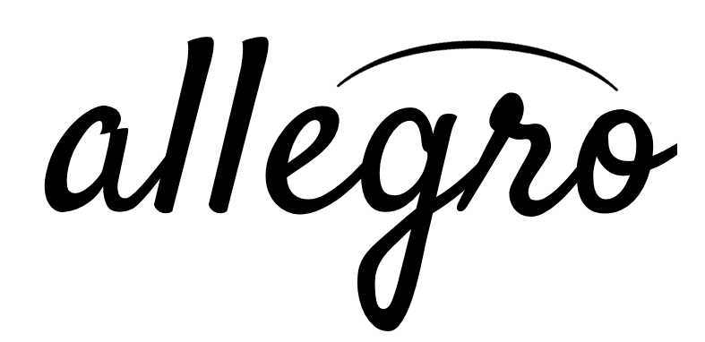
Compose anywhere.

Slide 4
1.
Value Proposition
Allegro is a music creation and composition app for professional composers and musicians. It provides a quick, easy, and on-the-go way for composers to jot down their ideas and transcribe them to a musical score.

Slide 5
2.
Tasks
Compose
Arrange
Share

Slide 6
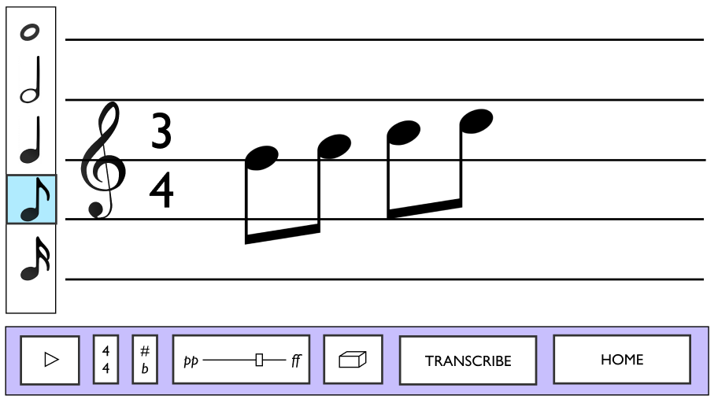
Compose [complex]
Create notes and chords using simple, intuitive gestures

Slide 7
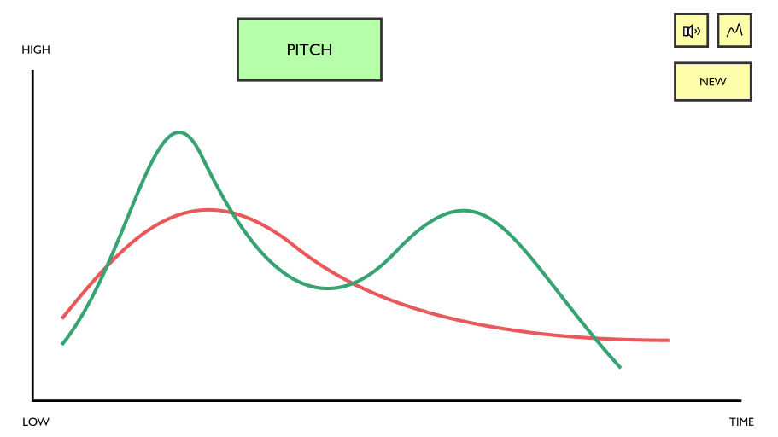
Arrange [medium]
Combine multiple ideas and instruments into a single composition

Slide 8
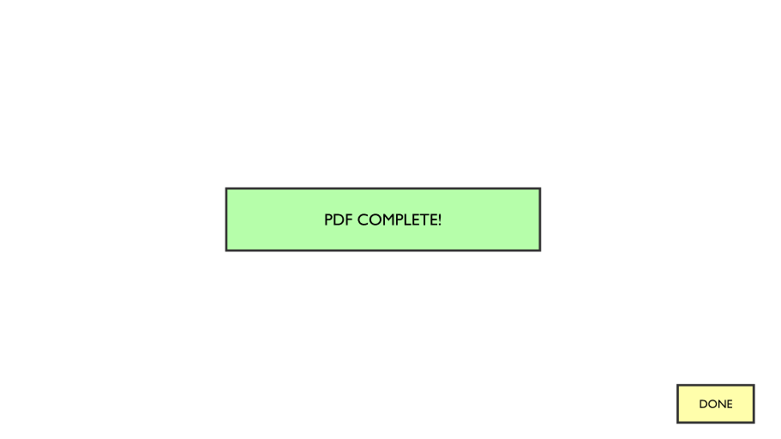
Transcribe [simple]
Transcribe the composition to a PDF score to give to a musician

Slide 9
3.
Revised Interface Design
UI Changes

Slide 10
Change #1: Improve intuitiveness of musical interface
Remove “new measure” button: measures are added automatically
Redesign “add key signature” screen

Slide 11
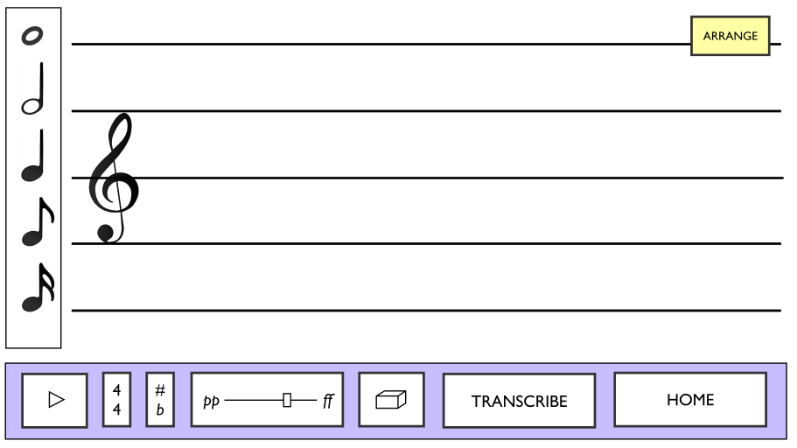
Remove “new measure” button
Before
After

Slide 12
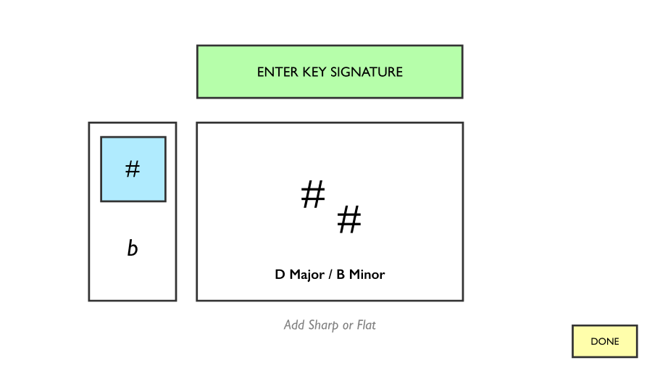
Redesign “add key signature” screen
Before
After

Slide 13
Change #2: Improve navigability
Added a home screen and instructions
Improved flow between “new composition” and “arrange”
Clicking “transcribe” results in a “completion” pop-up message

Slide 14
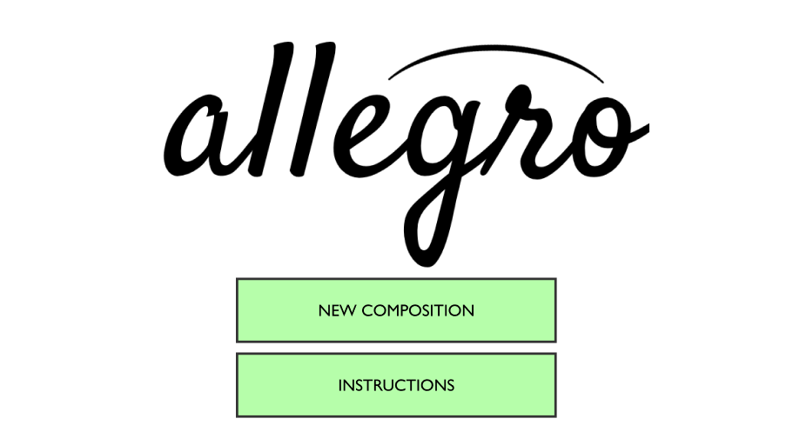
Add home screen & instructions
Before
After

Slide 15
Improve flow between “compose” and “arrange”
Before
After

Slide 16
Completion message after clicking “transcribe”
Before
After

Slide 17
Change #3: Add chord annotations
Before: chord dialogue box inserts an entire chord
Ambiguities:
Is the chord in close or open position?
Where is the root tone?
What duration is it?
Solution: chord dialogue just adds Jazz annotations. User can draw chord manually
We also allow user to draw multiple tones at a time

Slide 18
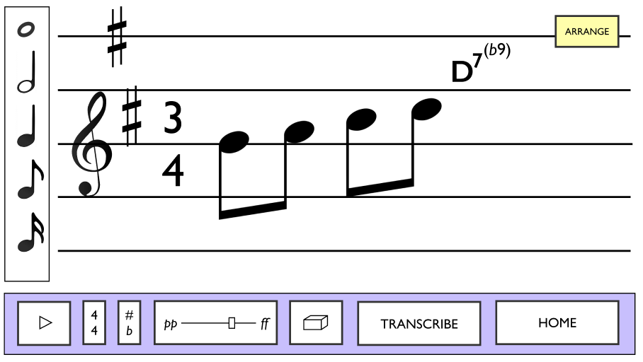
Redesign “add chord” dialogue
Before
After

Slide 19
3.
Revised Interface Design
Medium-Fi Task Flows

Slide 20
Compose [complex]

Slide 22
Arrange [medium]

Slide 25
Transcribe [simple]

Slide 27
4.
Prototype Overview

Slide 28
Tools, Limitations, and Tradeoffs
Figma to create individual screens
Collaborative; easy to work together
Had to create many duplicate screens to show transitions
Marvel to animate the demo
Made the app feel more real
Easy to use
Limited support for different gestures
We couldn’t implement certain iOS UI features, such as tickers and sliders

Slide 29
“Wizard of Oz” Techniques
You can’t really create a new composition; there are pre-set touch “hot spots”
Time signature and key signature are pre-selected
We couldn’t animate “continuous” actions such as interacting with sliders and tickers

Slide 30
Thanks!
Any questions?

Slide 31
Credits
Special thanks to all the people who made and released these awesome resources for free:
Presentation template by SlidesCarnival
Photographs by Unsplash
Backgrounds by Pixeden

