Slide 1
Lo-Fi Prototype
Amy Bearman, Kevin Coelho, Hieu Minh Pham

Slide 2
ROADMAP
- Mission Statement
2 User Interface Sketches
Selected Interface
Lo-Fi Prototype Task Flows
Experimental Method
Experimental Results
Suggested UI Changes
Summary

Slide 3
“Compose anywhere.”
Notes:
Mission statement: to create a quick, intuitive, and on-the-go way for composers to record and visualize their ideas and transcribe them to a musical score.

Slide 4
Prototypes

Slide 5
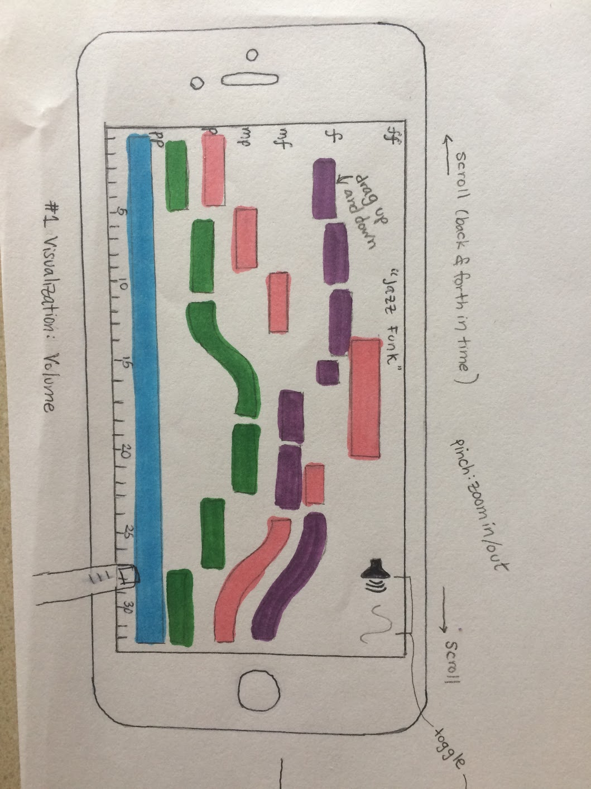
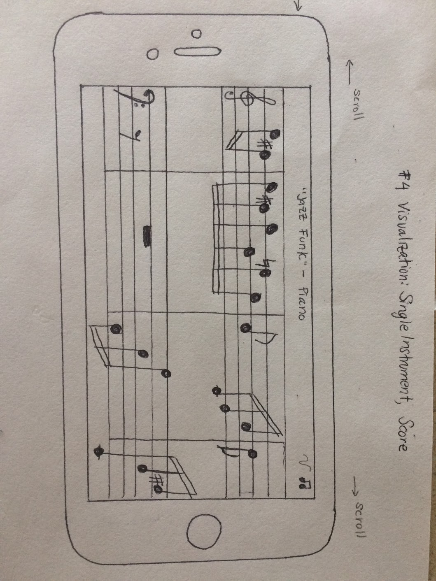
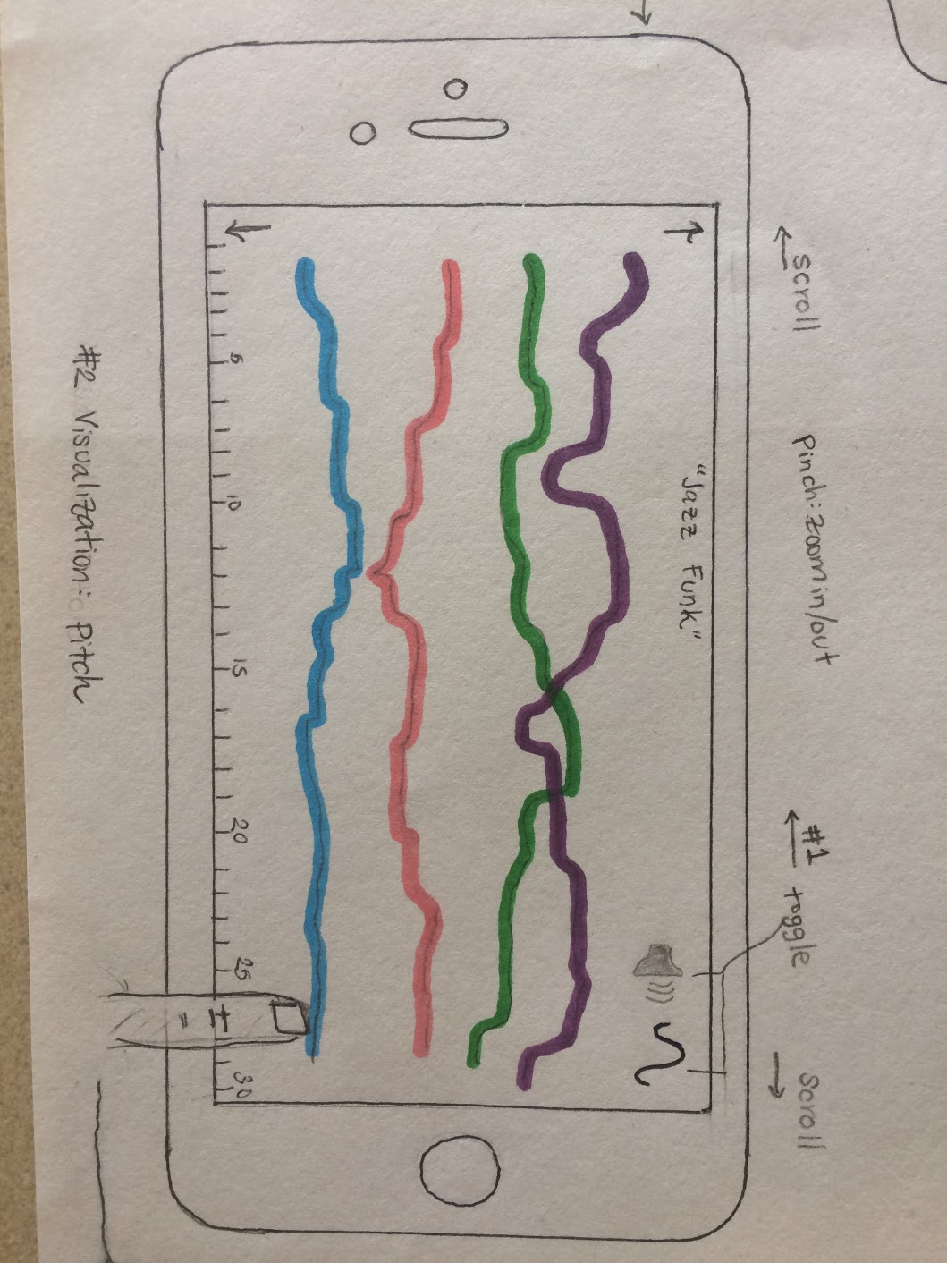
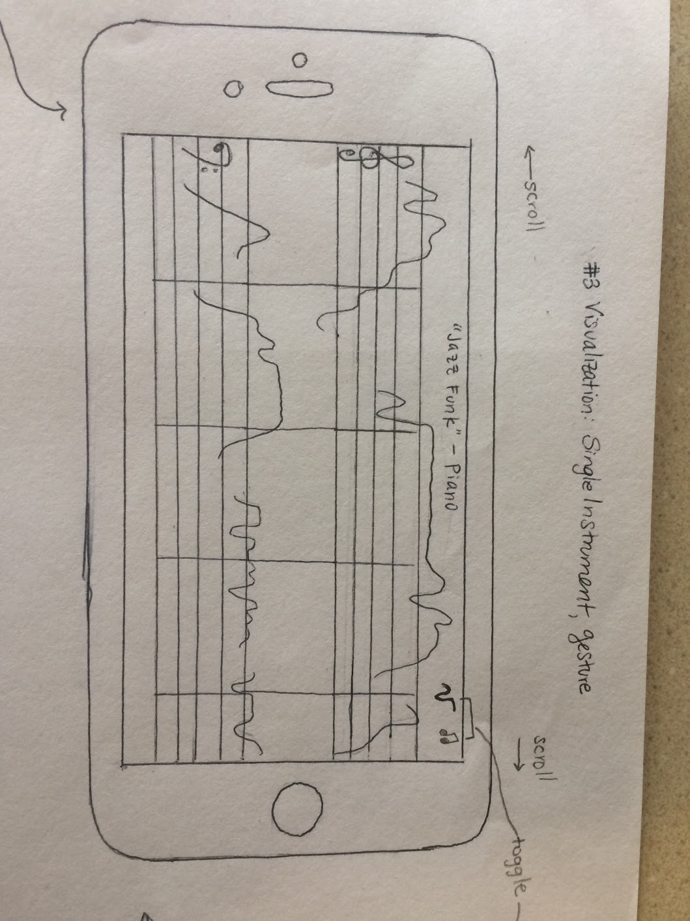
Prototype 1: Visual-centric
Visualizations
Gestures
Notes:
Vision is the dominant perception input.
Learn through doing - gestural skills have been developed thousands years.

Slide 6
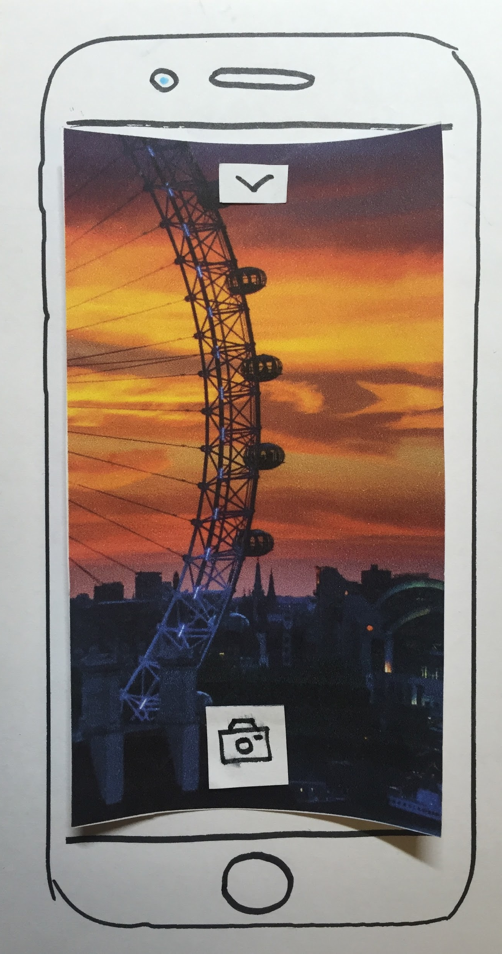
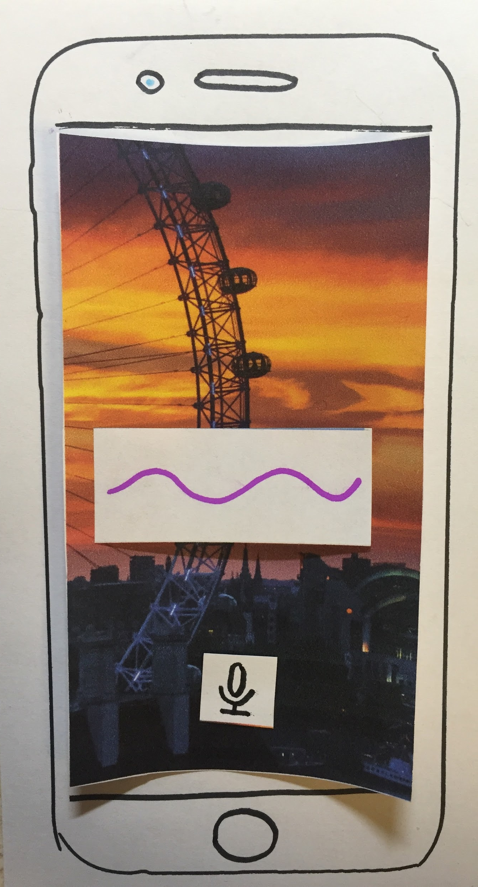
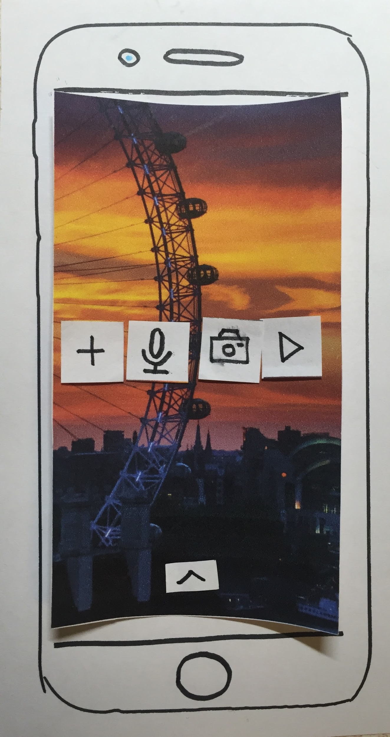
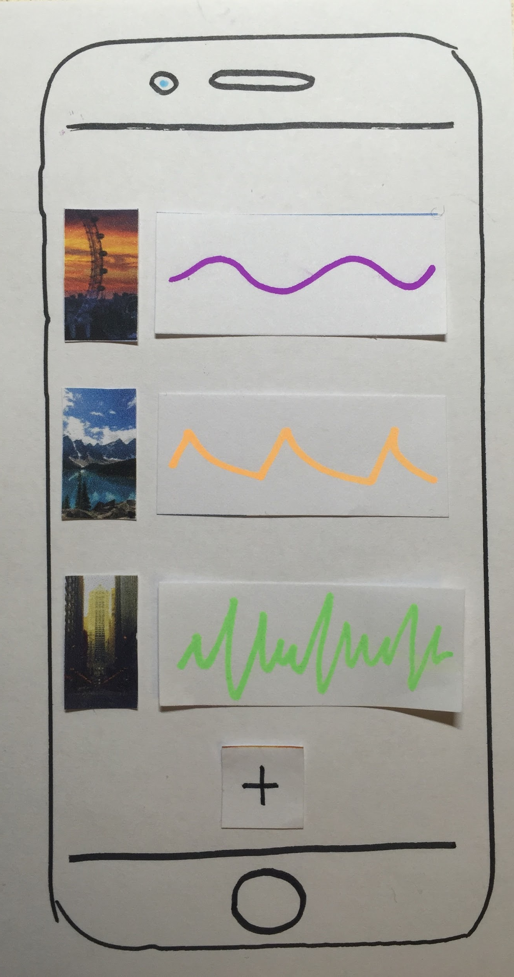
Prototype 2: Audio-centric
Notes:
Prototype 2 encourage users to record the moment when they thought of the ideas.

Slide 7
Audio prototype wasn’t really composing: feedback was that it seemed like an “immersive photos” app.
Audio prototype didn’t provide feedback and discoverability.
Visual prototype, despite having simple interface, was very intuitive for professional musicians.
Winning interface:
Visual-centric

Slide 8
Tasks
Compose:
create notes and chords using simple, intuitive gestures.
[complex]
Arrange:
combine multiple ideas and instruments into a single composition.
[medium]
Share:
transcribe the composition to a PDF score to give to a musician.
[simple]

Slide 9
Task 1: Compose
[Complex]
Create notes and chords using simple, intuitive gestures.

Slide 10
Task 1: Compose
change time signature
change key signature
add single notes
add accidental
erase notes
create chords

Slide 11
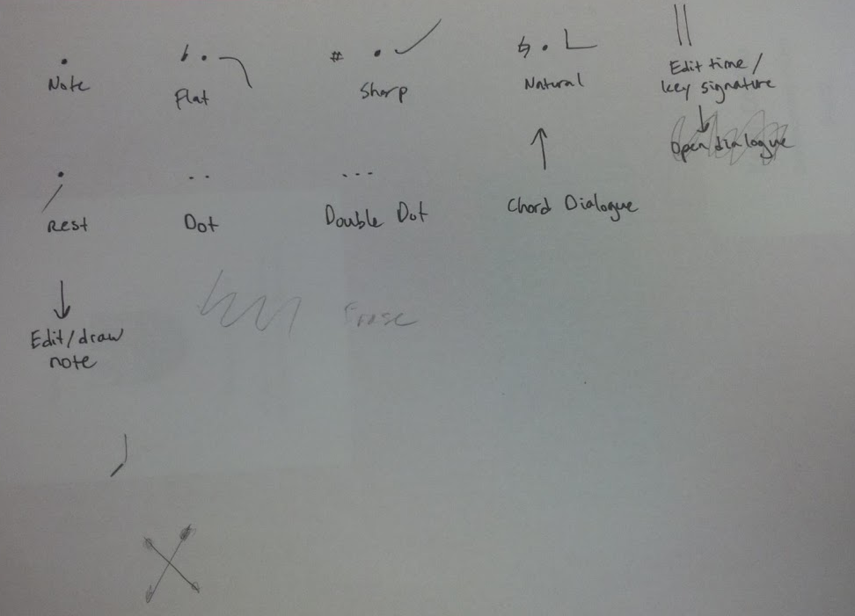

Slide 12
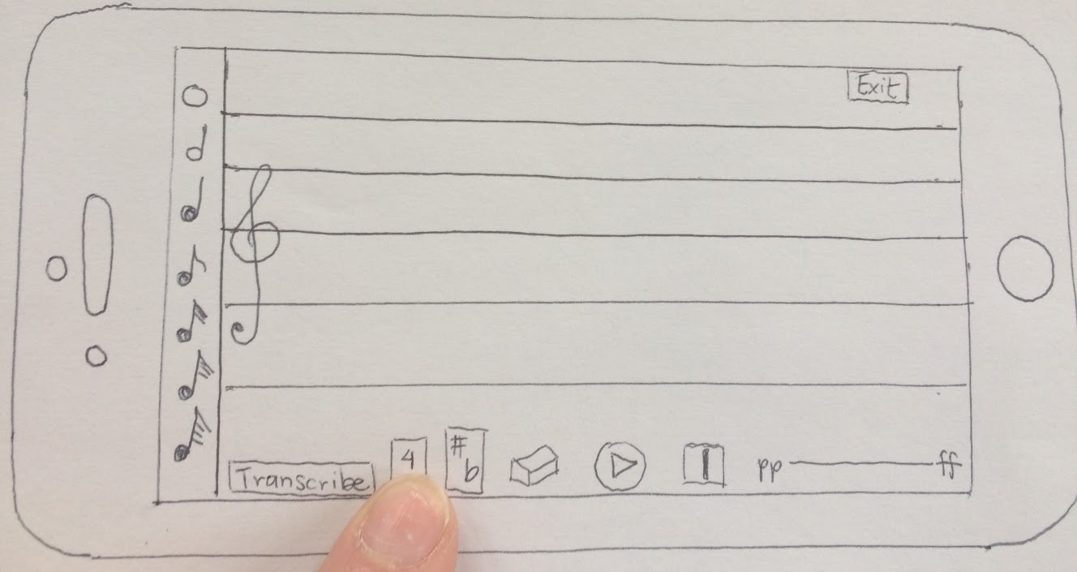
Task 1 (change time signature)

Slide 13
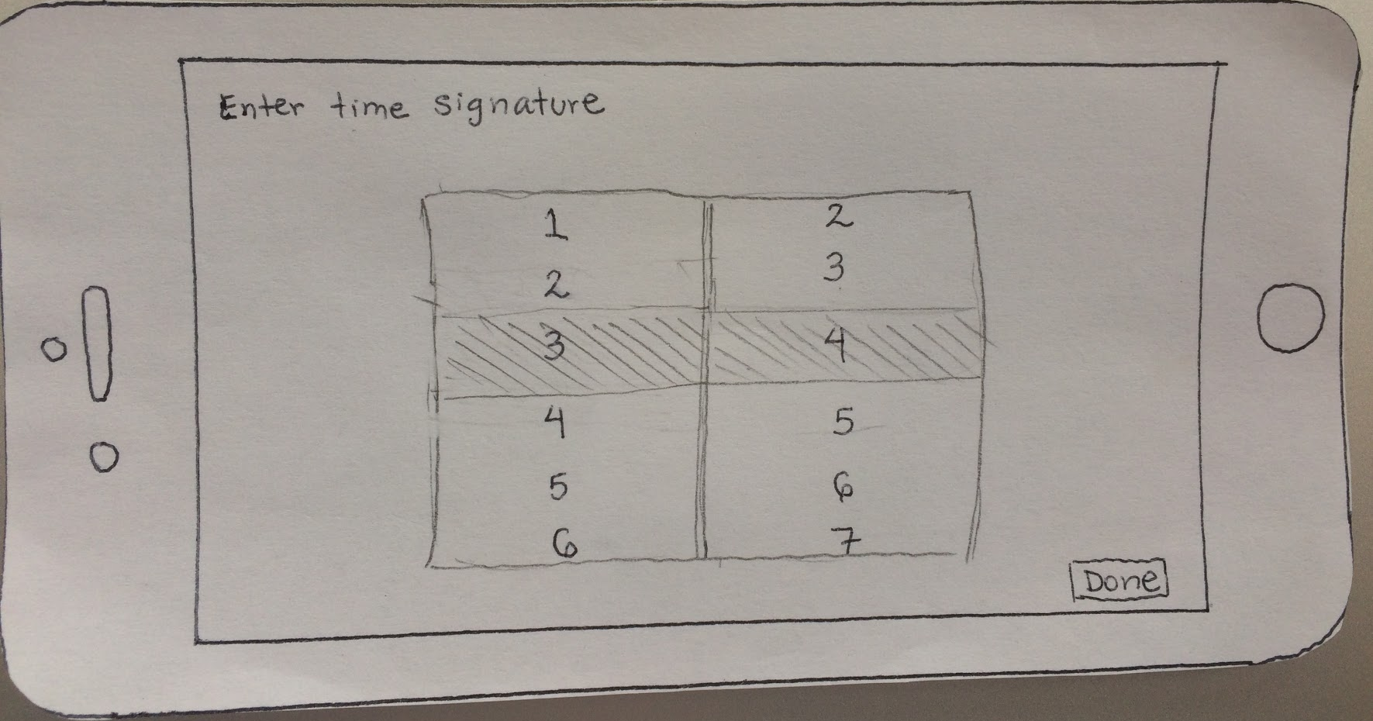
Task 1 (change time signature)

Slide 14
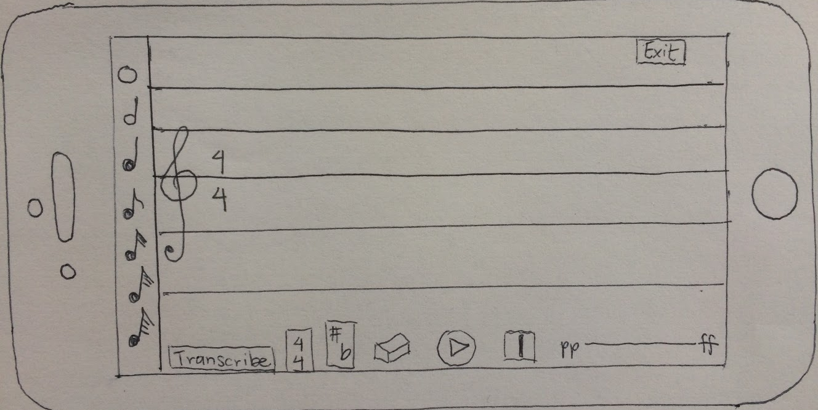
Task 1 (change time signature)

Slide 15
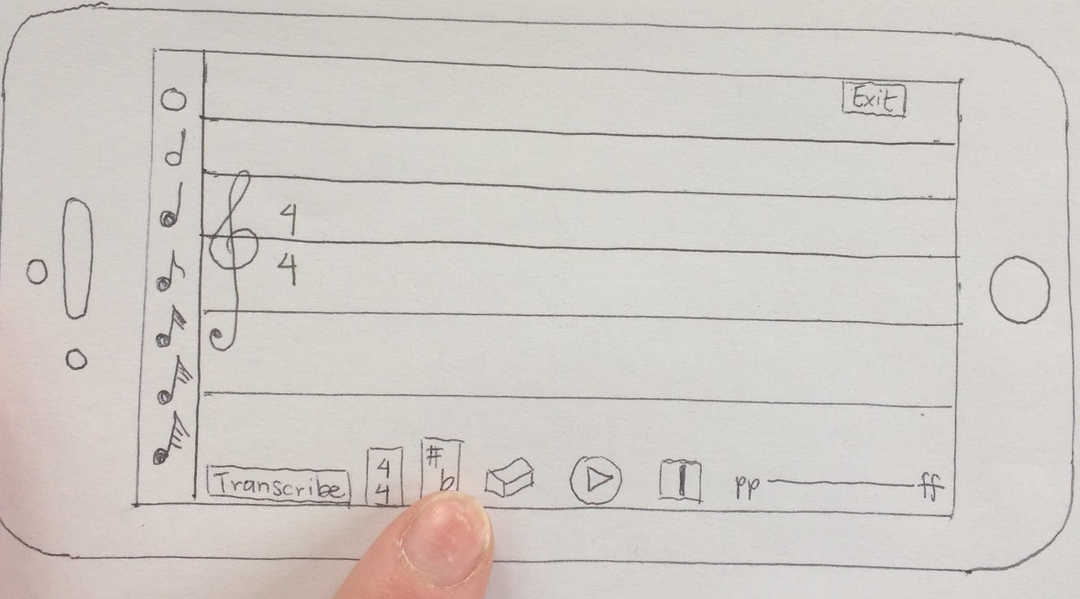
Task 1 (change key signature)

Slide 16
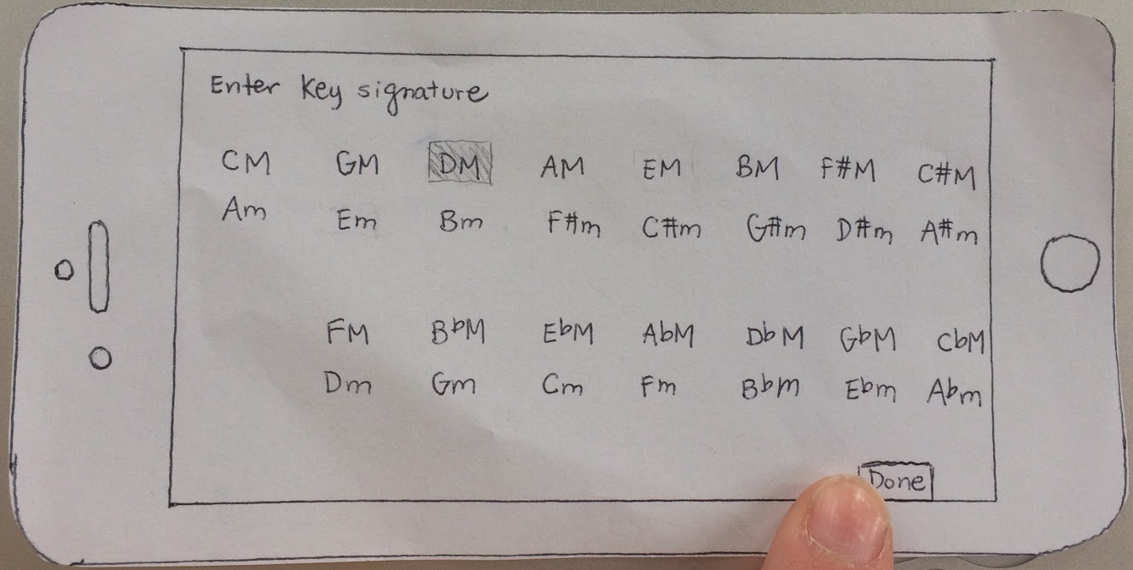
Task 1 (change key signature)

Slide 17
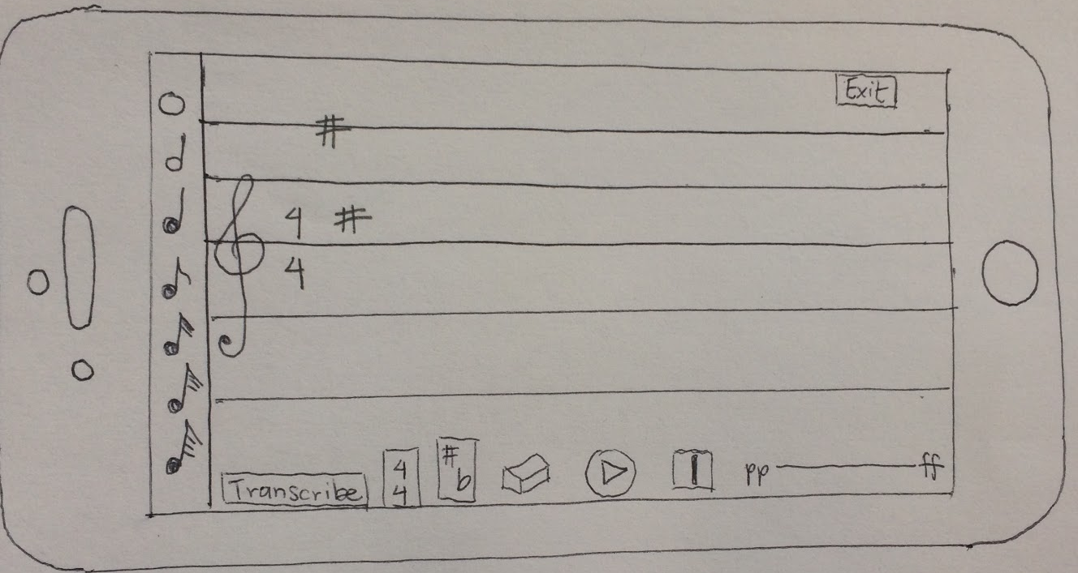
Task 1 (change key signature)

Slide 18
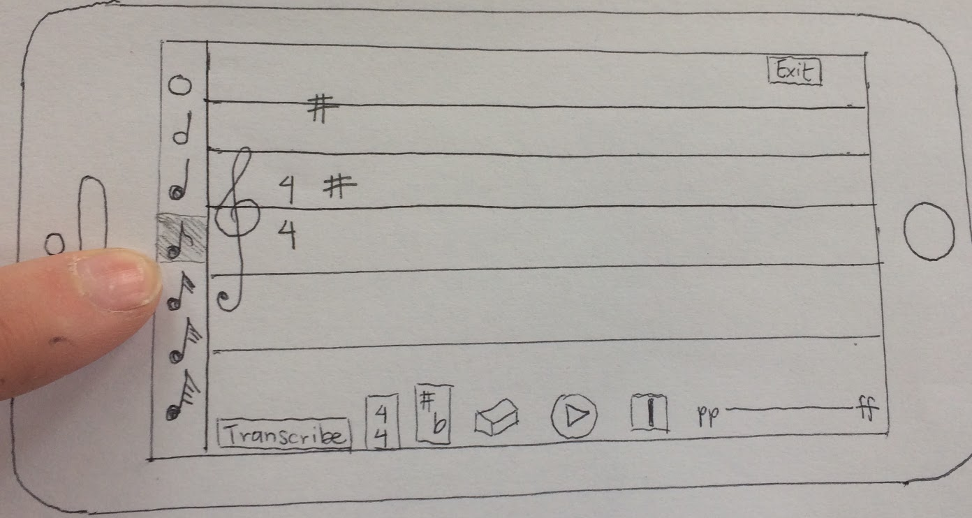
Task 1 (add single notes)

Slide 19
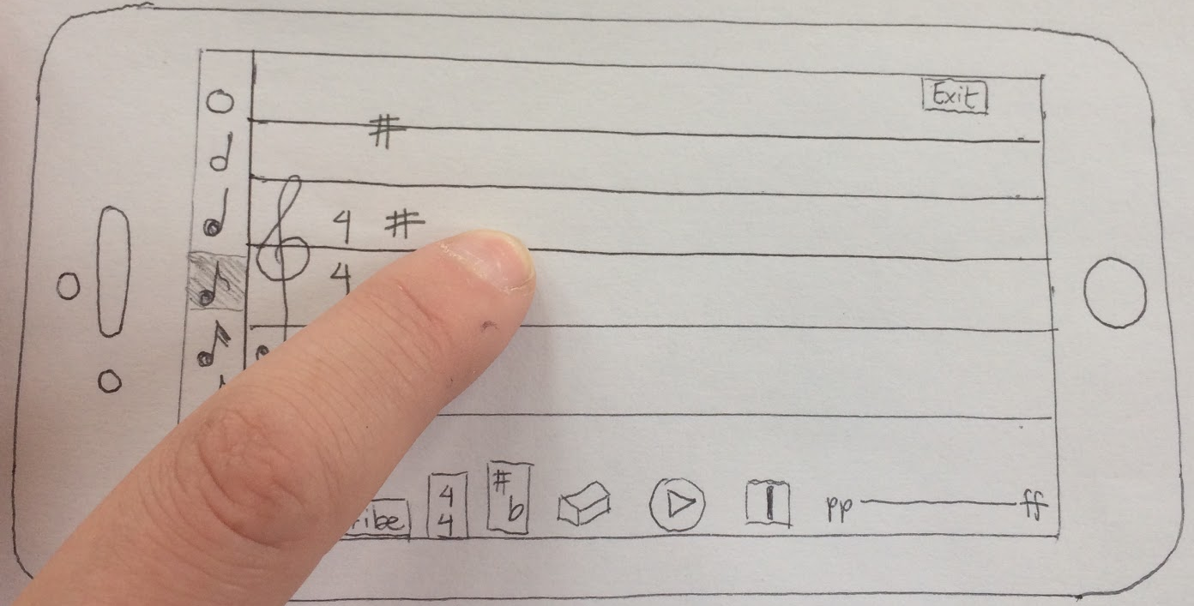
Task 1 (add single notes)

Slide 20
Task 1 (add single notes)

Slide 21
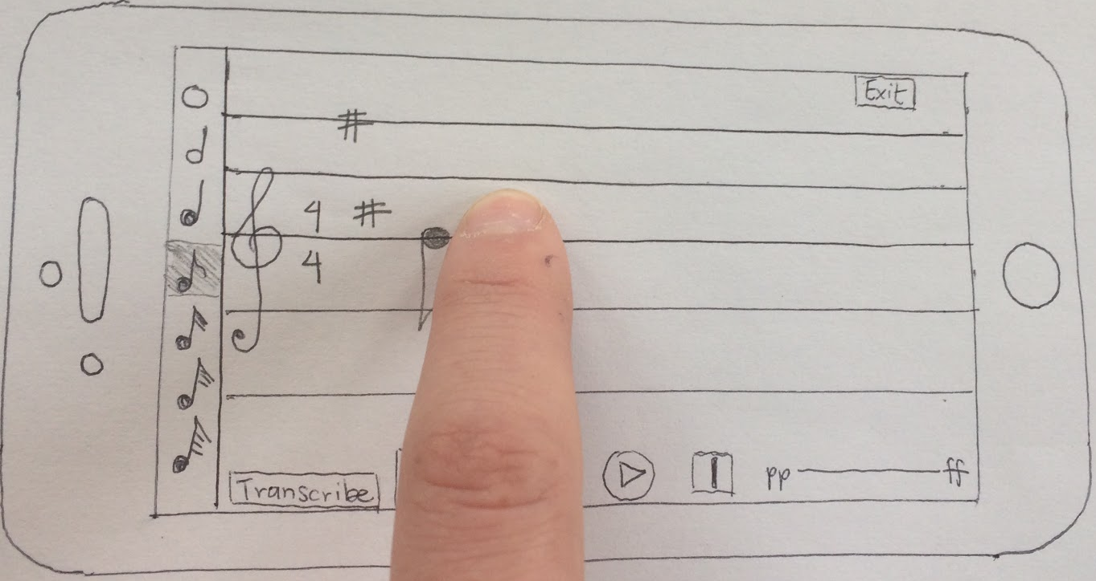
Task 1 (add single notes)

Slide 22
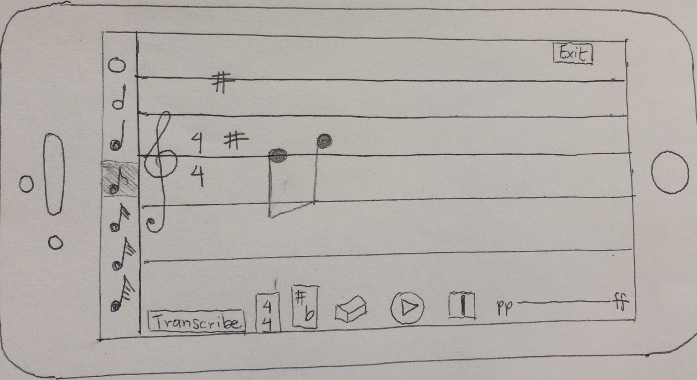
Task 1 (add single notes)

Slide 23
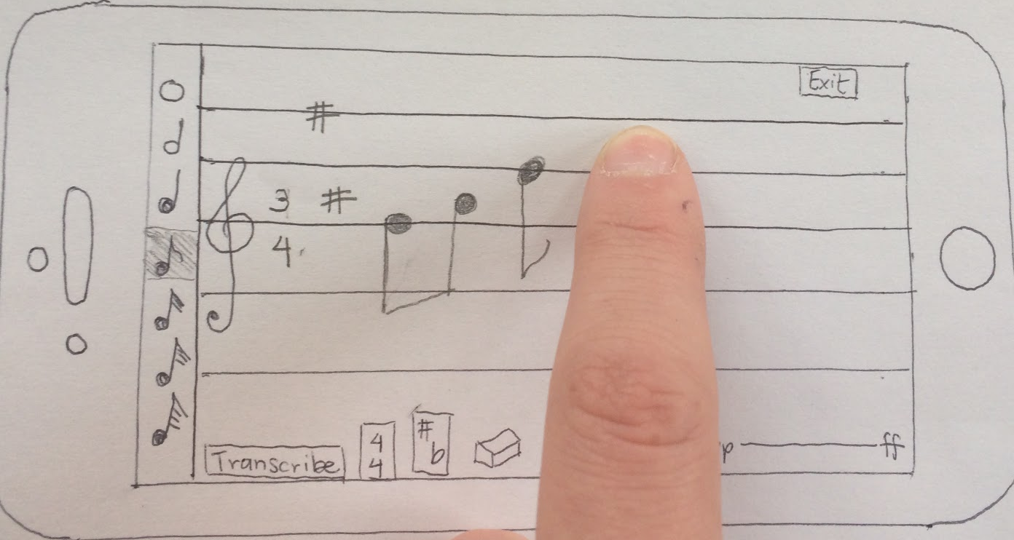
Task 1 (add accidental)

Slide 24
Task 1 (add accidental)

Slide 25
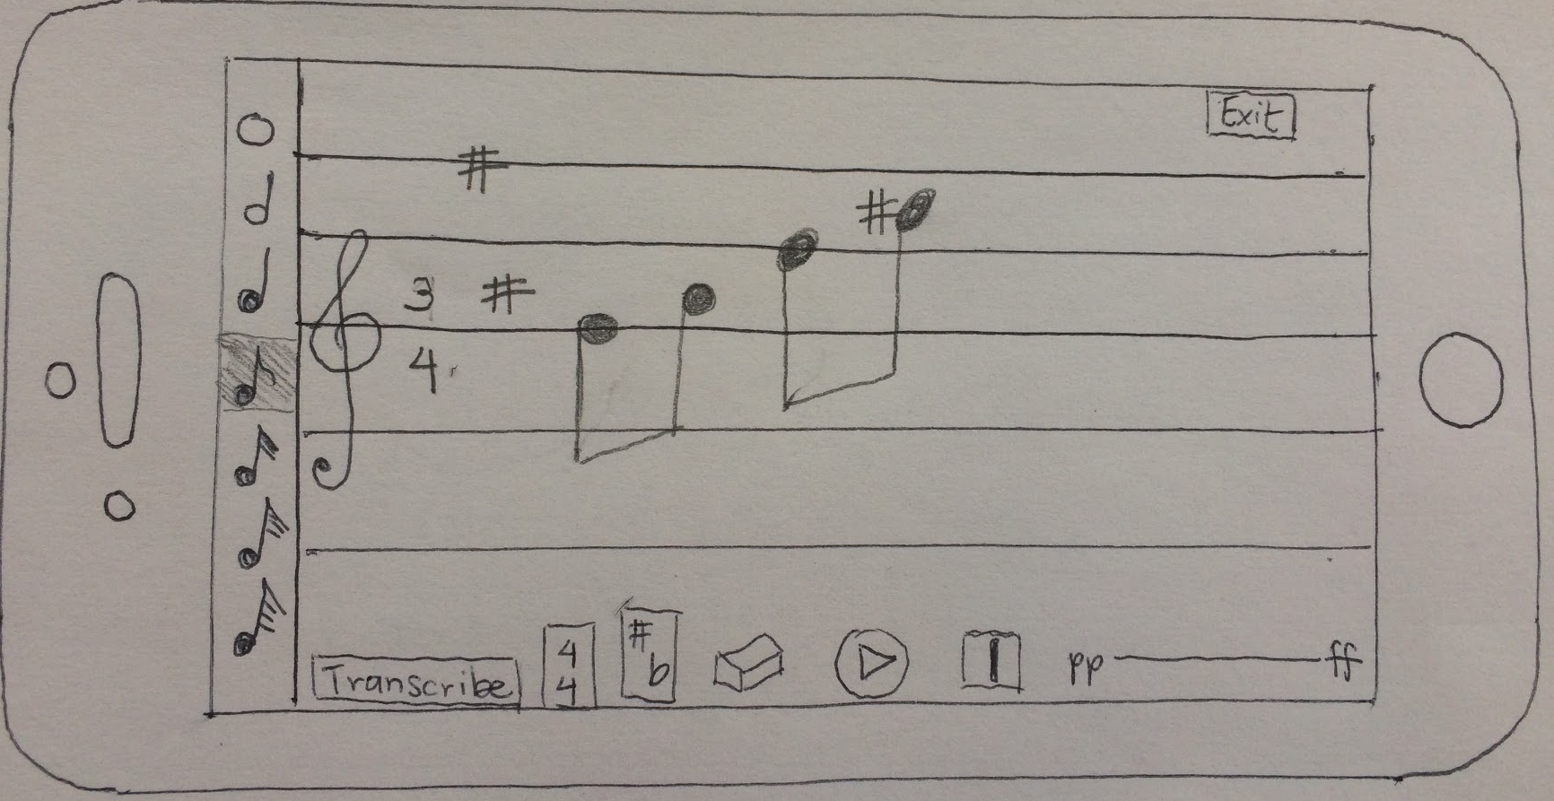
Task 1 (add accidental)

Slide 26
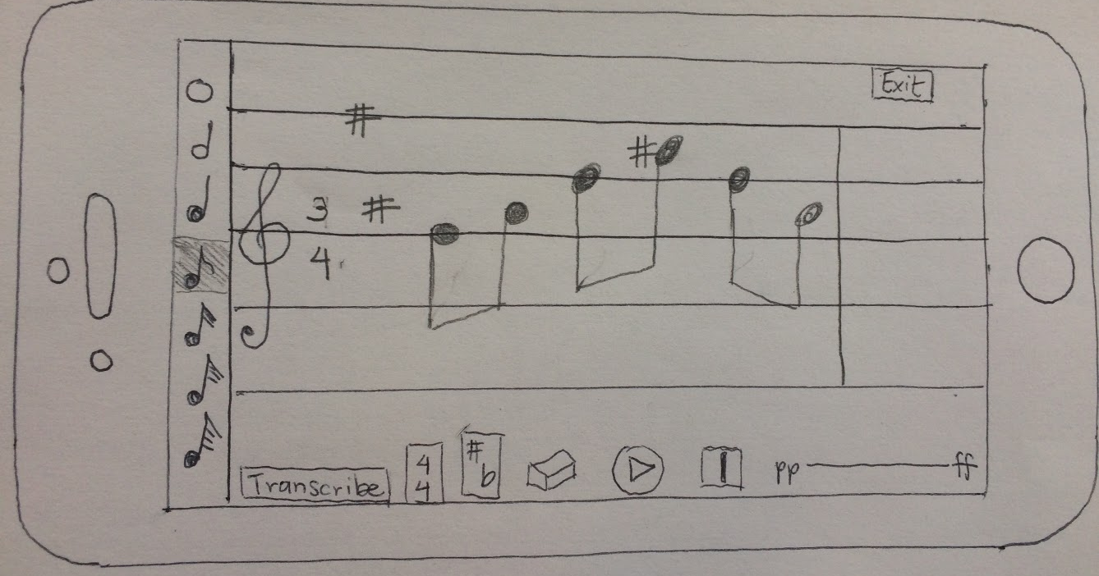
Task 1 (automatically add bar line)

Slide 27
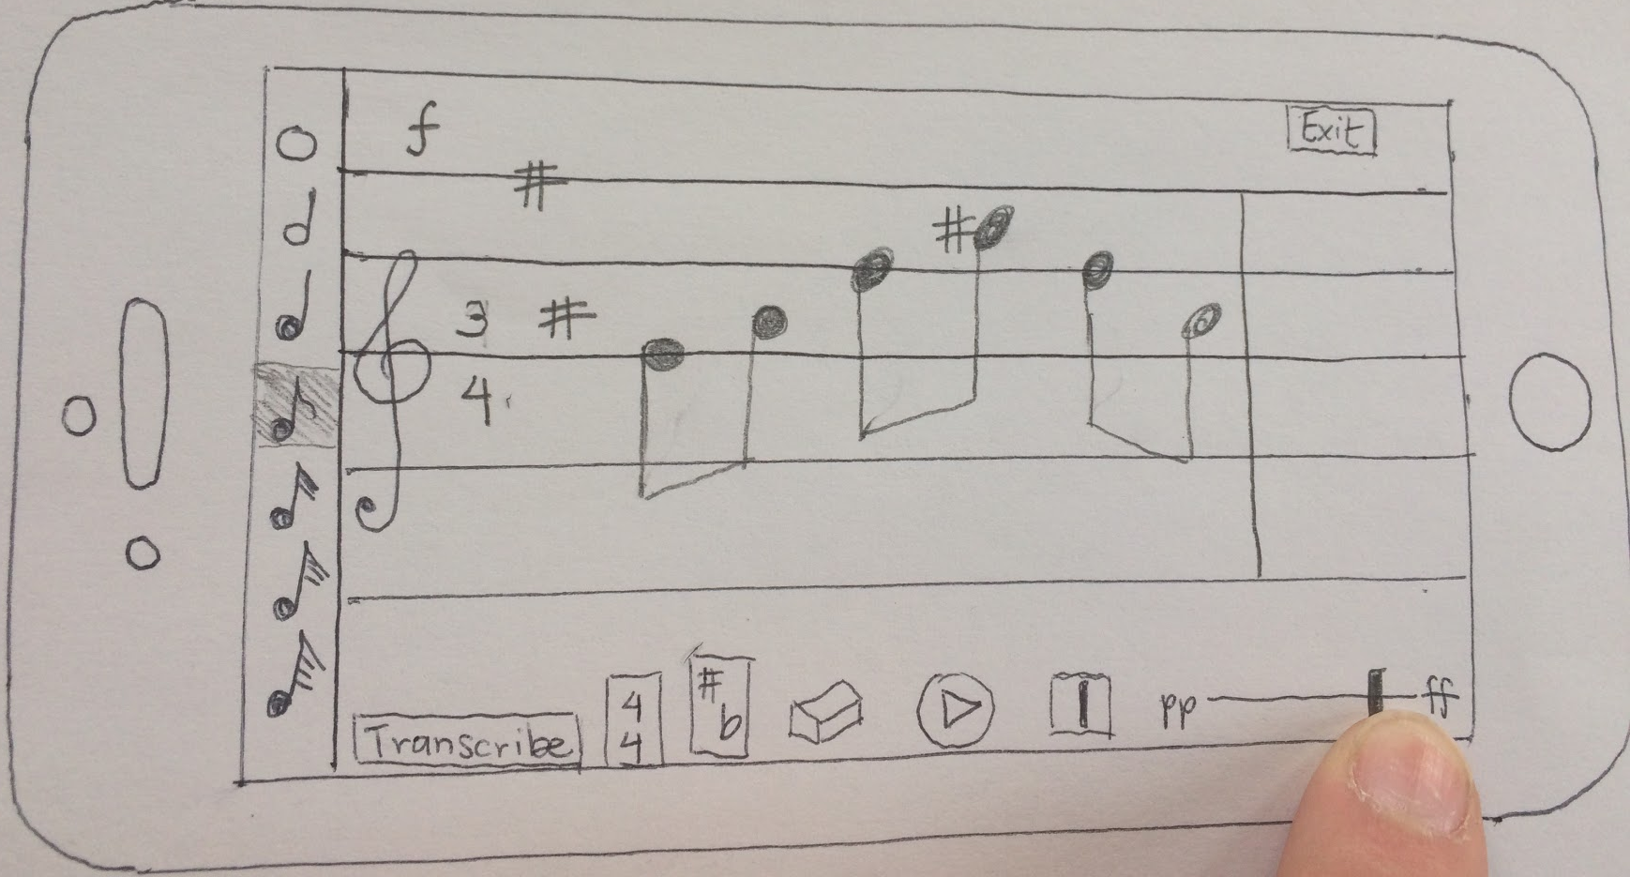
Task 1 (change volume)

Slide 28
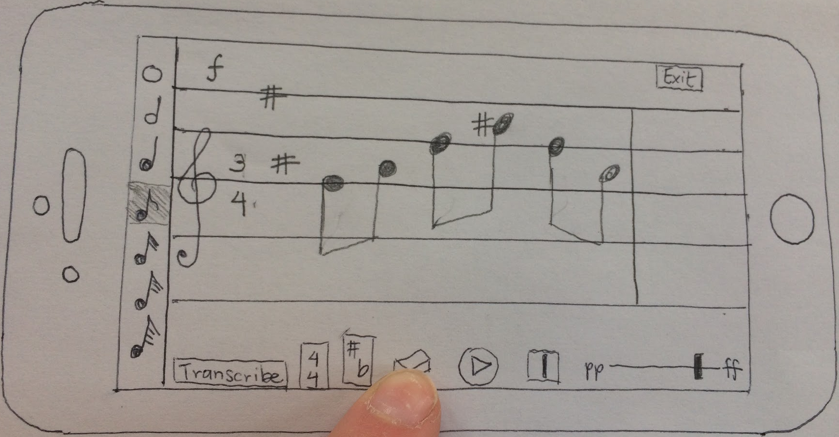
Task 1 (erase notes)

Slide 29
Task 1 (erase notes)

Slide 30
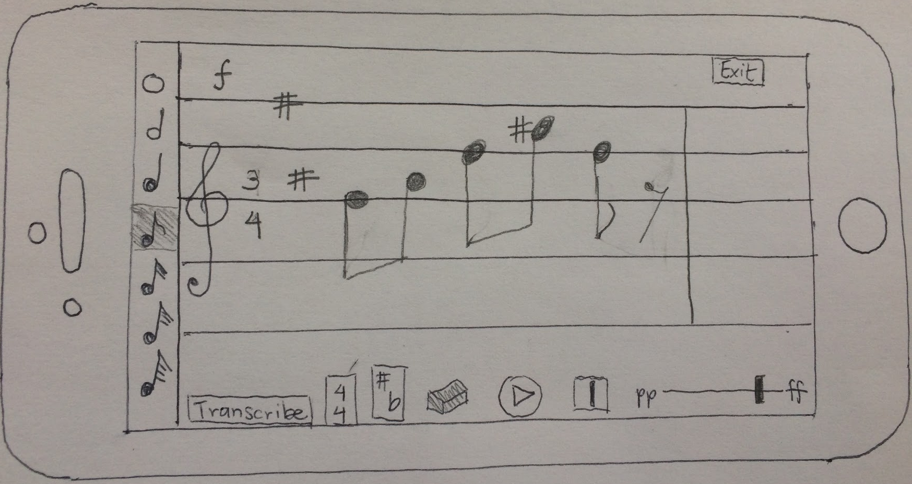
Task 1 (erase notes, automatically add rest)

Slide 31
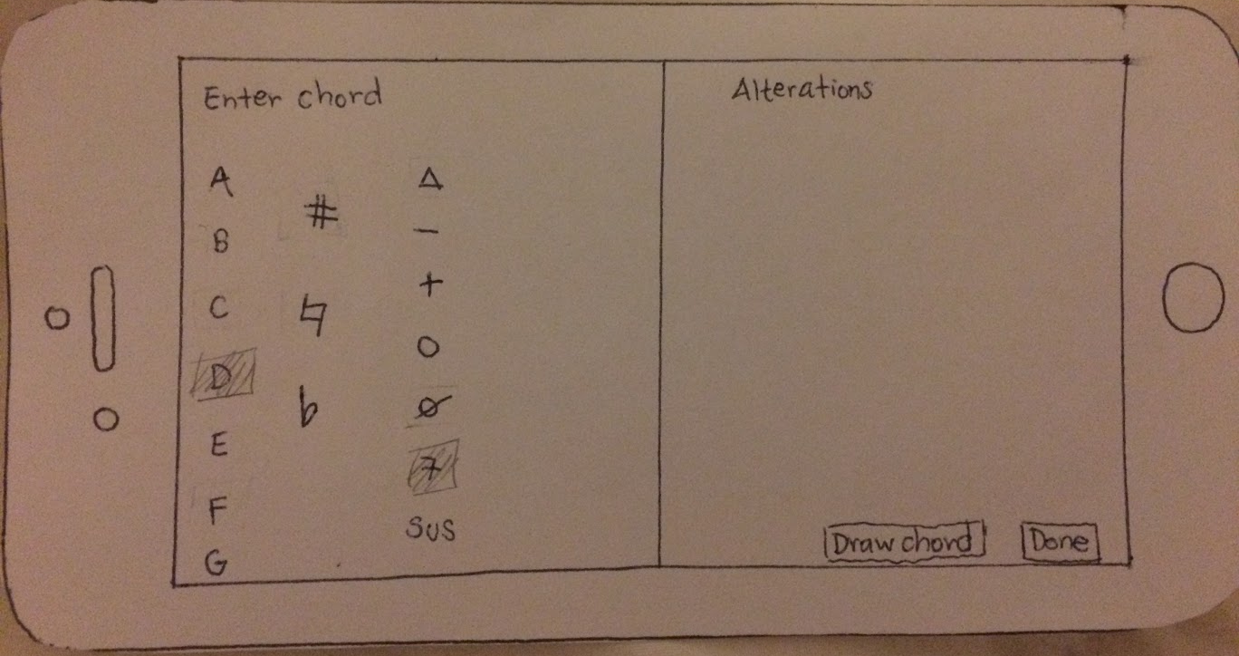
Task 1 (create chord)

Slide 32
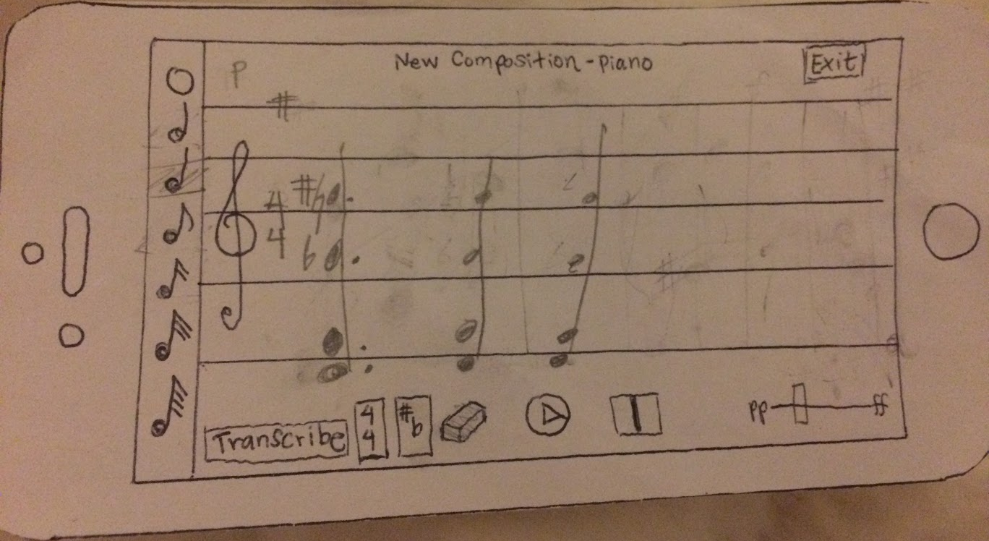
Task 1 (create chord)

Slide 33
Task 2: Arrange
[Moderate]
Combine multiple ideas and instruments into a single composition.

Slide 34
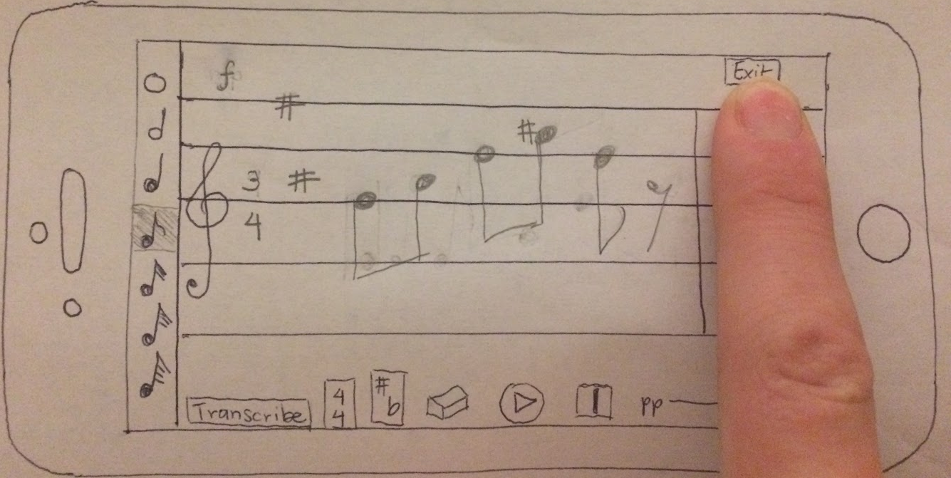
Task 2

Slide 35
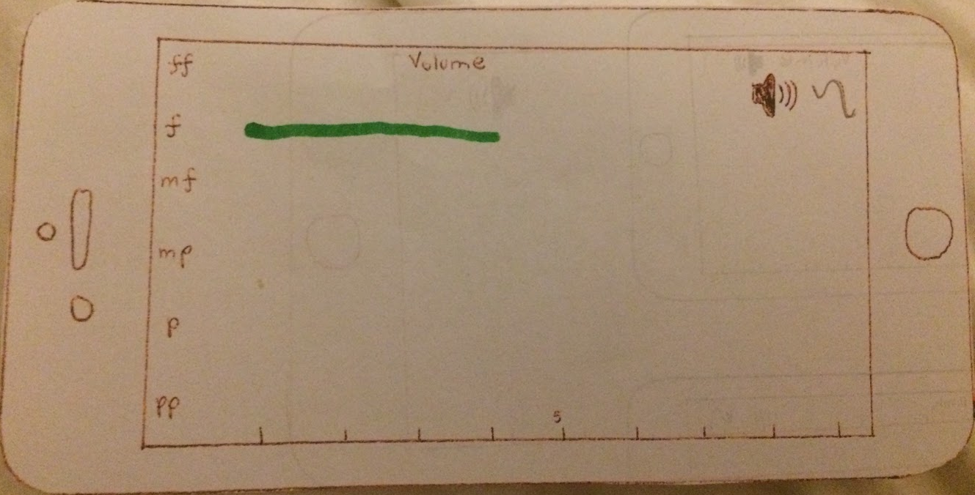
Task 2 (volume view)

Slide 36
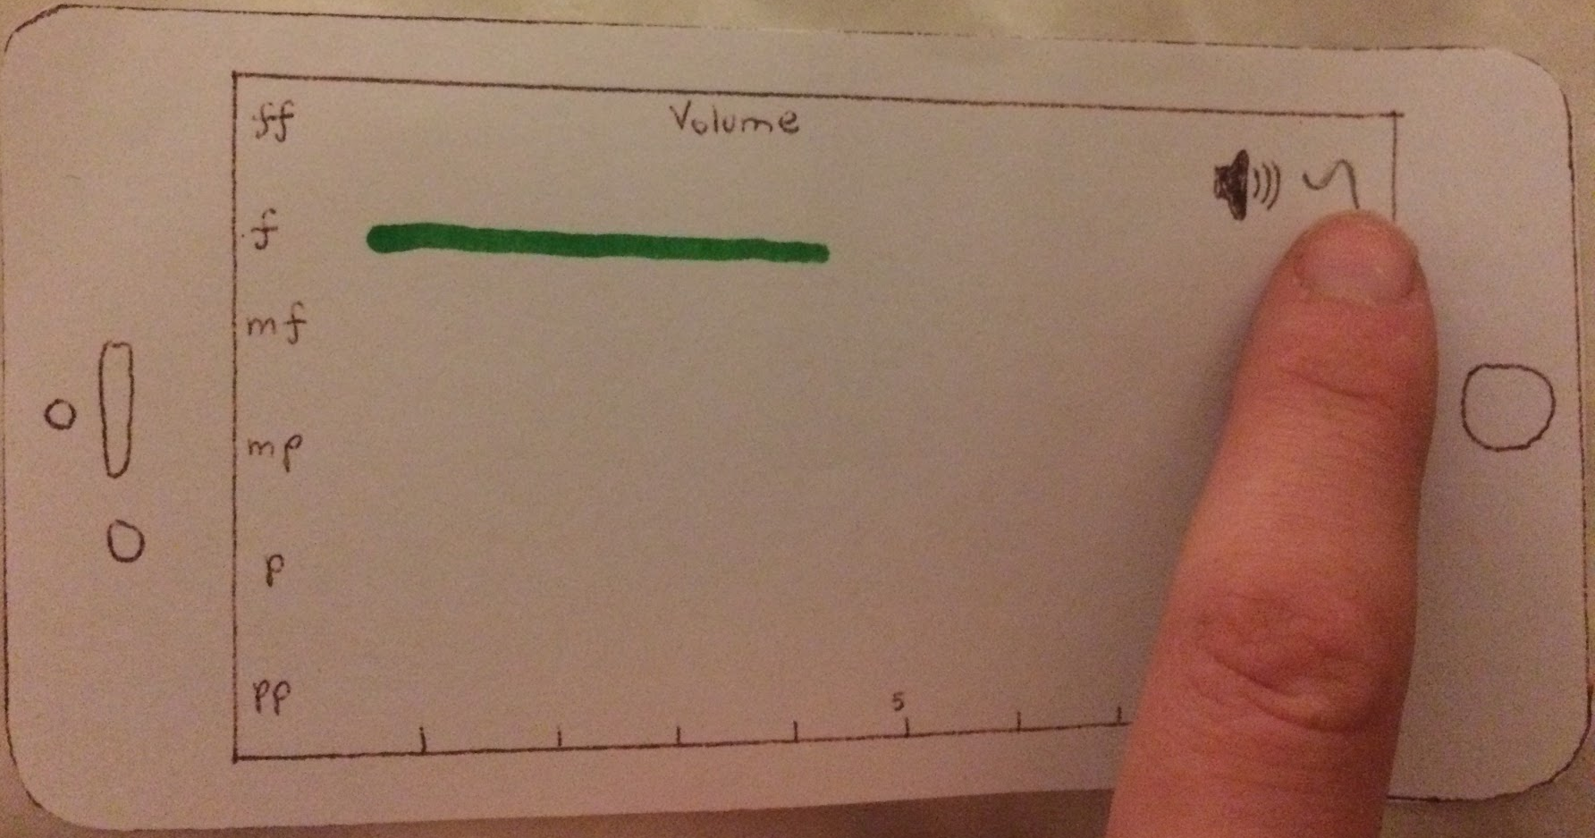
Task 2 (volume view)

Slide 37
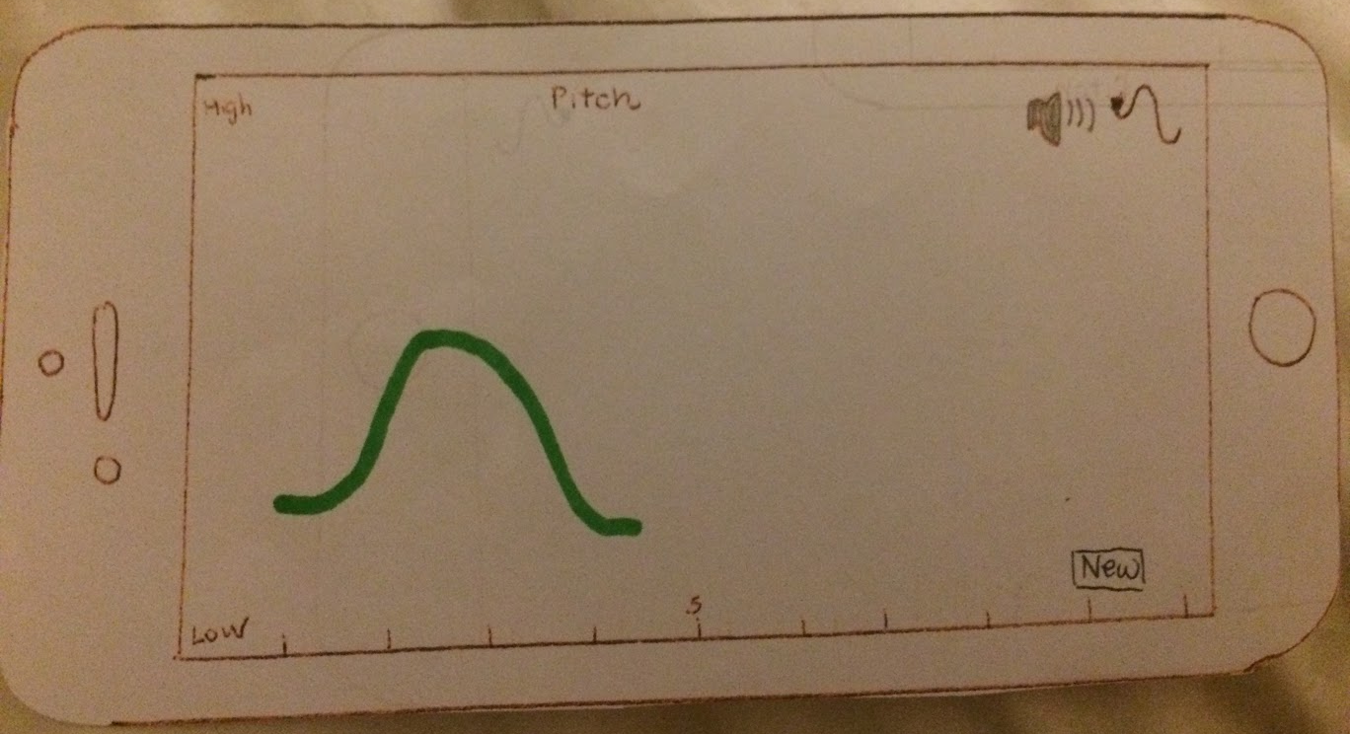
Task 2 (pitch view)

Slide 38
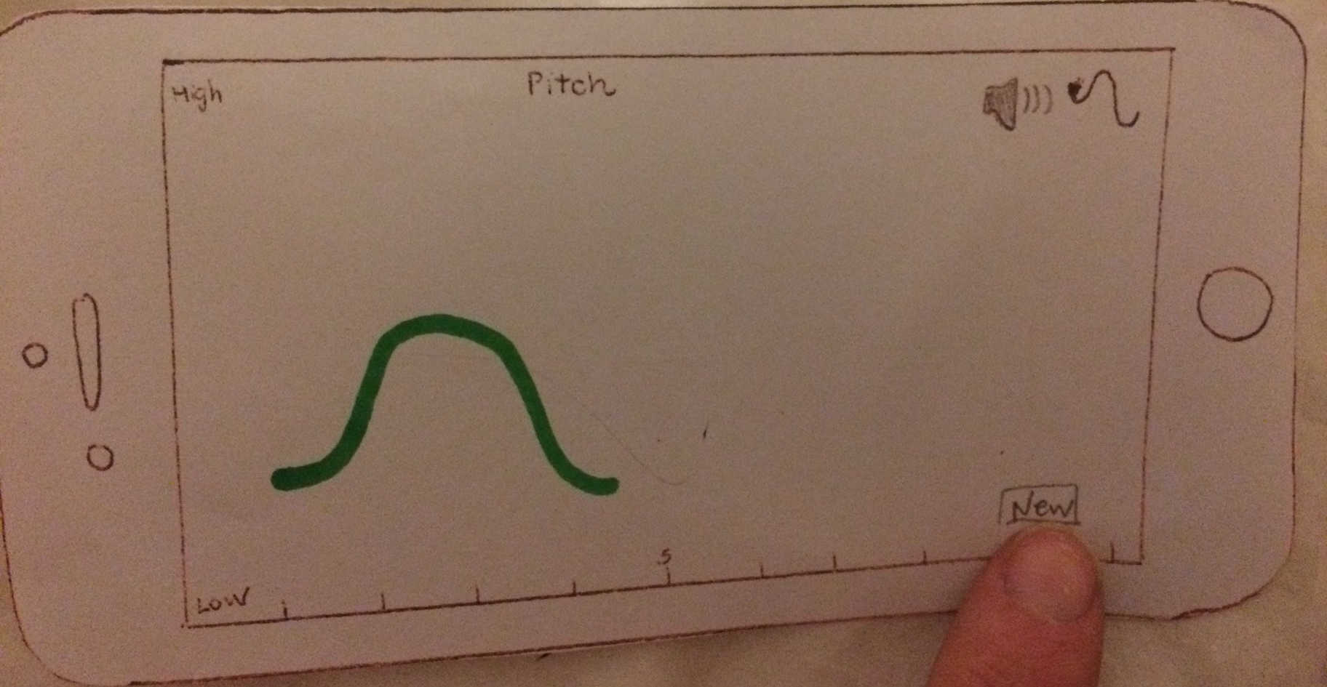
Task 2 (pitch view)

Slide 39
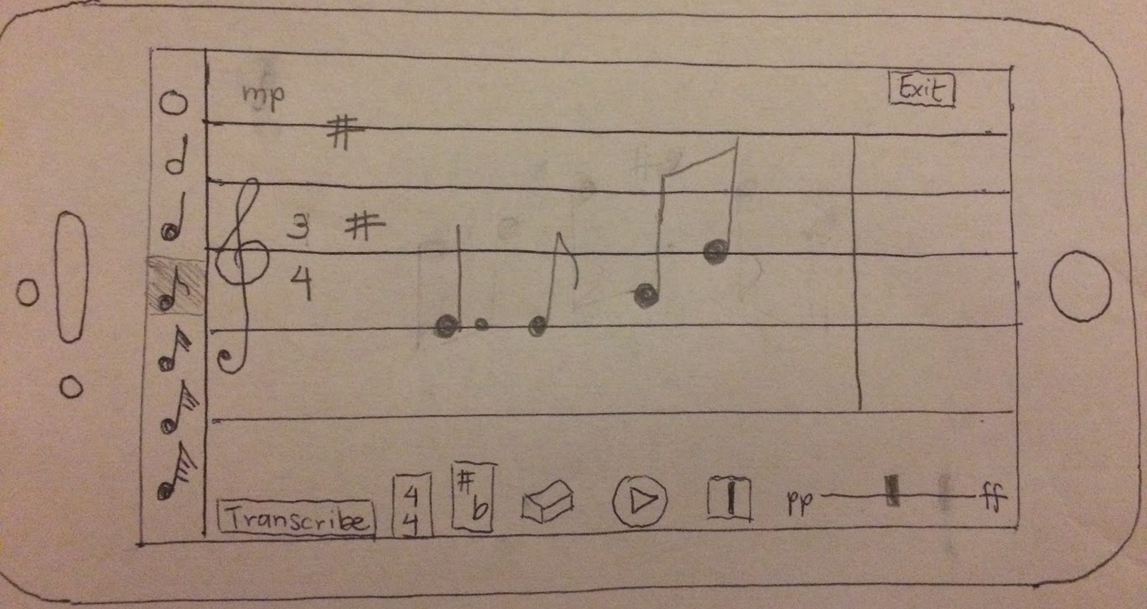
Task 2 (compose new part)

Slide 40
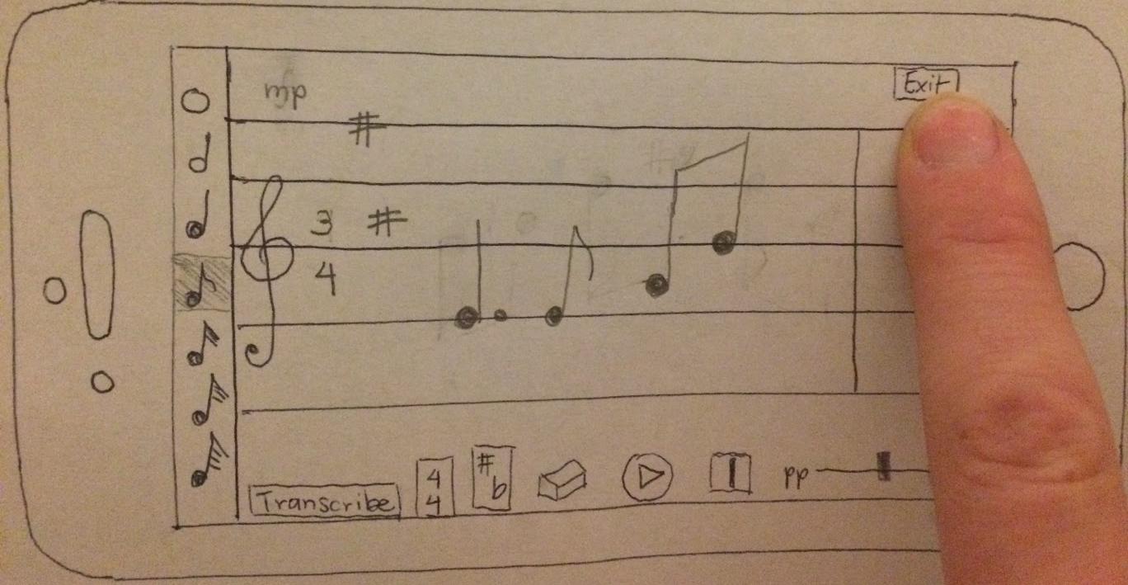
Task 2 (compose new part)

Slide 41
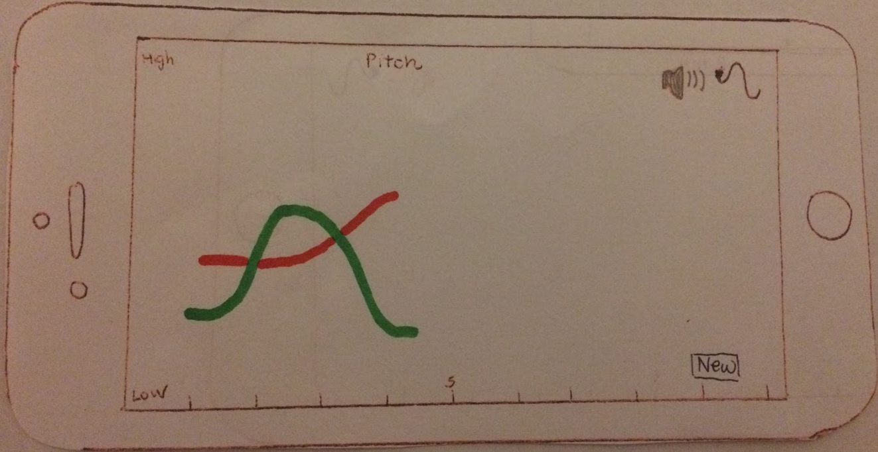
Task 2 (pitch view, multiple parts)

Slide 42
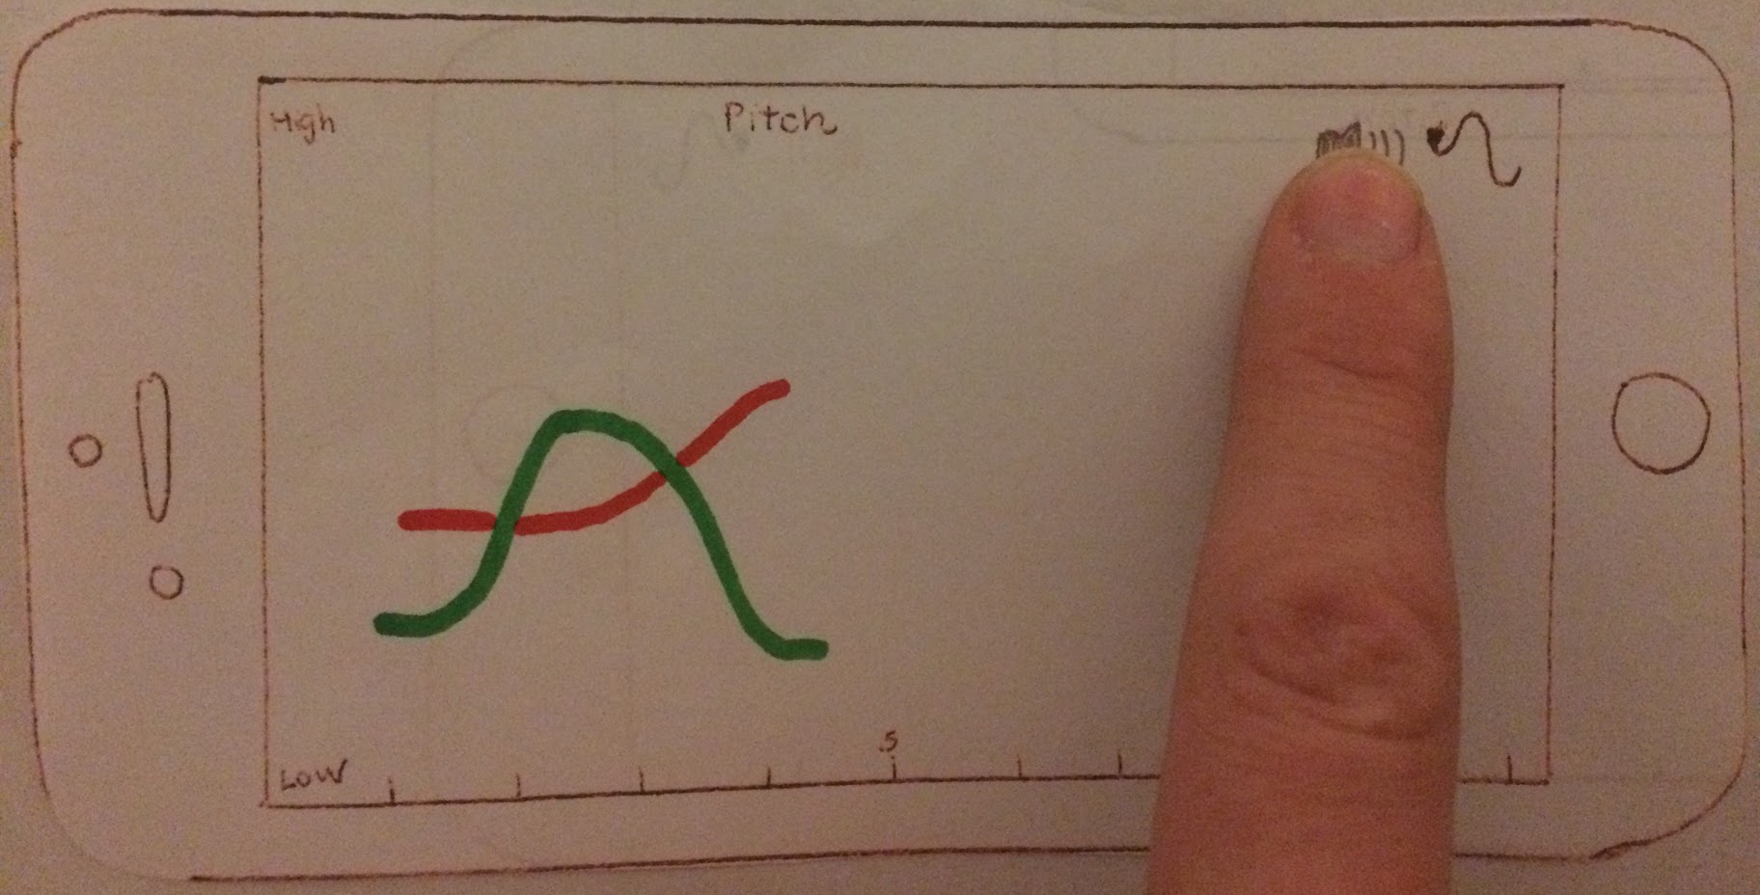
Task 2 (pitch view, multiple parts)

Slide 43
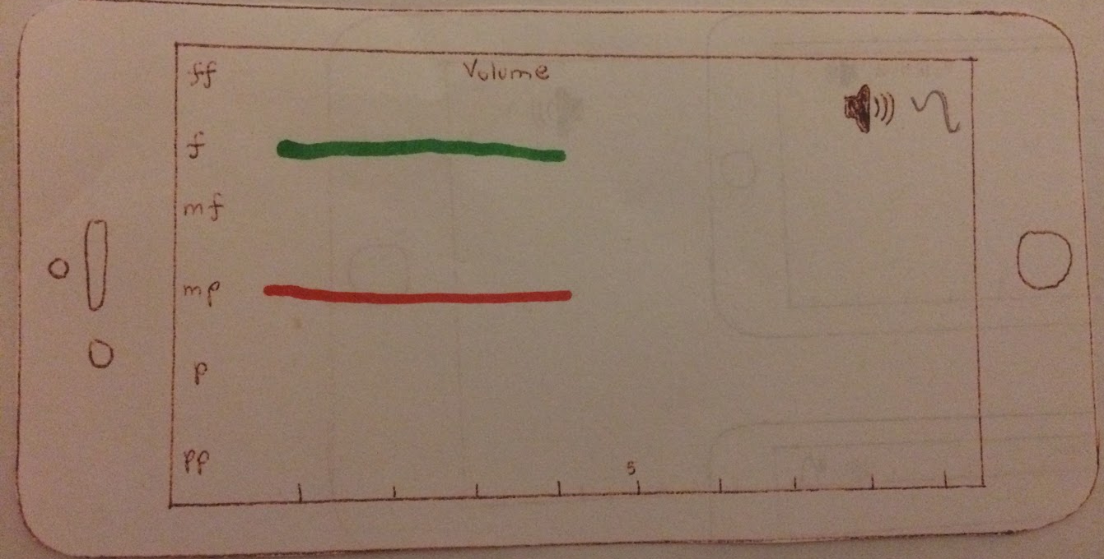
Task 2 (volume view, multiple parts)

Slide 44
Task 3: Transcribe
[Simple]
Transcribe the composition to a PDF score to give to a musician.

Slide 45
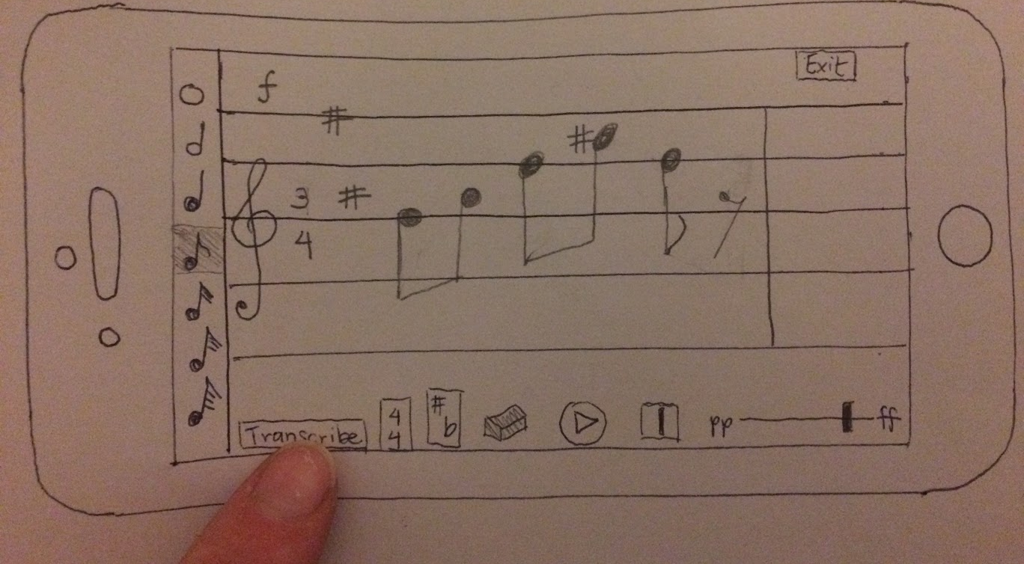
Task 3

Slide 46
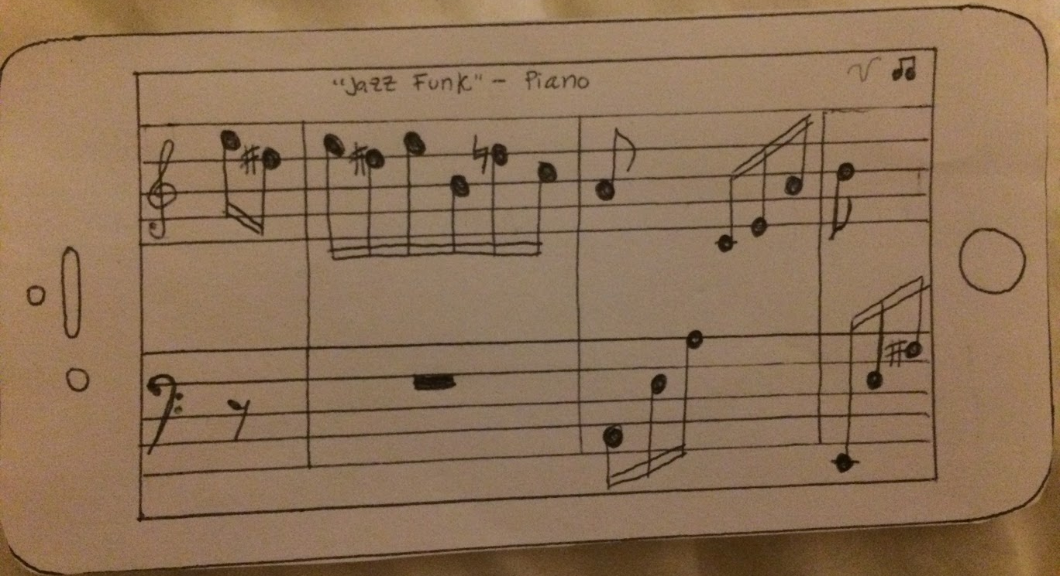
Task 3

Slide 47
User Testing

Slide 48
Experimental Method
- Composer
- Stanford graduate in Music, Science & Technology
- Involved with research through CCRMA
Participant 1: Byron
- Composer
- Vocal director
- Ear training instructor in the music department
- Member of the Stanford Mendicants
Participant 2: Alexander
- Composer
- Prolific user of music composition apps (Sibelius, Finale, MuseScore, Notion, and Logic)
- Member of Stanford chamber chorale
Participant 3: Joss

Slide 49
Desired Features
Copy and paste: ability to duplicate notes, chords, and phrases
Tied notes (including across bar lines)
Tempo: (in beats per minute, for playback)
Click and drag notes to change their pitch
Chord inversions
Notes should change color when selected
Articulation mode (e.g., accents, stacatto, legatto, crescendo)
Select all to make multi-note changes
General menu or “welcome” screen to go back to
Clear all and undo buttons
Ability to stack multiple notes (even if they’re not a chord)

Slide 50
Experimental Results
✓
Users remembered the gestures, and all found them intuitive!
Had fun playing with the app and found it useful.
Were pleasantly surprised by all of functionality packed into a deceptively simple interface.
Users were all confused by the “chord drawing” screen, and drew different things depending on their backgrounds.
Hated the “insert bar line” button, and wanted automatic bar lines.
Ambiguity about creating chords, e.g., what octave? What duration? What notation (jazz or classical)? Closed or open position?
Everyone was confused by the “Exit” button and never got to the visualization screens.
✓
✓
×
×
×
×

Slide 51
Summary

Slide 52
Compose, Arrange, Share.
Visual-centric prototype.
Interfaces are intuitive and easy to use -> Natural Mapping
Limitation: Music is complex! It’s challenging to make a simple interface.
Implementation: easier, faster -> embodied interaction, suggestion.
Design the whole experience.

