Slide 1
Value Proposition:
Travel together
Problem/Solution Overview:
People consistently choose to drive cars over using public transit despite the cost on the environment, the opportunity cost of productivity, and the tedium of traffic. Why? It doesn’t fit their self image. If we can bring people together on public transportation, we m, and cool public transit means a friendlier, cleaner, and more sustainable world.
Notes:
Problem/solution overview: Many people dislike sitting in traffic during their morning commute, but still choose to drive to work. If we can make public transportation more enticing, we can convince many of these people to use it over driving personal cars. This, in turn, will contribute to sustainability by decreasing gasoline usage/the use of polluting vehicles.

Slide 2
Tasks:
Task 1: Finding a friendly person on the train (moderate)
Task 2: Playing a game with a friendly person (complex)
Task 3: Label yourself as a friendly person (simple)

Slide 3
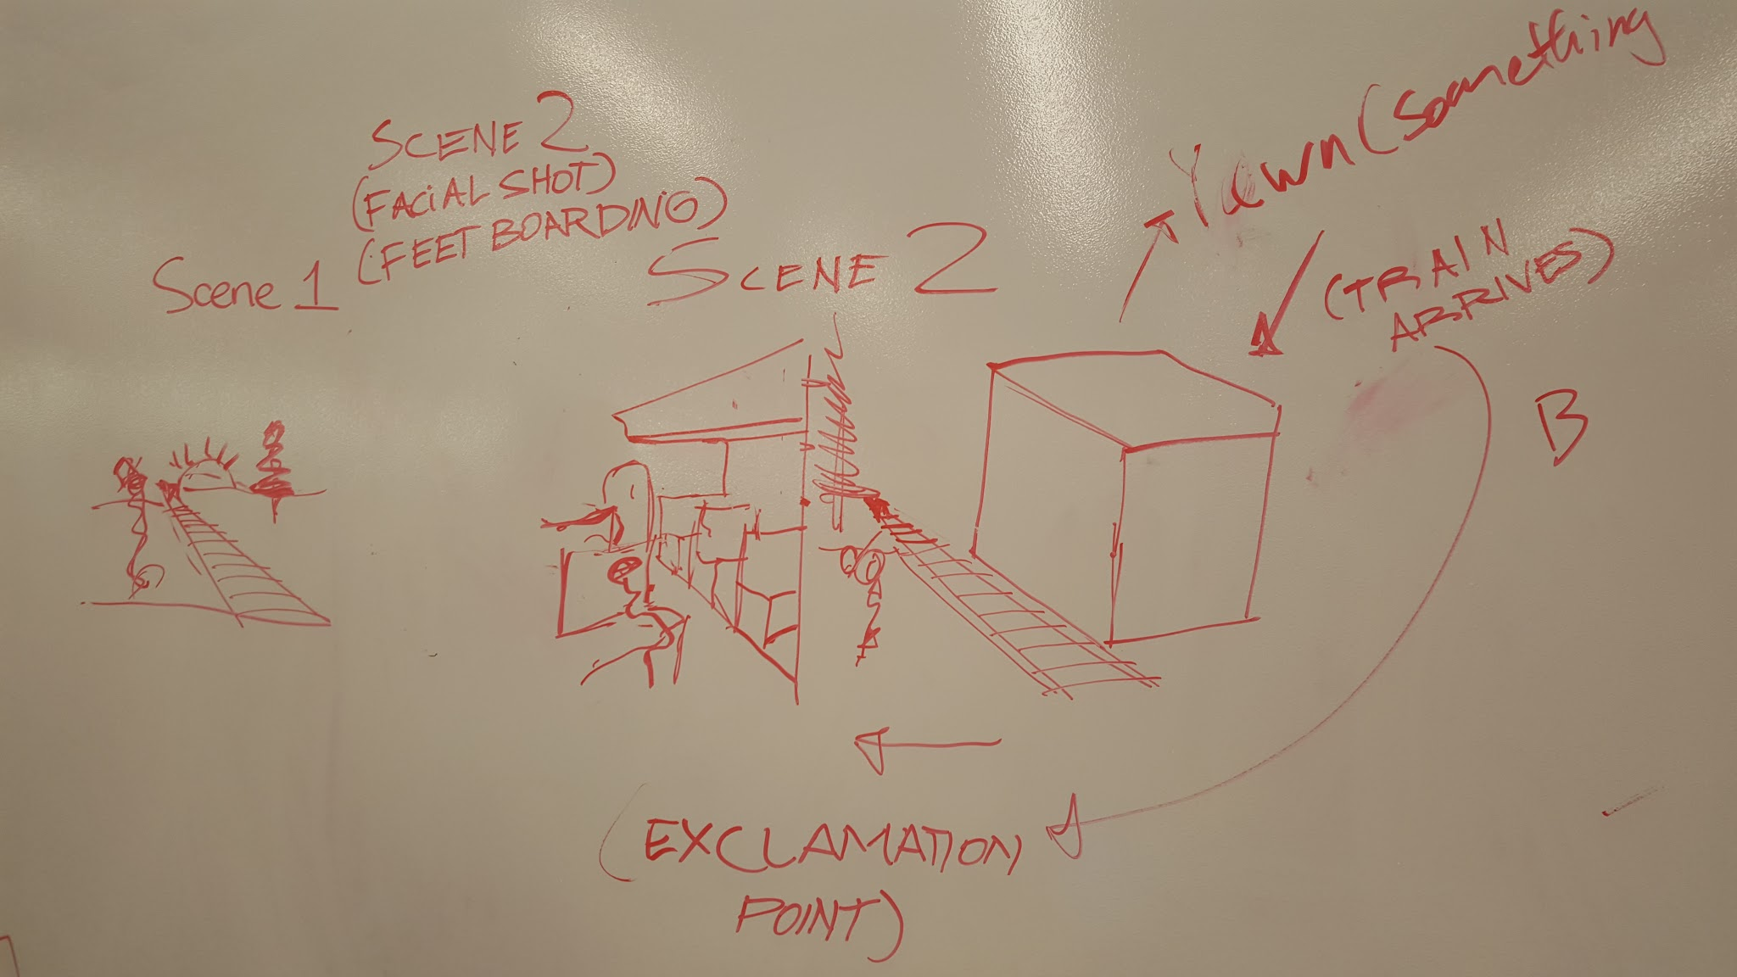
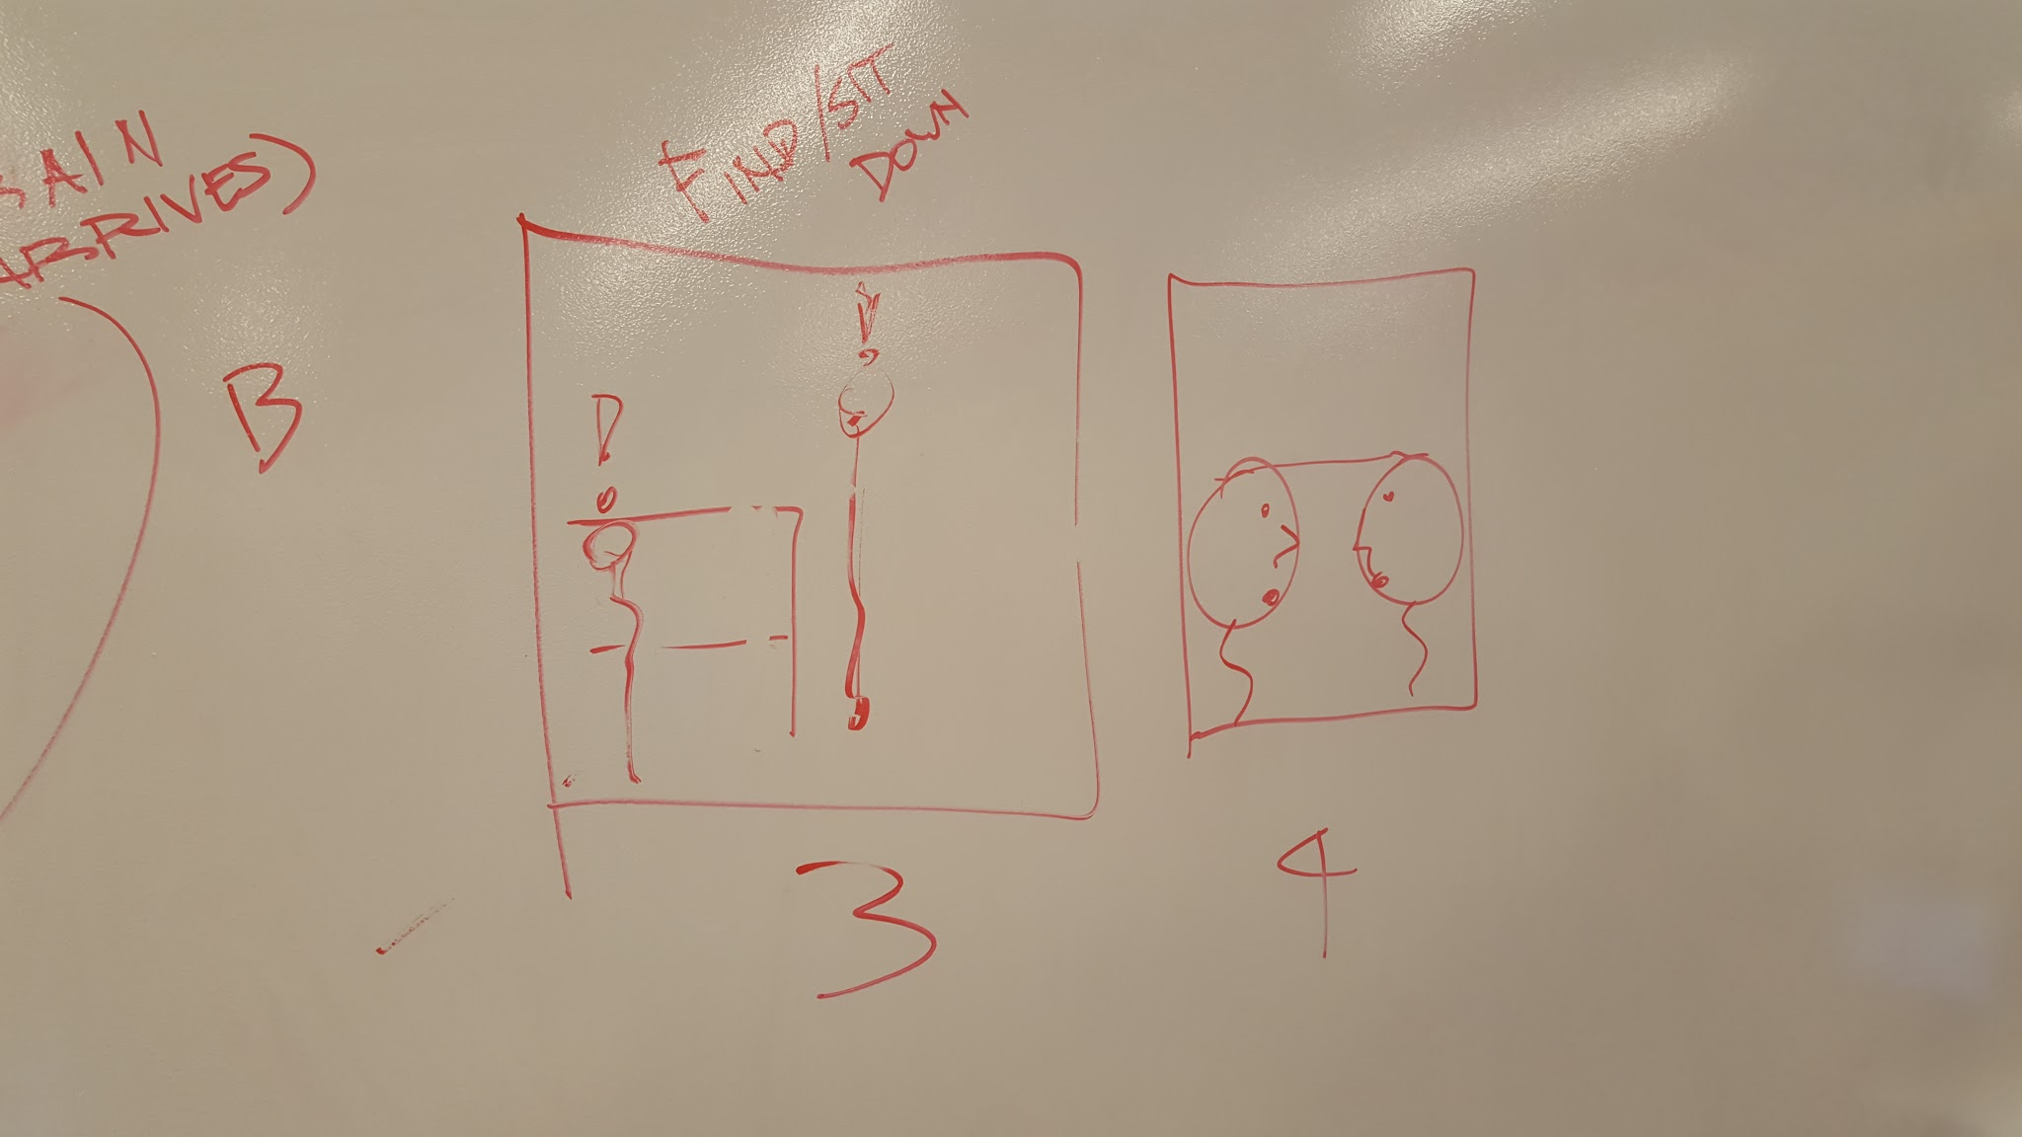
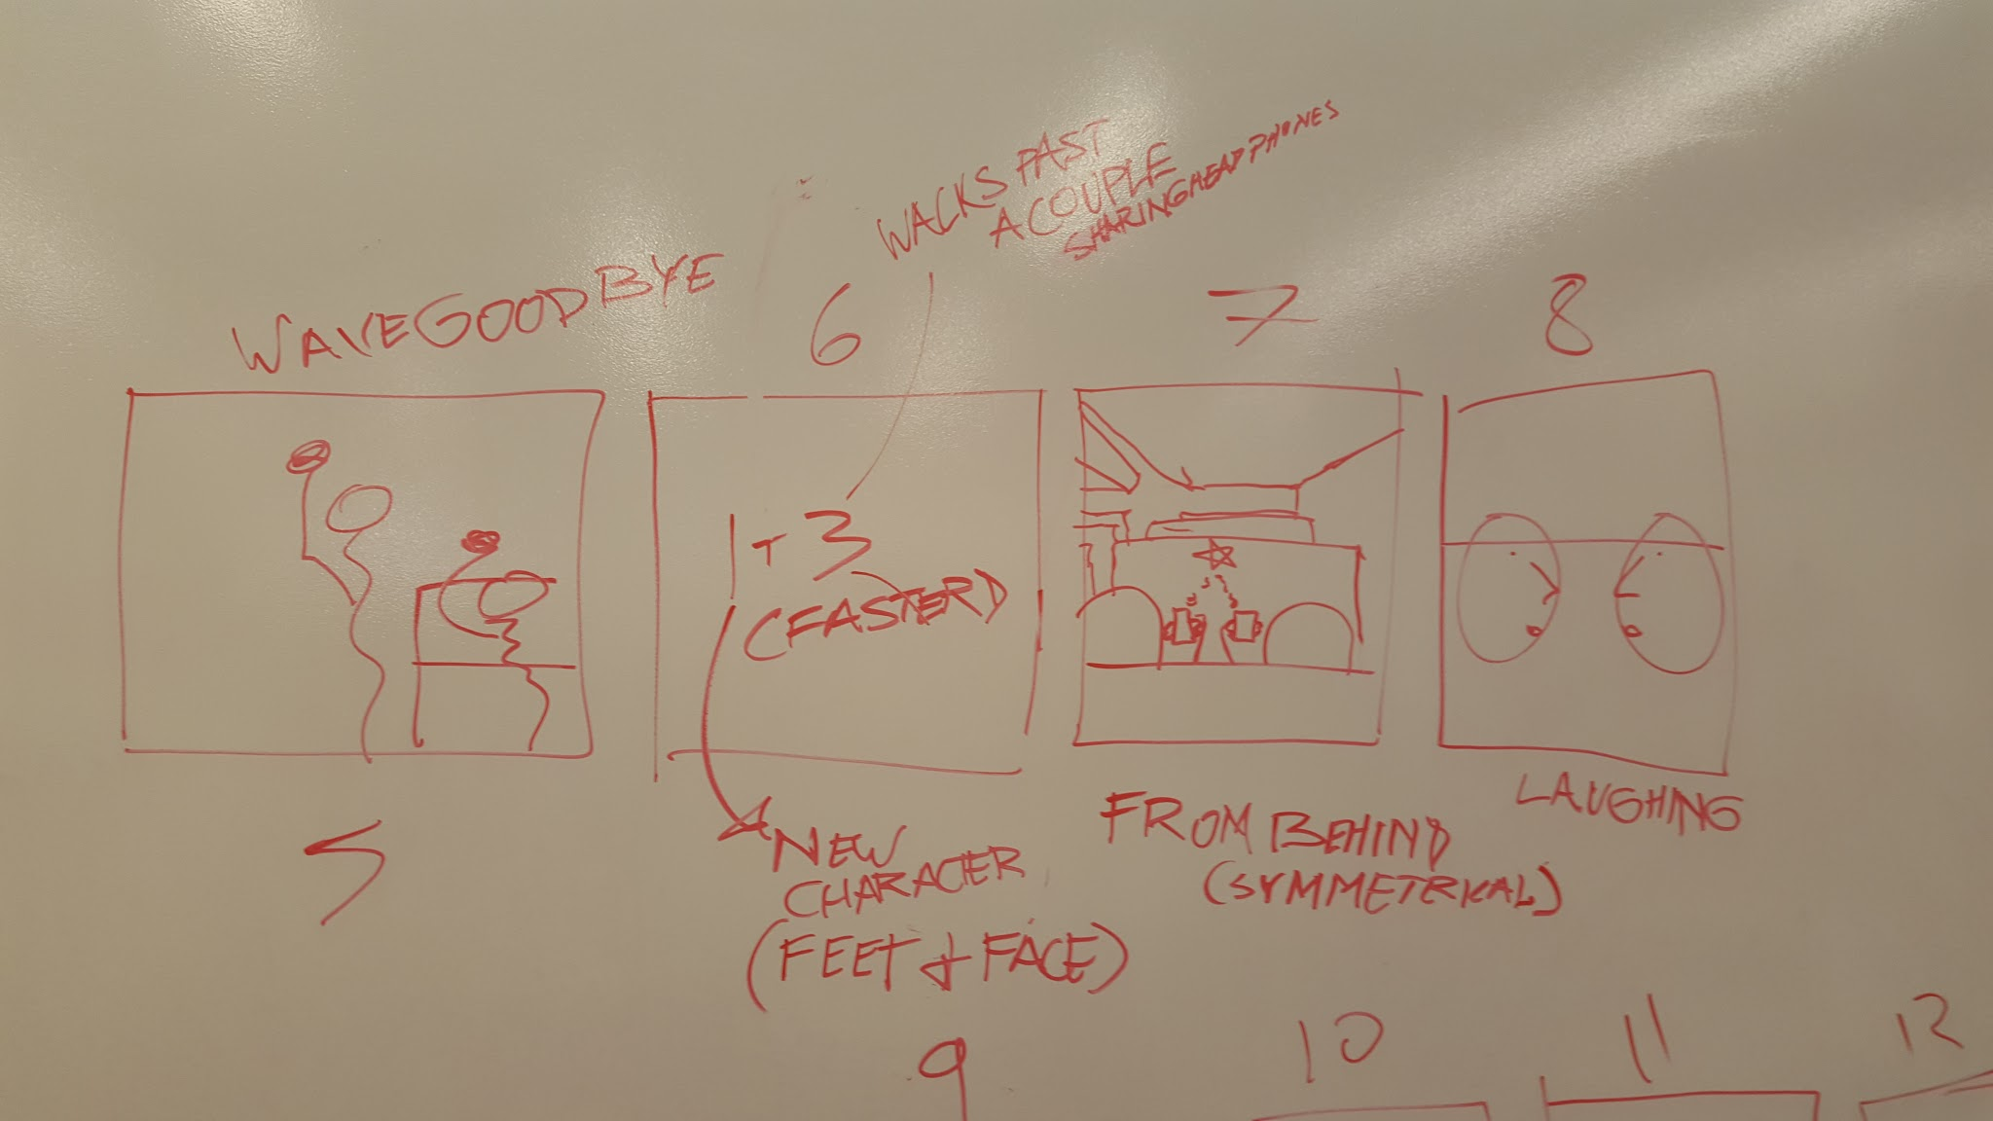
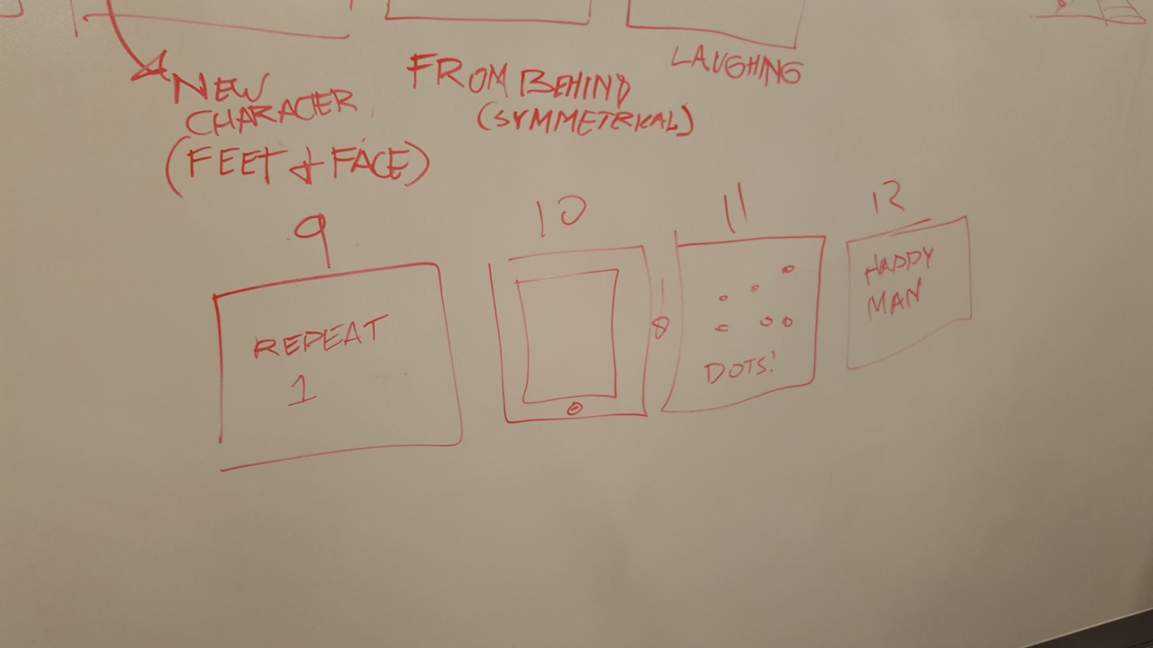
Video Storyboards:

Slide 4
Our Video
Link: https://youtu.be/fpQM4s3MH2c

