Slide 1
Adrian H., Christian M., Scott A., Ashwin K.
Sustainability
Commutes
Performance Metrics
Childhood Habit Formation

Slide 2
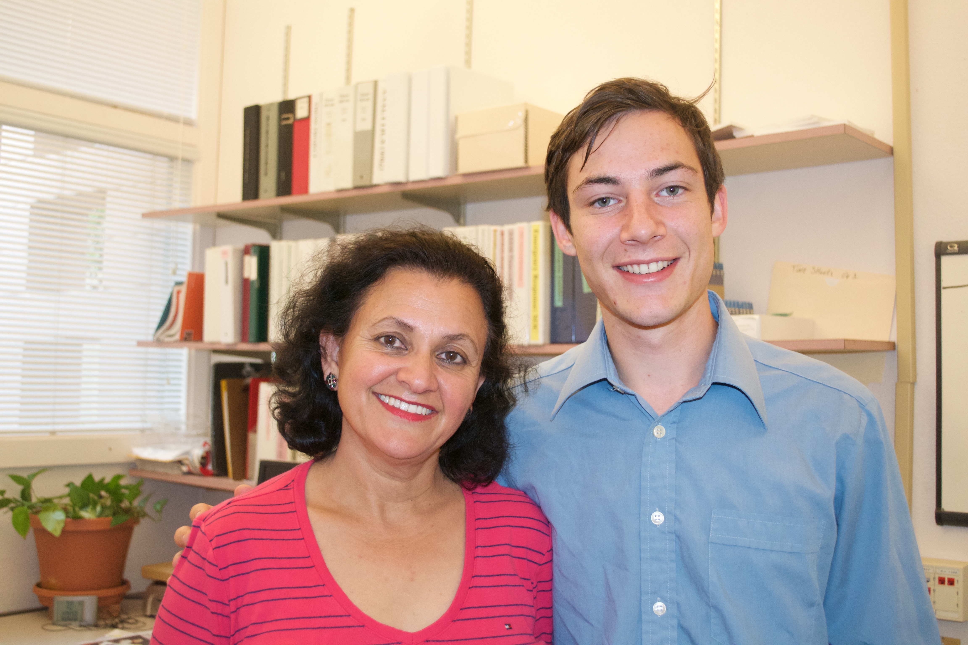
Initial POV
Commutes
Performance Metrics
Childhood Habit Formation
Aparna Sharma
Librarian
Swain Chemistry Library
Early 50’s
From Punjab, India
Dislikes Waste, Loves Walking and
her CalTrain Commute

Slide 3
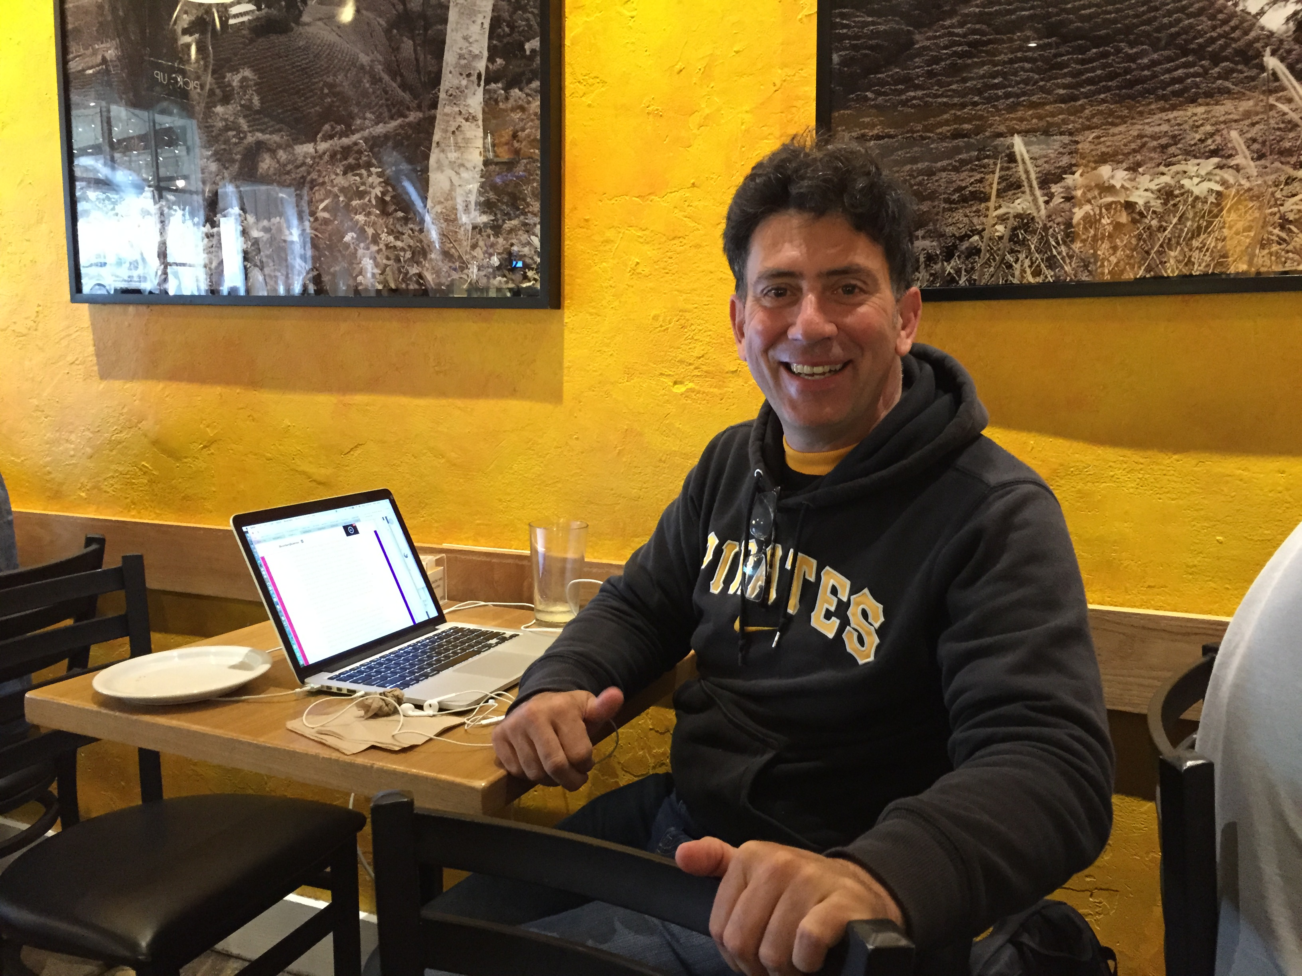
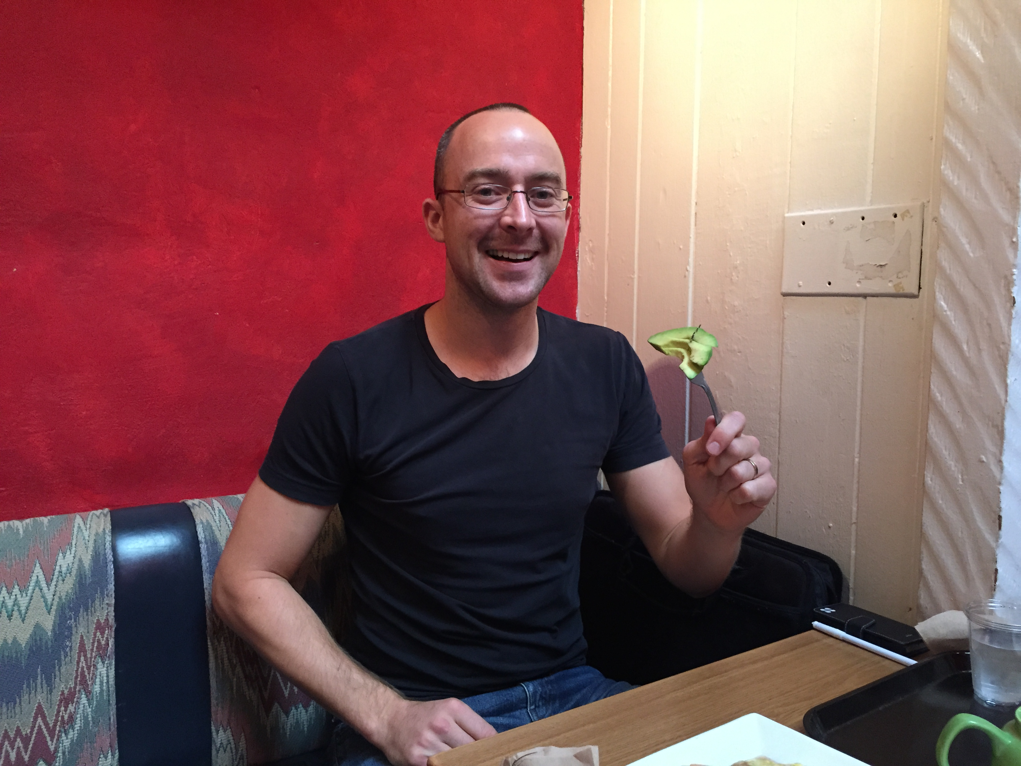
New Findings
Commutes
Performance Metrics
Childhood Habit Formation
Cafe Interviews
Mike, 40 Y.O., Pittsburgh, Entrepreneur
Uses public transit, doesn’t like “sustainability”,
but also doesn’t like waste
Andy, 34 Y.O., Ireland,
Food Service Entrepreneur
The time to change habits is childhood,
foodservice hard to make sustainable
without bigger structural changes.

Slide 4
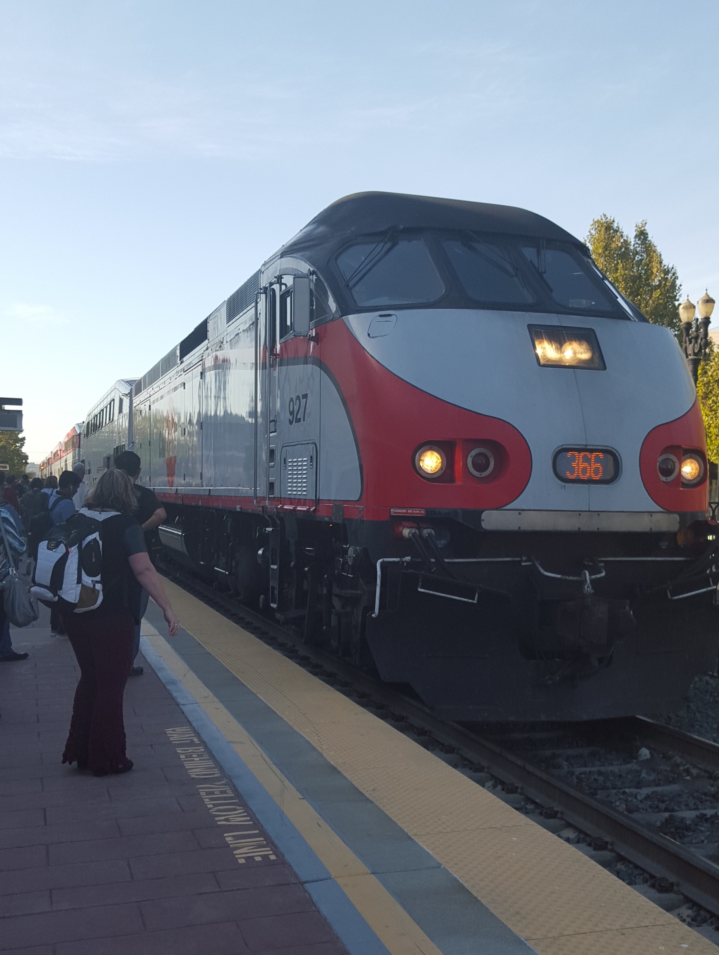
New Findings
Commutes
Performance Metrics
Childhood Habit Formation
CalTrain Interviews
Leila, Late 20’s, UCB grad, Consultant
engaged and social, waiting to talk
John, Mid 50’s, Med School Lab
Committed to CalTrain, Shy

Slide 5
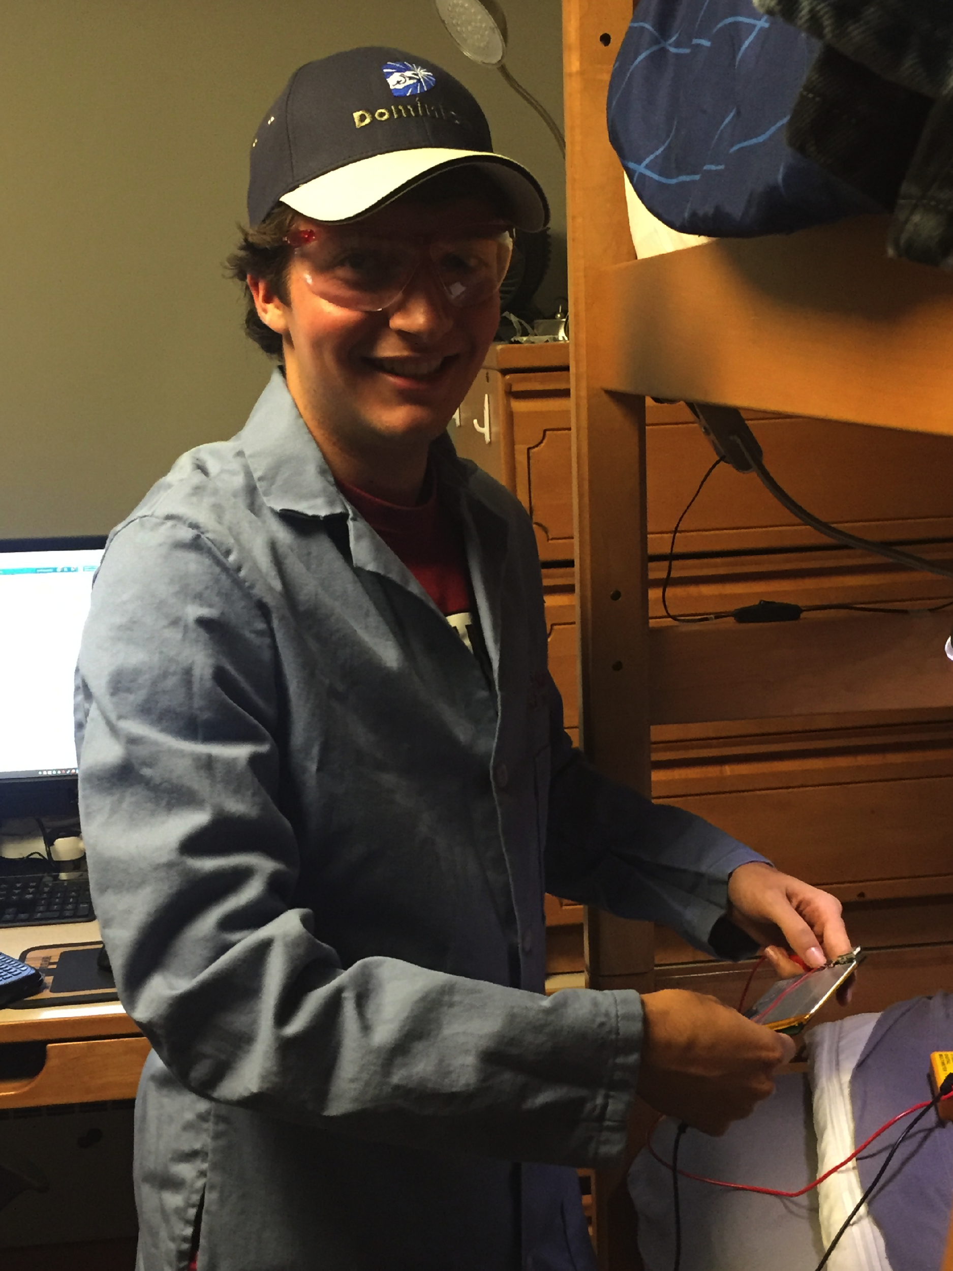
POVs
Commutes
Performance Metrics
Childhood Habit Formation
POV
We met Justin, an expert on atmosphere and energy, who needs sustainable habits to be more convenient and apparent, because of his busy life style. It would be game changing to make sustainable living more convenient.

Slide 6
POVs
Commutes
Performance Metrics
Childhood Habit Formation
POV
We met Saul, hospitality manager at Stern, who needs a better way to bring sustainability to his home life, because it already matters so much at his workplace. It would be game changing if we could help him educate his children about the importance of sustainable habits.

Slide 7
POVs
Commutes
Performance Metrics
Childhood Habit Formation
POV
We met Aparna, a Stanford librarian. We were amazed to realize that she met people and had a loose circle of friends on her daily Caltrain commute. It would be game changing to make sustainable transit more social for those who want it to be.

Slide 8
Guiding HMW Questions
Commutes
Performance Metrics
Childhood Habit Formation
HMW Get people to believe that the small stuff counts?
Justin
Make commuting sustainably more fun/social?
Aparna
Incentivize companies to practice sustainable food sourcing?
Saul

Slide 9
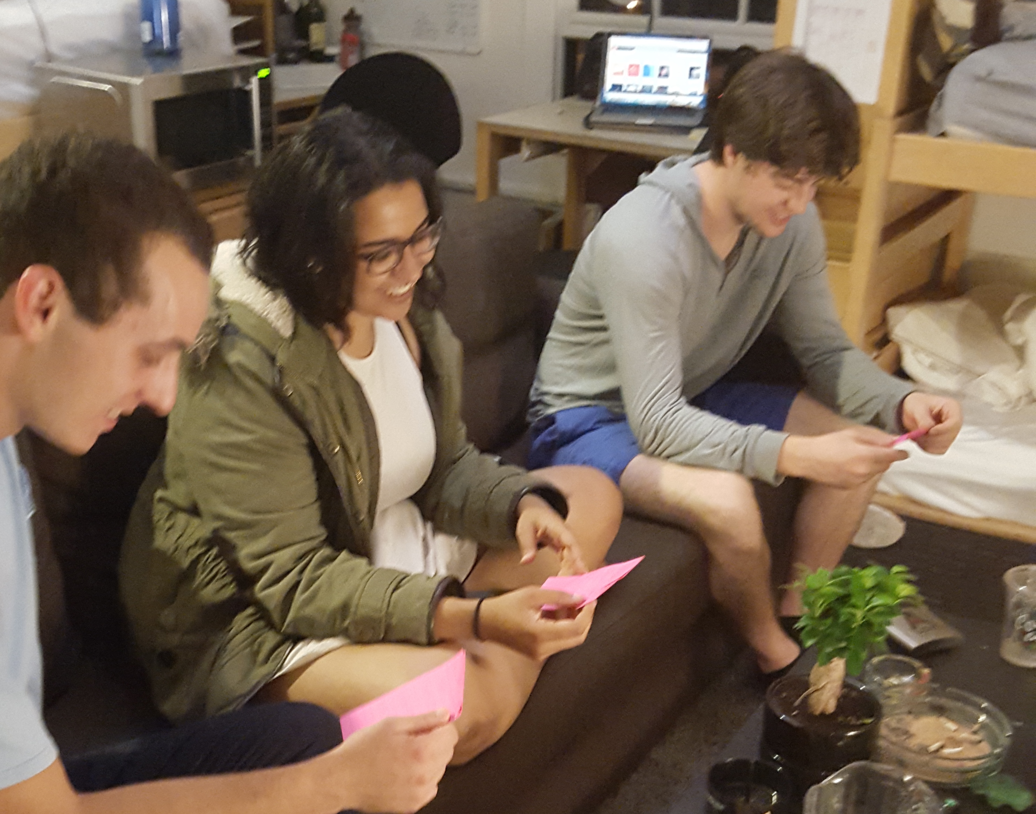
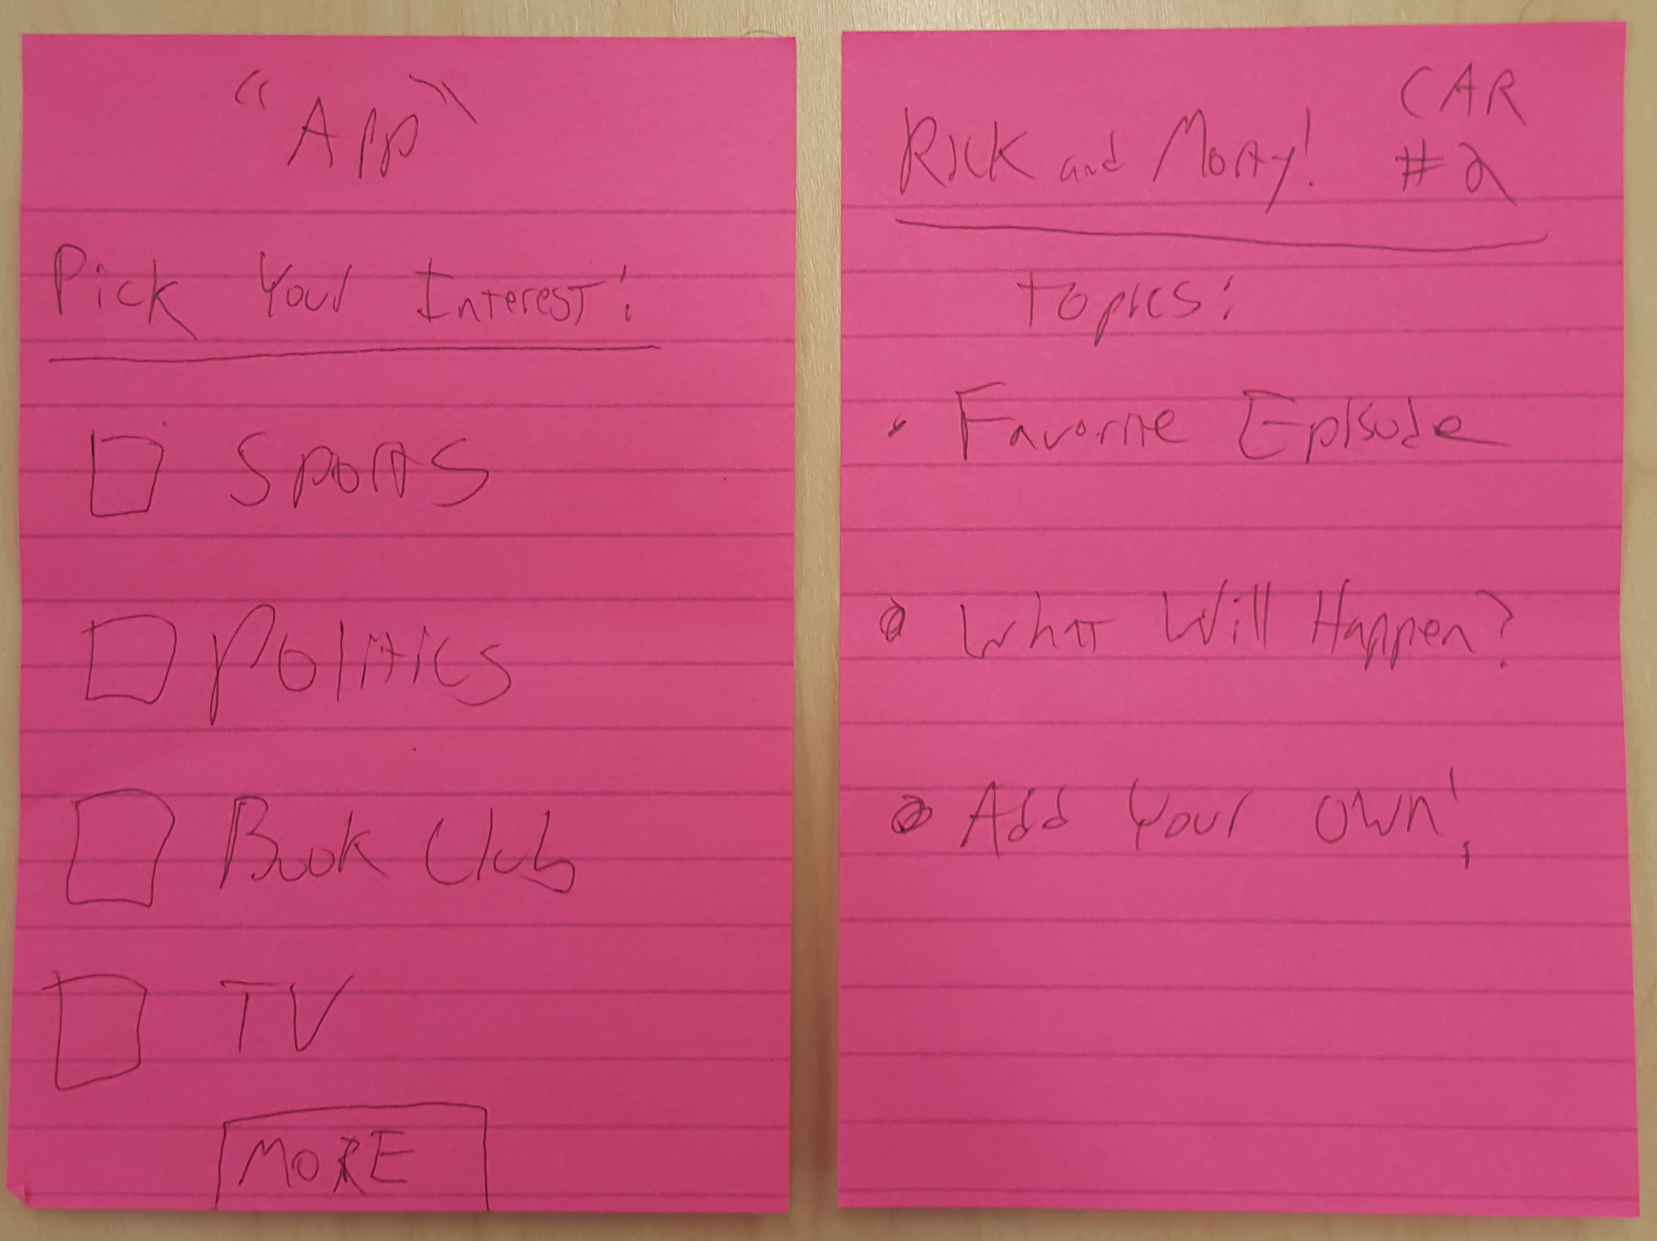
Commuting
Commutes
Performance Metrics
Childhood Habit Formation
Social Train App
Idea
connect people over similar interests
“bike car effect”
prototyping
stickies given to three acquaintances
sparked conversation!
topic too empty? questions felt forced?
conversation drifts
“lifestyles”, not interests
people do feel comfortable connecting over specific topics
three acquaintances =/= three strangers
prototype mediated by person, not machine

Slide 10
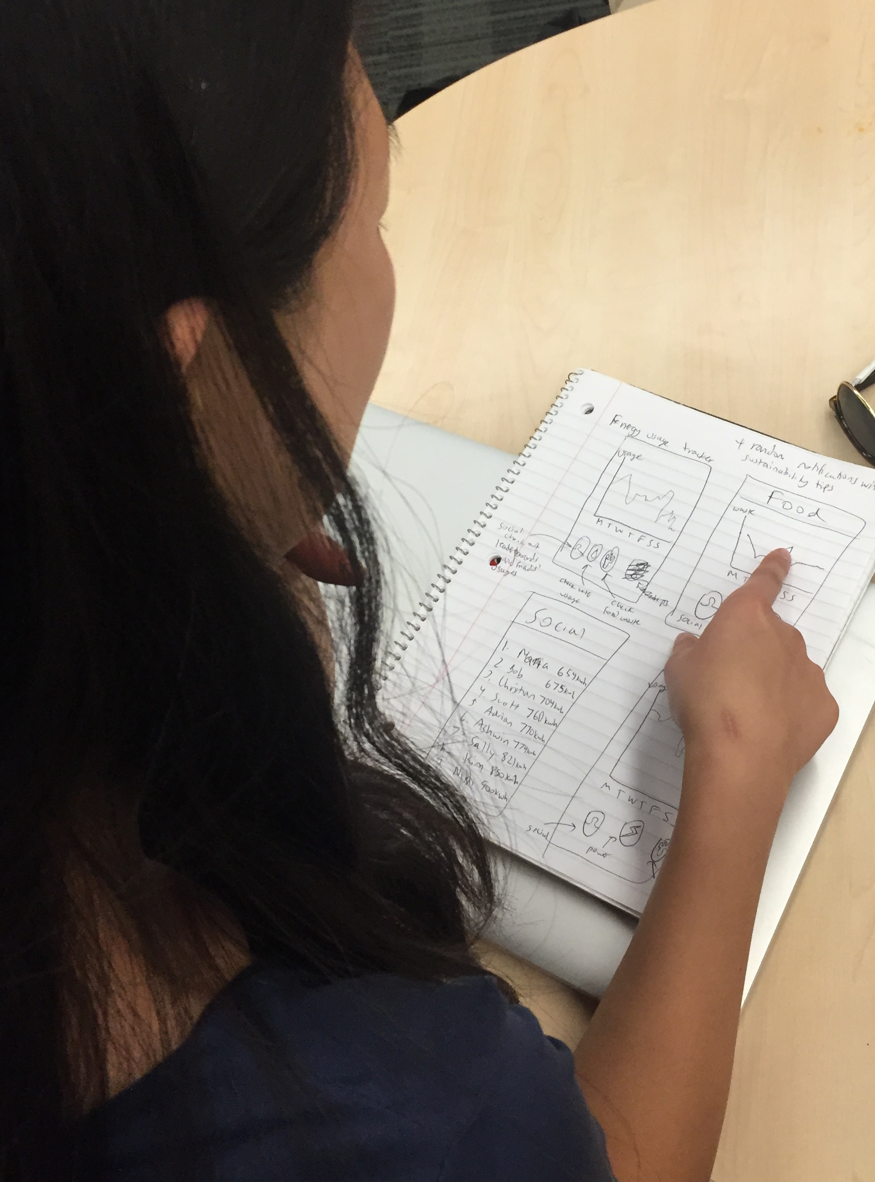
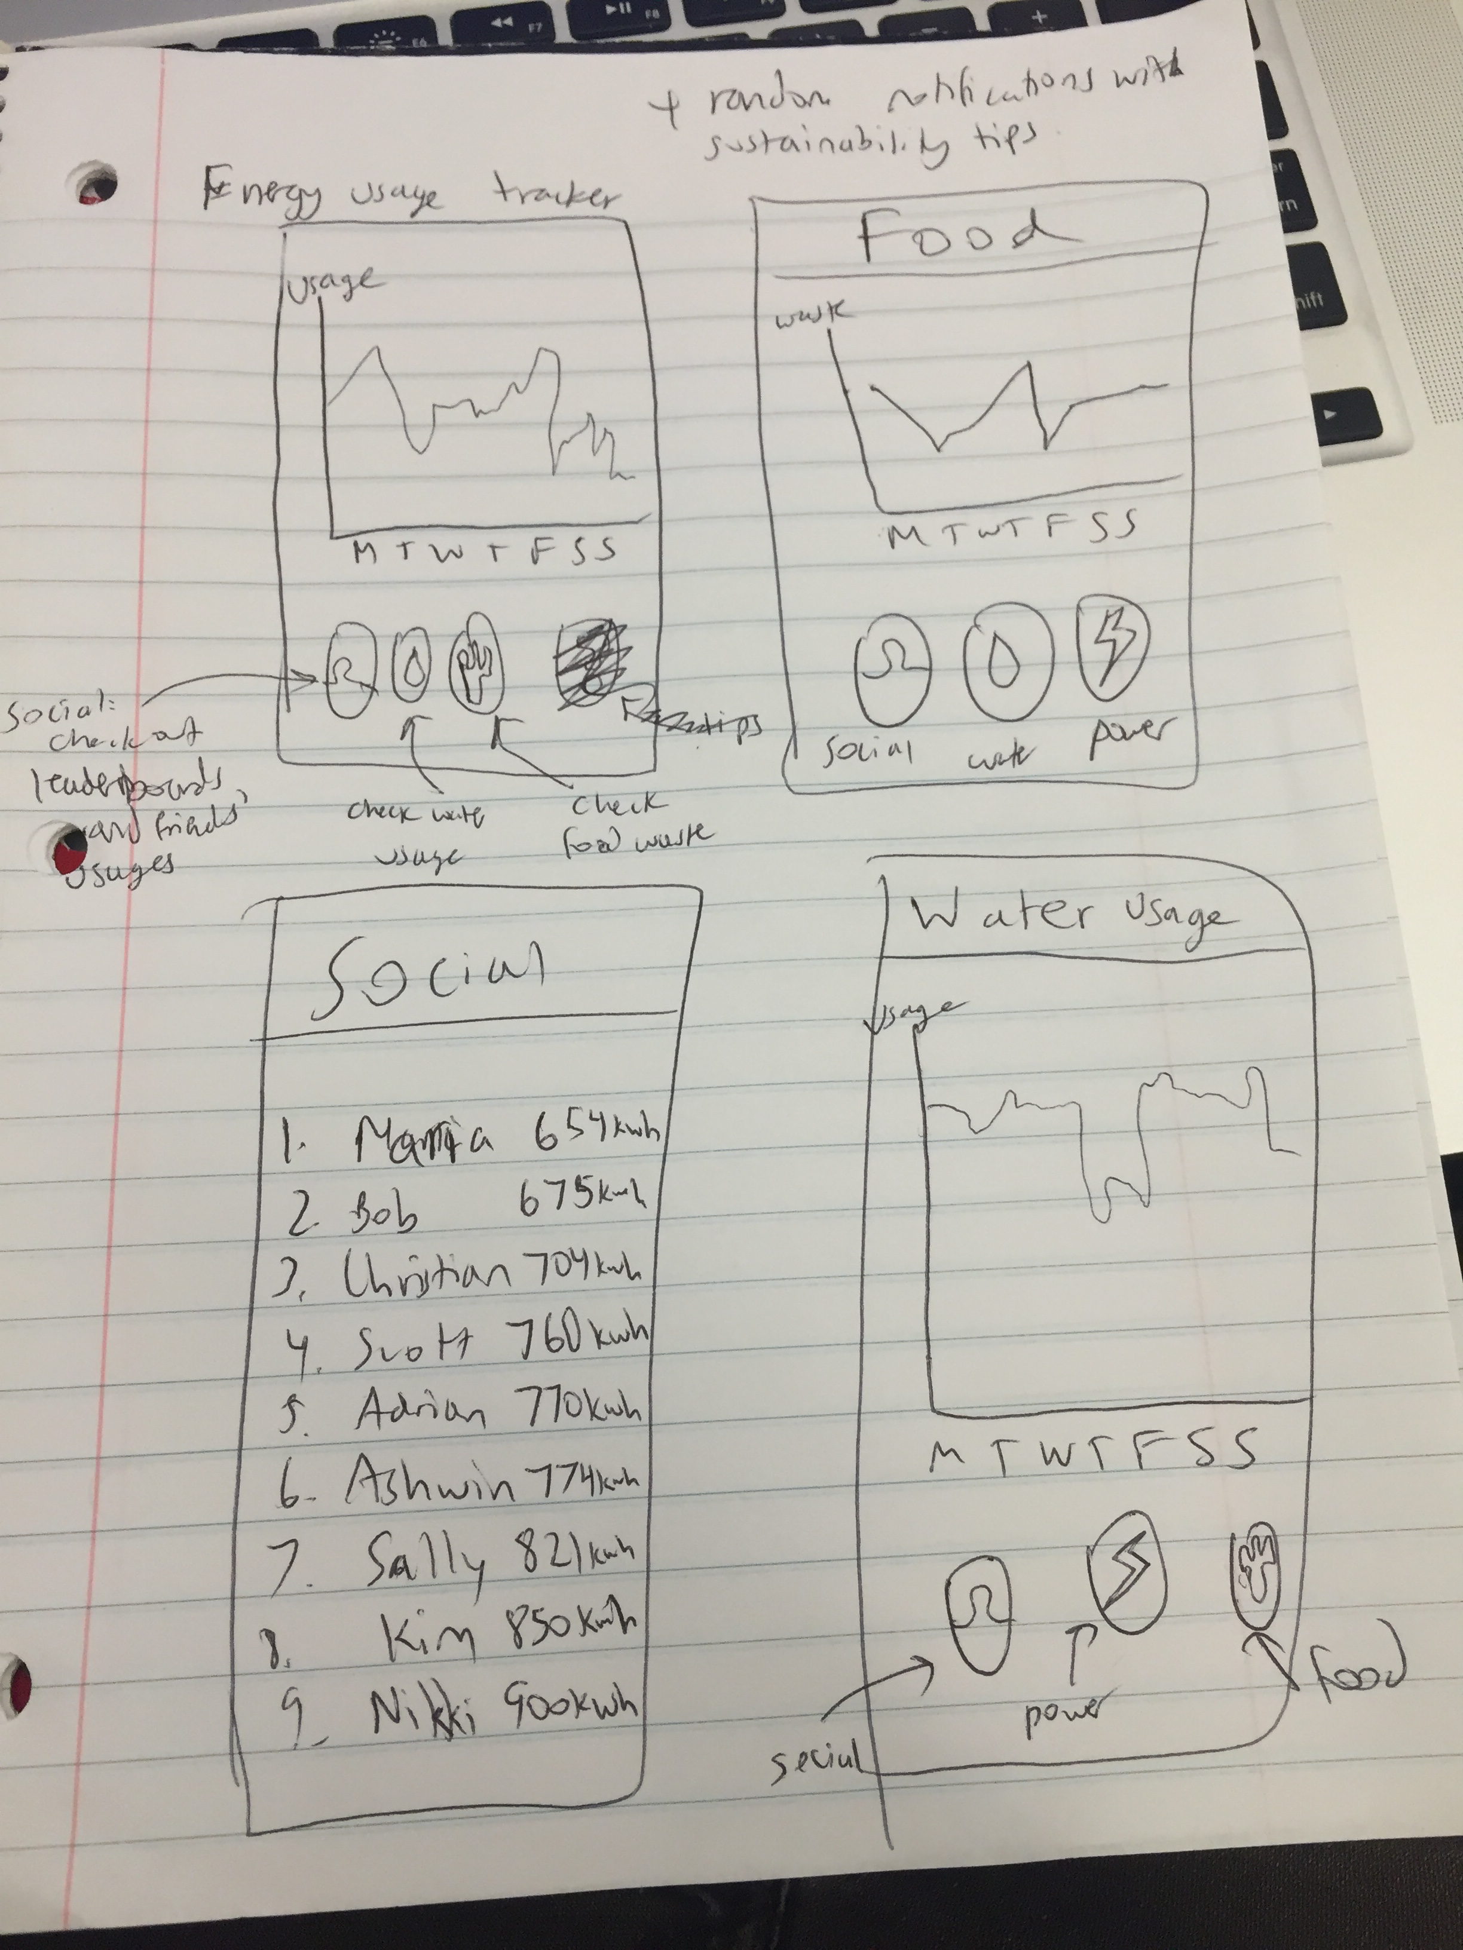
Performance Metrics
Commutes
Performance Metrics
Childhood Habit Formation
Usage Tracker App
Idea
awareness of environmental impact
make sustainability social
prototyping
Krysten plays with UI, running commentary
Interested in comparing with others.
no real info, no hardware
competition increases motivation
refine hardware and daily life integration
people do want competition

Slide 11
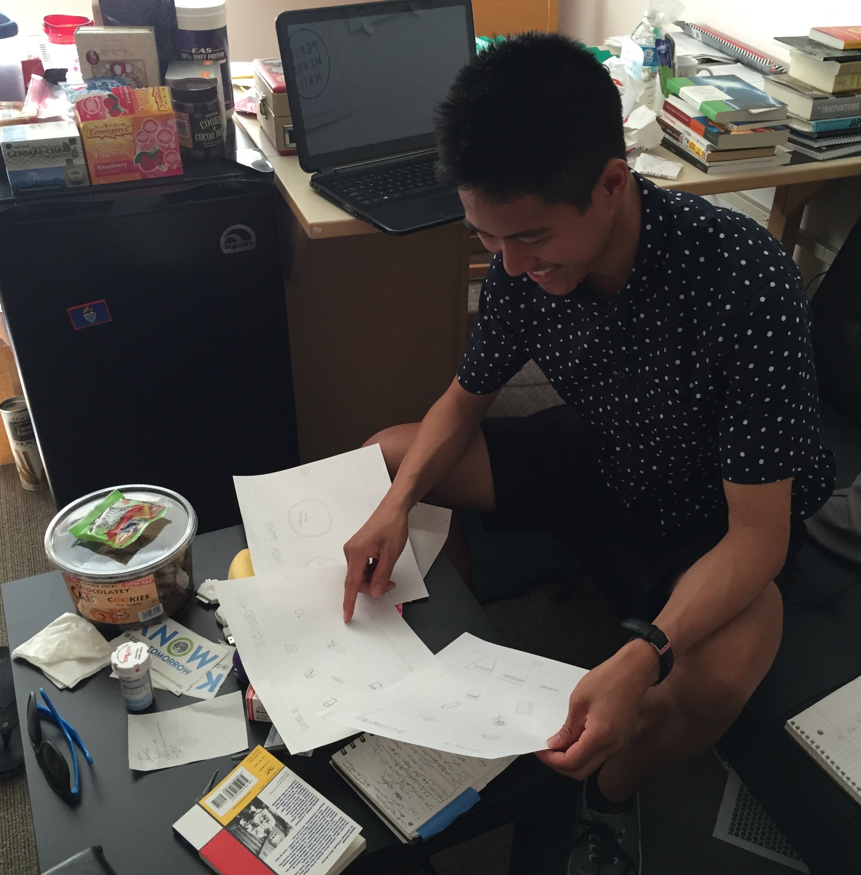
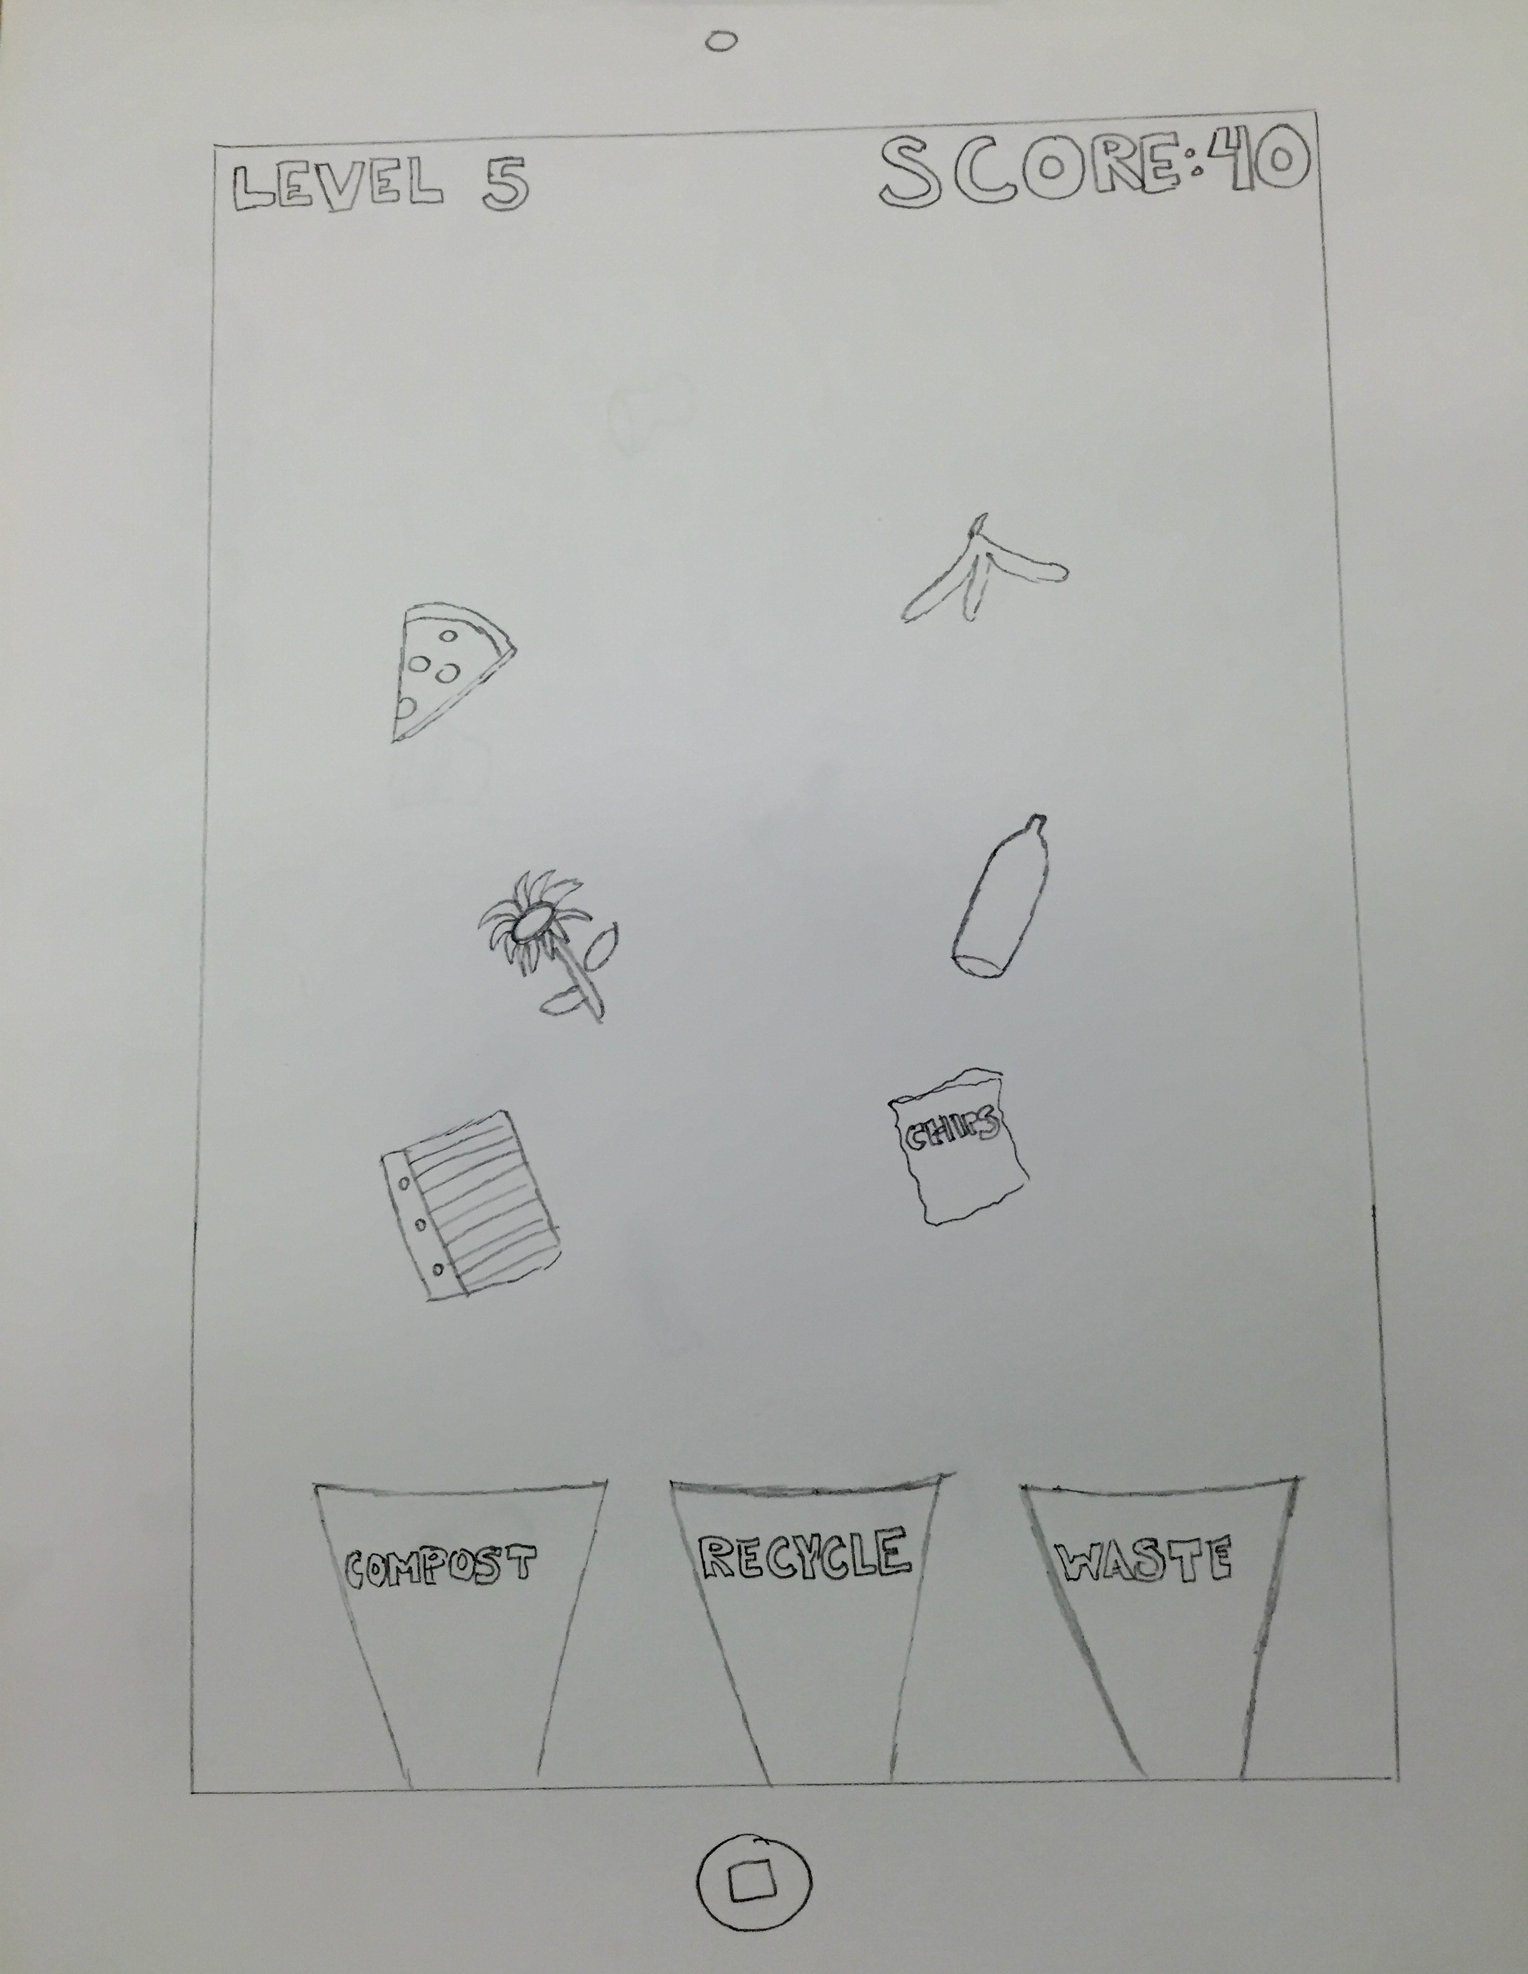
Childhood Habit Formation
Commutes
Performance Metrics
Childhood Habit Formation
Sustainability Game
Idea
ingrain sense of sustainability early
supplement parenting through educational game
prototyping
Josh presented with series of game screens, running commentary
positive reception, showed idea clearly
no children, no impact assessment
no need for tutorial
Applications in schools?
informational aspect?
requires adult comprehension of game

