Slide 1
Needfinding
Sustainability

Slide 2
Introduction
Team Members: Scott Arkin, Ashwin Kumar, Adrian Harrison, Christian Medina.
Possible Problem Domains:
Sustainability of commuting
At home sustainability
Food service sustainability
Notes:
Team members
Domains - Broad

Slide 3
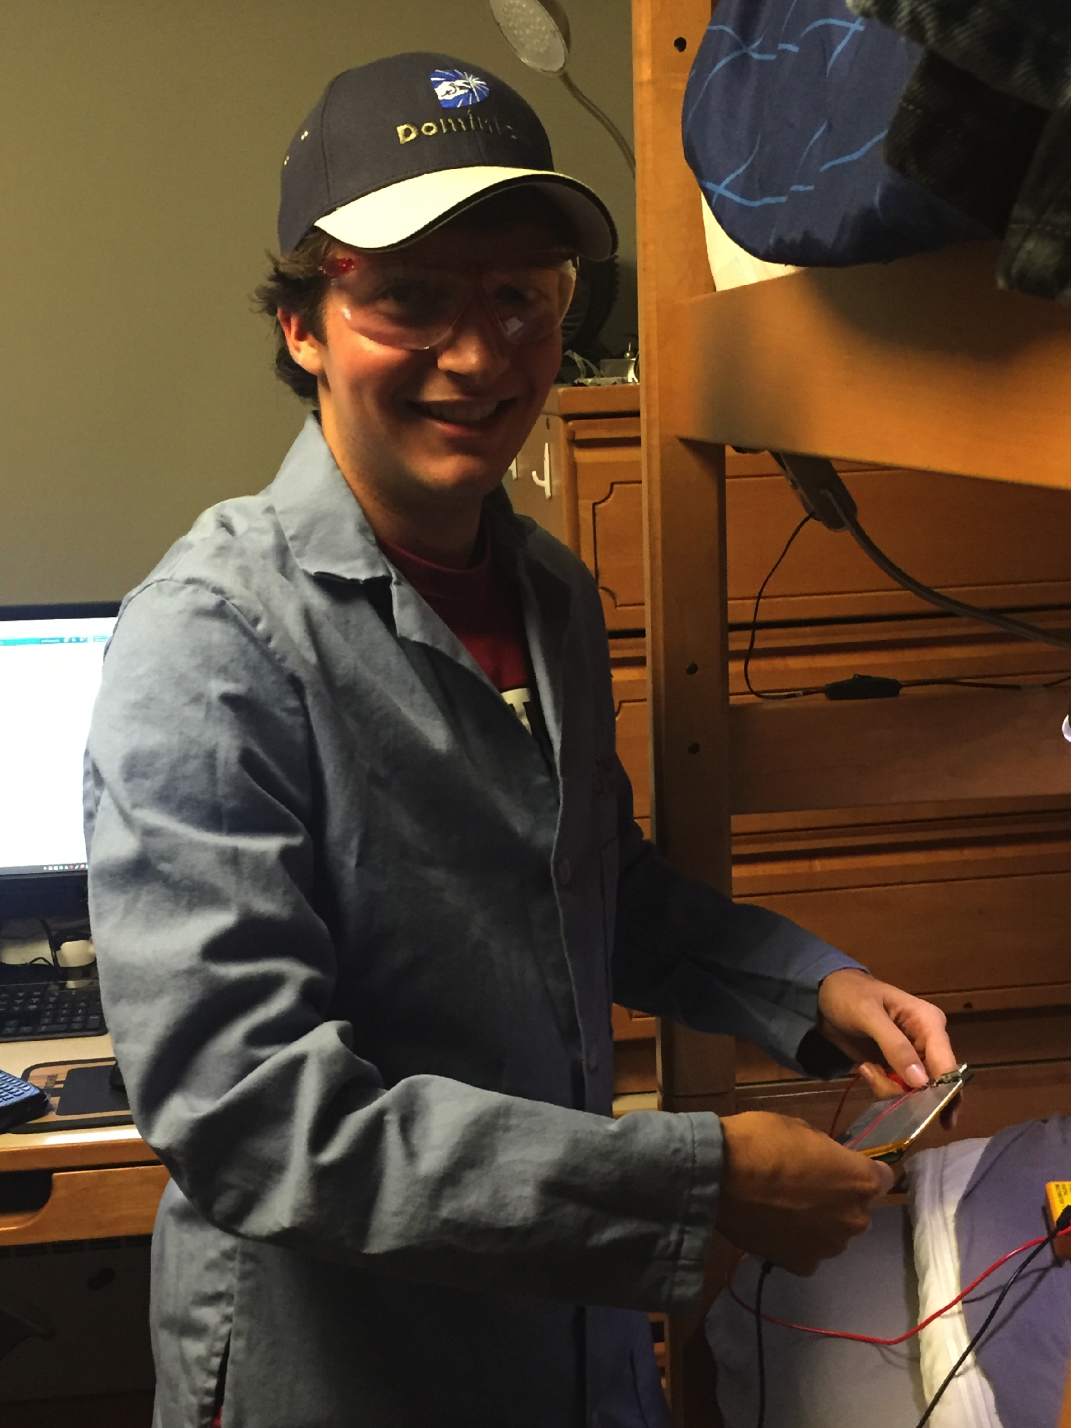
Justin Adamson
Stanford Junior
Atmosphere and Energy Engineering Major
Notes:
Expert

Slide 4
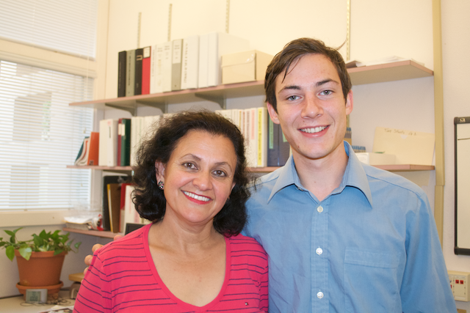
Aparna Sharma
Librarian
Swain Chemistry Library
Early 50s
From Punjab, India
Notes:
Librarian at Stanford
Originally from India

Slide 5
Saul Cardenas
Hospitality Manager at Stern Dining
“Responsible for the happiness of the customer, the student, and the overall experience when they come into the dining room.”
Mid 40s
Notes:
Hospitality manager
Works for r and de

Slide 6
Questions:
Personal Sustainability Questions
Commute Questions
Person Specific Questions
Notes:
Overarching themes of questions
Didn’t want to narrow ourselves
Person Specific - r and de

Slide 7
Justin Adamson Interview
2 major problems
Mass transportation
Local effects
What do you do to live sustainably?
Education on how to live sustainably is important.
Notes:
2 major areas
Mass transit
Smog
cars, electric
Solar panels, grid
Lots of info
Personal consumption
Education limiting factor

Slide 8
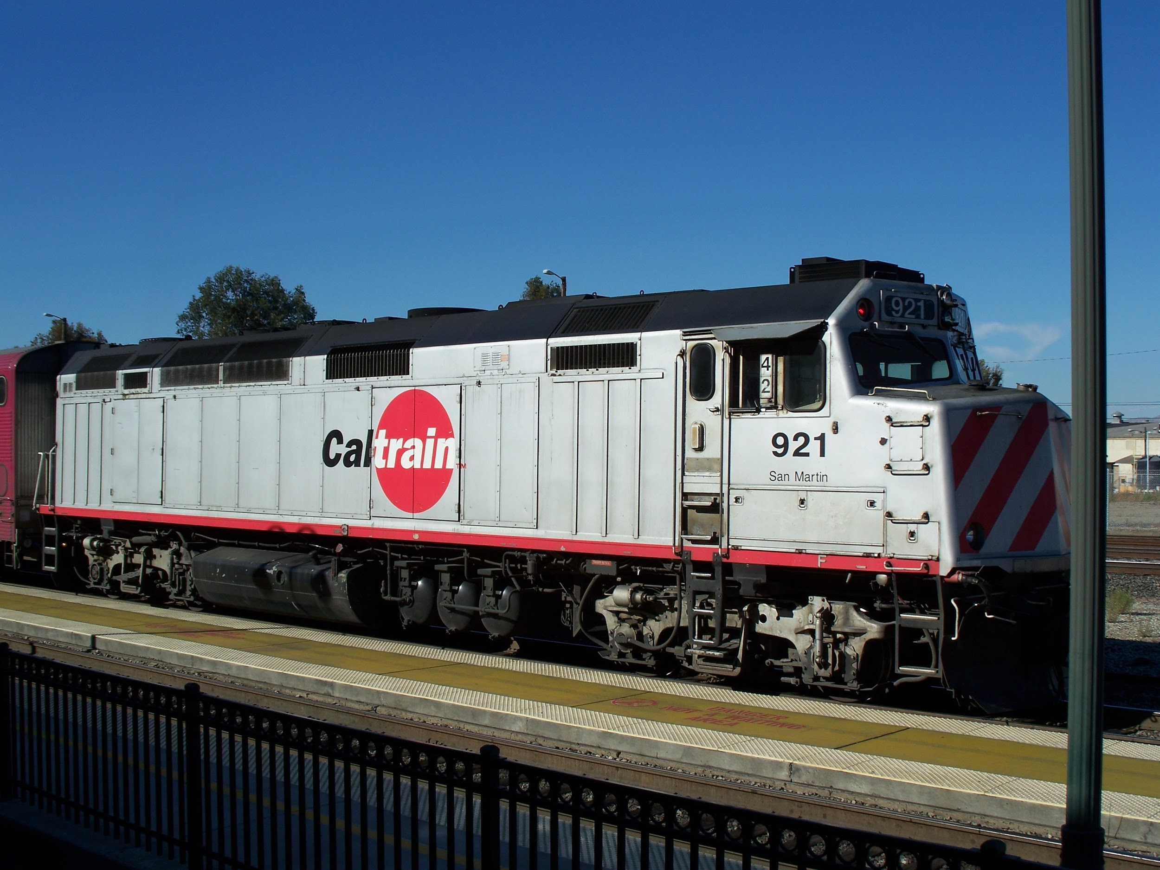
Aparna Sharma Interview
Commutes on Caltrain+Walking
“Crazy” to take bus
Socializes on train
Bikers scary
Tries to be personally sustainable
Saves food from events
Uses reusable dining ware
Notes:
More than just getting to work, socialize
Bikers scare her while walking
gets annoyed with her boss

Slide 9
Saul Cardenas Interview
Large Sustainability effort by R&DE
Buy Local
Donate Leftovers
Keeps Family on Sustainable Regiment
Kids don’t understand yet
Skateboards to work
Notes:
r and de has a large effort
Australian beef
At home, kids 5 and 9 on regiment, lights, water

Slide 10
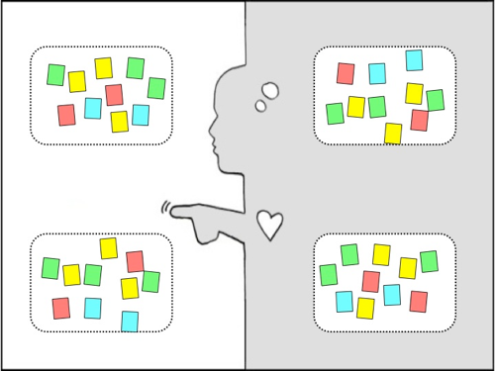

Slide 11
Empathy Map - Justin
SAY:
Many people do care about the environment, and want to live sustainably, but it’s currently so hard to do so”,
“sustainability push is good on a local level, but the actual energy creation and extraction part is not controlled by people, it is controlled by entities and governments, that’s going to be the real challenge
THINK:
User might be more inclined to live sustainably if it were laid out for them in an easy to follow/understand manner
DO:
I noticed that he seemed uncomfortable when I asked him about all of the things he does to live sustainably. My hunch is that he felt guilty from knowing he doesn’t do a whole lot right now, but should. Could be a reflection over more of the population
FEEL:
regret and guilt over not doing a lot to live sustainably, frustration in that it is difficult to live sustainably
Notes:
People want to be sustainable, but it’s hard
Even our expert

Slide 12
Empathy Map - Aparna
SAY:
“Crazy” to take the bus when it’s so nice to walk
bothers her that her boss packs pre-packaged lunches, and then also uses disposable plates and forks.
THINK:
Important for people to live sustainably
Commute is social as well as responsible
People often lazy and wasteful
DO:
Shifted gaze when asked about sustainability
Liked to lean forward when explaining her opinions as if inviting agreement, but unsure that I would agree
FEEL:
Eager to “sell herself” - appear sustainable
Embarrassed when not understanding what sustainability was at first
Notes:
Wants to be sustainable as well, doesn’t like when others aren’t

Slide 13
Empathy Map - Saul
SAY:
“I try to get them to understand how all that works and how it fits into the environment”
“They think I’m crazy, but that’s what we do around the house”
THINK:
Saul probably thinks that people should aim to be more environmentally conscious. He probably also thinks that people don’t know much about the sustainability efforts made by the hall.
FEEL:
enthusiastic - knew exactly what he wanted to say on the topic of sustainability
proud - sharing the accomplishments made by Stern during his 23 years
proud - that he encourages environment friendly habits at home
DO:
Saul is usually smiling. However, when we sat down for the interview, he became serious. I have a feeling that the topic of sustainability is a very important one to him.
Notes:
Very serious about sustainability at work and at home

Slide 14
Inferences and Analysis
Many people are eager to live sustainably, but lack the education or the resources to do so
Even our “expert” seemed to have guilt over this
Aparna tries to save food
R&DE makes a large effort - They have the resources
Commute is more than just getting from point A to B, it can also have a social component which may make it more enjoyable
Sustainability is something that can be instilled in the next generation from a young age
Food waste is an issue that is very visible and that people would like to reduce
Workplace sustainability may encourage at home
Notes:
Want to do it, but limited
r and de could because they have resources

Slide 15
Summary
Many possible problem domains
Participants all sympathetic to sustainability
Divide between infrastructural sustainability and personal sustainability
HCI solution more likely to apply to personal

