Slide 1
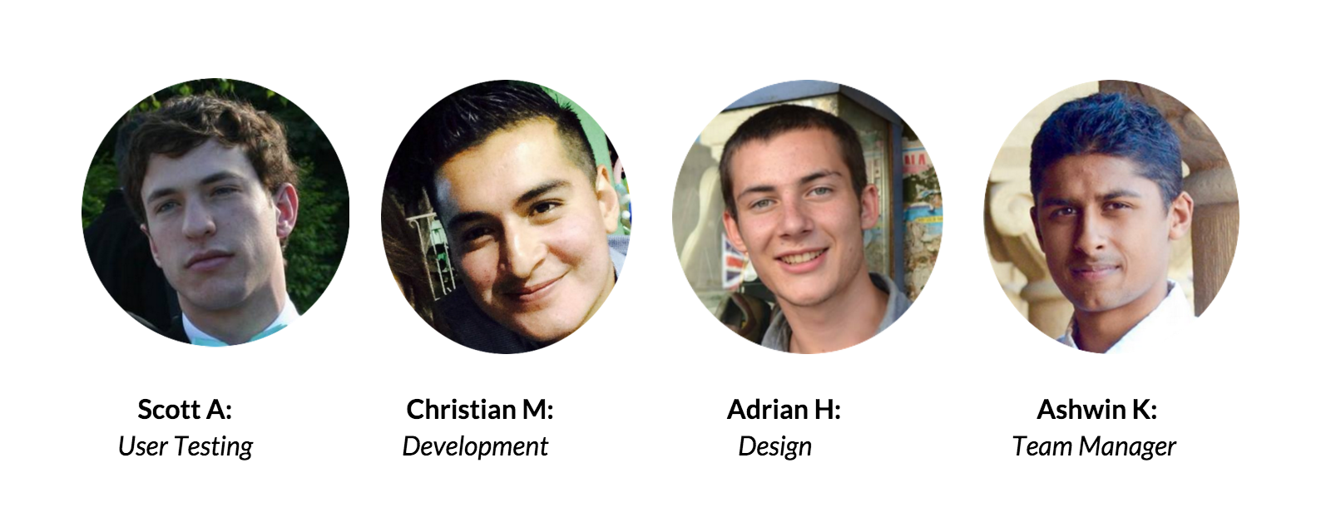

Slide 2
Where We’re Going
Problem Definition
Value Proposition
Tasks
Revised Interface
Prototype Overview

Slide 3
Where We’re Going
Problem Definition
Value Proposition
Tasks
Revised Interface
Prototype Overview

Slide 4
Where We’re Going
Problem Definition
Value Proposition
Tasks
Revised Interface
Prototype Overview

Slide 5
Where We’re Going
Problem Definition
Value Proposition
Tasks
Revised Interface
Prototype Overview

Slide 6
Where We’re Going
Problem Definition
Value Proposition
Tasks
Revised Interface
Prototype Overview

Slide 7
Problem Definition
105 million US drivers
= 7000lbs CO2/year
= 260hrs/year

Slide 8
Value Proposition
“Travel together”
+
=

Slide 9
Tasks
complex
Playing a Game
moderate
Find a Match
simple
Become Available

Slide 10
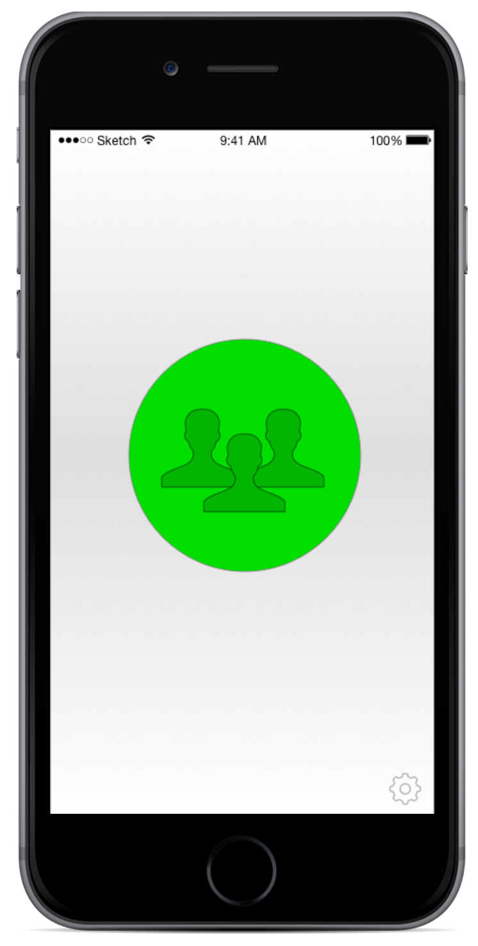
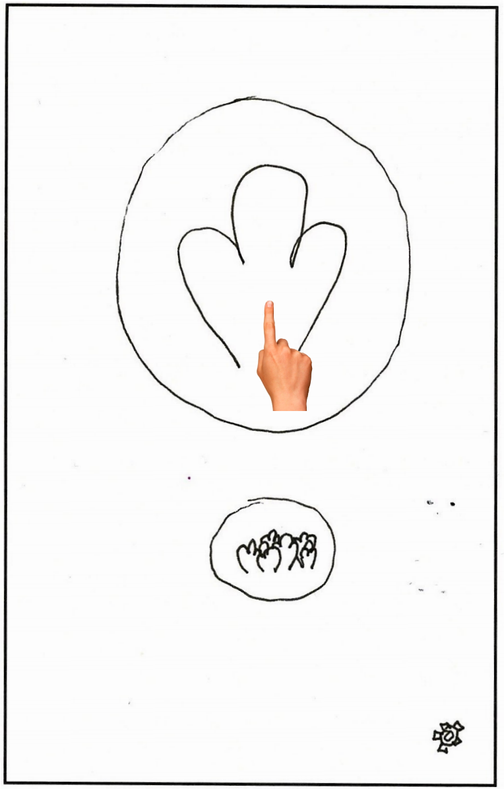
Revised Interface #1

Slide 11
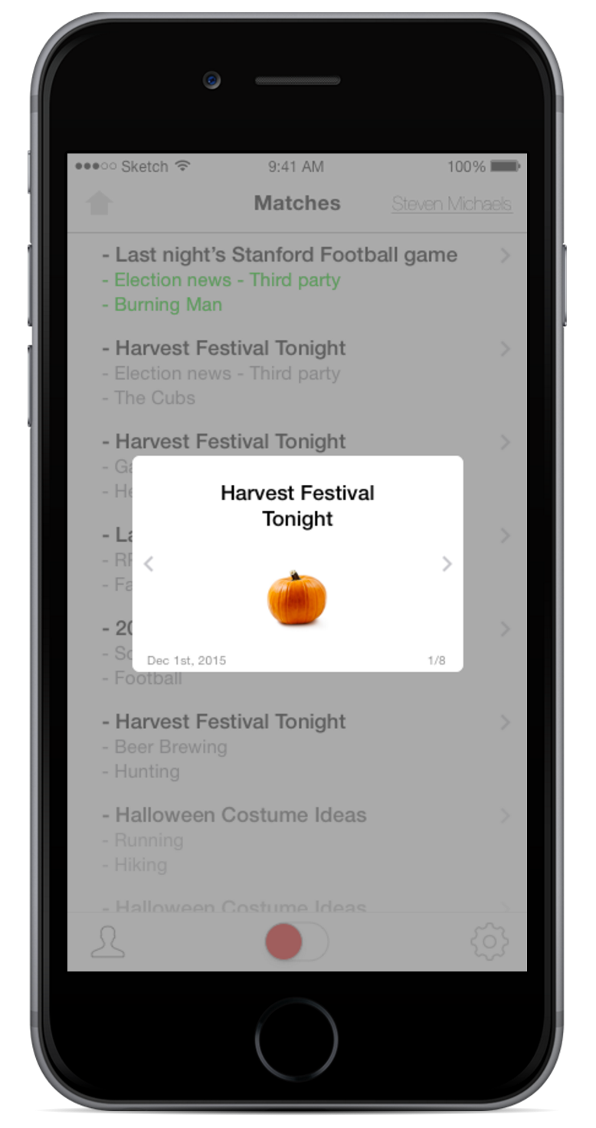
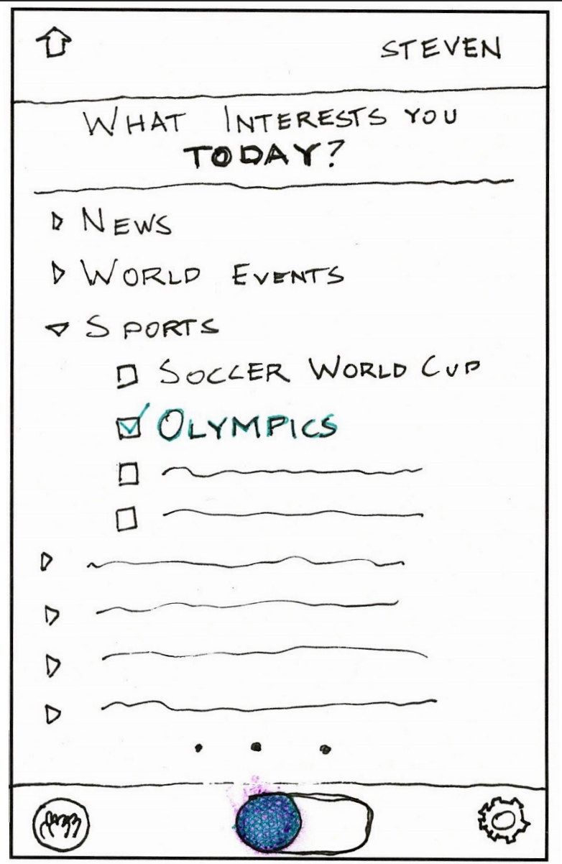
Revised Interface #2

Slide 12
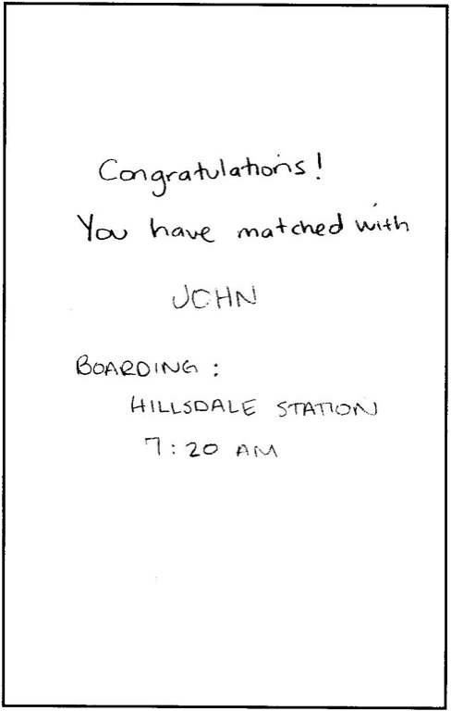
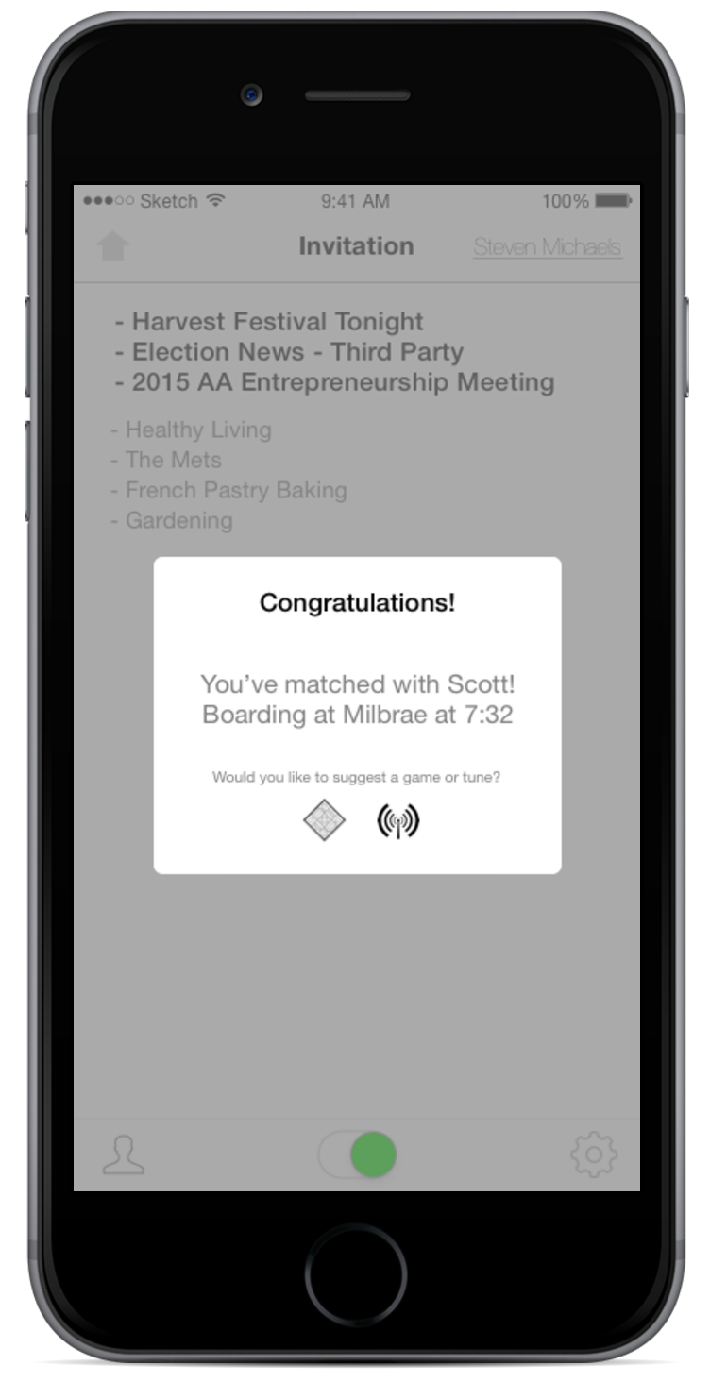
Revised Interface #3

Slide 13
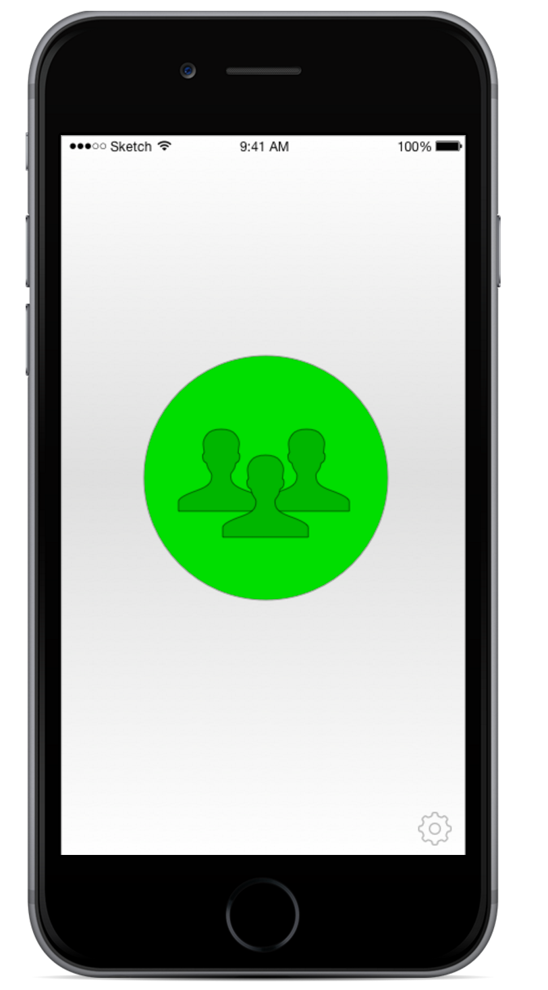
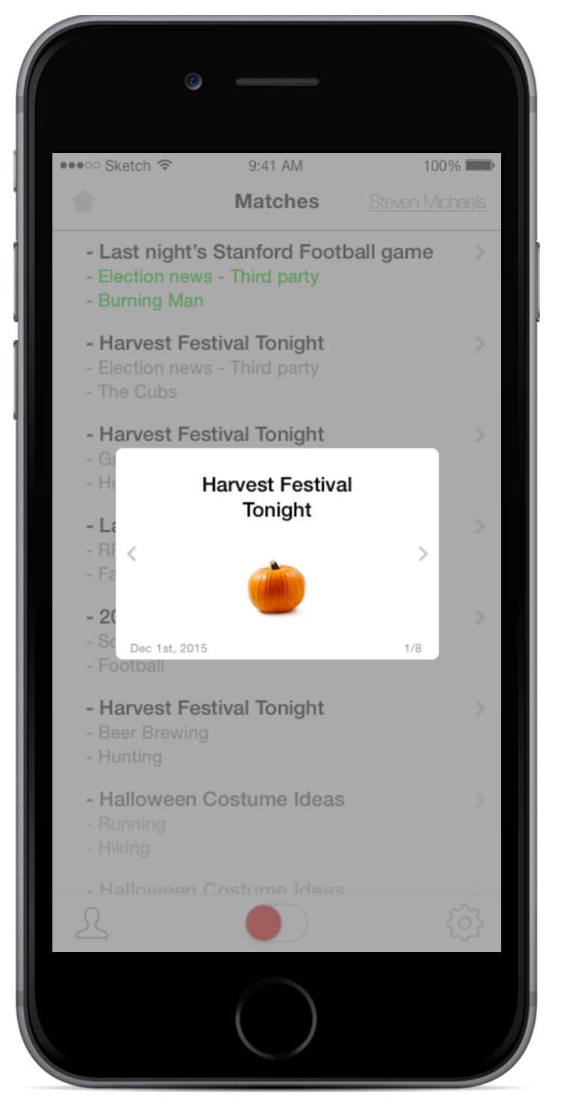
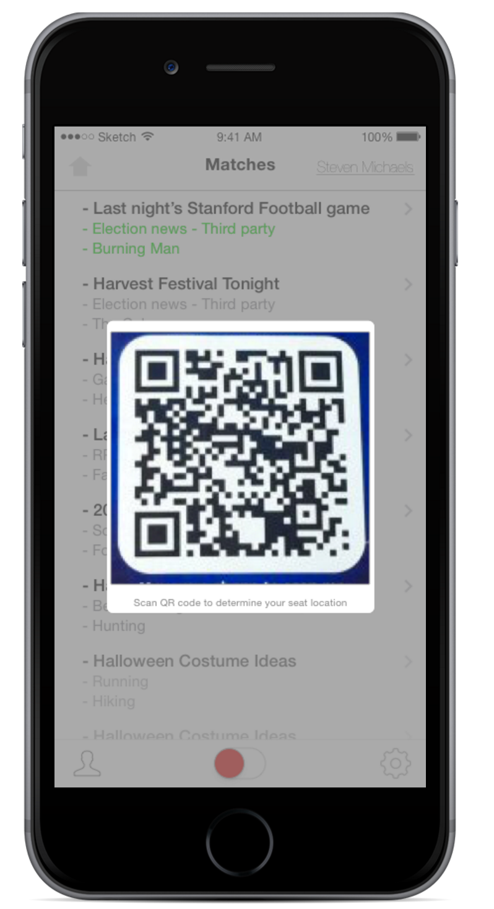
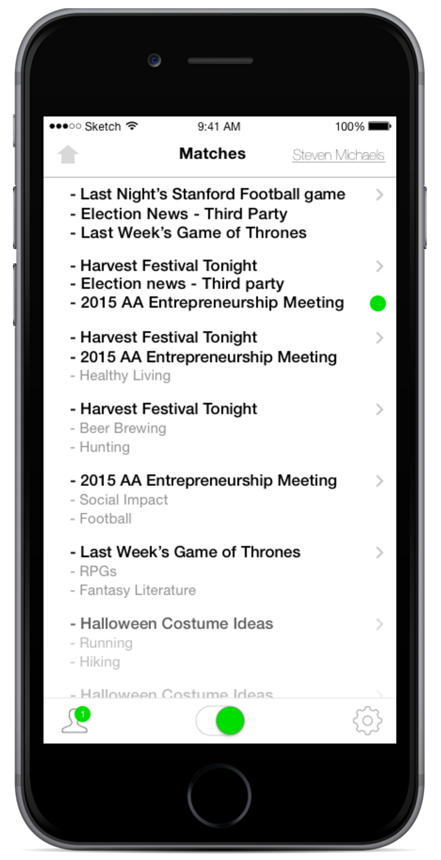
Task 1: Become Available

Slide 14
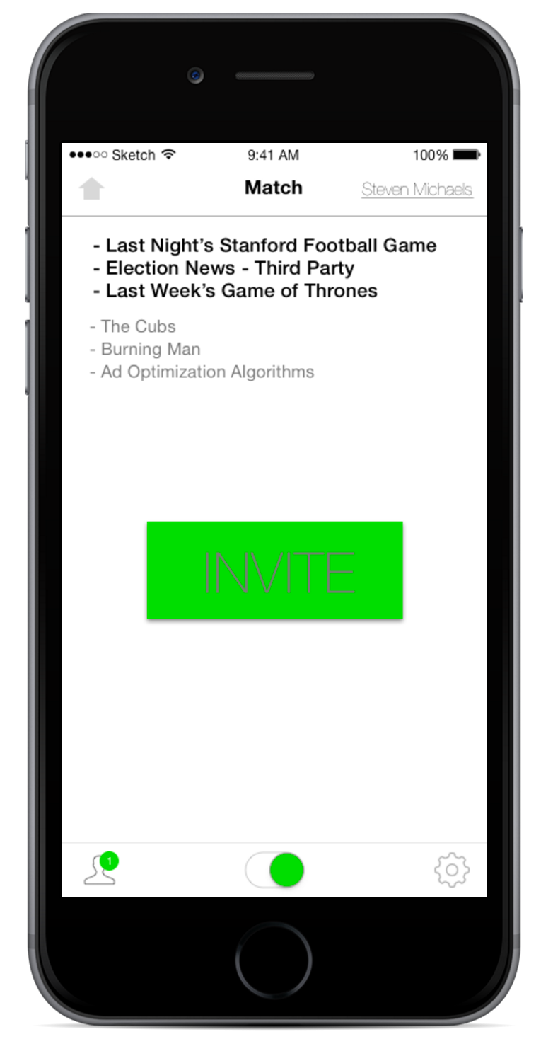
Task 2: Find a Match

Slide 15
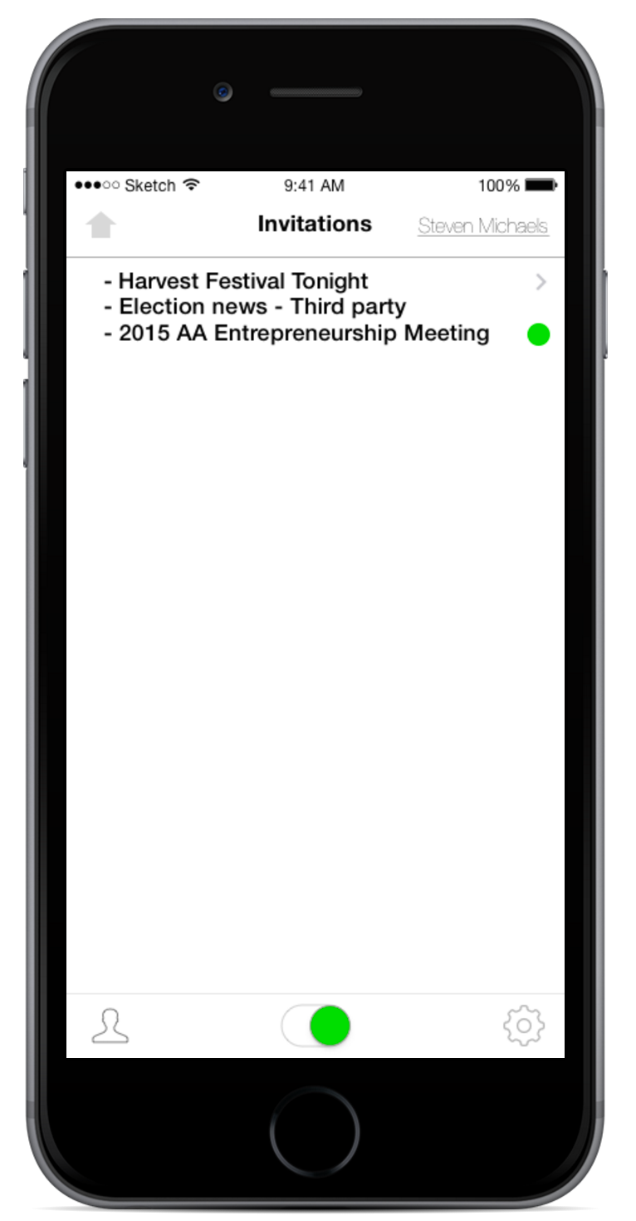
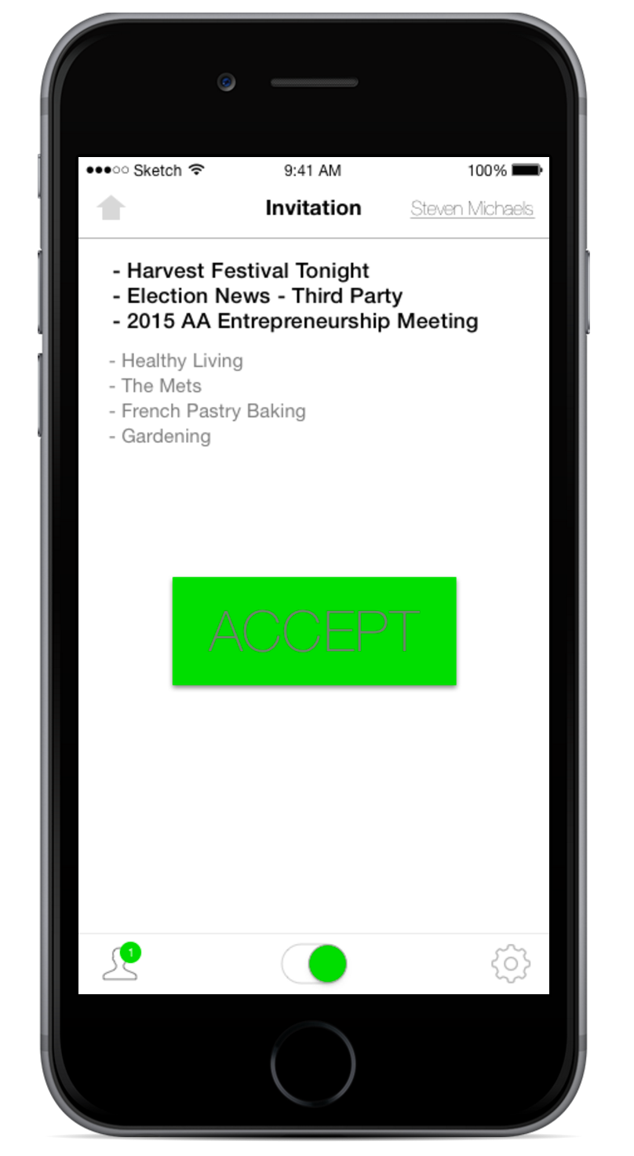
Task 2: Find a Match

Slide 16
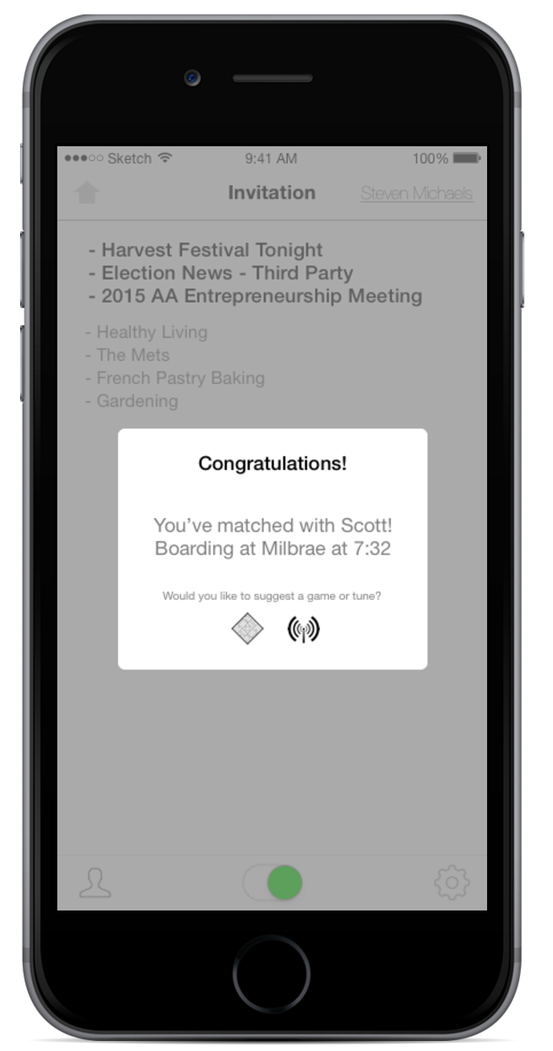
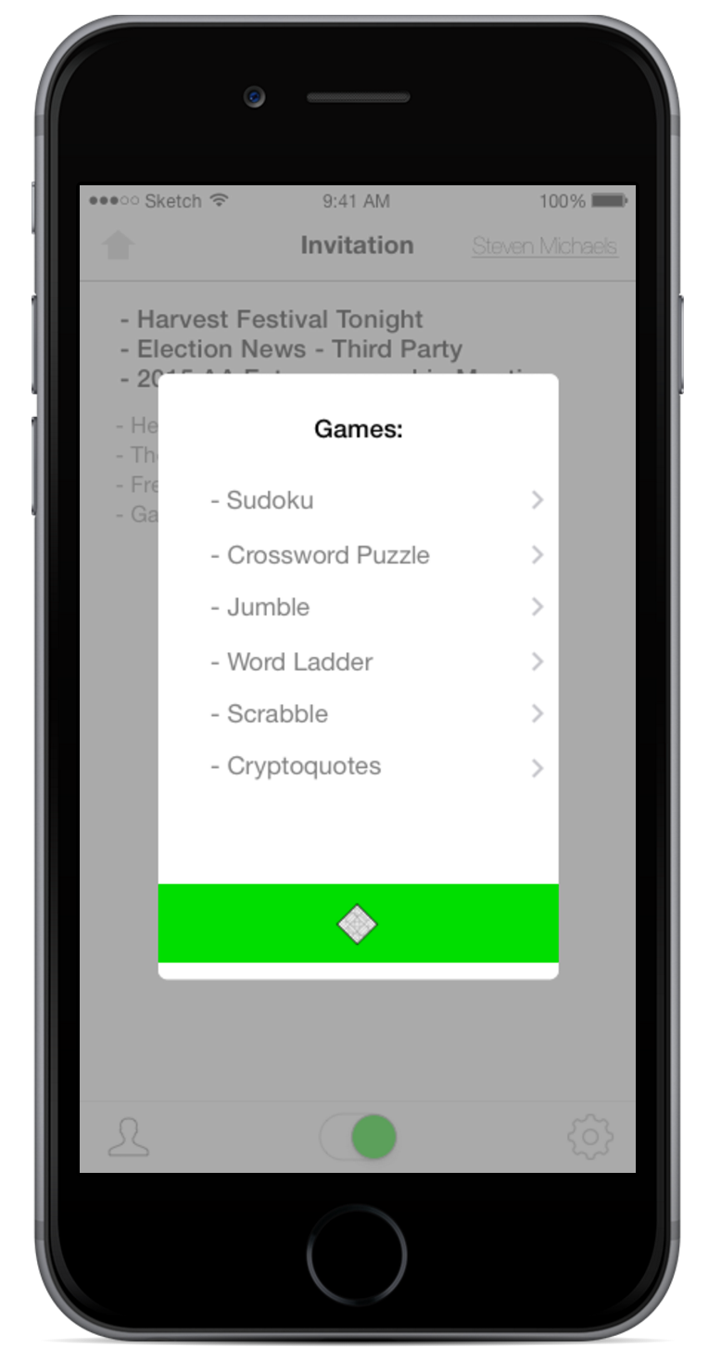
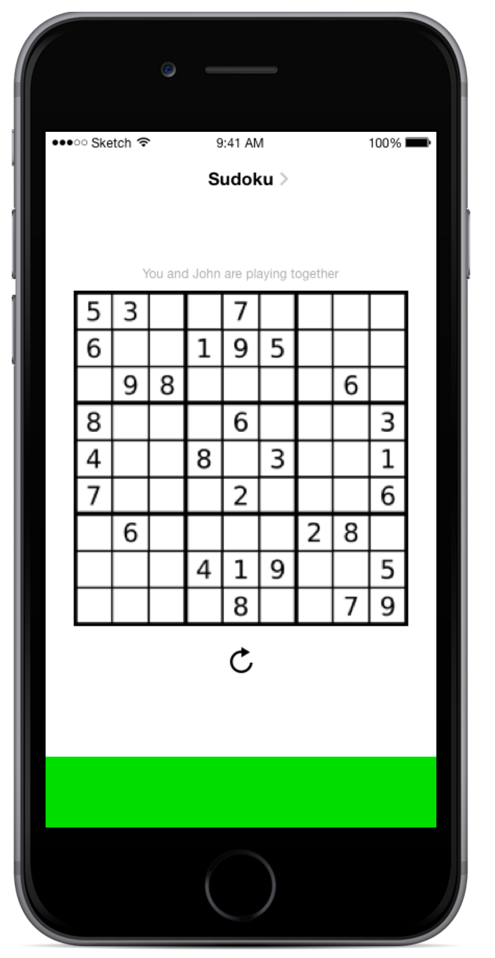
Task 3: Play a Game

Slide 17
Prototyping Overview
Tools Used:

Slide 18
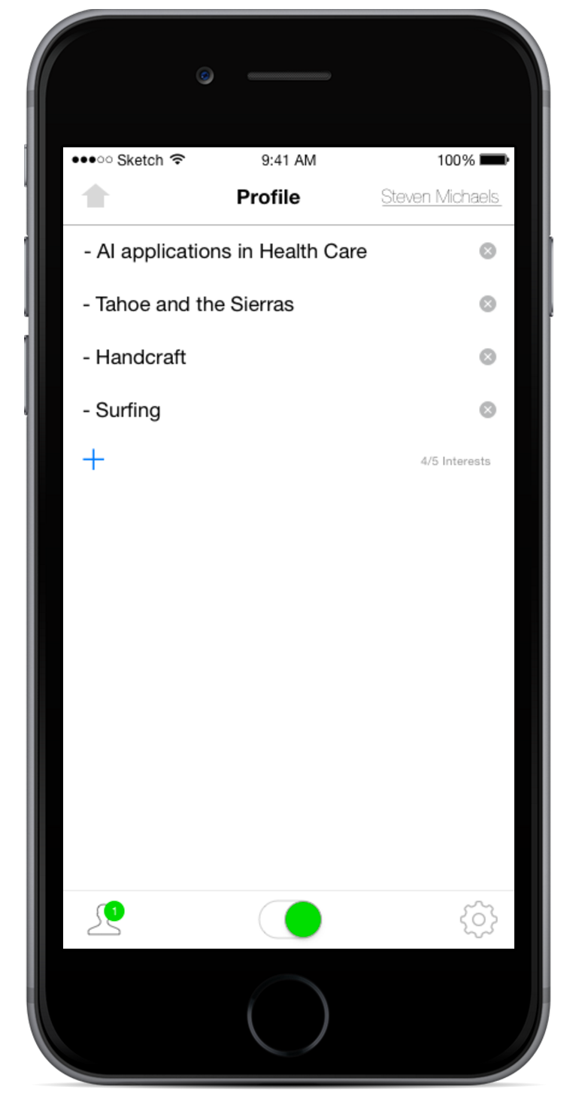
Extra

Slide 19
Links
Interactive Prototype: https://marvelapp.com/120bjch#8508639
Website: http://web.stanford.edu/class/cs147/projects/sustainability/Masa/dotTrainSite/

