Slide 1
Joynus
LOW-FI PROTOTYPING & USABILITY TESTING
CS147; Hilary S. Bronwyn E. Clark P. Bernardo V.

Slide 2
OVERVIEW
Chosen user interface
Prototype & Task Flows
Results & Changes to be Made

Slide 3
MISSION STATEMENT
To allow people to form meaningful connections in a new and innovative way: by meeting new people and sharing experiences.
VALUE PROPOSITION
Connect through spontaneous events.

Slide 4
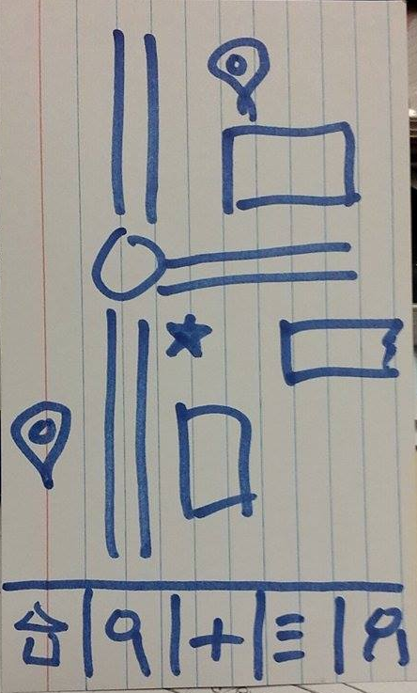
SELECTED UI
MAP
NAVIGATION BAR
HOME
SEARCH
CREATE
LISTING OF EVENTS
PROFILE

Slide 5
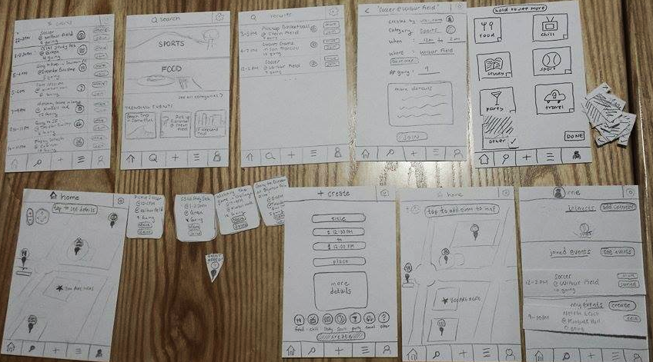
PROTOTYPE

Slide 6
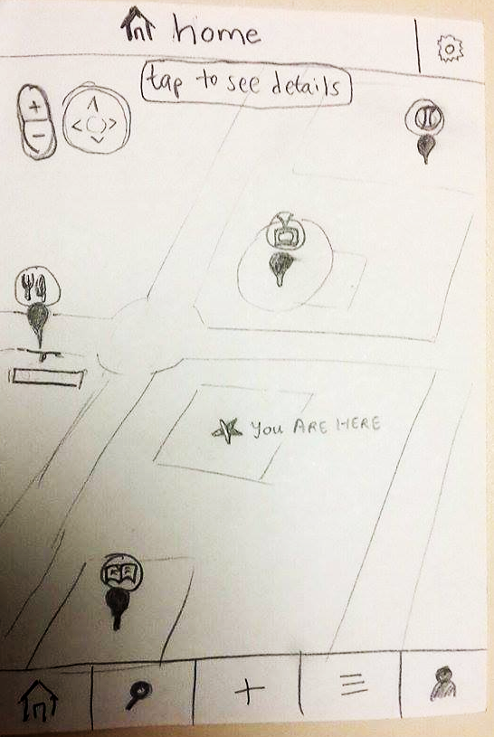
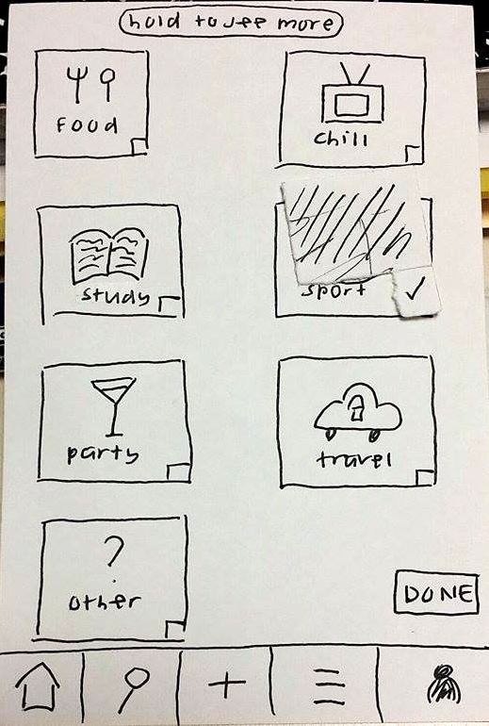
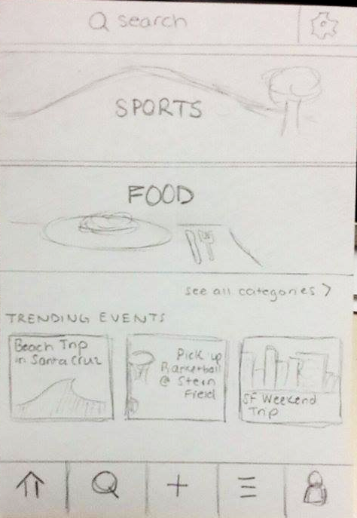
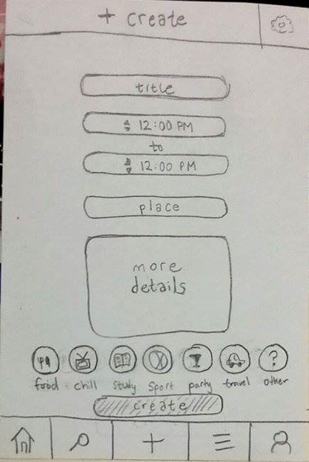
PROTOTYPE

Slide 7
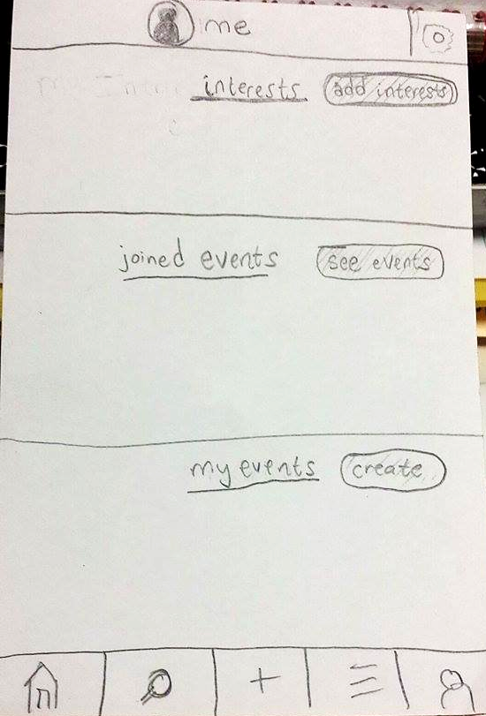
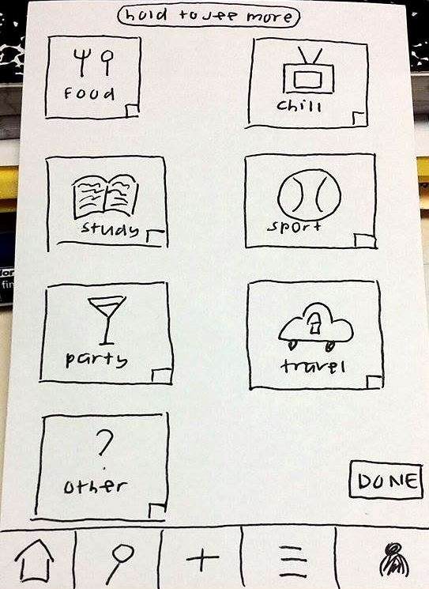
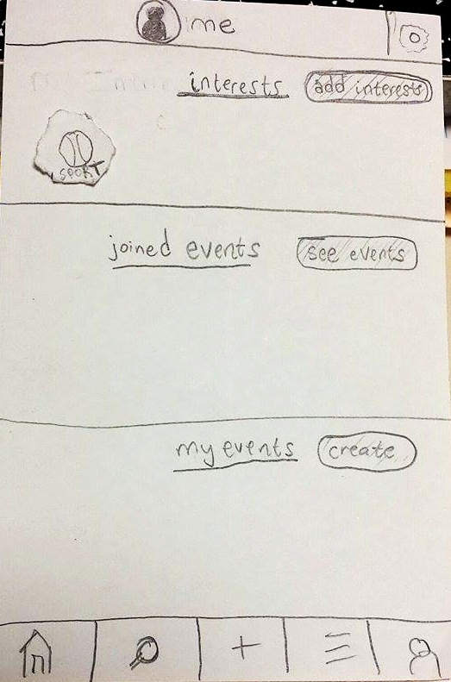
TASK 1: Customize your profile to add “Sports” to your interests.
“Add Interest”
“Profile”
“Sport”
and then “Done”

Slide 8
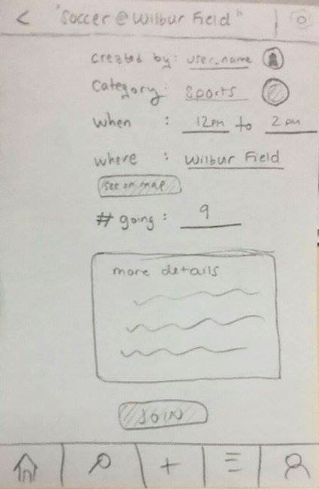
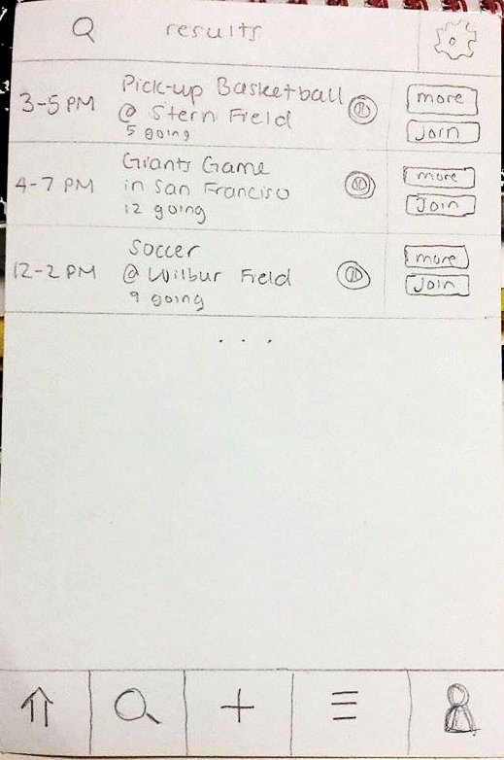
TASK 2.a: You want to play soccer. Find and join a relevant event.
sports
“Join”
“More”
“Search”

Slide 9
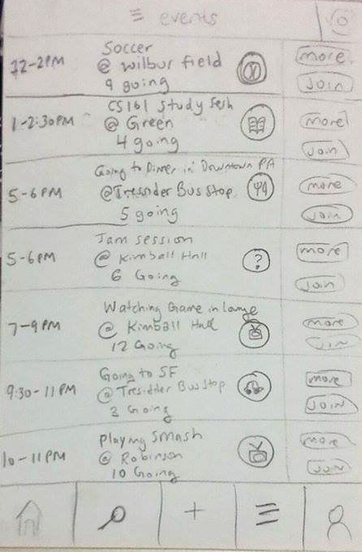
TASK 2.b: You want to play soccer. Find and join a relevant event.
“Join”
“List”

Slide 10
TASK 2.c: You want to play soccer. Find and join a relevant event.
“tap to see details”

Slide 11
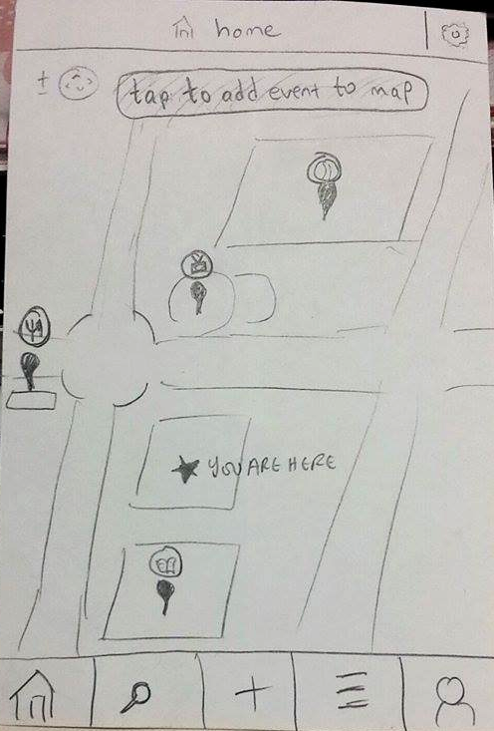
TASK 3: You want to Netflix and chill with new people from 9PM-10PM at your current location. Create an event.
“Create”
“Create”

Slide 12
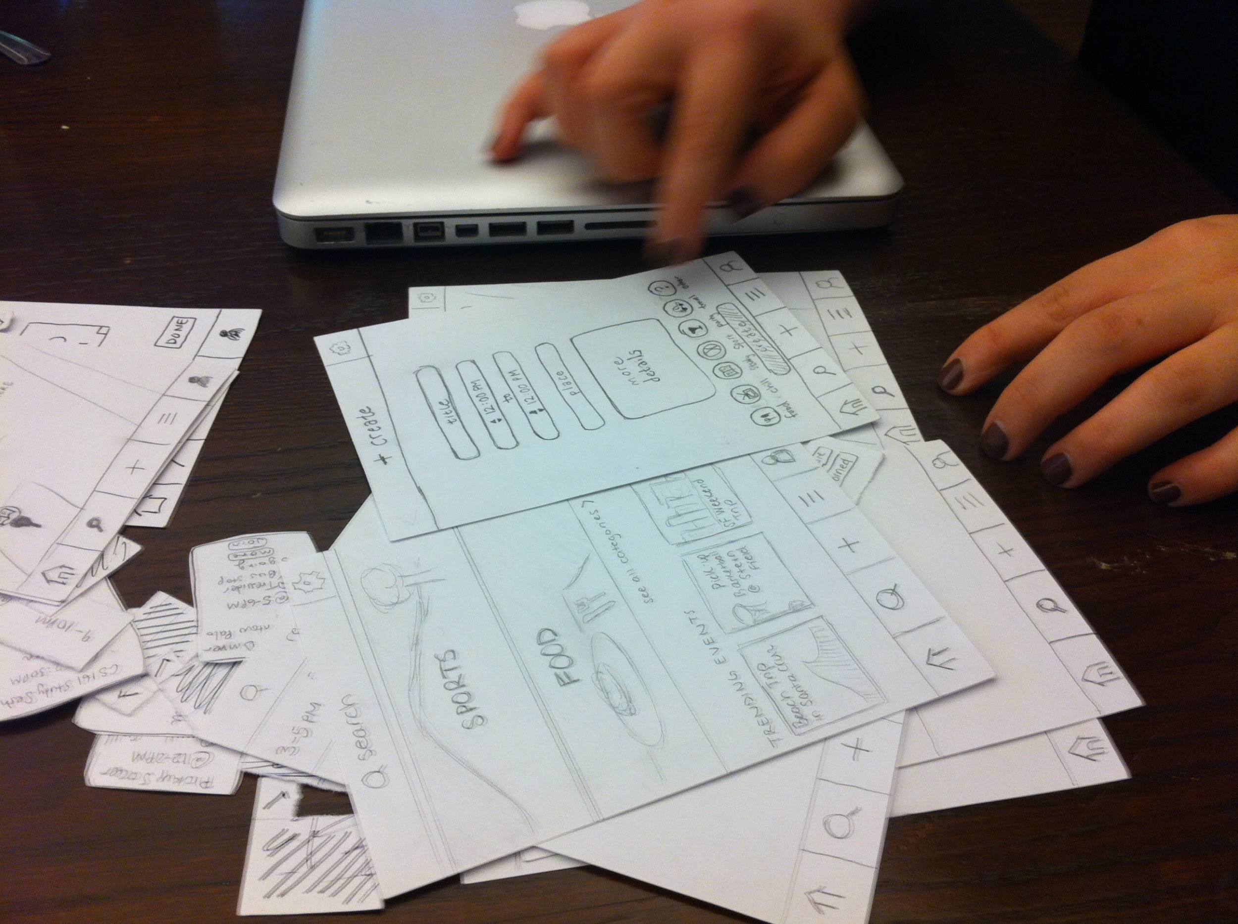
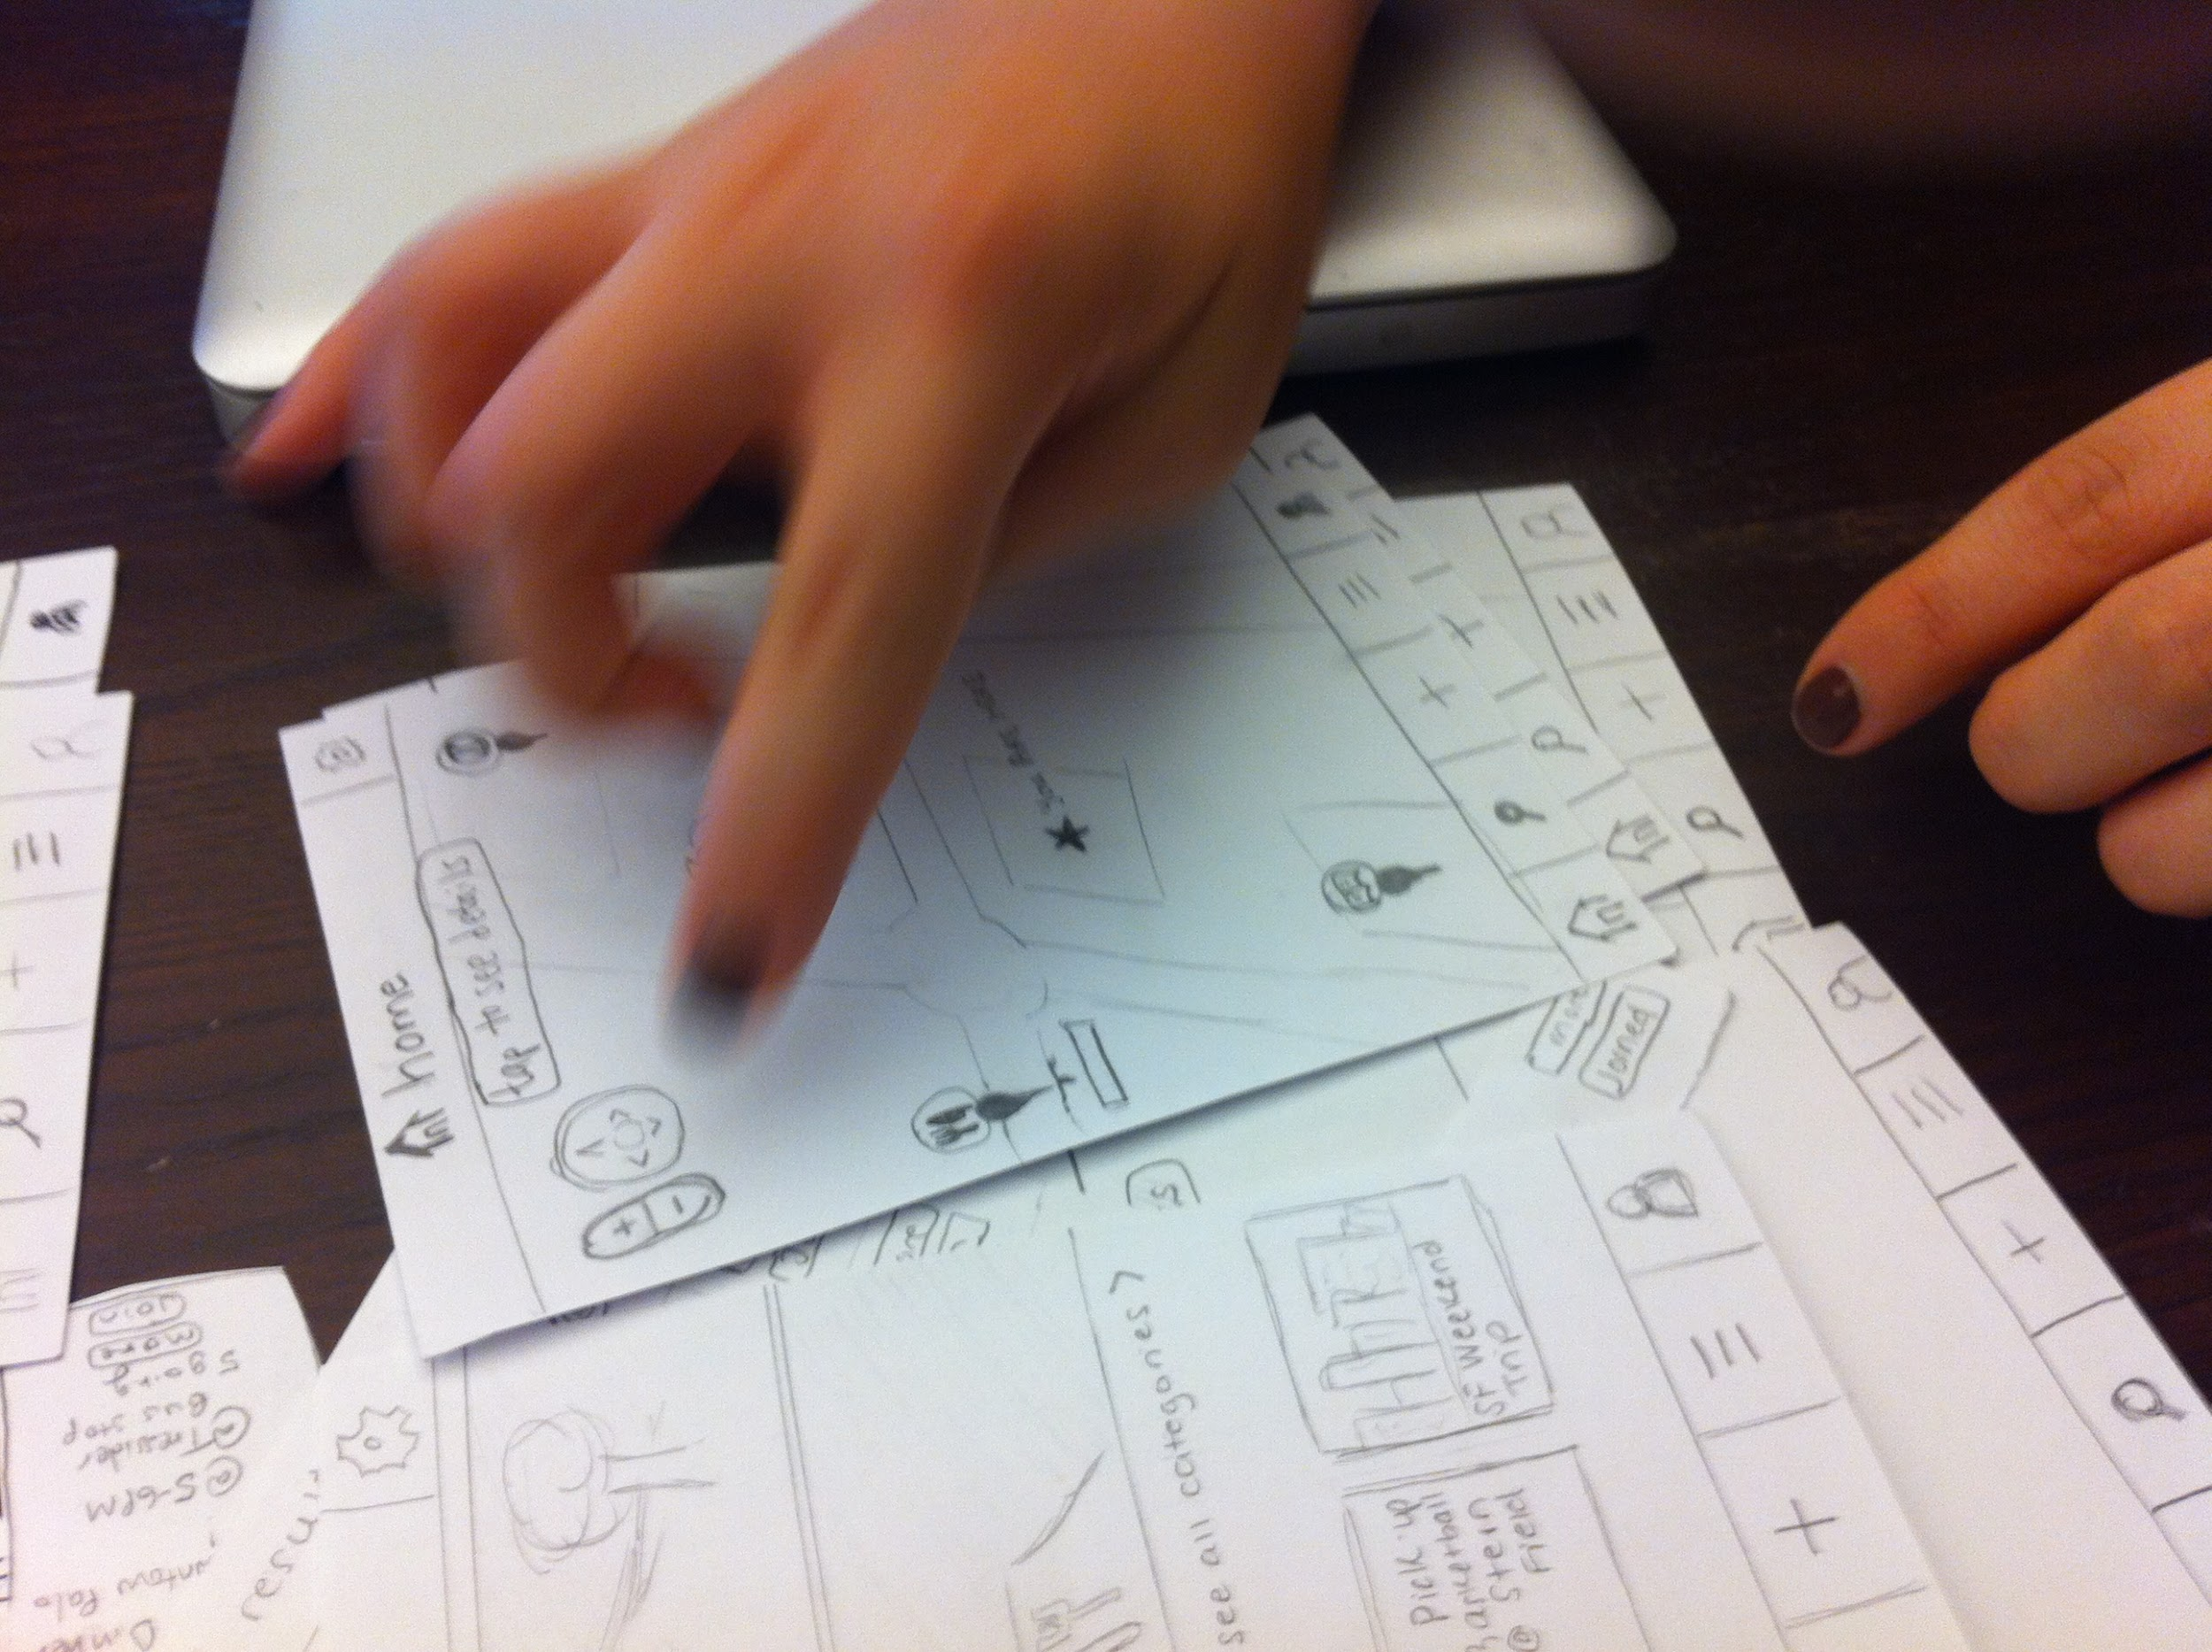
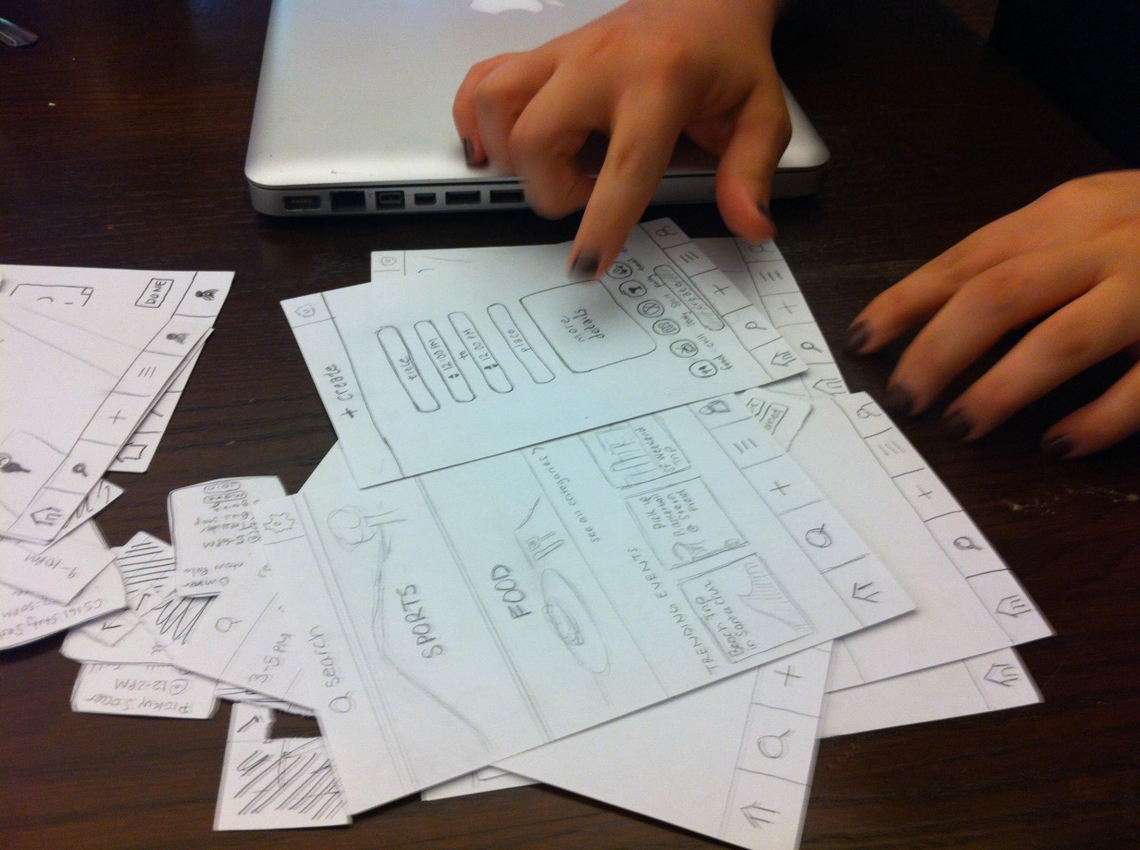
METHOD
participants:
-students & travelers
environment:
-seated at large tables
-facilitator next to participant
procedure:
-set team roles
-consent form
-participant talked us through
-wrote down observations
-Q&A at the end
test measures:
-+/- log
-task flow of participants
-Q&A

Slide 13
RESULTS
homepage:
+ navbar
+ icons
- map
icons:
+ universal

Slide 14
RESULTS
task 1 (adding interests to profile):
+ few clicks
task 2 (searching for and joining events)
+ straightforward
- event blocks

Slide 15
RESULTS
task 3 (creating an event):
+ “+” universal
+ form understandable
- map to add event

Slide 16
SUGGESTED UI CHANGES
Search bar more easily findable
Adding location to “Create Event”
Minor aesthetic problems → color

Slide 17
SUMMARY
well-received and successful
changes: increase usability

