Slide 1
concept video
hilary, bronwyn, clark, bernardo
cs 147, assignment 4

Slide 2
value proposition
Connect through spontaneous events
problem/solution overview
It is difficult, but desired, to engage with new people; spontaneous activities can be a vehicle for genuine interactions.

Slide 3
tasks
Simple: Bernardo, a bored student studying abroad, is looking for something to brighten his day. He searches through the posted events and decides to join Clark’s hike.
Medium: Clark, a stressed college student, wants to get out and see the meteor shower with his friends, but all of them are busy. He uses the app to post a meteor-shower event which anyone may join.
Complex: Amy, a regular adventurer, knows she enjoys meeting new people through outdoor activities. She sets a filter so she will receive notifications when there are local “outdoorsy” activities taking place. When she sees one she likes, she “joins.”

Slide 4
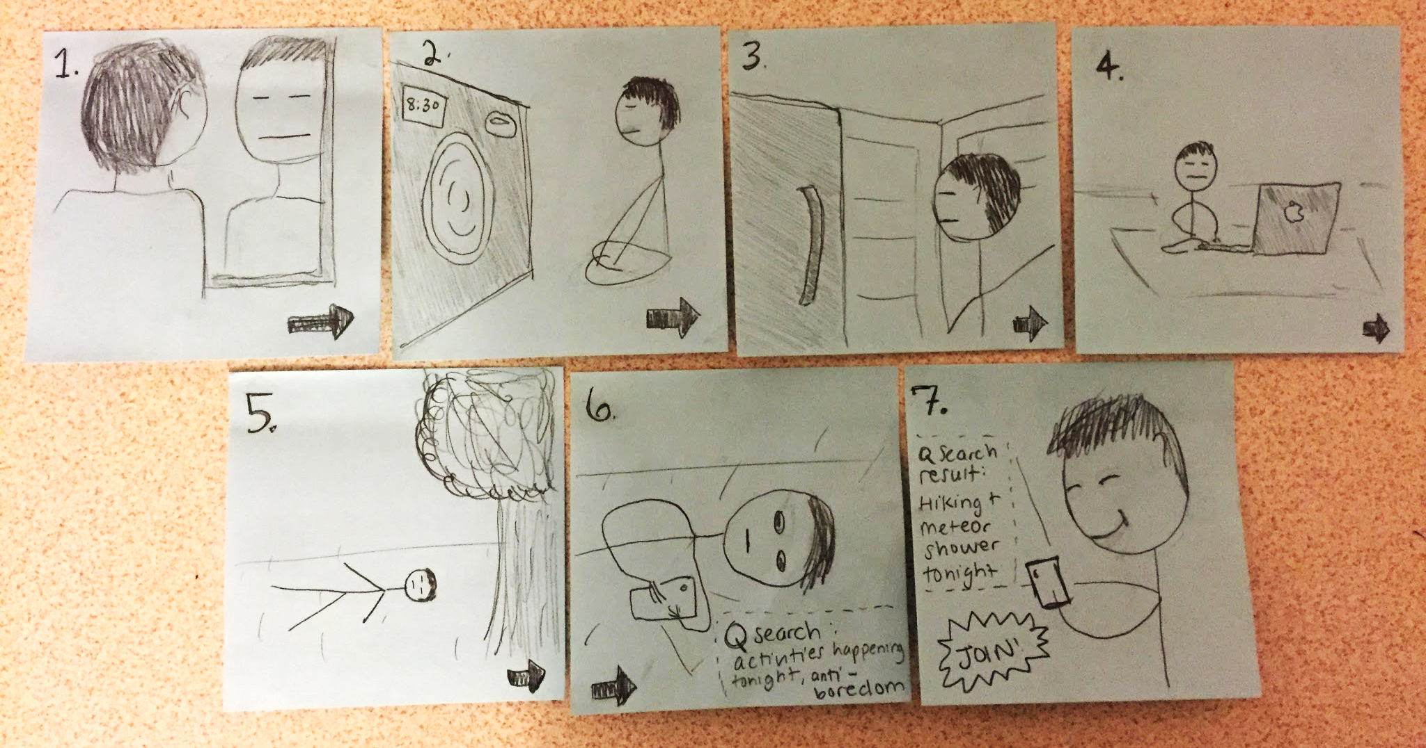
video storyboard:
simple task
SCENE: dorm place
1. still shot of looking into mirror after washing face, closer crop of upper body. He sighs.
2. still shot of side full body waiting for laundry, include audio of laundry machines. He sighs.
3. still half shot of looking in fridge for stuff to eat. He sighs
4. still full shot of doing homework in empty room. He sighs
5. full shot, walks in from left, collapses onto grass exhausted from boredom, takes out phone, rolls on side.
6. close shot of on side, suddenly gets up excited
7. clicks join (CLEAR CLICK)

Slide 5
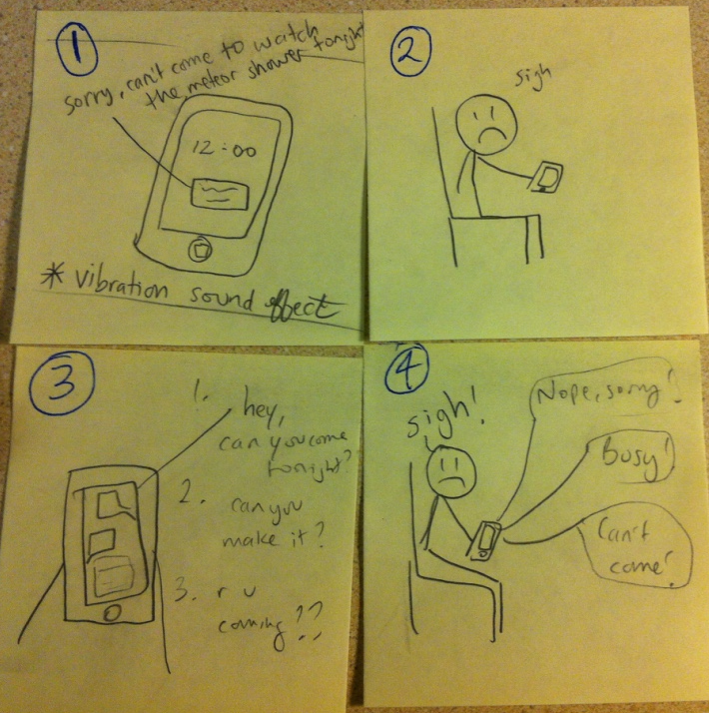
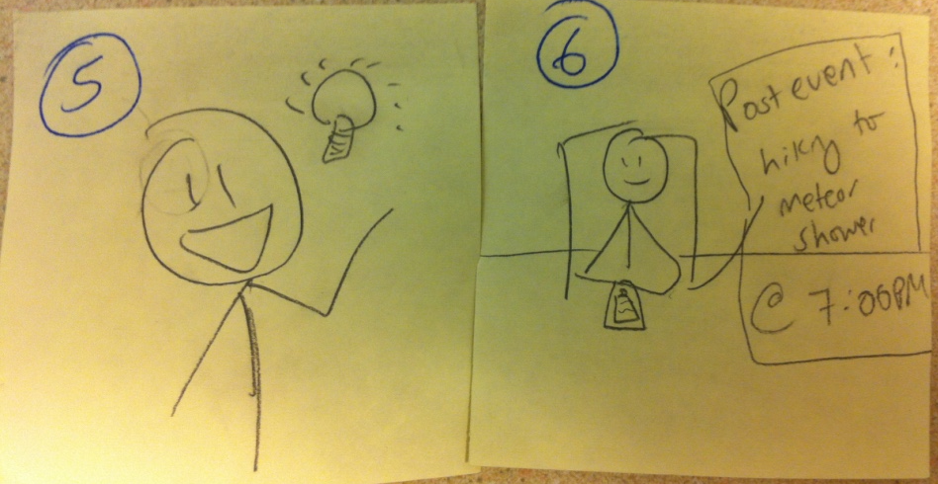
SCENE: Clark’s room
1. Close up zoom on phone notification. Make sure message (“can’t come to meteor shower tonight”) is clearly readable. Include a vibration sound effect.
2. Show text recipient in mid range shot, make sure disappointed expression is emphasized.
3. Close up of texting from different angle - display messages in post. Texts reach out to other friends asking if they’re coming.
4. Same kind of shot as in 2, popping up messages of friends saying they’re busy. Emphasize disappointment again.
5. Close up on face to show sudden realization - add lightbulb in post.
6. Zoom out as event is created on screen, with user visibly “using” the app.
video storyboard: moderate task

Slide 6
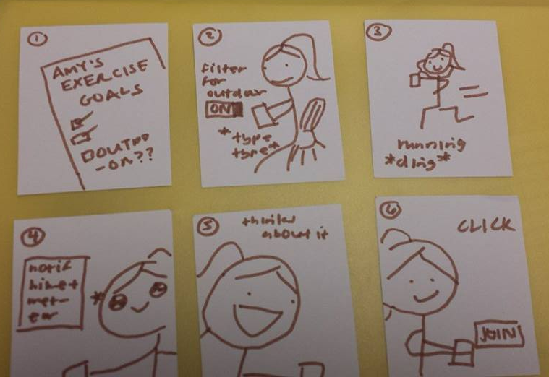
video storyboard:
complex task
SCENE: outdoors
1. close up of Amy’s exercise goals, maybe circle or question mark outdoors activity to show she wants to do that
2. view of Amy front, typing on phone, popup that she turned on filter for “outdoor”
SCENE: another new outdoors, exercising
1. running shot, maybe add another where it is close shot and then far? or far and then close? notification ding
2. checks notification (shows Clark’s event) and is like YEAH
3. thinks about joining it and then decides YEAH, other angle but still focused on upper body
4. same upper body shot, clicks on “JOIN” CLEAR CLICK

Slide 7
link to concept video
https://youtu.be/aHoEHdBeX1E

