Slide 1
Jam-a-Lot
By: Matt Herrero
Yunha Hwang
Mohammed Rahman
Value Proposition: Meet up. Rock out. Repeat.
Problem/Solution Overview: People enjoy practicing music in groups, but it can be hard to find others of similar skill level near them. Jam-a-Lot solves this problems by connecting compatible jam partners through an app service.

Slide 2
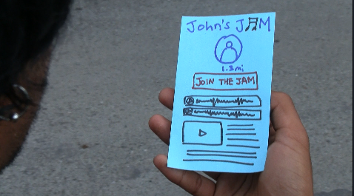
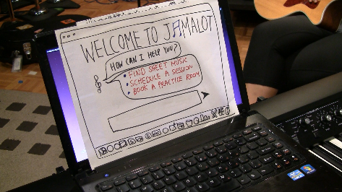
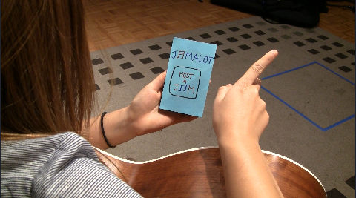
Three Tasks
Simple: Find and join a jam session.
Moderate: Find shared music to jam with.
Complex: Host a jam session.

Slide 3
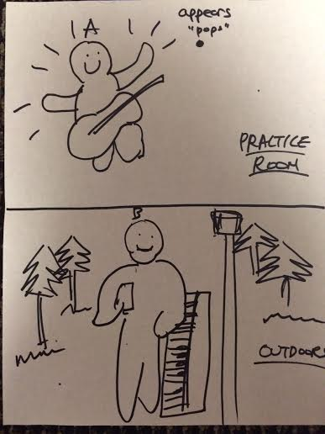
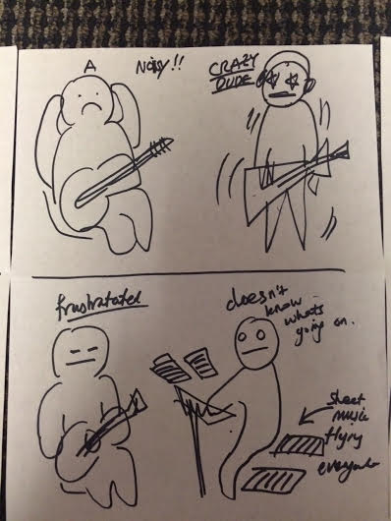
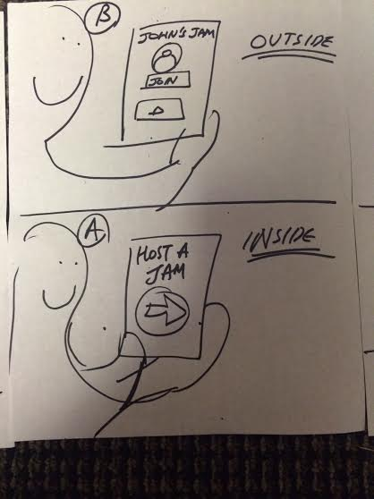
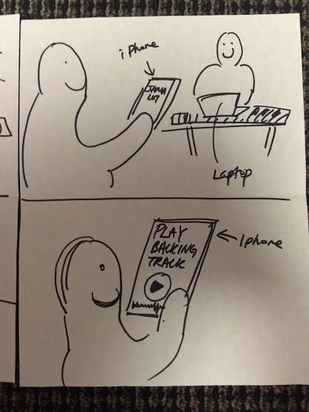
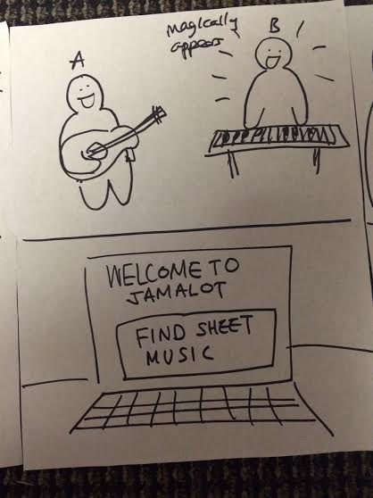
Storyboard

