Slide 1
Needfinding with a Beat
What might design thinking uncover about our
music experiences and music sharing habits?
Team Members:
Yunha Hwang
Mohammed Rahman
James Stallworth
Matt Herrero
Studio Theme - Sharing
Notes:
What might design thinking uncover about our music experiences and music sharing habits?
Yunha Hwang
Mohammed Rahman
James Stallworth

Slide 2
Needfinding Methods - Who/ What to ask?
Diversity in interviewees
4 Major Question Themes
Means? Personal? Social? Context?
Notes:
Diversity in interviewees
came up with 4 different types of people we wanted to interview
1st, typical music consumer (Used spotify/ online streaming service, consumed mostly digitally, did not create music, representative of majority of music listeners in 2015)
2nd, atypical music consumer (Mainly consumed instead of produced music, did not/ rarely used online streaming services, frequented/ preferred record stores, shared music, just perhaps not digitally)
3rd, musician/ music creator (Consumed music as well as produced/ released music of their own, interacted with digital music from more than one side of the equation)
4th, pre-internet music generation (Perhaps used spotify/ online streaming services, but grew up in a world without online music sharing)
4 Major Question Themes
Means of Consumption?
what services/ technology do you use to listen to and explore for new music? through what means to people share music/ you share music with others?
Personal Music Identity?
What habits/ memories/ beliefs do you have in the context of your own experience with music?
Do you consume music broadly or deeply?
Do you have any pieces of music that make you feel nostalgic
Social Music Identity?
What habits/ beliefs do you have in the context of your community with regards to music?
What was the last piece of music you recommended to someone else?
How do you find new music?
Tell me about a time you met someone with a similar musical taste as you.
Musical Context
How do you fit music into your life?
Do you mainly listen to music through headphones or speakers

Slide 3
EXCLUSIVE SPOTIFY USER
Who? San Francisco resident/ friend
Why? Quintessential Music
consumer in 2015
Where? Home in SF
Questions?
Notes:
WHO?
San Francisco resident, my friend
compensated with a half-eaten box of cookies from Safeway
interview took place on the roof of a very tall building in Hayes Valley
phone in hand in photo open to spotify, streaming 19 by Adele to a wireless speaker
WHY?
pays to use Spotify, doesn’t use other services
listens to music every day, but is not a music expert
QUESTIONS:
How do you discover new music?
Could you tell me about a time when you were frustrated with Spotify?
How do your musical tastes fit in context with those of your parents and friends?
Why do you create and share playlists on Spotify?

Slide 4
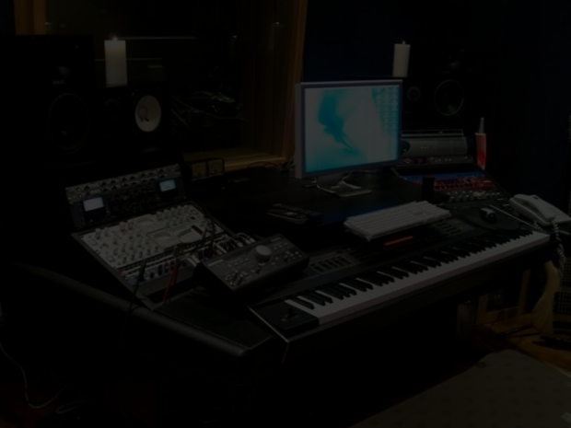
MUSIC PRODUCER - STANFORD STUDENT
Who? Music producer, Stanford student, produces and releases original music on online platforms
Where? Tresidder Union
Why? Expertise in Music industry and consumption
How? Friend of a group member
Notes:
Who? A music producer, a student on campus, who has realized numerous original music and performed at some large concerts who would rather like to remain anonymous.
Where? On campus, Tressider Union
Why? He gives us a different perspective as both a producer and a consumer. He understands concerns from the artist’s perspective. He can also be considered as an extreme user, since his engagement with music is much more in-depth and a lot more frequent.
Questions included:
What do you think about existing platforms of streaming music?
Tell me about your process of musical production?
When do you feel most awarded in your musical production?
What is your taste? do you have one?
How do you explore new music? How much time do you spend doing it?

Slide 5
RECORD STORE ENTHUSIAST
Who?
23 year old from Tennessee
Why?
Extensive record collection
Where?
Phone call to home in
Tennessee
Questions?
Notes:
It would be interesting to mention that we tried to interview someone in an actual record store. The record store itself was empty, and
the owner was allegedly too busy to do the interview. Records were all stacked so viewing the artwork was next to impossible. No music was
even playing in the background. It was clearly a store only for people who knew exactly what they wanted, not a place to find new music. Only
classic rock available. Not the most successful record store. Record Man in Redwood City. Interesting frame of reference when compared to Marek,
who only has positive experiences in record stores.
Who?
Resident of Tennessee who listens to music primarily by putting on LP’s. Friend of group member. Interview took place by phone call and lasted approximately.
Why?
Hardly ever uses Spotify or Pandora, instead likes the physical experience of being in a record store
Most of his musical library consists of LP’s as opposed to digital playlists.
Questions:
What is one of your more cherished LP’s? What about it in particular moves you so much?
How did you get into listening to LP’s, as most kids our generation listen to music online?
With Spotify and Pandora, sharing music is as simple as copying a link and posting it. How does owning physical copies of
your music affect the way you share it?
Have you ever bought LP’s of bands you have never heard of before?
Have you ever found any new music in a record store that ended up becoming your favorite?
What do you do (physically) while youre listening to your records (i.e. lie in bed, work out, etc.)?

Slide 6
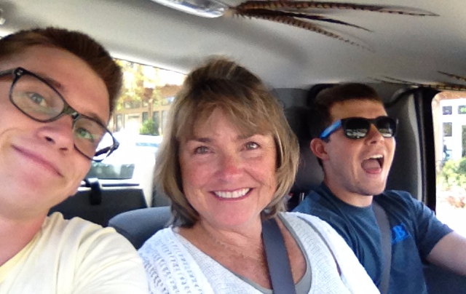
BABY BOOMERS (AND BEYOND)
Who? My Mom (Suzanne), Aunt (Teresa), and Grandmother (Corinne)!
Why? Target music experience of those who largely predated music sharing/ social media sites
Where? In the kitchen of my home
in Marin County
Questions?
Notes:
Questions
Do you think you listen mainly to “your generation’s” music?
Do you have any pieces of music that take you back to a certain time in your life? Nostalgia songs?
Do you consume music broadly or deeply? Do you consume a lot of different songs, or listen to the same songs many times?
Do you use online music streaming services? Any other pieces of tech to stream music?

Slide 7
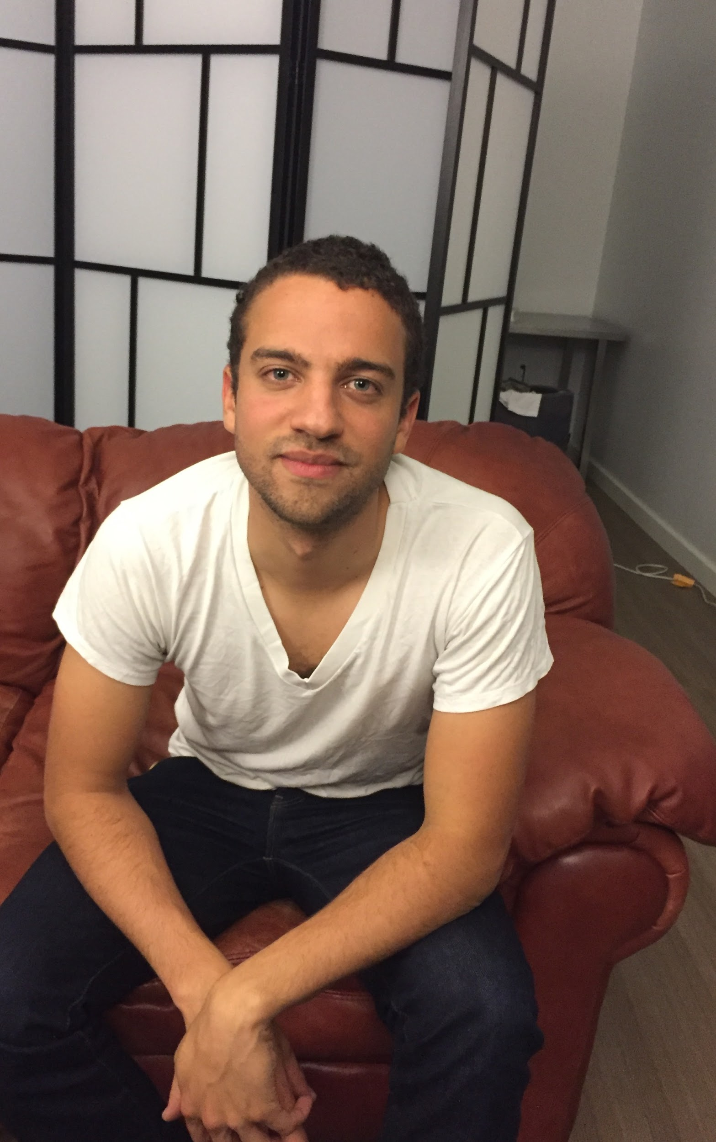
Interview Results - Jaron
“ I don’t really know most of my friends’ musical tastes… people these days really listen to everything. ”
wishes there was a ‘monoculture’ of music consumption
Notes:
Hard to share songs with a specific person (they might not use spotify)
Too many widely used music apps (Apple Music, Spotify, Youtube, Pandora, and so on)
Enjoys sharing playlists with close friends
Shares links to songs on slack ‘tunes’ channel at work
frustrated when searching for new music on his own (takes too long, difficult)
50% of new music comes from a single close friend

Slide 8
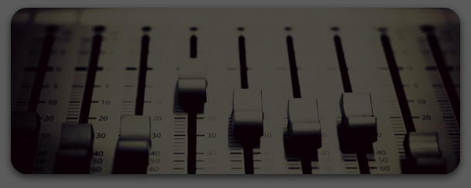
Music producer
“Music is fundamentally social [...] I produce music to be listened to by people”
“I love communicating with my listeners, and finding out where in the world, my music is being listened to”
“I read music blogs when exploring new music”
“I don’t think I have a strict musical taste, I’m pretty open-minded when exploring music”
Notes:
The biggest thing he wants with his music is to be listened to by as many different people from all over the world.
in fact communicating with his listeners is one of the favourite things he does as a producer (except the making of music itself of course) and he does it by sending soundcloud messages to his frequent listeners.
I says navigates and explores the new music library by reading music blogs and listening to what his favourite artists listened to or talked about.
We found it striking that despite his expertise in electronic music that he actually has a very open musical taste and listens to all sorts of music from different times and cultures.
One thing he adds is that he wishes that he could know what other people think about a song or an album integrated in the streaming platform (i.e. commenting features)

Slide 9
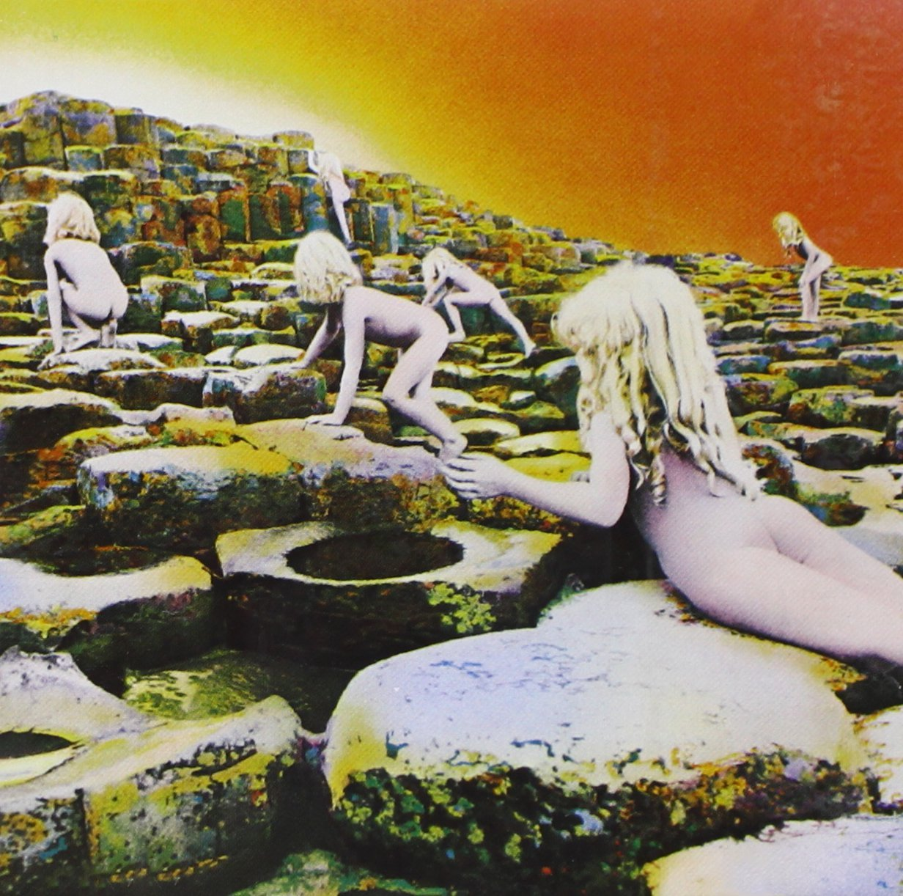
Interview Results - Marek
“My favorite LP is Houses of the Holy by Led Zeppelin ... seeing the artwork and just being blown away.”
Finds record store culture vintage and cool.
Sharing music is more intimate when it physically exists (LP, CD, tape)
Notes:
The album art on the slide belongs to Houses of the Holy by Led Zeppelin. This was one of his fathers records which eventually has been
passed down to him.
Record stores allow him to browse a comfortingly finite collection of music on his own time.
makes sharing music more intimate, digital music doesn't physically exist like a record. With an album, you have to sit and listen and you can associate the record with the person who gave it to you,
too much control to stop/start wherever you want with digital music- LP’s encourage listening to the album in its entirety, which he thinks is very important
music is an experience worth investing in (buy physical copy as opposed to digital) - that way you get more out of it as opposed to letting it fade into the background

Slide 10
Suzanne, Teresa, and Corinne
Suzanne: “I listened to James Taylor mostly because that’s what I grew up with, that’s what was played in our house”
Suzanne: Vivid memories of dancing around at pool parties during high school when she hears the song “Beyond the Sea” by Bobby Darin
Teresa: Lets songs that she doesn’t necessarily like play in full out of politeness since “it’ll be over soon”
Notes:
Other moments:
Who would you recommend?
LONG PAUSE - why not just recommend the person who you like most?
“Can I refer to my pandora playlist?”
T: We battle our memories
S: When you’re recommending someone, you feel like you have to be contemporary
G+M: You have to look at that person and judge what you think they’ll like
We were talking about James Taylor…
Always choose James Taylor “Because they were raised”
MUSIC SUGGESTED “Wait til you hear Ben Taylor”
they both got excited, it was a fun moment

Slide 11
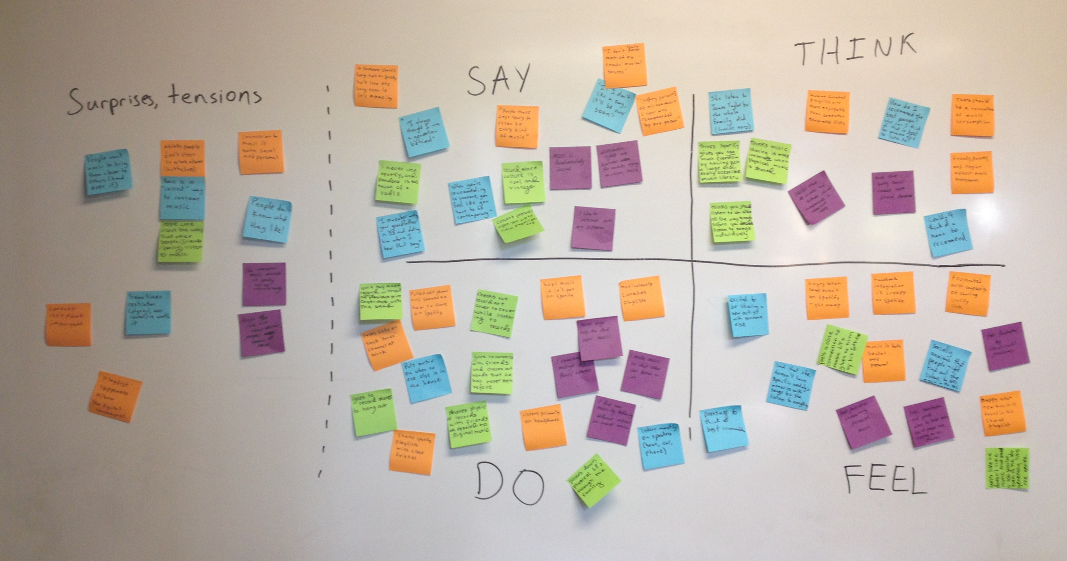
Our Empathy Map

Slide 12
Inferences and Conclusions?
Notes:
sometimes constrictions (physical), user-control are worth it to prevent people from feeling overwhelmed and inconvenienced by the massive music libraries of services like spotify
Marek: Thinks Spotify gives you too much freedom by having such a large and easily accessible music library.
Jaron: frustrated when searching for new music on his own
Marek: Record store is all laid out, limited selection so you can see them all.
People who grew up sharing music with their family value that
Suzanne: “I listened to James Taylor mostly because that’s what I grew up with, that’s what was played in my house”
Jaron: remembers and likes songs from his dad’s CD collection
Marek: Feels a close connection to LP’s given to him by his father.
People not only care what others are listening to but how others are listening to music
Marek: People should listen to albums all the way through before listening to individual songs off of the album
Jaron: Thinks there should be a monoculture of music consumption
Jaron: thinks people don’t listen to full albums anymore, but they should
Teresa: The polite thing to do when a song that you don’t like comes on in a social setting is to let it play out, “it’ll be over soon”
people don’t really know what they like (their musical taste) and don’t really know what others are listening to
MP: I want to know what other people think about music
MP: I have a very open minded approach to music
Jaron: “people these days listen to everything”
Jaron: “I don’t really know most of my friends’ musical taste”
people want music to bring their communities closer.
MP: I wish there was a commenting feature in spotify
Jaron: happy when new music is found in shared playlist
Marek: goes to record shops to hang out
Marek: goes with friends to concerts to check out bands he’s never heard before
Suzanne: Vivid memory of all her high school friends listening to Hot Tuna, dancing around a friend’s pool
Marek: Shares records because the act of sharing is more intimate when physical music is shared.
often the music people listen to is not context specific
Jaron: posts links to songs on slack ‘tunes’ channel at work
All: not strongly opinionated on headphones vs speakers (whatever’s convenient)

Slide 13
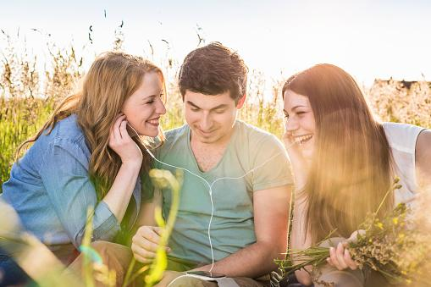
Needs? Insights?
People need for social connection around their music to be easier.
People need help choosing music so that it isn’t an overwhelming experience.
Notes:
There are probably more needs to find from this empathy map, but a few are this...

Slide 14
Summary
We sum everything up!
Images Cited:
http://www.fivecentnickel.com/uploadedfiles/wp-content/uploads/2010/07/2010.07.14.jpg
http://www.gettyimages.com/detail/photo/group-of-friends-sitting-in-field-sharing-high-res-stock-photography/536991121

