Slide 1
Needfinding - Moving
Alexei Bastidas, Austin Connelly, John Valentine

Slide 2
Honing in on topic
Moving?
Home buying?
Apartment rental?
All key stages of a person’s life and often significant investments.

Slide 3
David Serpa
Top Realtor in the Inland Empire area
Worked with hundreds of families
Expert on home buying and selling.

Slide 4
Alison Valentine
Didn’t do the house-search herself, parents did all searching, bought house and are renting.
Stereotypical overscheduled Stanford Student
Recently began renting a house in Menlo Park to live in while taking classes here.
Sharing house with other college-aged roommates.
Very recently went through the huge ordeal of relocating.

Slide 5
Matt Chiswell
Recent college graduate and former UK resident
Currently living at home, but will soon have to move out
Wants to begin apartment-hunting, but can’t until he knows where he will be relocated in the winter

Slide 6
Takeaways-David
Buyers come in with unrealistic expectations
Online tools for home buying unreliable and inaccurate
Most buyers are in the market due to their family situation
Biggest issue for home buyers is “lack of transparency”
Buyers have to coordinate with up to five different agents to finalize purchase

Slide 7
Takeaways - Alison
Moving into a first house is an incredibly exciting if somewhat nerving experience.
Moving takes a LONG time and a lot of work, especially if new furniture needs to be bought.
If renovations necessary, can take months if not years to get proper permits/materials, even for only a few weeks of work.

Slide 8
Takeaways-Matt
Nervous to leave parents’ home.
Previous moves have been tied to parents or organized by a university, so did not affect him.
Unfamiliar with the moving process, and worried about having the added pressure of a time-constraint.
Finding a place to live is often much more stressful than moving in

Slide 9
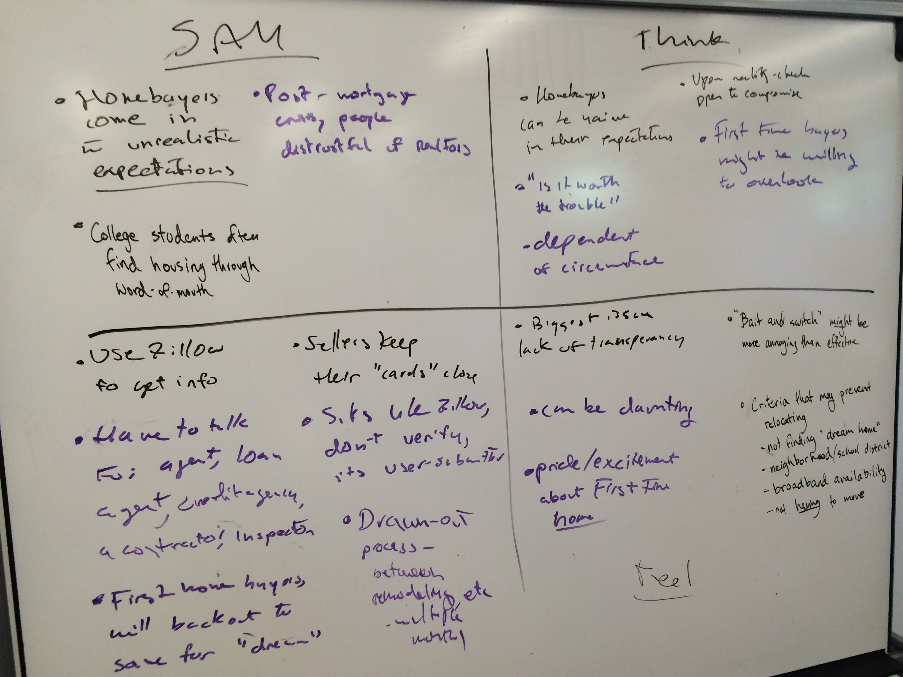
Empathy Map

Slide 10
Analysis
Pride/excitement about first home purchase.
Relocating unnecessarily stressful/complicated?
Lack of transparency -- nature of business?
Drawn out process.
Modern web tools not trustworthy. Word of mouth/open houses/ads most successful.

