Slide 1
HomeClear Milestone
Team Soupy Good Cup

Slide 2
Bringing transparency to real-estate.

Slide 3
Tasks
Search for a specific house report
Search for listings in an area
Search for lots as a land developer in an area

Slide 4
Heuristic Evaluation
& Revisions

Slide 5
Feedback
Streamline Search
Three tabs as well as filter system can overwhelm user.
No parsing of search queries.

Slide 6
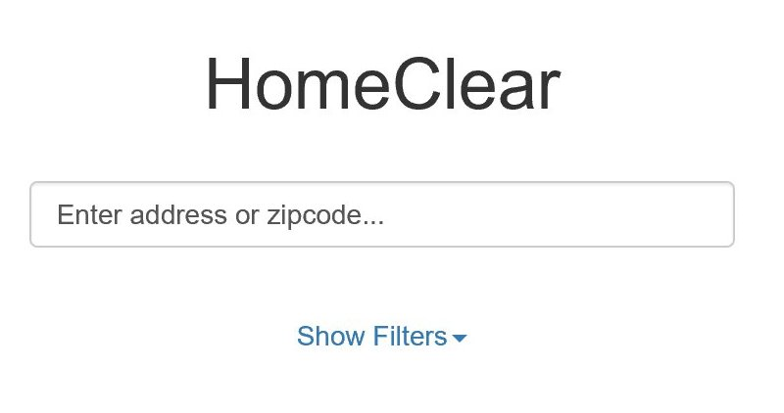
Revision
Streamline Search
Get rid of tabs, parse search to define results: address - report, zipcode/city - listings.
Add toggle for lots in Map View.

Slide 7
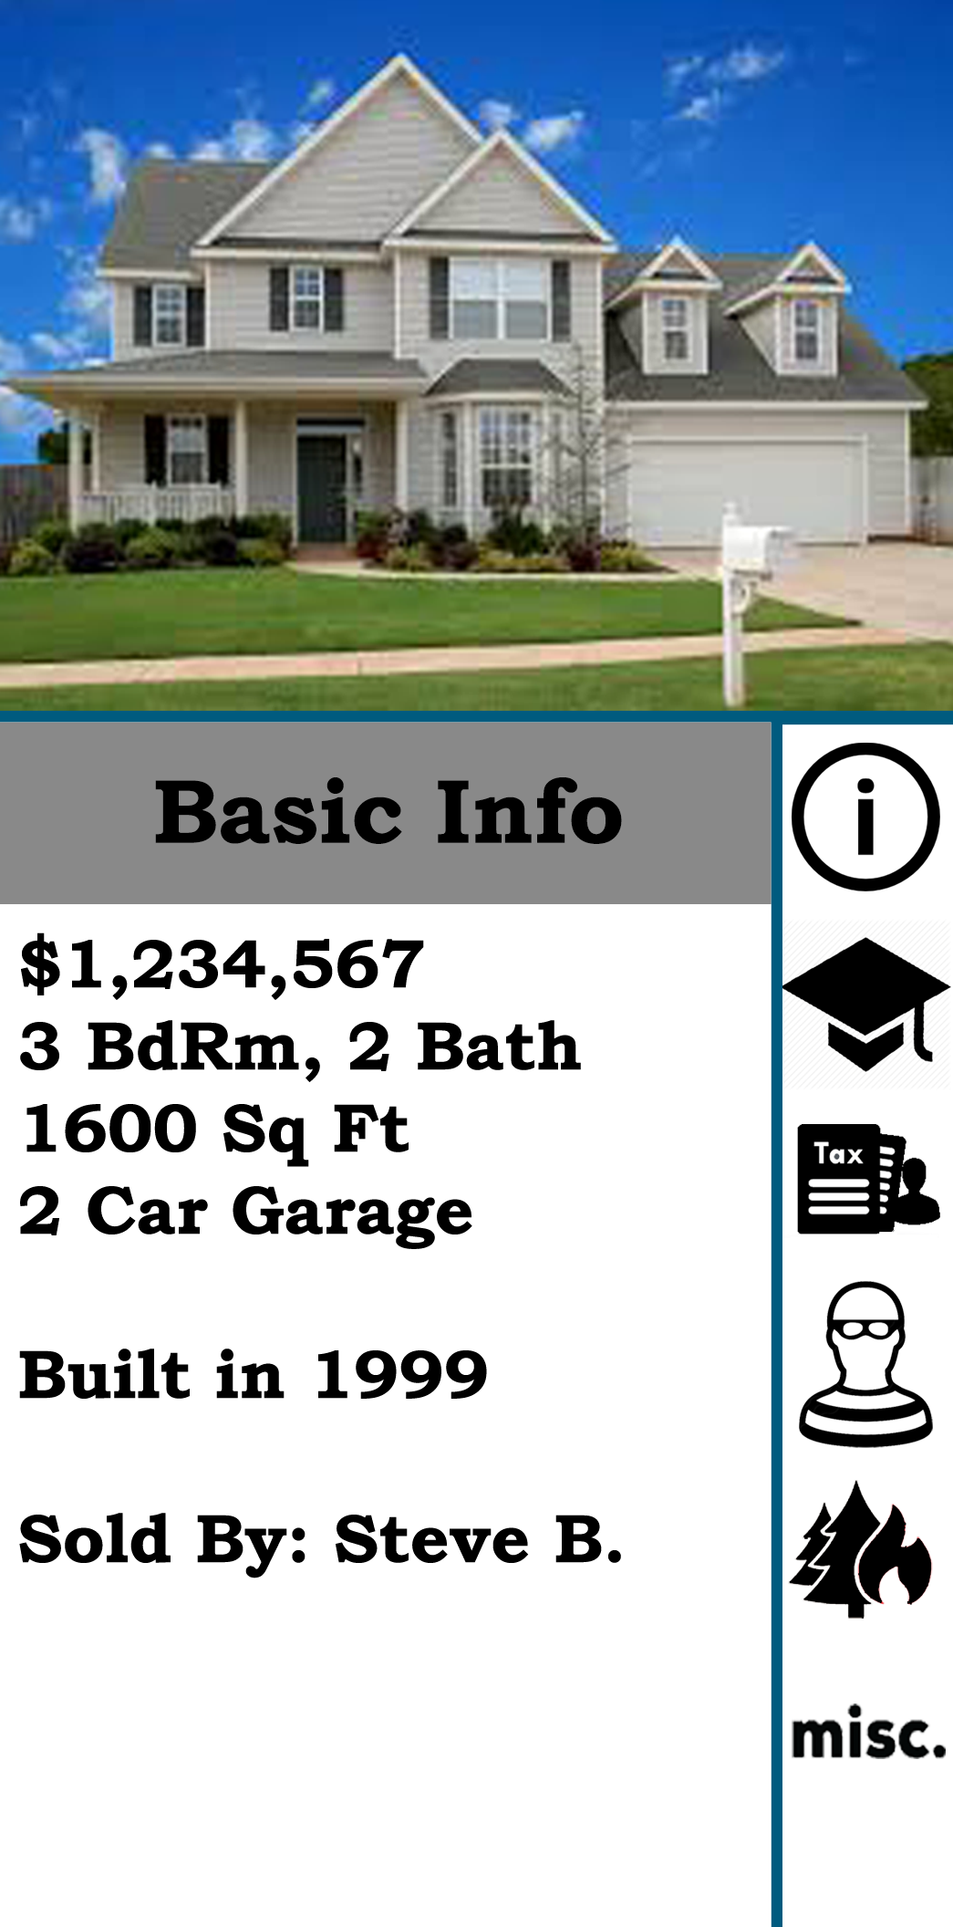
Feedback
Inconsistent Information
Graphs presented were not uniform
Colors were out of sync with one another
Detailed view did not show address.

Slide 8
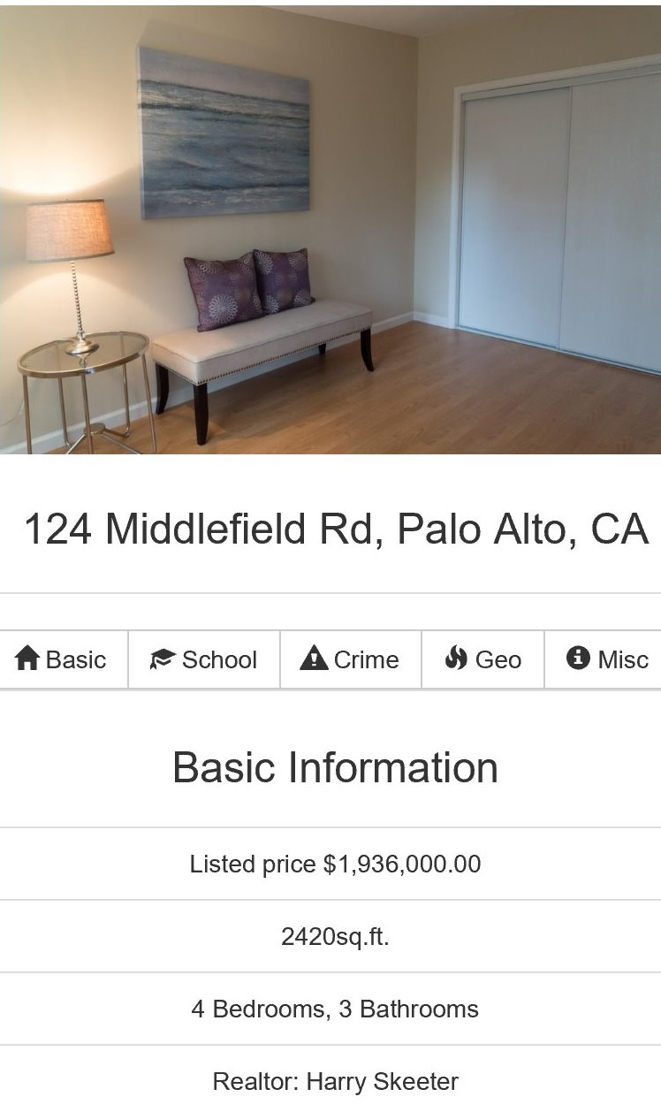
Revision
Inconsistent Information
Cleaned up information display, made graphs informative, ensured address is shown.

Slide 9
Feedback
User Control & Freedom
Users cannot apply filters to search results, cannot sort/edit favorites.

Slide 10
Revision
User Control & Freedom
Add filters in map view nav bar
Ability to sort / edit favorites (in development).

Slide 11
Prototype Status

Slide 12
Web Implementation
Back-end
Database/ORM
Front-end

Slide 13
Currently
Database models setup
User/Login Functionality
Report view

Slide 14
Still Need
Search parsing
Photo carousel
Lot & listings view
Favorites
Branding / Logo
Style & polish UI

Slide 15
Wizard of Oz
Listings are procedurally generated based on search string
Images are unrelated to addresses
Currently - Graphs hard coded

Slide 16
Demo

Slide 17
Thanks!
Any questions ?
Notes:
Demo

Slide 18
Credits
Special thanks to all the people who made and released these awesome resources for free:
Presentation template by SlidesCarnival
Photographs by Unsplash

