Slide 1
Concept video
team soupy good cup
alexei bastidas
austin connelly
john valentine

Slide 2
Bringing transparency to homebuying
Through our need-finding interviews, we realized the biggest issue in the real estate space is a lack of transparency when it comes to finding suitable homes, apartments, or land.
Based on our experience proto-typing, we settled on developing a web-application that can query government topographical, police, school district, and natural hazard data to provide any potential homebuyer with the information they need.

Slide 3
tasks
Largely due to our experience proto-typing, but also drawing from our POVs and HMWs, we isolated the three following tasks crucial to the homebuying process that we seek to address:
Research - looking for a new neighborhood, plot of land for development, or a good school district for children. Complex task involving a broad search.
Looking for available listings – searching for homes in a given price range and matching certain criteria. Medium complexity.
Confirmation – the user has already picked a home with the aide of a realtor and wants to verify the information they were told or look for any hidden issues that would not show up in an inspection. The simplest task.

Slide 4
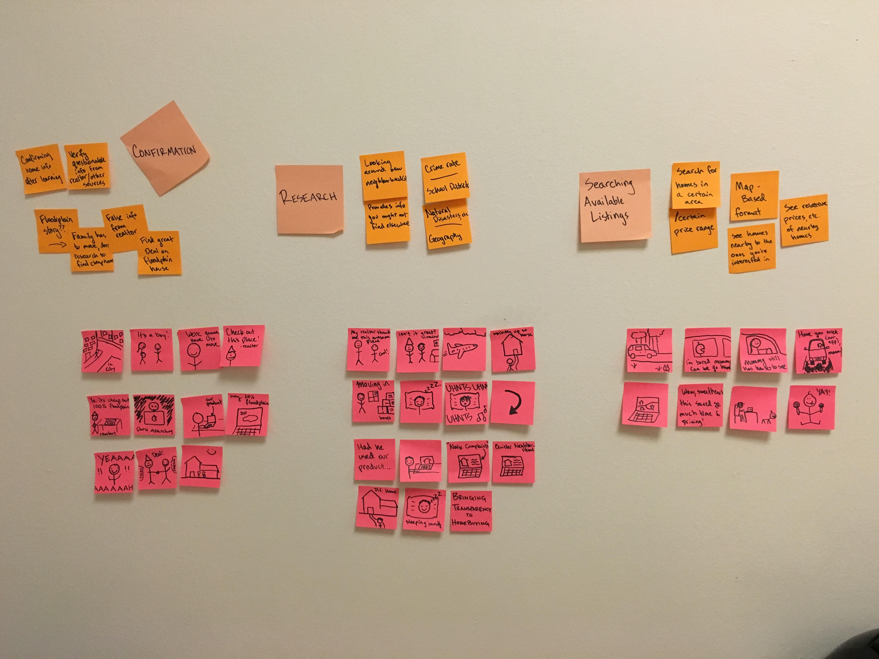
Storyboards

Slide 5
Video link
https://youtu.be/O3V8zsj4lCA

