Slide 1
Experience Prototypes
CS 147 Assignment 2

Slide 2
hello!
We are Team Awesome

Slide 3
Studio Theme: Mobility Domain: Enhancing the mobility of regular commuters.

Slide 4
initial point of view

Slide 5
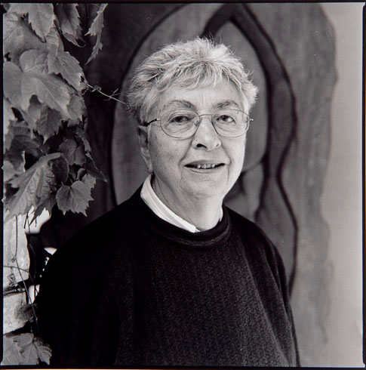
Elderly commuter, worried about safety

Slide 6
additional needfinding

Slide 7
Five more interviews (total 9)
Young professionals
Middle-aged professionals
Professionals traveling with children
During commute

Slide 8
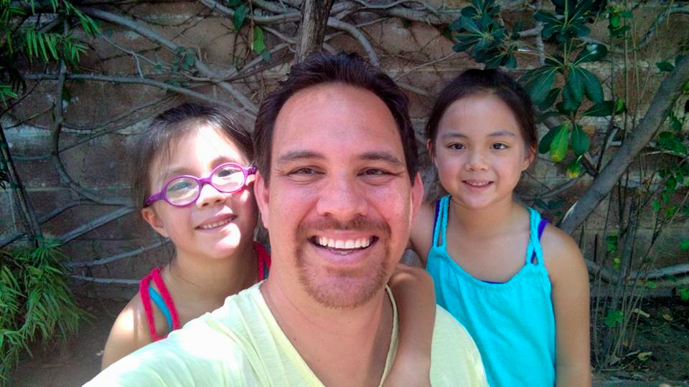
scared and have to focus on what I need to bring for kids

Slide 9
annoyed by stop and go traffic
Notes:
Gave feedback aloud
Asked if onboarding was intuitive
Asked about communication habits

Slide 10
young professionals
1

Slide 11
point of view

Slide 12
WE MET Heather.
WE WERE AMAZED TO REALIZE that traffic conditions shape her emotional state throughout the day.
IT WOULD BE GAME CHANGING TO make traffic a positive experience for Heather.

Slide 13
how might we

Slide 14
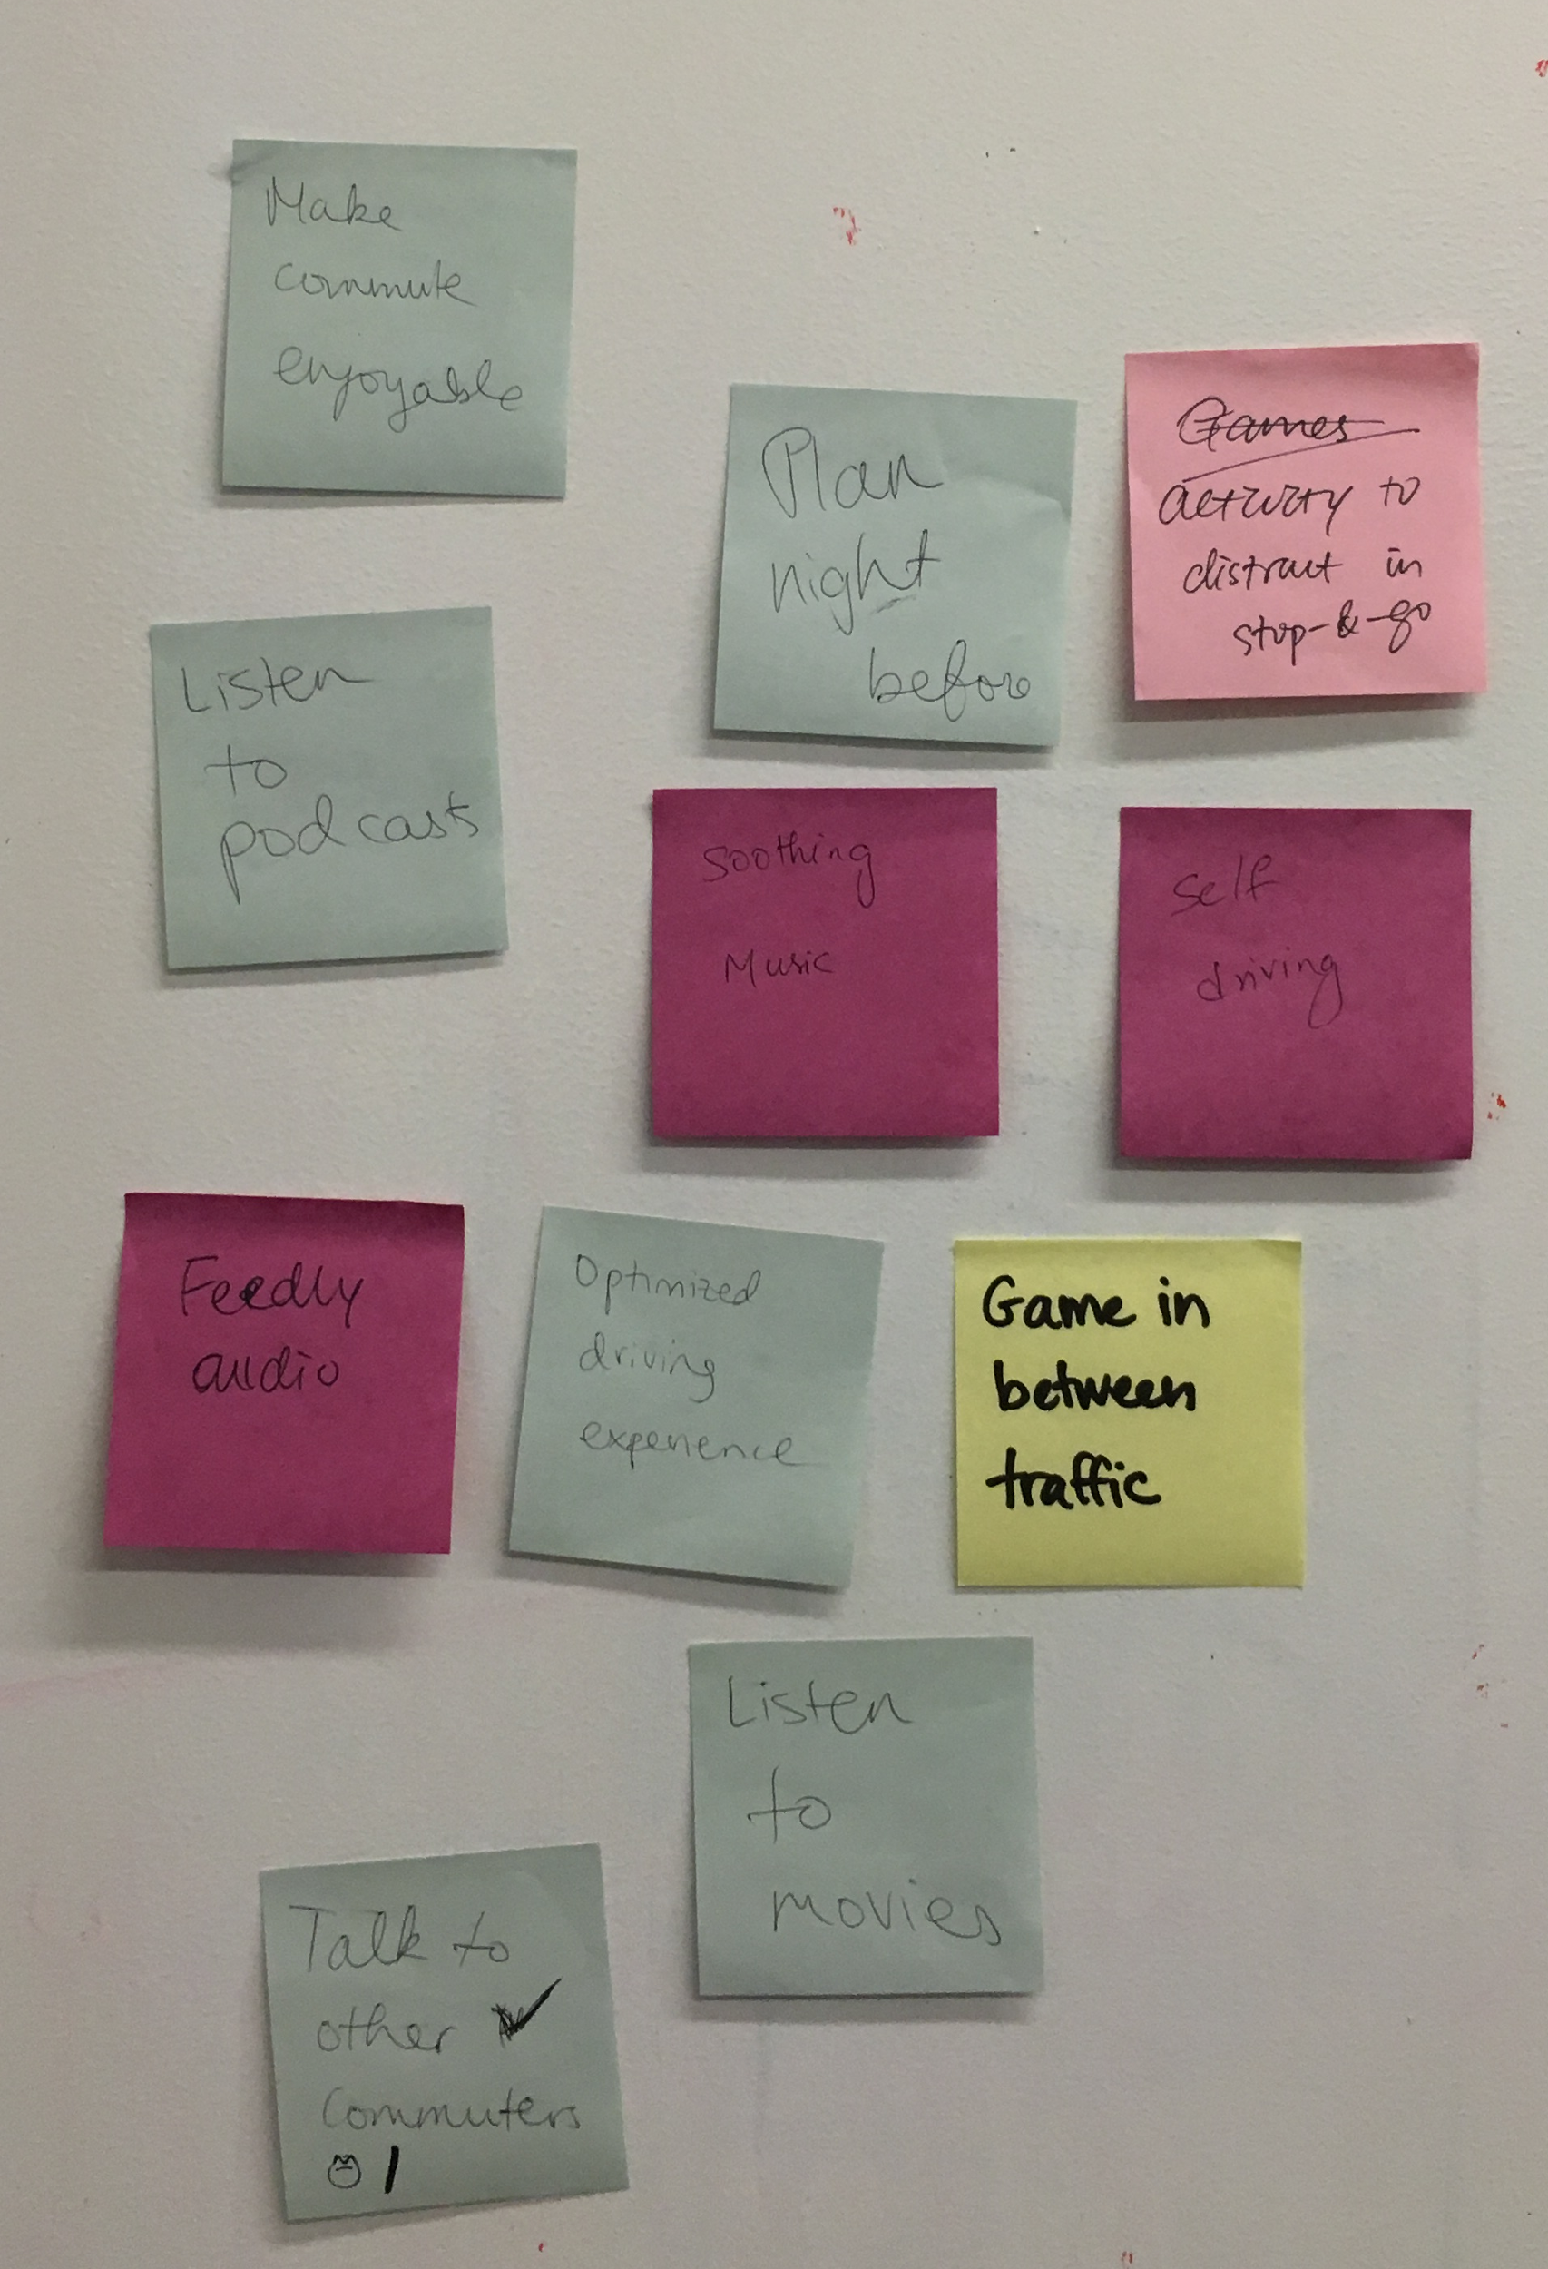
Solutions
HMW prevent Heather’s annoyances during stop and go traffic?

Slide 15
experience prototype

Slide 16
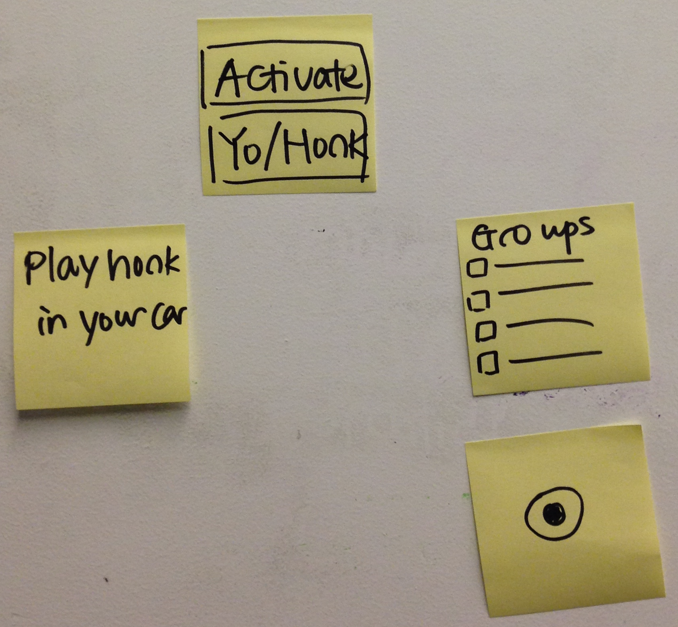
Role: commuter
Scene: in a car
Prop: sticky-note prototype
User 1: commuter
User 2: other commuters

Slide 17
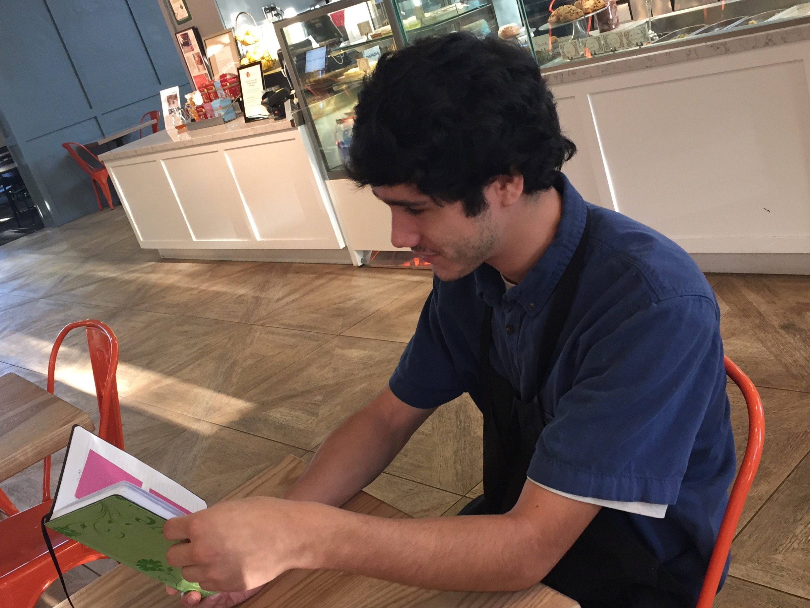
Testing
Give feedback aloud
Was onboarding intuitive?
Tell us about who you want to communicate with.

Slide 18
Results
communicating with people stuck in traffic
only connecting to people he knew
sharing music
utility of the product
Notes:
give loud feedback
onboarding was intuitive
communication habits

Slide 19
regular commuters with kids
2

Slide 20
point of view

Slide 21
WE MET Josh.
WE WERE AMAZED TO REALIZE that his priority is ensuring that his kids are not negatively affected during daily commute.
IT WOULD BE GAME CHANGING TO remove Josh’s anxiety about forgetting an item valuable to his kids .

Slide 22
how might we

Slide 23
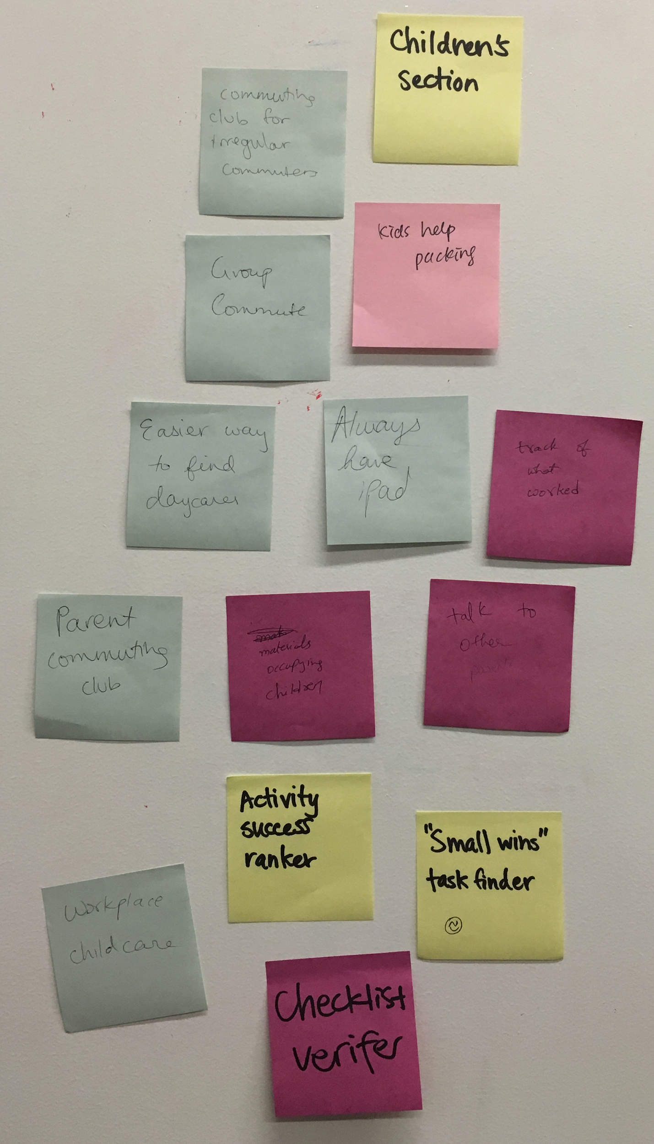
Solutions
HMW ensure Josh remains calm and prepared to meet the demands of commuting with his children?

Slide 24
experience prototype

Slide 25
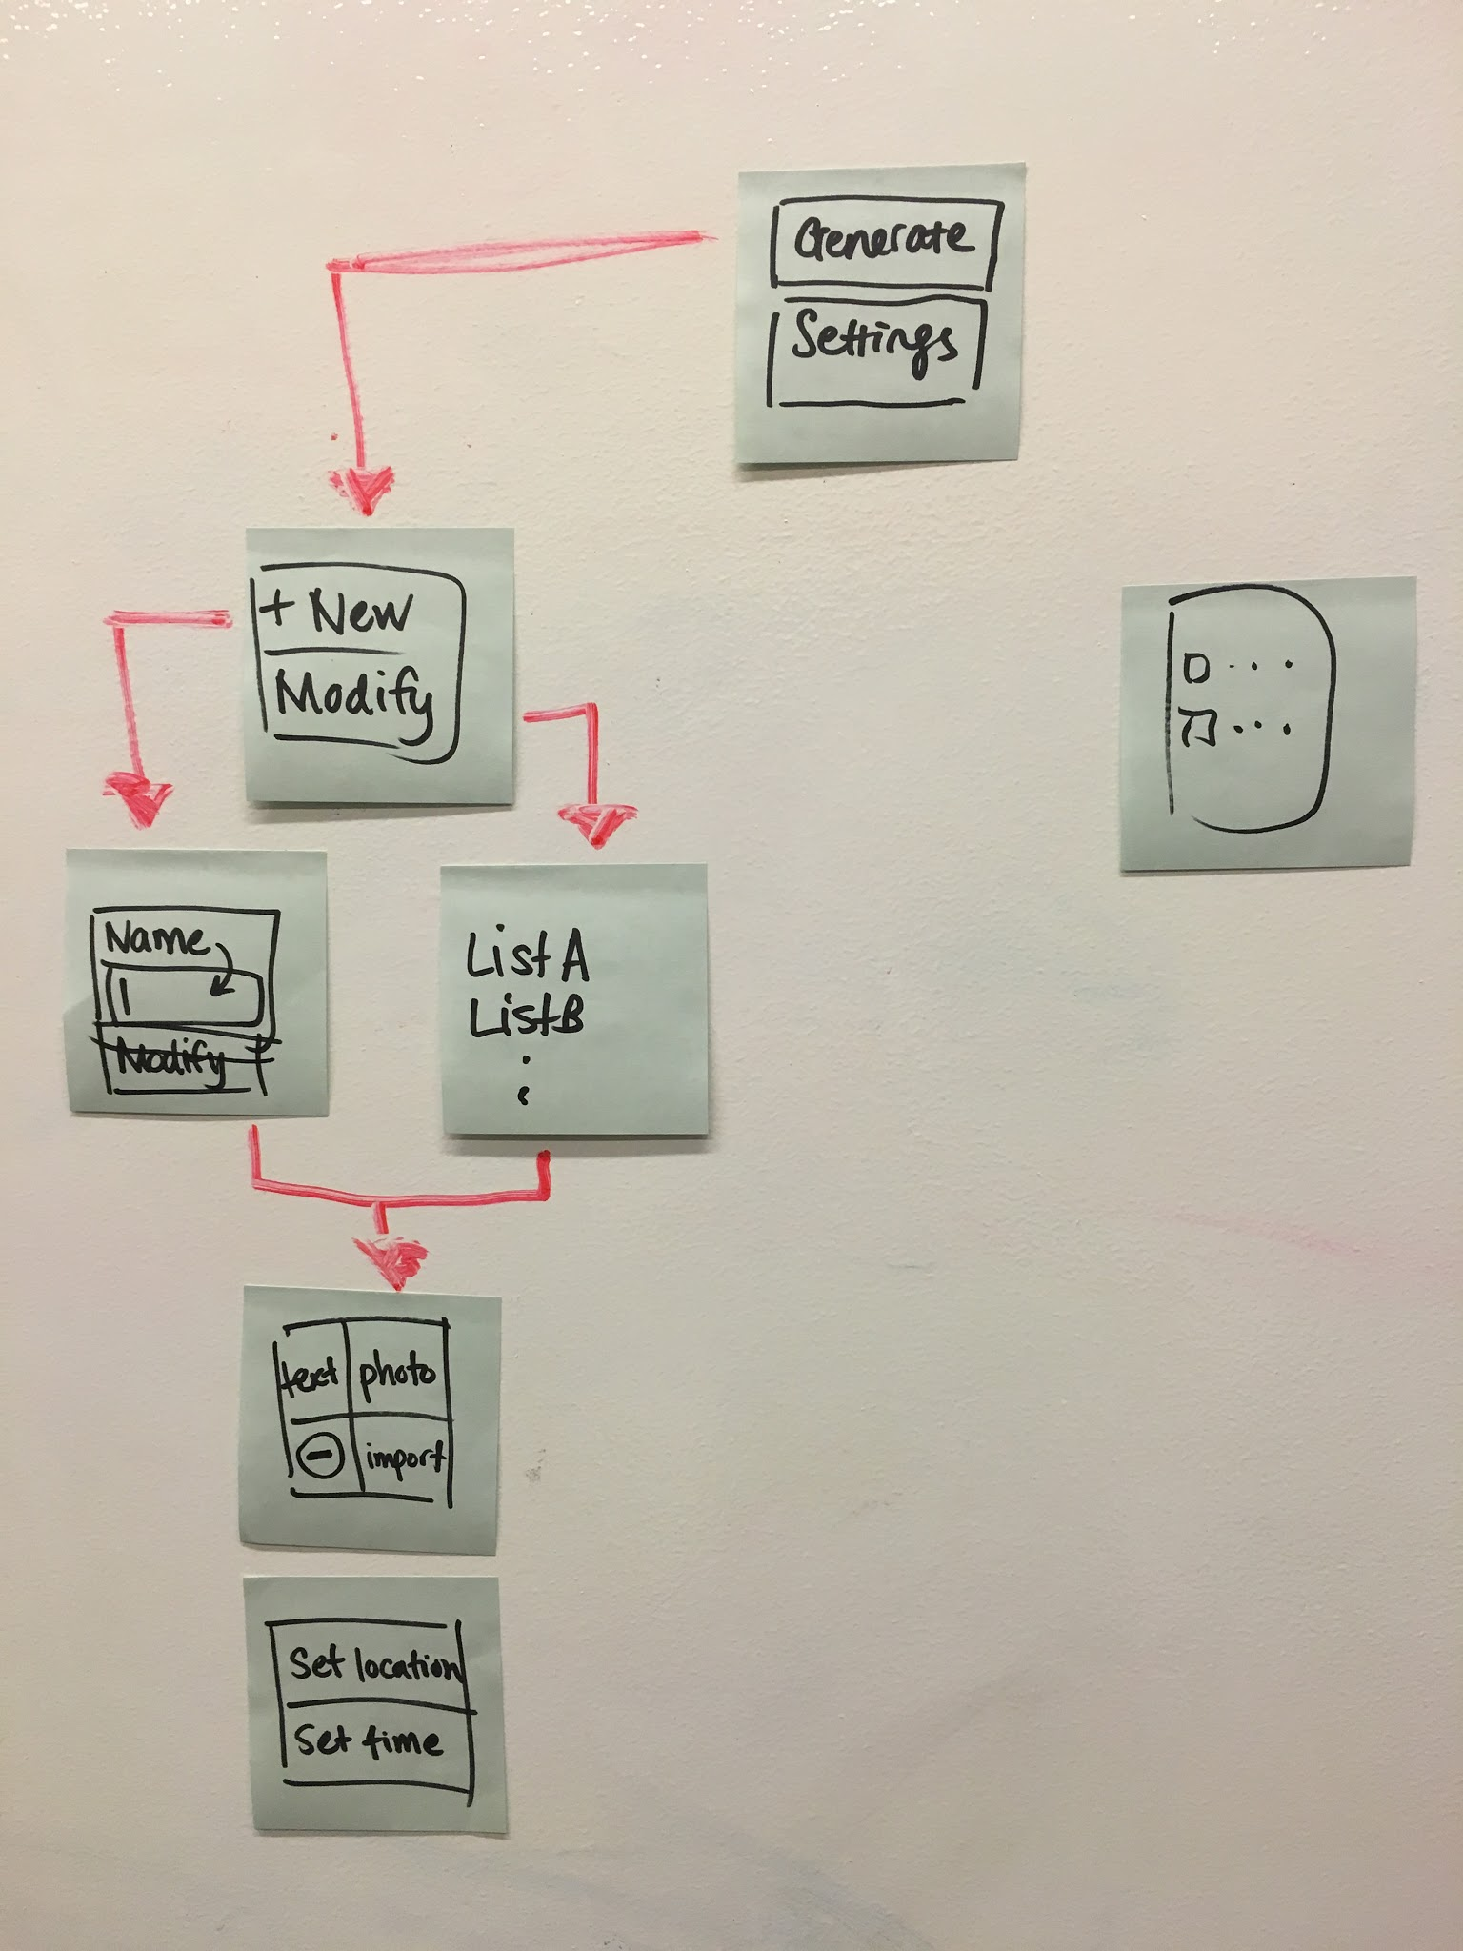
Role: commuter
Scene: about to leave for work
Prop: sticky-note prototype

Slide 26
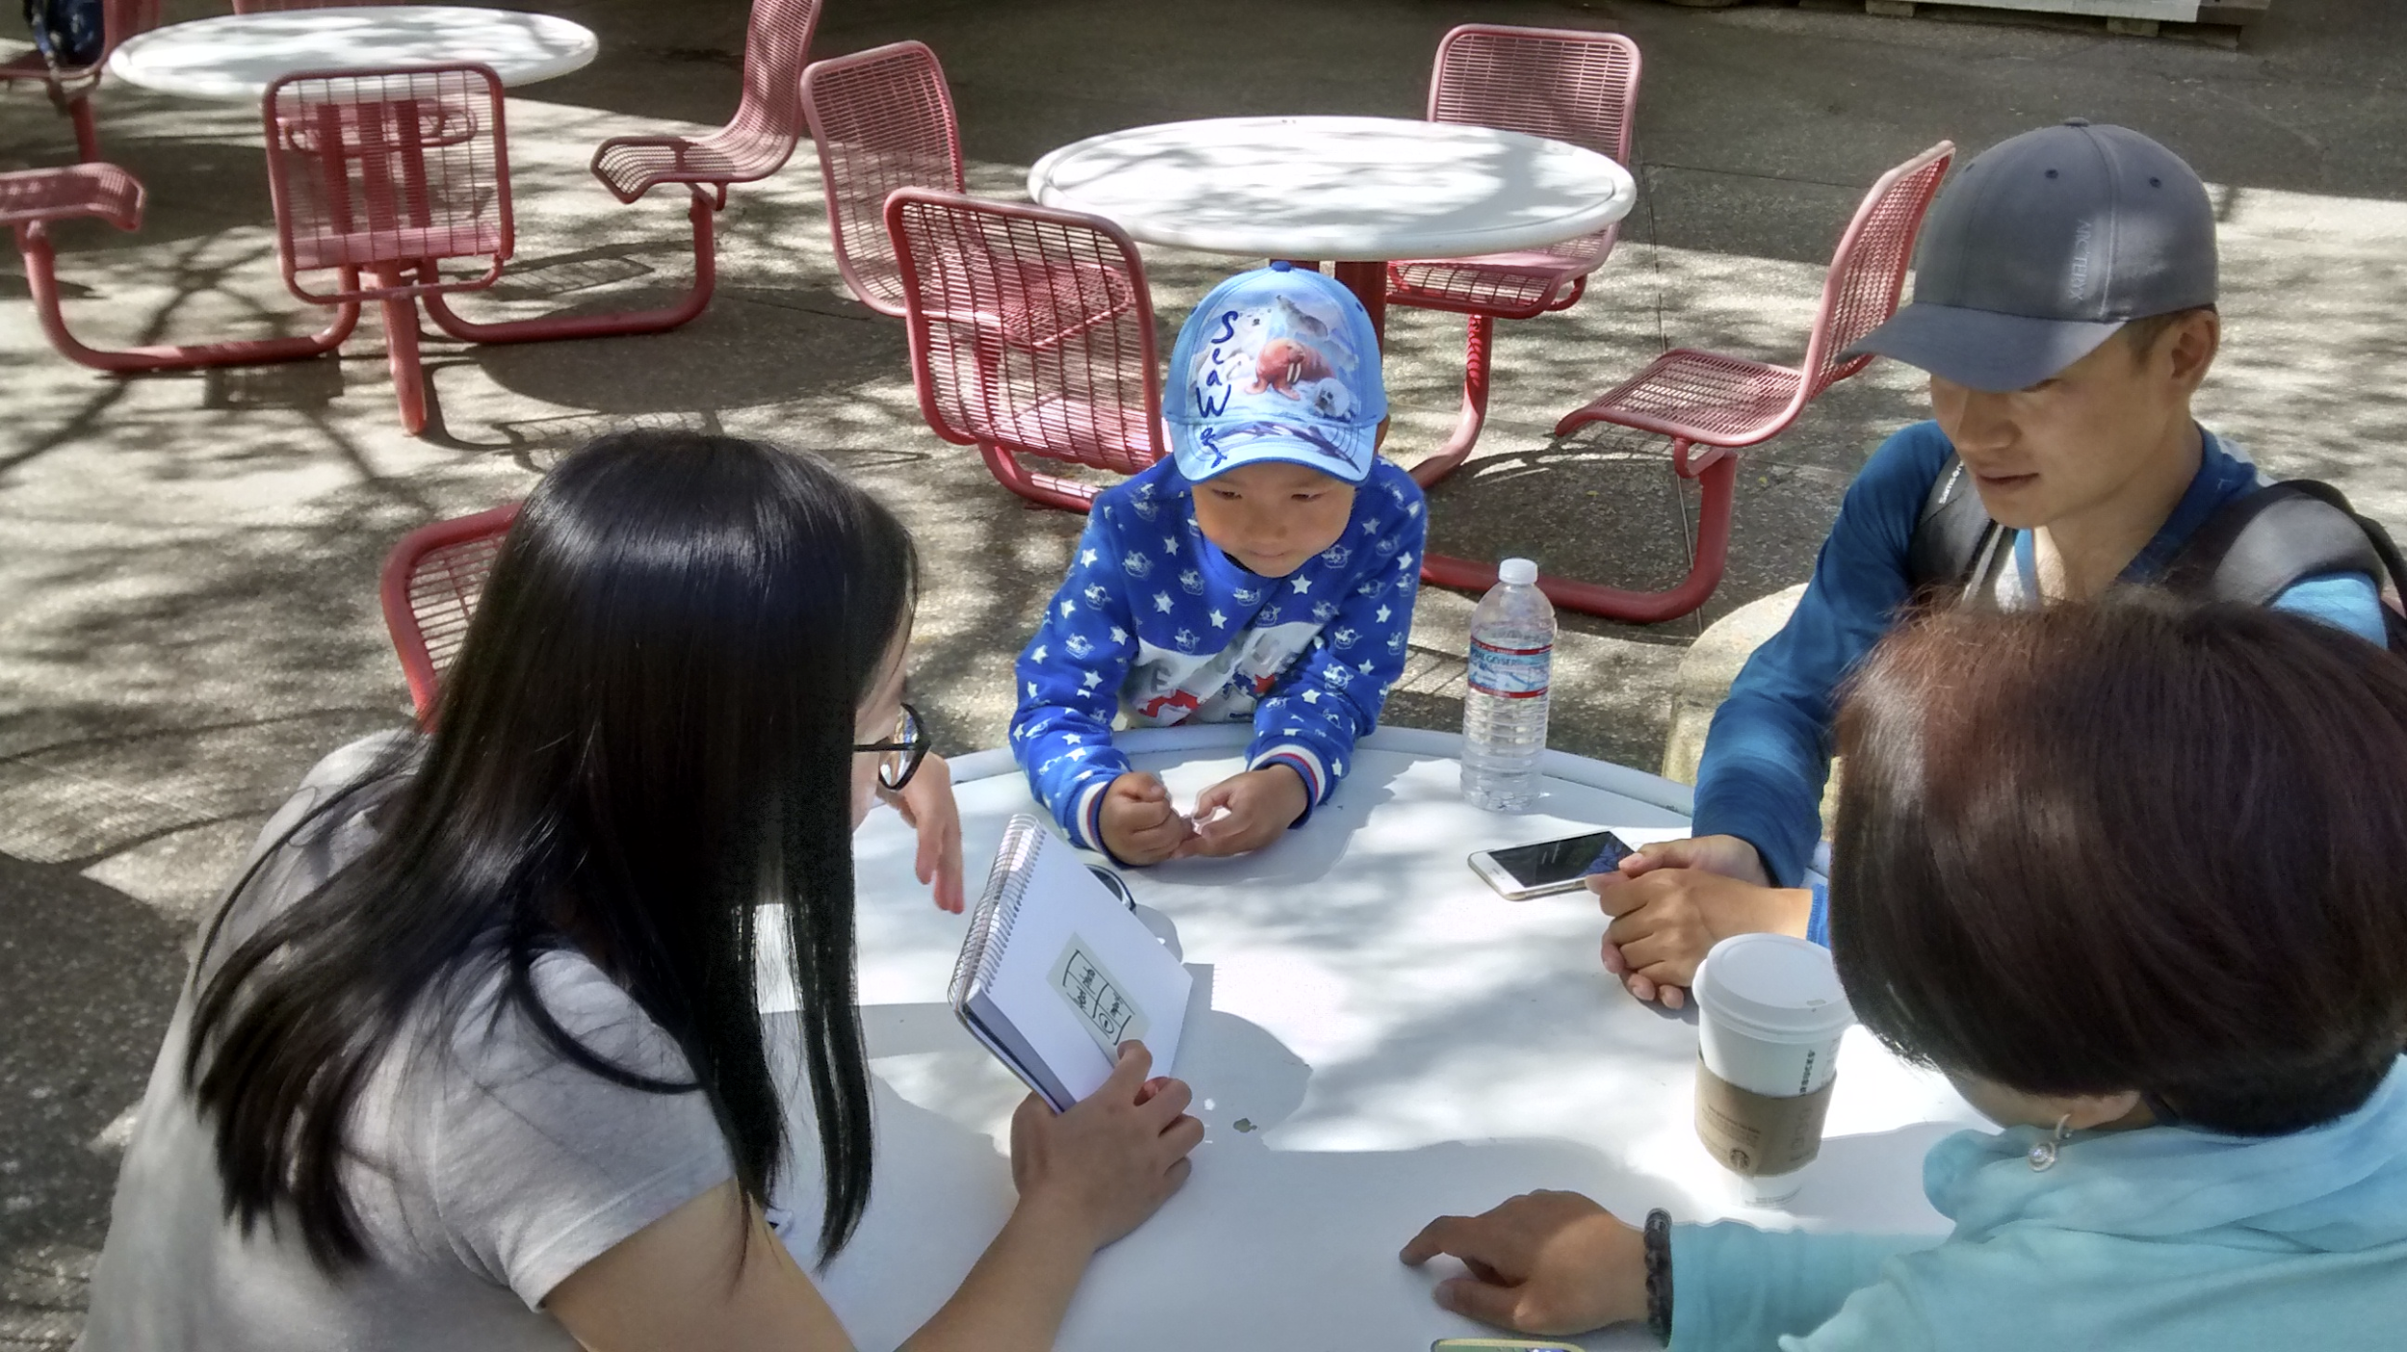
Testing
Give feedback aloud
What would you use this for?
Is there anything feature you would need?

Slide 27
Results
prompts at predetermined location/time
sharing
expecting automatic prompts
Usage in grocery stores, visits
Need for sharing

Slide 28
elderly commuters
3

Slide 29
point of view

Slide 30
WE MET Marion.
WE WERE AMAZED TO REALIZE that her commute experience is dictated by safety and health concerns.
IT WOULD BE GAME CHANGING TO ensure that she feels confident about her health before driving.

Slide 31
how might we

Slide 32
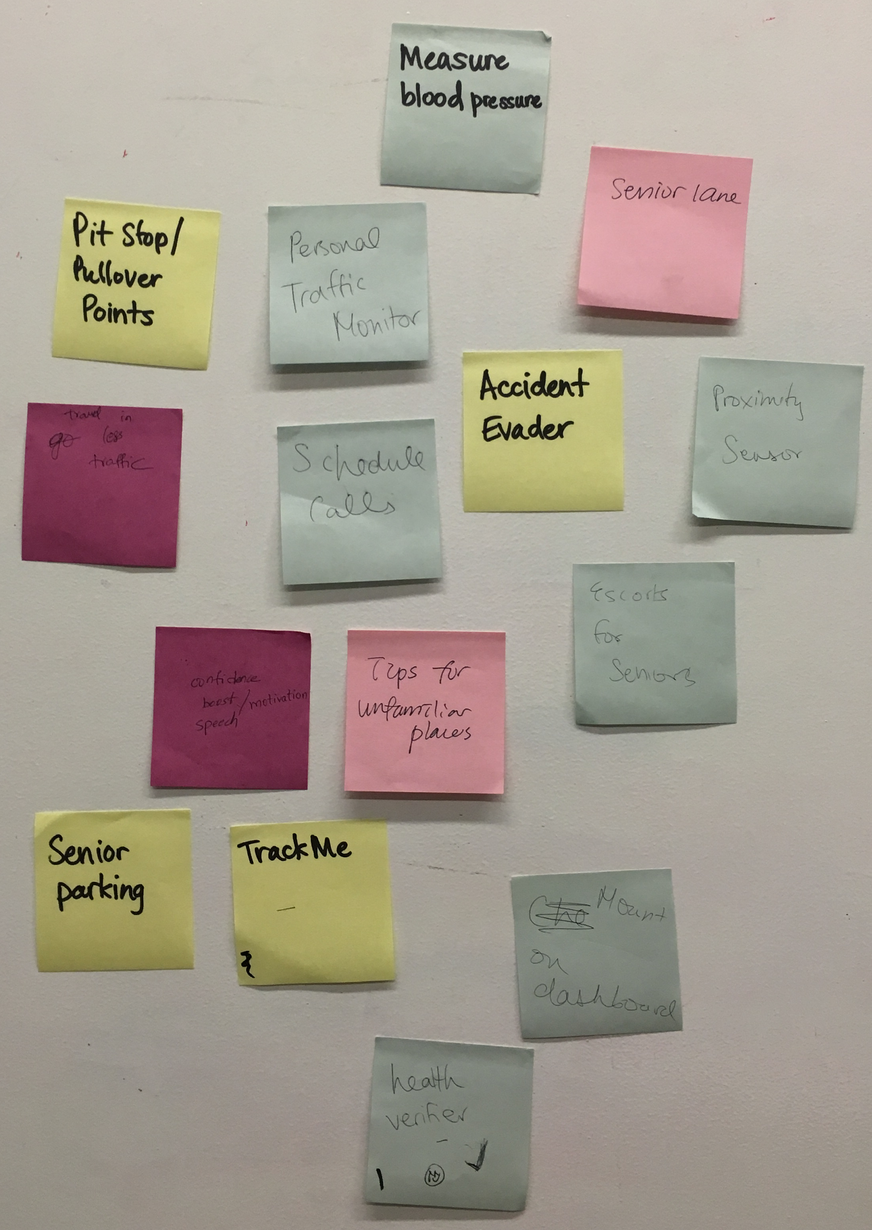
Solutions
HMW help Marion be more aware of her state of health before starting her commute?

Slide 33
experience prototype

Slide 34
Role: elderly commuter
Scene: in the car/before commute
Prop: sticky-note prototype

Slide 35
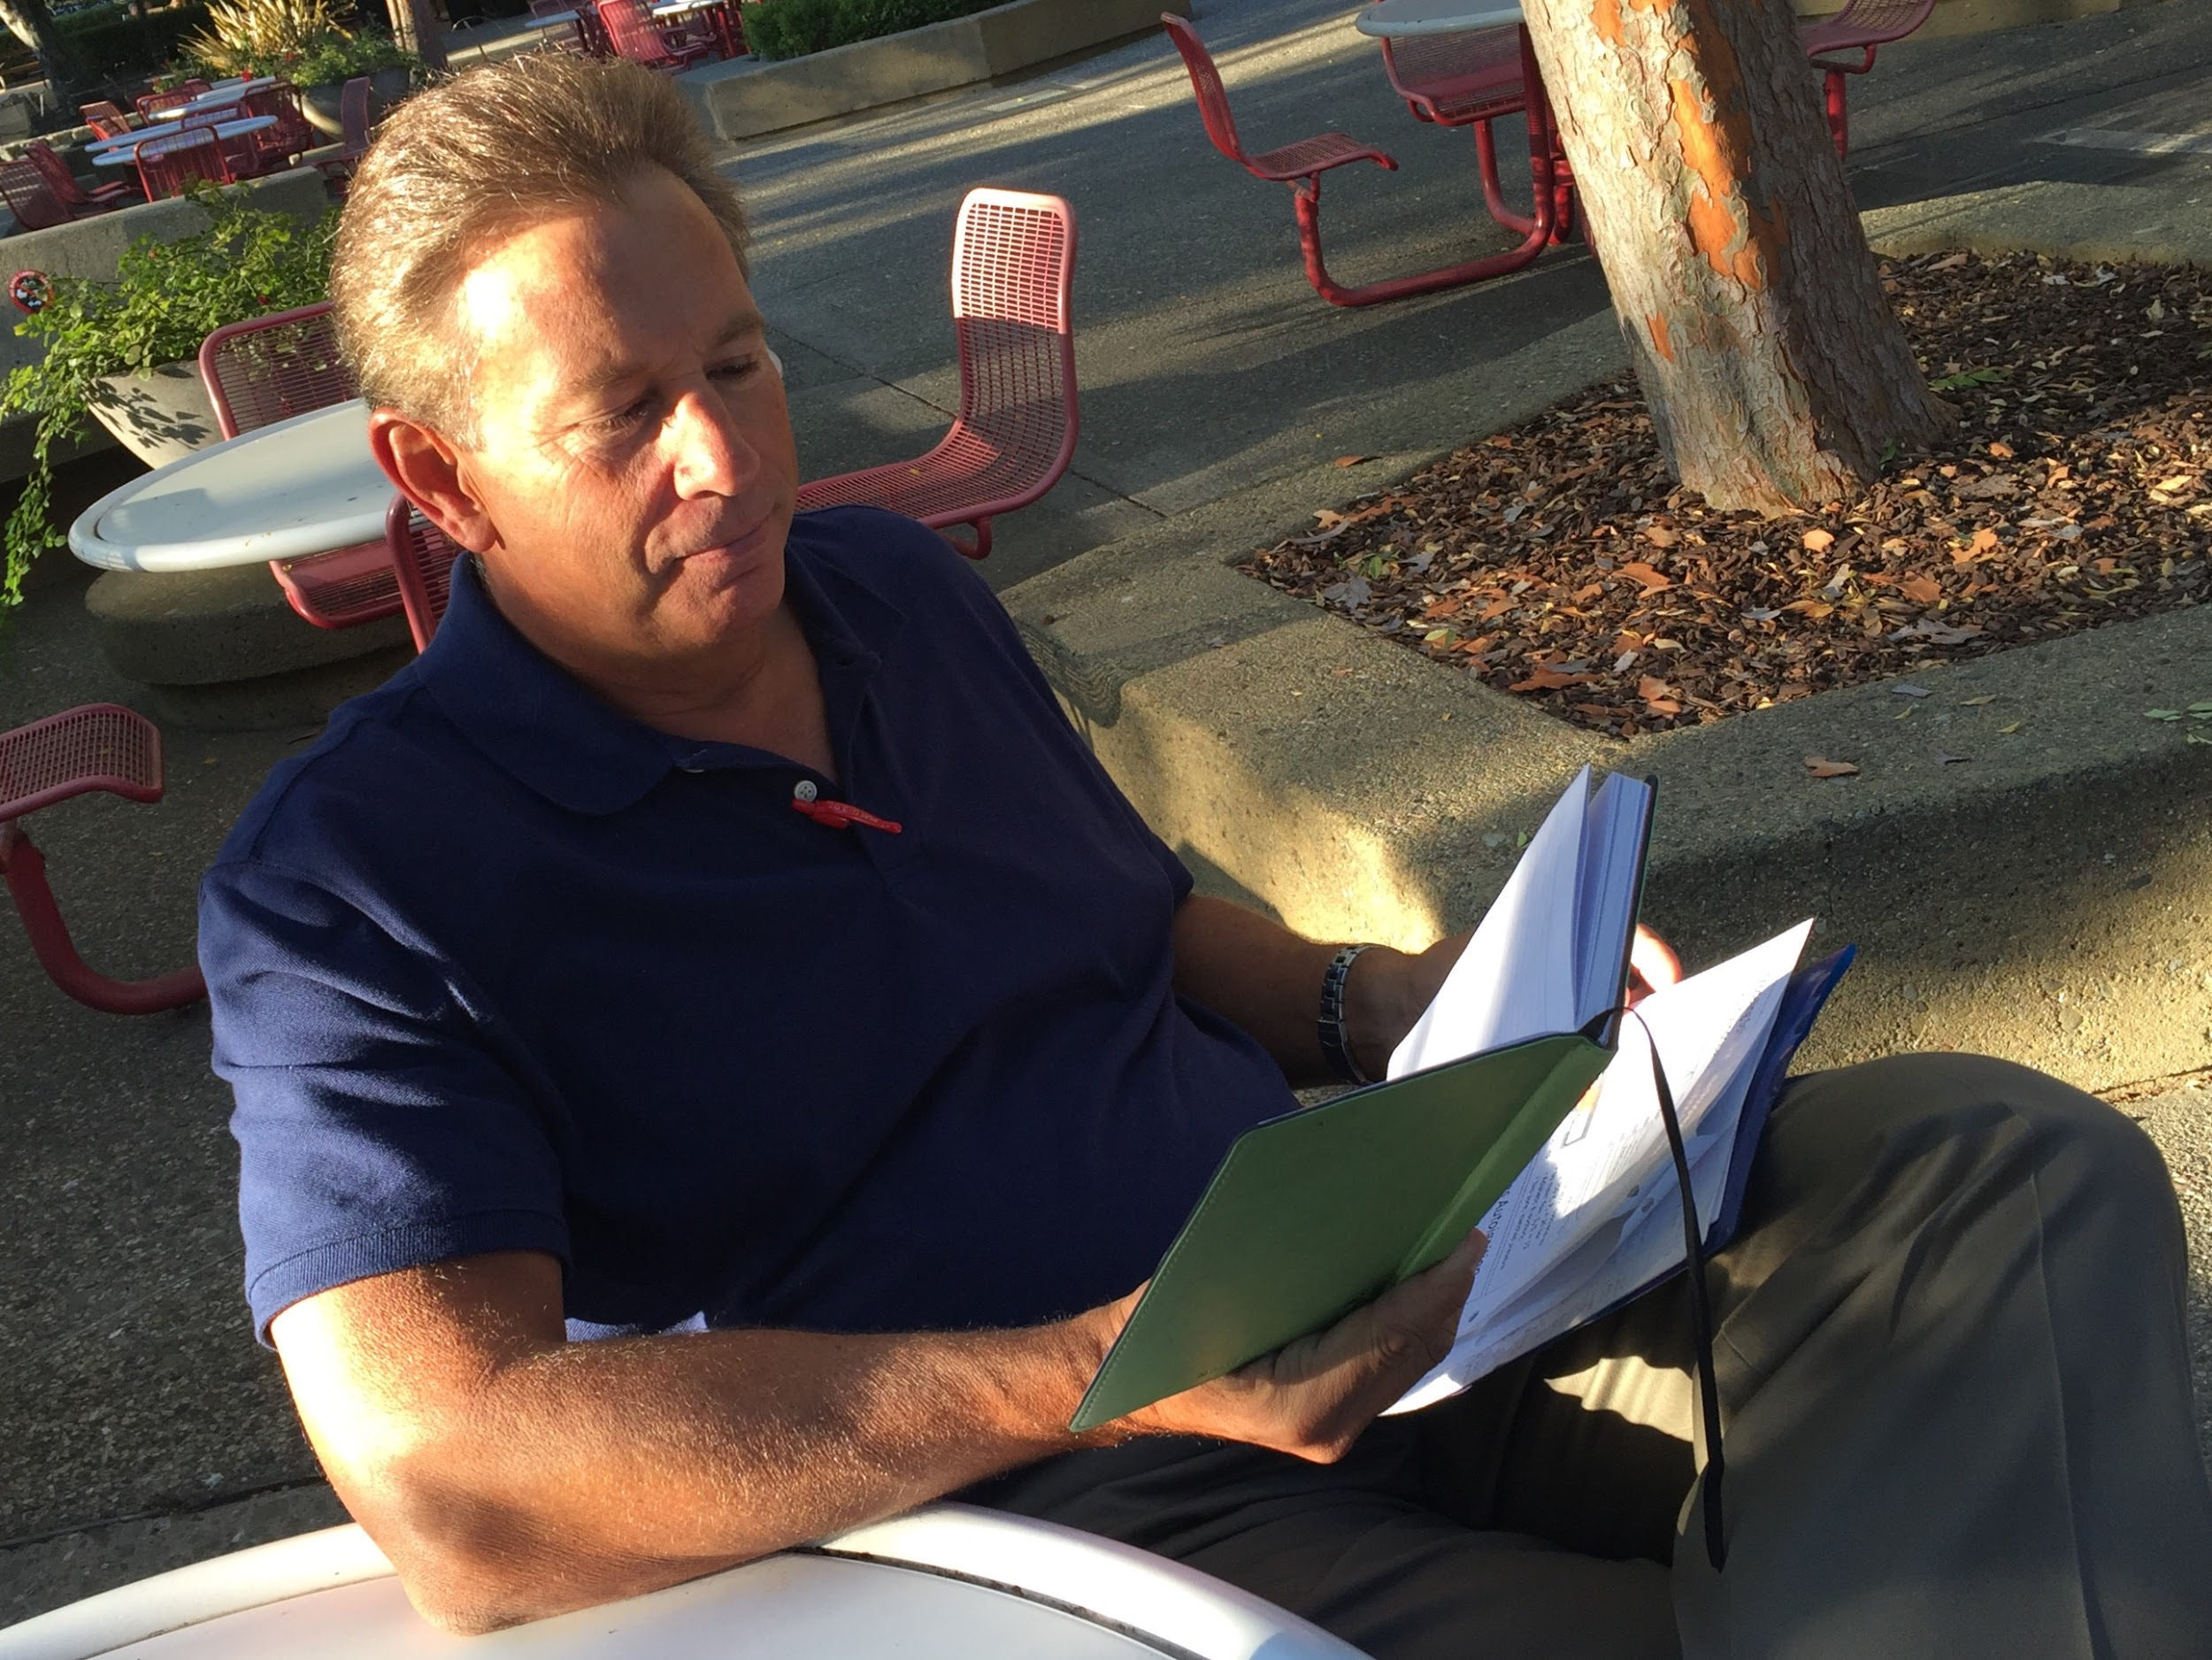
Testing
Asked to give feedback aloud
Which tests would you add?
Are the current tests applicable?
Was the onboarding intuitive?

Slide 36
Results
relevant tests
call emergency contact
medication checklist
people suffering from medical conditions
utility of the product

Slide 37
Thank you! Any Questions?

