Slide 1
Needfinding
CS 147 - Team Awesome

Slide 2
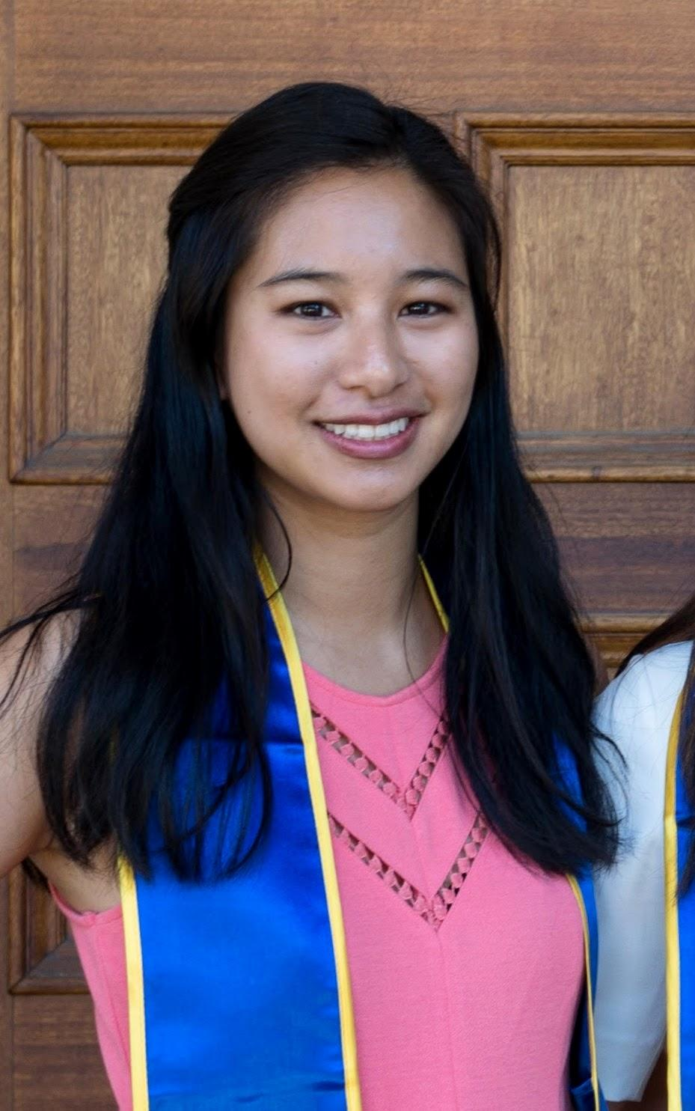
Domain: Enhancing the mobility of regular commuters.

Slide 3
Interviewing

Slide 4
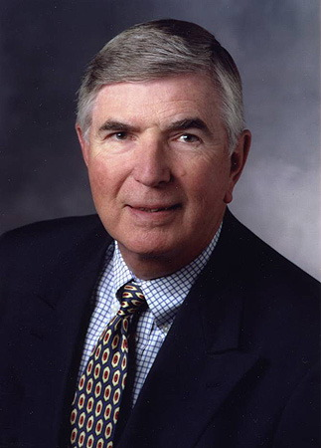
Joel
72 years old
Philadelphia, PA
Consulting Professor
Notes:
4 participants in total. Basic qualification: regular commuter.
P1 and P2 are found near Tressider. We recruited them by asking a few pre-screening questions (What kind of transportation? (public transportation, carpool, driving); What is the purpose of your commute? (work, business, some responsibility-related tasks); How long is your commute? How often do you commute?), and we qualify them for the interview if commute is a regular part of their life (at least once in awhile and for a long period of time).
P3 and P4 are people we know personally that commute on a regular basis.
Once they qualify for the interview, we ask them more specific questions about their commute experience.
Participant #1: Interviewed at Tressider
Consulting Professor, African Studies
Age: 72
Male
Grew up in Philly
Licensed driver, own car
Why chosen: Interviewed because he drives to commute on a regular basis (2 times/week) even though not daily & commute takes a considerable amount of time (about 30 min one-way)
Recruited/where: approached at a table inside Tressider; he was sitting there working on his laptop
What we asked: As a driver, we had him describe her commutes to Stanford nowadays (including what kind of preparation he has to do before the commute, what kind of activities he does during the commute, and what happens after he gets to Stanford campus), why he decided to commute in the way he does, and how she would approach transportation decisions when it comes to different environments (e.g., for leisure, for new places)

Slide 5
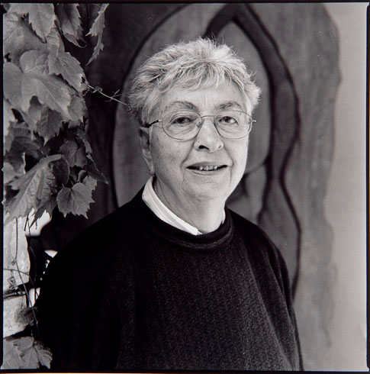
Marion Lewenstein
88 years old
Cleveland, OH
Retired Professor Emeritus
Notes:
Participant #2: interviewed at Marguerite Stop
Retired faculty at Stanford (Communications Department)
Age: 88
Female
Grew up in Cleveland, OH
Licensed driver, own car, lives in a senior house
Why chosen: Interviewed because she is an “extreme user” case as a senior
Recruited/where: approached at a bench near Tressider parking lot; she was sitting at a bench w/cane
What we asked: As a driver, we had her describe her commutes to Stanford nowadays, comparing the experience to her previous travel when she was working as well as how she makes transportation decisions when it comes to different environments (farther, unfamiliar places)

Slide 6
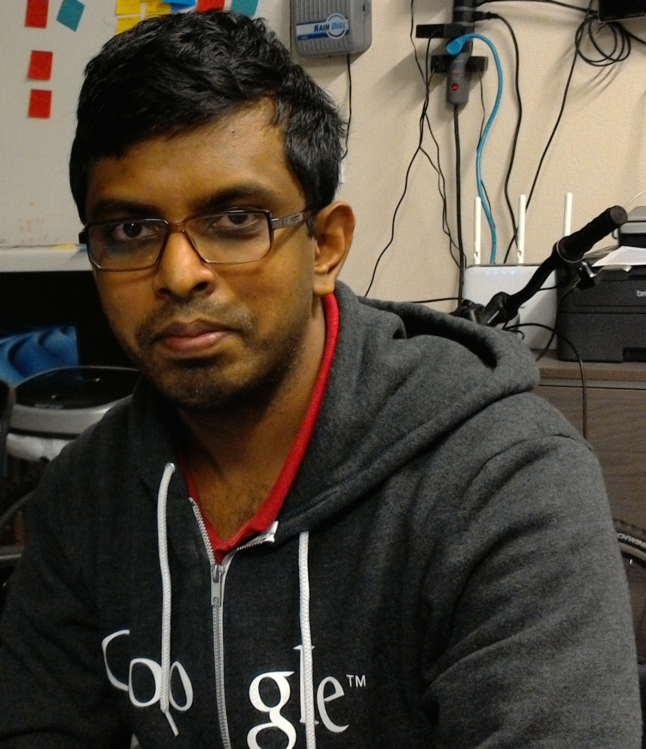
Aditya
27 years old
Stanford graduate
Engineer at startup
Notes:
Participant #1: Interviewed at work place
Profession: Engineer at Startup
Age: 27
Male
Grew up in India
Why chosen: Interviewed because he commutes daily for work and it takes 30-40 minutes for commute
Recruited/where: recruited through prior contact. they were interviewed at work place
What we asked: how does he commute, reasons for the way he commutes, activities before, during and immediately after commute, bad commuting experiences, commuting decisions beyond regular work

Slide 7
Jackie
21 years old
Stanford student
Student, Actress

Slide 8
Functionality & Convenience

Slide 9
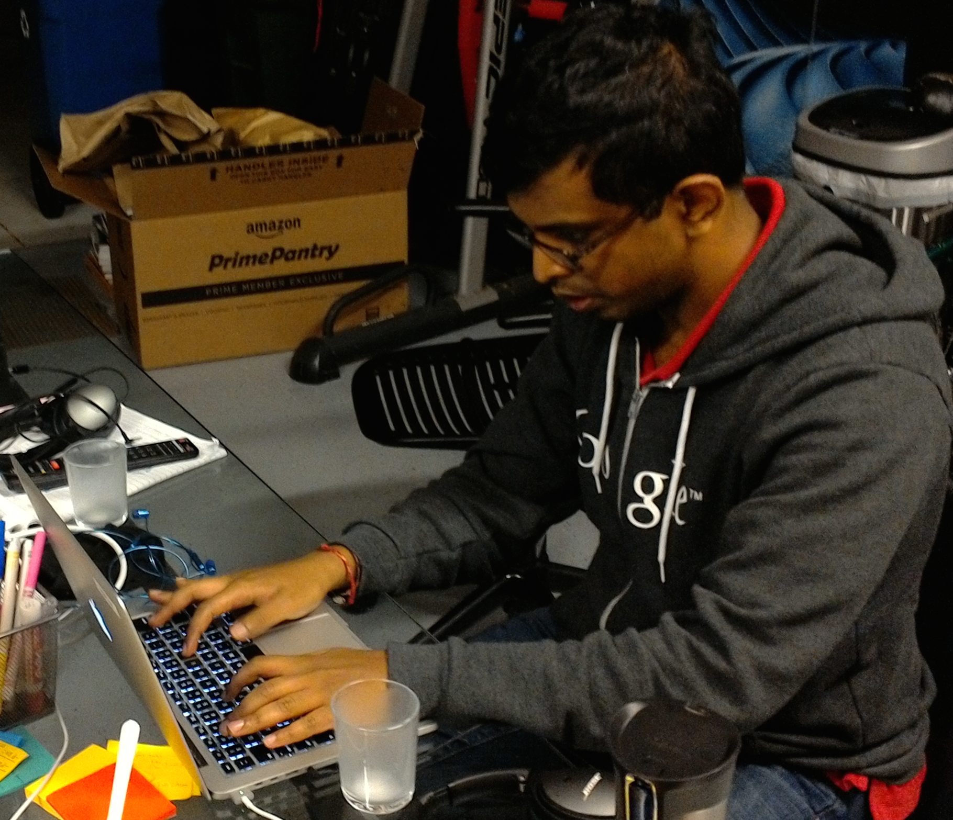
“Working on my laptop is not convenient on a bus.”
Notes:
Photo: Aditya wants to work on his laptop even during commute
He did not get license as he uses uber for places not reachable by public transport.
He wants to get work done during the commute like checking emails and attending phone calls on which he need not speak.
He wants to commute by car as it reduces commute time by half. Surprised he still takes public transport inspte of above complaints.

Slide 10
Guilty
Convenience
Utilitarian
Notes:
Photo: StreetView screenshot of the benches I interviewed Marion at - pointed out that there’s shuttles nearby
Both (elder) drivers viewed their travel experience at face value for its functionality and convenience
This is emphasized by the fact that both say they don’t do much else in their car besides driving
Surprised that both did not mention anything negative about driving that they had control over, only complaints were about traffic and other interactions w/commuters - for instance, the night lights on the bikes.

Slide 11
Health & Caution

Slide 12
“If I’m going somewhere farther away and new … the preparation is different.”
“When I’m uncertain about my driving ability I prefer to go with somebody healthier”
Notes:
Health/caution:
Health plays an important role in the elderly’s commute decision making.
For Marion, she will assess her driving ability based on her physical health and decide if she should drive there by herself or if she should ask friends for a ride.
She will also exercise extra caution when she needs to get to somewhere new and unfamiliar.
Quotes:
P2 “If it is for somewhere farther away and new, I'll begin to ask friends if i can ride with them. the preparation is different.”
When further asked Why?
She said “When I feel uncertain about my driving ability, like I feel a little dizzy, I prefer going with somebody with a better health.”

Slide 13
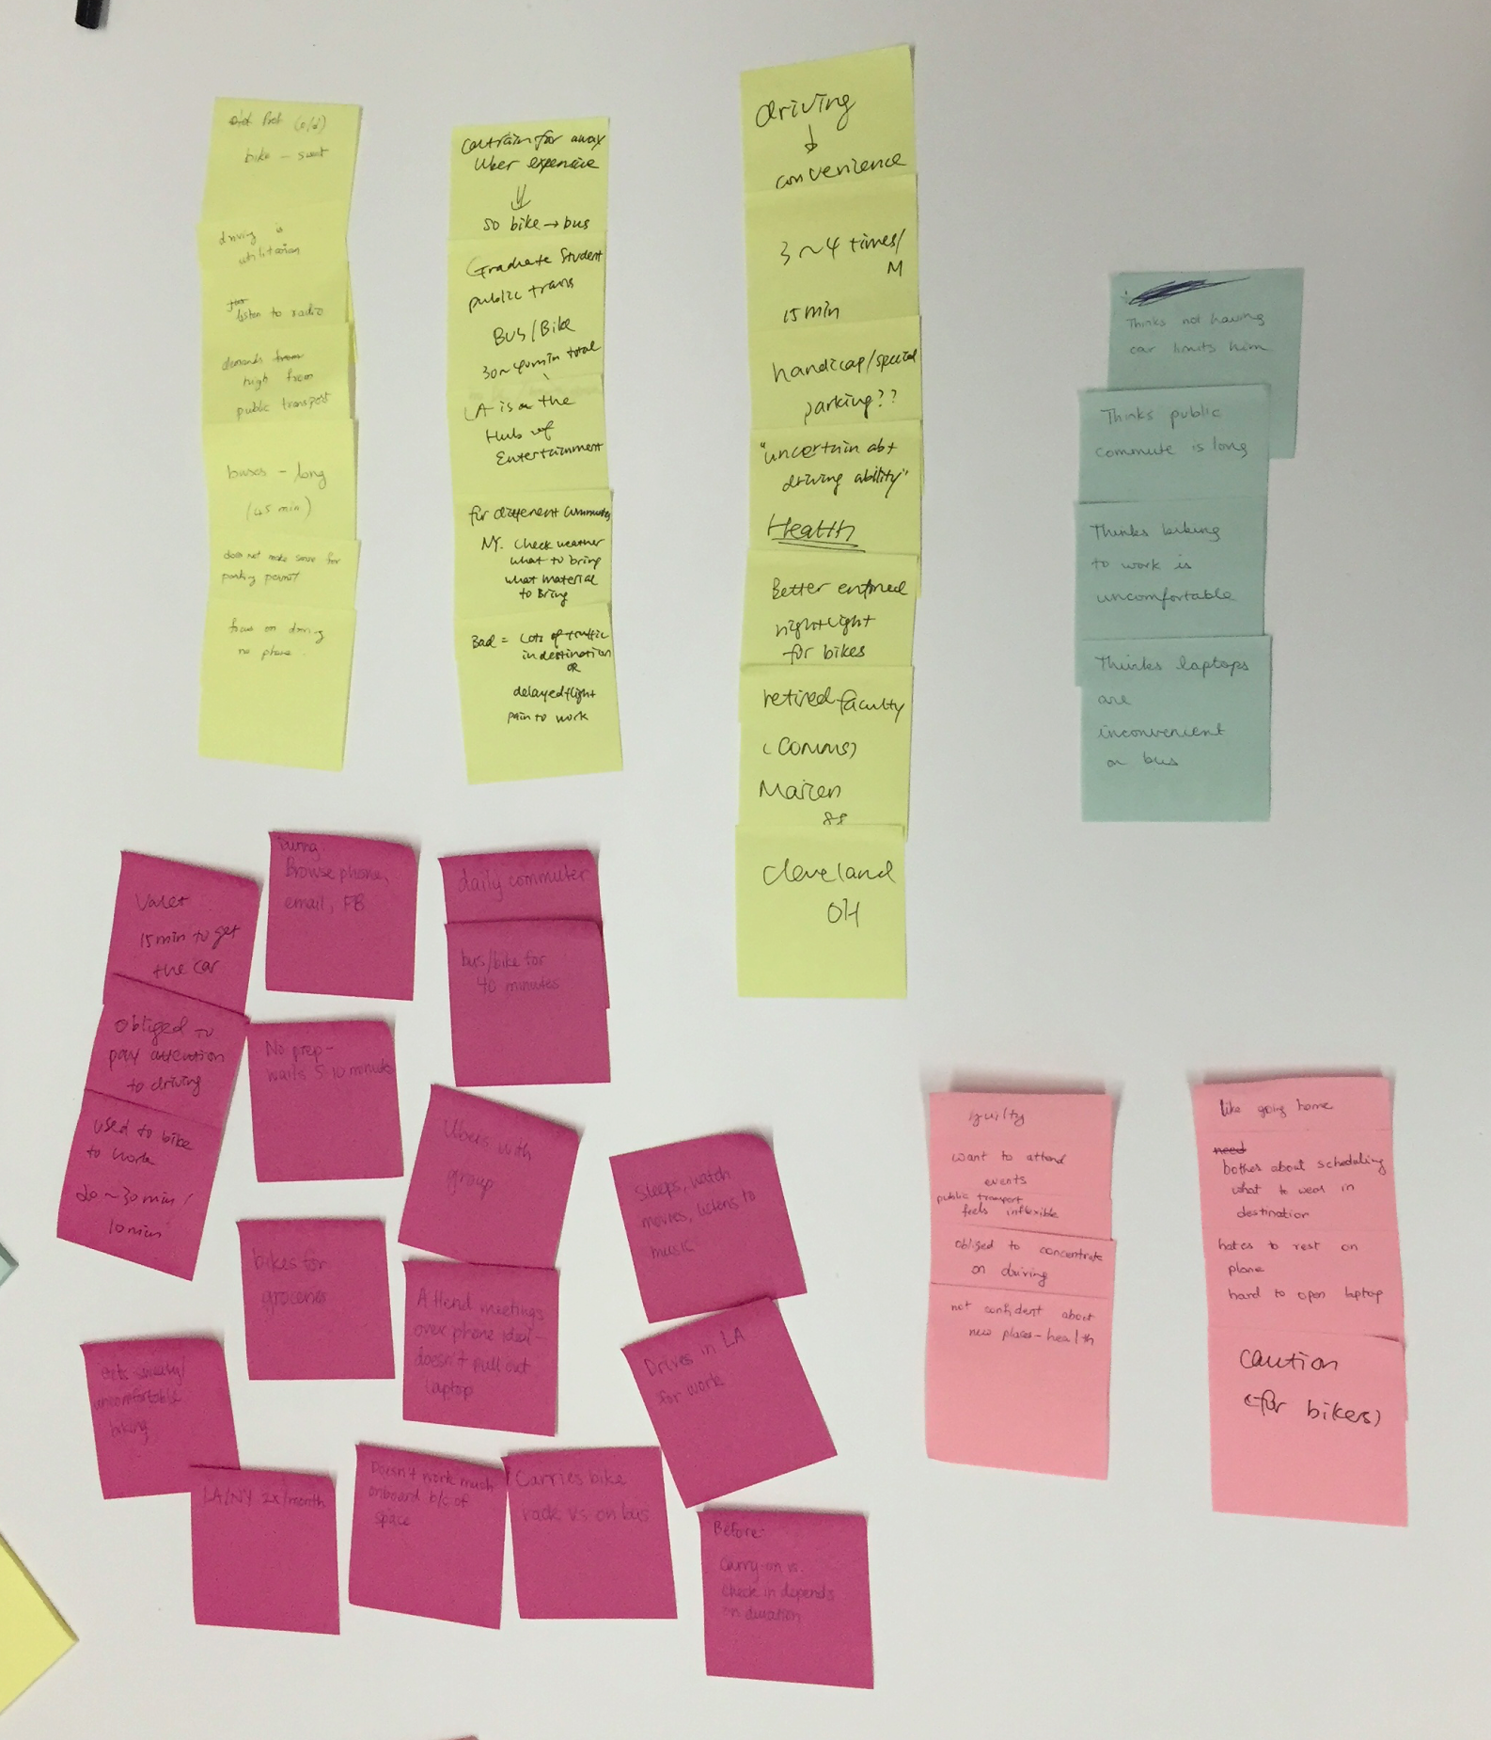
Notes:
Inferences:
elderly only focus on driving itself
elderly feel concern about their health condition: if they are in a good shape to drive
elderly still drive whereas p3 didn’t have a DL
4. comfort is important in commuting decisions, both in choosing a mode of transportation and during the journey itself
Some questions that came to mind:

Slide 14
Say
High expectations from public transport
Uncertain about driving ability

Slide 15
Do
Focus solely on driving.
Find ways to
stay productive.

Slide 16
Think
Laptops are inconvenient on public transport.
Having to bike is uncomfortable.

Slide 17
Feel
Obliged to concentrate on driving.
Driving = utilitarian

Slide 18
Different age group, different commuting needs.
Notes:
Health/caution:
Health plays an important role in the elderly’s commute decision making.
For Marion, she will assess her driving ability based on her physical health and decide if she should drive there by herself or if she should ask friends for a ride.
She will also exercise extra caution when she needs to get to somewhere new and unfamiliar.
Quotes:
P2 “If it is for somewhere farther away and new, I'll begin to ask friends if i can ride with them. the preparation is different.”
When further asked Why?
She said “When I feel uncertain about my driving ability, like I feel a little dizzy, I prefer going with somebody with a better health.”

Slide 19
Emotional Reactions
vs
Optimizing the Experience

Slide 20
How do we make public transport more efficient?
How do we cater to needs of different age groups?
Why is there a different sentiment towards commuting between the different age groups?

Slide 21
Looking forward….

Slide 22
