Slide 1
Medium-Fi Prototyping

Slide 2
TEAM AWESOME
Niharika B
Karen T
Manikanta K
Phoebe F

Slide 3
VALUE PROPOSITION
HealthMap
Stay confident and accountable about your health before getting behind the wheel.

Slide 4
OVERVIEW
At one point or another, everyone has been a bit too tired, ill, or under the influence to drive. Though it may seem easier to just get in the car and drive, those actions can have negative consequences for you and your fellow drivers. HealthMap is an intuitive and easy health verifier that tests your motor skills, helping you make a more informed decision before hitting the road (or not).
Notes:
From our low-fi feedback and comments during last week’s studio, we’ve revised our solution overview to clarify that the app advises you, but doesn’t enforce its recommendations upon you.

Slide 5
TASKS
I want to know if I am fit enough to drive (complex)
I want to know how to be a safer driver (simple)
I want to get help when I need help (medium)

Slide 6
Revised Interface Design

Slide 7
REVISION #1
Before:
Taps “Enter”
Taps “Contacts”
After:
Notes:
Welcome Screen
Emergency call button:
-Rationale: user feedback, not a feature currently existing in phones (Most phones have a Favorites which requires a second tap, no existing primary contact feature)
Contacts access: added pathway to edit your emergency contacts as well as import from address book
-Rationale: user feedback and arose organically from the fact that we didn’t have a way to modify your contacts in the event that relationships change

Slide 8
REVISION #2
Before:
Taps “Begin”
After:
Notes:
Disclaimer: warning that it’s still up to driver’s discretion to interpret his/her HealthMap results
-Rationale: byproduct of modifying our solution overview, and reaction to confusion from users and classmates about how to make this a preventative product → chose to keep it as an advisory app

Slide 9
REVISION #3
Before:
After:
Notes:
Vision Test: diving into details, vision test will be multiple choice
-Rationale: from feedback, the wording of our original test was confusing, plus we couldn’t figure out an intuitive way to tell people to tap on the screen a certain number of times and then confirm that they’ve stopped tapping

Slide 10
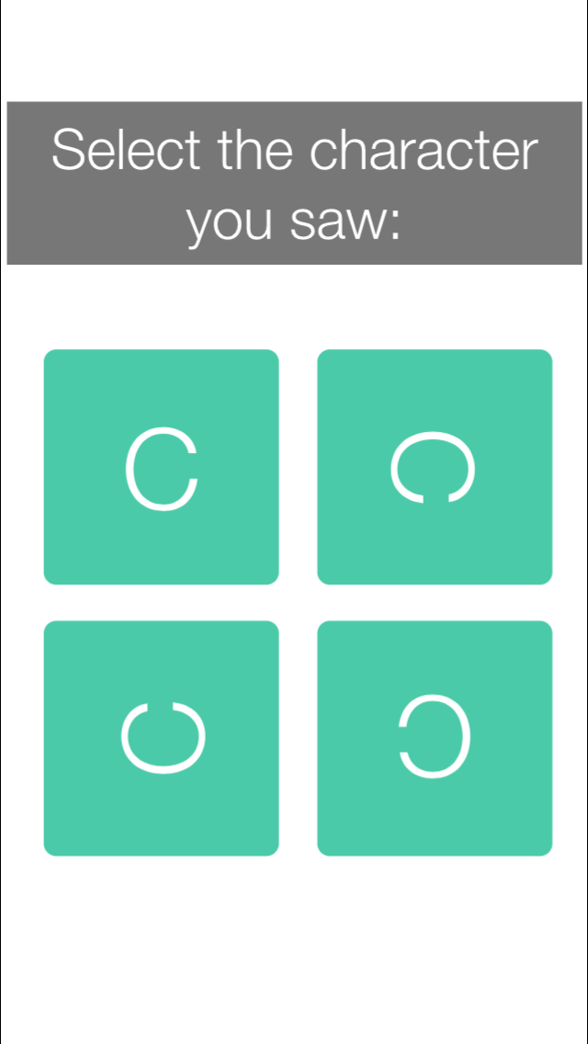
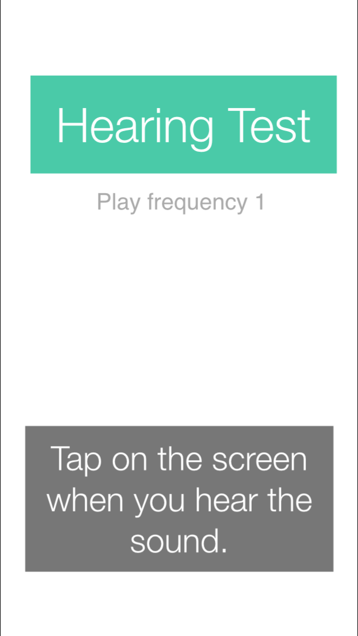
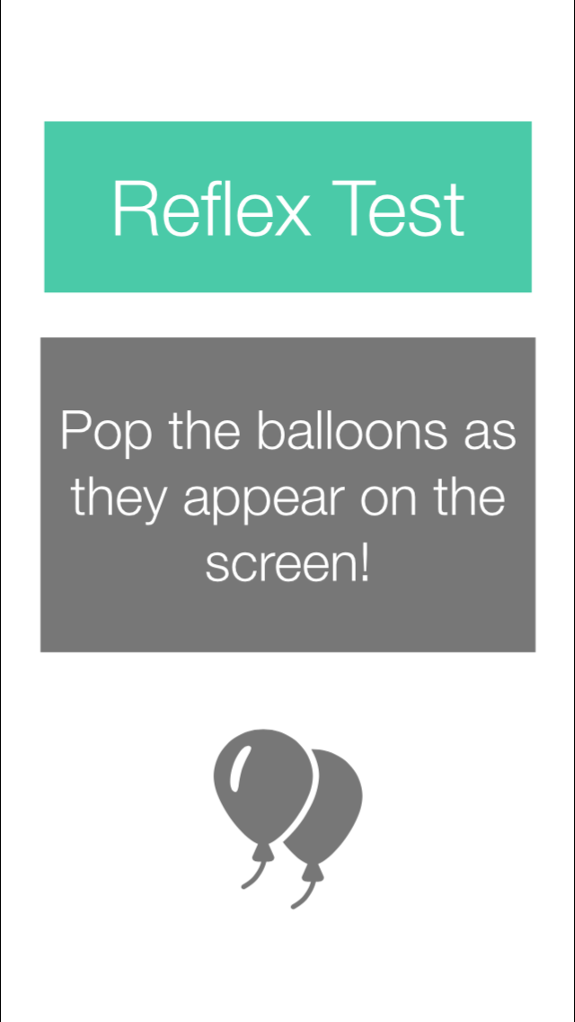
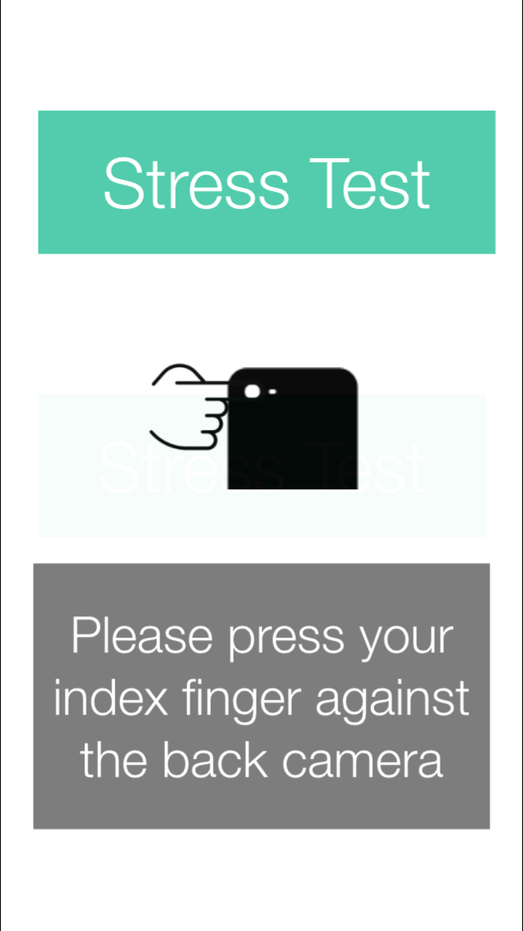
TASK #1
Vision
Hearing
Reflex
Stress
If passed
If passed
If passed
“I want to know if I am fit enough to drive”
Notes:
Vision
Hearing
Reflex
Stress
Tests are presented sequentially.
If passed all tests, then show the “you are all set screen”
The whole process should take less than a minute. Each task is about 10 - 15 sec.
If interrupted, start from the particular test. Timeout if it exceeds 1 min.

Slide 11
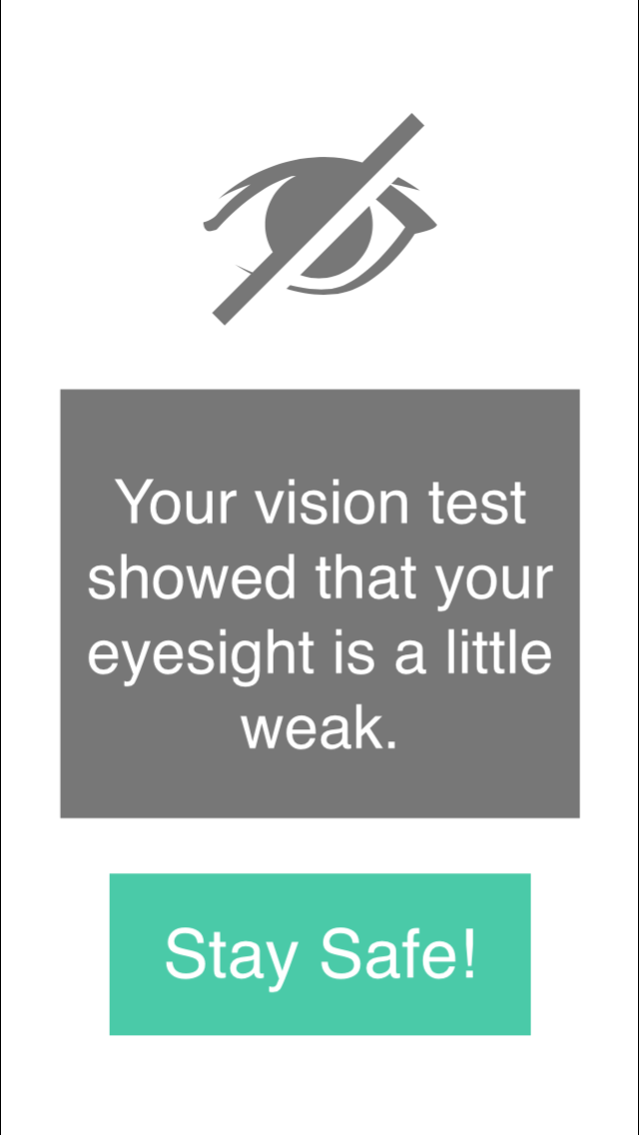
TASK #2
Inconsistent results in vision
“I want to know how to be a safer driver”
Notes:
If the user had inconsistent results in any of the tests, we prompted them with a caution screen, and showed them suggestions.

Slide 12
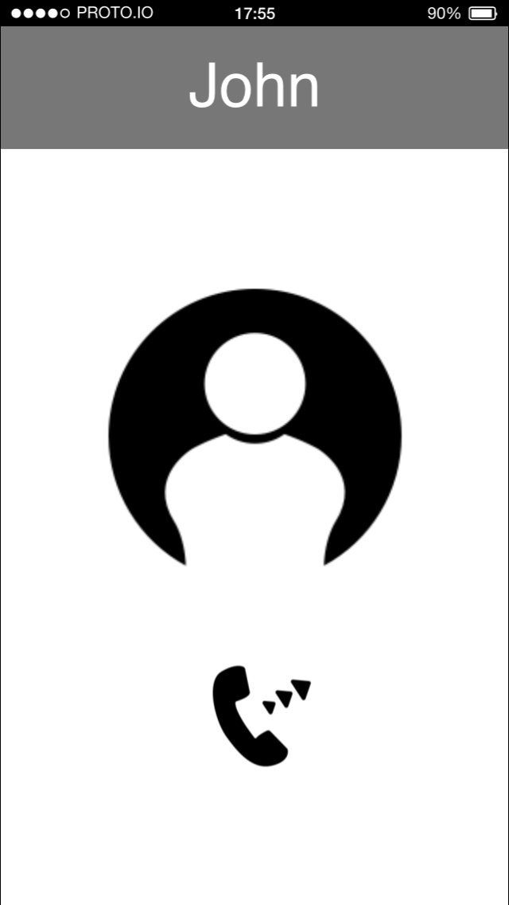
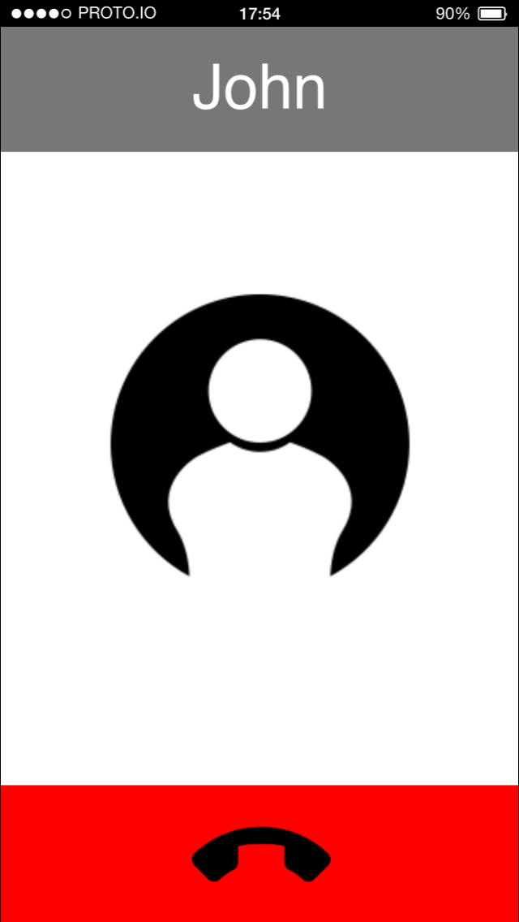
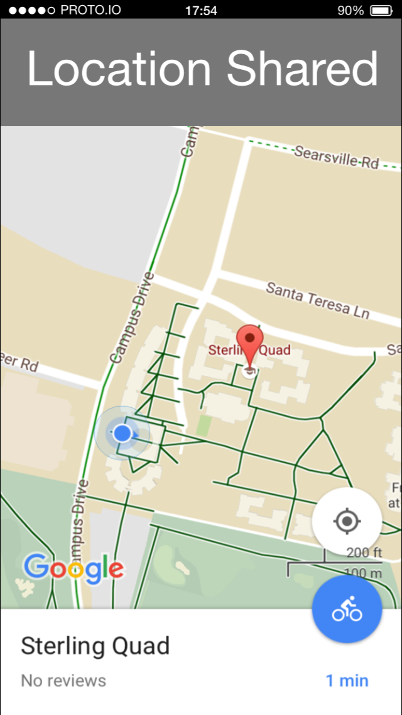
TASK #3
Contact accepts call
“I want to get help when I need help”

Slide 13
Prototyping Overview

Slide 14
PROTOTYPING TOOL
Proto.IO
Sketch and add transitions in one tool
Multiple editors not supported

Slide 15
WOZ Techniques
Heart rate measurements
Notes:
Not implemented in code/prototype yet, would need a human behind the prototype to get the pulse

Slide 16
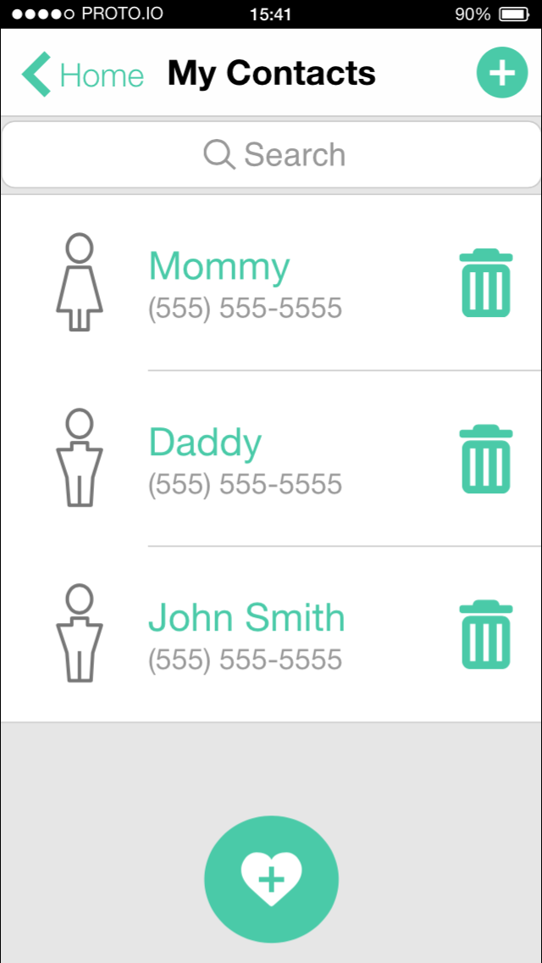
Hard-Coded Features
Test history
Address contacts
Location sharing
Notes:
Subset to appear you have data to understand task

Slide 17
THANKS!
Any questions?
Demo our prototype:
Task 1
Task 2
Task 3

